Slide 1




ALUMNI RELATIONS OFFICE
OF
K. R. MANGALAM UNIVERSITY
Welcomes
\
NAAC PEER TEAM
June 16-18 ,2025
Notes:
New Courses replaced with New Programmes

Slide 2


CONTENTS
About Alumni Relations Office , K.R Mangalam University
Vision and Mission
Alumni Association of K.R. Mangalam University registration Certificate
How do we Function
Importance of Alumni Association
Registration in Alumni Association
Alumni Registrations
Process of Registration in Alumni Association
Alumni Communication
Alumni Engagements
Star Alumni
Alumni Testimonials

Slide 3
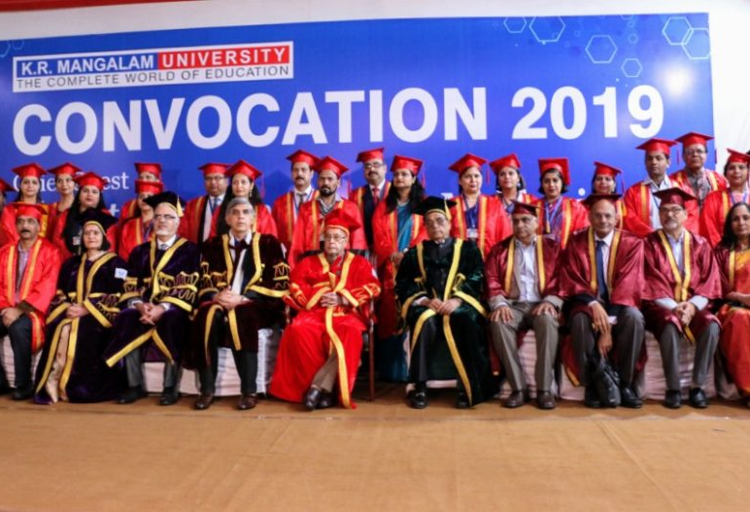
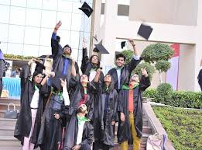
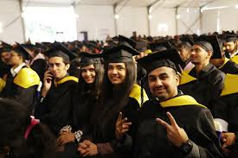
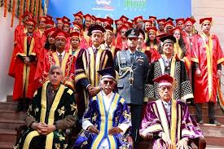
ALUMNI
RELATIONS
OFFICE
The Alumni Relations Office at K.R. Mangalam University serves as a vital bridge between the university and its growing network of graduates.
Established with the vision of fostering lifelong connections, the office is dedicated to building a vibrant, engaged, and supportive alumni community.

Slide 4
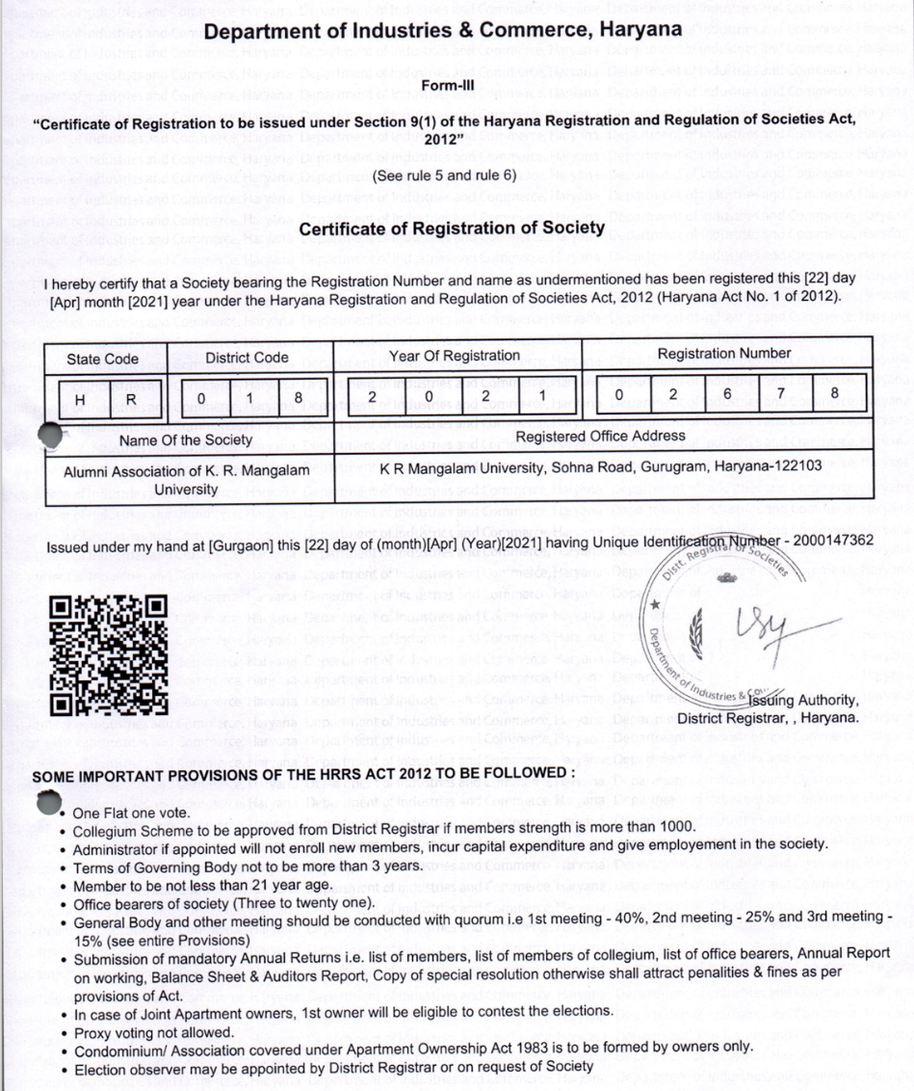
Registration
Alumni Association of K.R. Mangalam University is a registered Society under the Haryana Registration and Regulation of Societies Act,2012 (Haryana Act No, 1 of 2012) with Registration no. 026778

Slide 5


Vision & Mission
Vision
To Nurture a Strong and Inclusive Global Network Of Alumni Who Continue to uphold the Values of The University, act as Its Lifelong Ambassadors, and Actively Contribute To Its Progress, Reputation, and The Growth of Its Student Community.
Mission
To Meaningfully Connect With Alumni Through Well-curated Initiatives, Services, And Platforms That Encourage Engagement, Celebrate Achievements, And Create Opportunities For Collaboration Strengthening Their Ties With The University, With Each Other, And With Society At Large.

Slide 6
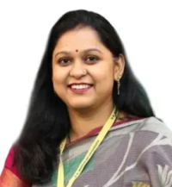
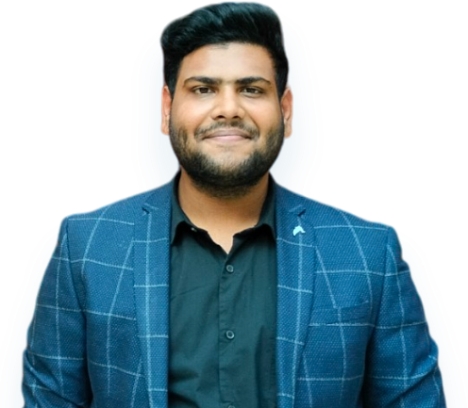
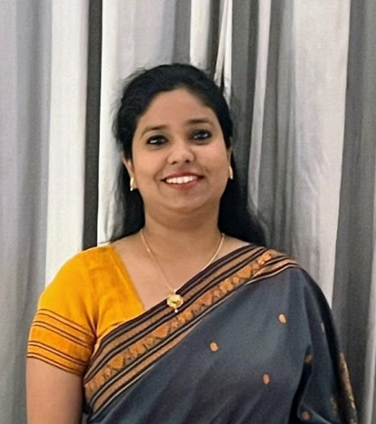
How do we function?
Dean Student
Welfare
Manager – Alumni Relations
Dedicated School
Alumni Coordinators
Alumni Relationship Officer
School Faculty
Members
Alumni Members
DR. ANJANA SINGH
Dean,
STUDENT WELFARE
University Registrar
Alumni Relationship Officer
Dedicated School Alumni Coordinator
Faculty Members
Mr. MANAV PODDAR
Manager,
ALUMNI RELATIONS OFFICE
Dr. ANKITA SAMUEL
Officer,
ALUMNI RELATIONS OFFICE

Slide 7
Importance of Alumni Association of K.R. Mangalam University
Lifelong Connections: Alumni can maintain connections with classmates and professors, building lifelong friendships and professional relationships.
Career Advancement: The alumni network can provide opportunities for career advancement, including job referrals, mentorship, and networking events.
Giving Back: Alumni can give back to their alma mater by volunteering, mentoring students, or donating to the university.
Staying Connected: The alumni association can keep alumni updated on the latest news and developments at the university, as well as provide opportunities to stay involved.

Slide 8
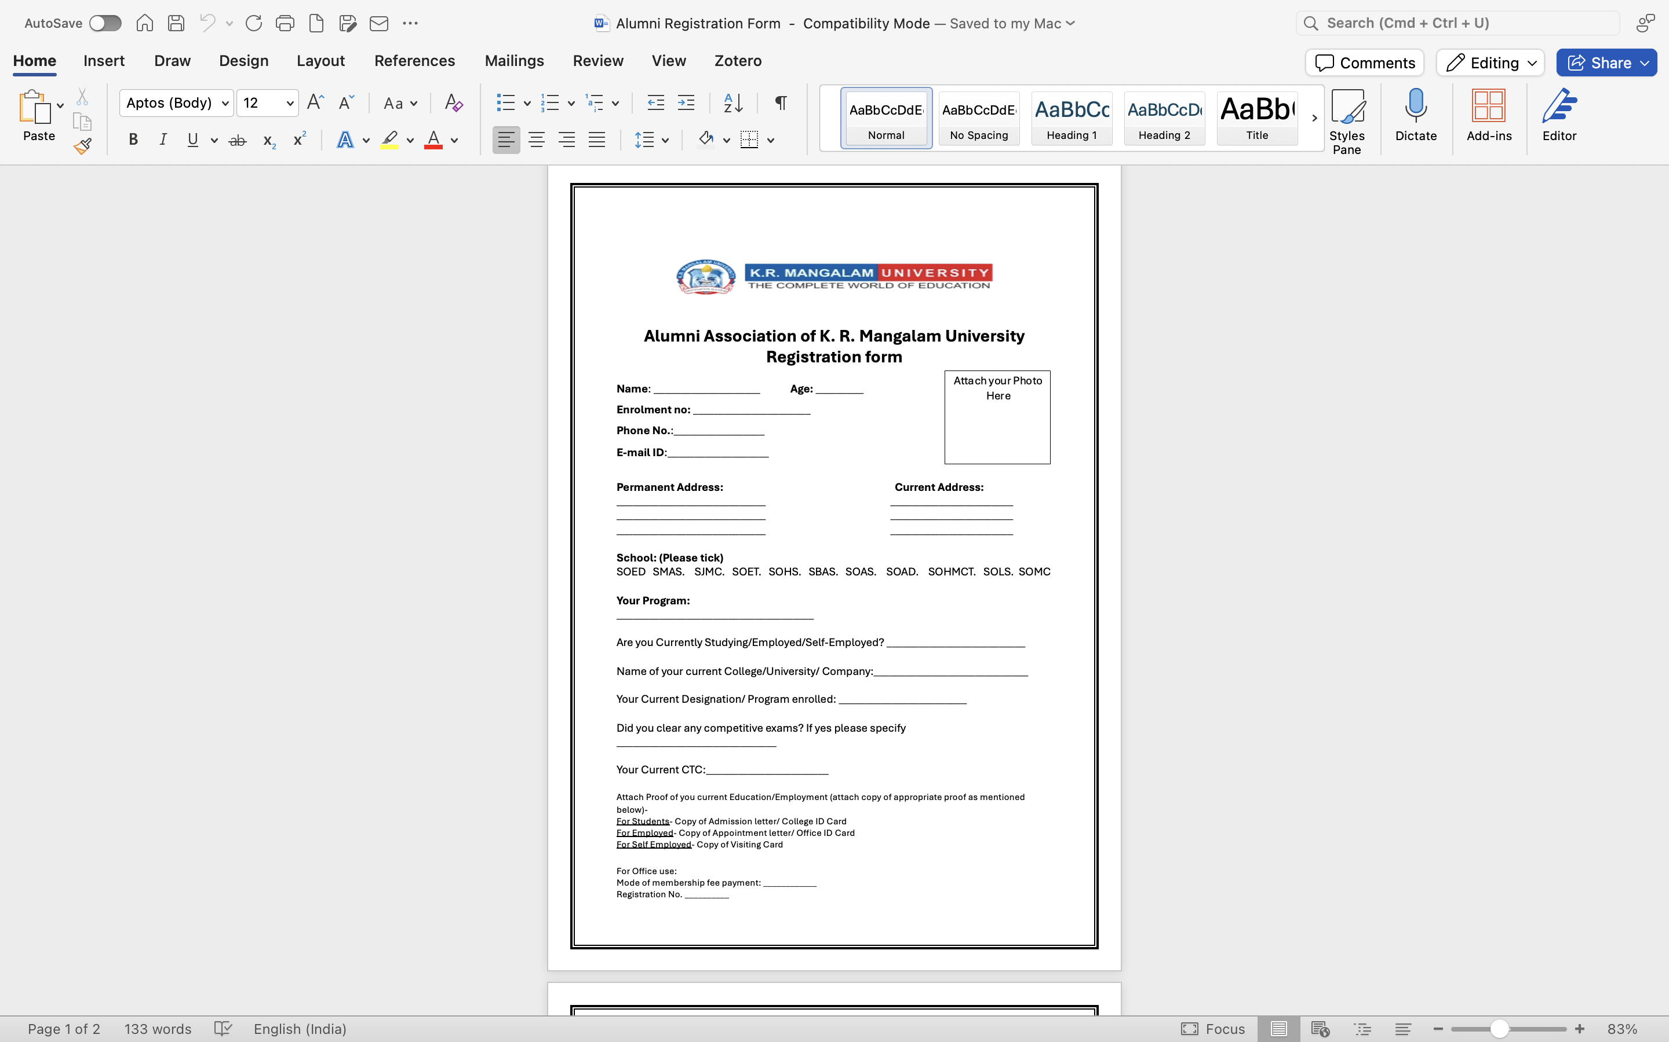
Registration Process in Alumni Association of K.R. Mangalam University?
The individual must be a bona fide graduate of K.R. Mangalam University, having successfully completed an academic program leading to the award of an Undergraduate, Postgraduate, PhD or Diploma qualification, as recognized by the University.
The individual must have formally enrolled as a member of the Alumni Association by fulfilling the applicable membership contribution requirements as stipulated by the University’s Alumni Relations Office.

Slide 9
Alumni Registrations

Slide 10
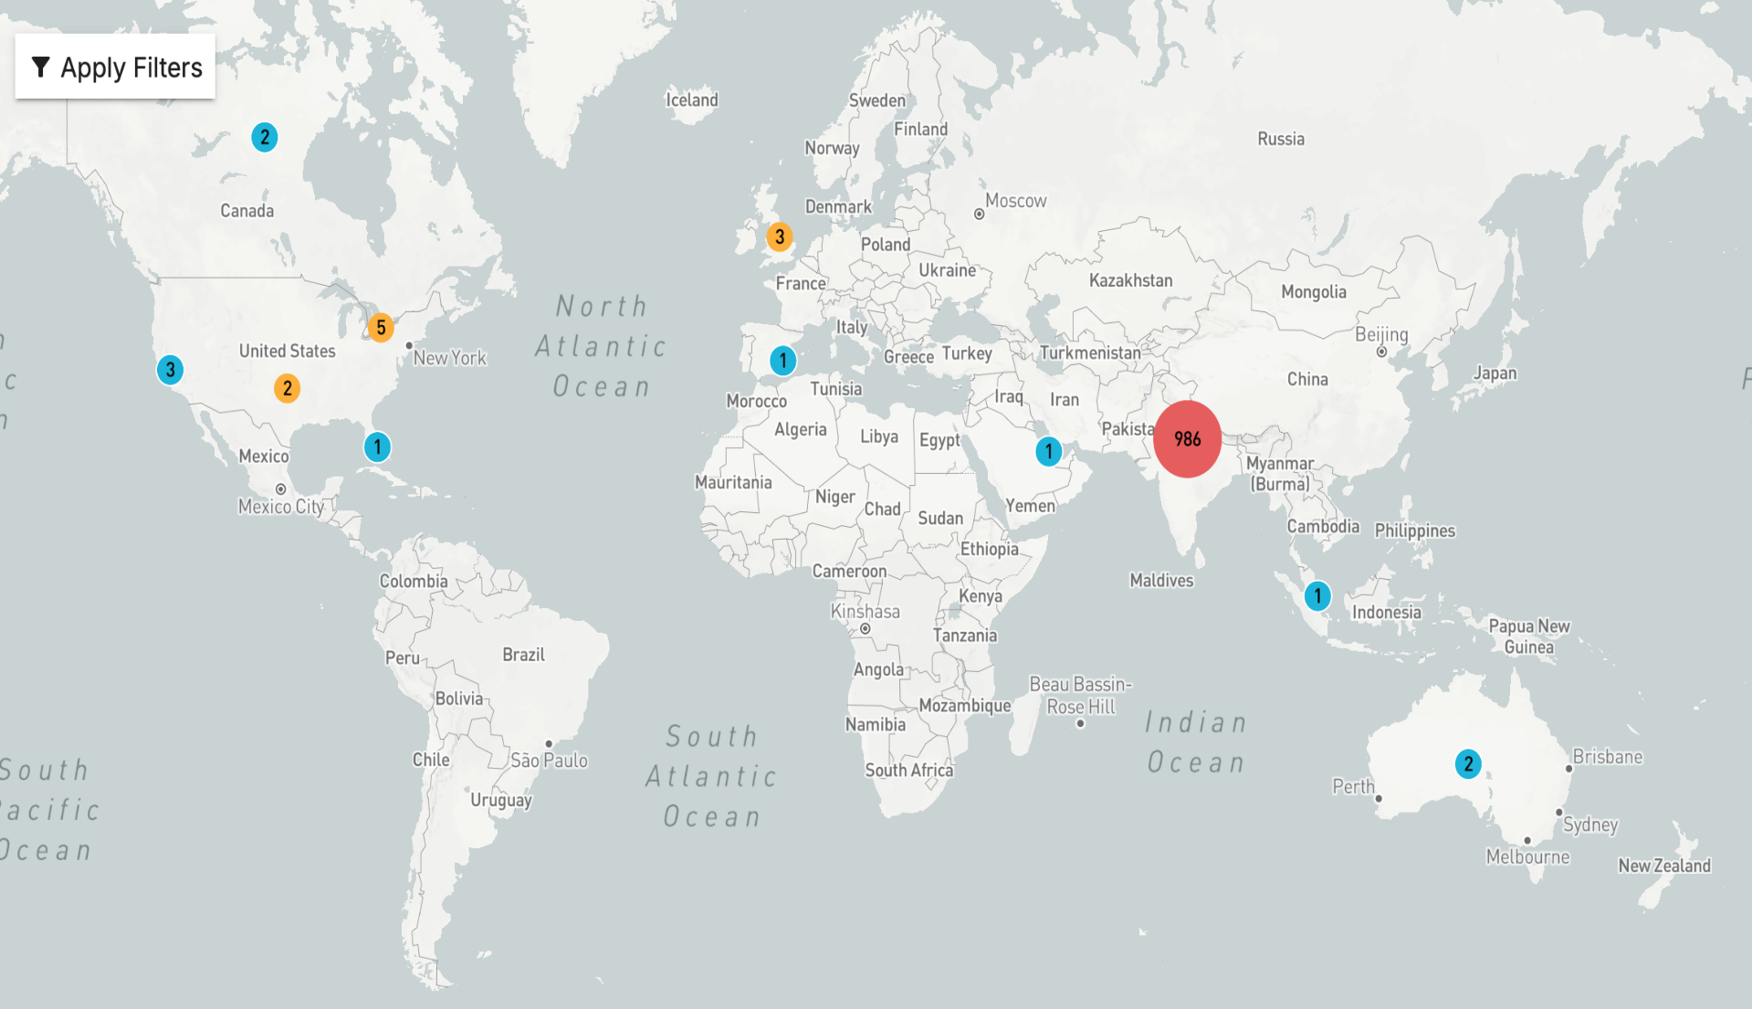

Alumni Registrations
Proud to be backed by a thriving global network of over 3,406 registered alumni trailblazers, changemakers, and leaders , leaving their mark across industries and continents, and continuing to elevate the legacy of our institution with every milestone they achieve

Slide 11
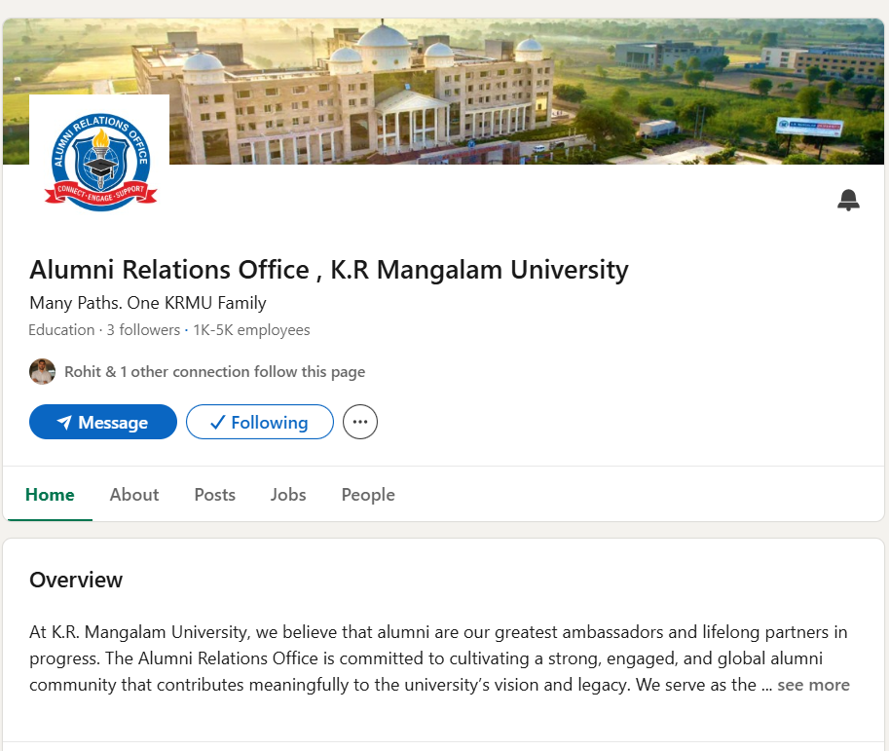
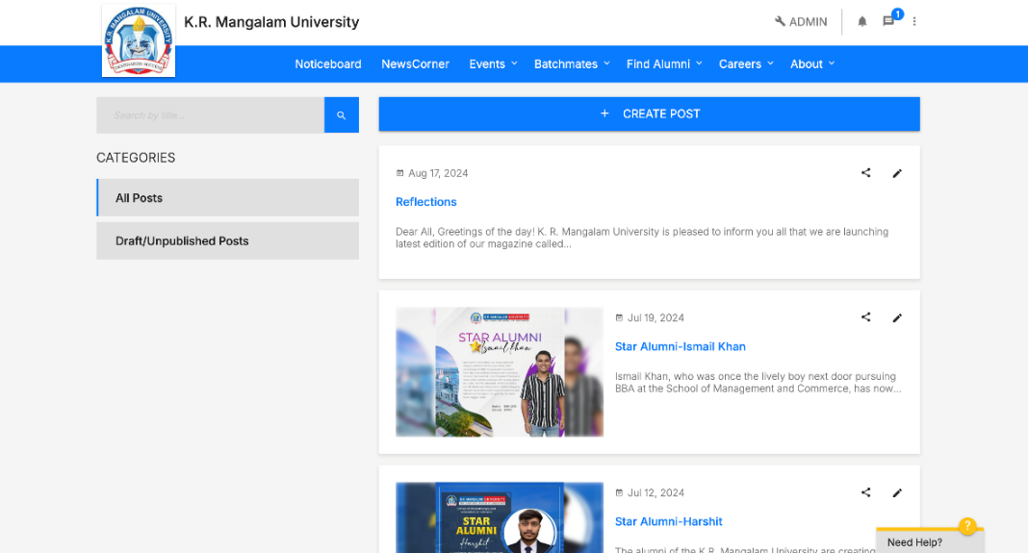
Alumni Connect
K.R. Mangalam University actively engages with its alumni through a diverse range of digital platforms to ensure consistent communication and meaningful connections:
Almashines: Our official alumni portal for registrations, networking, job opportunities, and event updates.
Instagram: A visual platform to showcase alumni achievements, event highlights, and nostalgic campus moments.
LinkedIn: A professional network for sharing career updates, university news, and fostering industry connections.
Facebook: A community hub for event promotions, photo memories, and alumni interaction.
WhatsApp Groups: Batch-wise and regional groups used for real-time updates, coordination, and quick engagement.

Slide 12
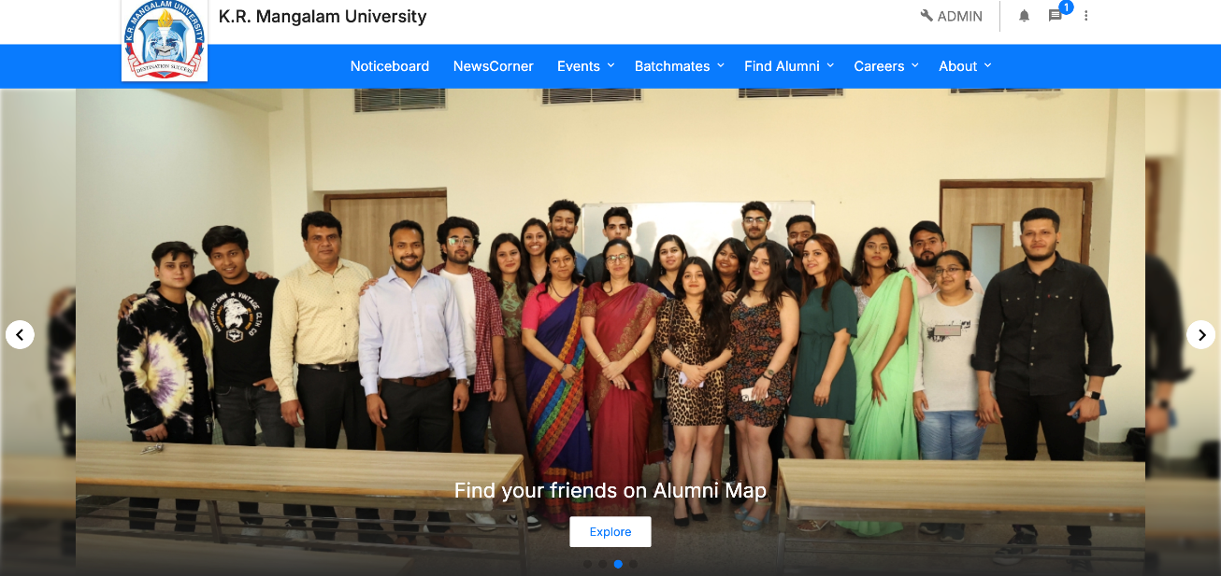
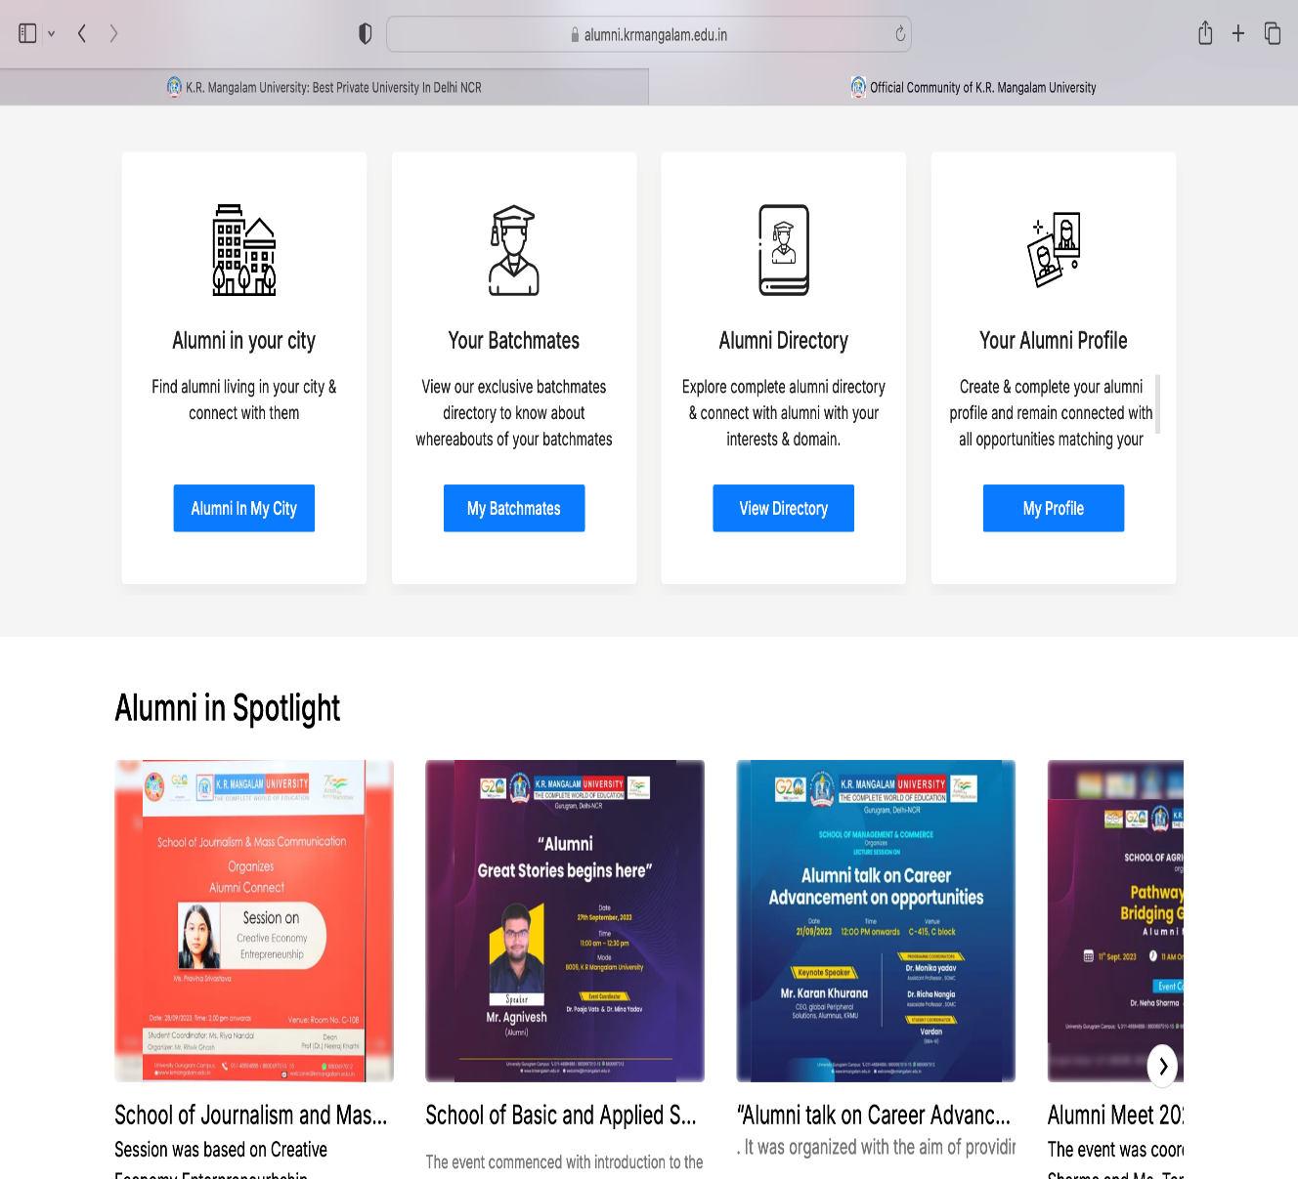
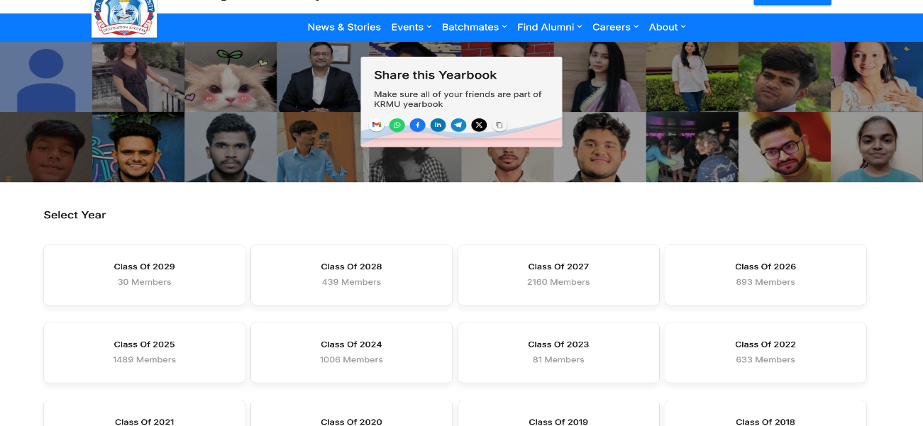
Alumni Portal: Almashines
https://alumni.krmangalam.edu.in/

Slide 13
Alumni Contributions
Job Opportunities
Alumni actively share openings, offer referrals, and support recruitment efforts.
🔸 Career Counseling
They guide students and graduates in career planning, upskilling, and interview preparation.
🔸 Real-life Success Stories
Their inspiring journeys serve as motivation and benchmarks for current students.
🔸 Networking Platforms
Alumni help build strong professional networks through meetups, forums, and events.
🔸 Knowledge Sharing via Talk Series
They lead sessions on industry trends, innovations, and professional experiences.
🔸 Industry Mentoring
Alumni mentor juniors, offering practical insights and bridging the gap between academics and industry.

Slide 14
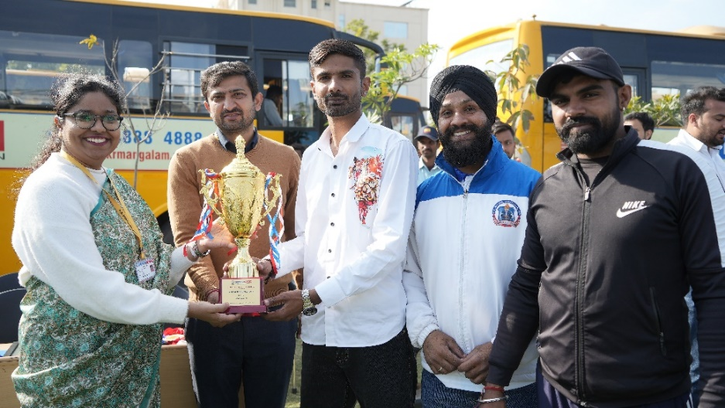
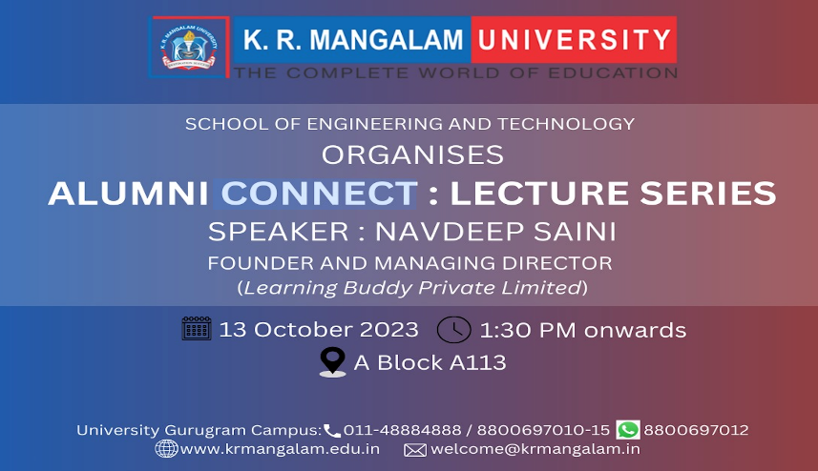
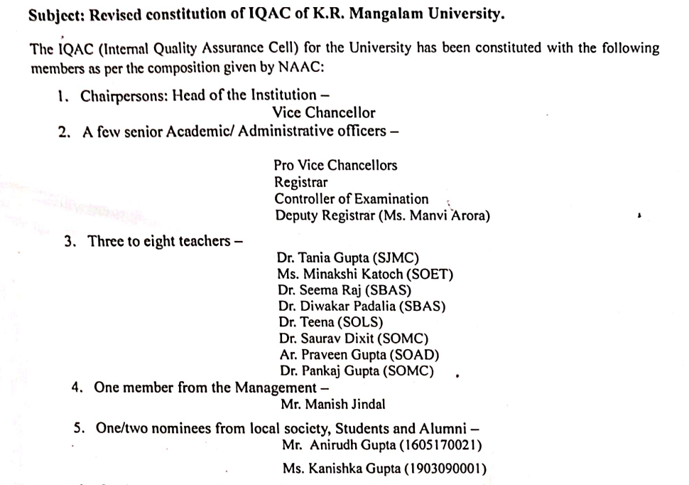
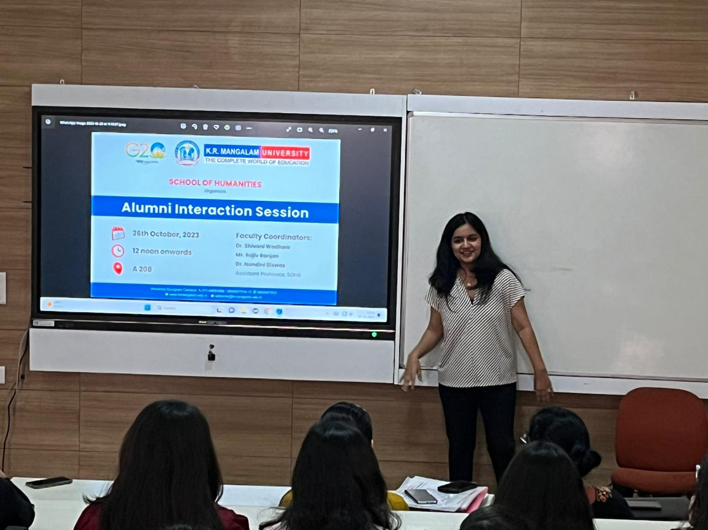
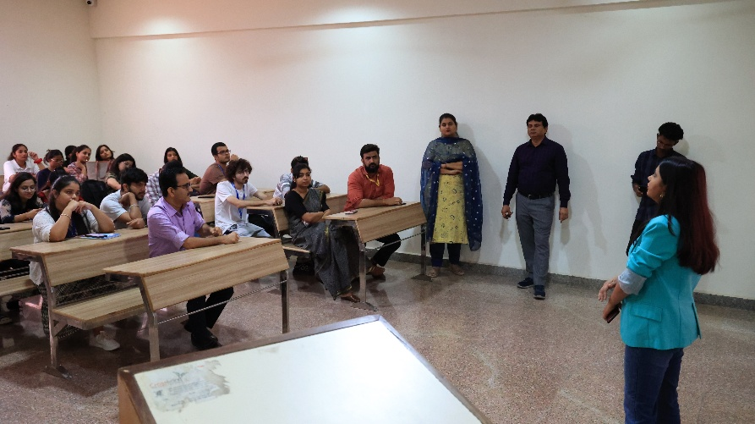
Alumni Engagements
Guest Lectures
Student Orientation: Aarambh
Alumni meets
Curriculum Feedback
Career Counseling
Campus Placements
Interactions
IQAC Committee

Slide 15
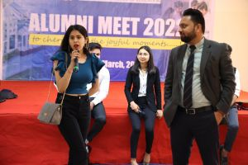
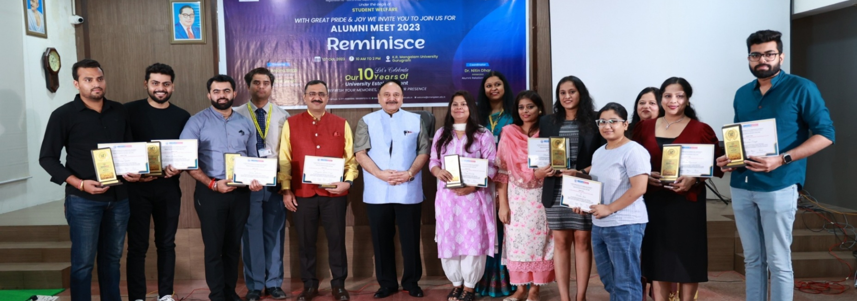
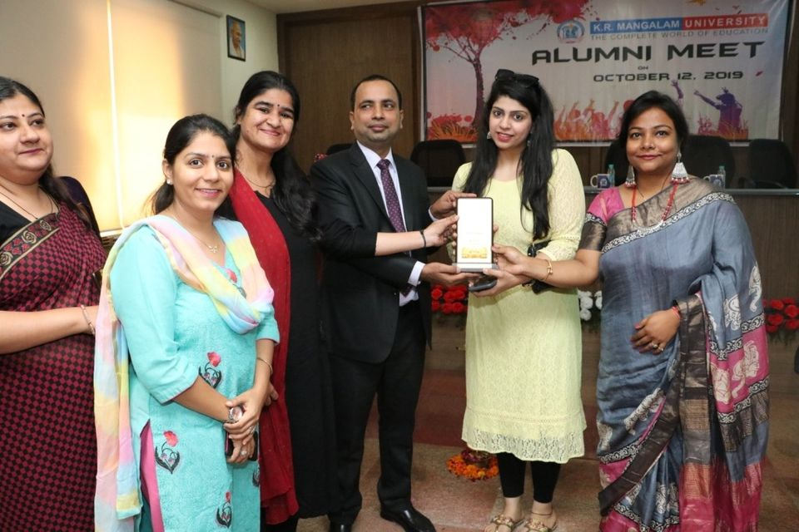
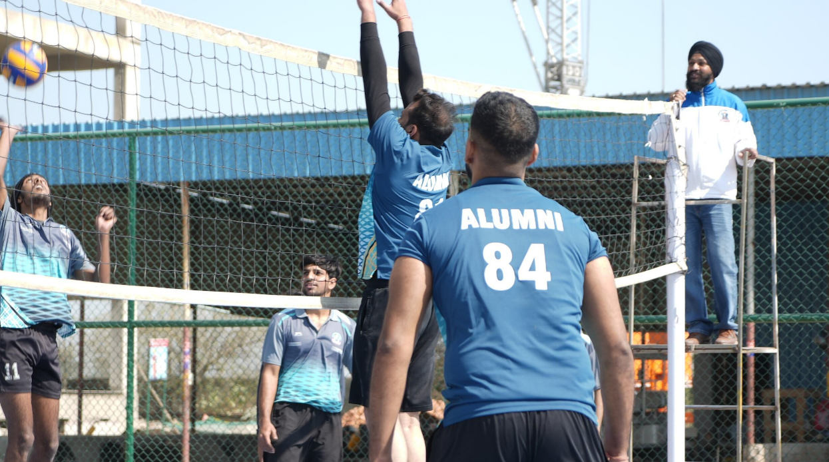
Alumni Meet

Slide 16












Alumni Placements
Few of our Alumni are placed in top most companies in the world

Slide 17
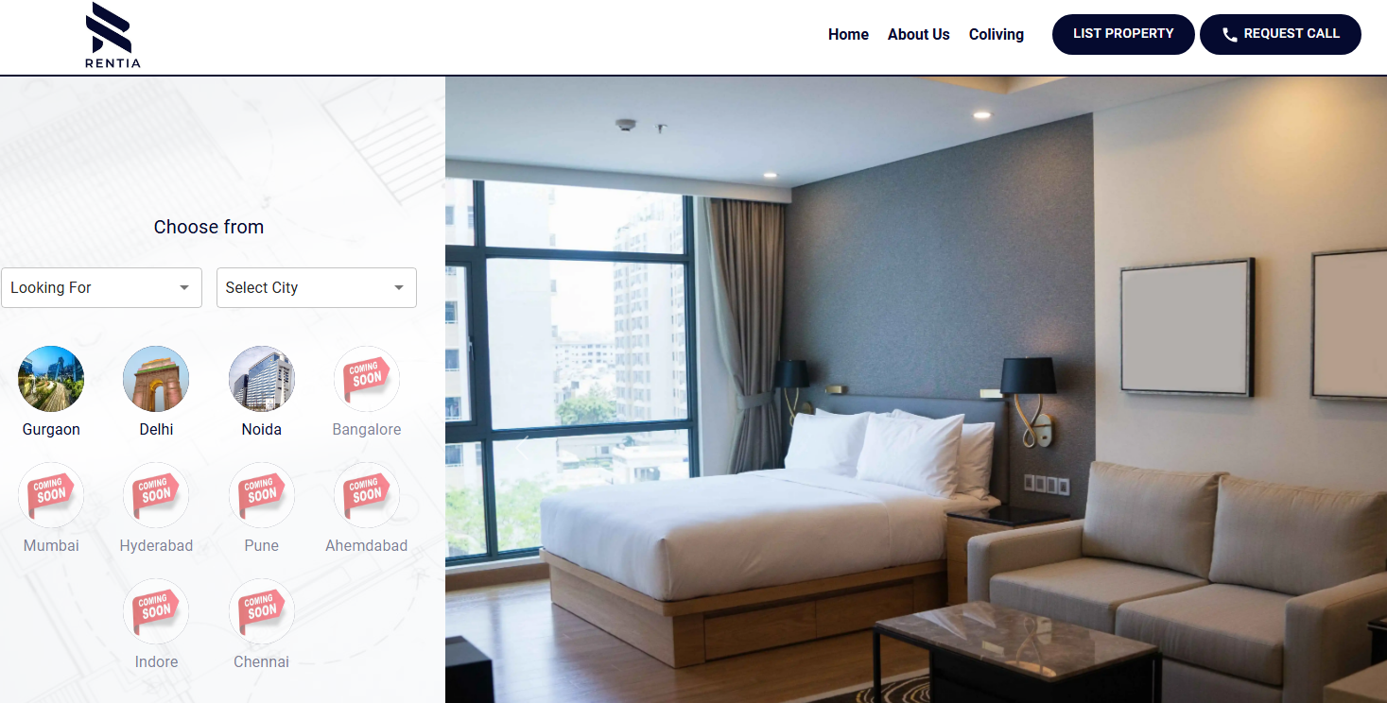
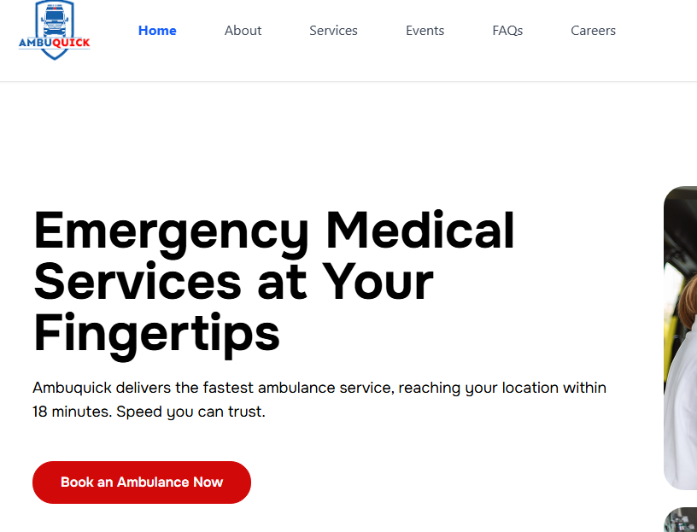


Start-ups owned by our Alumni

Slide 18








Alumni in Higher education

Slide 19
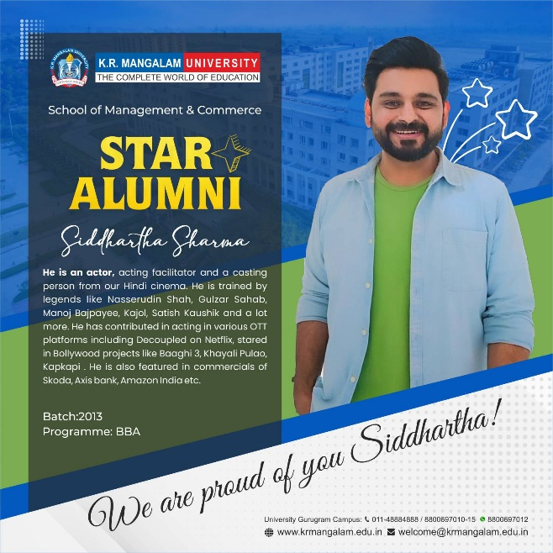
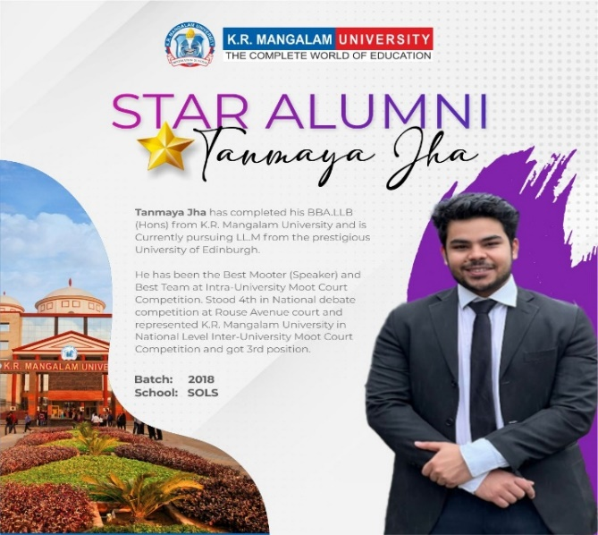
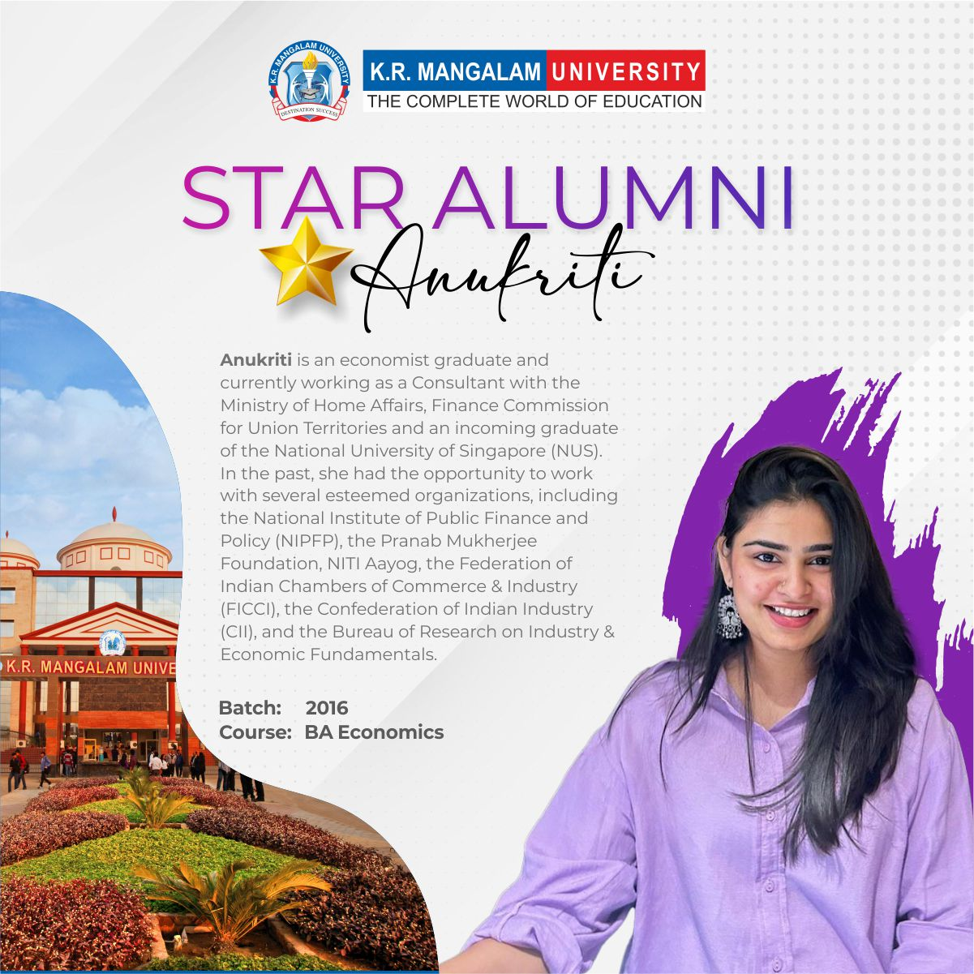
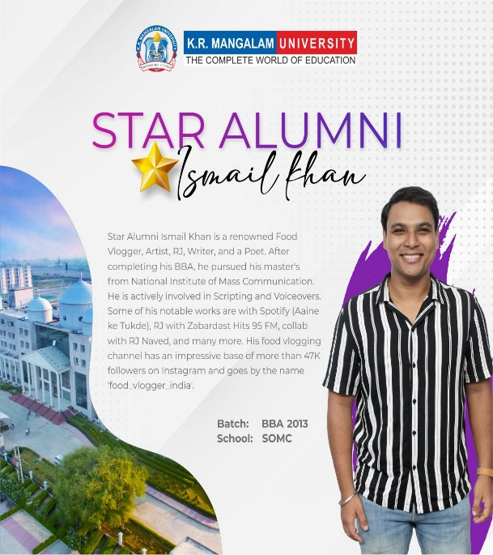
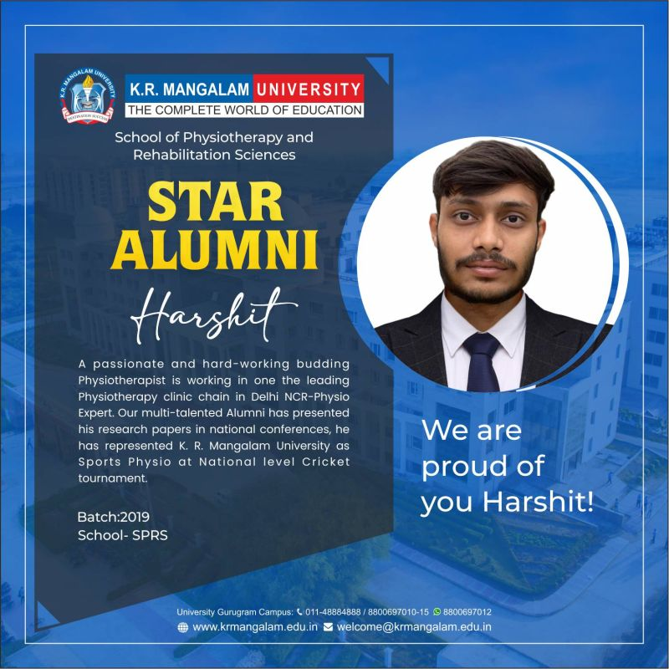
Star Alumni

Slide 20
Upcoming Alumni Initiatives & Corpus Utilization
UPCOMING ALUMNI ENGAGEMENT INITIATIVES:
• Chapter-Wise Alumni Meets (PAN India): Hosting regional gatherings across key cities.
• Alumni Hall of Fame: Honoring distinguished alumni during orientation.
• Alumni Podcast Series: Featuring success stories and insights from alumni across industries.
• Bi-Monthly Alumni Newsletter: Sharing achievements, updates, and opportunities.
PLANNED UTILIZATION OF CORPUS FUNDS:
• Alumni Research & Innovation Grants: Supporting alumni-led research and startups.
• Social & Networking Events: Cultural evenings, alumni reunions, and city-based meetups.

Slide 21
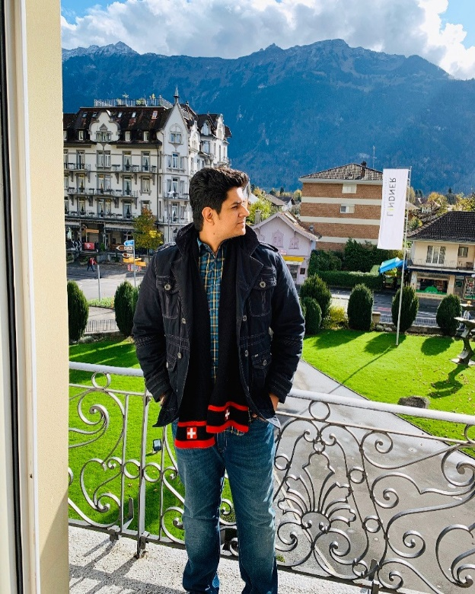
Alumni Testimonials
Omung Lalchandani,
Senior Associate Design, Skootr Global Pvt Ltd Gurgaon
It’s been a great experience at K.R Mangalam University. Never thought that a college could change lives in terms of education, learning and experience. The course bachelors of architecture(B.arch) is one of the finest and most toughest course known till date in comparison to the rest of the courses offered by our education industry. Doing B.arch from this college has made me realise that the most difficult course was taught to us in the most easiest way possible, with the help of weekly evaluations, monthly juries and yearly final submissions. K.R Mangalam has the best faculty from various best institutes and backgrounds wherein we got to learn with all their knowledge & experiences. I myself got motivated in one of the subjects which was taught to us and later after completing my Bachelors went for my post graduation (Masters In Urban Design)
The college is great in terms of faculty, Facilities, Experience ,overall academic and cultural activities happening all around the year.

Slide 22
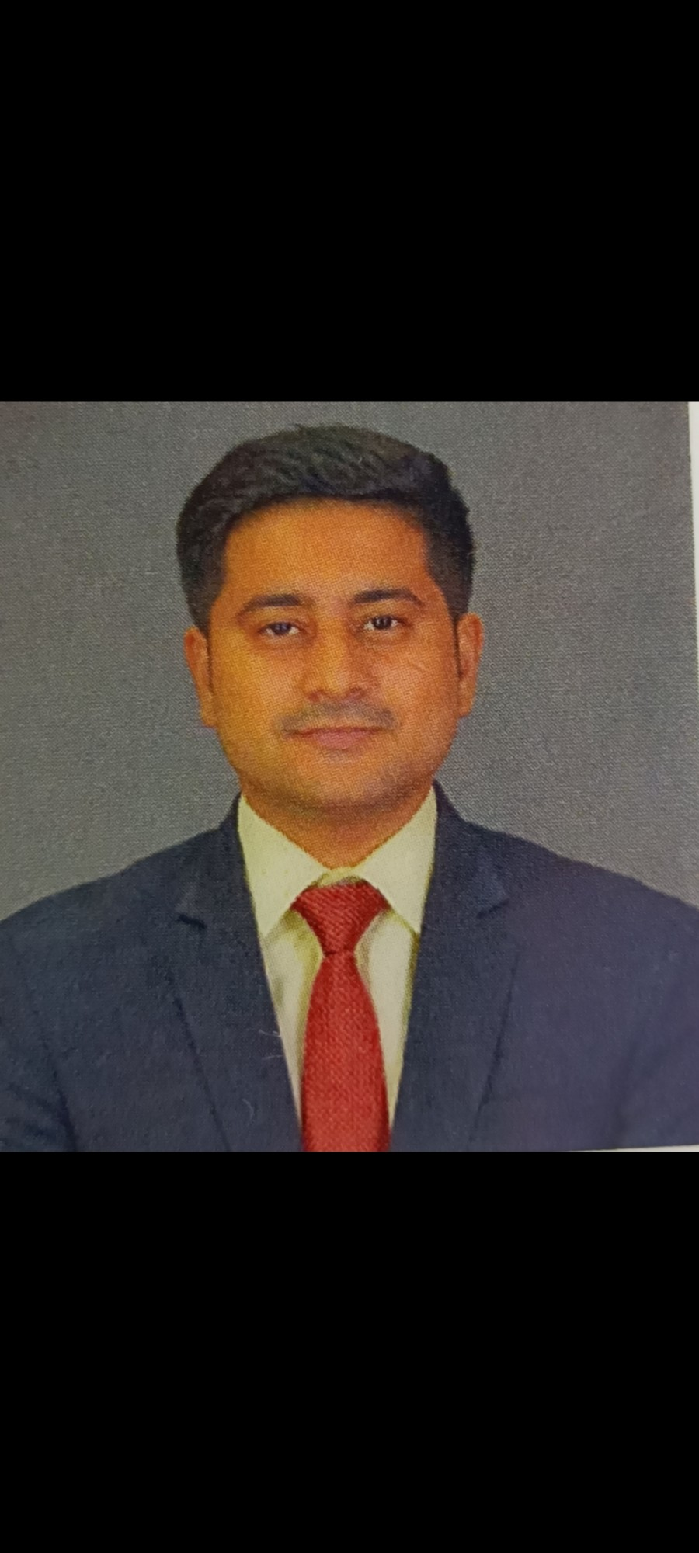
Alumni Testimonials
Gaurav Chauhan,
Manager, Axis Bank Ltd
I am very proud and blessed to be a part of KRMU as it has taught me many lessons for life. I have learnt to be disciplined towards my studies and carrier. The faculty here are the best as they are friendly and motivating. They are very focused towards our carrier and has very good subject knowledge. The non teaching staffs are a set of hardworking individuals who makes all the activities and events successful.

Slide 23
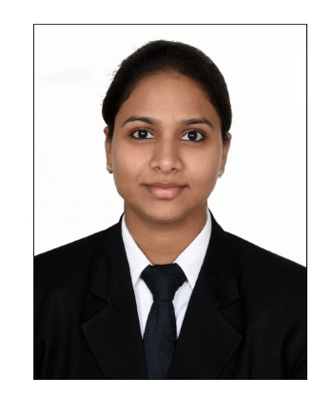
Alumni Testimonials
Komal Sharma,
Director, Ataraxia IP
I am very blessed that I took admission in KRMU. The University has the best Infrastructure and Social Atmosphere.
The quality of education is very nice and the professors are highly experienced and supportive.
I am Thankful to all my teachers for sharing their valuable knowledge and making learning such an interesting experience for us.
Eventually KRMU is a strong pillar of my career.

Slide 24
Thank You

