Slide 1



WELCOMES
NAAC Peer Team
16th -18th June

Slide 2
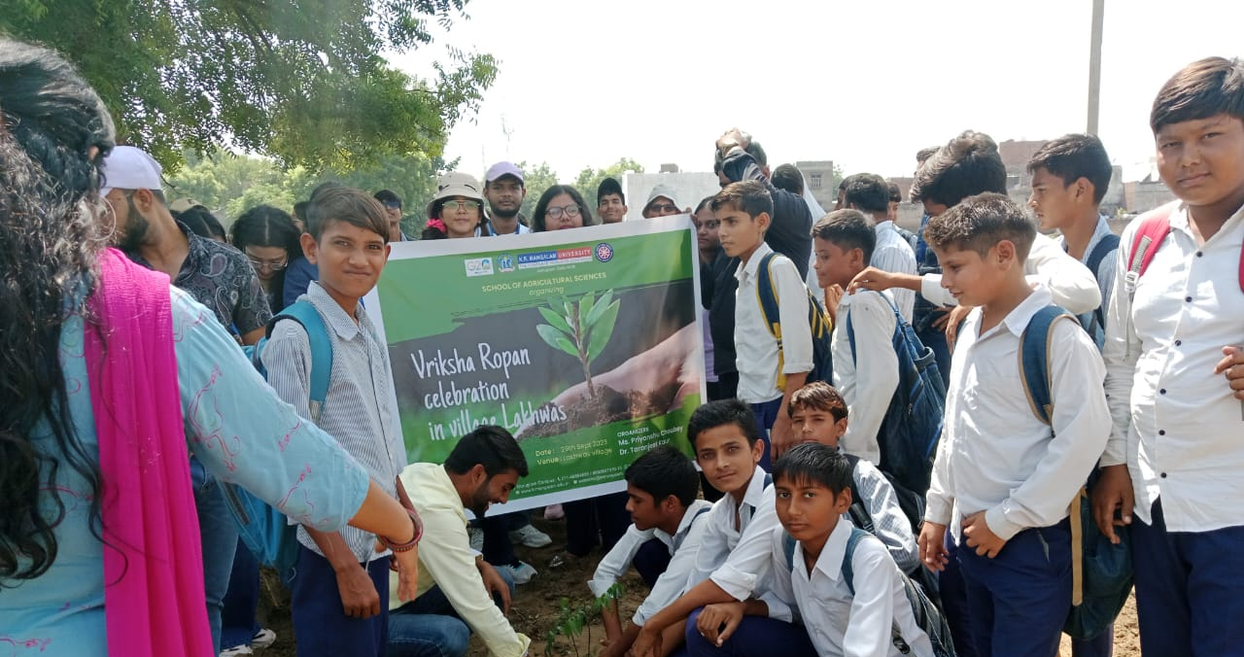
Best Practice-1
Nurturing Eco – Conscious
Behavior: Taking Step Towards
Environment Sustainability

Slide 3
OBJECTIVE
METHODOLOGY
INDEX PAGE
THE PRACTICE
OUTCOME

Slide 4
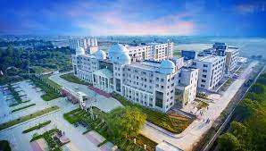
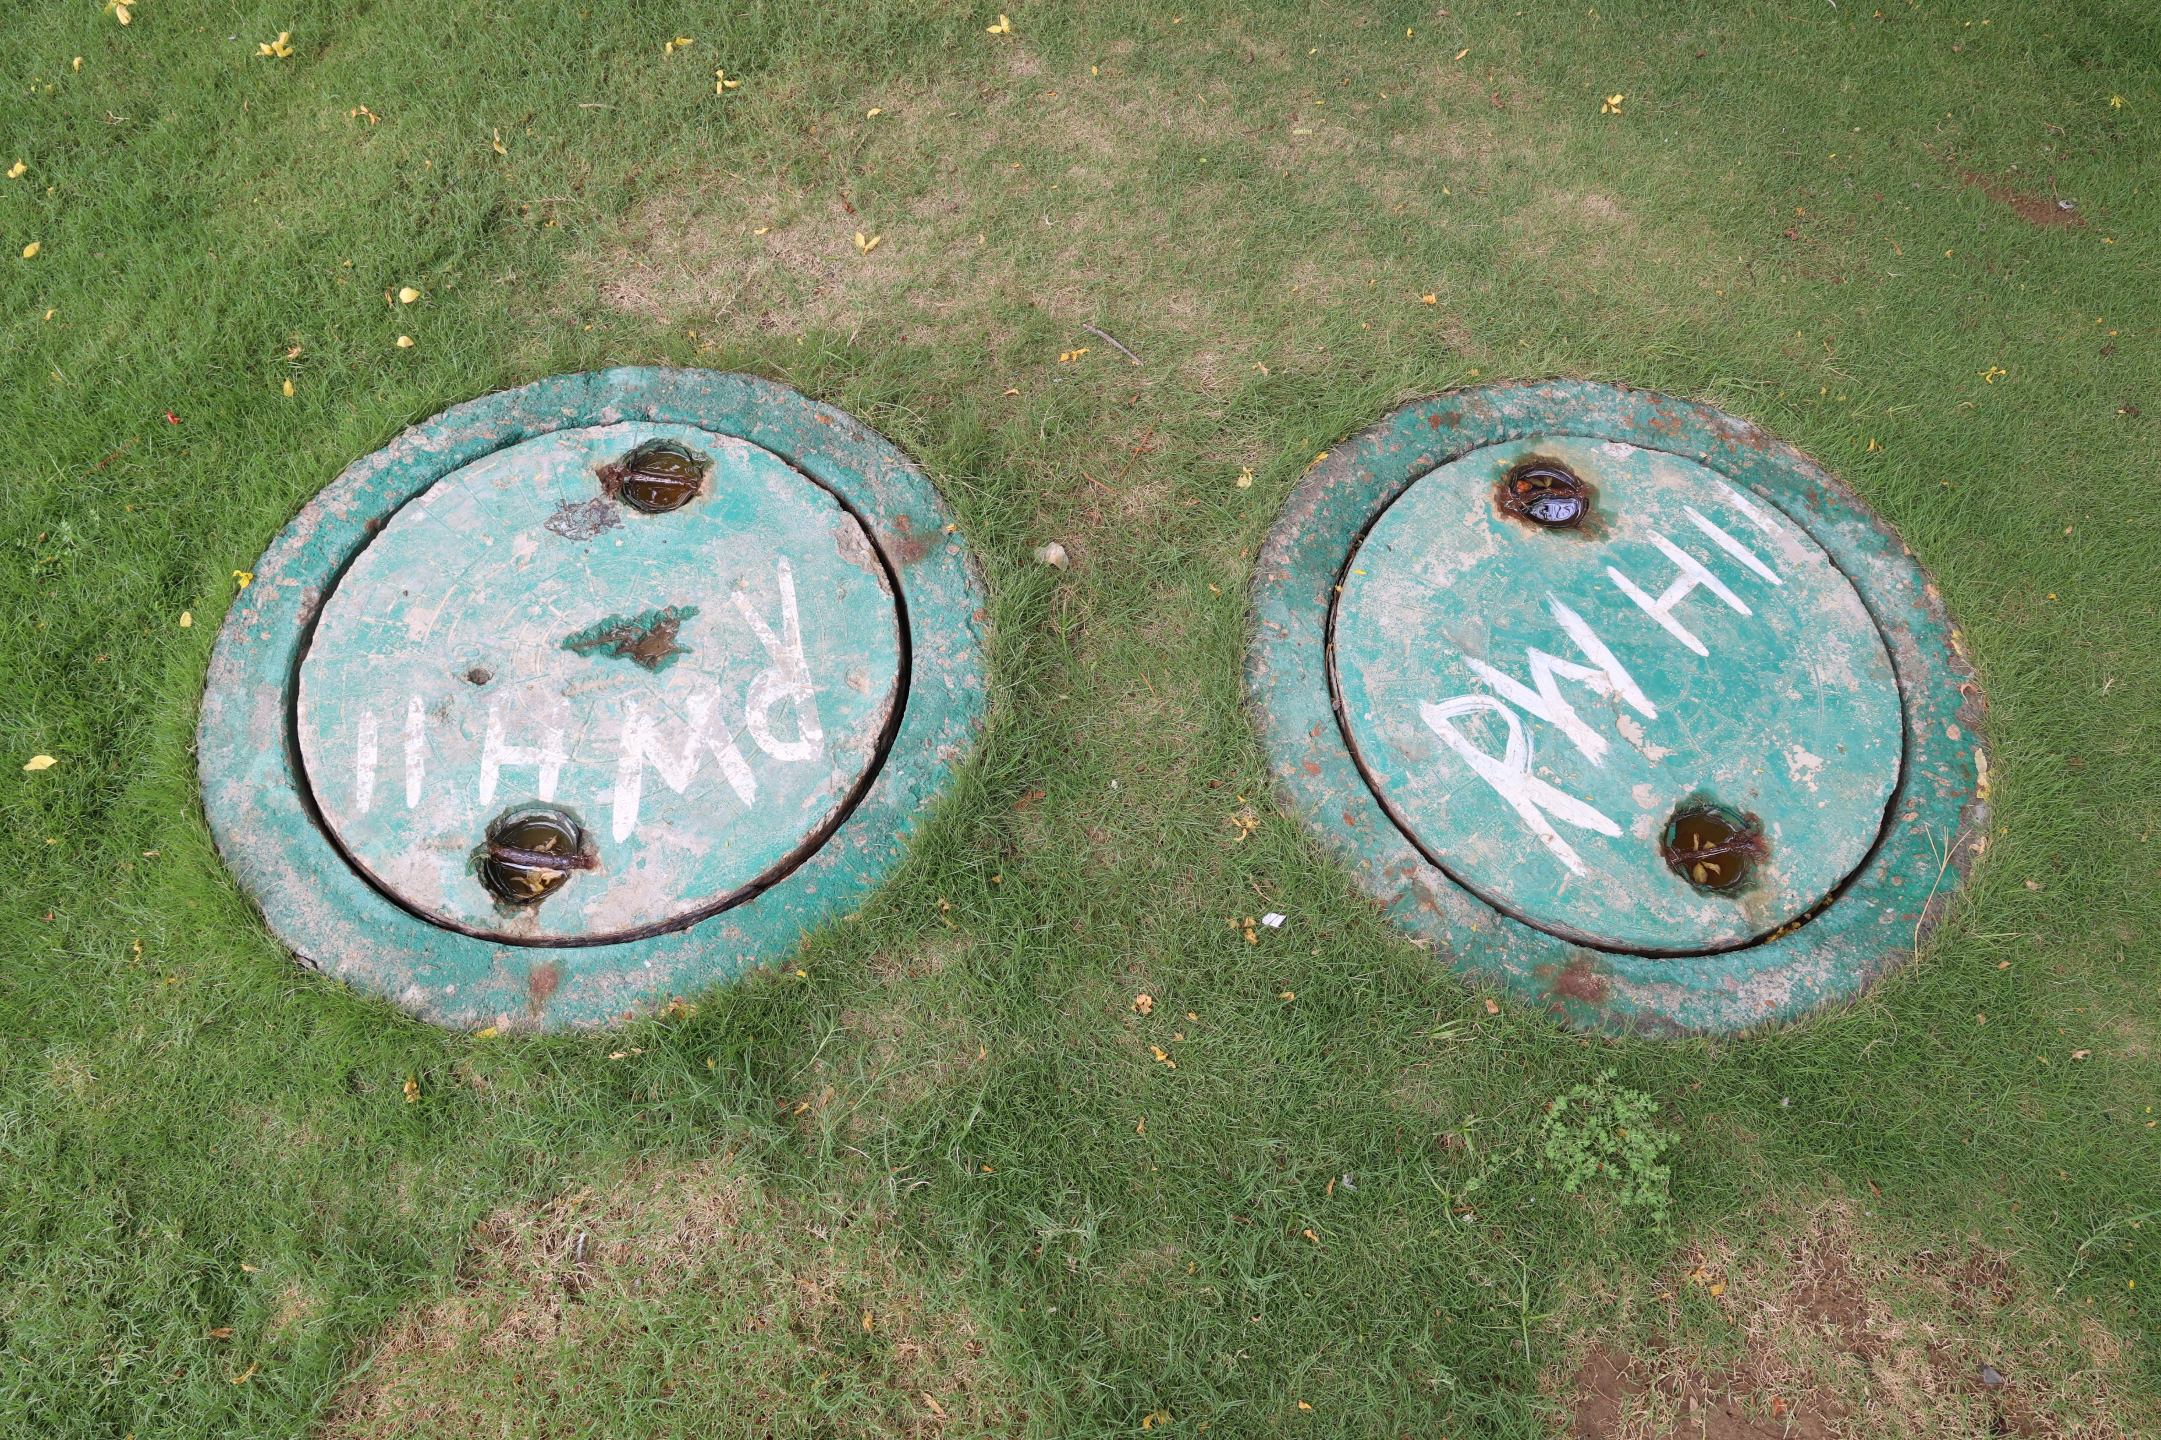
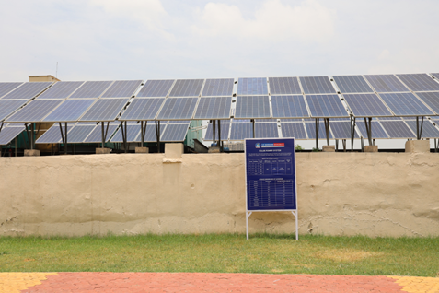
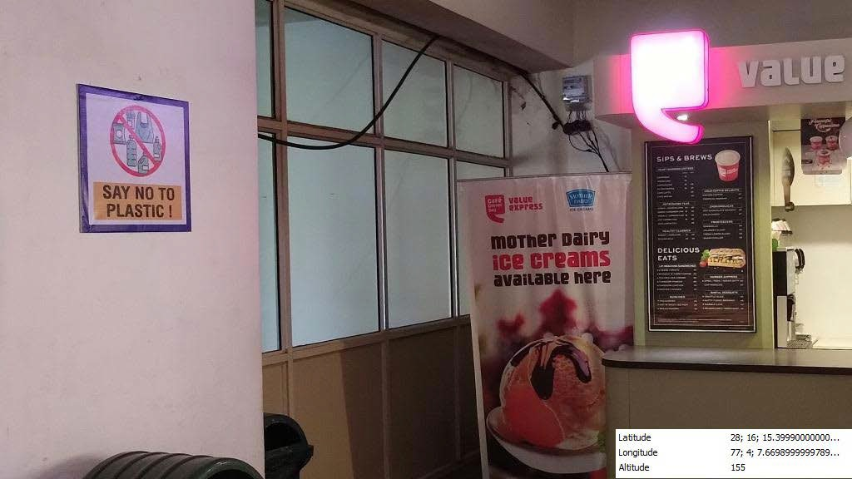
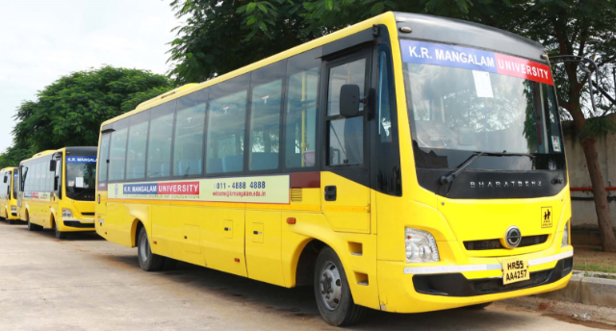
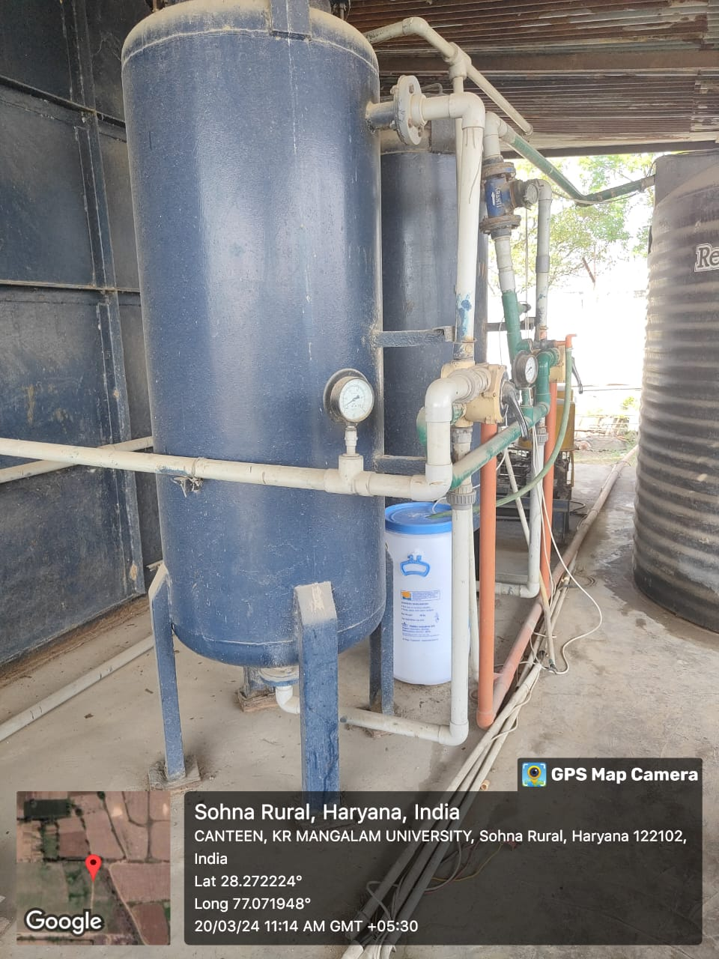
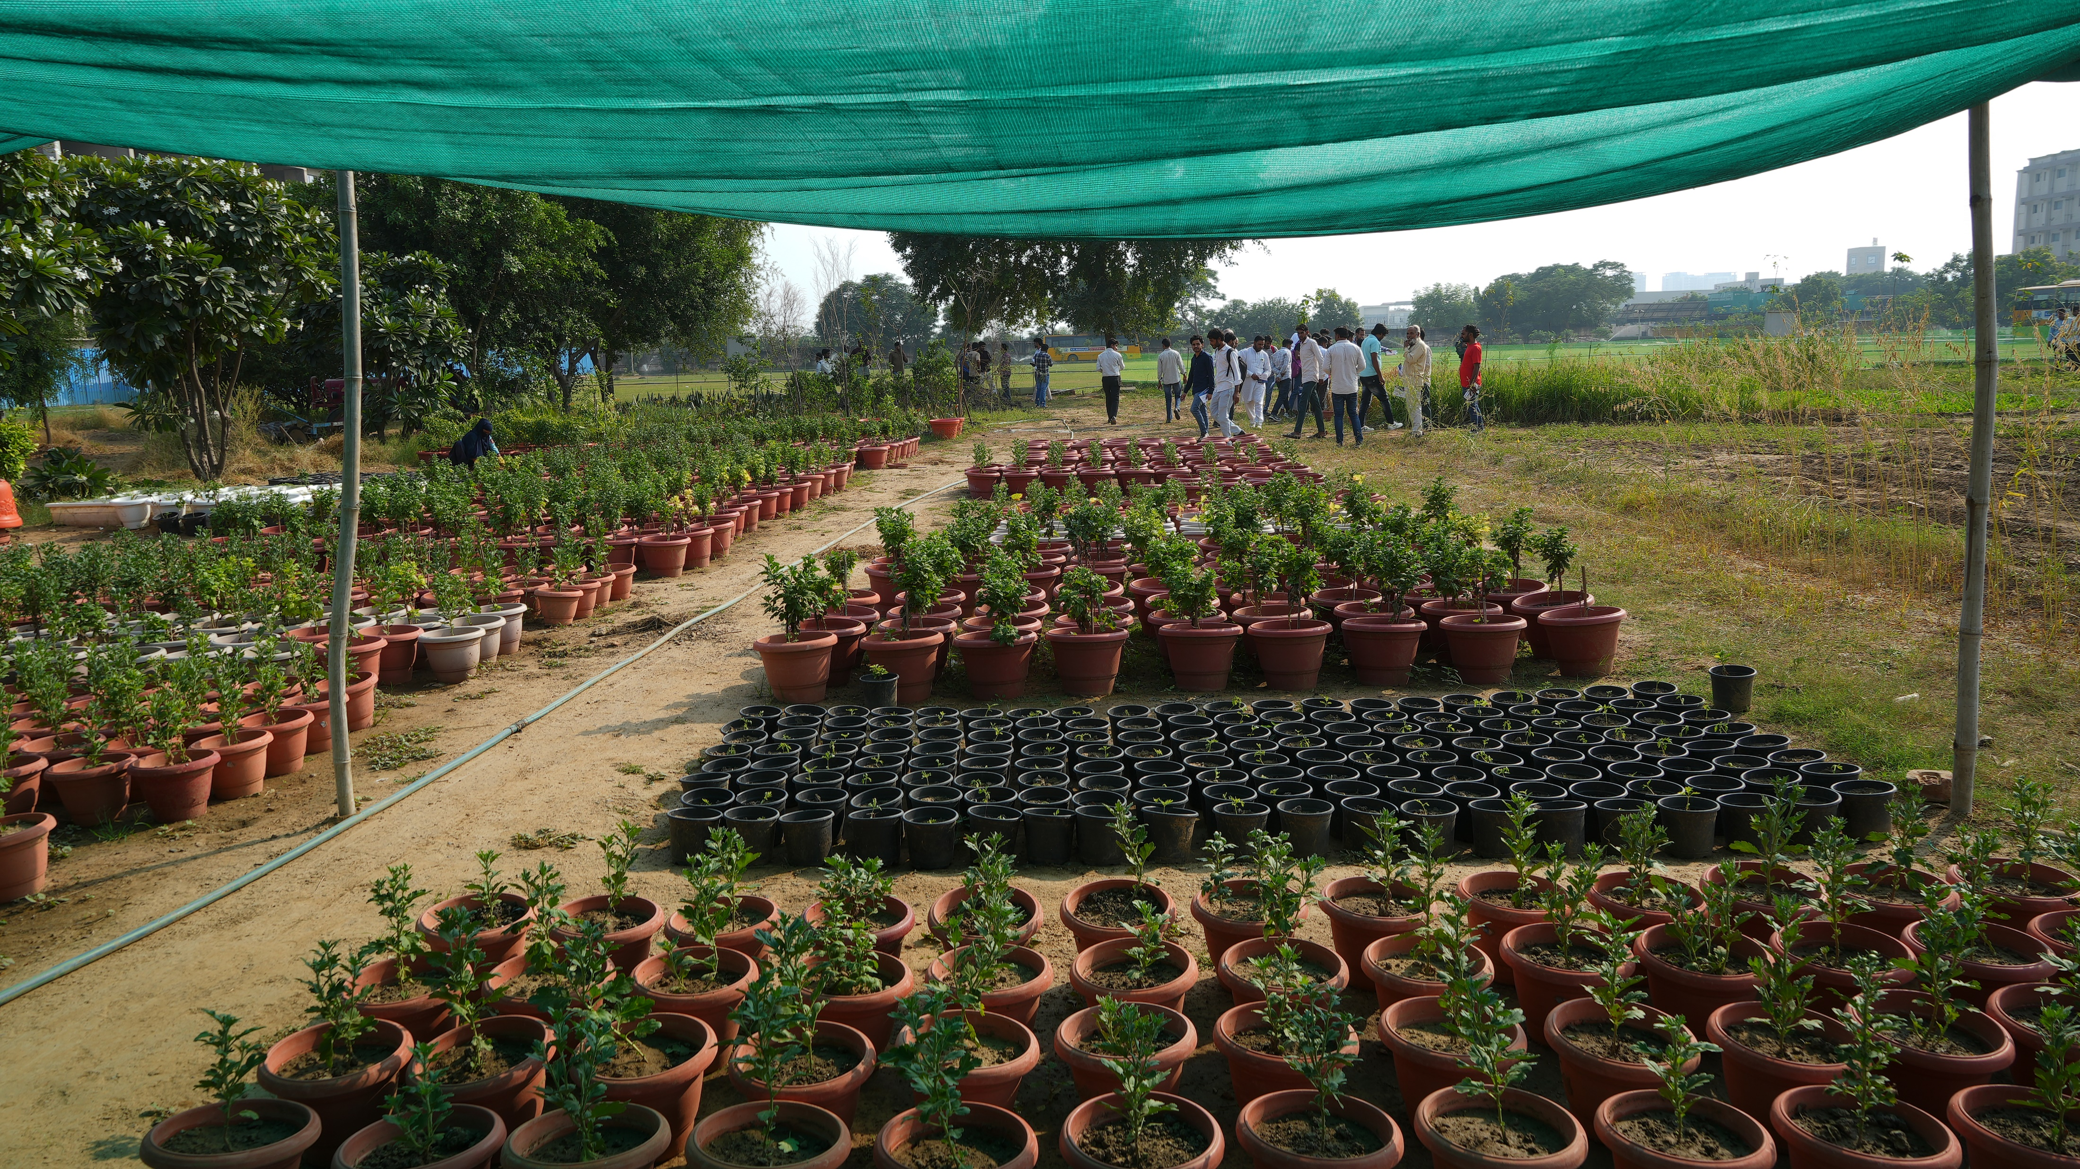
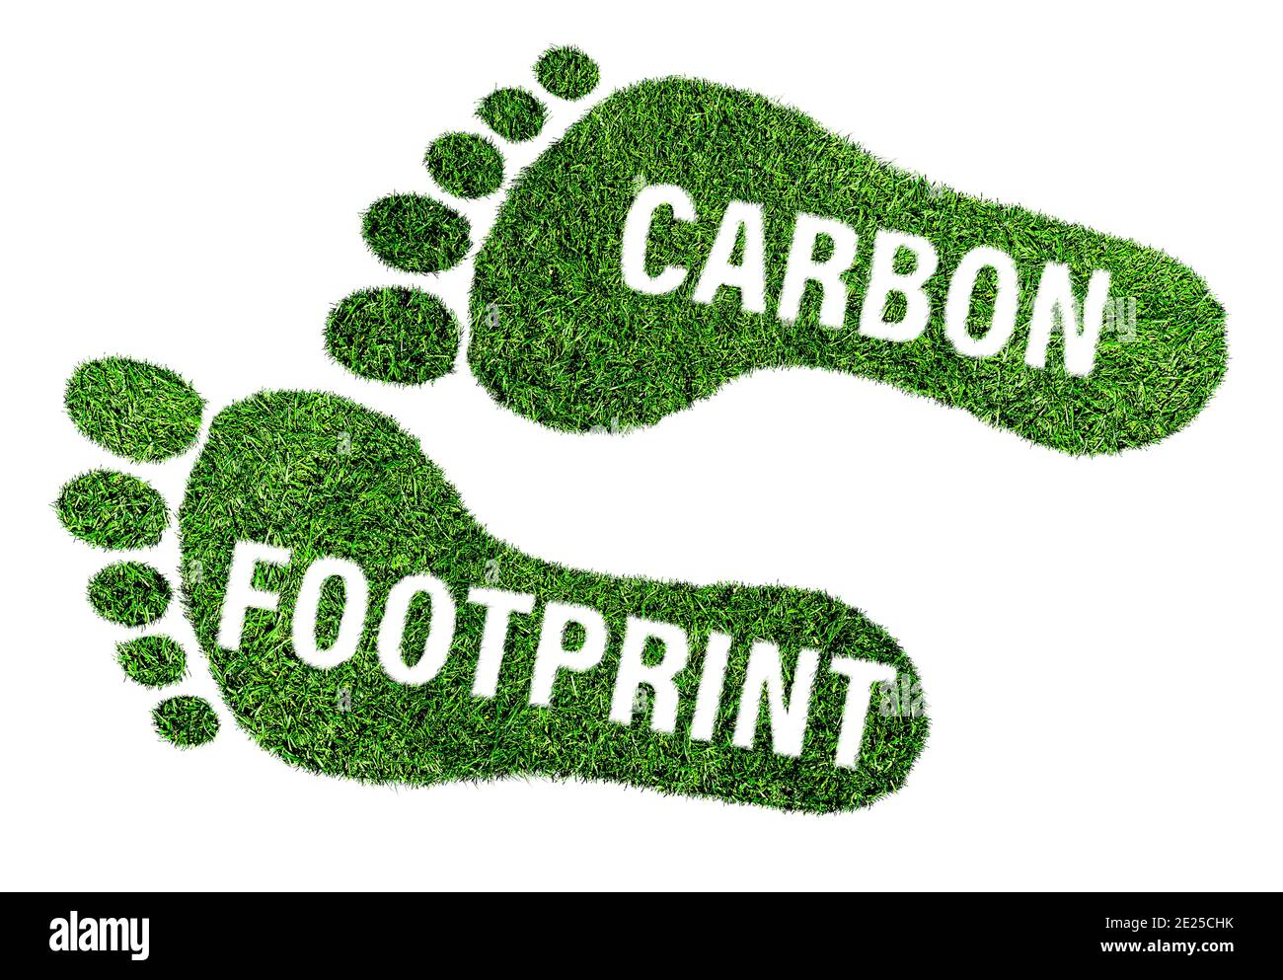
Eco-Friendly University
26.4 Acres Lush Green Campus with more than 3000 Trees and plants
Water Conservation: 17 Rainwater Harvesting Pits
01
05
Solar Panel with Total Capacity: 41850 units/Month
02
06
100% Plastic Free Campus
03
1 Lakh Ltr Capacity of STP for plant irrigation
70+ CNG Buses
07
Carbon Footprint of KRMU 1.66 which is much lower than India & Global Average
04
In-House Nursery
08
4

Slide 5
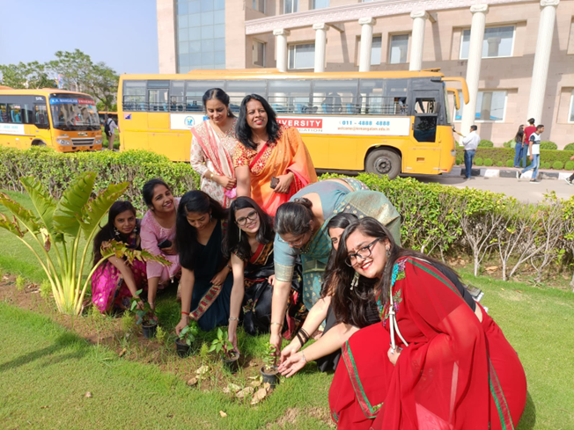
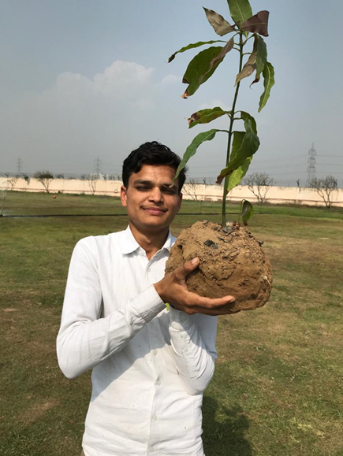
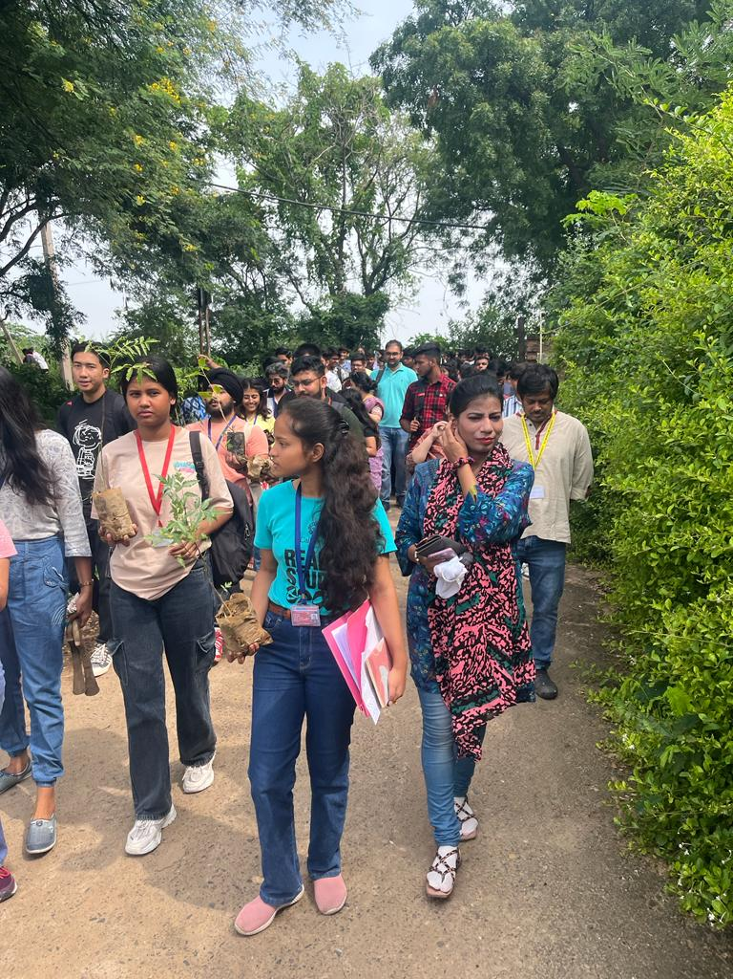
Objective
To inculcate a sense of responsibility and a moral duty among students, individuals and communities to foster the behaviour for preservation and conservation of environment.
Eco-Friendly Behaviour
Centralized 60 CNG Buses & Carpooling
Solar Energy & Energy Conservation (CAPACITY)
Power-Efficient Equipment
Digital Media for Paper Reduction
Sustainability Center for Excellence (SDG)
In-House Nursery & Green House
Organic Orchard: Paper Recycling Plant (MoU)
Zero Plastic Policy
Environmental Sustainability Awareness 40+
Tree Plantation
QR Coding of Plants and Trees
Plantation Drives

Slide 6
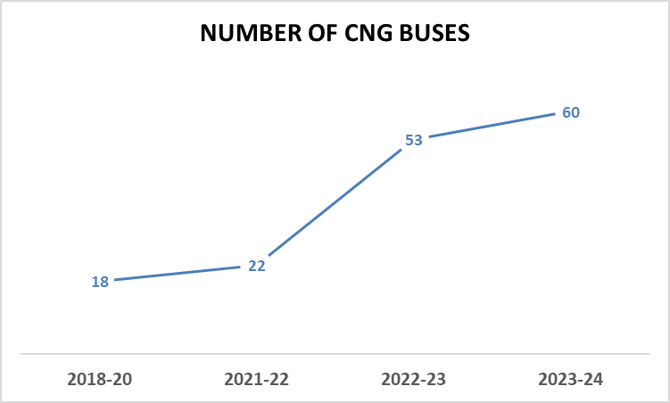
THE PRACTICE
Tree Plantation
Green Campus Expenditure
CNG Buses
Carbon Footprint KRMU 2023-24
Country | Carbon Footprint per Person (Tonnes CO2e)
India | 1.8-2.0
KRMU | 1.66
Global Average | 4

Slide 7
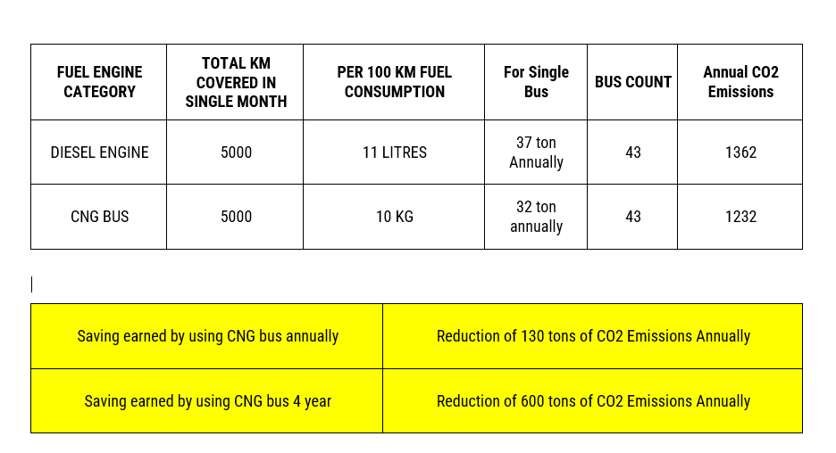
Carbon Footprinting Calculation 2023-24
FUEL ENGINE CATEGORY & TYPES | Commutating Size | Price PER DAY BASIS | ANNUAL BASIS (260 Days a year)
Private Buses, Cab, Private vehicles: DIESEL ENGINE | 4,5 max 20 at a time | 800 RS/DAY INC.RETURN | 208000 RS.
Autos, Private Vehicles: PETROL ENGINE | 4,5 max 20 at a time | 600 RS/DAY INC.RETURN | 156000 RS.
Public Transport CNG BUSES | 20 | 100 RS/DAY INC.RETURN | 26000 RS.
SELF University Transport CNG BUSES | 40 | 73 RS/DAY INC.RETURN | 18980 RS.
S.No. | Source | Diesel Generator Consumption | Total Co2 Emission Annual
1 | DG Set | 275 Ltr. | 742.5
 | in tonnes Total Annual |  | 0.505
Relevant Links for data collection
faculty google form for carbon footprint analysis.pdf
https://8billiontrees.com/carbon-offsets-credits/carbon-ecological-footprint-calculators/carbon-footprint-calculator-for-students/
https://yerun.eu/2021/04/uef-calculated-its-carbon-footprint-aims-to-become-carbon-neutral-by-2025/

Slide 8
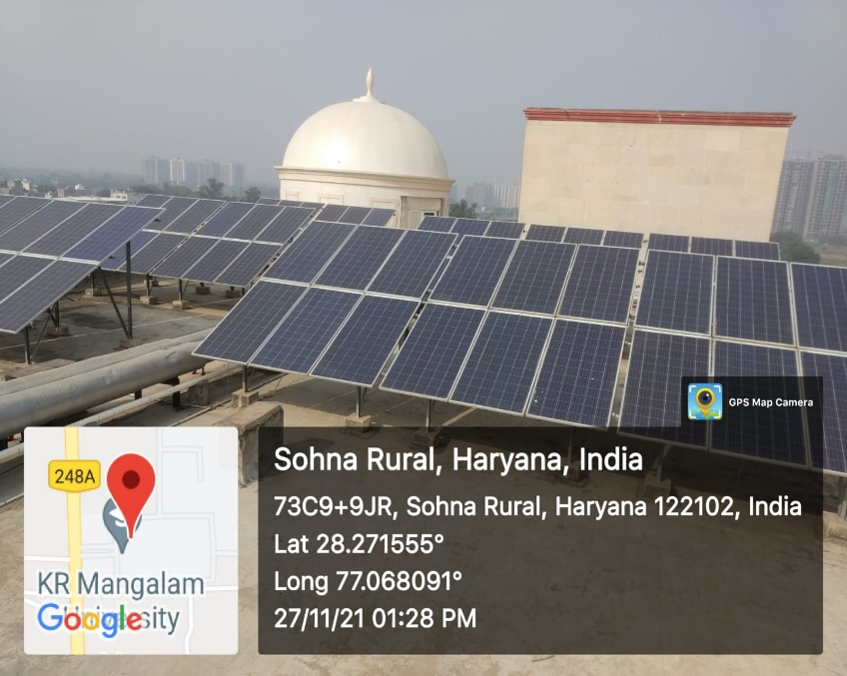
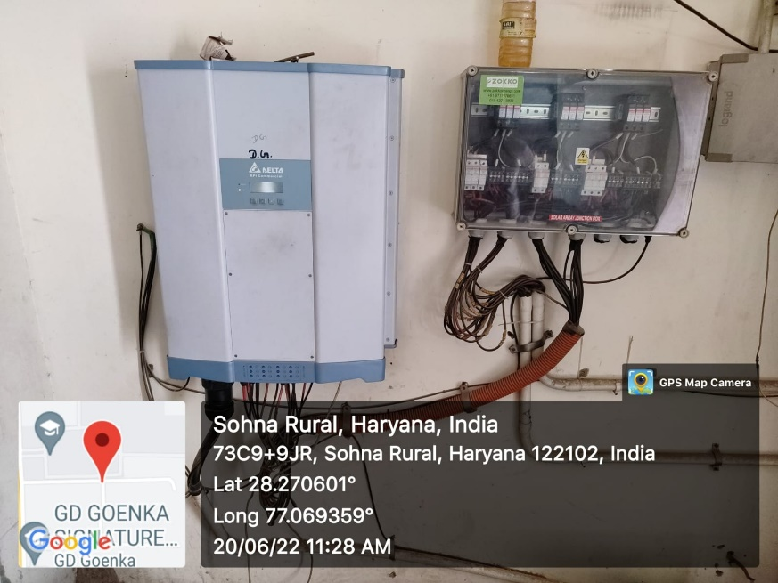
Solar Panel
Data for Solar Panels
Sr.No | Building | No. of Panels | Total no. of solar panels | Capacity | Total capacity | Rebate rate
1 | A | 157 | 984 | 310 Kw/day | 41850 units/month | 0.25
2 | B | 375
3 | C | 204
4 | DG | 120
5 | Hostel | 128

Slide 9
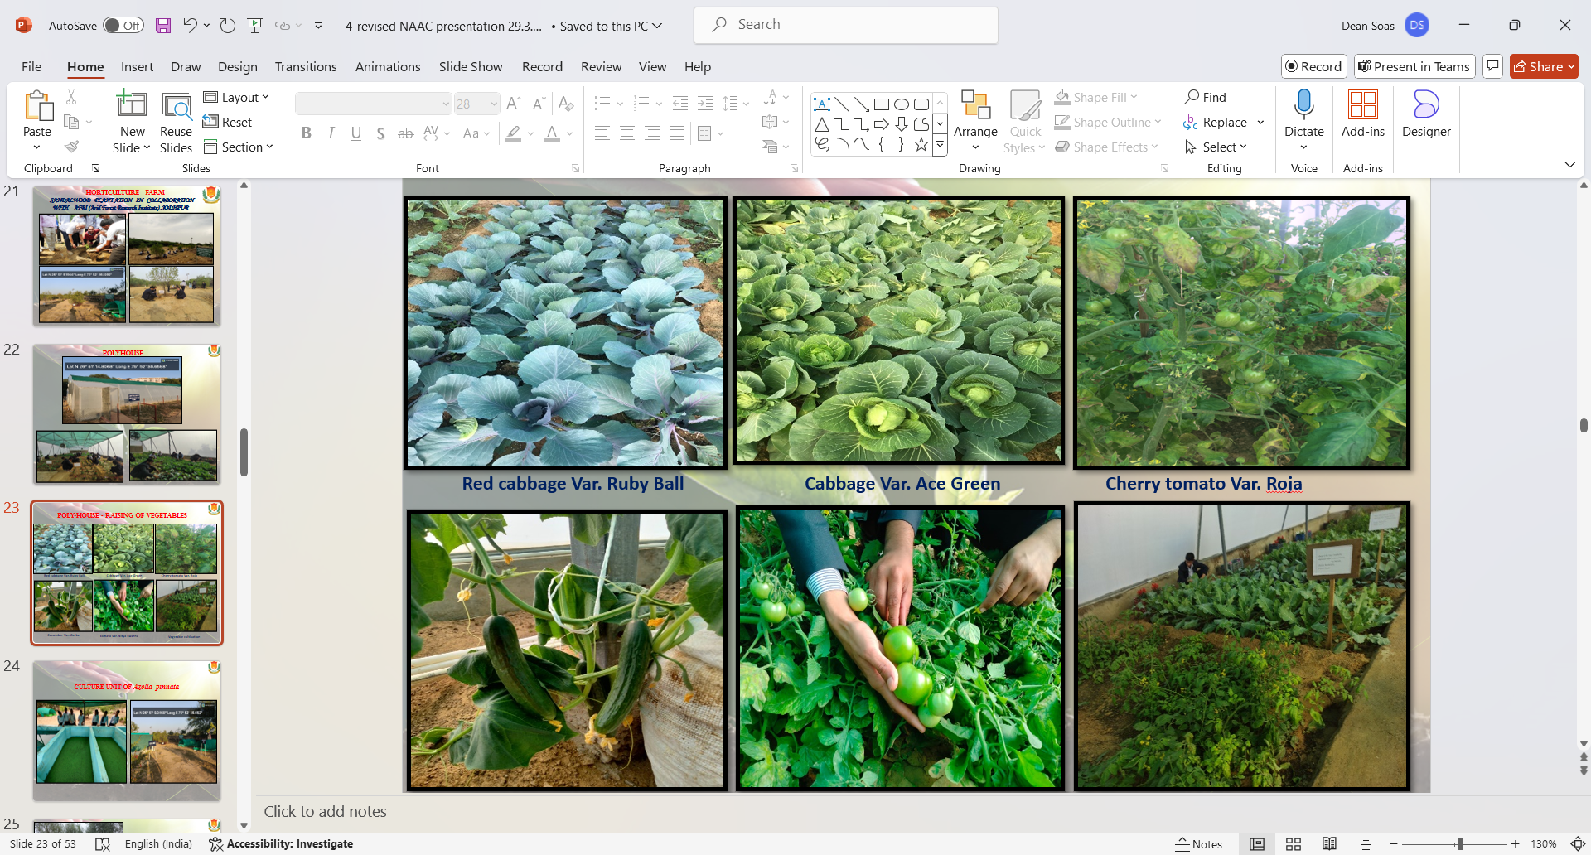
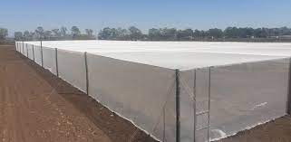
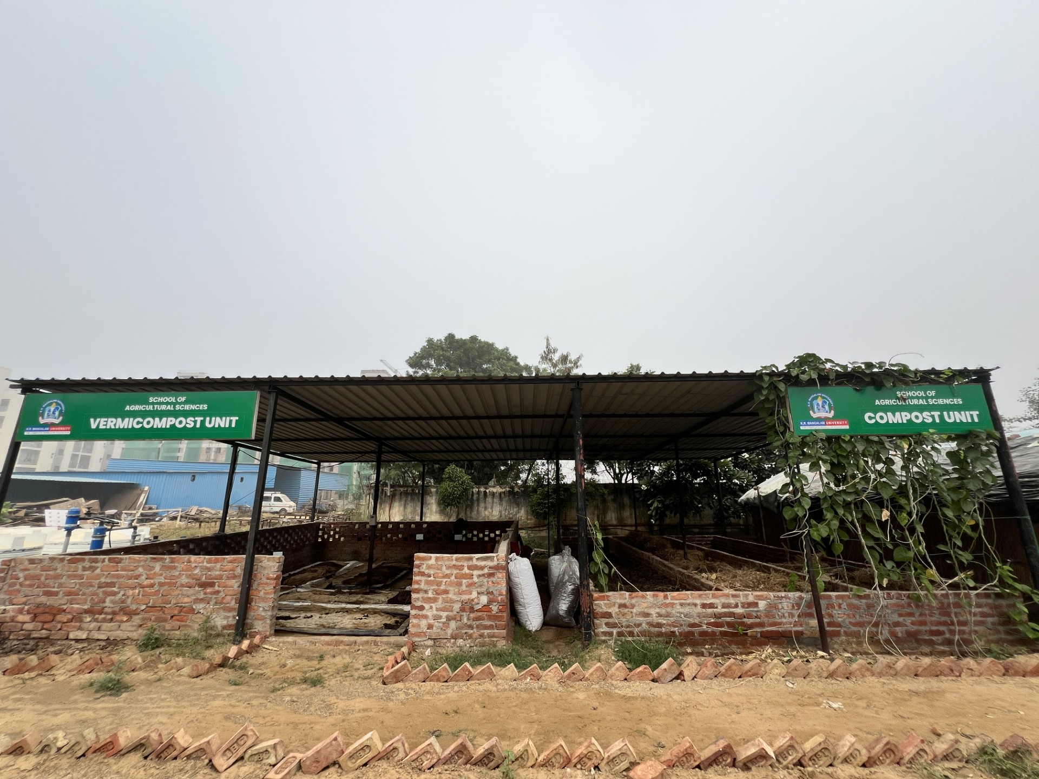
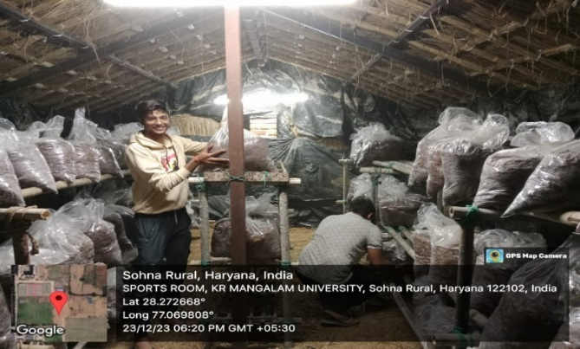
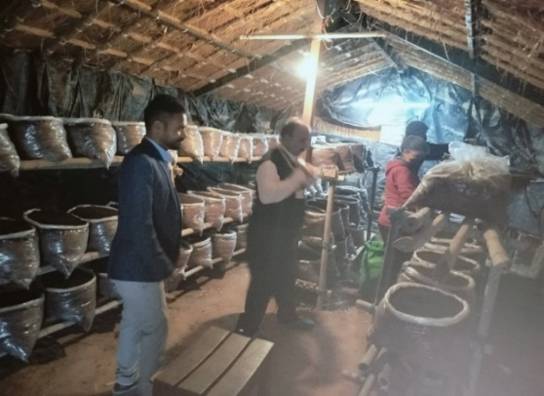
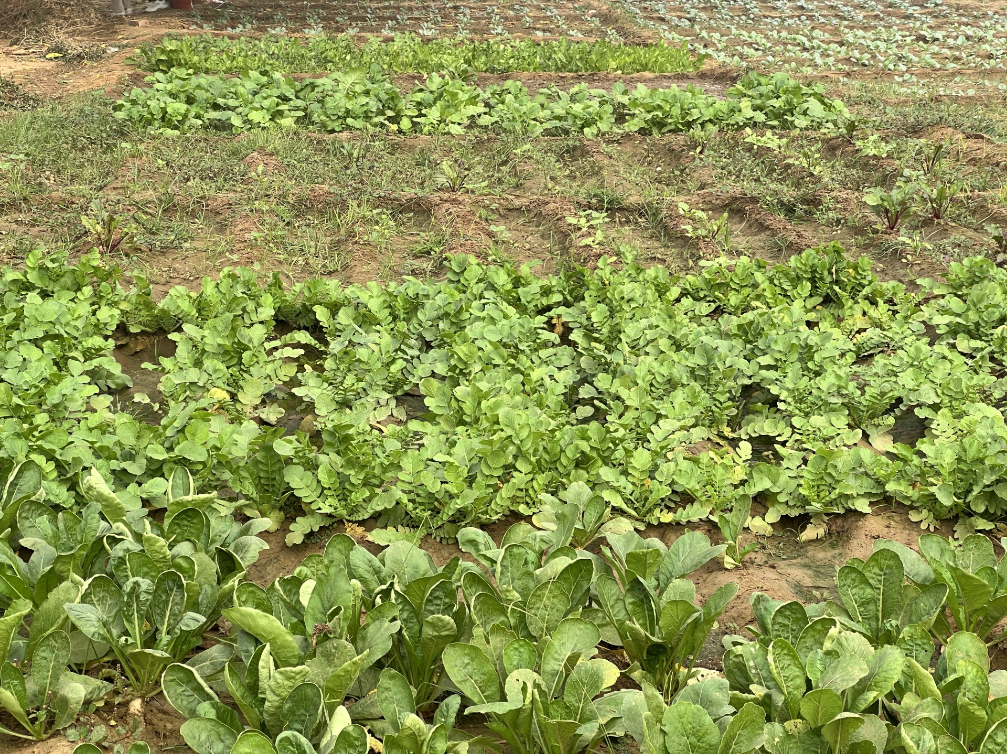
Sustainable Practice by SOAS
Organic Farming
Poly House and Shade Net
Zero Use of Chemical Fertilizers and Pesticide in Field Crops and Horticulture Farming
Vermicompost
Organic Mushroom Cultivation Unit
Field Crops

Slide 10
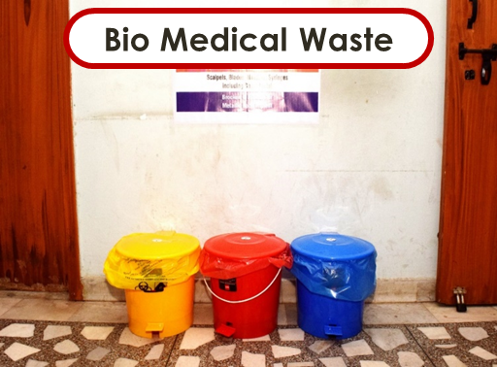

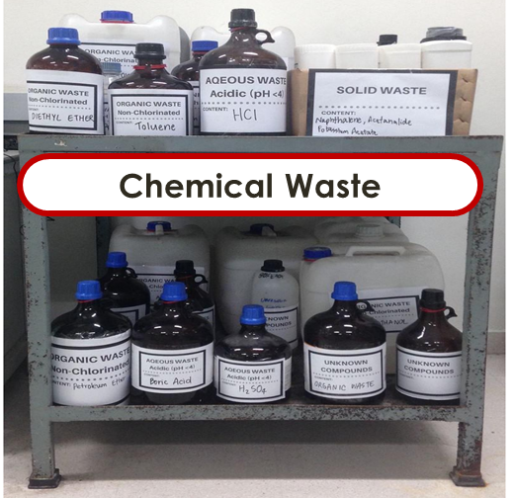
Waste Management by SMAS
Biomedical Waste Management
Chemical Waste Management
Open Elective Course on Chemical Hazards of 03 credits with 45 hrs engagement is offered pan university
Orientation sessions conducted for students & staff regarding handling of chemicals
Chemical waste management to maintain Environmental Sustainability

Slide 11
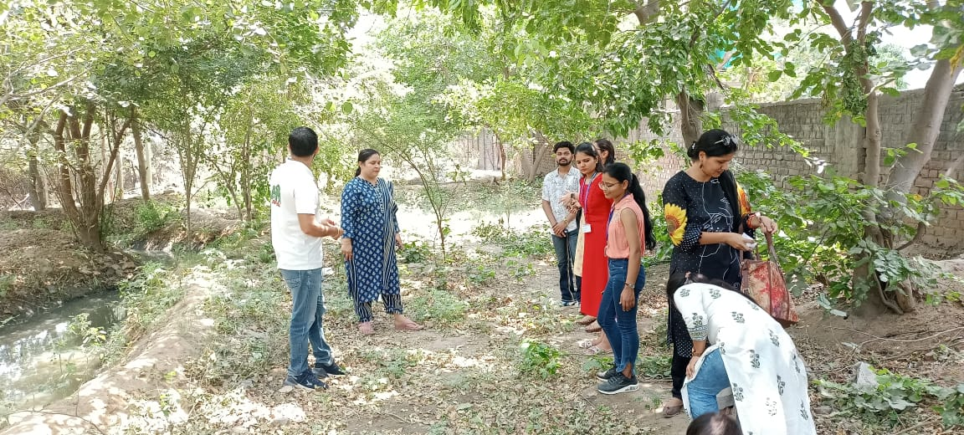
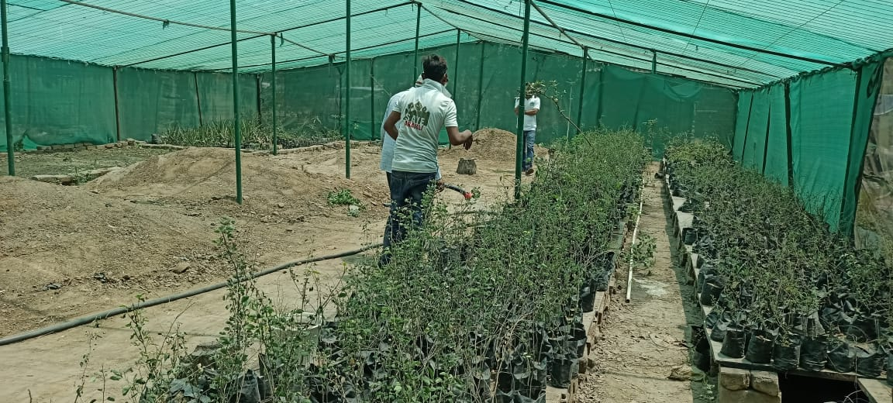
Sustainable Practice by SOED
SOED had collaborated with Save Aravali Trust to inculcate the values among students to conserve the environment.
Students of SOED has completed the field project:
Protection and Conservation of Species in Aravali Range, Faridabad
Wastewater Management

Slide 12
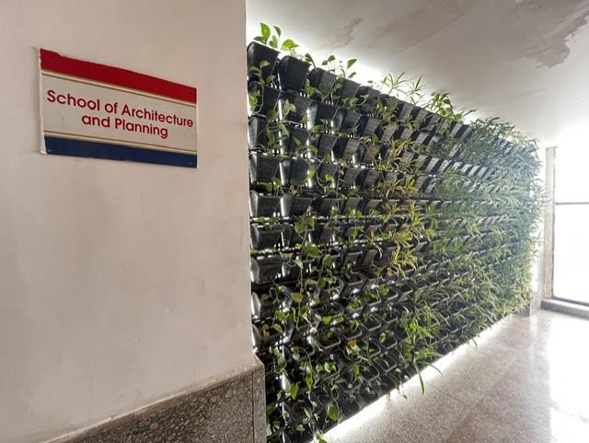
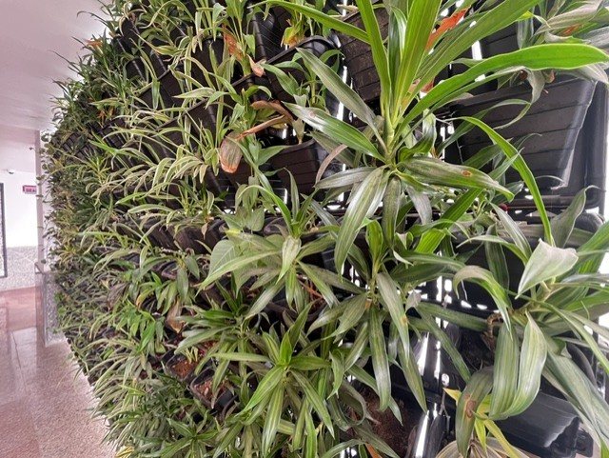
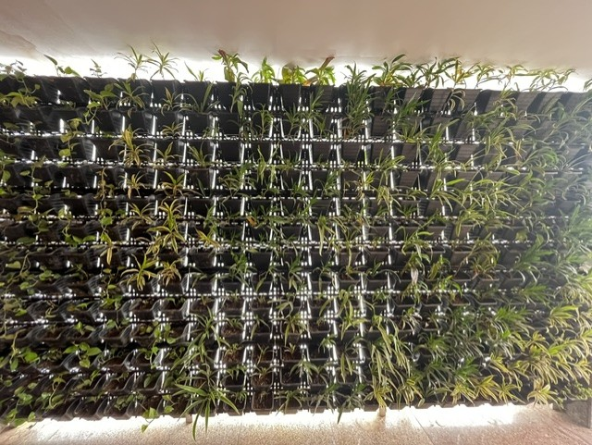
Sustainable Practice by SOAD
SOAD has introduced green walls on the 1st, 2nd, and 3rd floors of the C Block lobby. These lush installations not only regulate indoor temperatures and enhance the microclimate but also bring a breath of fresh greenery into our built environment.
Green walls on the 1st, 2nd, and 3rd floors of the C Block lobby

Slide 13
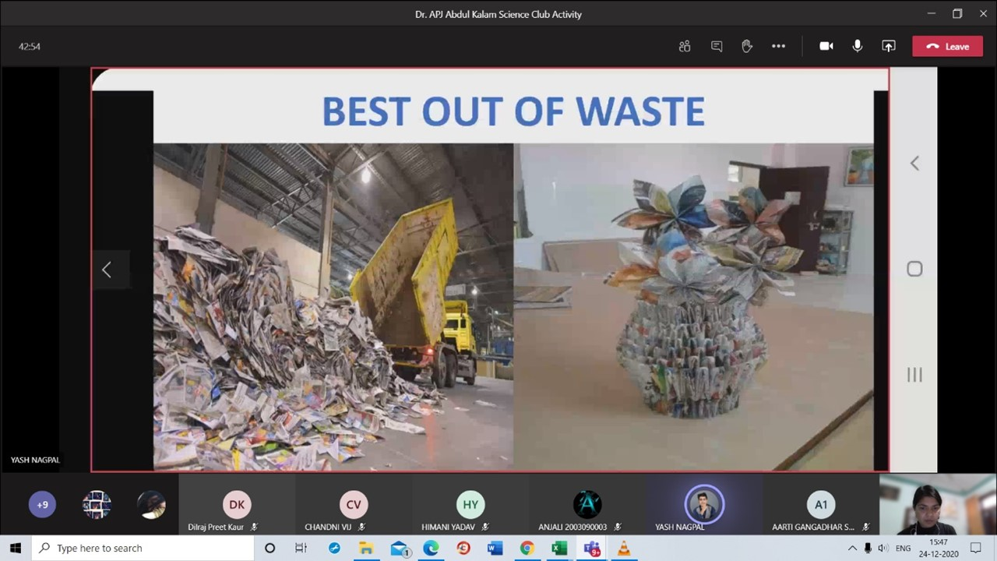
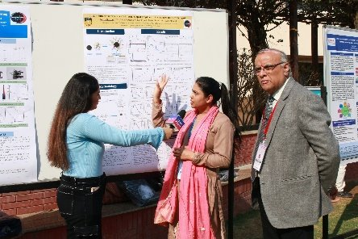
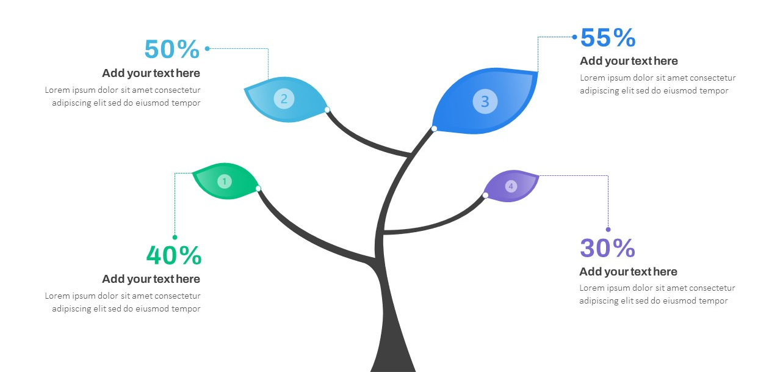
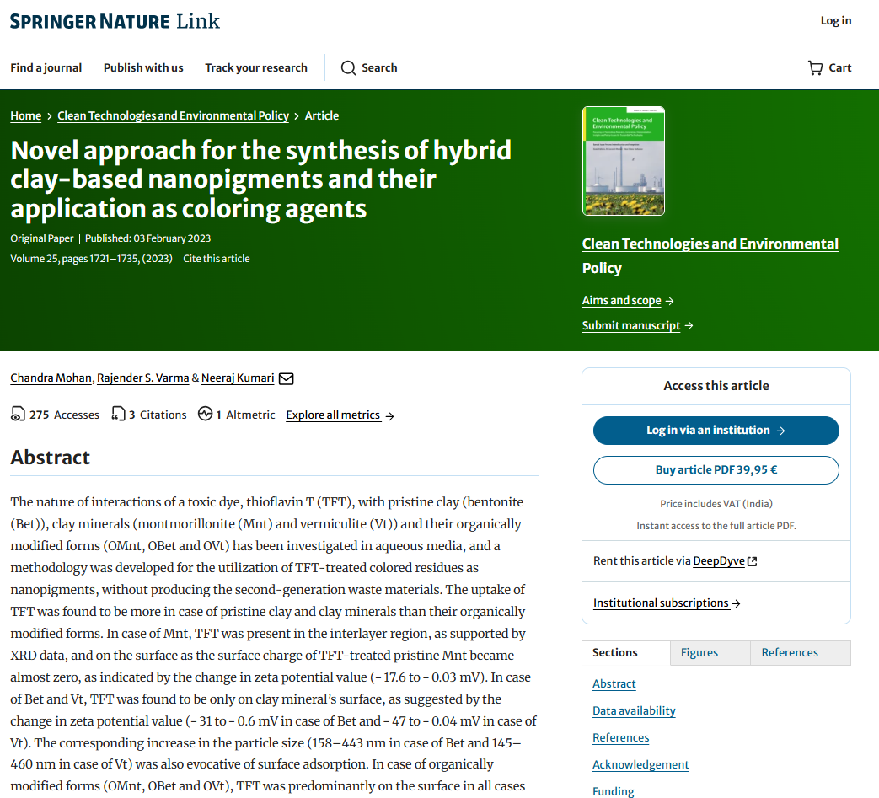
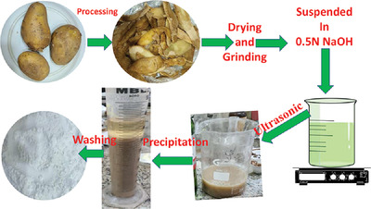
Sustainable Practice by SBAS
Conference on Advanced Materials for Green Chemistry and Sustainable Environment , February 15-16,2024
Events conducted by SBAS on environmental sustainability = 09
Projects conducted by graduated students on Environmental Sustainability = 05
Research Articles on Sustainability = 30
Offering Minors in Environmental Studies(2023 Onwards)

Slide 14
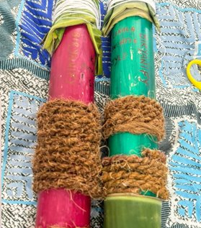
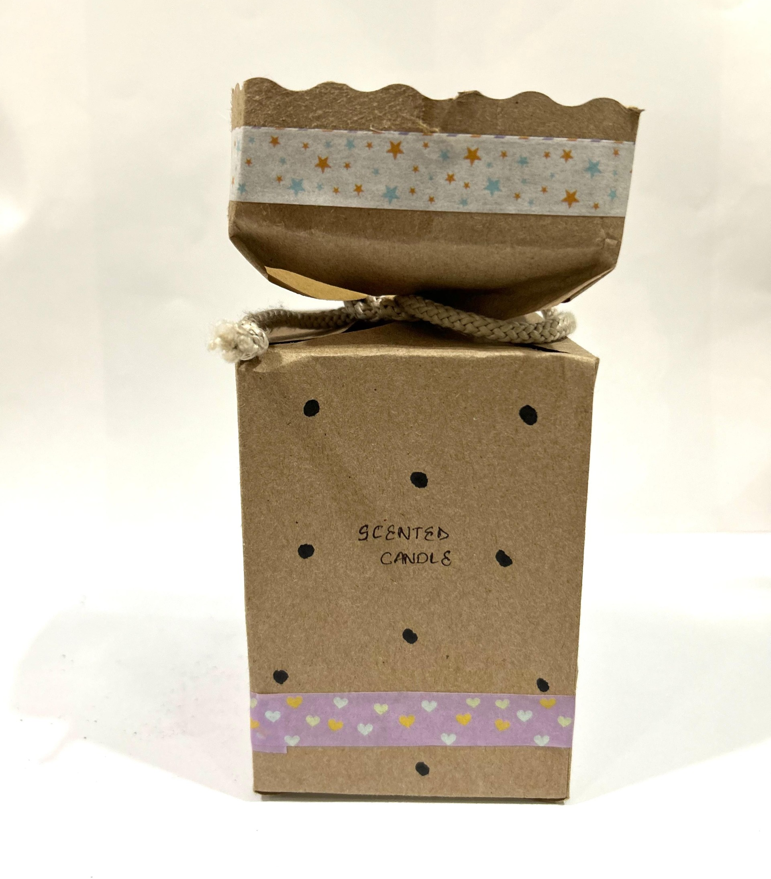
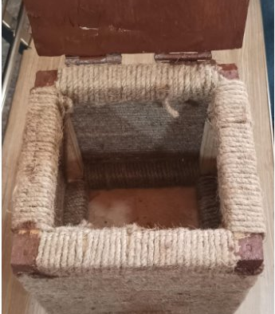
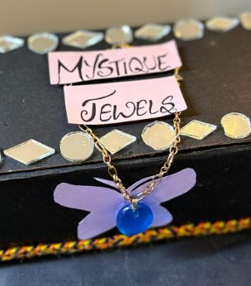
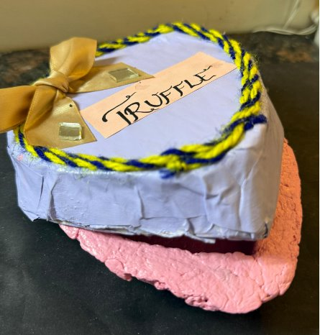
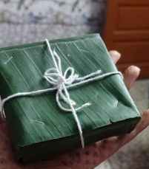
Sustainable Practice by SOMC
Best Out of Waste Making: The assignment was given to explain green marketing and packaging in course Marketing Management. SOMC plan to take this initiative further with support of Indian Institute of Packaging​

Slide 15
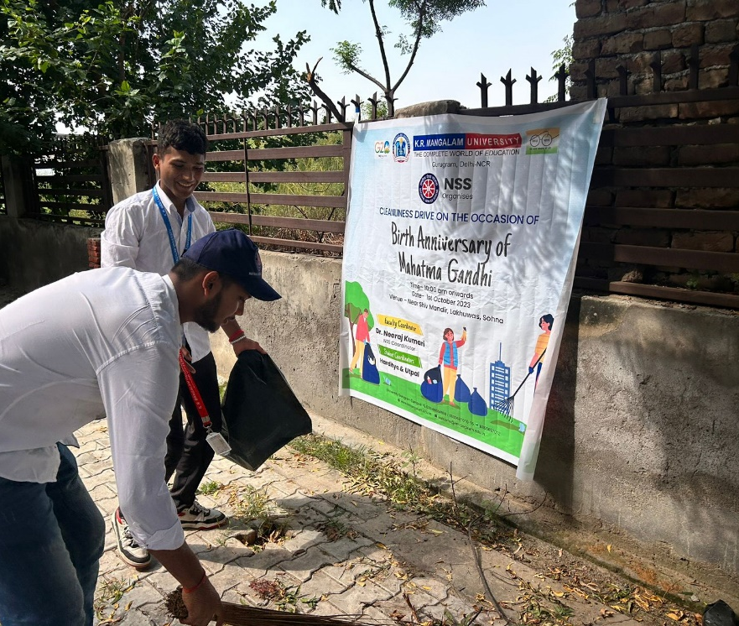
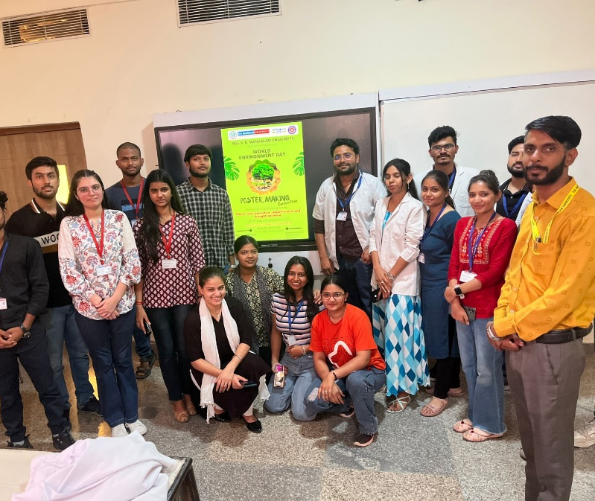
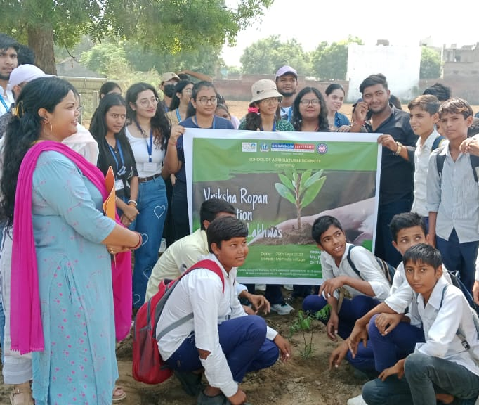
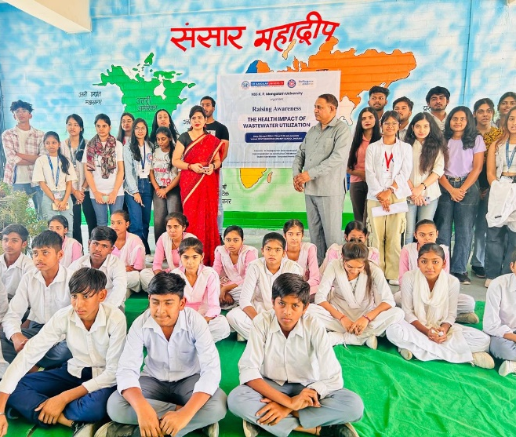
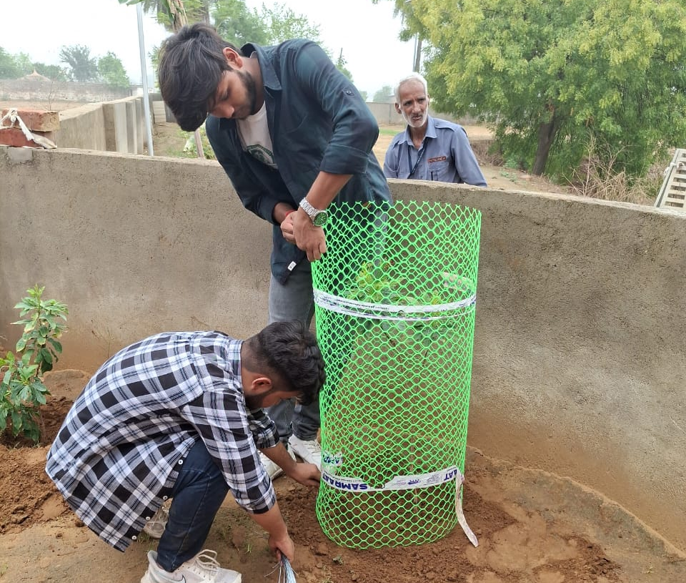
K.R. Mangalam University has organised 40+ awareness programme, tree plantation, cleanliness drives etc.

Slide 16




Initiative by DSW
QR Coding of Plants and Trees by Students of APJ Abdul Kalam Society
Indian jujube (Beri)
Zizyphus mauritiana
(Rhamnaceae)
Mulberry
Morus alba
(Moraceae)
White cheesewood
Alstonia scholaris
(Apocynaceae)
Indian rosewood
(Sheesham)
Dalbergia sissoo
(Fabaceae)

Slide 17
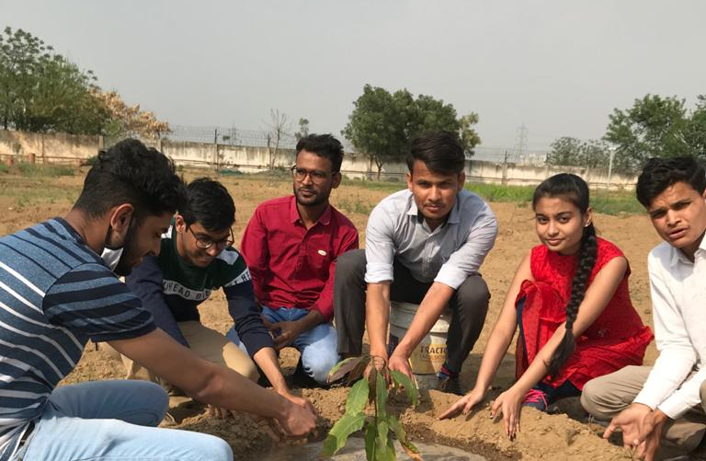
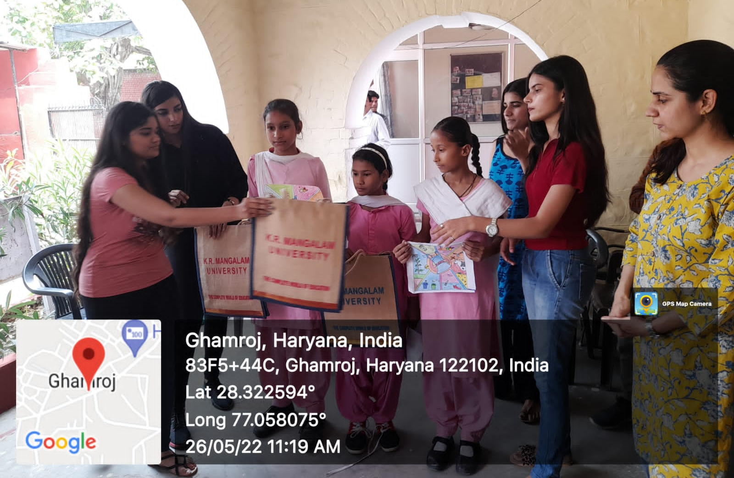
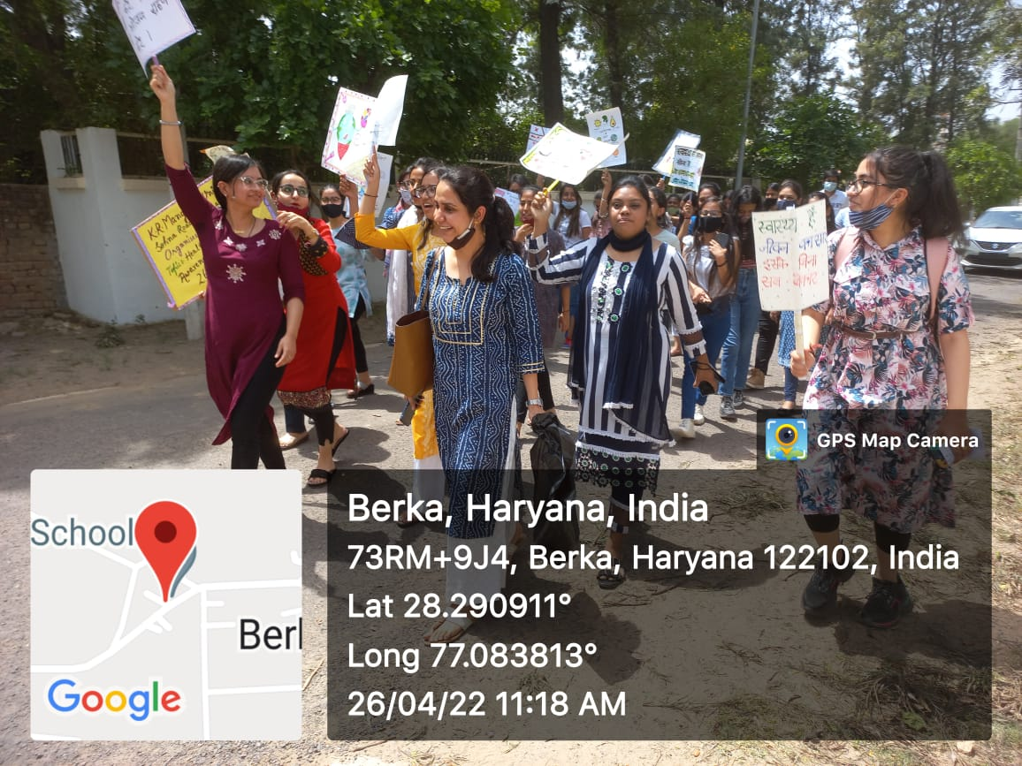
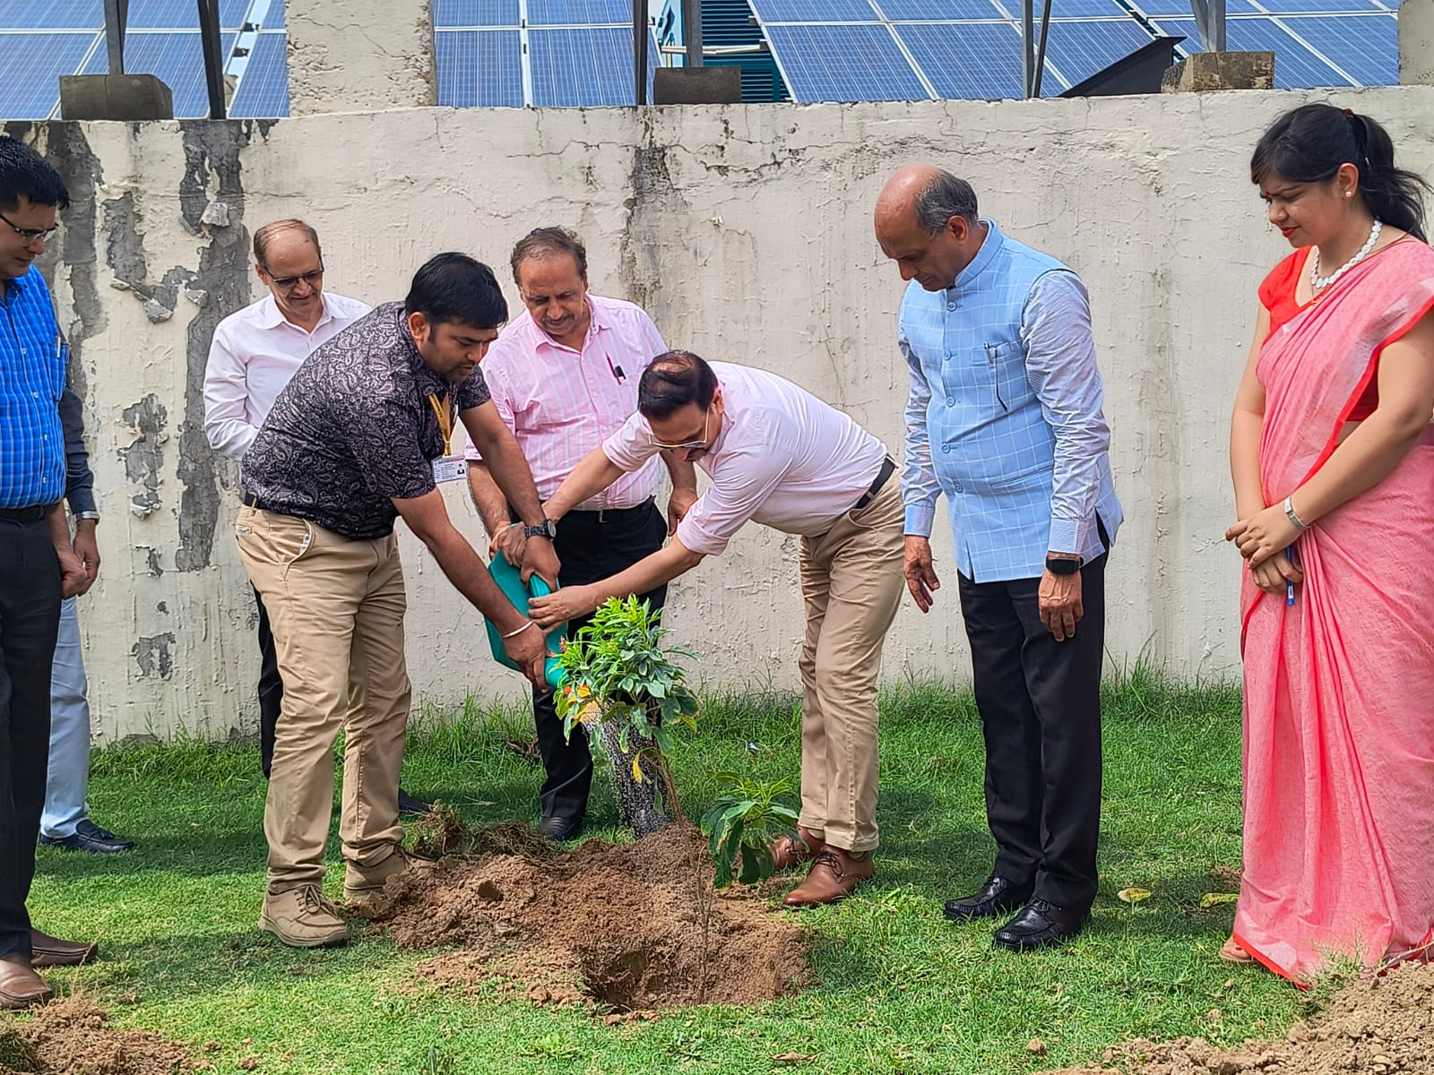
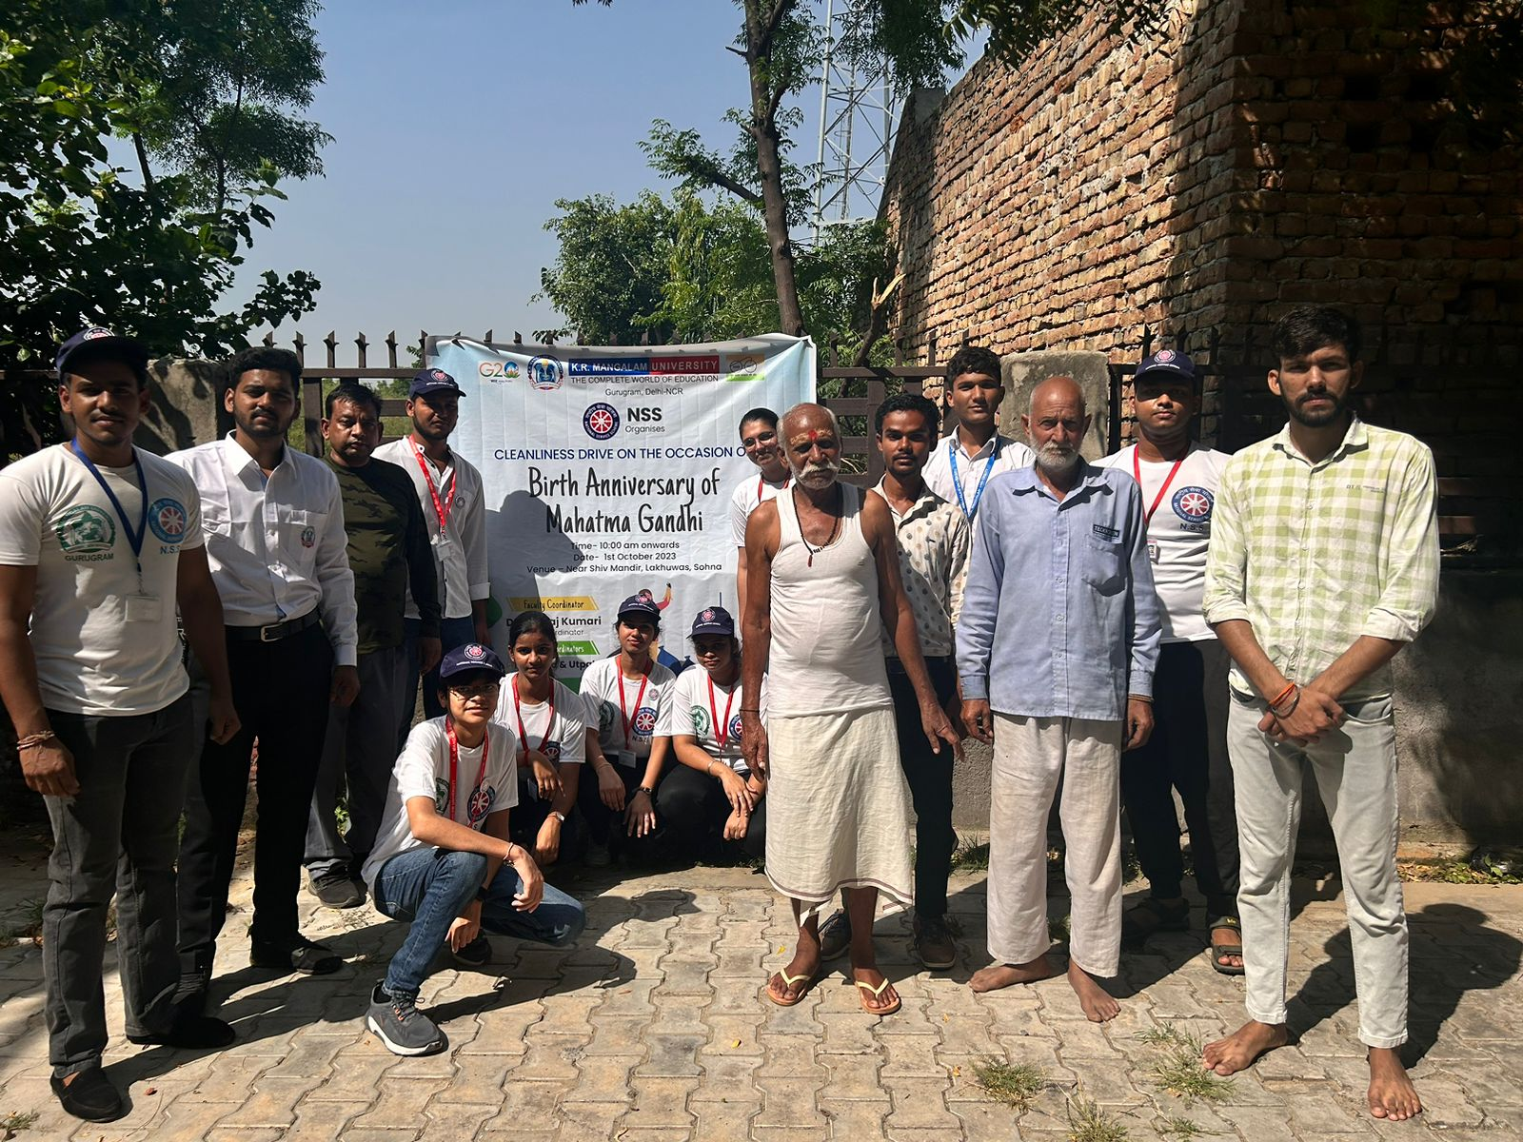
Glimpses of the Activities

Slide 18
Impact & Outcome
Reduction in Carbon Footprint: 11668 tons by transport , 2.71 tons by reduction in paper use, 6854.01 tons by use of solar power and LED, 52.41 tons by LPG use.
Medical garden and organic farming managed by university students and staff.
In collaboration with MGIEP and the UNESCO Center of Excellence started the VAC course which has more than 1500 enrolled students.
A+ green ranking award 2023in diamond category by sustainable Institution of India.
Publication of Books, Articles, and research papers aligned with SDG’s.
1
2
3
4
5

Slide 19

Publications aligned with SDG as per SCOPUS database (1 Jan 2014 to 30 Sep 2024 )

Slide 20


Awards & Recognition for Sustainable Practice
Sustainable Green Ranking- Diamond and Gold in 2023 and 2024

