Slide 1



Career Development Center
Welcomes
NAAC Peer Team
16th – 18th June 2025

Slide 2
Career Development Center
VISION
"To empower students at K.R. Mangalam University by providing them with the skills, knowledge, and experiences essential for success in an increasingly dynamic global environment. We aim to foster a culture of lifelong learning while positioning the university as a leading institution in career readiness, innovation, and professional development."
MISSION
Boost Employability: Offer career services, training, and mentorship to enhance skills and align with industry needs.
Promote Lifelong Learning: Encourage continuous growth through workshops, seminars, and projects that foster innovation and research.
Facilitate Industry Collaboration: Build partnerships for internships, placements, and projects to tackle real-world challenges.
Support Global Integration: Enable international collaborations and exchange programs to prepare students for global careers.
Notes:
Glimpses instead of Glimpse

Slide 3
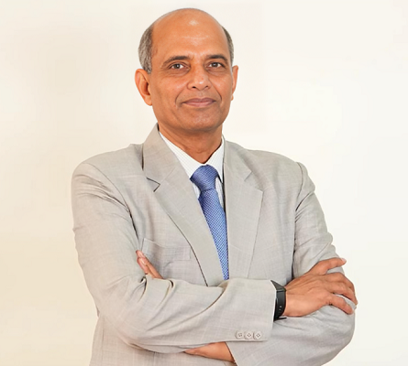
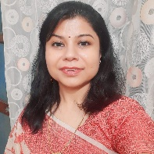
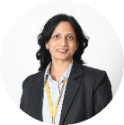
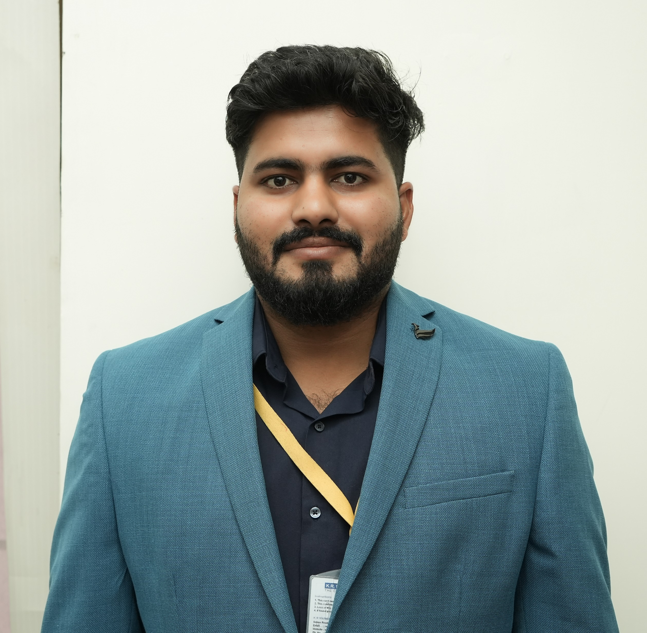
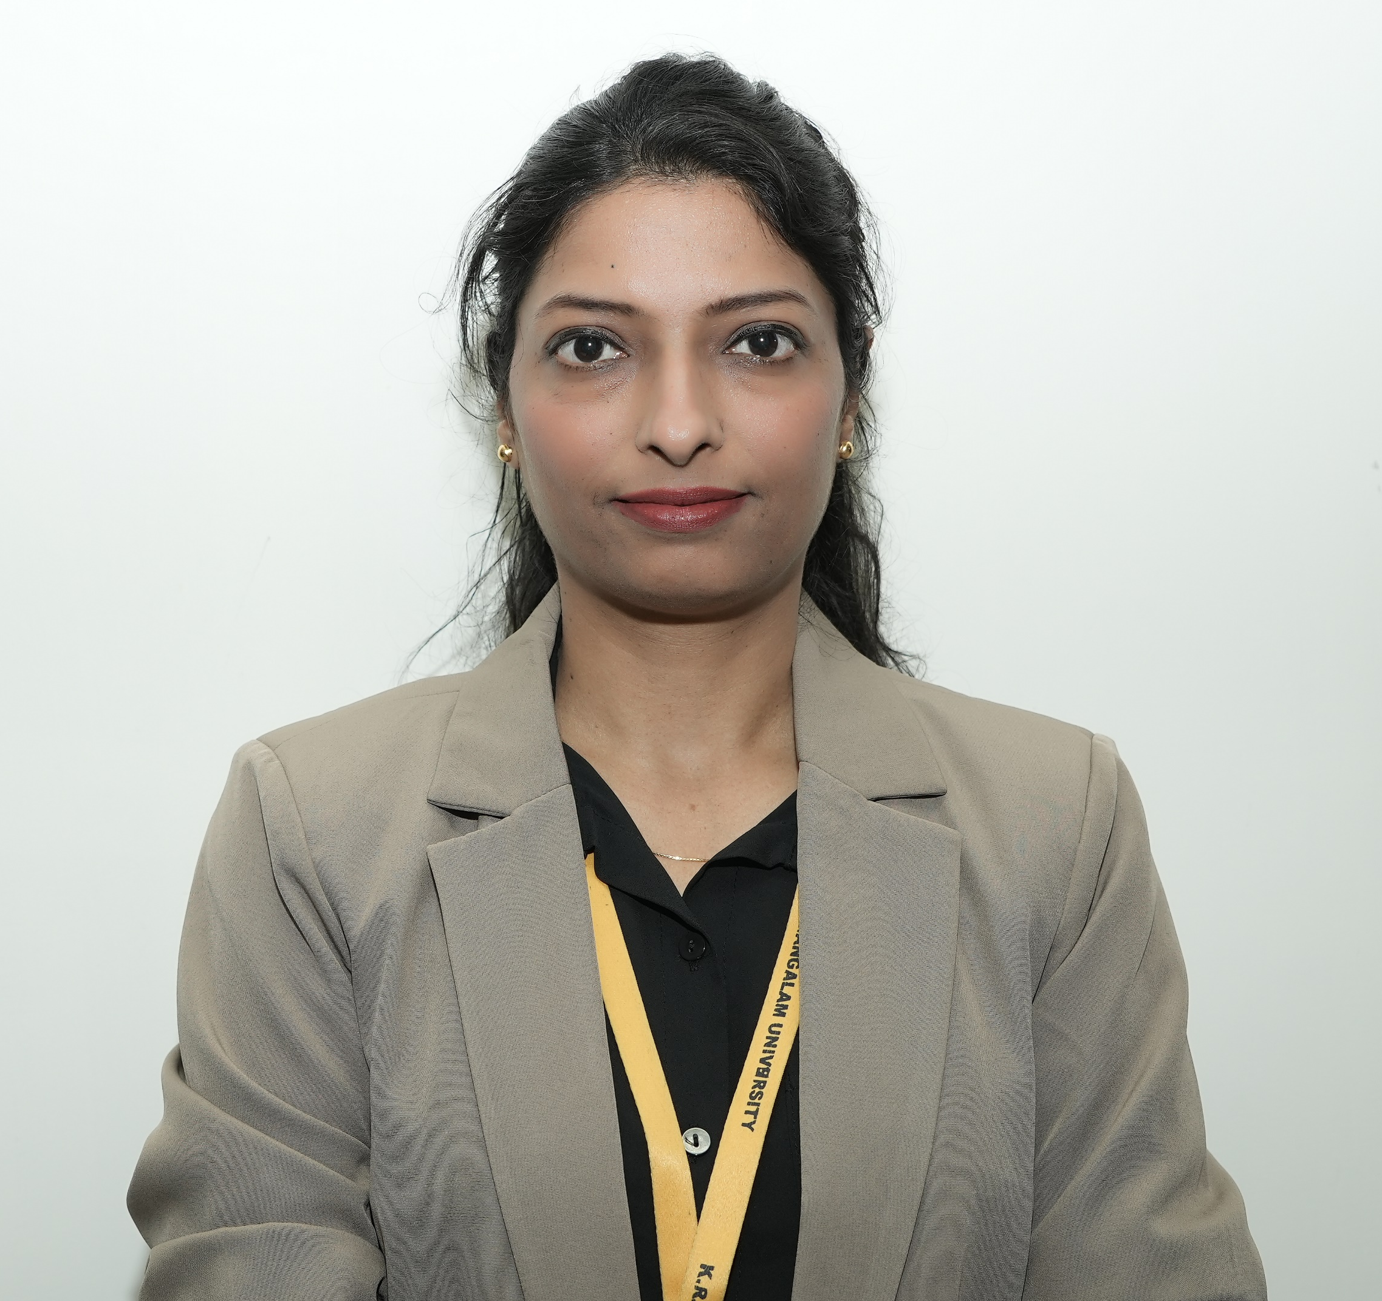
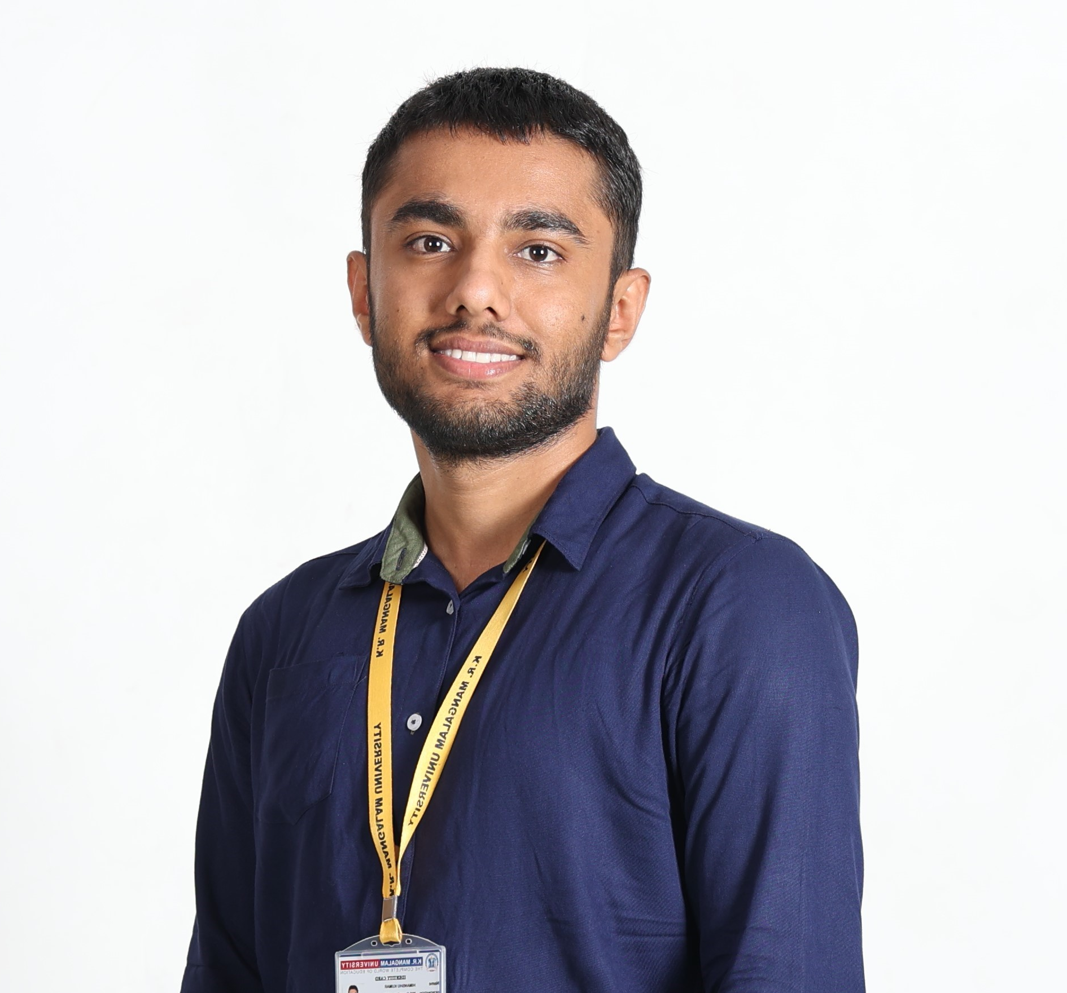
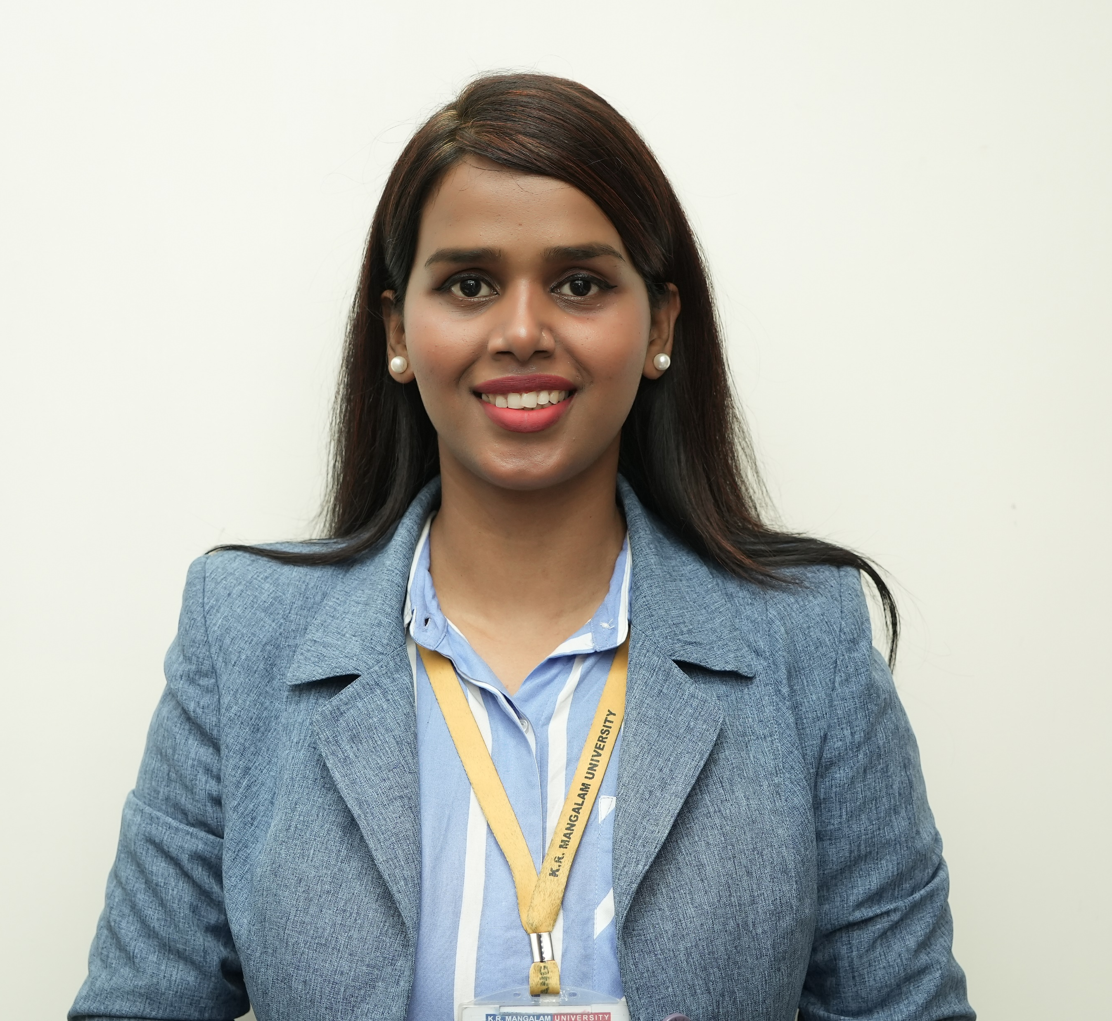
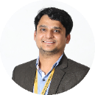
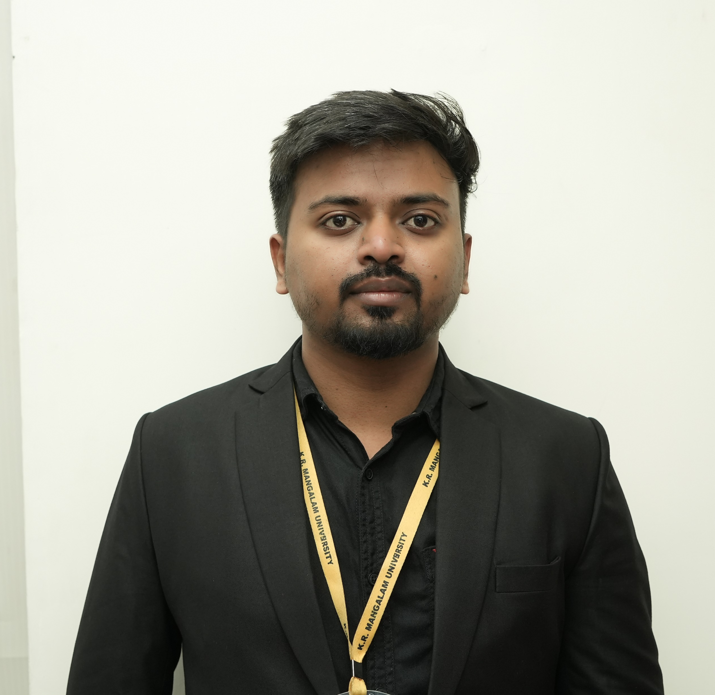
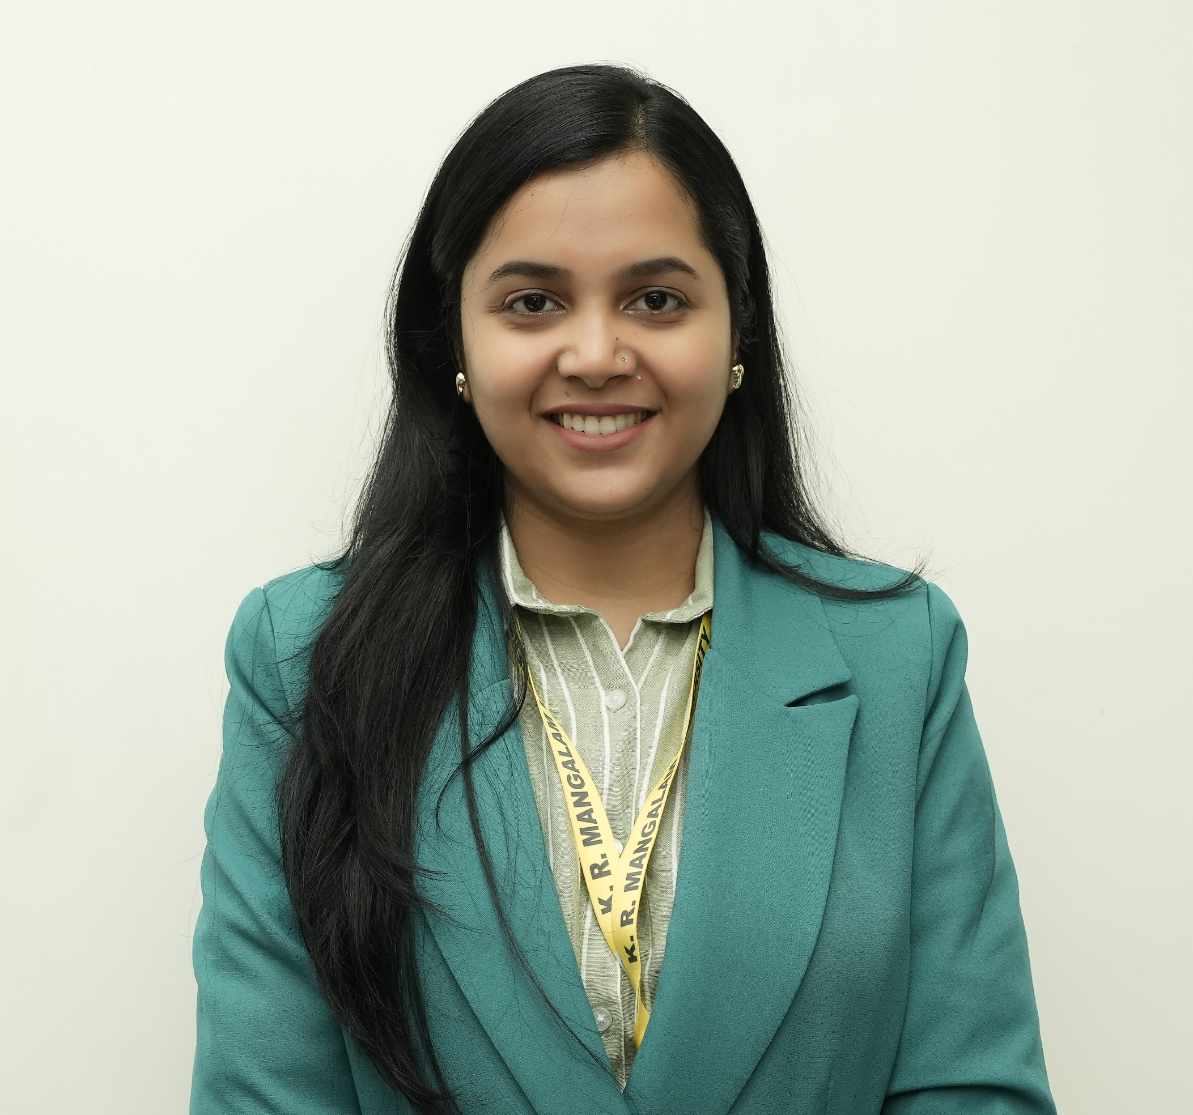
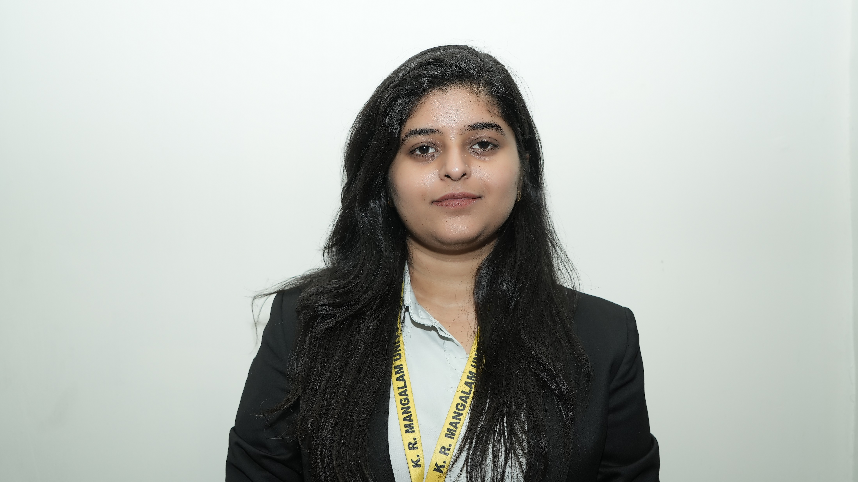
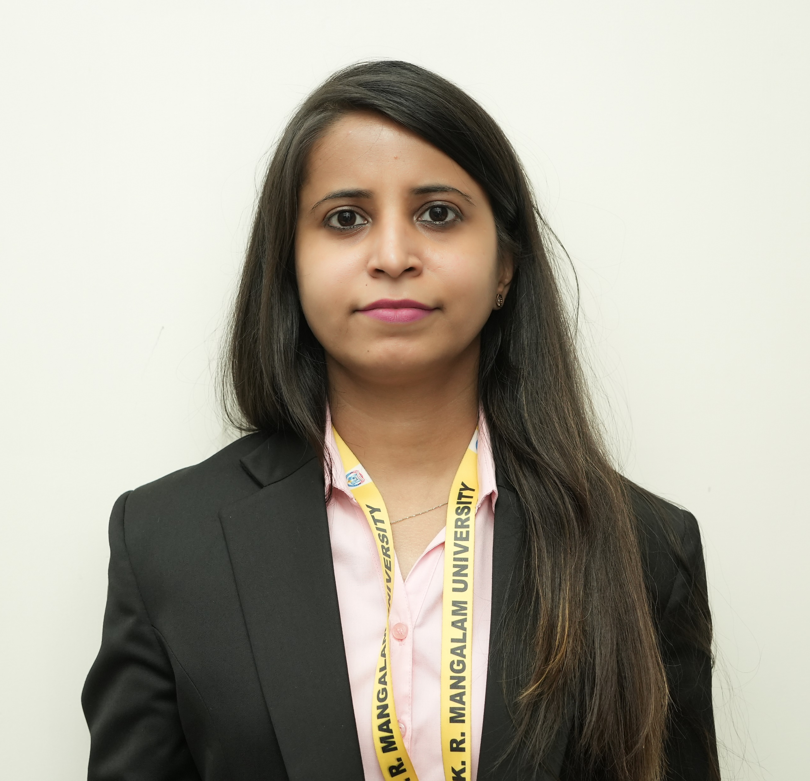
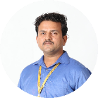
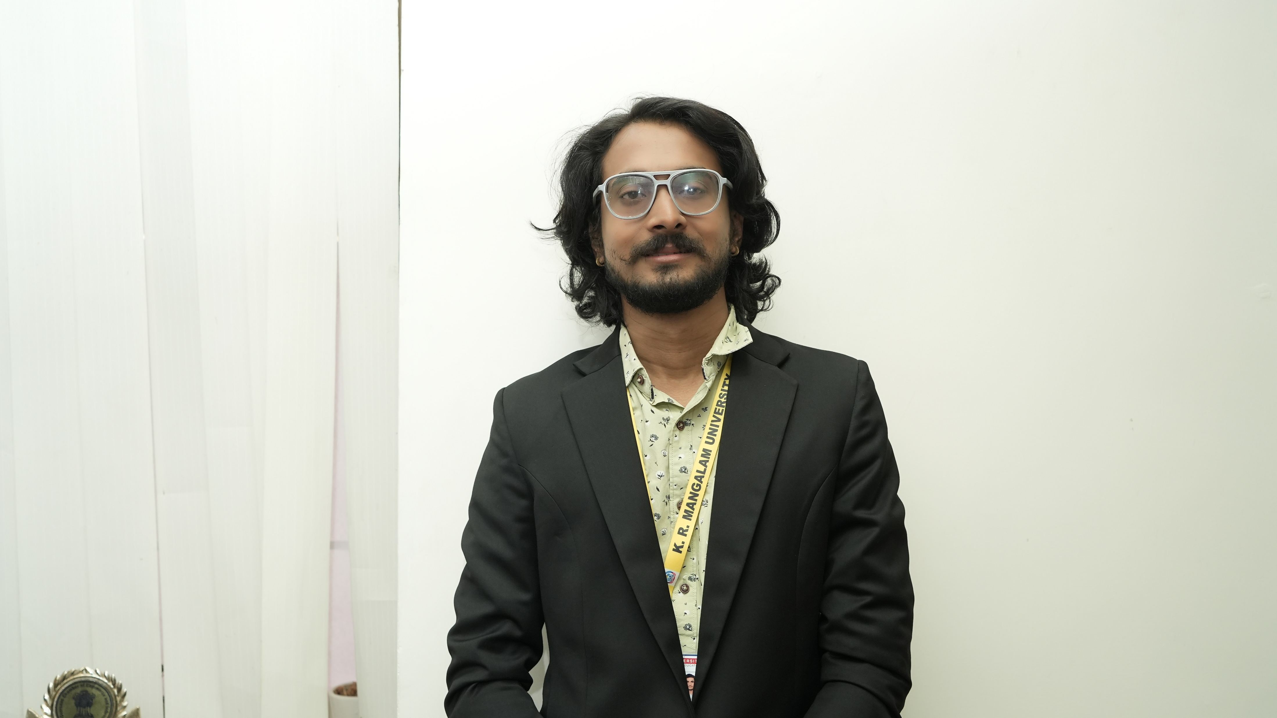
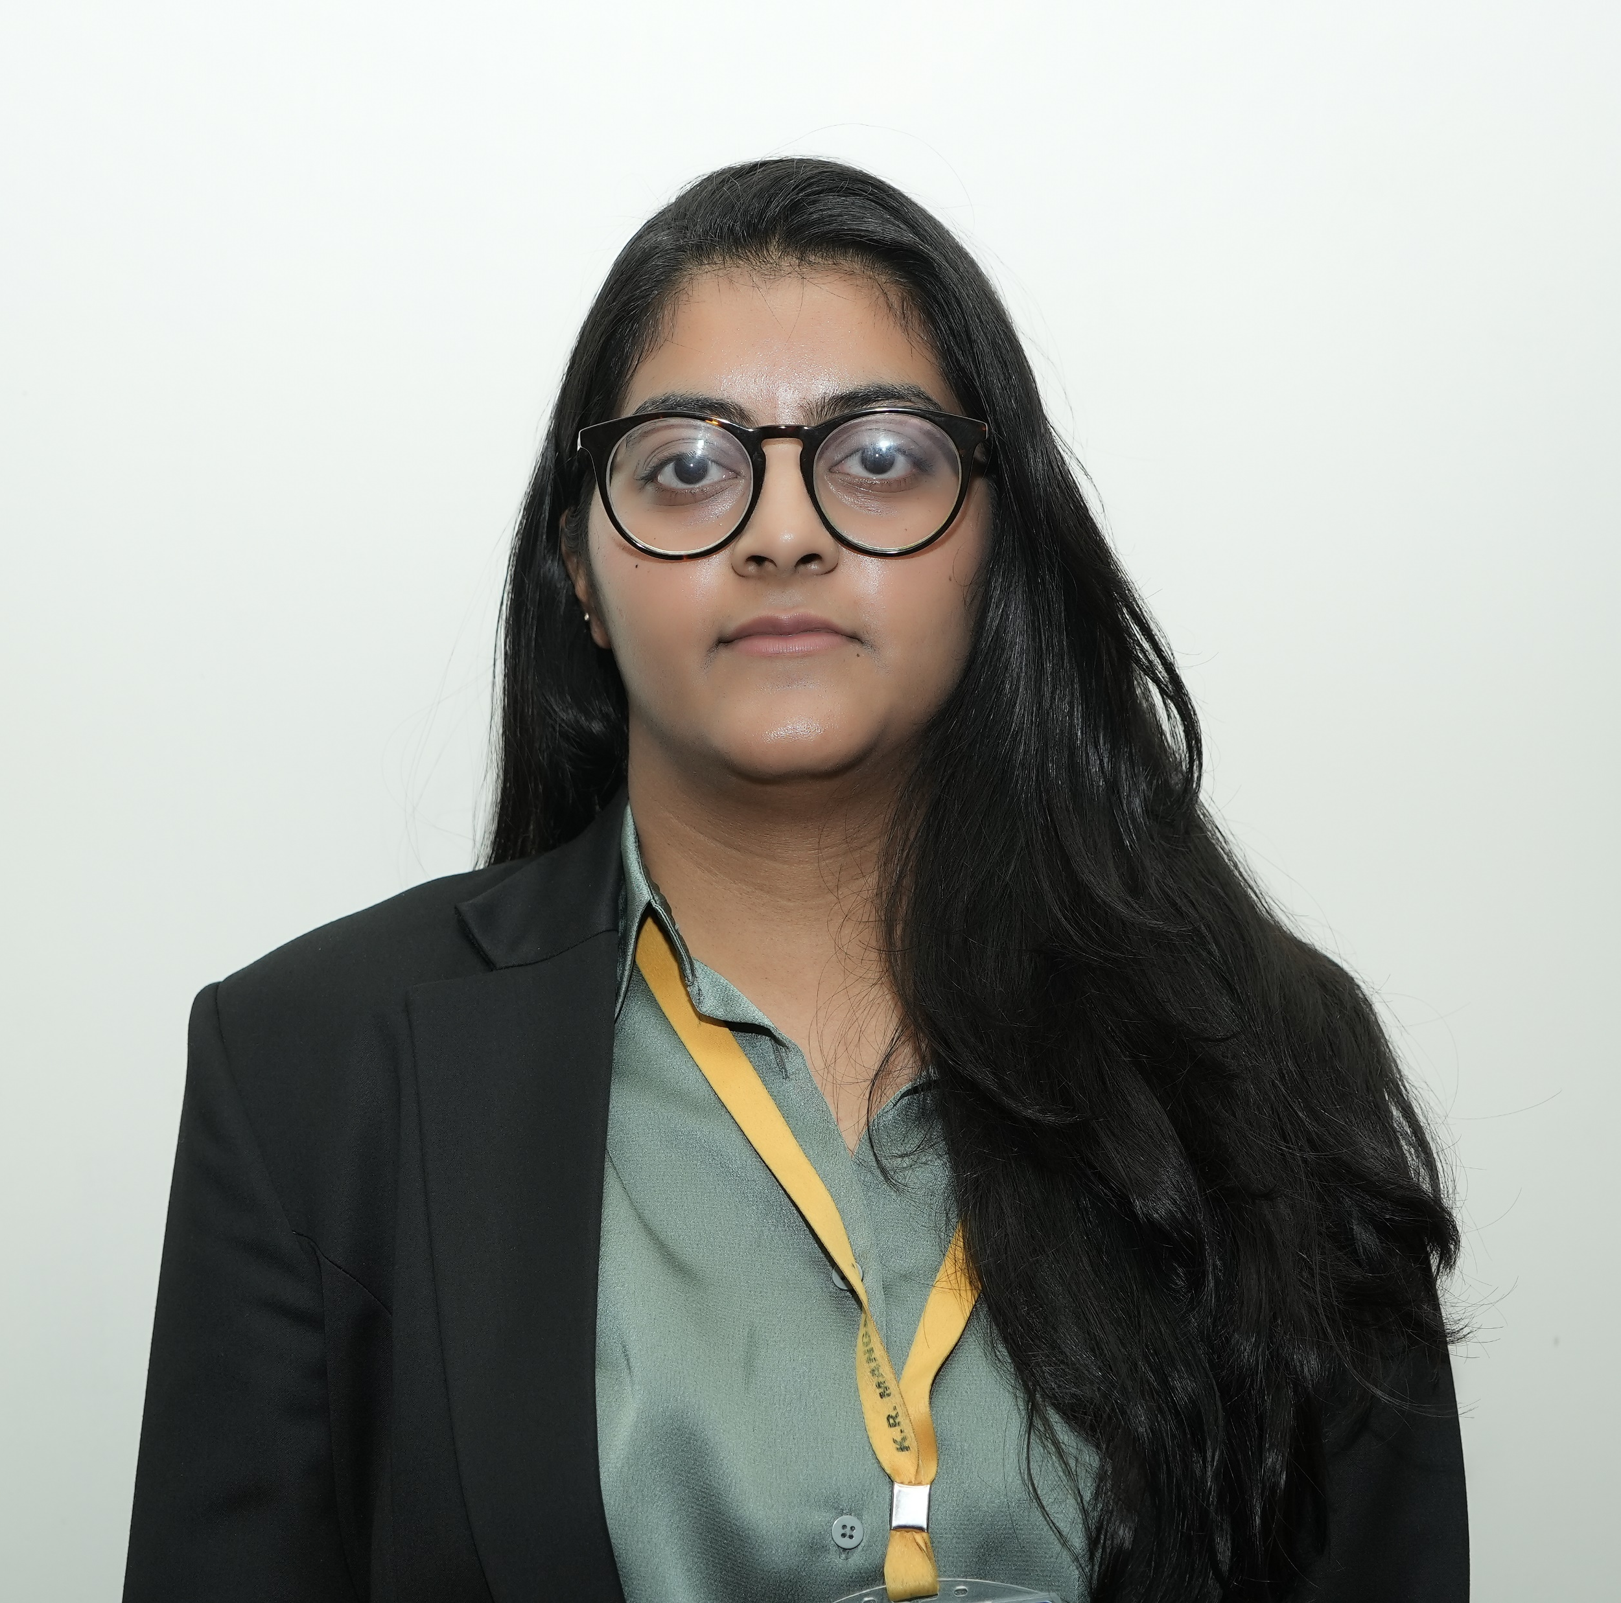
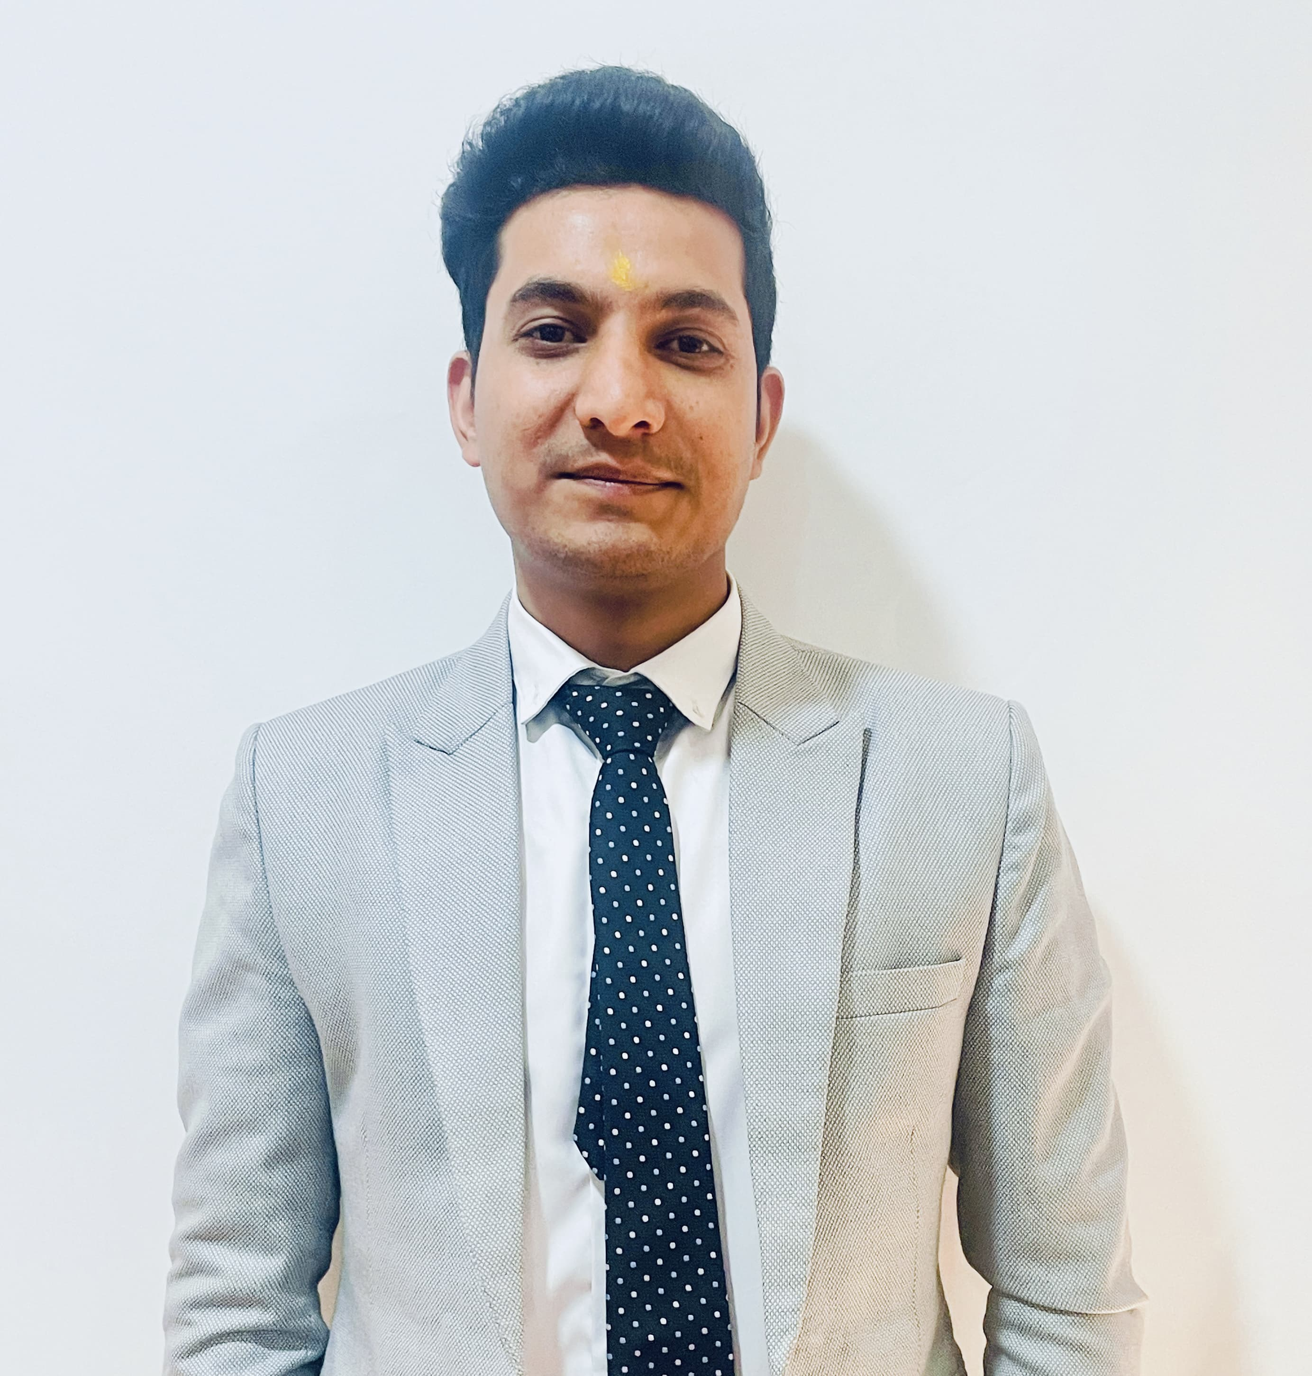
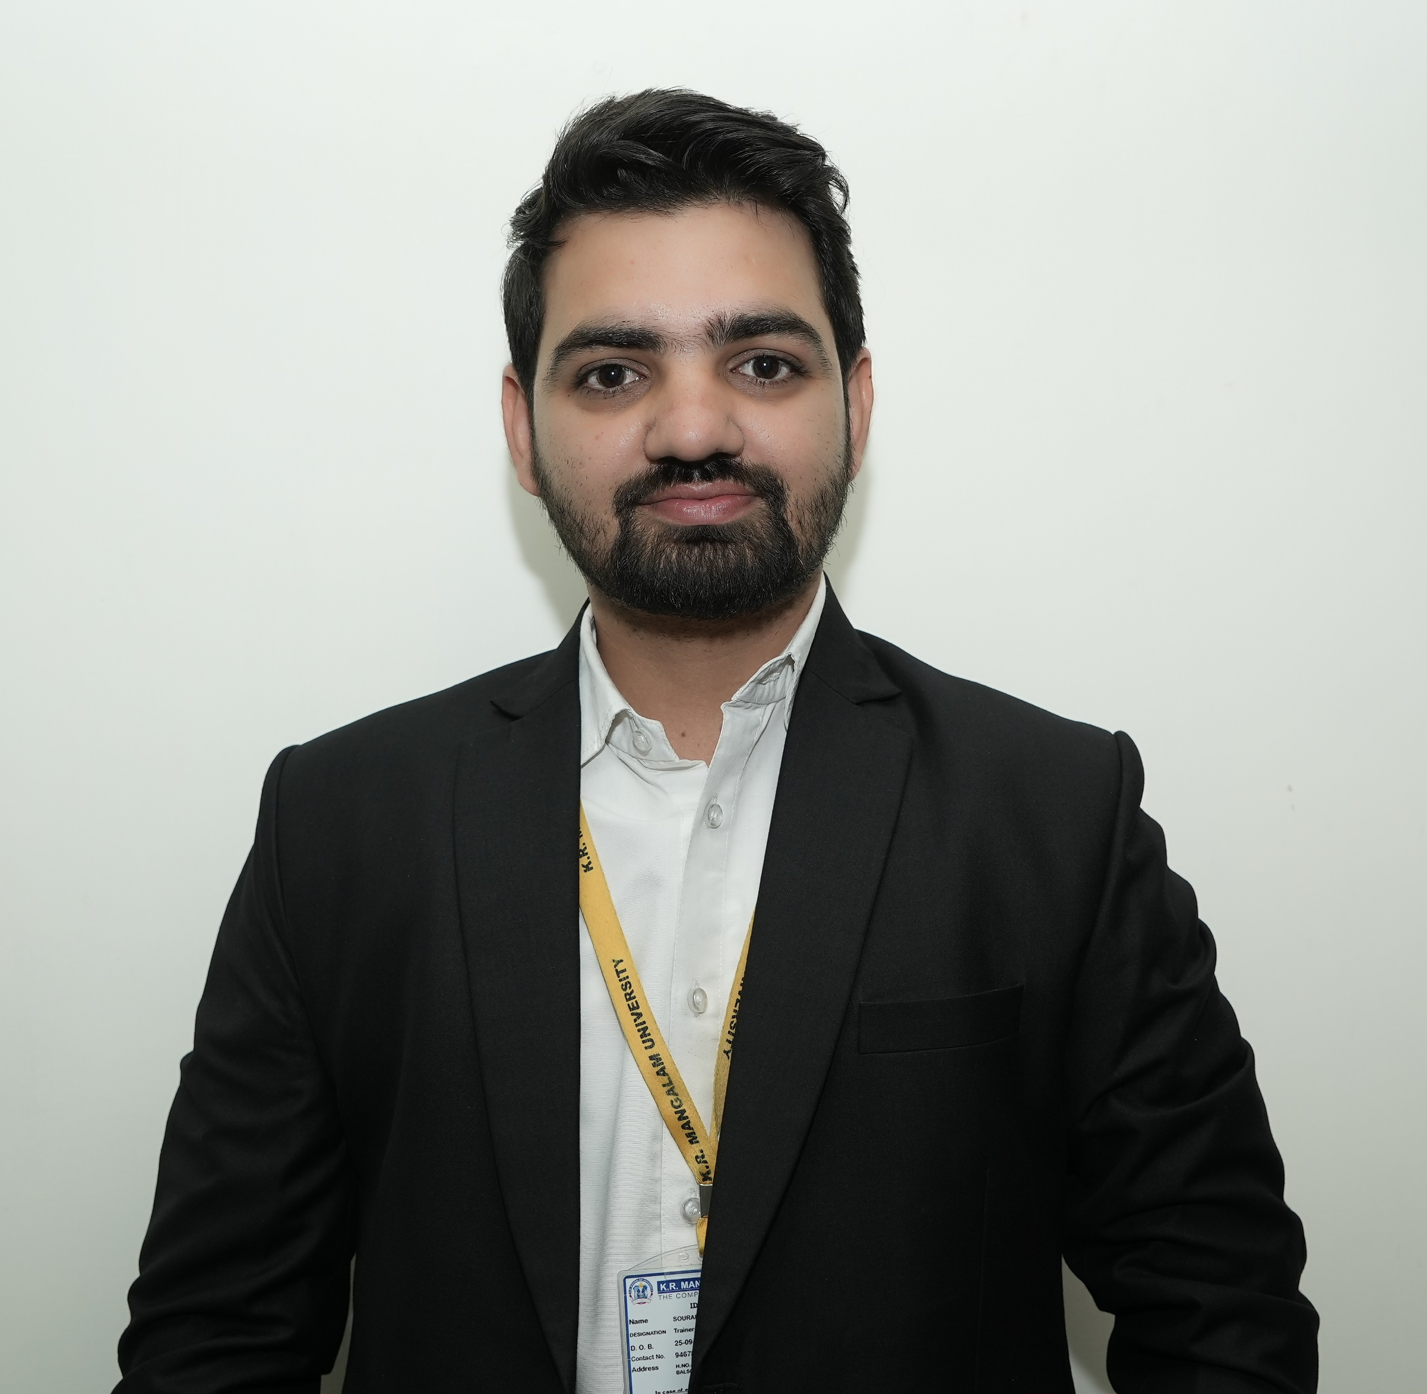
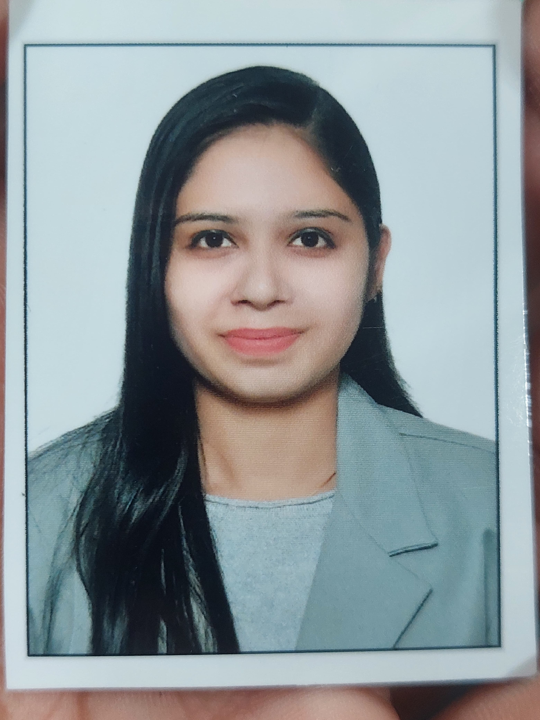
Organogram CDC
Prof. (Dr.) Raghuvir Singh
V.C. , K.R. Mangalam University
Dr. Vibha Thakur
Director, CDC
Career Skills
Tech Skills
Placement
CDC Office
Ms. Tuhina Ray
Head Career skills
Mr. Atul Singh
Technical Trainer
Ms. Shruti Bansal
Asst. Manager
Mr. Himanshu Kr.
MIS Executive
Ms. Sonam Yadav
Soft Skills Trainer
Mr. Rohit Agarwal
Aptitude Trainer
Mr. Abhishek Singh
Technical Trainer
Ms. Mansi Shrivastava
Asst. Manager
Ms. Muskan Yadav
Placement Executive
Ms. Charu Dudeja
Verbal Ability Trainer
Mr. Vikas Singh
Aptitude Trainer
Mr. Suman Kr. Das
Technical Trainer
Ms. Charu Gola
Placement Manager
Mr. Vijay Purohit
Verbal Ability Trainer
Mr. Sourabh Dhull
Aptitude Trainer
Ms. Tanu Sharma
Asst. Manager

Slide 4
CDC Structure
Career Development Center
Training
Placement
Career Counselling
Career Skills
Tech Skills
Industry Engagement
Campus Placement Drives
Mega Job Fairs / Pool Drives
Internships + Pre-Placements
International Placements
Notes:
Glimpses instead of Glimpse

Slide 5

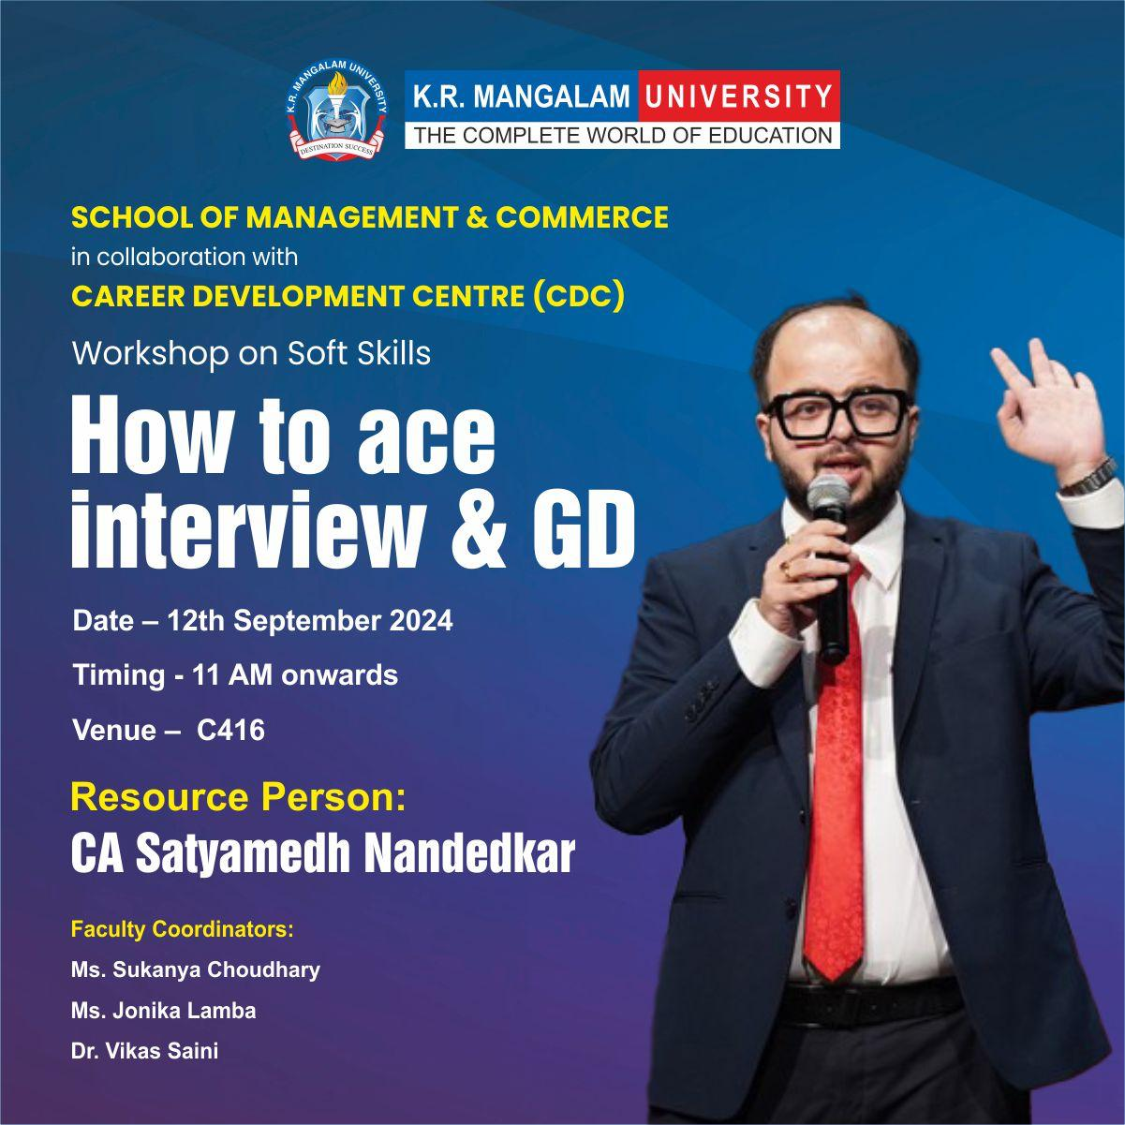
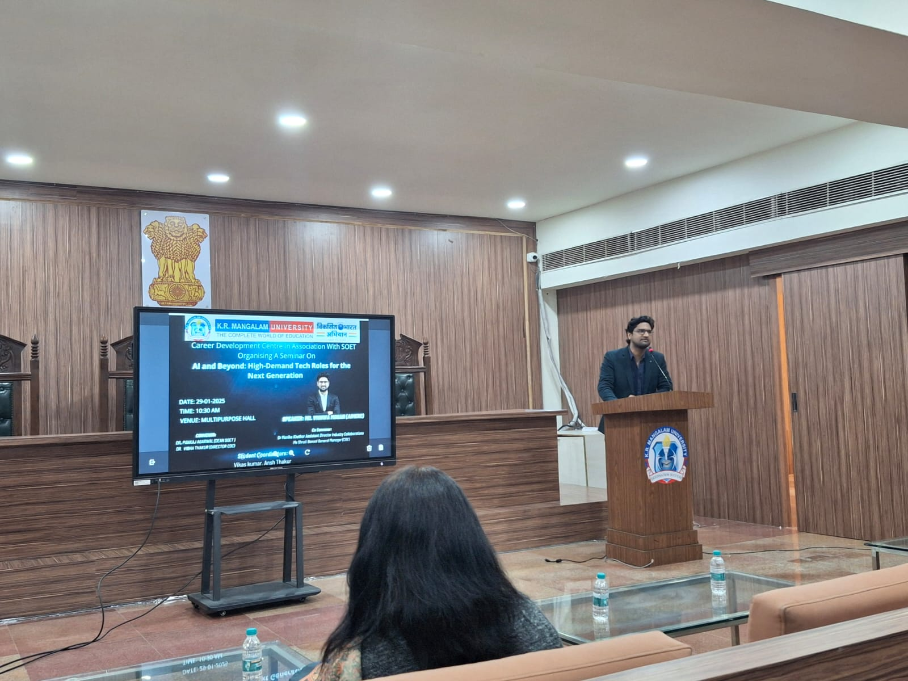
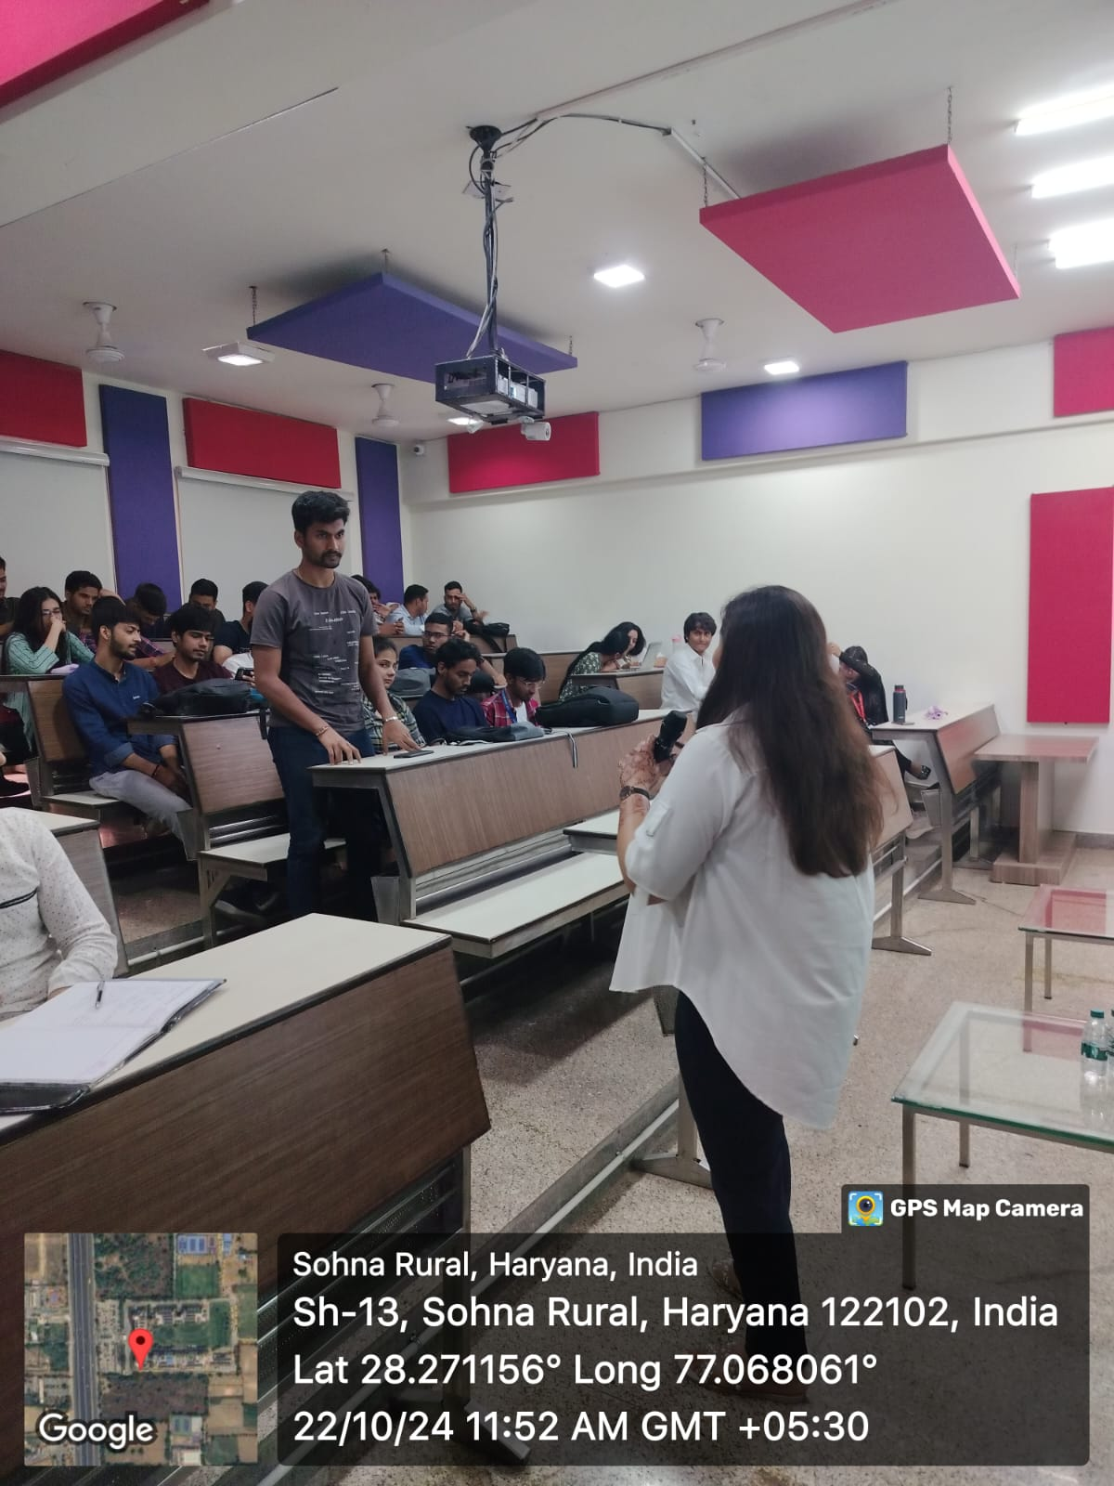
Career Counselling
1
Higher Studies Counselling
2
Career Planning
3
Placement Preparatory Counselling
4
Competitive exam preparation
Notes:
Glimpses instead of Glimpse

Slide 6
Career Counselling Conducted
Year | Mode of counselling | Sessions Conducted | Attendees
2024-25 | ONE TO ONE | 160 | 160
 | CLASSROOM | 3 | 142
 | E-COUNSELLING | 2 | 107
2023-24 | ONE TO ONE | 65 | 65
 | CLASSROOM | 2 | 70
 | E-COUNSELLING | 2 | 82
2022-23 | ONE TO ONE | 92 | 92
 | CLASSROOM | 2 | 55
 | E-COUNSELLING | 2 | 63
2021-22 | ONE TO ONE | 0 | 0
 | CLASSROOM | 3 | 99
 | E-COUNSELLING | 1 | 39
2020-21 | ONE TO ONE | 0 | 0
 | CLASSROOM | 0 | 0
 | E-COUNSELLING | 4 | 110
2019-20 | ONE TO ONE | 0 | 0
 | CLASSROOM | 5 | 255
 | E-COUNSELLING | 1 | 35
2018-19 | ONE TO ONE | 0 | 0
 | CLASSROOM | 5 | 287
 | E-COUNSELLING | 1 | 17

Slide 7
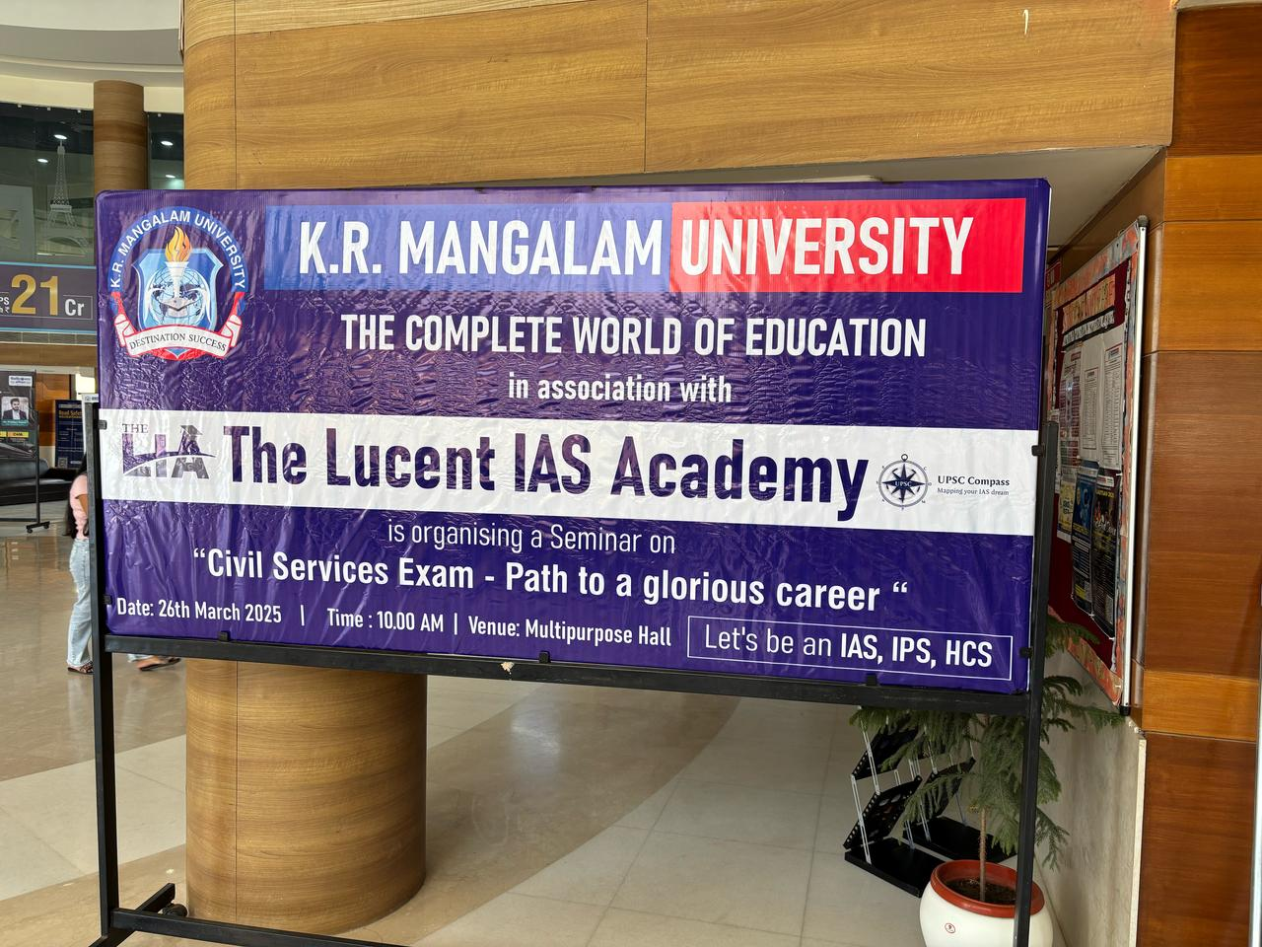
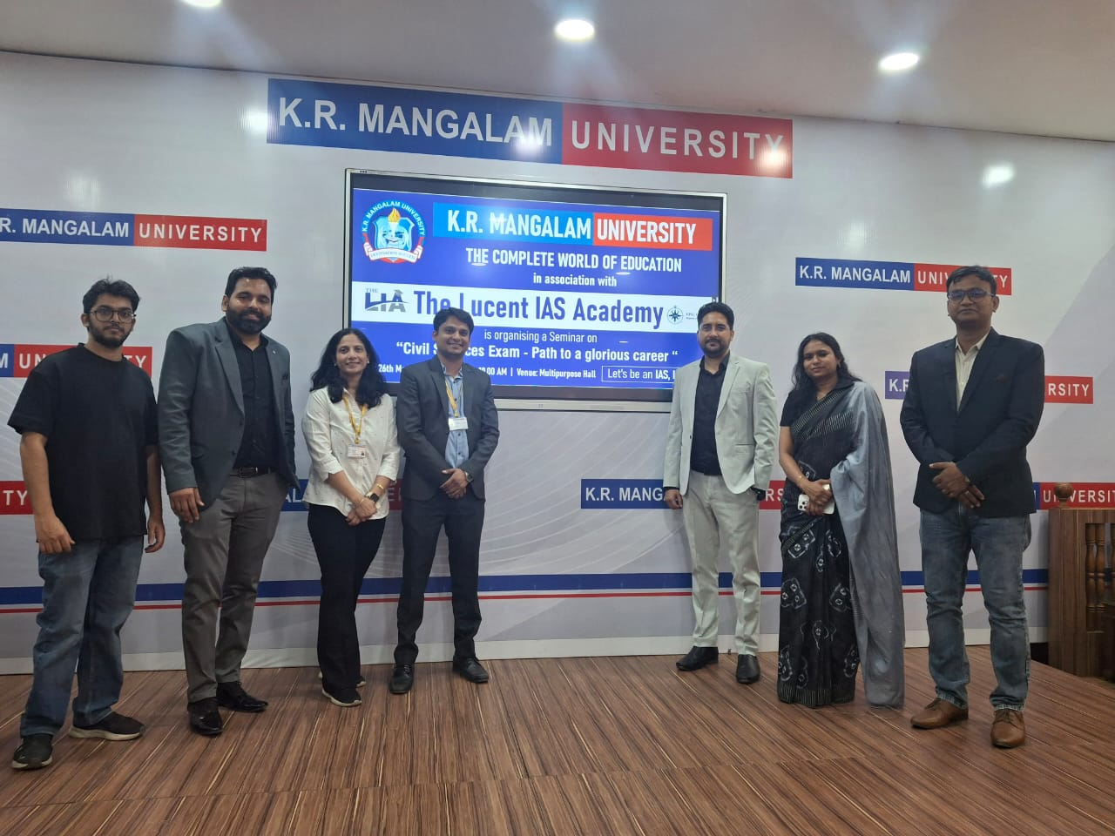
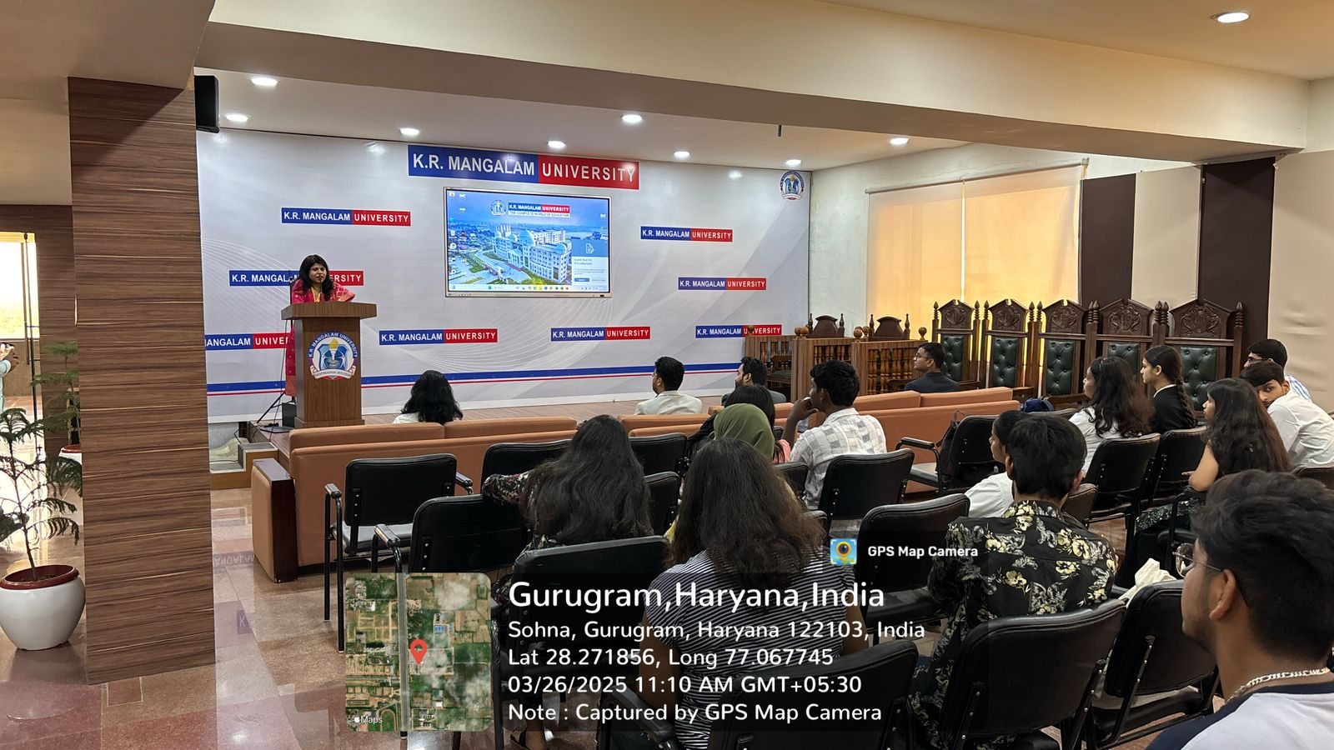
Competitive Exams
Year | Selection count
2022-23 | 8
2021-22 | 5
2020-21 | 19
2019-20 | 14
2018-19 | 4

Slide 8
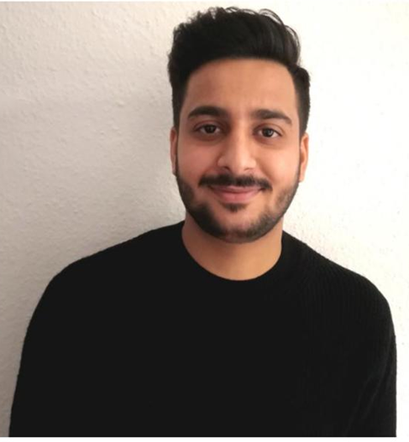


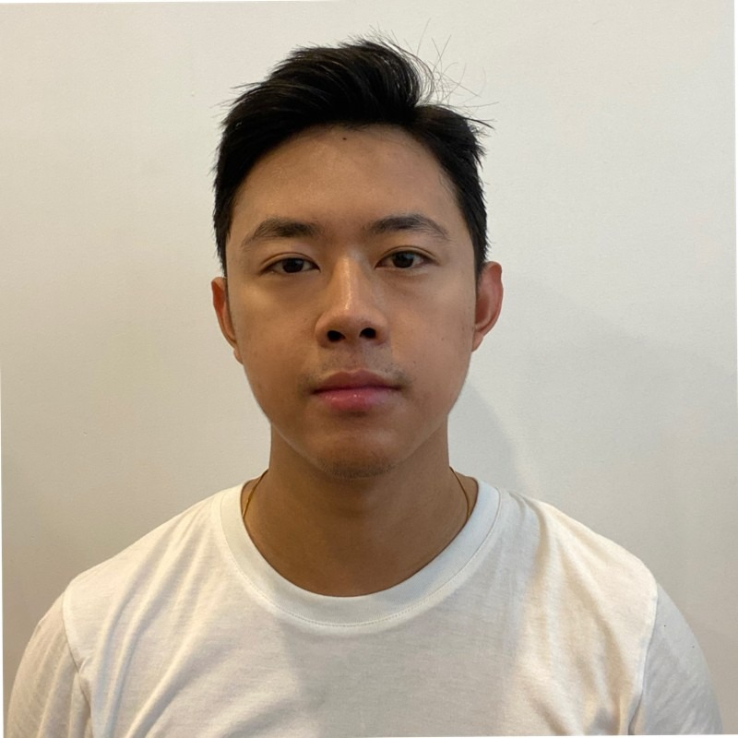
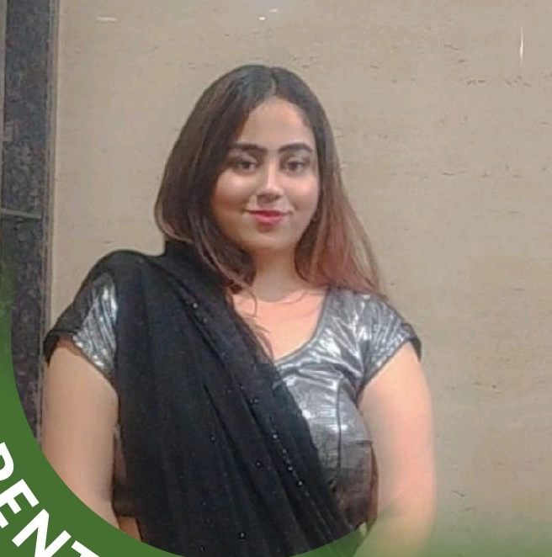
Higher Education
Academic Session | No. of students for Higher Education
2023-24 | 44
2022-23 | 47
2021-22 | 64
2020-21 | 41
2019-20 | 19
2018-19 | 13
Manoj Kumar
M. Sc. Chemistry, 2020
Ph.D. RUHR University Bochum, Germany (Pursuing)
Diksha Boken
B. Sc (H) Chemistry, 2020
M.Sc. (H) Environmental Science, 2022 Amity University
Khushi
B. Sc (H) Psychology, 2022
Masters of Science in Psychology, 2024 University of Exter, London
Zuren
B. Arch., 2019
Master of Architecture,
University of Pennsylvania, US
Parinika Arora
B.A. (H) Psychology, 2024
M.Sc. in Mental Health PT, University of Birmingham, UK

Slide 9




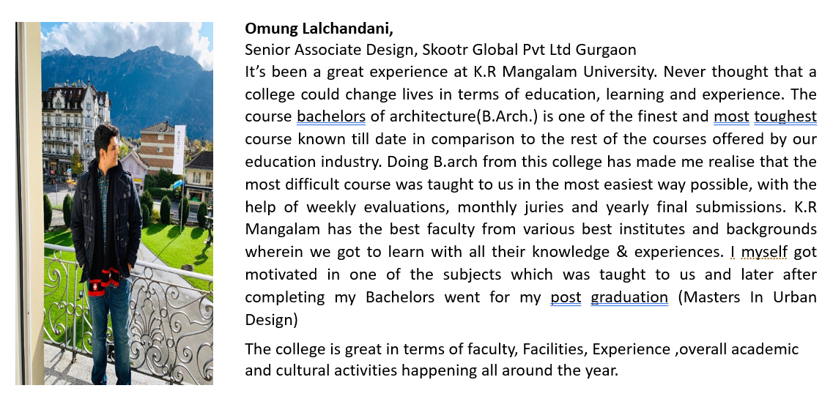

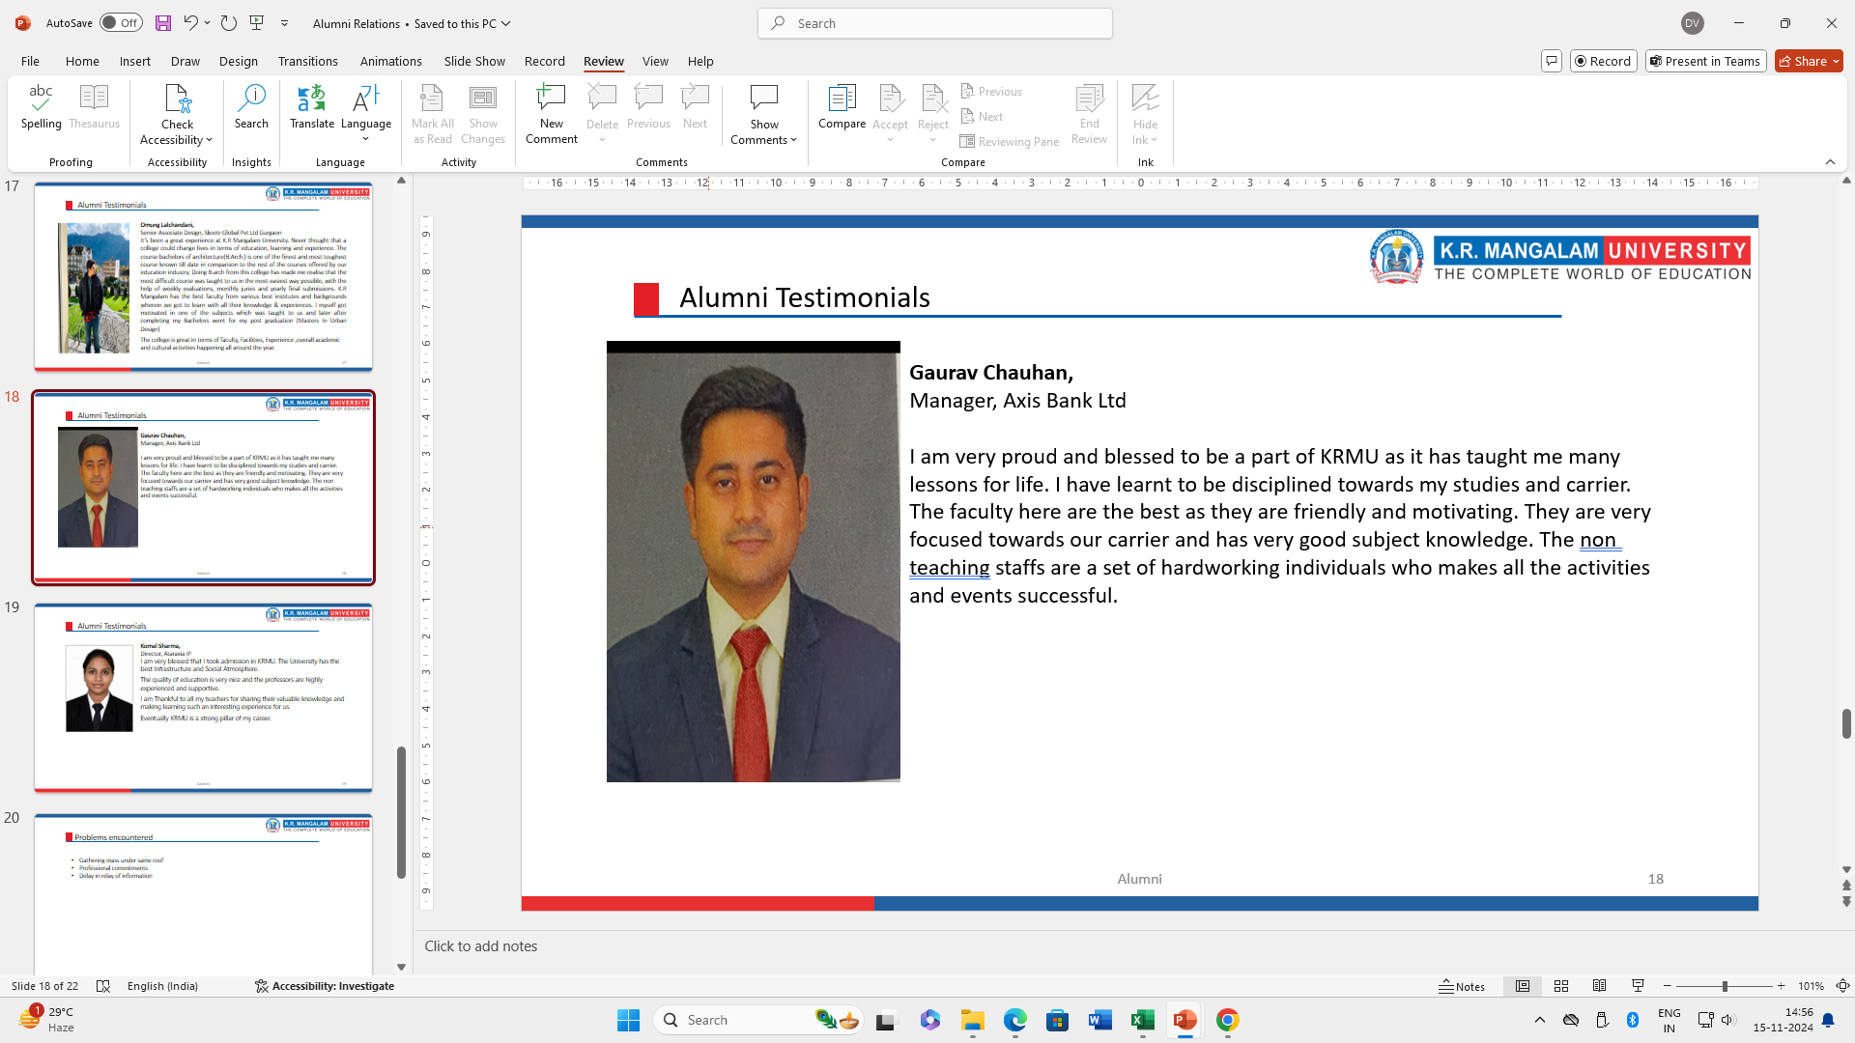
Our Shining Alumni
Notes:
Glimpses instead of Glimpse

Slide 10
Various Trainings Conducted
Academic Session | Various Trainings | Number of Trainings conducted | Number of Student trained
2024-2025 | Company Specific | 5 | 345
 | Profile Speciifc | 14 | 994
 | Boot Camp IPRP | 1 | 300
 | Curriculum Embedded Training | 41 | 3051
 | Industry interaction | 9 | 504
2023-2024 | Boot Camp | 1 | 200
 | Curriculum Embedded Training | 16 | 820
 | Industry interaction | 3 | 120
2022-2023 | Training Sessions | 57 | 912
2021-2022 | Training Sessions | 36 | 653
2020-2021 | Training Sessions | 20 | 425
2019-2020 | Training Sessions | 21 | 228
2018-2019 | Training Sessions | 19 | 224

Slide 11
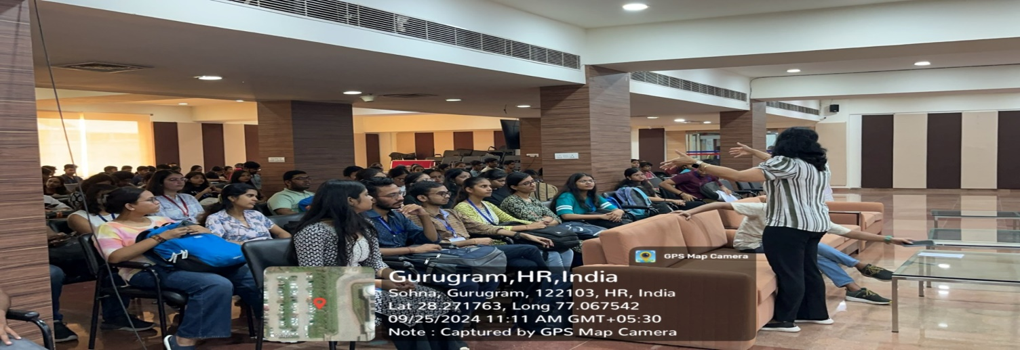
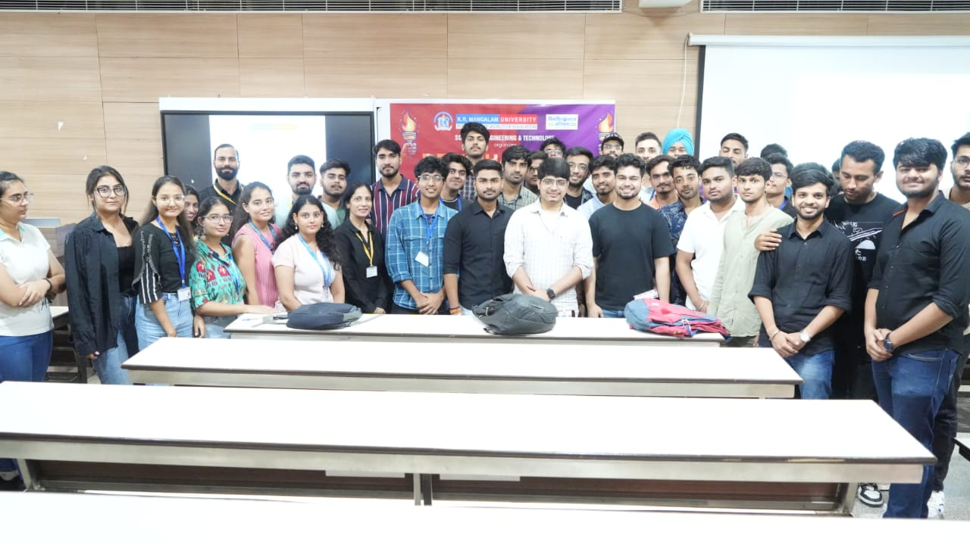
Training Overview
Courses Embedded in Curriculum
1
Boot Camps
2
Profile Based Trainings
3
Company Specific Trainings
4
Training Support
Company Specific Training
Group Discussion & Mock Interviews
Boot camp
Using standardized curriculum training is provided to students to cover all aspects of placement.
Students engage in GD & mock interviews as part of their preparation for placement
CDC conducts intensive training before the placement starts.

Slide 12







Career Skills
Quantitative Aptitude and Logical Reasoning
Soft Skills (Body Language ,Professional Grooming & Etiquettes)
VARC (Verbal Ability and Reading Comprehension)
Personality Development
Group Discussions
Presentation Skills
Personal Interviews
Training Modules
Notes:
Glimpses instead of Glimpse

Slide 13
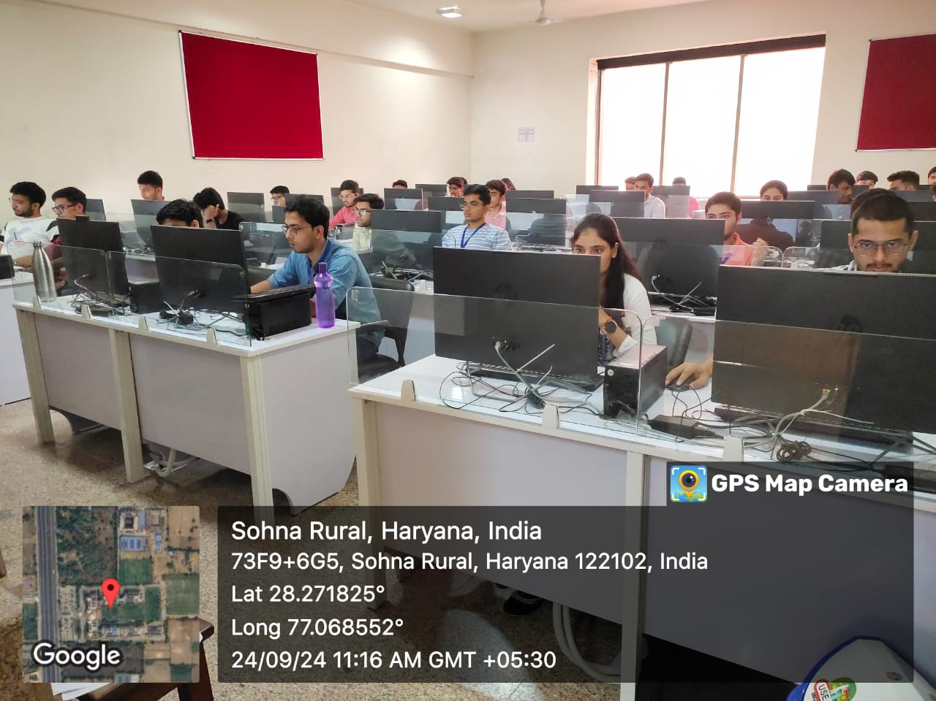
Technical Skills
Program Offerings
1
Audit Based Courses
The curriculum includes audit-based courses covering various subjects like
Competitive Coding.
2
Value Added Skills
Students develop valuable skills through workshops and boot camps.
3
Placement Supports
The university provides comprehensive placement support to students.
4
Skilling Partners
Collaborations with industry partners enhance student skills.
Xebia, Samantrix Consulting Pvt. Ltd., IBM.(Allsoft Sollutions and Services)
Placement Support
Company Specific Placement
Mock Tests
Student Segregation
The university offers company-specific placement training programs.
Students participate in mock tests to prepare for job interviews.
The university segregates students to match them with suitable companies.
Notes:
Glimpses instead of Glimpse

Slide 14
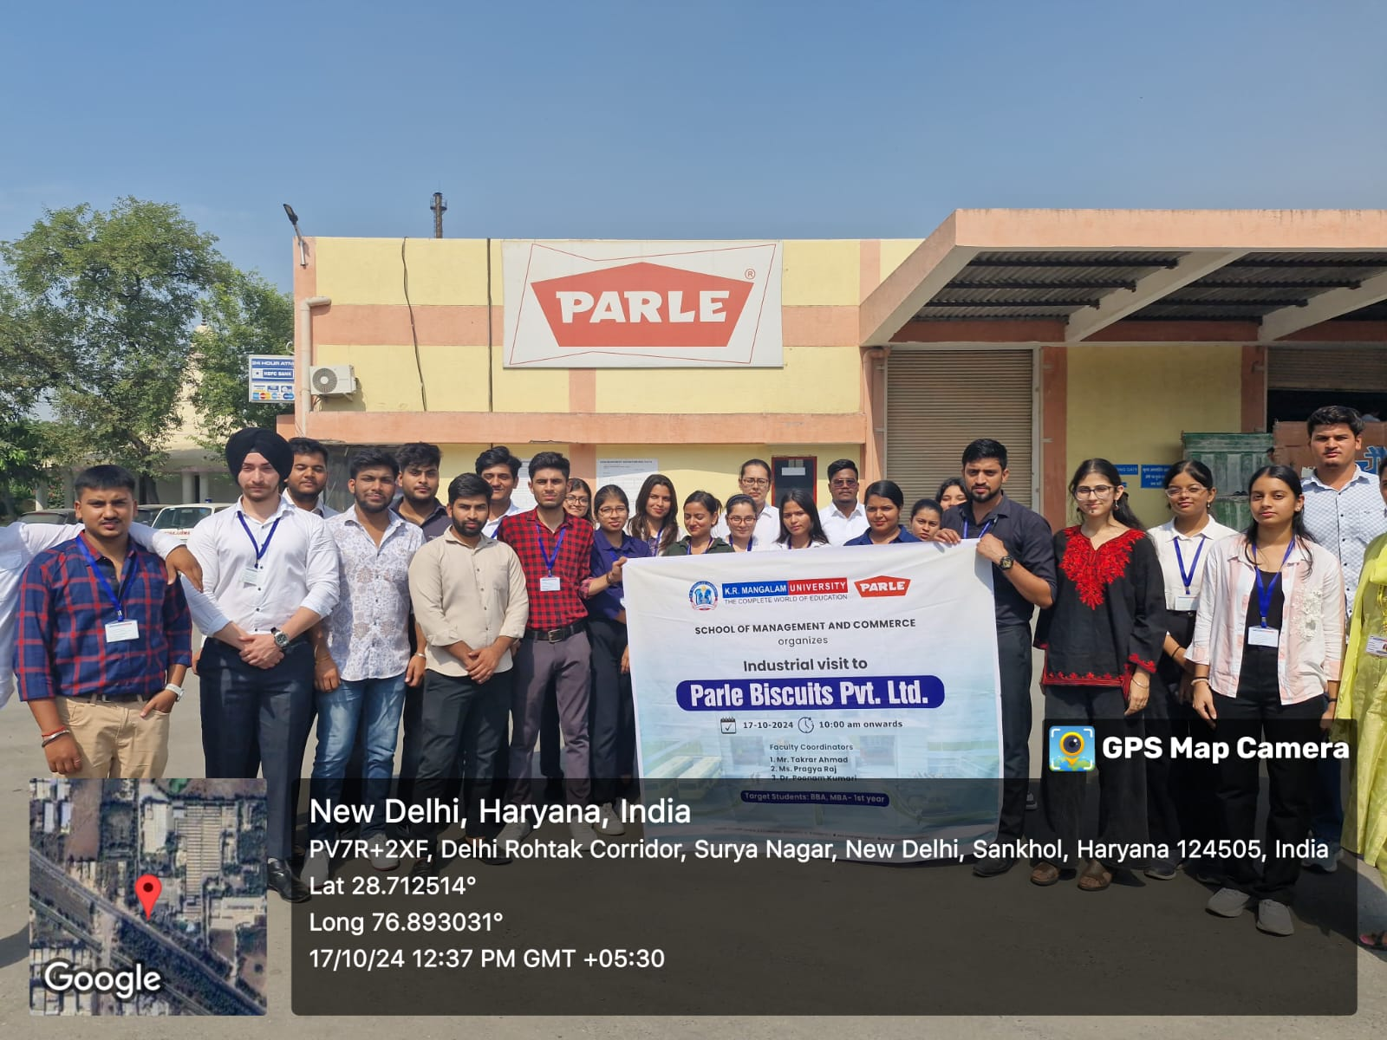
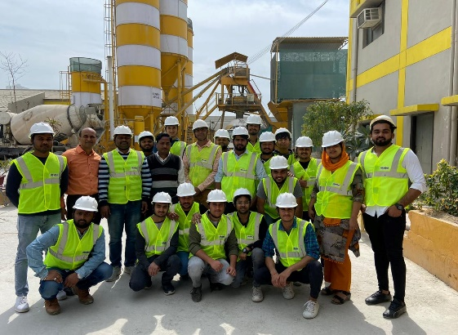
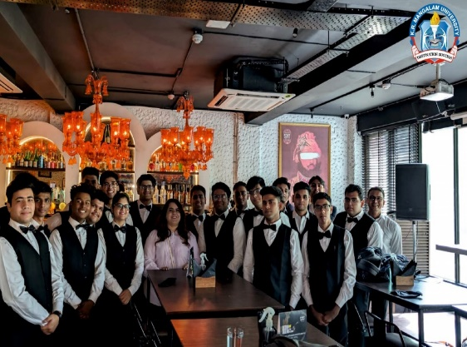
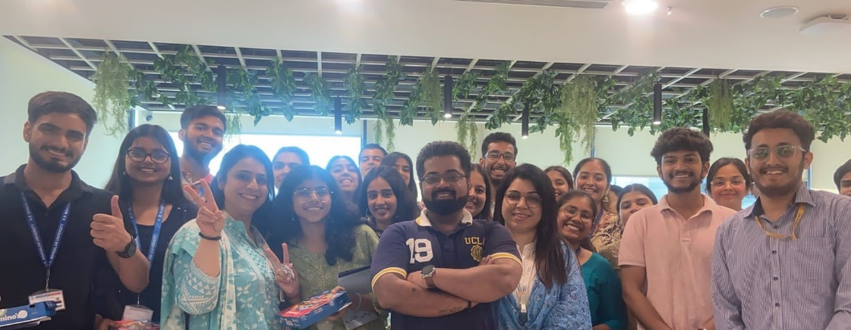


Industry Engagement
MoUs and Tie-ups
Guest Lectures
Latest Tools and Technologies
Industry Updates and Applications
Workshops
Upskilling
Hands-on Sessions
Industry Visit
Hack-a-thons
Bringing all the stake holders to one platform
Notes:
Glimpses instead of Glimpse

Slide 15


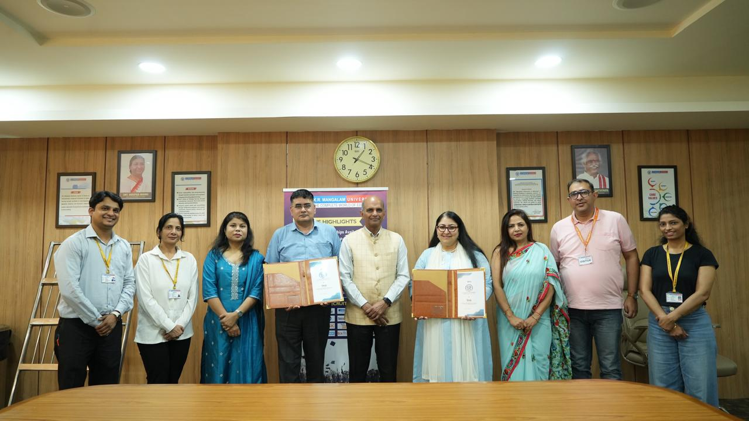







MoU and Tie-ups

Slide 16


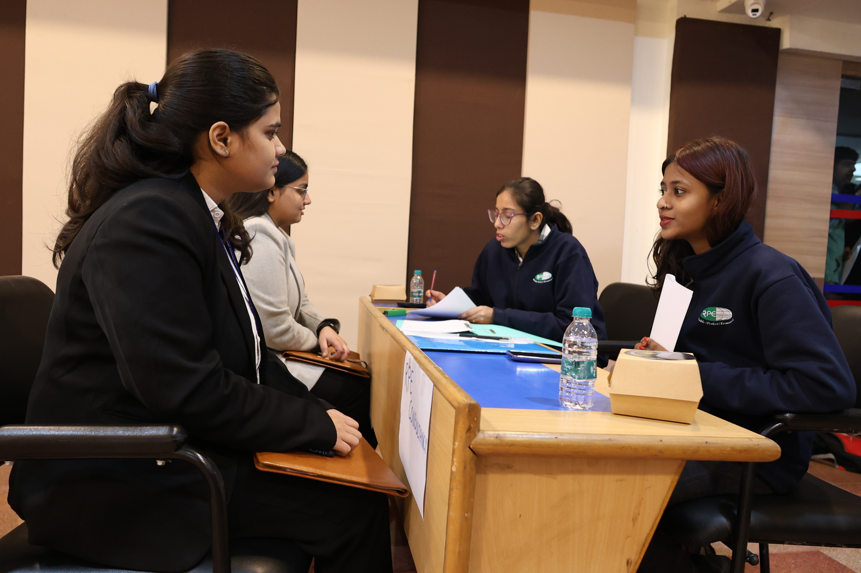







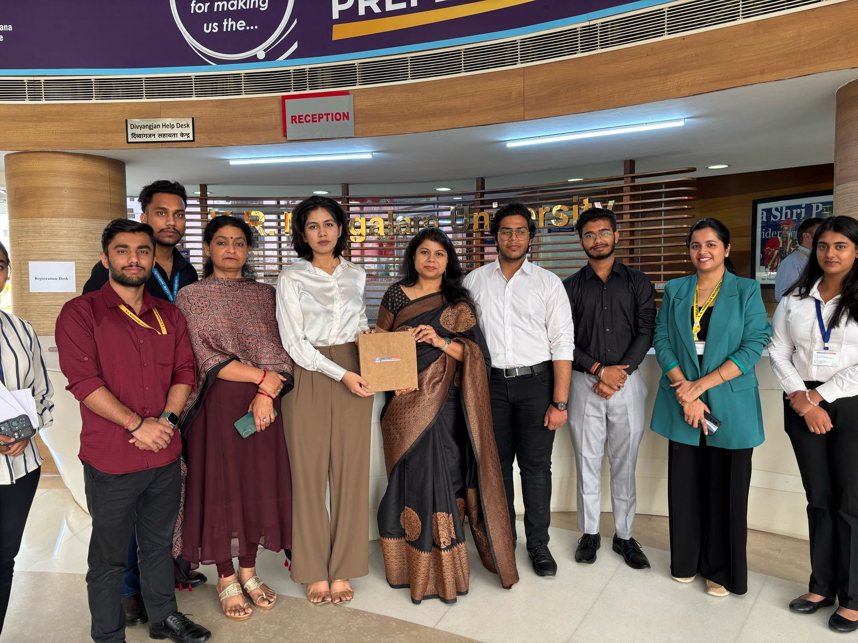












Internship Status

Slide 17






Placement Policy
Responsibilities of the Career Development Center
Career Development Center Committee Responsibilities
Placement Regulations
General Guidelines
Early Joining Norms
Disciplinary Action
Placement Policy

Slide 18

Placement Process
Pre-Placement Talk by company’s
representative
06
05
Online/Offline Aptitude test
04
07
Group Discussion
Registration
03
08
Interaction in the class
Personal Interview
02
09
Sharing with the students
Result Announcement
01
10
To receive JD from the company
On Boarding process assistance
Notes:
Glimpses instead of Glimpse

Slide 19
Placement Status
Year | Total Students | Campus Placements
2024-25 | 1015 | 816
2023-24 | 714 | 603
2022-23 | 504 | 399
2021-22 | 547 | 327
2020-21 | 477 | 459
2019-20 | 464 | 452
2018-19 | 391 | 345
Highest Package: 56 LPA
Average Package: 3.5 LPA

Slide 20
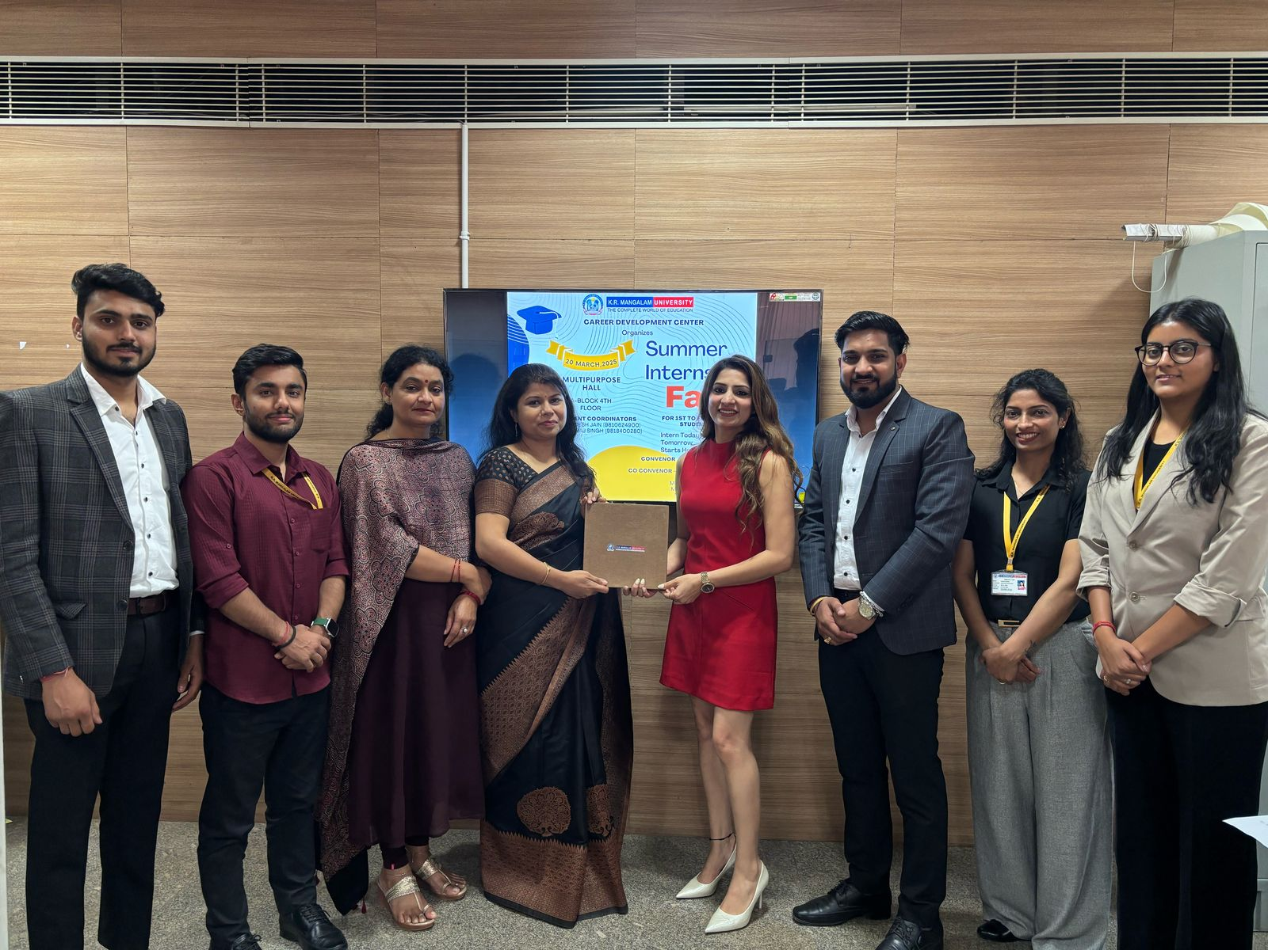
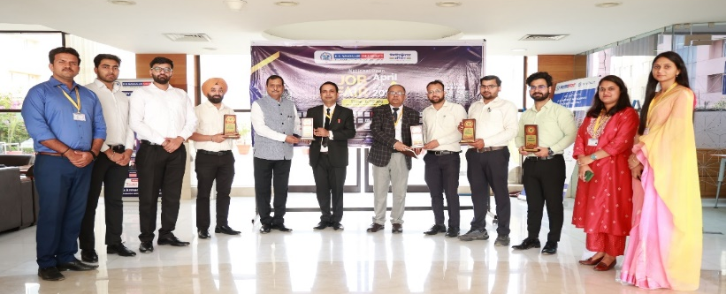
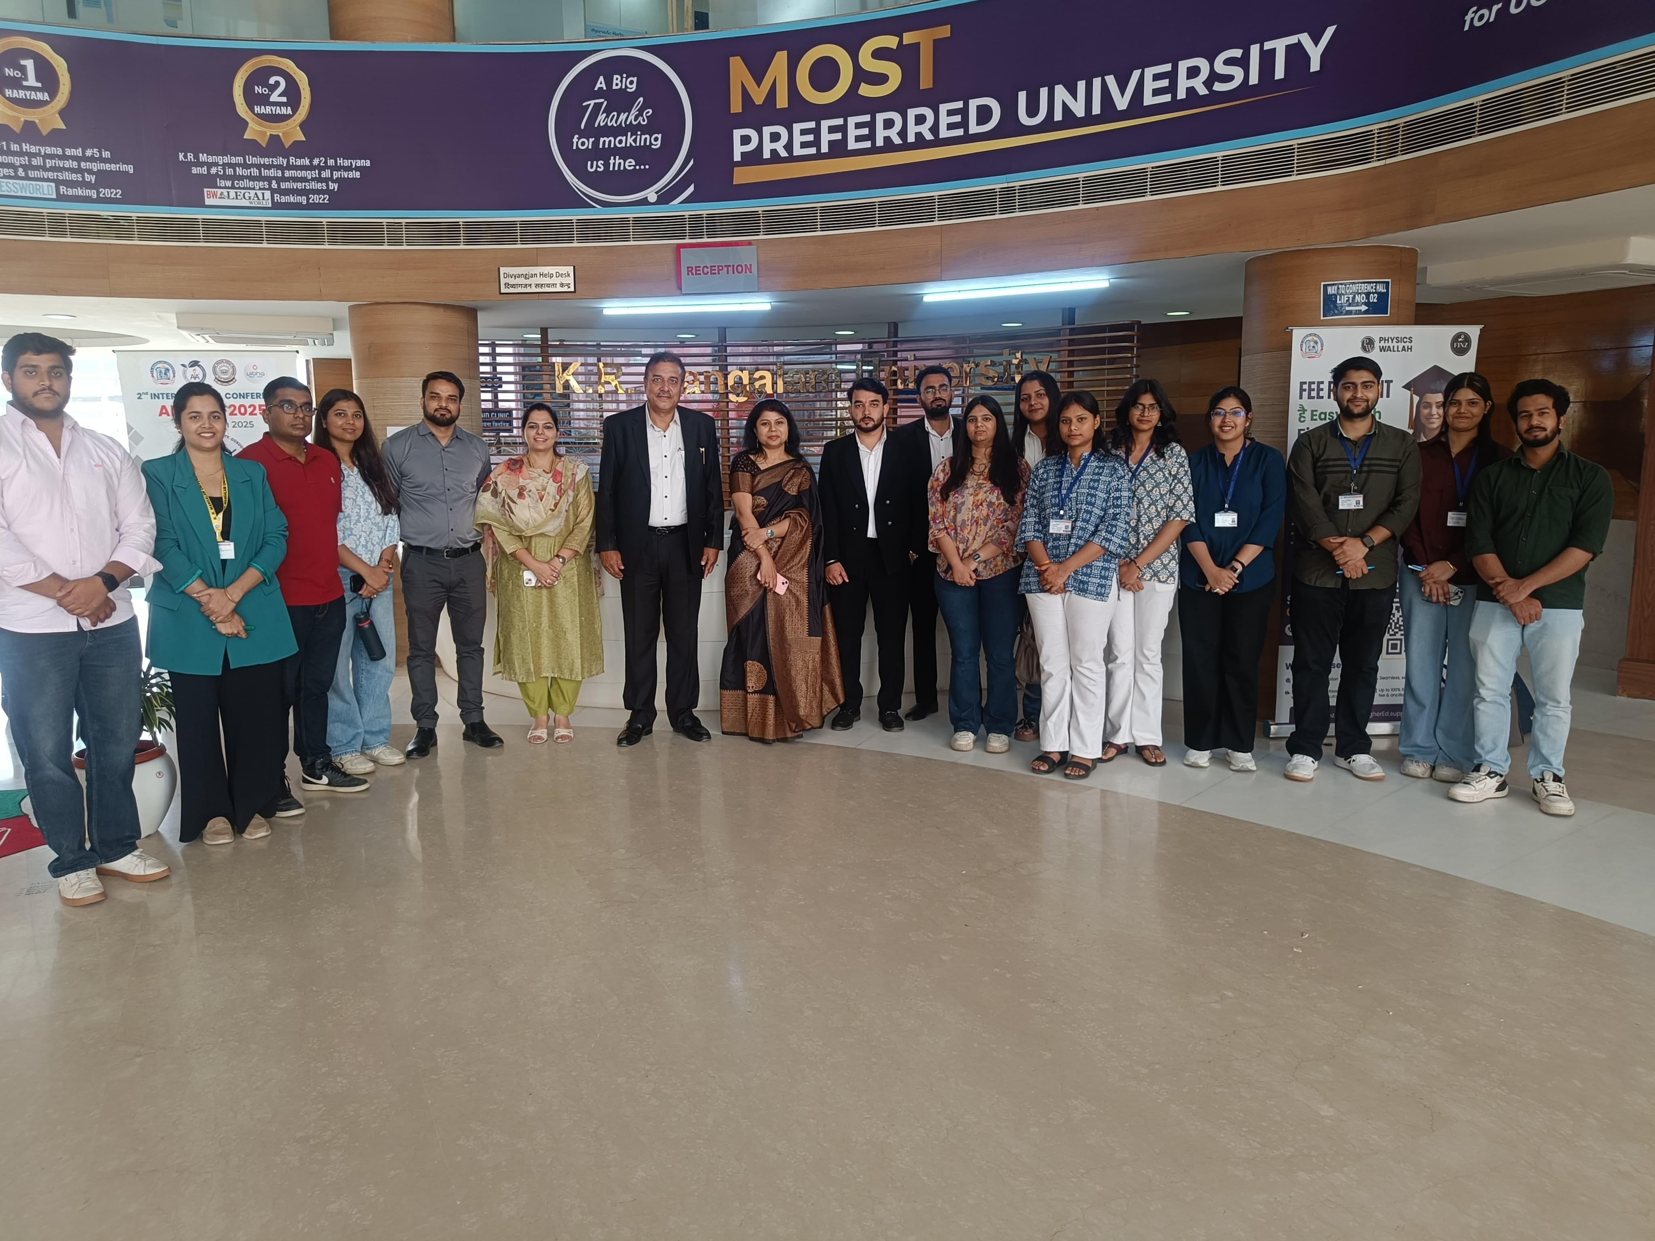
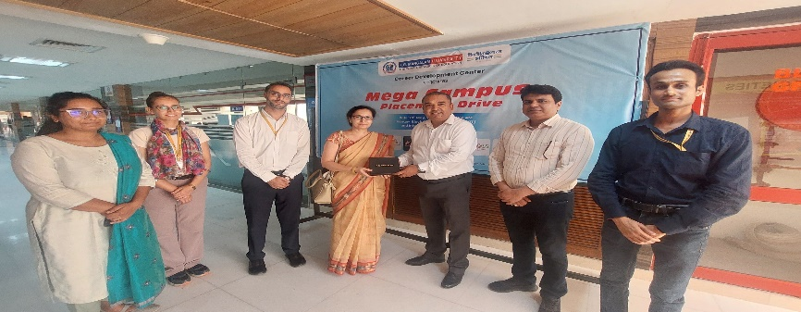
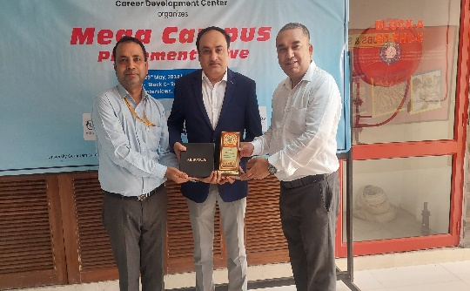
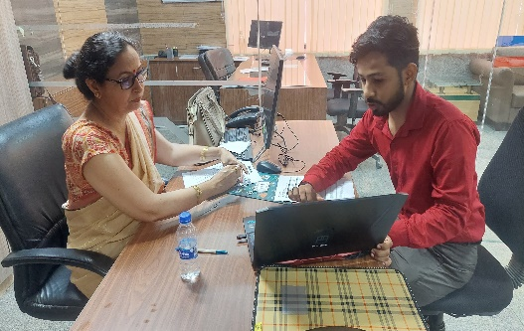
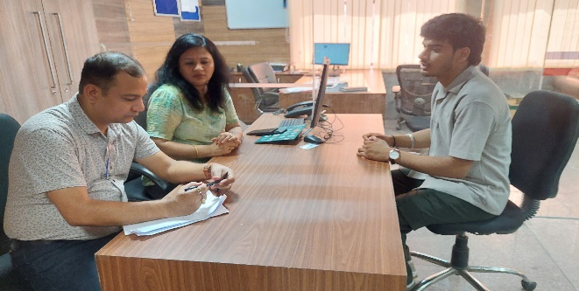
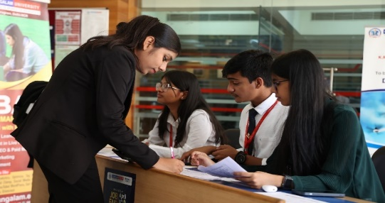
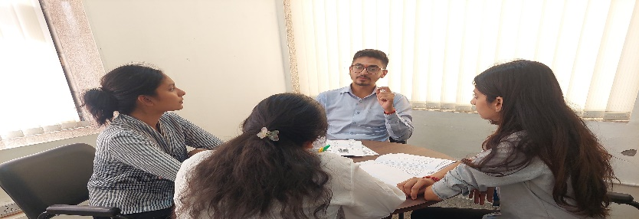
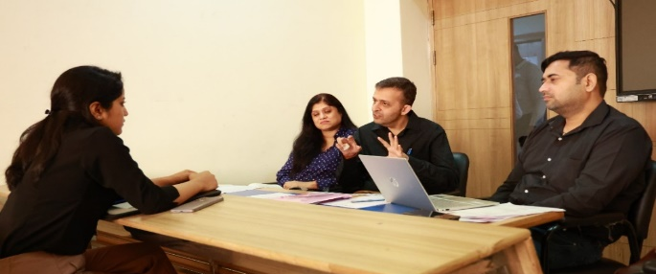
Mega Job Fair &
Placement Drives
Mega Job cum Internship Fair
Notes:
Glimpses instead of Glimpse

Slide 21
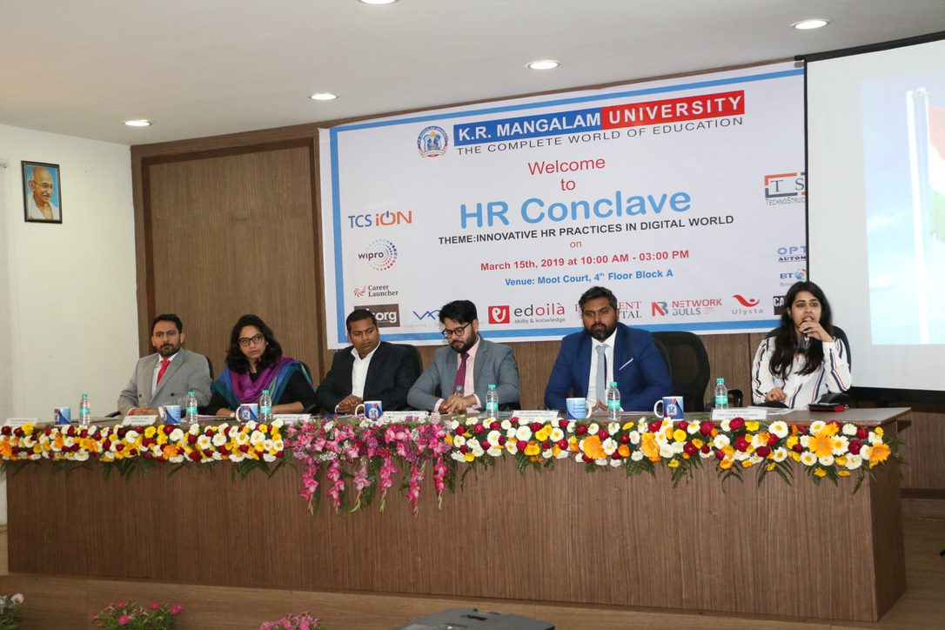







HR Conclave

Slide 22








Placement Highlights

Slide 23







































Some of our Key Recruiters
Engineering
&
Technologies
Commerce
&
Management
Others
23

Slide 24
Future Roadmap
Consultancy
HR event
MoU & Collaboration – 15
HR event – 03
Placement – 75%
Internship – 100%
Training - & Guest Lecture – 15
MoU & Collaboration – 20
HR event – 03+02
Placement – 80%
Internship – 100%
Training & Guest Lecture - 30
MoU & Collaboration – 25
HR event – 04+02
Placement – 85%
Internship – 100%
Training & Guest Lecture - 40
MoU & Collaboration – 25
HR event – 04+03
Placement – 90%
Internship – 100%
Training & Guest Lecture - 50
MoU & Collaboration –30
HR event – 05+03
Placement – 95%
Internship – 100%
Training & Guest Lecture - 60
Target Achievement
All 12 schools
Career counseling
From Session
2025-26 to 2029-30
International Collaboration – 02
Implementation of T&P ERP Module
Corporate Outreach – 1000
Corporate Visit – 500
Industry Immersion Program Centre - 02
Year
Placement
Infrastructure
Corporate Visit
2025-26
2026-27
2027-28
2028-29
2029-30
International Collaboration – 05
Corporate office in Bengaluru
Corporate Outreach– 1200
Corporate Visit – 600
Industry Immersion Program Centre - 04
International Collaboration – 08
Corporate Offices – Dubai, Singapore
Corporate Outreach– 1500
Corporate Visit – 1200
Industry Immersion Program Centre - 06
International Collaboration – 12
Corporate Offices – Canada
Corporate Outreach– 1800
Corporate Visit – 1500
Industry Immersion Program Centre - 08
International Collaboration – 15
Corporate Offices –UK, US
Corporate Outreach– 1800
Corporate Visit – 1500
Industry Immersion Program Centre - 10
Action, Implementation, Development and Attainment
International Collaboration
Consultancy

Slide 25
Thank you!
Notes:
Glimpses instead of Glimpse

