Slide 1



Centre of Excellence
in
Robotics and Automation
WELCOMES
NAAC PEER TEAM
Presented by : Dr. Ayyala Kishore Ajay Kumar,
Chairperson, CoERA.

Slide 2
Index
Establishment
Objectives
Mission and vision
Members Associated
List of selected Equipment’s
Activities
Outcomes and Achievements
Future roadmap

Slide 3

Established 28.08.2024
Center of Excellence in Robotics and Automation(CoERA) serves as a hub for research, development, and practical application of robotics and automation technologies.

Slide 4
Objectives
Education and Training
Industry Partnerships
Outreach and Awareness
Technology Transfer
Research and Development

Slide 5
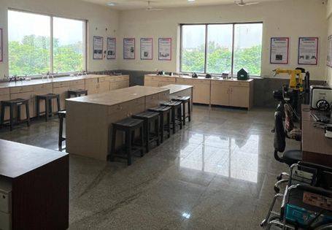
Vision
To Empower innovation and excellence in robotics and automation through cutting-edge research, industry collaboration, and transformative technology solutions.
Mission
Interdisciplinary Collaboration
Skill Development and Education
Research and Innovation
Sustainable Solutions

Slide 6
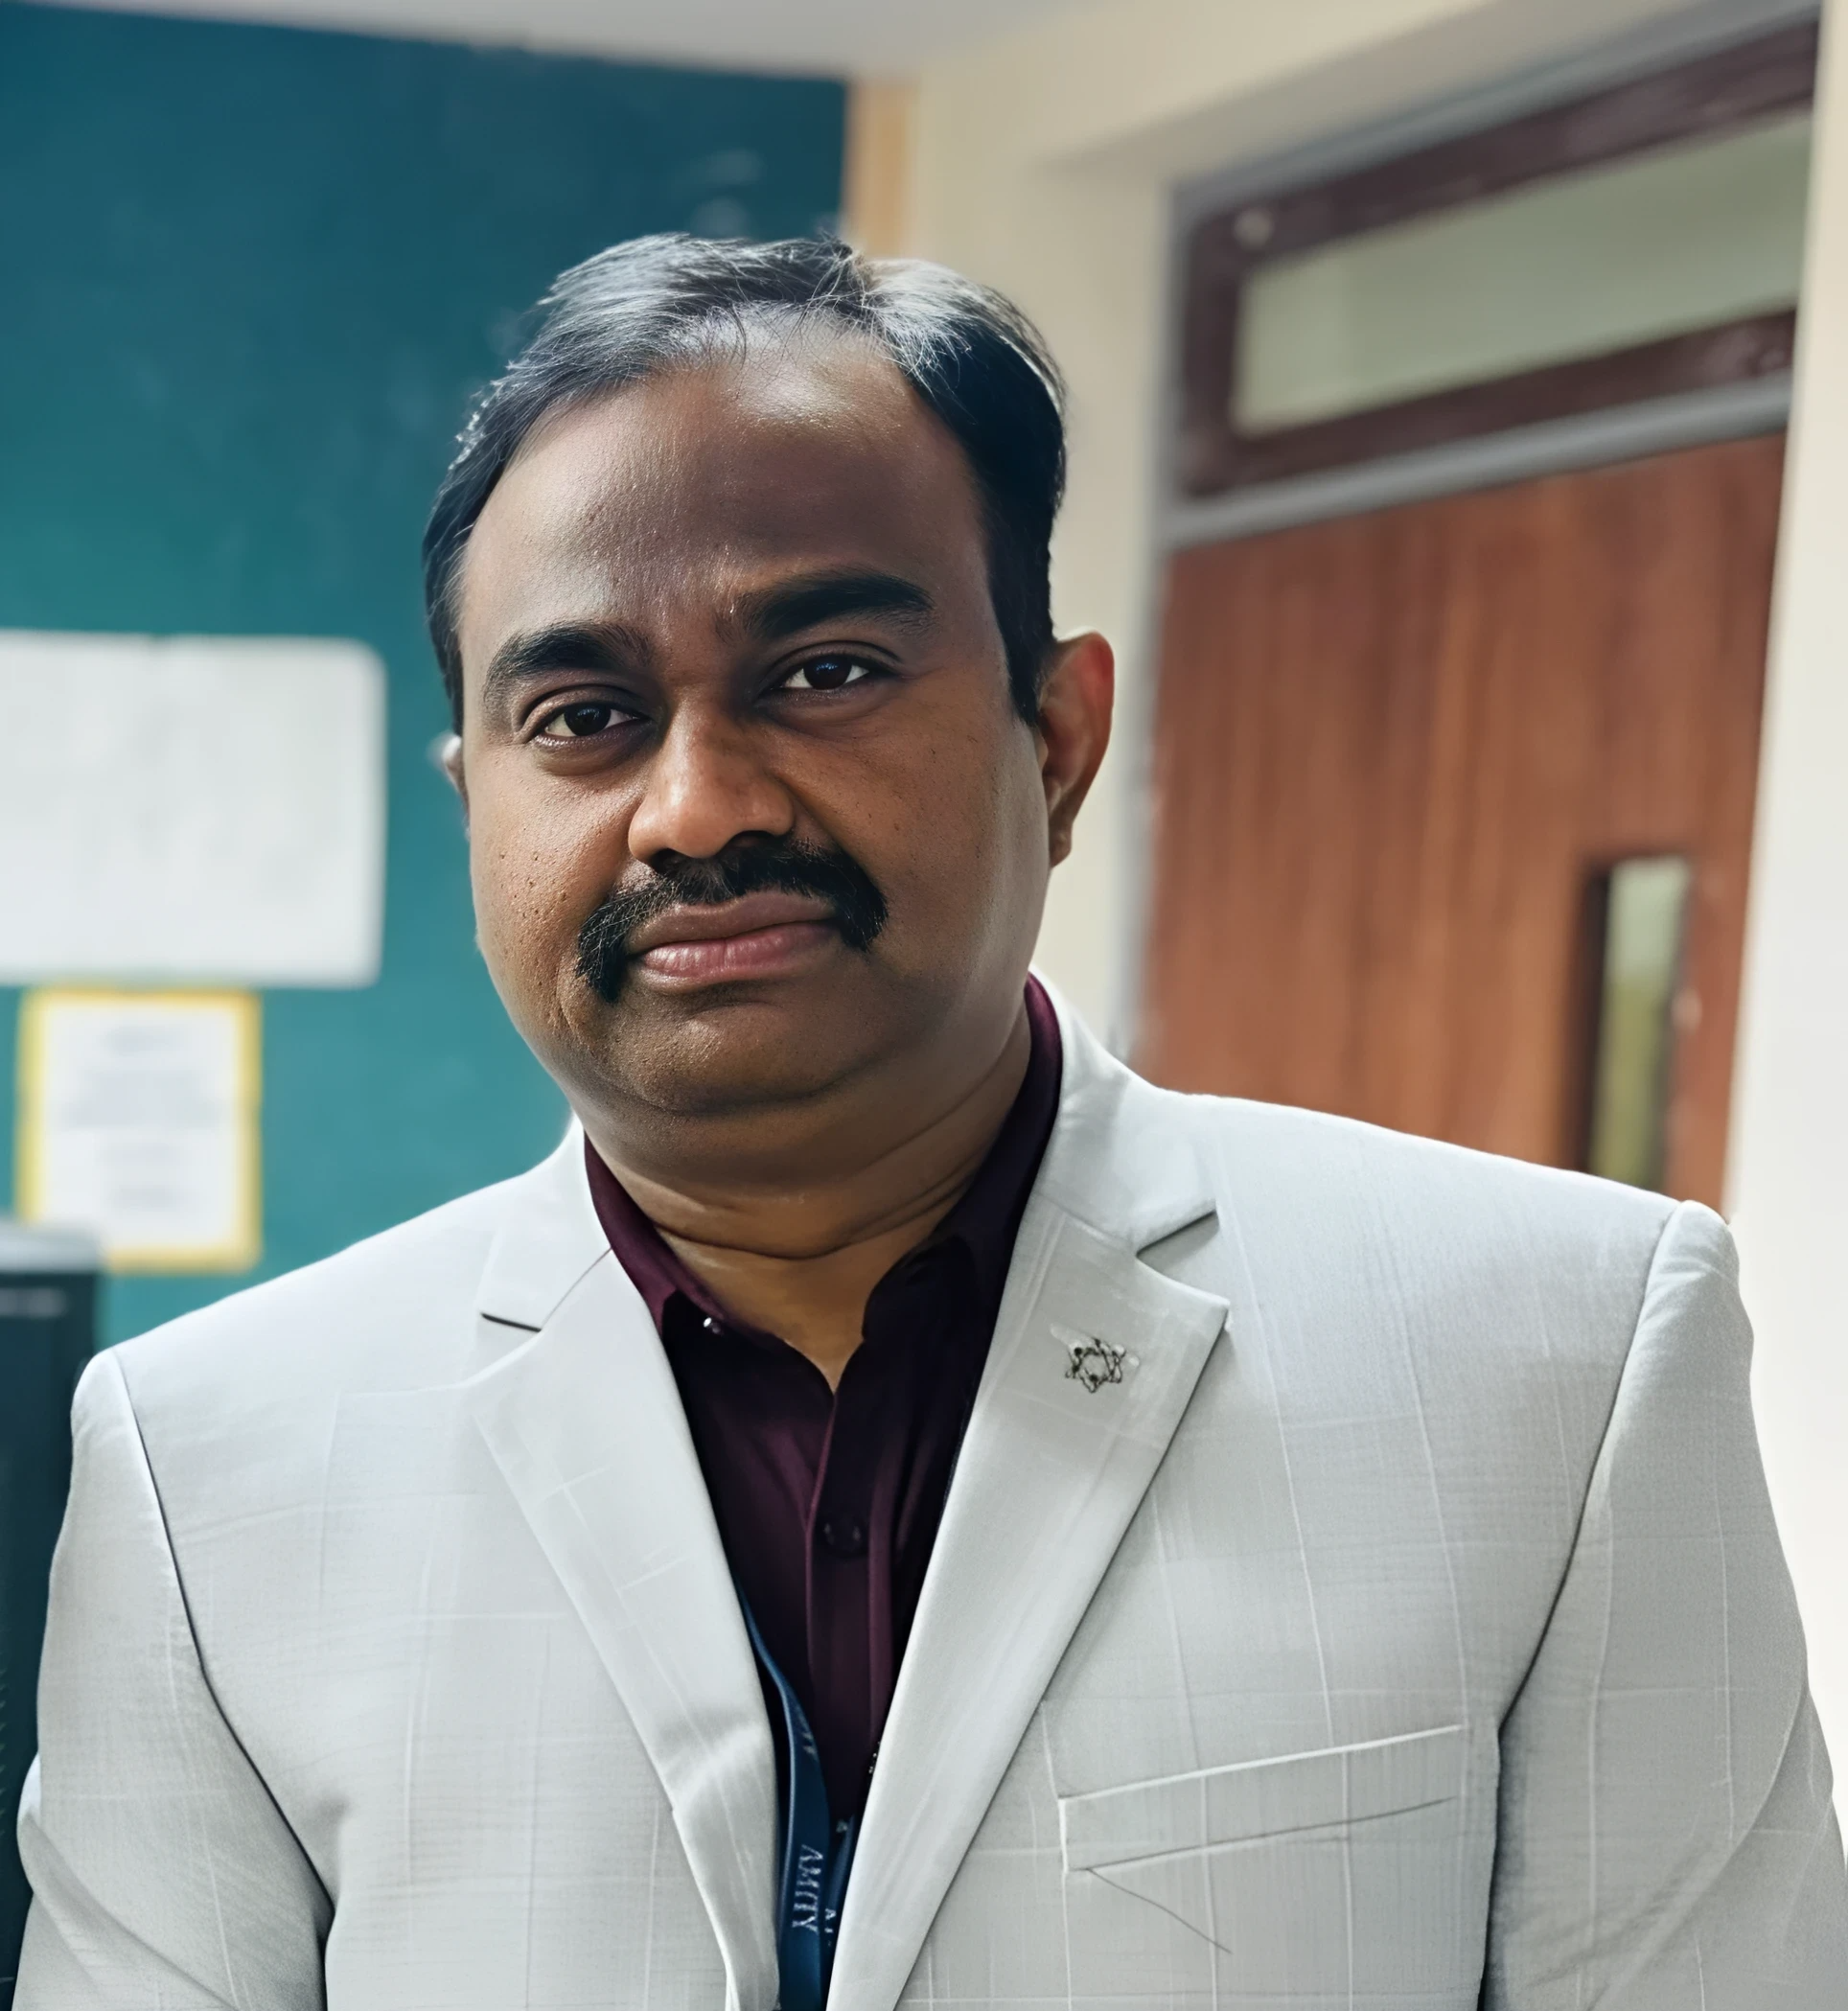
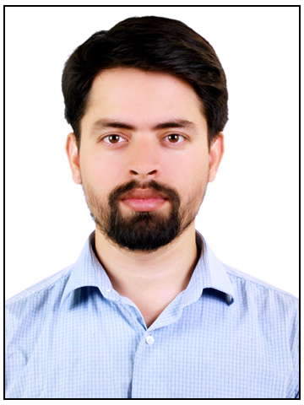
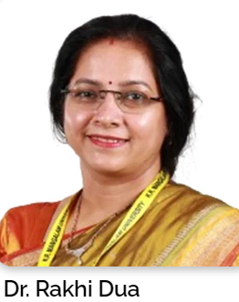
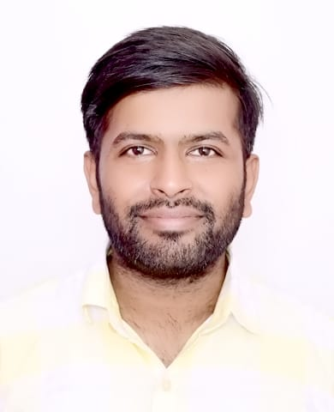
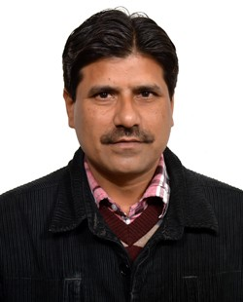
Members Associated
Office order
Dr. Ayyala Kishore Ajay Kumar
Chairperson, IoT and Embedded
Dr. Digvijay Singh
Coordinator, Electrical
Dr. Rakhi Dua
Co-coordinator, Electronics systems
Dr. Appurva Jain
Member, Robotics
Dr. Imran Siraj
Member, Automation

Slide 7
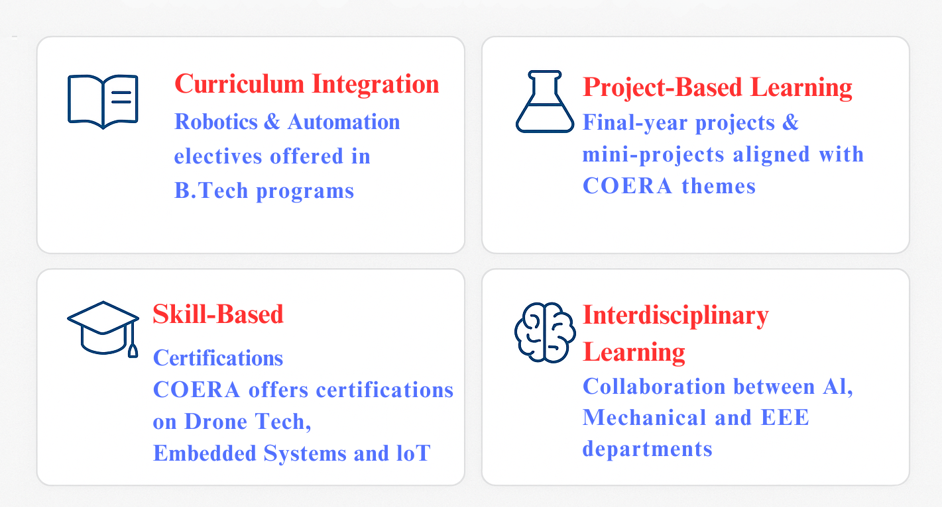
Education & Training

Slide 8
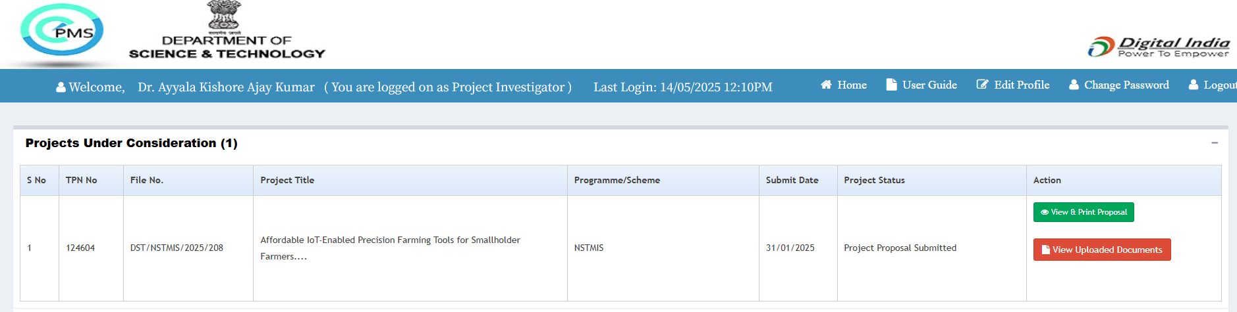
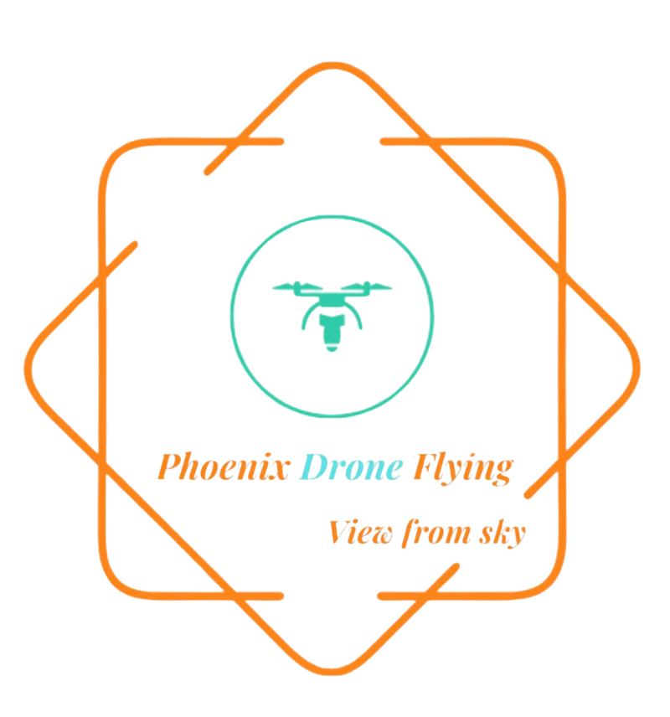

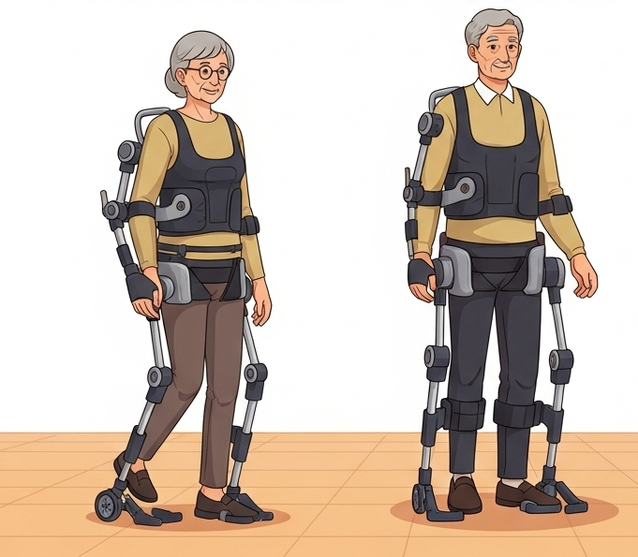
Industry and Partnership
Project Fundings
2024- Till now
Waiting for approval
Seed Grant Approved
MoU Under process

Slide 9
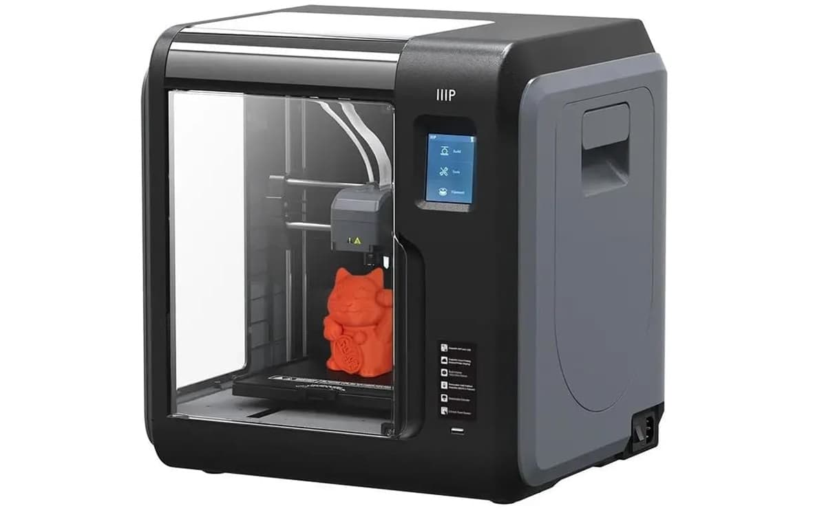
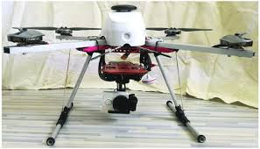
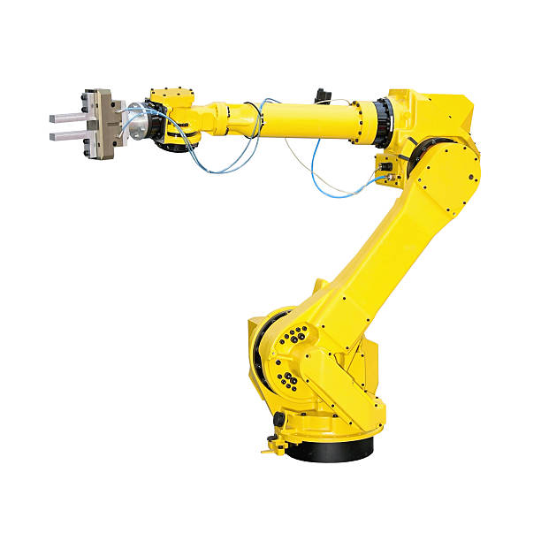
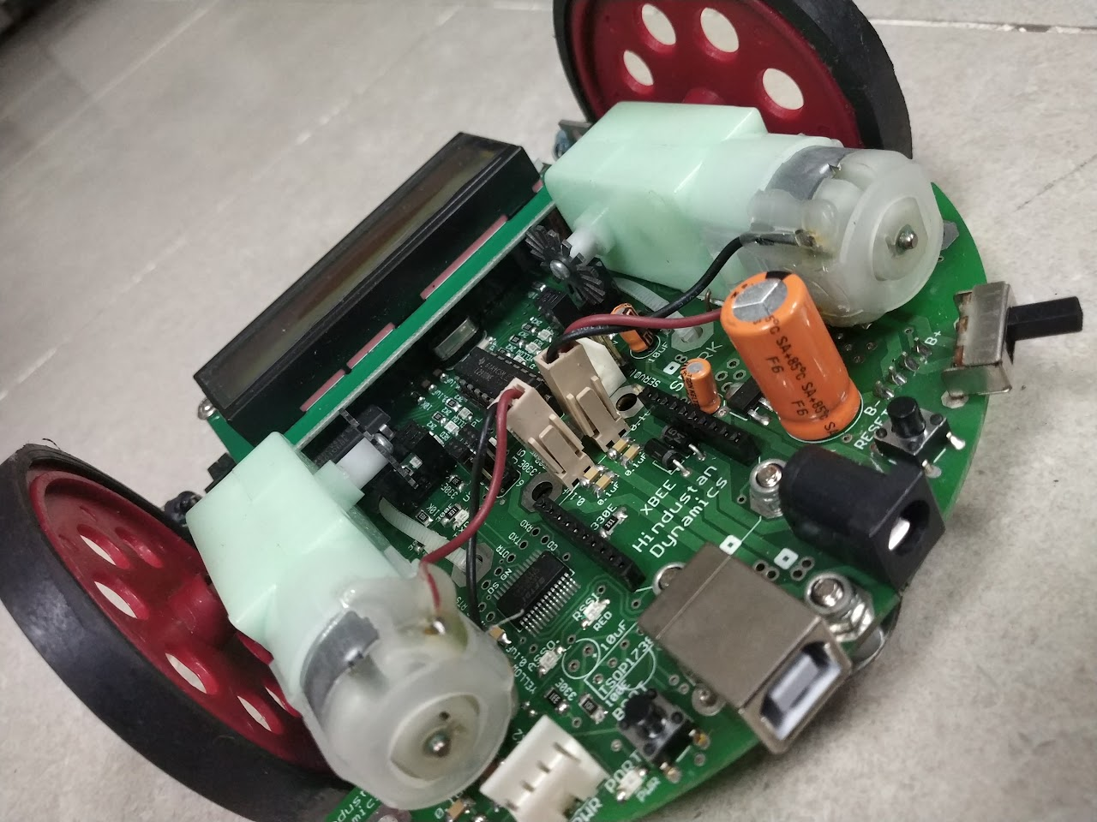
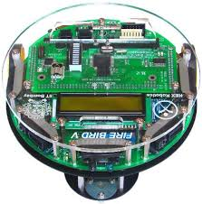
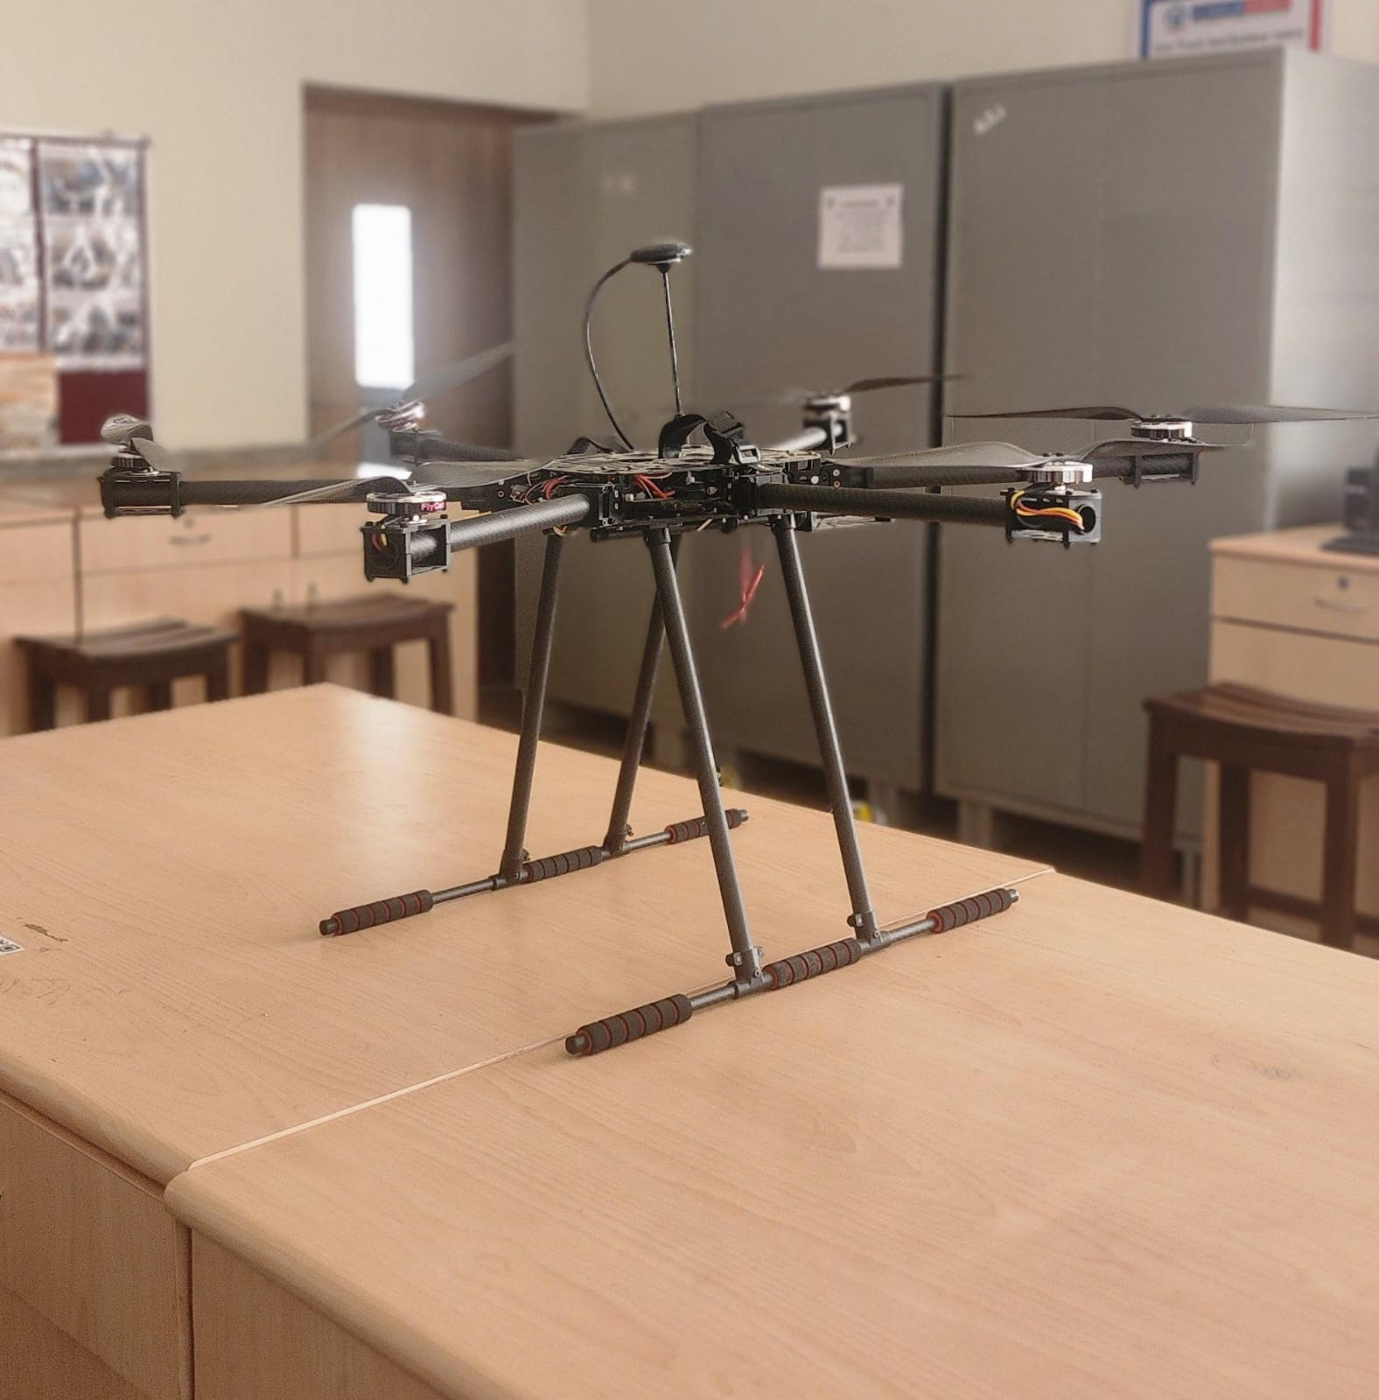
List of Selected Equipment’s in CoERA
3D Printer
Quadcopter - Pixhawk Series Drone
Robotic Arm
Complete list
Spark V Robot
Fire Bird V 2560
Hexacopter

Slide 10
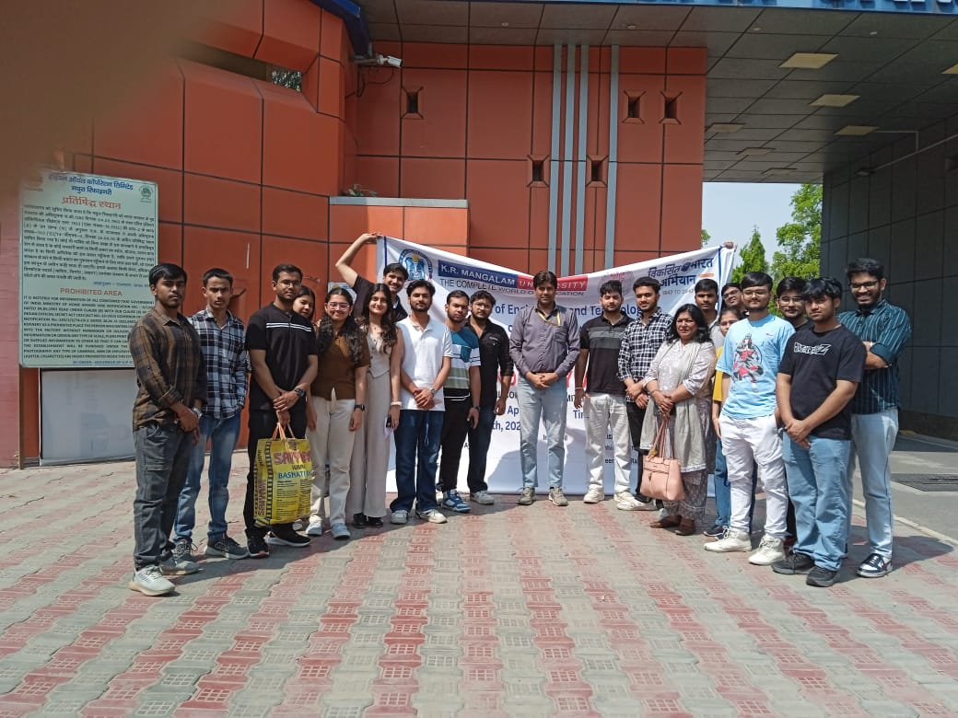
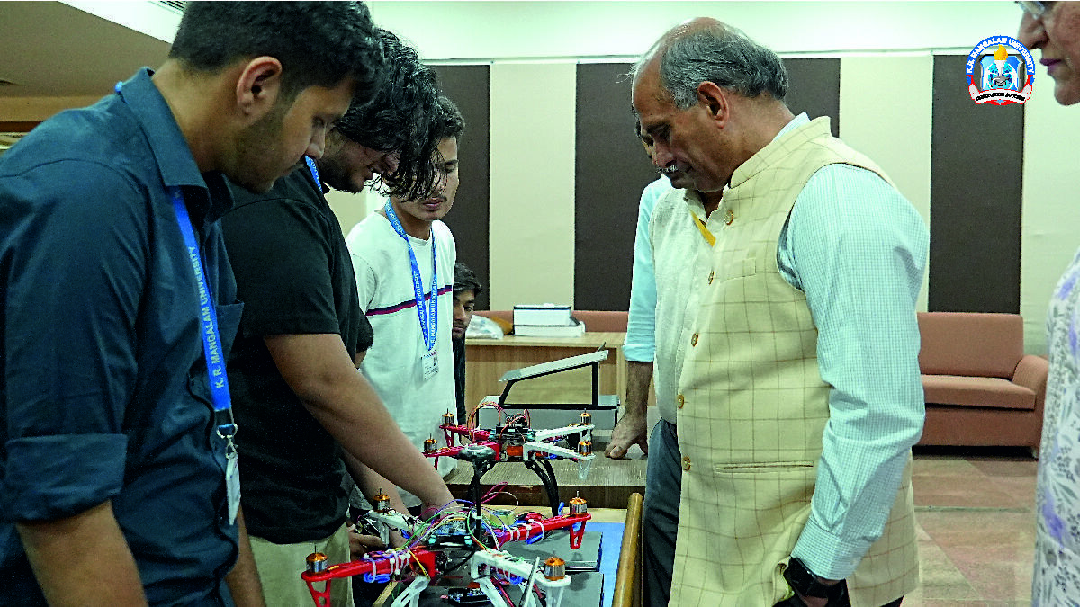
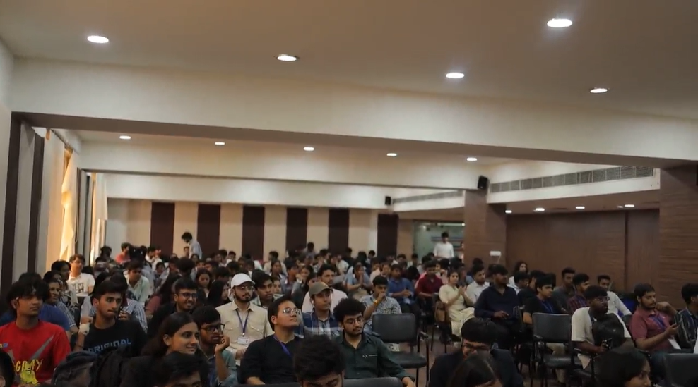
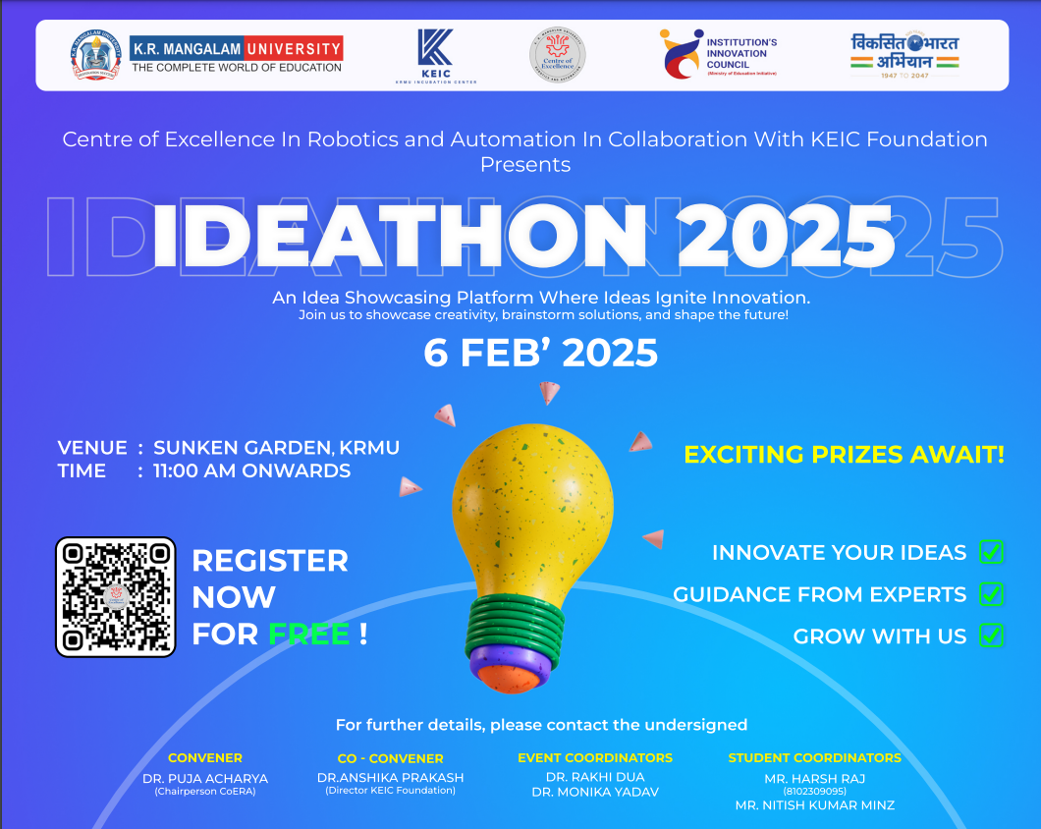
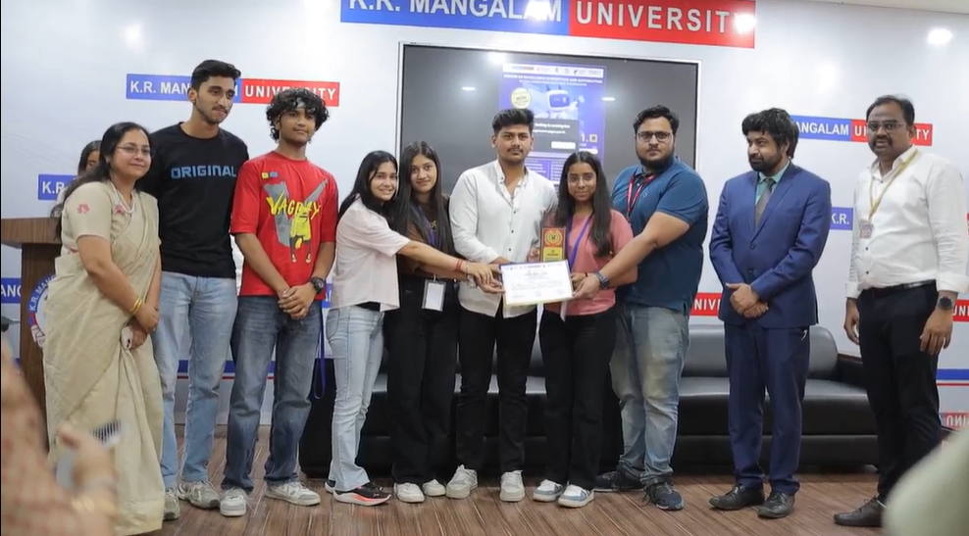
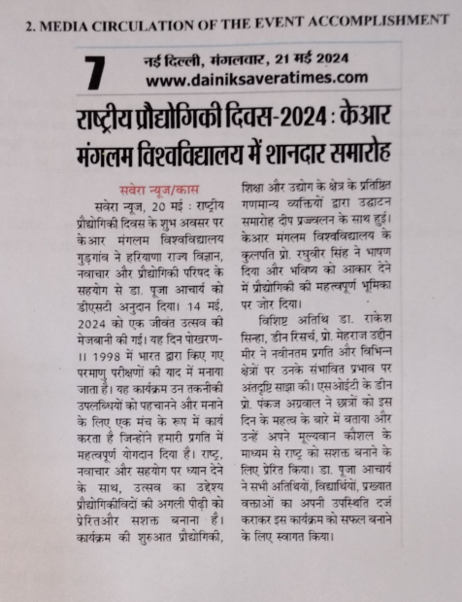
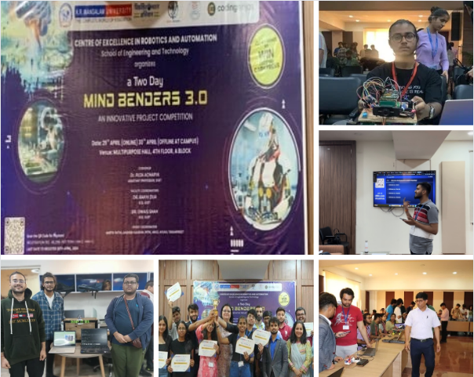
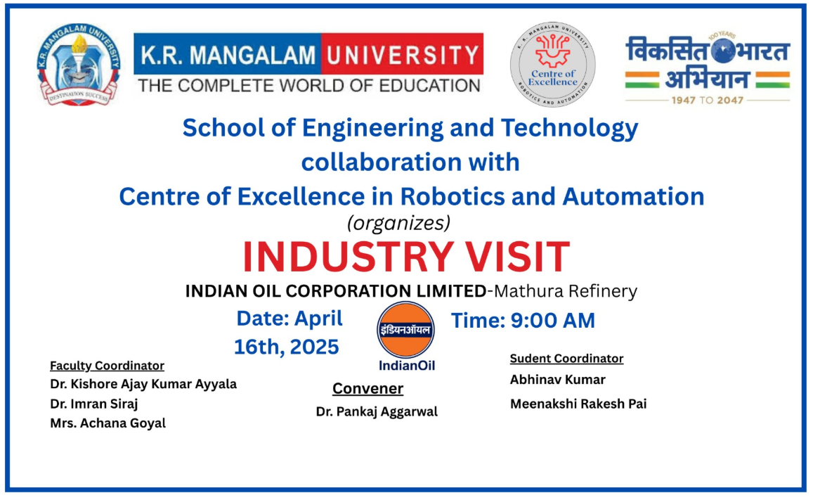
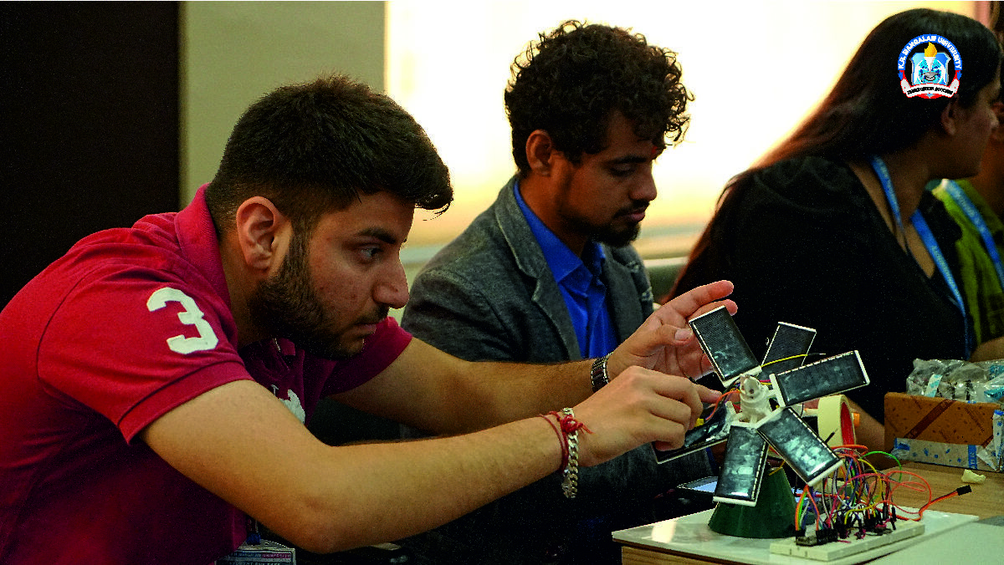
Activities chart
1.RoboRush 1.0 (26th April 2025)
2. IOCL, Mathura(16th April 2025)
3. Ideathon (6th Feb 2025)
4. MindBenders3.0(29th April 2024)
5. MindBenders2.0(25th Nov 2023)
6. MindBenders1.0(20th Oct 2022)
7. National Technology Day-2024(DST Haryana Received)

Slide 11
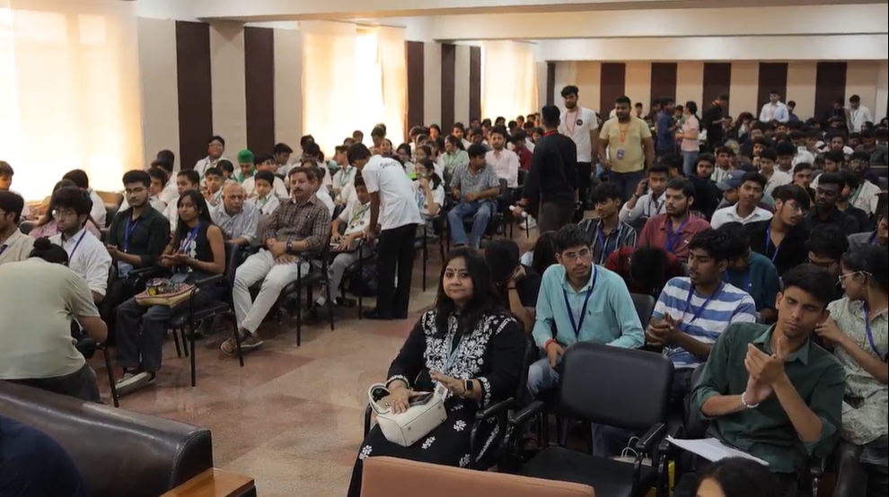
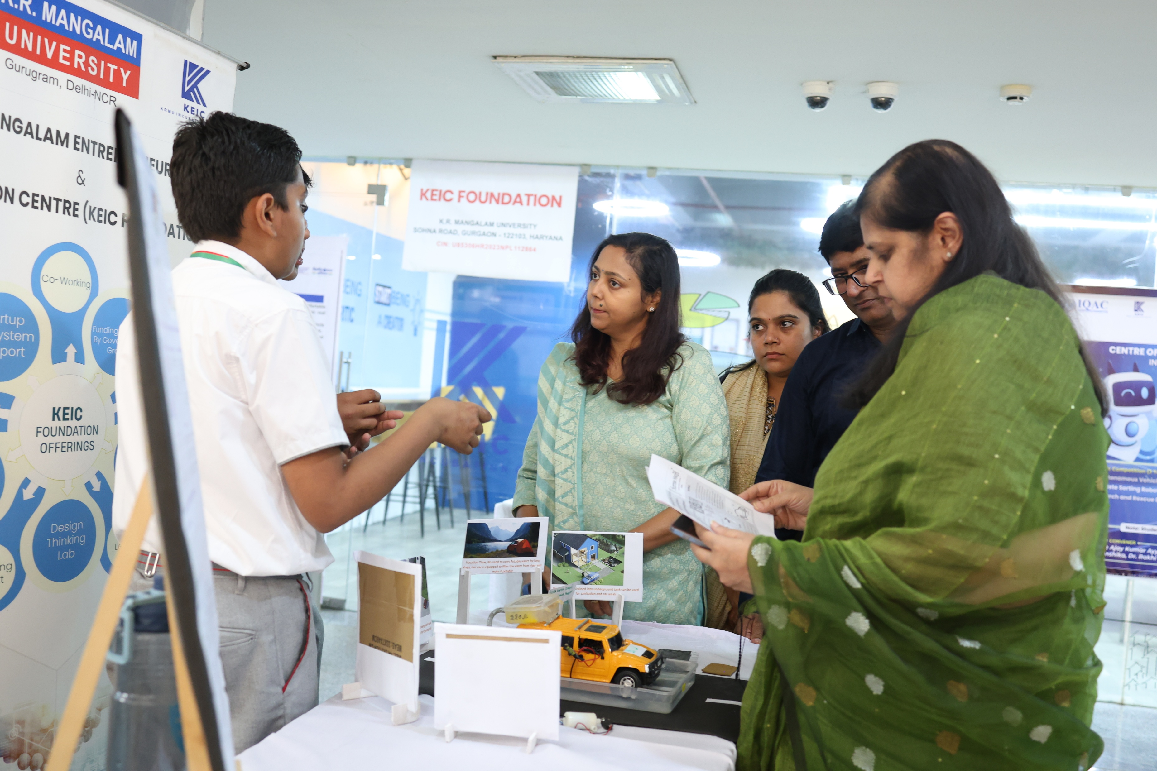
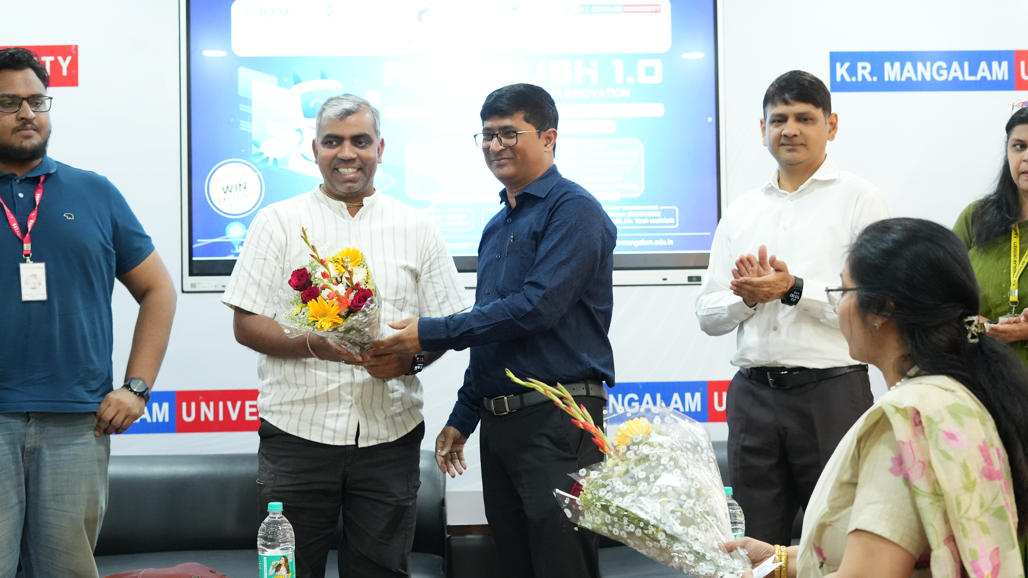
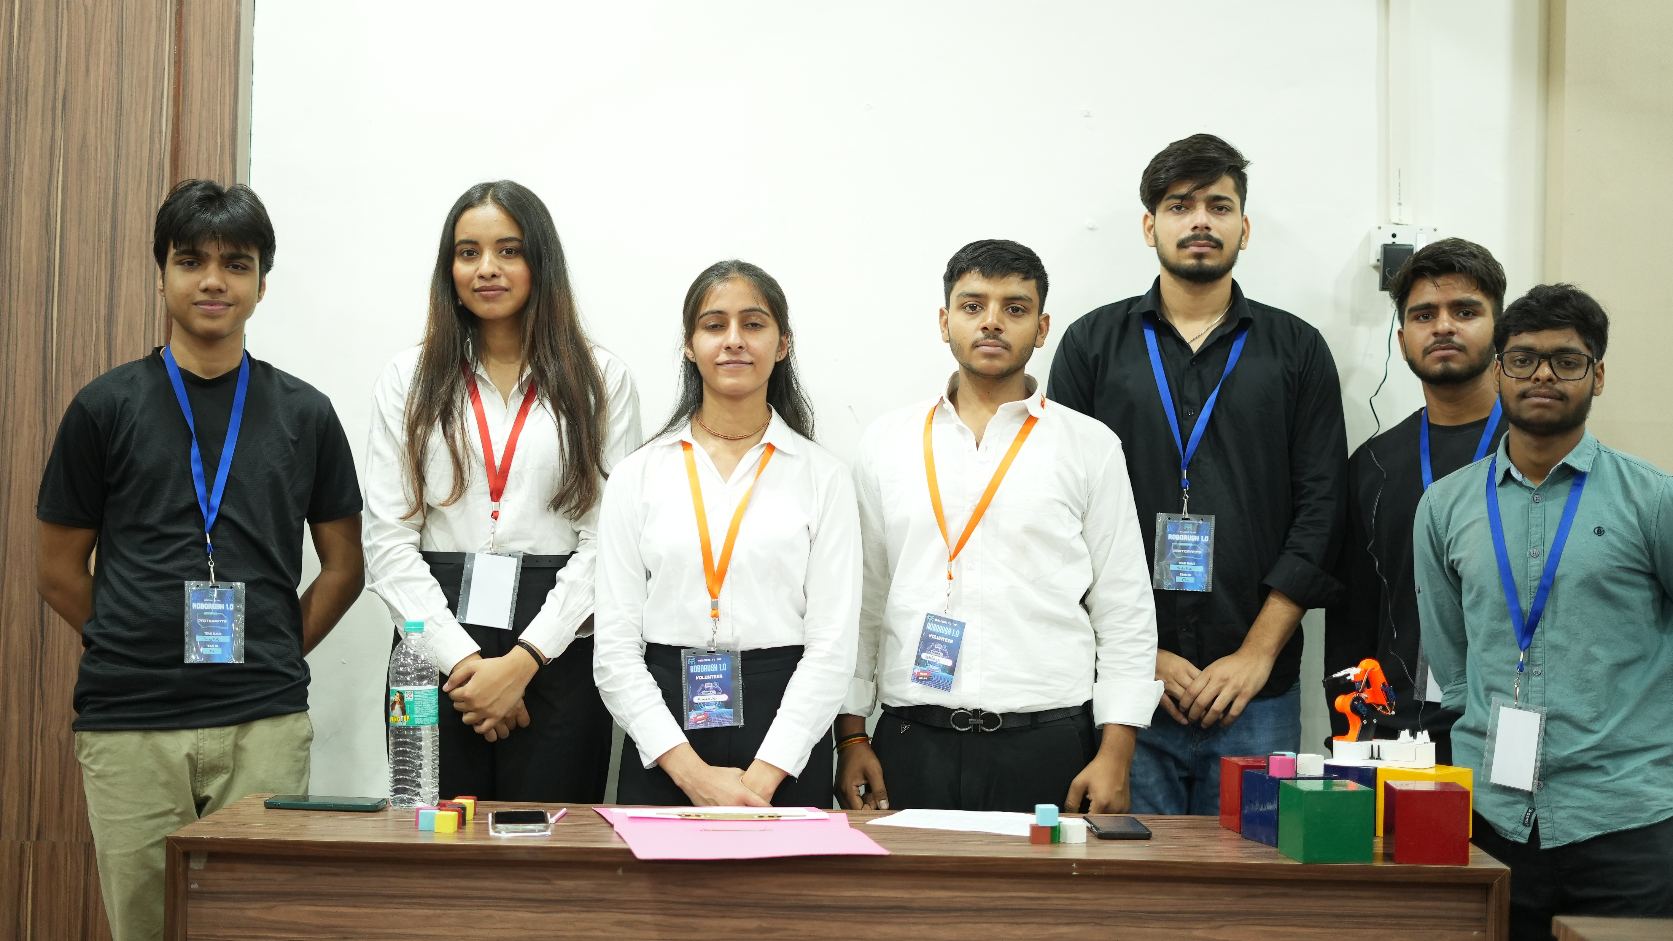
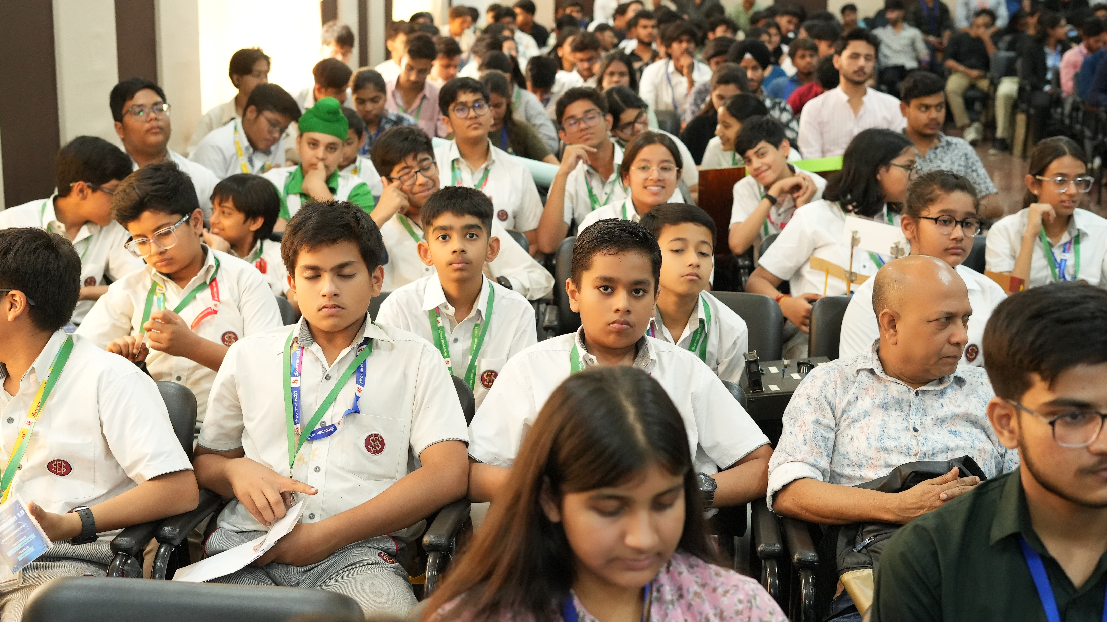
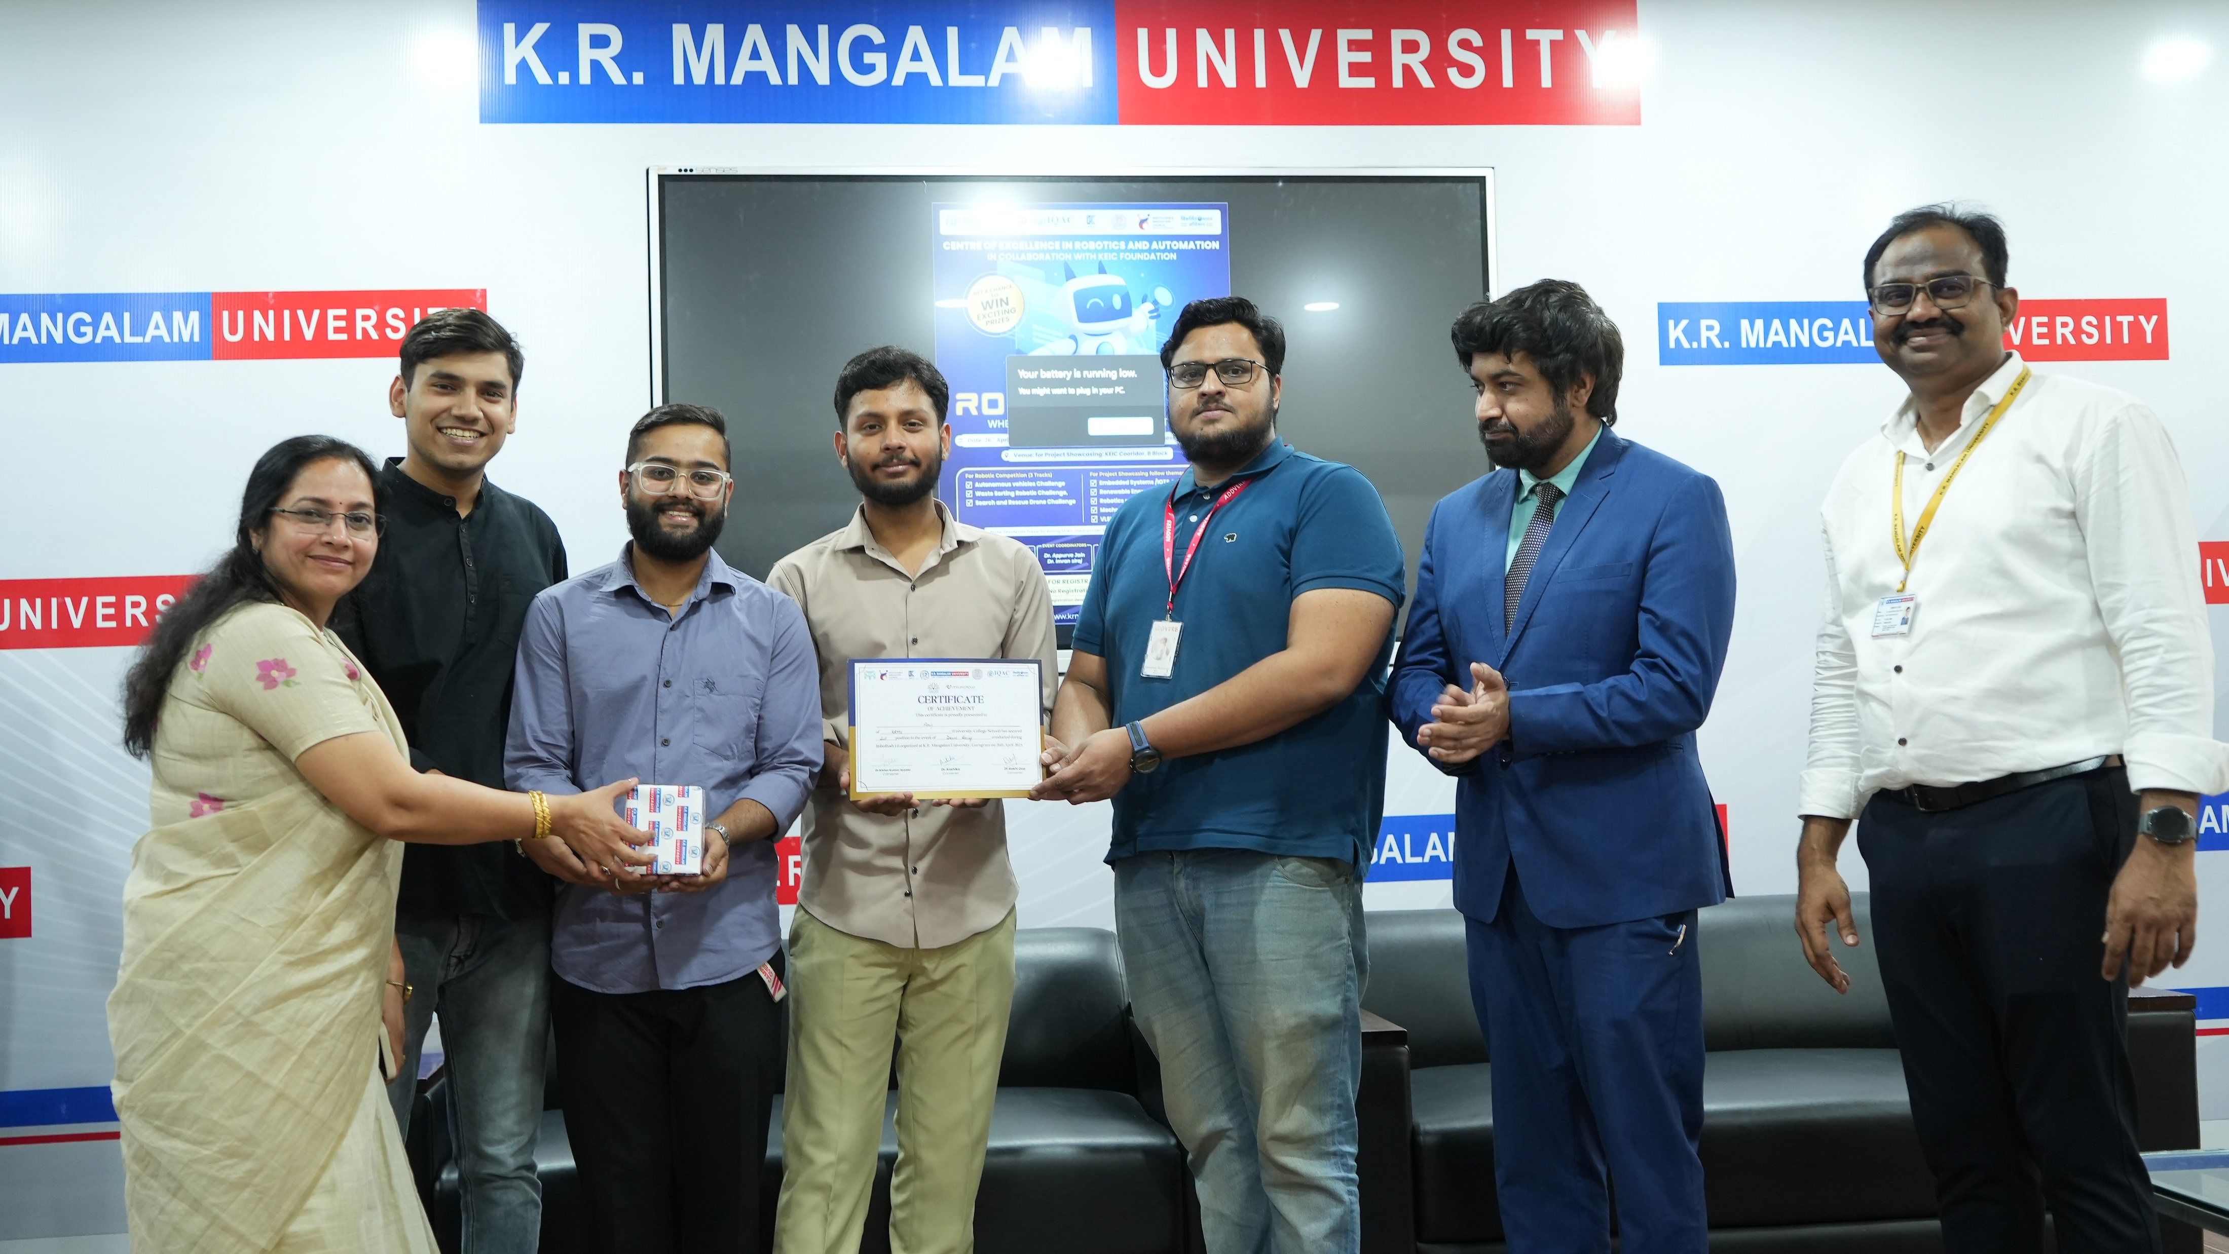
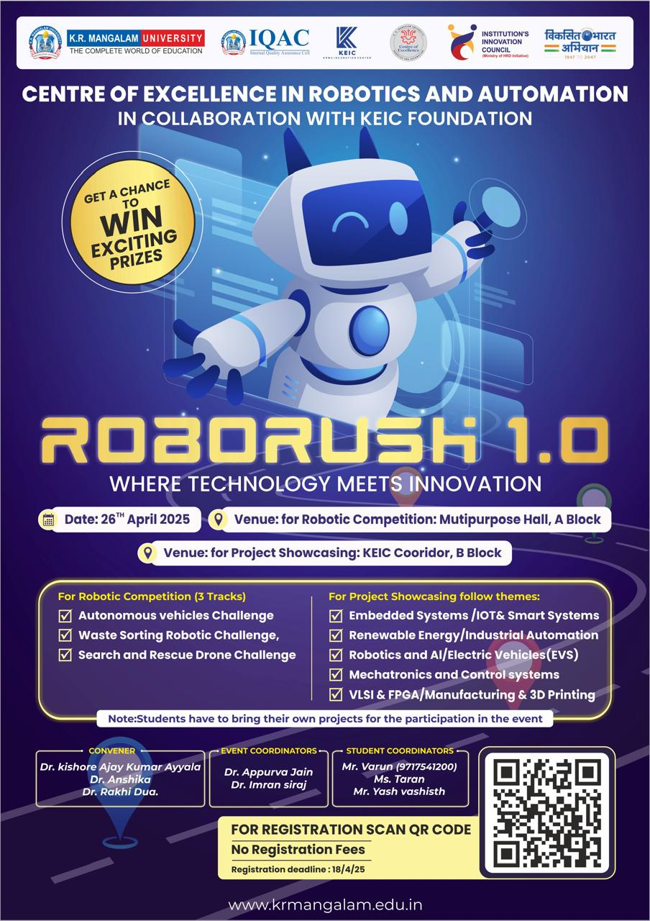
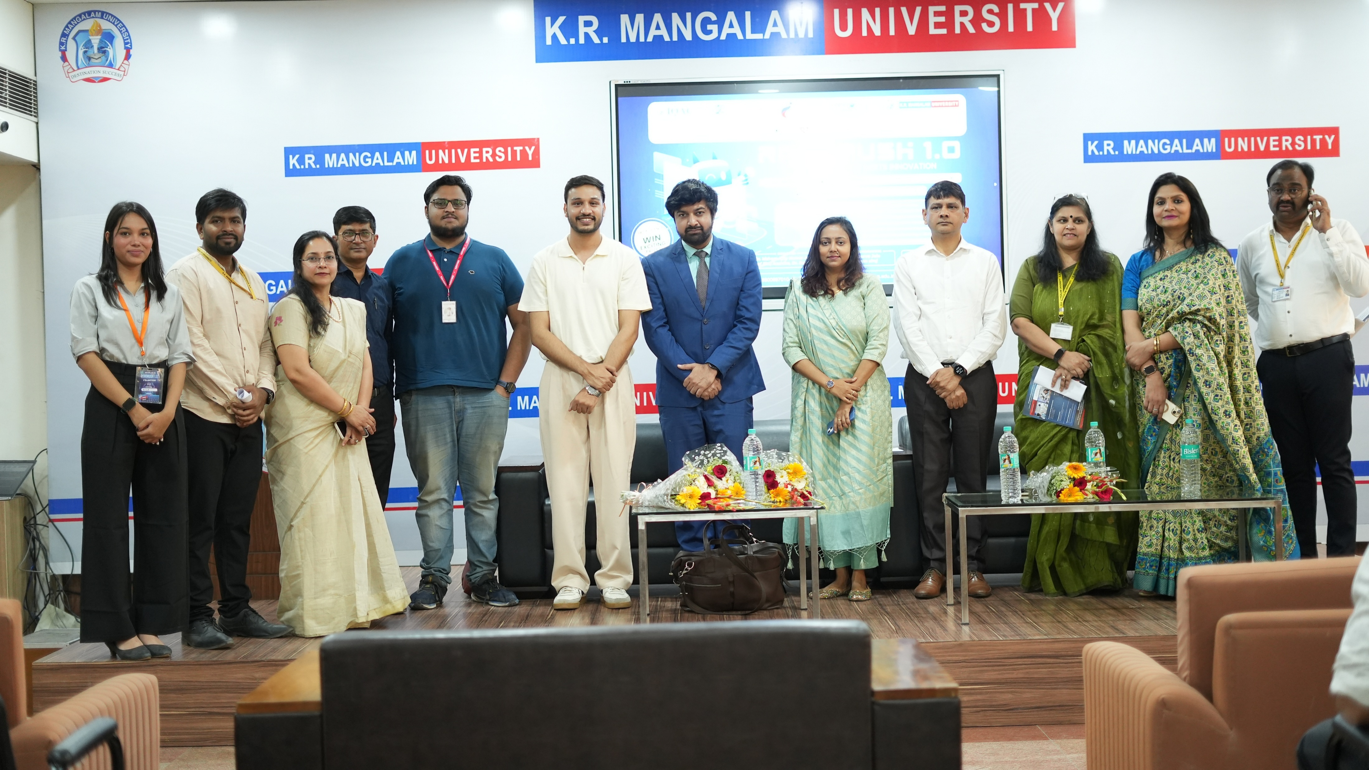
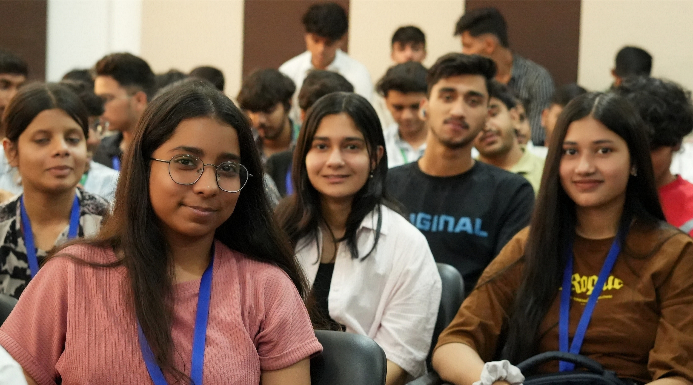
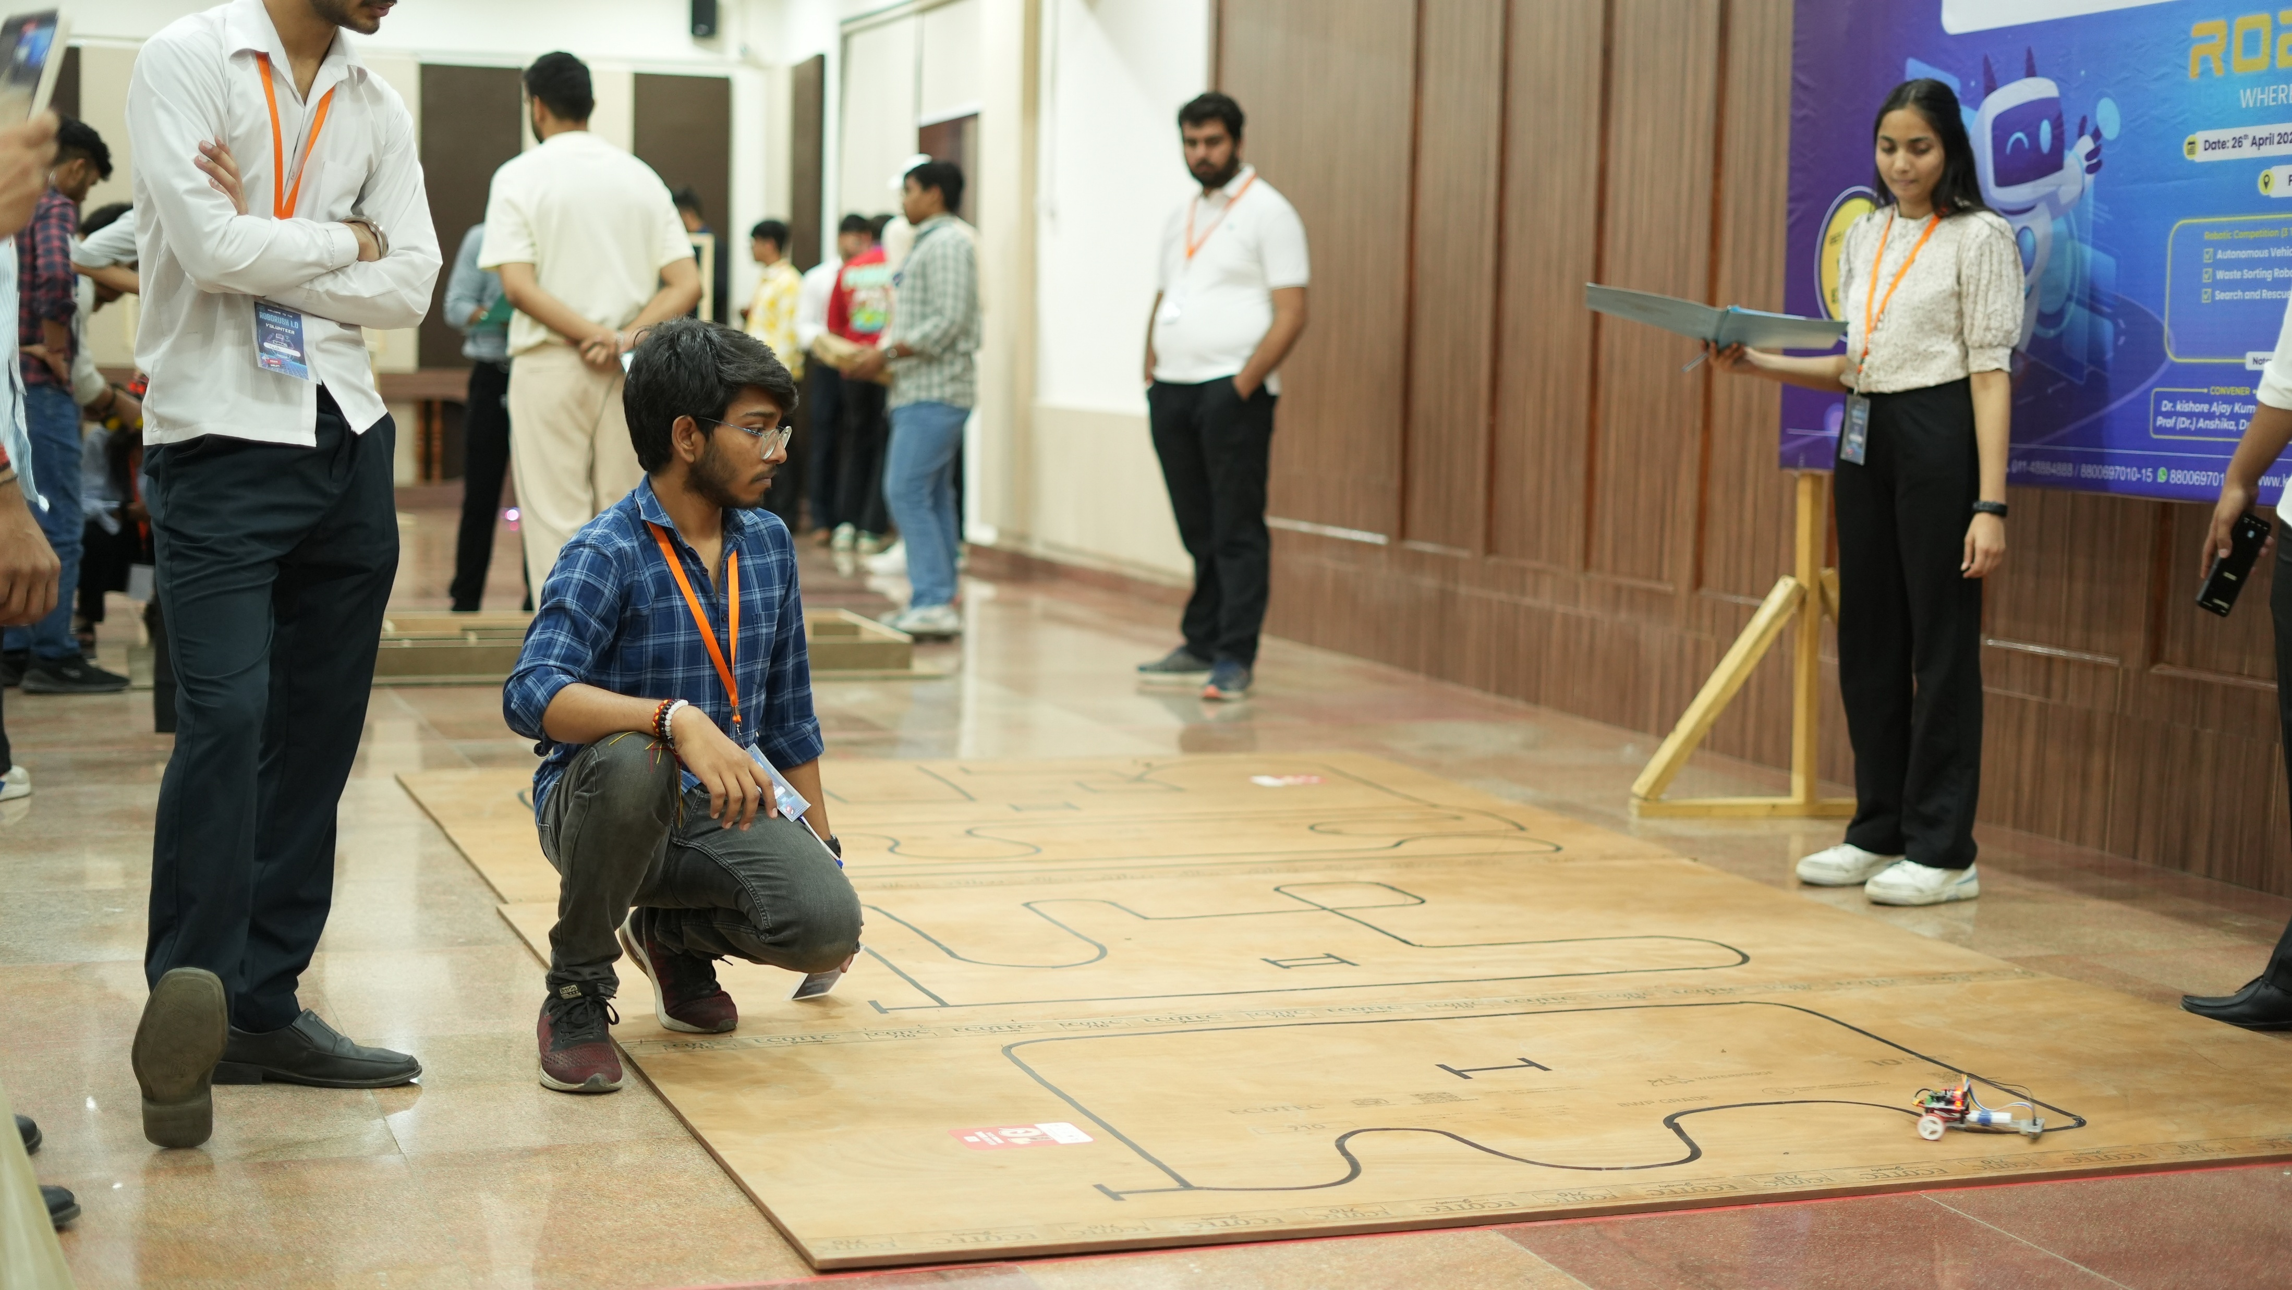
Activities 2024-25

Slide 12
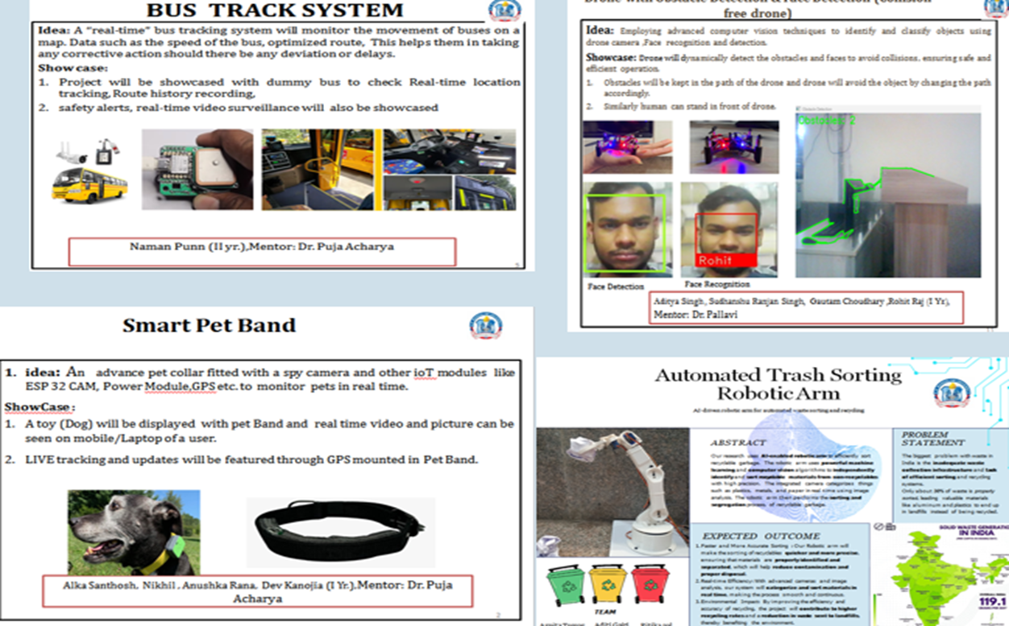
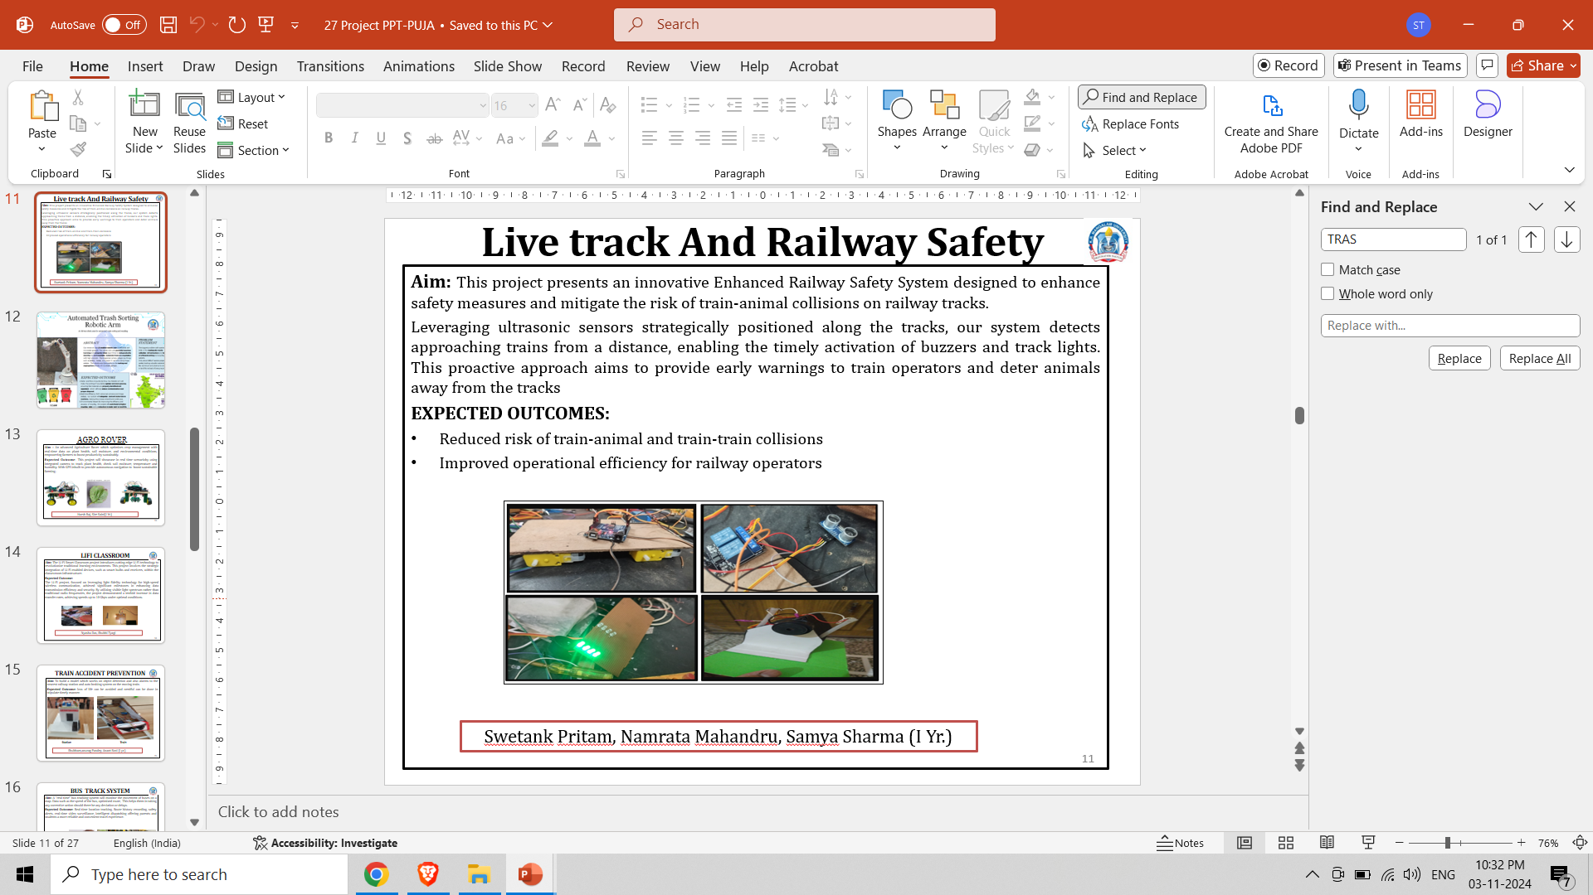
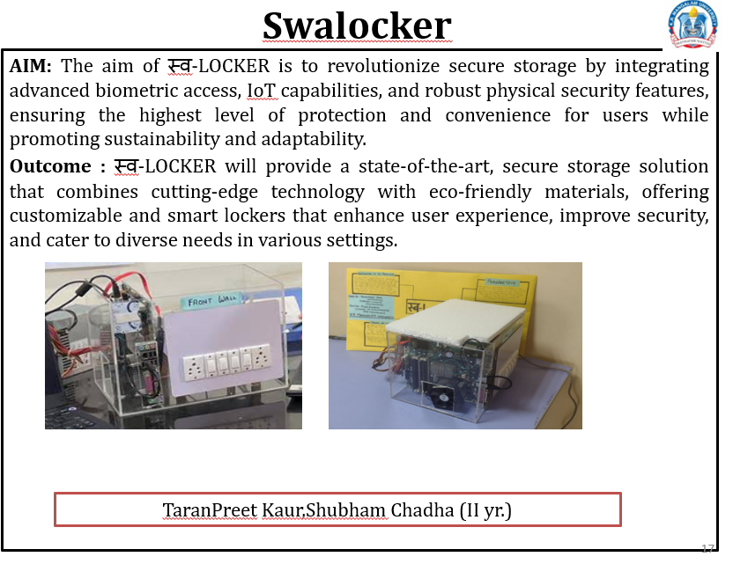
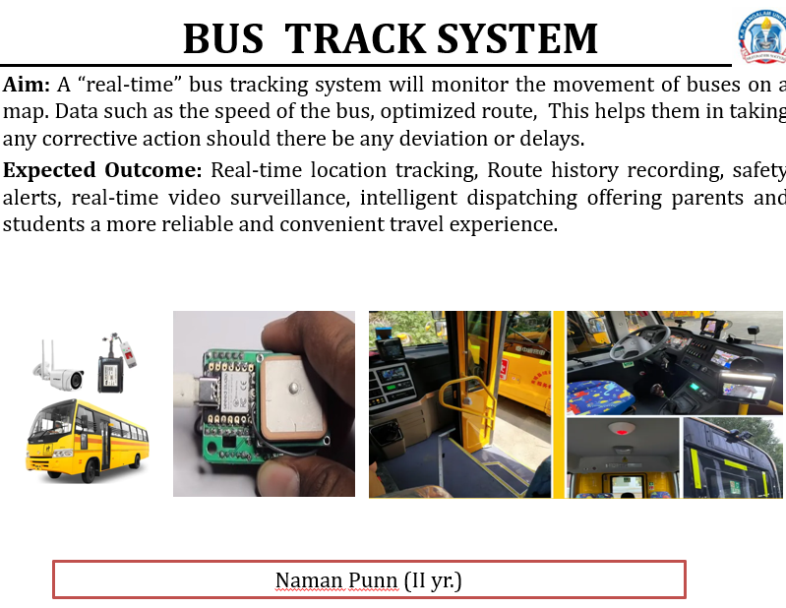
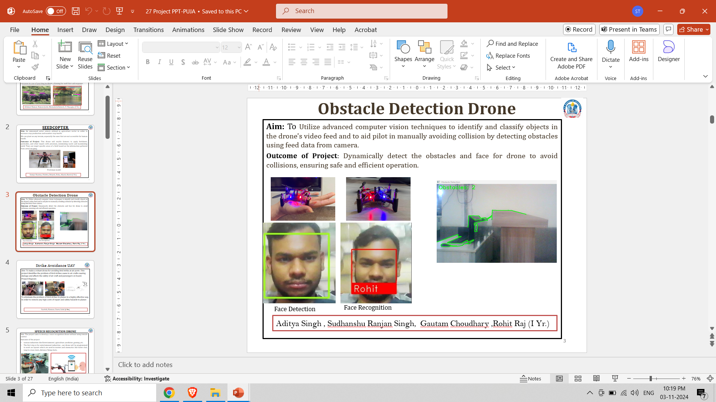
Project Executed

Slide 13
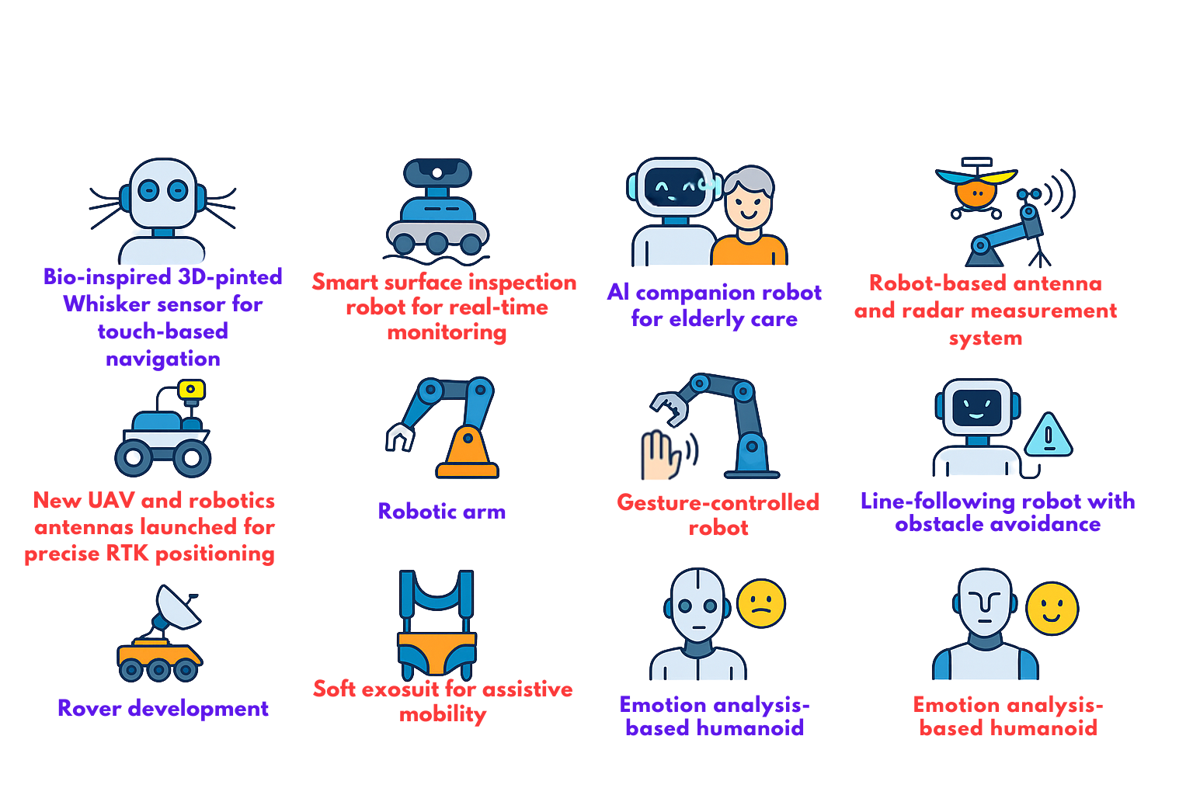
Ongoing Projects

Slide 14
Achievement Awards
Team Name | Name | Project Name | Competition / Conducted By | Award / Position
AeroAI | Vaibhav | Smart Sky | HackKRMU 4.0 – K.R. Mangalam University | 1st Position
 | Yash
 | Diwakar |  | Zenith 4.0 – YMCA (J.C. Bose Institute of Science), Faridabad | 2nd Position
 |  |  | Roborush 1.0 – K.R. Mangalam University | 2nd Position
SYNTAX-SQUAD-001 | Yash Malik | OBSERVO | Hack on Hills 6.0 – NIT Hamirpur | 1st Position (IoT Track)
 | Sneha Sharma
 | Amit Sharma
 | Lavya Kumar Beriwal
Rotors | Anuj | ATRS (Aerial Tactical Response System) | Galgotias University, Greater Noida | 1st Position
 | Krish Agarwal
 | Somya Sharma
 |  |  | IILM University, Gurgaon | 1st Position

Slide 15
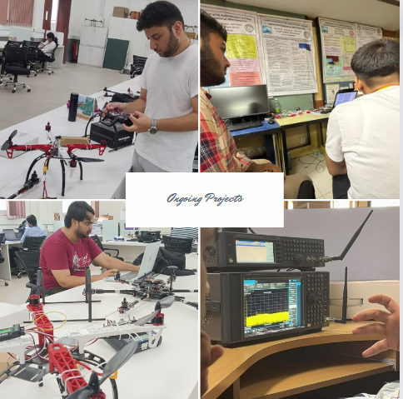
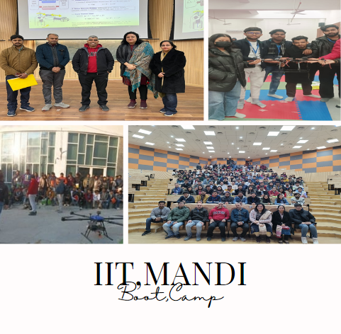
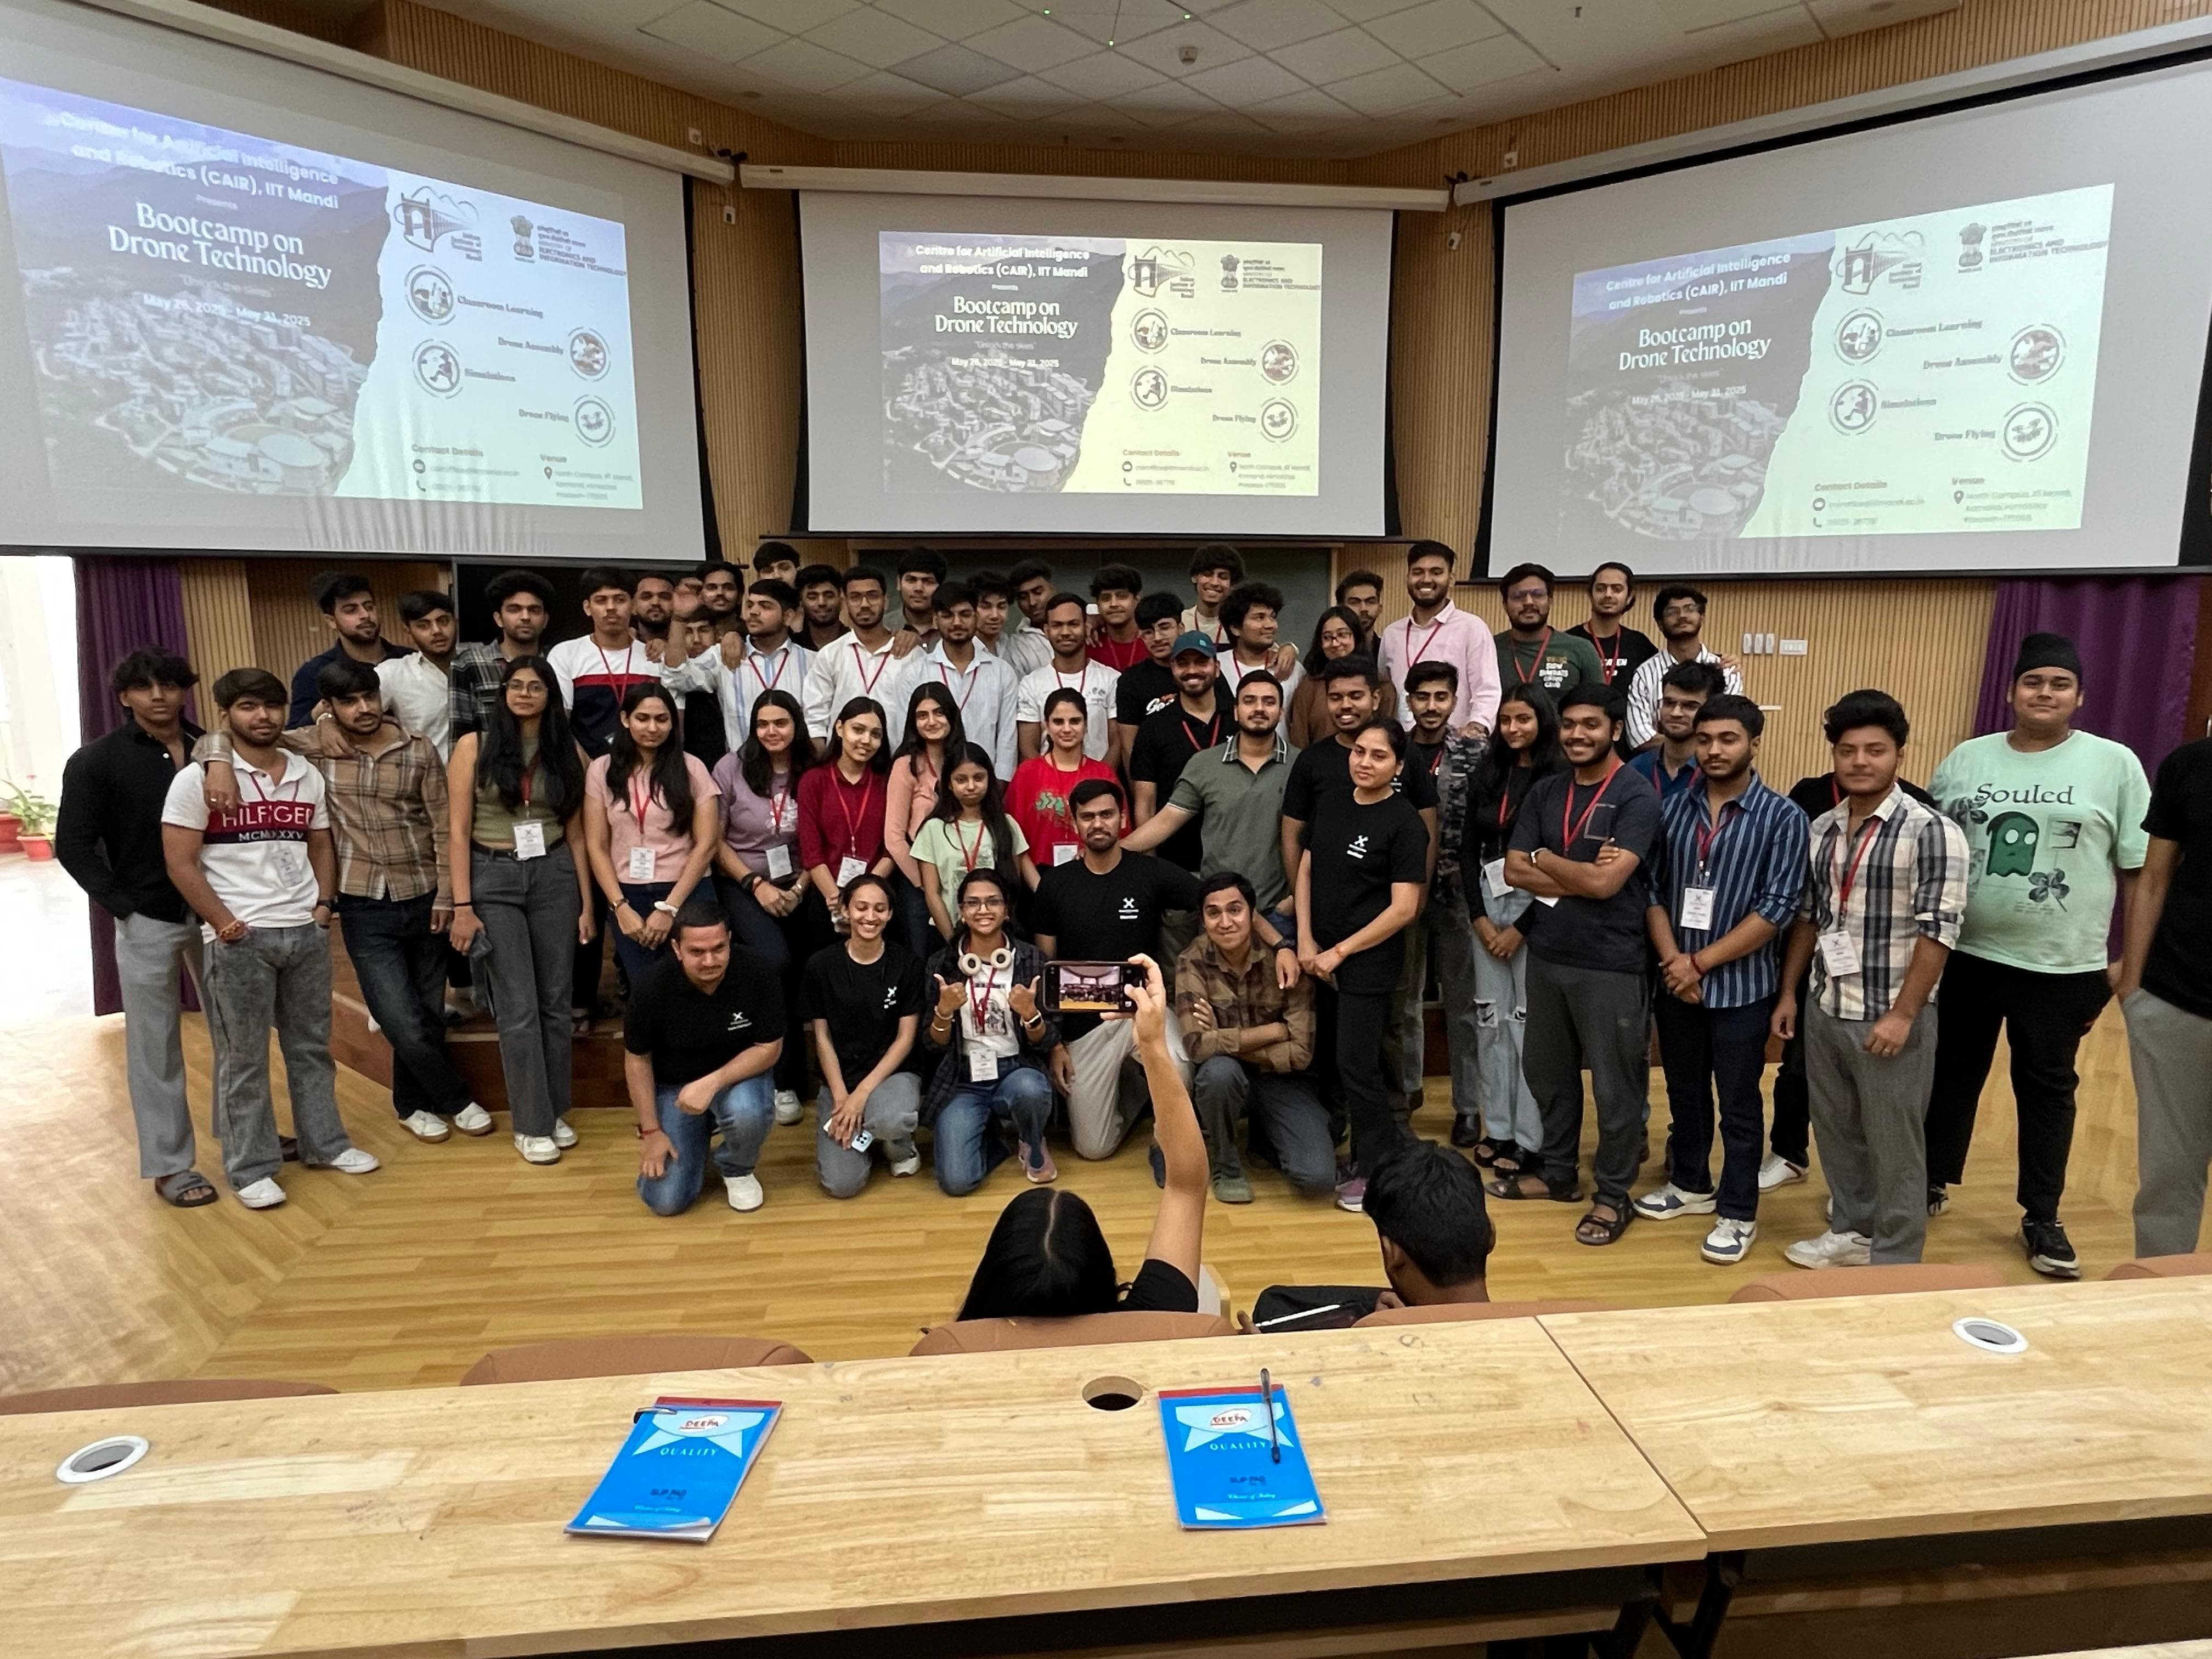
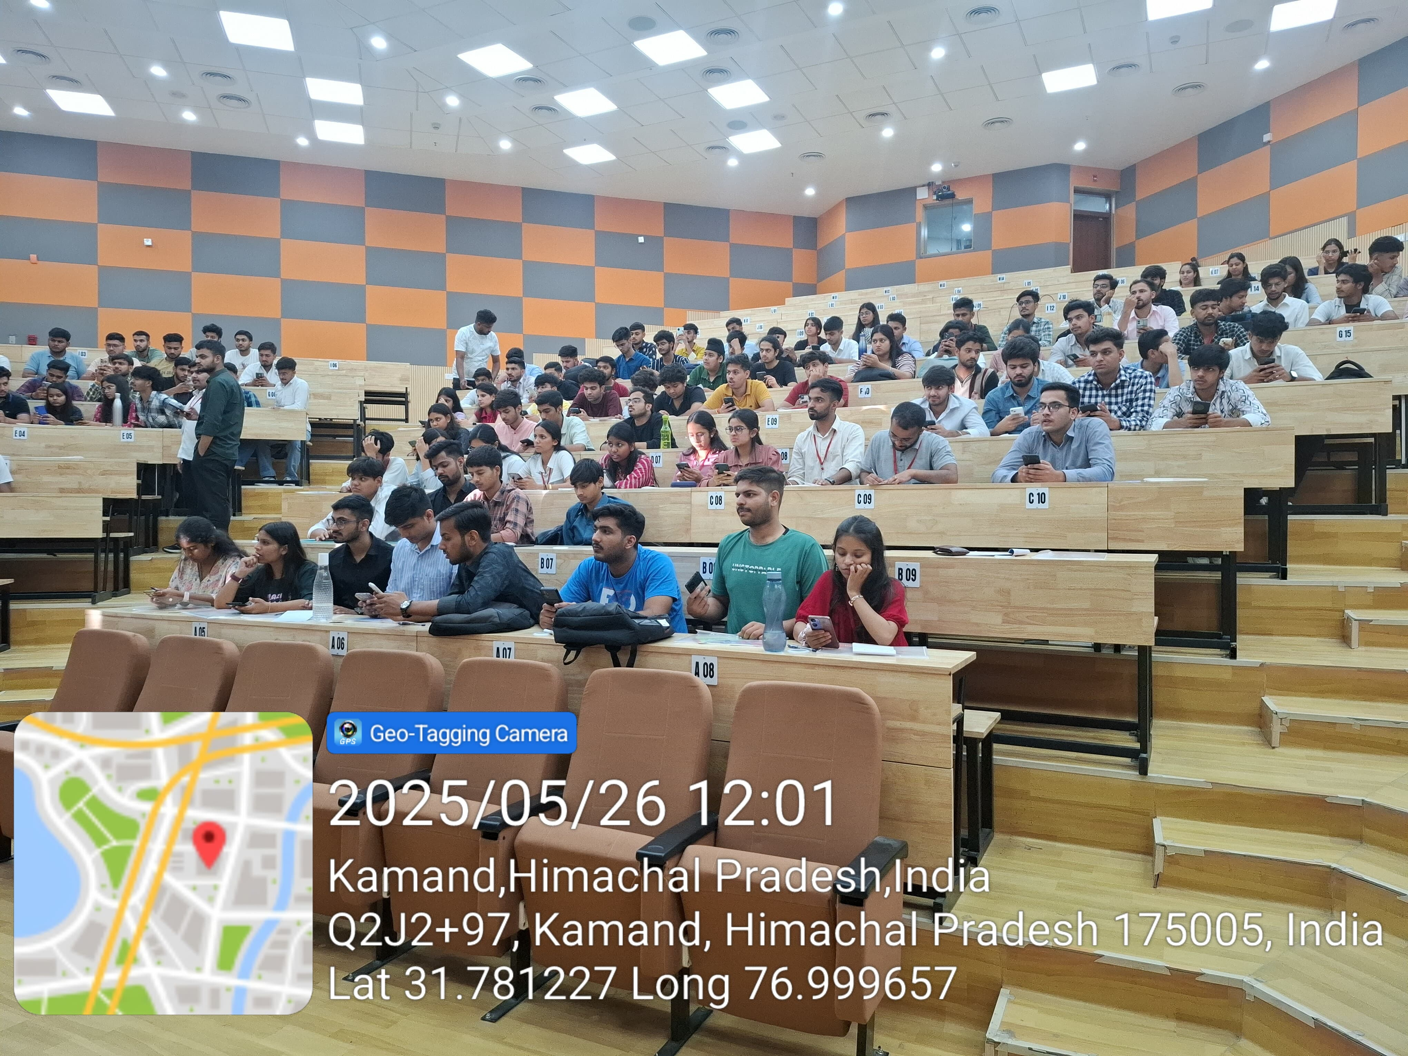
Outcomes & Achievement
Practical exposure to Robotics & Drone Making Bootcamp for K R Mangalam University students at IIT Mandi from 25-30 Dec-2023
150(2024) and 40(2025) Students during the bootcamp received the certificates after successful completion of project followed by test.
4 students completed internships with IIT Gandhinagar conducted by AB6 on Robotics.
Varun topped in program.
10 Student received DGCA Approved Remote Pilot certification in Drones in Small and Medium class ( up to 50 kg of Drone ).
Students during Internship@ IIT Mandi

Slide 16
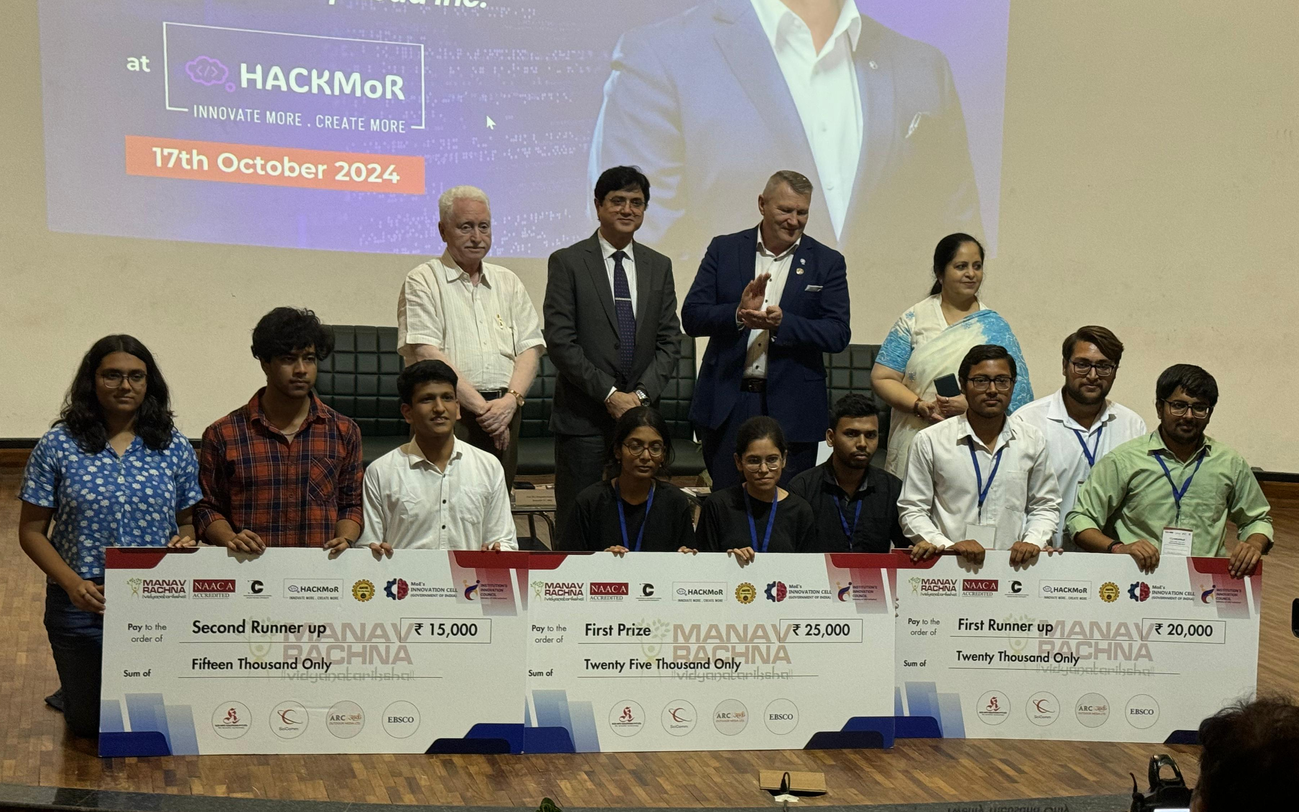
Outcomes After Projects
Incubation
Upgrading Projects
Internship provision
B-TRACK
Drone with EMP Gun
Drone with Radar Spoofing
Face Following Drone
Origami Rescue Bot (Orumbot)
Wall climber Robo car
Smart Sky
ATRS (Aerial Tactical Response System)
Milagrow
More than 40+ students attained free internship from RoboRush 1.0 Event
Electric Vehicles (EV)
Smart AI-Powdered
Waste sorting robot
Robotics & AI
Air purifier
Swalocker

Slide 17



Student Testimonials
Project Title: Lip Synchronization Using OpenCV Project Summary
I used the Wav2Lip model to design a lip synchronization project during my internship at IIT Mandi. I also made a video quality enhancer to boost the final video output. High SSIM and PSNR ratings from this work greatly improved the quality of the footage.
Project Title: Design and Development of Drone Project Summary
During my internship at IIT Mandi, I worked on the assembly and hardware installation of drones. The project involved constructing the drone’s frame, installing motors, ESCs, and other essential electronics and precise alignment of components to optimize performance.
Project Title: Husky UGV Project Summary
During my internship at IIT Mandi, I focused on simulating and controlling the Husky UGV (Unmanned Ground Vehicle) using ROS Noetic and Gazebo. I successfully set up the Husky UGV simulation, created custom environments, and implemented path-planning algorithms like A* and RRT.

Slide 18




Outcomes & Achievement
Publications
Proceedings/Journal: 12
Patent: 2

Slide 19
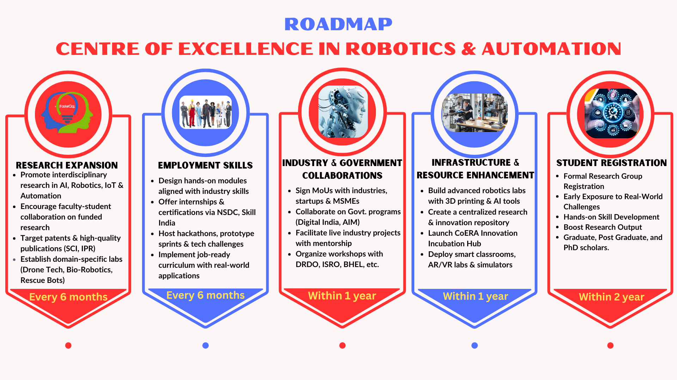
Mapping

Slide 20
Thank you
NAAC Team

