Slide 1


HR@KRMU
Presented
by
Human Resource Department
Notes:
New Courses replaced with New Programmes

Slide 2

HR Dept.
Organizational Chart
Deputy Registrar
(Mr. Deepak Mishra)
Head-HR (Ms. Pooja Sharma)
Recruitment Head (Mr. Sunny Vohra)
Operations Manager - HR & Academic (Mr. Rohit Bhati)
Senior Executive-HR (Mrs. Suman Rawat)
HR Executive (Ms. Ruchi Sharma)
Office Assistant (Mr. Parveen Kumar)
Office Assistant (Mr. Pritam)
HR Executive (Ms. Deepam Sartan)
HR Executive (Ms. Drishti Malik)
Registrar (Dr. Rahul Sharma)
Vice Chancellor
BOM

Slide 3
HR Activities @ KRMU
Recruitment of Teaching & Non-teaching staff
Conduct awareness sessions of HR policies
Performance assessments, Grant of increments, Promotions
Issuance of Appointment letters, Experience letters, Promotion letters, NOCs for various purposes
Management of employees personal files
Processing of resignations including full and final settlements
Monitoring attendance system & Payroll
Recognition and reward
Grievance Handling
Orientation of New Employee
Birthday e-card to employees & monthly celebration
Execution of PF & ESI, Group Insurance
Exit Interview after Resignation
Training & Development

Slide 4
AC Bus transport facility for faculty at nominal rate and free for non-teaching staff
CAS, Annul increment in 2 appraisal cycles (Jan & Jul) & Faculty incentive Scheme
Mental Welbeing Counseling Center
OPD Physiotherapy facilities at nominal rate
Creche facility for Employees kids
20% fee concession to employees on PhD program for employee
15% Fee concession to employees wards for admission in KRMU Courses
Financial support for participation in prestigious academic event
Recreational Facilities (Gym & Sports)
Employee Provident Fund (EPF) & ESI
Group Insurance
Organic Veg mart for employees (subsidised rate)
24x7 Electricity, ATM, Medical & Ambulance facility
Gratuity after 5 years
Staff Welfare Measure
& Material Benefits
Notes:
New Courses replaced with New Programmes

Slide 5

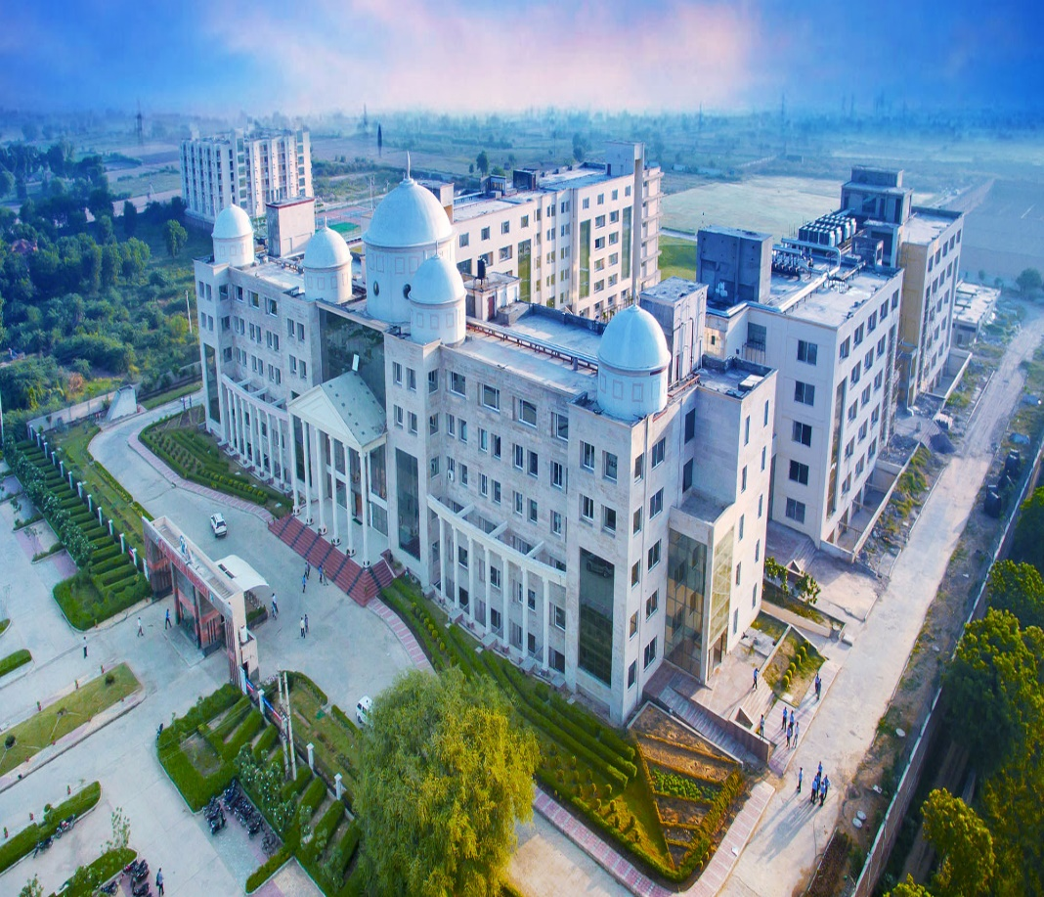
KRMU has implemented an Education Management System like iCloud EMS to digitize its academic & administrative processes.
Employee biometric attendance marking, monitoring & leave management is carried out using iCloud EMS
Detailed training manual will be shared on official email ID
Contact Person : Mr. Rohit Bhati, Manager – HR & Academics, 3rd Floor, Block-A
Email: rohit.bhati@krmangalam.edu.in
Mobile : 9250000543
Notes:
New Courses replaced with New Programmes

Slide 6
HR Policy
Working hours - 7 hours a day from 9.00 am till 4.00 pm on all working days.
2nd, 4th, and 5th Saturdays of the month are working as per regular schedule.
Punch in relaxation in the morning is till 9:10 am.
All members are expected to strictly follow punctuality.
Attendance Marking: Through Biometrics Machines available in Block – A & B & updated through icloud software.
Types of Leave for Employees
Casual Leave
Medical Leave
Earned Leave
Academic Leave
On duty Leave
Short Leave
Note : New employee can avail leaves as per their eligibility only completion of one month from the date of Joining.
Dress Code : - Men: Business Suits, Formal Shirt and Trouser with formal shoes.
Women: Business Suits, Indian Attire: Saree, Suits.
Note : Detailed Leave Policy along with other policies concerned will be shared on New employee official email id

Slide 7

THANK YOU

