Slide 1



Internal Quality Assurance Cell
(IQAC)
WELCOMES
NAAC Peer Team
16-18 JUNE 2025​
Notes:
New Courses replaced with New Programmes

Slide 2

IQAC: Presentation Overview
IQAC Vision and Mission
Quality Policy and Strategic Objectives
IQAC Initiatives and Incremental Improvements in Quality Assurance
Future Roadmap
Composition of IQAC
Functions of IQAC
IQAC Philosophy
Conclusion
IQAC Incremental Improvement Targets (Post Accreditation)
1
Notes:
Glimpses instead of Glimpse

Slide 3

IQAC Vision
Establishment of IQAC: December 2017
To establish and maintain a culture of excellence in interdisciplinary education, research, and innovation by embedding quality assurance practices that support lifelong learning, employability, and socially responsible nation-building.
2
Notes:
Glimpses instead of Glimpse

Slide 4
IQAC Mission
Promote
Promote continuous improvement in academic and administrative processes through robust quality frameworks aligned with cutting-edge technology and global best practices.
Facilitate
Facilitate outcomes-based education and innovative thinking to enhance students' employability, entrepreneurship, and leadership skills.
Foster
Foster collaboration with premier universities, industries, and research centers to meet global standards and expectations.
Instill
Instill ethical values, environmental awareness, and leadership qualities, ensuring the holistic development of the university community.
3
Notes:
Glimpses instead of Glimpse

Slide 5
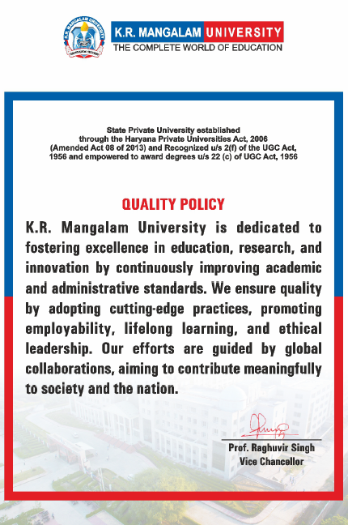
Quality Policy and Strategic Objectives
To design systems and processes to enhance academic and administrative quality.
To execute and oversee academic and administrative initiatives aimed at improving quality.
To act as the nodal agency for coordinating and documenting all activities related to quality assurance, enhancement and sustenance.
To encourage practices that nurture a culture of quality within the institution.
4
Notes:
Glimpses instead of Glimpse

Slide 6
Composition of IQAC
Chairperson | Prof. Raghuvir Singh, Vice-Chancellor
Director | Prof. Tania Gupta, Dean, School of Education
Additional Director | Dr. Deepak Jain
Coordinator | Dr. Shikha Dutt Sharma, Assistant Professor, School of Humanities
Senior Administrative Officers | Dr. Rahul Sharma, Registrar (Ex-Officio) Dr. Vineet Dahiya, Controller of Examination (Ex-Officio) Mr. Anil Chamoli, Finance Officer (Ex-Officio) Dean Academics Dean Research Mr. Deepak Mishra, Deputy Registrar
Teachers | Dr. Meena Bhandari, Professor, School of Basic and Applied Sciences Dr. Seema Raj, Associate Professor, School of Basic and Applied Sciences Dr. Anshul Saluja, Assistant Professor, School of Education Ms. Jyoti Kataria, Assistant Professor, School of Engineering and Technology Mr. Prashant Panwar, Assistant Professor, School of Legal Studies
Management Member | Mr. Manish Jindal
Nominees from Local Society, Students and Alumni | Mr. Ansh Kumar (Roll No: 2206860007) Ms. Kanishka Gupta (Roll No: 1903090001)
Nominee from Employers/Industrialists/Stakeholders | Ms. Shefaly Dutta (Academic Partnership Leader-IBM)
5
Notes:
Glimpses instead of Glimpse

Slide 7
IQAC Philosophy
Quality as Measurable
Define
Deliver
Measure
Compare
Correct
Continuous Improvement
Determine
6
Notes:
Glimpses instead of Glimpse

Slide 8
Functions of the IQAC
Establishing Quality Benchmarks for Curricular, Co-Curricular, Extra-Curricular and Administrative Activities of the Institution
Creating a learner-centric and inclusive environment that promotes quality education
Gathering feedback from stakeholders on institutional quality processes
Disseminating information on quality standards and parameters in higher education
Organizing Workshops, FDP, Seminars and Conferences on quality-related themes
Documenting programs and activities aimed at quality improvement
7
Notes:
Glimpses instead of Glimpse

Slide 9
Functions of the IQAC
Maintain an institutional database to support quality enhancement
Fostering a Quality Culture on Campus
Promoting Research Culture in the Campus
Developing and monitoring quality assurance, sustenance and enhancement strategies for students, staff and alumni
Serving as a coordinating body for quality-related initiatives, including implementing best practices
8
Notes:
Glimpses instead of Glimpse

Slide 10
Curricular Aspects
Phased Implementation of National Education Policy (NEP) 2020 with new programmes being offered under multiple-ENTRY and EXIT options from academic year 2023-24
Introduction of Semester and Credit Based System
Implementation of a Choice-based Credit System (CBCS) from academic year 2019-20
Implementation of Learning Outcome Based Curriculum Framework (LOCF) from academic year 2020-21
Implementation of Outcome Based Education (OBE) from academic year 2021-22
Feedback Mechanism
NEP 2020
SDGs
IR 4.0
Centres of Excellence
Indian Knowledge Systems
Outcome Based Education
Assess, Revise, Enhance
9
Notes:
Glimpses instead of Glimpse

Slide 11
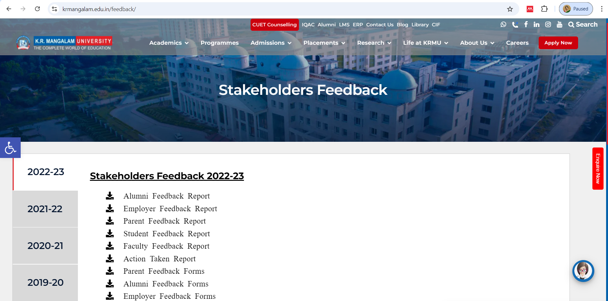
Stakeholder Feedback
https://www.krmangalam.edu.in/feedback/
10
Notes:
Glimpses instead of Glimpse

Slide 12
Feedback Outcomes
Feedback outcomes
Improved Curriculum
Improved Teaching Learning
Industry Ready Curriculum
Increased Employability
Improved Infrastructure
11
Notes:
Glimpses instead of Glimpse

Slide 13
Curriculum Revision and Enrichment
New Courses
Skill Based Courses
Value Added Courses
Interdisciplinary Open Electives
Internships
Research Projects
Entrepreneurship Courses
12
Notes:
Glimpses instead of Glimpse

Slide 14

IQAC Initiative: NEP 2020 Implementation Plan
The National Education Policy (NEP) 2020 Implementing Committee was set up on February 9, 2023.
Strategic Planning and Policy Alignment
Curriculum Reforms and Academic Restructuring
Faculty Training and Capacity Building
Student-Centric Reforms
Monitoring and Evaluation Framework
Documentation and Reporting
13
https://www.krmangalam.edu.in/pdfs/nep-implementation-plan_KRMU.pdf
Notes:
Glimpses instead of Glimpse

Slide 15
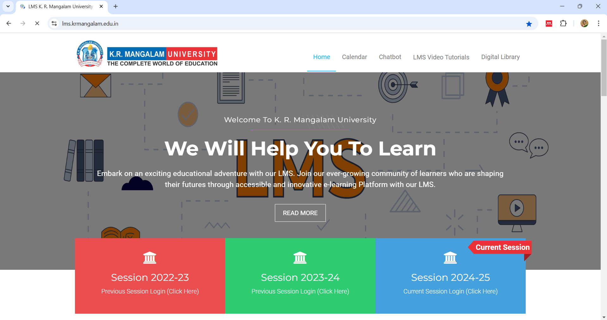
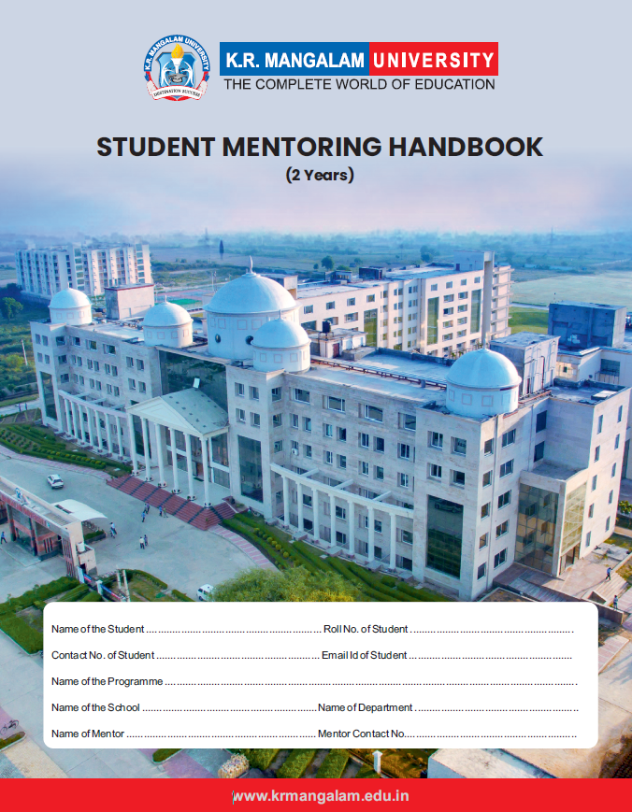
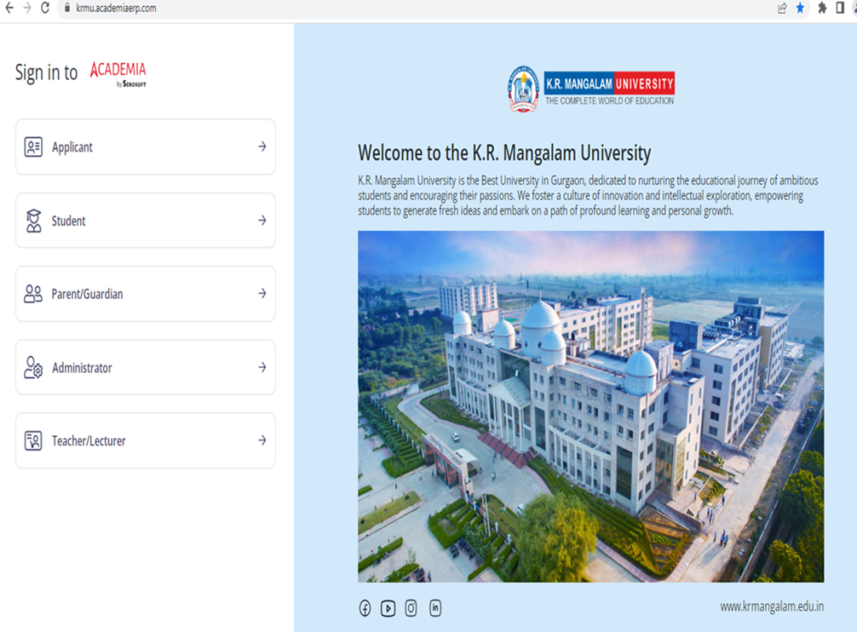
Teaching-Learning and Evaluation
Initiation and Training Support in the implementation of Outcome Based Education (OBE)
Developing Teaching Competency Model and Training Faculty on Skills Enhancement
Leveraging ICT Integration and Support to needs of diverse learners through KRMU LMS-MOODLE
Support in developing a Robust Mentor-Mentee System. University Mentoring Committee
Training and Support to Faculty in Preparing Question Papers that are outcome-based
14
Notes:
Glimpses instead of Glimpse

Slide 16
Research, Innovations and Extension
Research and Innovation
Initiation in Revision in Research Policy
Advocating Establishment of a dedicated Research and Development Cell, IPR, Legal and Ethical Matters Cell, Centres of Excellence, IKC Cell and Gallery, International Relations Office
Extension
Support in Adoption of 05 nearby villages through an MoU with DC, Gurugram Office
Support in organizing impactful Extension Activities and conducting and documenting case studies
Recommendations in Introducing the Research Incentive to Faculty for Quality Publications
Training Support to faculty in development of E-Content for KRMU Moodle and Other Platforms
15
Notes:
Glimpses instead of Glimpse

Slide 17
Infrastructure and Learning Resources
Physical Facilities
Lecture Rooms with Projectors/Smart Panels
IT Support
Digitalization
Library
Rich in textbooks and reference content
Wi-Fi Enabled Campus
CCTV surveillance
Medical Room
Counselling and Well Being Centre
Conference Halls
State of Art Labs and Studios
Central Instrumentation Facility
Improvised cultural and sports facilities
Divyangjan friendly accessible campus
Lecture Capturing System
Multiple Research Databases
E-Journal and e-Books subscriptions
Digital Section
Research Section
Academia by Serosoft: ERP system and now on i-Cloud
Greater use of ICT for administrative and academic purposes
Online Attendance and Result
Robust website periodically updated
Online Grievance Redressal
16
Notes:
Glimpses instead of Glimpse

Slide 18
Student Support and Progression
Support to various schools in organizing Guidance for Competitive Examinations and career counselling sessions
Creating a nurturing ecosystem for experiential and enhanced Students participation through activities organized by Clubs and Societies, Tech Fests, Cultural and Sports Events
Advocating and Support in establishing a Dedicated Counseling for Mental Health and Well Being-We Dost
Support in networking with Alumni and strengthening their engagement and reunions
17
Notes:
Glimpses instead of Glimpse

Slide 19
Structured Framework for Documentation
Approval and Documentation Process
Committees Documentation
Event Execution
18
Notes:
Glimpses instead of Glimpse

Slide 20
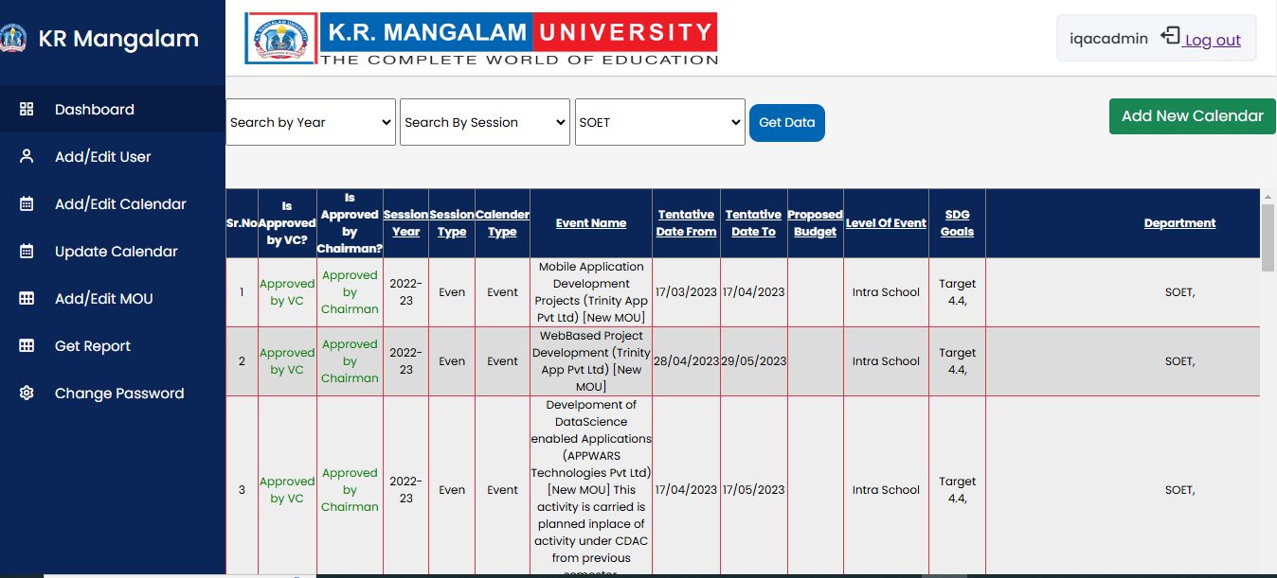
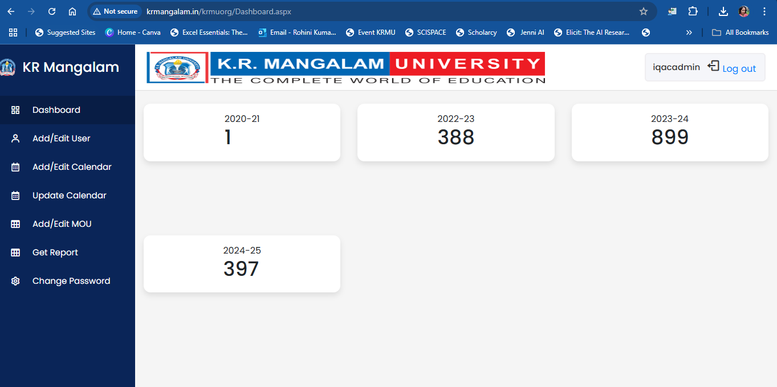
Automation of Documentation Repository
EXPERENTIAL LEARNING CALENDARS PREPARED FOR EACH SEMESTER
INTERNAL AUDITS
19
Notes:
Glimpses instead of Glimpse

Slide 21


Magazine and Newsletters0
University Annual Magazine
University Quarterly Newsletter
School Quarterly Newsletter
https://www.krmangalam.edu.in/happenings/magzine-reflections/
https://www.krmangalam.edu.in/krmu-times/
https://www.krmangalam.edu.in/school-of-humanities/
20
Notes:
Glimpses instead of Glimpse

Slide 22
Governance, Leadership and Management
Effective Functioning through Committees
Strategic Planning and Review Mechanism
NEP 2020 Implementation in a Phased Manner
E-Governance
Intellectual Capital
21
Notes:
Glimpses instead of Glimpse

Slide 23
Academic and Administrative Audits (AAA)
22
Notes:
Glimpses instead of Glimpse

Slide 24
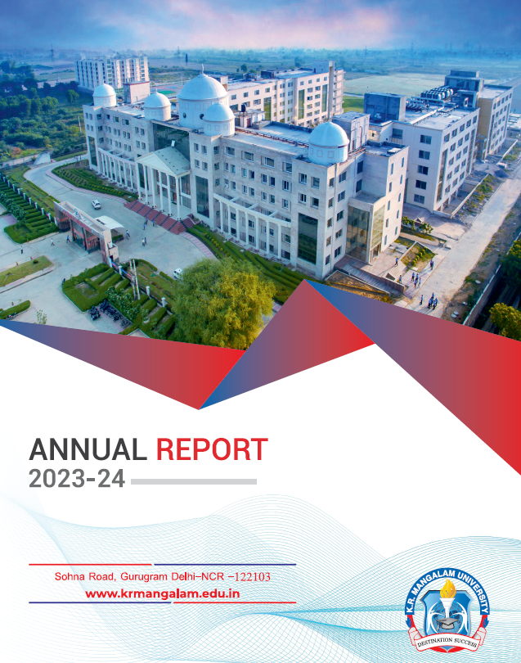
Annual Reports
https://www.krmangalam.edu.in/mandatory-disclosures/
23
Notes:
Glimpses instead of Glimpse

Slide 25


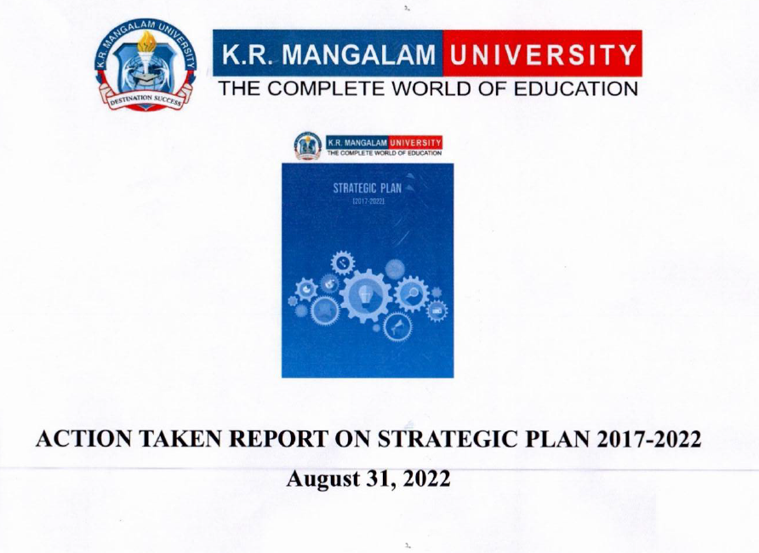
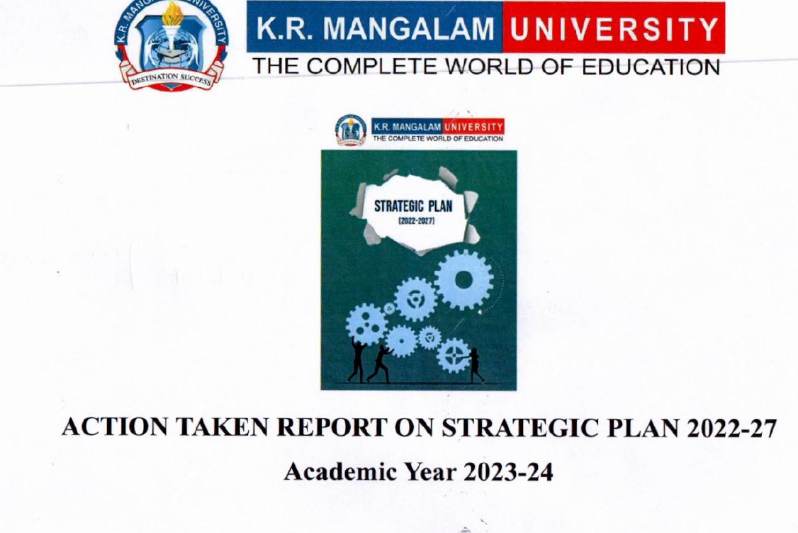
Strategic Plan
https://www.krmangalam.edu.in/iqac/
24
Notes:
Glimpses instead of Glimpse

Slide 26


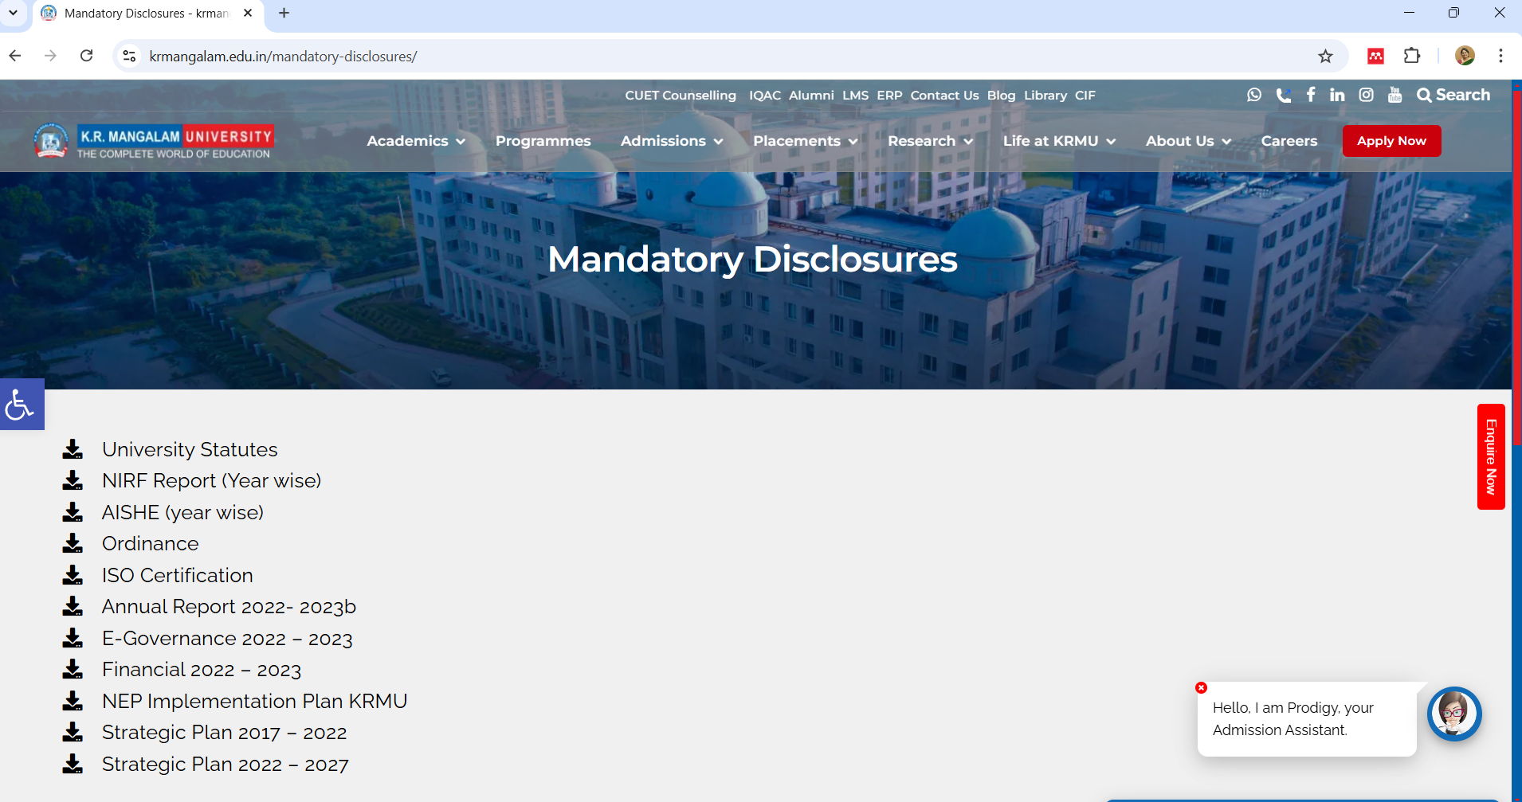
AISHE
https://www.krmangalam.edu.in/pdfs/md/AISHE-2022-23.pdf
25
Notes:
Glimpses instead of Glimpse

Slide 27
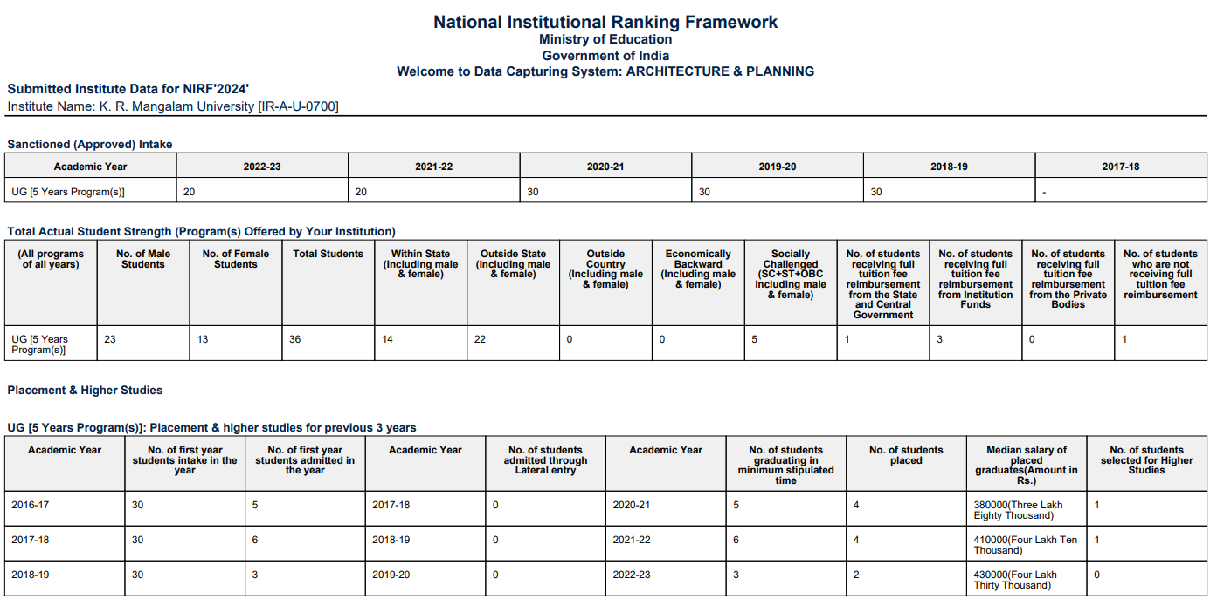

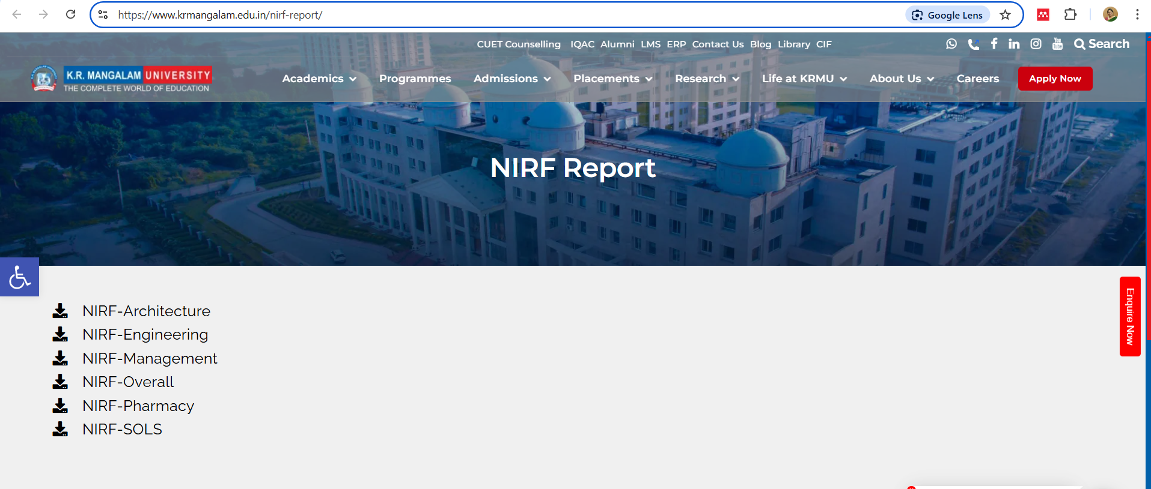
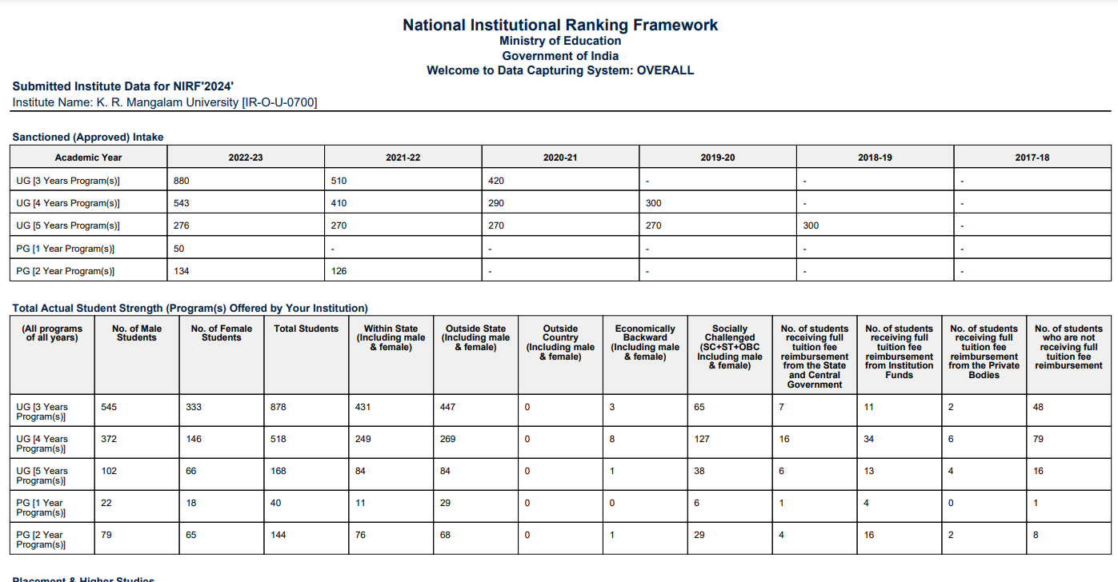
NIRF
https://www.krmangalam.edu.in/nirf-report/
26
Notes:
Glimpses instead of Glimpse

Slide 28
Institutional Responsibilities and Best Practices
Promotion of Facilities for Women on Campus for their Safety and Security, Gender Audits
Conducting Training and Sensitization Programmes related to Gender Issues, Constitutional Obligations, Code of Conduct and Professional Ethics
Advocating creation and augmentation in facilities to create an inclusive Divyangjan Friendly Barrier Free Access to Campus
Monitoring Sustainable Practices through Audits on Environment and Energy
Best Practices and Institutional Distinctiveness
27
Notes:
Glimpses instead of Glimpse

Slide 29
IQAC Initiatives: Conferences / Seminars / Workshops on Quality
Seminar on Total Quality Management in Education on June 1, 2023
Workshop on Examination Reforms on November 12, 2022
Sustainability, Climate, Equity Our Tomorrow needs Us Today on July 21, 2022
Preparation for Future Modes of Teaching-Learning on June 14, 2022
Patenting a Research and Innovations-the procedural aspects with specimens on June 29, 2022
28
Notes:
Glimpses instead of Glimpse

Slide 30
IQAC Initiatives: Conferences / Seminars / Workshops on Quality
Research Funding and International Cooperation from DST on June 11, 2022
Workshop on Research Methodology- Preparing an Effective Research Proposal on May 4, 2022
Research Methodology, Best Practices and Projects on April 5, 2022
Patenting a Research and Innovations-the procedural aspects with specimens on June 29, 2022
Interactive Workshop on NAAC- Awareness on November 20, 2021
29
Notes:
Glimpses instead of Glimpse

Slide 31
IQAC Initiatives: Conferences / Seminars / Workshops on Quality
How to write a funded Proposal on September 25, 2021
Innovative Teaching and Learning Practices on July 17, 2020
E-content Development for MOOC on May 28, 2020
Value Education: Dire Need of the Hour on February 18, 2020
30
Notes:
Glimpses instead of Glimpse

Slide 32
IQAC Initiatives: Collaborative Quality Initiatives with Other Institutions
Session on Angel investment and funding opportunities for early age entrepreneurs under the aegis of IIC on June 5, 2023
Faculty Development Plan on MOOC and e-Content Development from April 29- May 5, 2023 in collaboration with Teaching Learning Centre, Guru Angad Dev College, University of Delhi
31
Notes:
Glimpses instead of Glimpse

Slide 33
IQAC Initiatives: Collaborative Quality Initiatives with Other Institutions
Problem-Solving and Ideation on November 30, 2022 in collaboration with KEIC- KRMU and Institution Innovation Council (IIC)
Panel Discussion on Role of Teacher as envisaged in NEP-2020 on September 5, 2022
32
Notes:
Glimpses instead of Glimpse

Slide 34
IQAC Initiatives: Collaborative Quality Initiatives with Other Institutions
Faculty Development Program on "National Education Policy (NEP 2020): New Reforms in Higher Education" from July 27-August 2, 2022 in collaboration with the Council for Teacher Education Foundation Delhi-NCR Chapter
Seminar on Intellectual Property Right with focus on copyright and patent on April 9,2022
33
Notes:
Glimpses instead of Glimpse

Slide 35
IQAC Initiatives: Orientation Programmes Conducted on Quality Issues for Teachers and Students
Orientation Session on CO-PO Mapping on April 8, 2023
Orientation Program on Quality and Excellence in Higher Education Vis-à-Vis Institutional Preparedness for National Education Policy (NEP) on January 28, 2023
Training for Conducting Inquiries for ICC on November 10, 2022
34
Notes:
Glimpses instead of Glimpse

Slide 36
IQAC Initiatives: Orientation Programmes Conducted on Quality Issues for Teachers and Students
Orientation Program on "Role of IQAC and Good Documentation Practices" conducted on October 8, 2022
NAAC Awareness Programme on March 14, 2020
Education Summit titled Towards Meaningful Education: Redefining Goal and Pedagogies on December 23, 2019 at India International Centre, Lodhi Road, New Delhi
35
Notes:
Glimpses instead of Glimpse

Slide 37
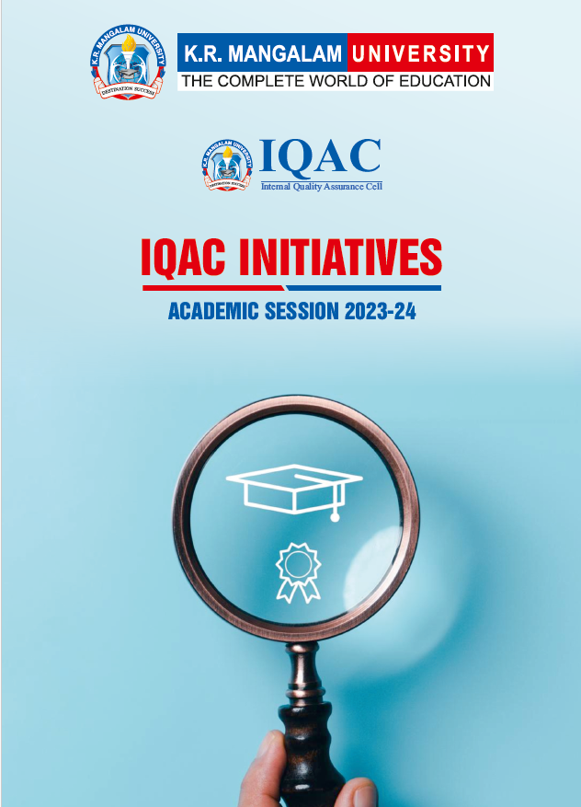
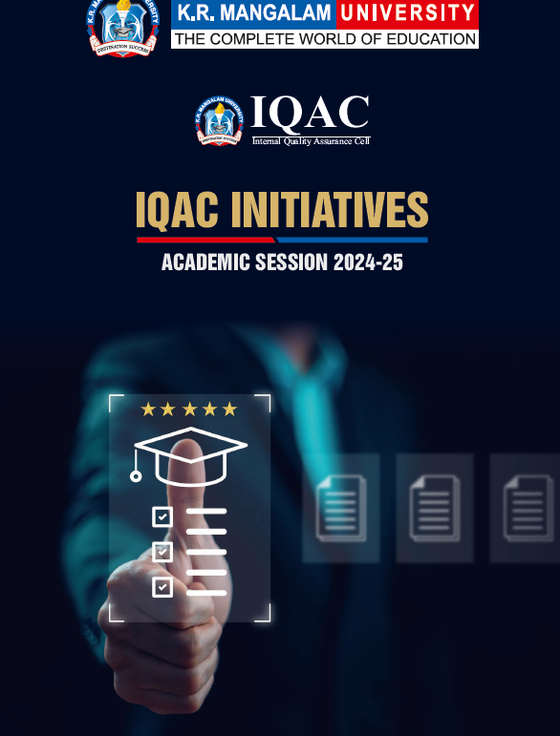
IQAC Initiatives: 2023-24 & 2024-25
36
Notes:
Glimpses instead of Glimpse

Slide 38


Audits: ISO Certifications
37
https://www.krmangalam.edu.in/iqac/
Notes:
Glimpses instead of Glimpse

Slide 39


Audits: Recognition Certificates
38
https://www.krmangalam.edu.in/iso-certification/
Notes:
Glimpses instead of Glimpse

Slide 40

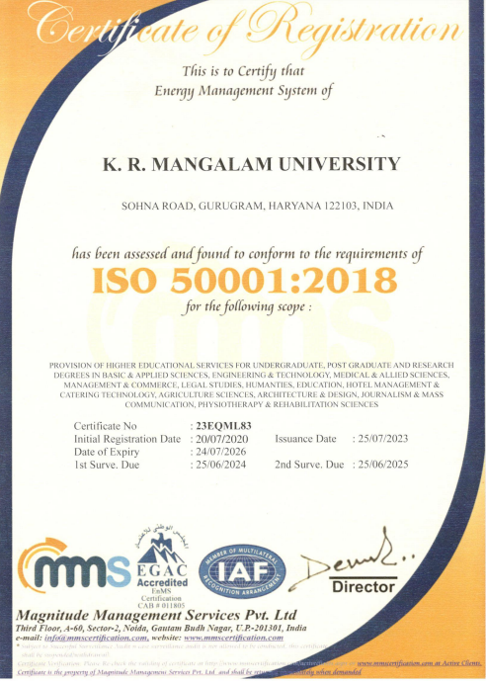
Audits: Recognition Certificates
39
https://www.krmangalam.edu.in/iso-certification/
Notes:
Glimpses instead of Glimpse

Slide 41
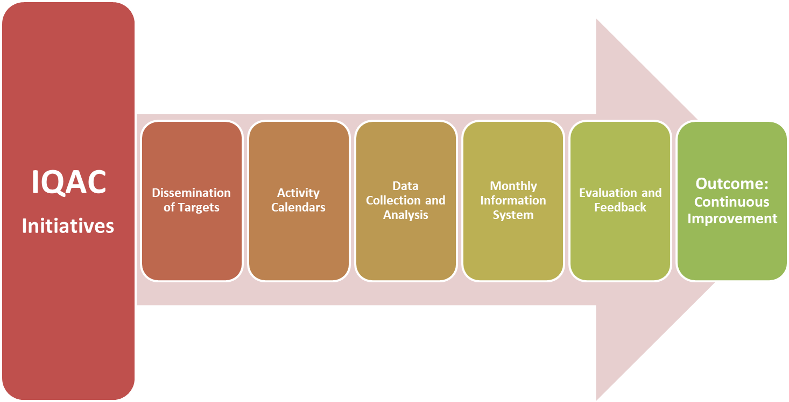
Conclusion: Role of IQAC in Fostering Quality Enhancement
40
Notes:
Glimpses instead of Glimpse

Slide 42
Future Roadmap
Enhancement in the number of Training Programmes on Quality Aspects for the faculty and staff.
Publishing a University Journal of Multi-Disciplinary Studies in academic session 2025-26 and getting it listed in UGC- Care List by academic session 2026-27.
Developing a Manual on Professional Standards for Teachers of K.R Mangalam University according to National Professional Standards for Teachers (NPST) developed by NCTE in session 2025-26.
Securing an improved University NIRF ranking by session 2025-26.
Applying and Securing various prestigious rankings and recognitions in a phased manner.
41
Notes:
Glimpses instead of Glimpse

Slide 43
IQAC Incremental Improvement Targets (Post-Accreditation)
Curriculum Enhancement: Review & Revise 100% curricula every 3 years with industry and academic feedback.
Teaching-Learning Reforms: Ensure 100% faculty undergo annual training in OBE, blended learning, and digital tools, Automation of Mentoring Records Digitally, Develop e-content for 60% of all courses and upload to LMS or institutional repository.
Research Innovation and Extension: Increase Scopus/UGC-CARE indexed publications by 15–20% per year.
Infrastructure & Learning Resources: Ensure annual library enrichment with minimum 10% growth in e-resources.
42
Notes:
Glimpses instead of Glimpse

Slide 44
IQAC Incremental Improvement Targets (Post-Accreditation)
Student Support & Progression: Set up a career readiness program reaching 100% final-year students annually, Review and update Strategic Plan KPIs annually with mid-year progress reports.
Governance, Leadership, and Management: Conduct internal academic and administrative audits every semester.
Institutional Values & Best Practices: Document and implement 2 new best practices per year with measurable outcomes, Ensure 100% faculty and student participation in environmental and gender equity drives, Become a green, paperless, and digitally inclusive campus by 2027.
43
Notes:
Glimpses instead of Glimpse

Slide 45
Thank You
44
Notes:
Glimpses instead of Glimpse

