Slide 1



Central Library
Welcomes
NAAC Peer Team
16-18 June 2025
Presented by: Dr. Helaluddin, University Librarian
Notes:
New Courses replaced with New Programmes

Slide 2

Index Summary
Library Infrastructure
Library Sections
Library Management Software (LMS)
Print Resources
Digital Resources
Services
Utilization
Other Activities

Slide 3
Library Infrastructure
Area : 1457 Sq. Mtr. (15683 Sq. ft.)
Computers : 67
Digital Library Computers : 35
OPAC Computers : 05
Research Center Computers : 10
Library Automation Software : Koha ( Ver. 22.05.03.000)
Printers : 03
Barcode Readers : 04
CCTV Cameras : 20
Smart Interactive Panel : 02

Slide 4
Library Sections
Acquisition Section
Technical Section
Processing Section
Circulation Section
Periodical Section
Reference Section
Digital Section
Research Center
User Assistance
Maintenance Section
Archival
SOP
(Standard Operating Procedure)
Library Policy

Slide 5
Library Committee Mo
Sr. No. | Name of the faculty member | Designation | Member type
1 | Dr. Prakash Chandra Jena | Professor, SOED | Chairman
2 | Dr. Inderpreet Kaur Saggu | Associate Prof., SOLS | Member
3 | Ar. Praveen Gupta | Associate Prof., SOAD | Member
4 | Dr. Saleem Ahmad | Assistant Prof., SOHS | Member
5 | Dr. Saroj Yadav | Associate Prof., SMAS | Member
6 | Dr. Mohammed Nizamuddin | Assistant Prof. SOMC | Member
7 | Dr. Archana Goyal | Assistant Prof. SOET | Member
8 | Dr. Neha Sharma | Assistant Prof. SOAS | Member
9 | Dr. Aaquib Anwar Butt | Assistant Prof. SJMC | Member
10 | Ms. Mamta Shankar | Associate Prof. SPRS | Member
11 | Dr. Helaluddin | University Librarian | Member Secretary
Meets twice in a year: March & November

Slide 6
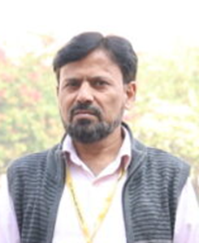
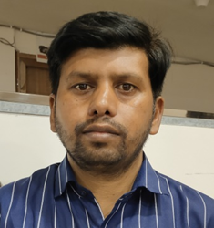
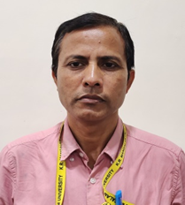
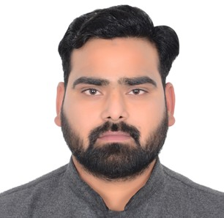
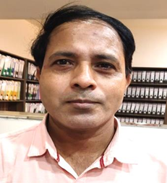
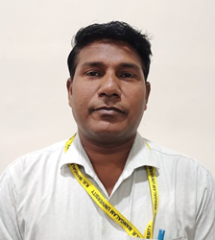
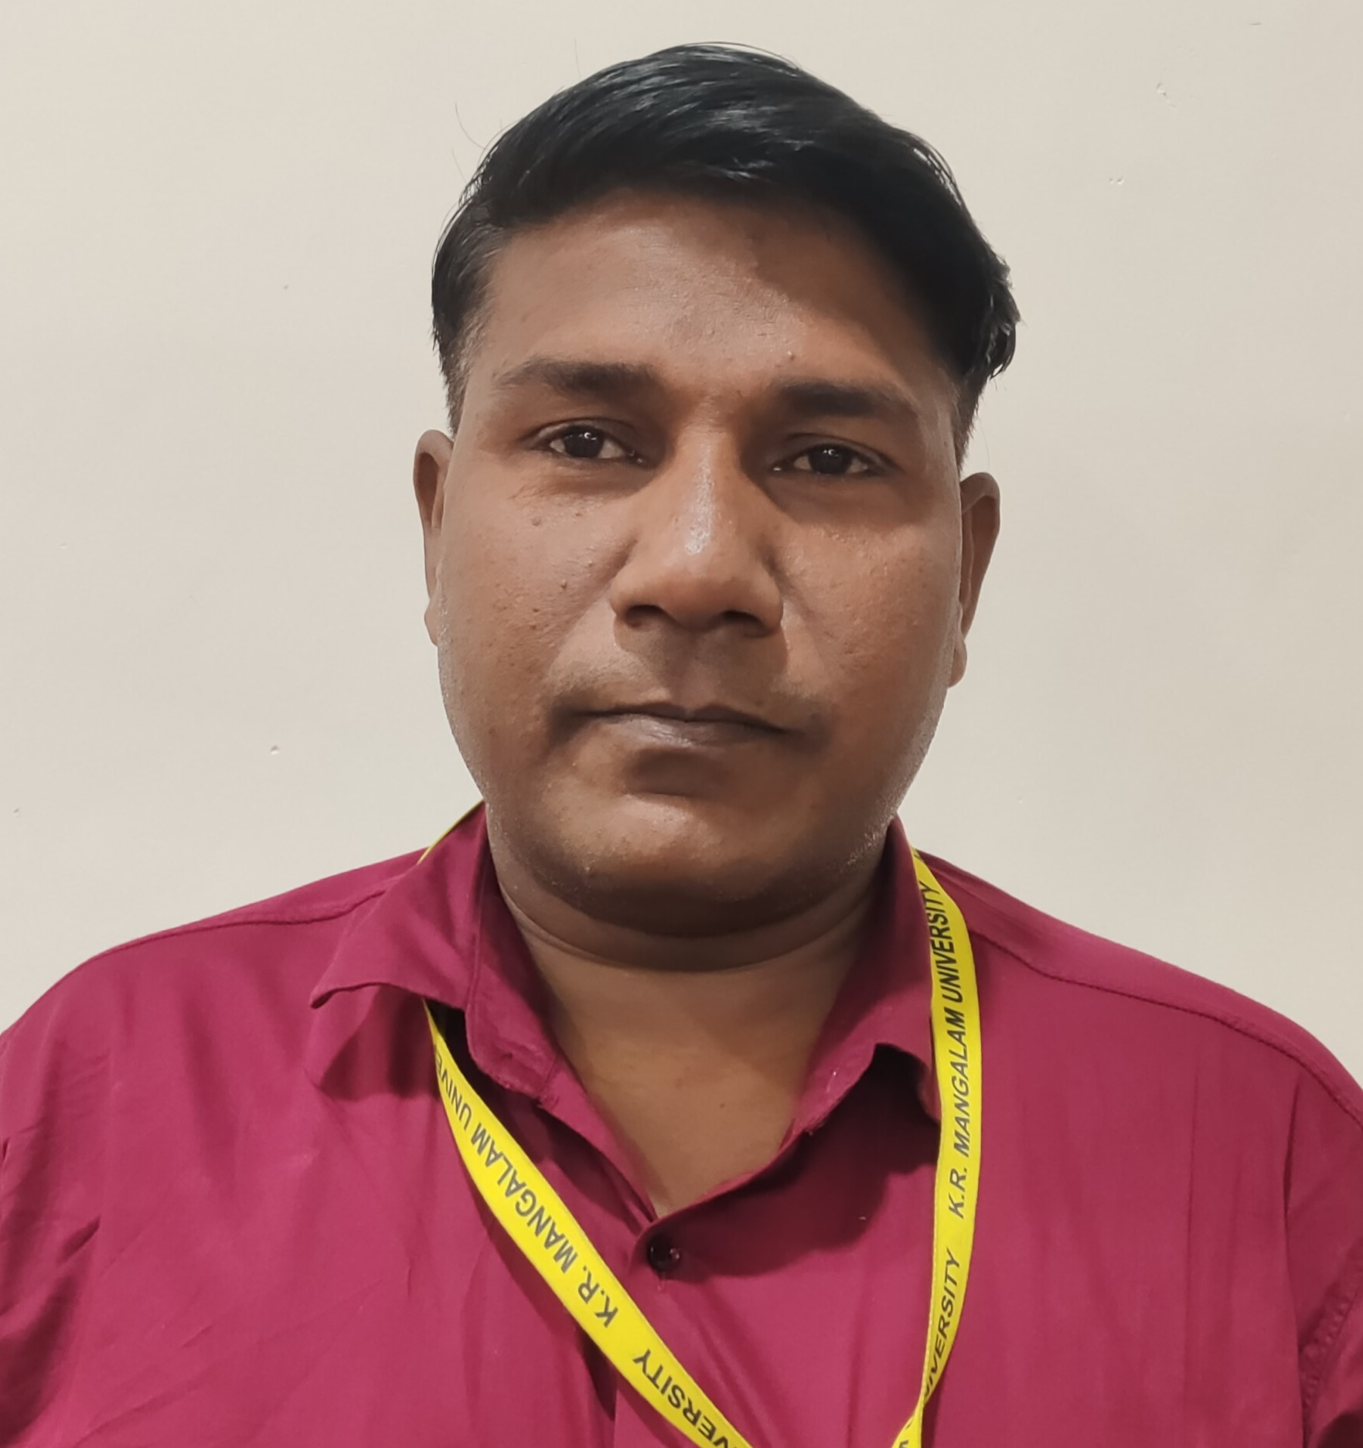
Library Staff Members
Dr. Helaluddin
University Librarian
Ph.D.
Master in Library & info. Sc.
M.A. (Hist.)
M.A. (Is. St.)
Shaida Husain
Assistant Librarian
Master in Library & Info. Sc.
PGDLAN
UGC-NET
Nadeem Javed
Assistant Librarian
Master in Library & Info. Sc.
LLB,
UGC-NET (2021, 2022, 2023, 3 times), Ph.D. (Pursuing)
Manmohan Das
Professional Assistant
Master in Library & Info. Sc.
M.A. (Hist.)
Kapil Dev
Library Assistant
Master in Library & Info. Sc.
B.A. (Hist.)

Slide 7
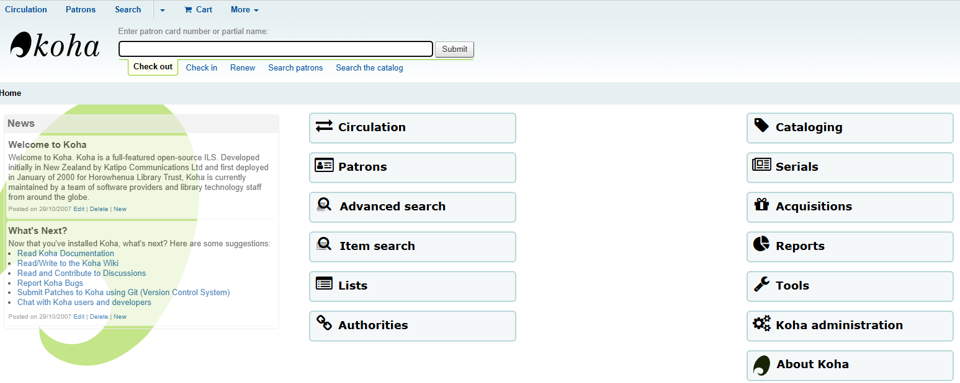
Software (LMS) Koha (Version: 22.05.03.000)

Slide 8
Library Resources
SSR Period Current Status
Total No. of Books : 44368 45189
No. of Titles : 12055 12676
No. of Text Books : 40897 42813
No. of Reference Books : 1360 1360
No. of Competitive Books : 196 198
IKS (Indian Knowledge System) : 741 818
CD/DVD’s : 506 506
E-Books (through Knimbus) : 73211 73532
Ph.D. Thesis Uploaded : 109 130
Self Study Report (SSR)

Slide 9
Library Digital Resources E-J 48872
SSR Period Current Data
No. of Journals, E-journals : 82, 12649 92, 34948
No. of Magazines, E-News P./Magazines : 49 49
No. of Newspapers : 41 41
IEEE database : 45 439767
IEEE Conference Proceedings : 10932 1017960
ProQuest Database : 1954 4254
DELNET IPC Pharma : 388 527
DELNET InfoTrac Architecture : 93 750
PDS (Plagiarism Detection Software) : DrillBit DrillBit, Turnitin

Slide 10












Digital Resources
Digital Resources
Anti Plagiarism Software
Anti Plagiarism Software
Engineering Database
Management Database
Legal database
Legal database
DELNET Architecture Collection
DELNET Pharmacy Collection
DELNET Resources Membership
Electronic thesis database

Slide 11
Digital Resources
E-Resources of the Library
SOURCE | Web site URL | Access Type
Digital Library | https://library.krmangalam.edu.in/ | Web based
Manupatra | https://www.manupatrafast.com/ | IP based
SCC online | https://www.scconline.com/ | IP based
ProQuest | www.proquest.com | IP based
IEEE | https://www.ieee.org/ieeexplore | IP based
IPC Pharma | https://go.gale.com/ps/start.do?p=SPJ.SP02&u=krmu&aty=ip | Web based
InfoTrac Architecture | https://go.gale.com/ps/start.do?p=SPJ.SP09&u=krmu&aty=ip | Web based
DELNET | https://delnet.in/ | Web based
NDL | https://ndl.iitkgp.ac.in/ | Web based
INFLIBNET | https://inflibnet.ac.in/ | Web based
IRINS | https://krmangalam.irins.org/ | Web based
Shodh Ganga | https://shodhganga.inflibnet.ac.in/ | Web based
DrillBit | https://www.drillbitplagiarismcheck.com/ | Web based
Turnitin | https://www.turnitin.com/ | Web based

Slide 12
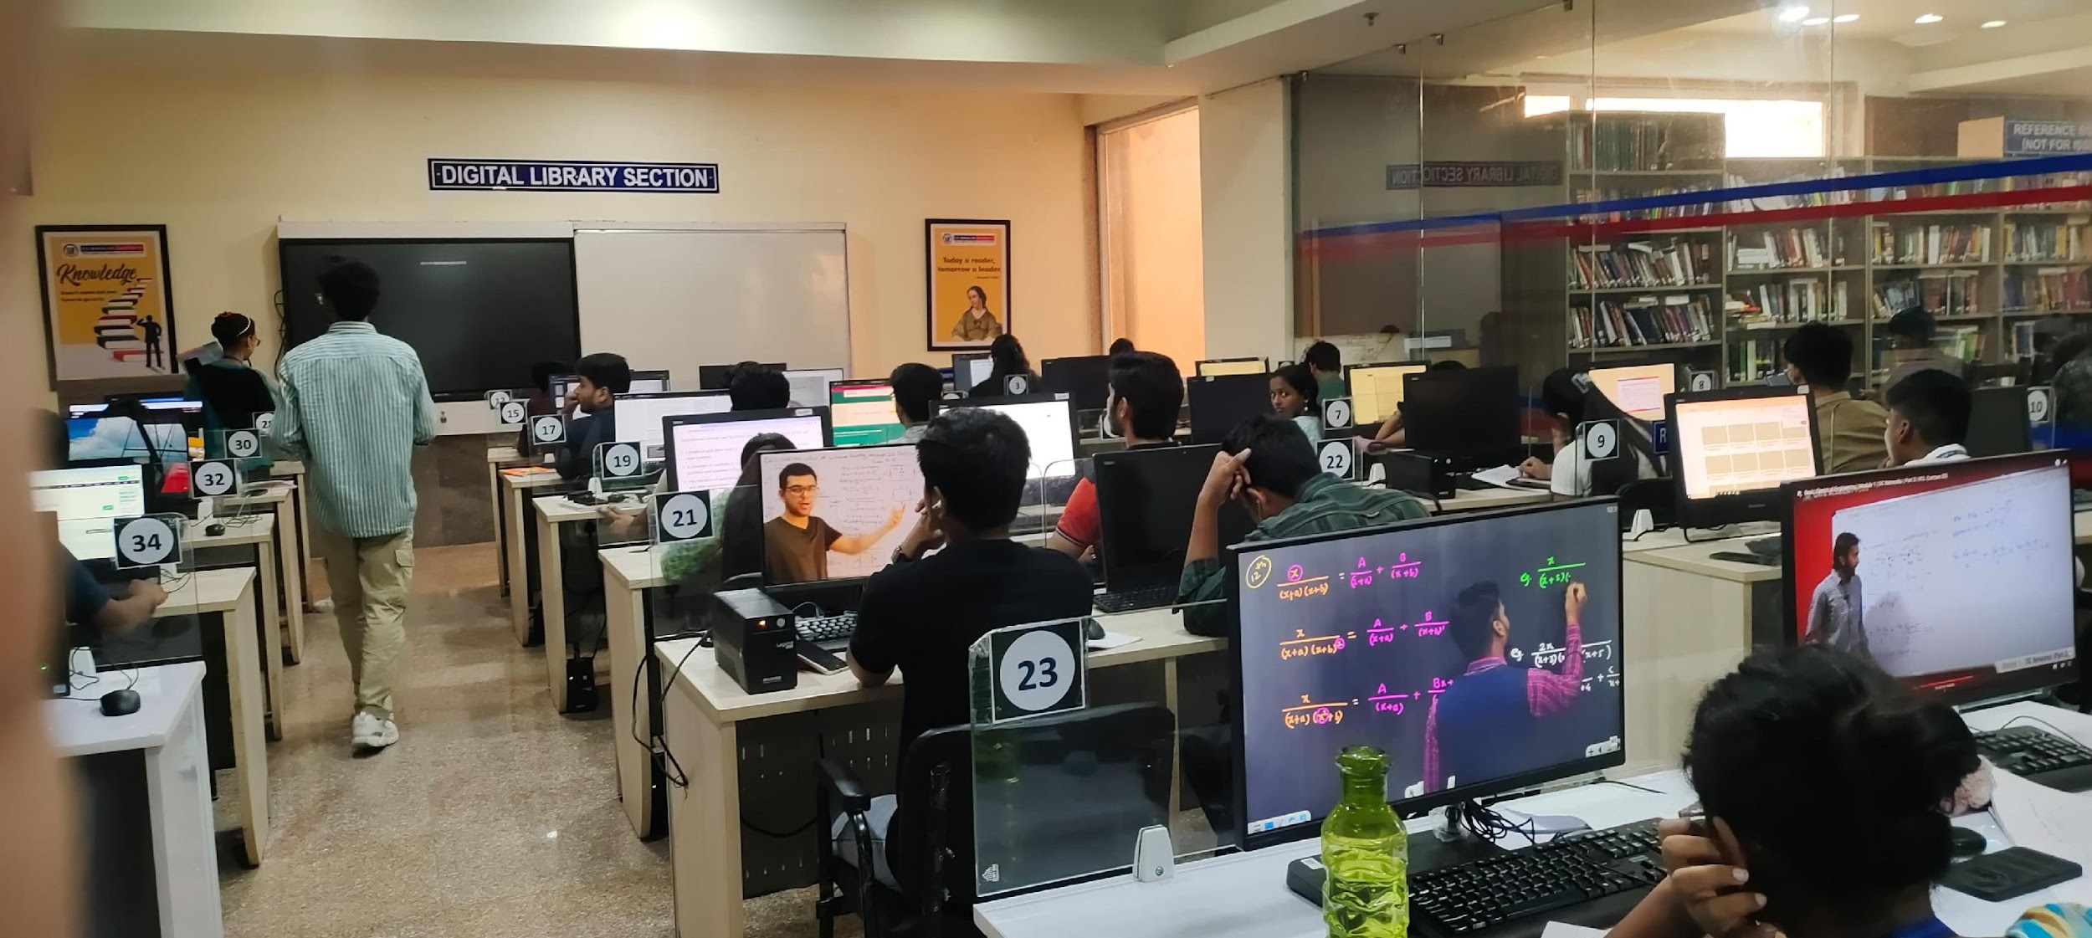
Digital Section
To Access Digital Resources
Students busy in their study through Digital Resources

Slide 13
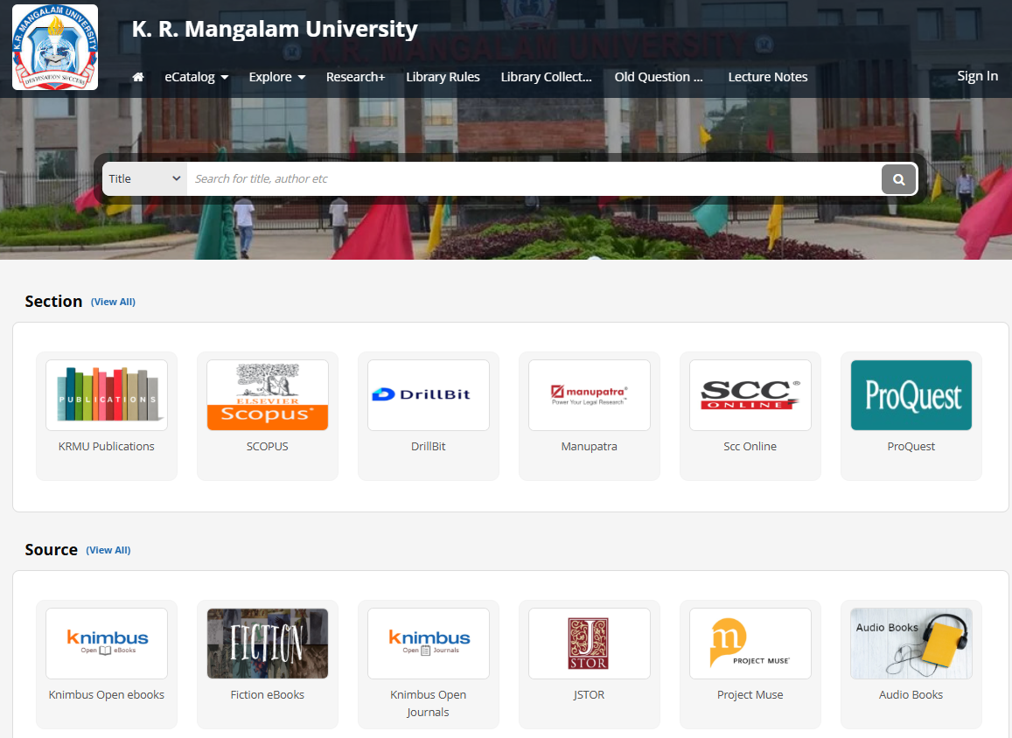
Remote Access E-Library Service

Slide 14







Membership of National Bodies
National Bodies Membership

Slide 15
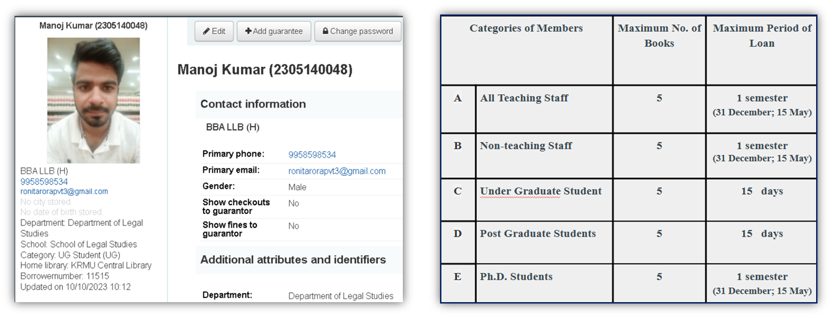
Circulation Service Usage Statistics
Membership Page
Circulation Policy
With Two times Renewal Option

Slide 16
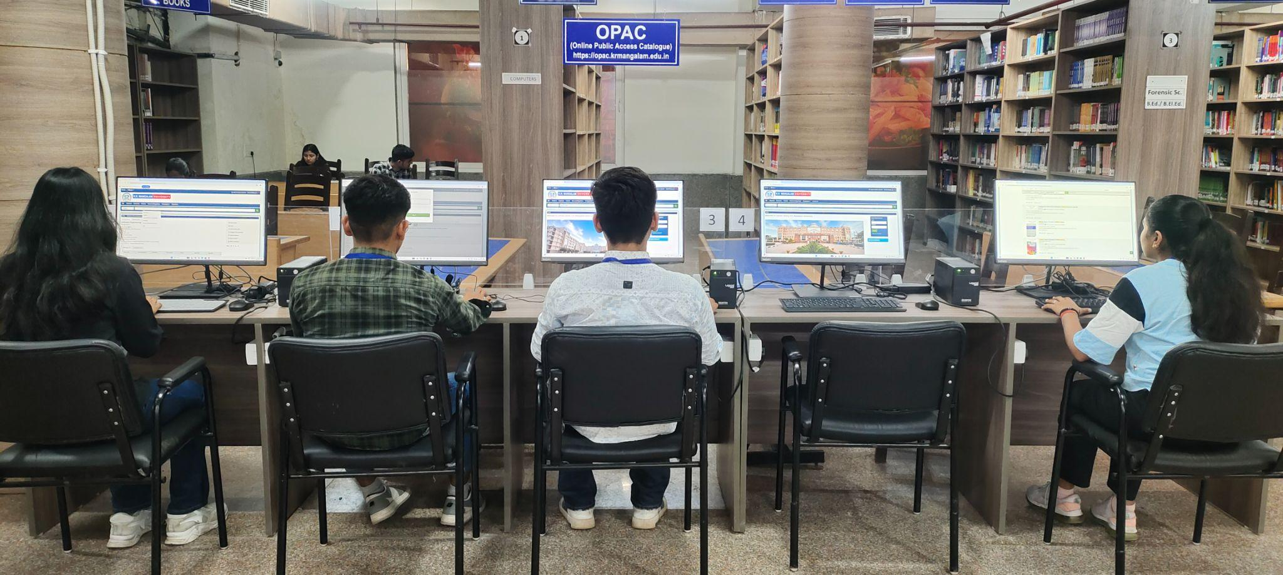
OPAC (Online Public Access Catalogue) Service Foot-Falls
Students searching library books of their interest

Slide 17
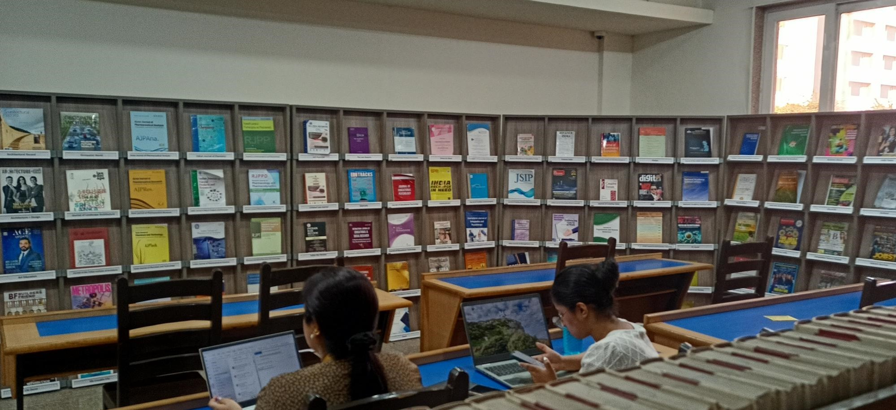
Periodical Service (Journals, Magazines, E-Resources, Databases etc.)
National & International Print Journals in various Stream
Thousands of Electronic Resources in various Stream
Periodicals displayed in the Periodical Section

Slide 18
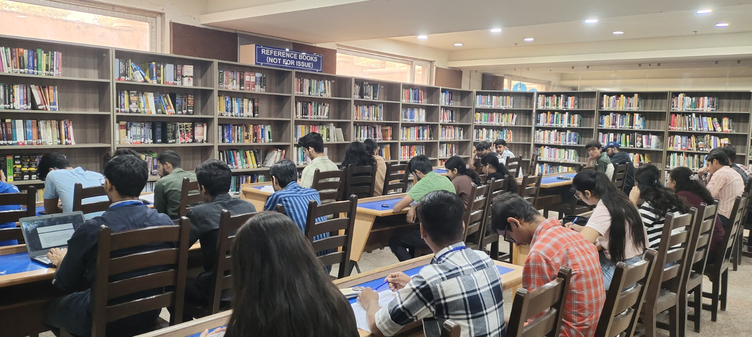
Reference Service
(Reserve Books Section)
Students reading in the Reference Section

Slide 19
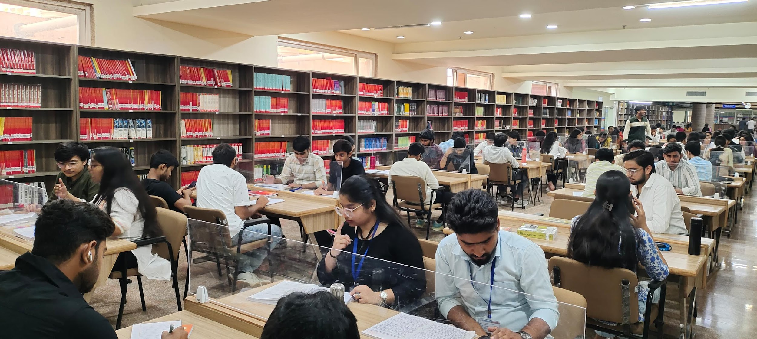
Reading Facility
Reading facility
250

Slide 20
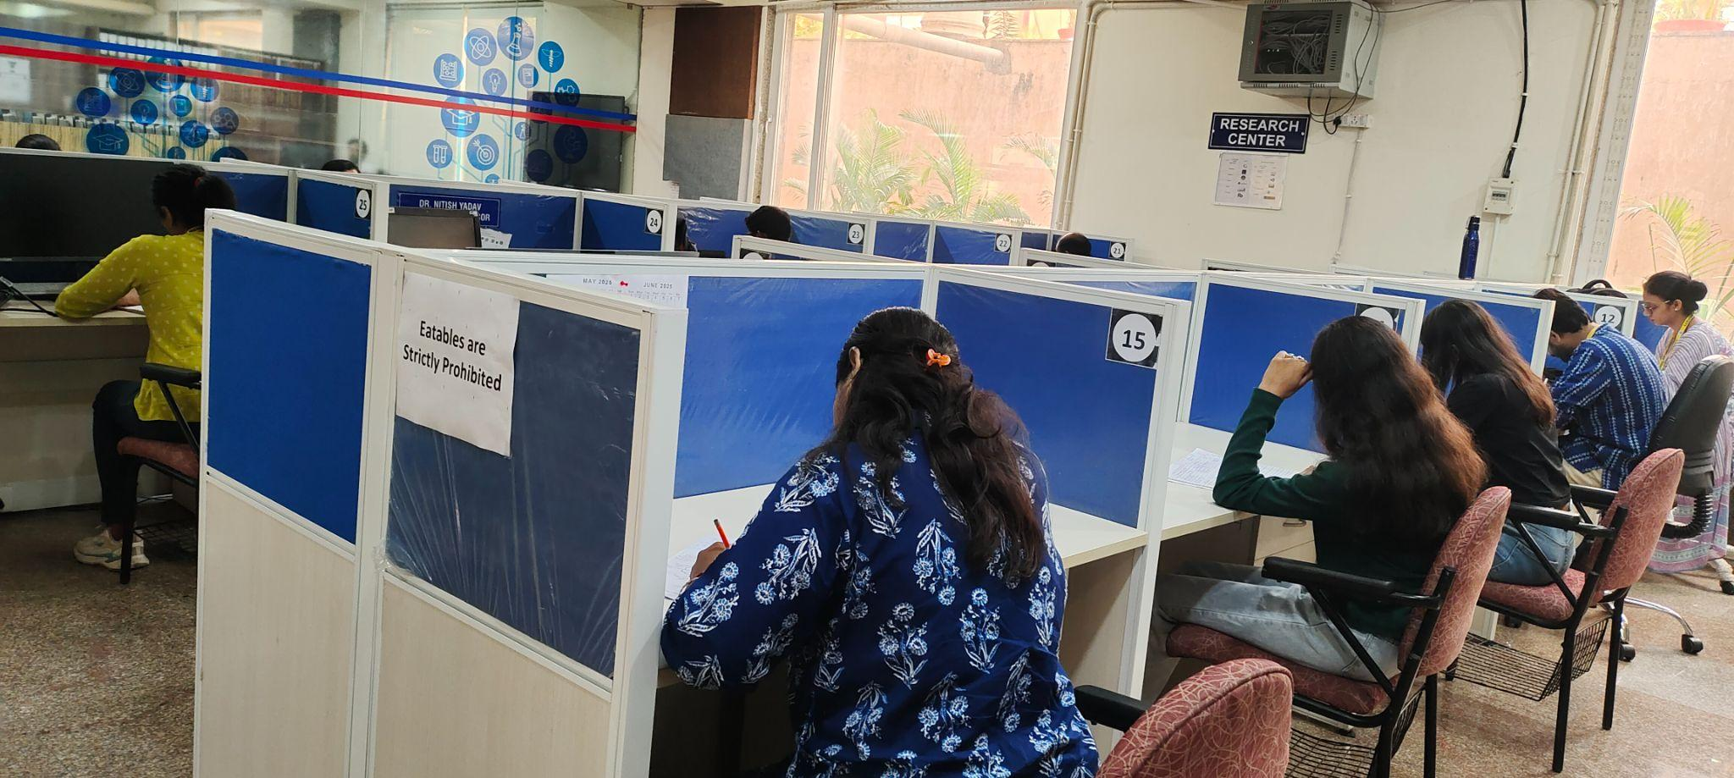
Research Centre

Slide 21
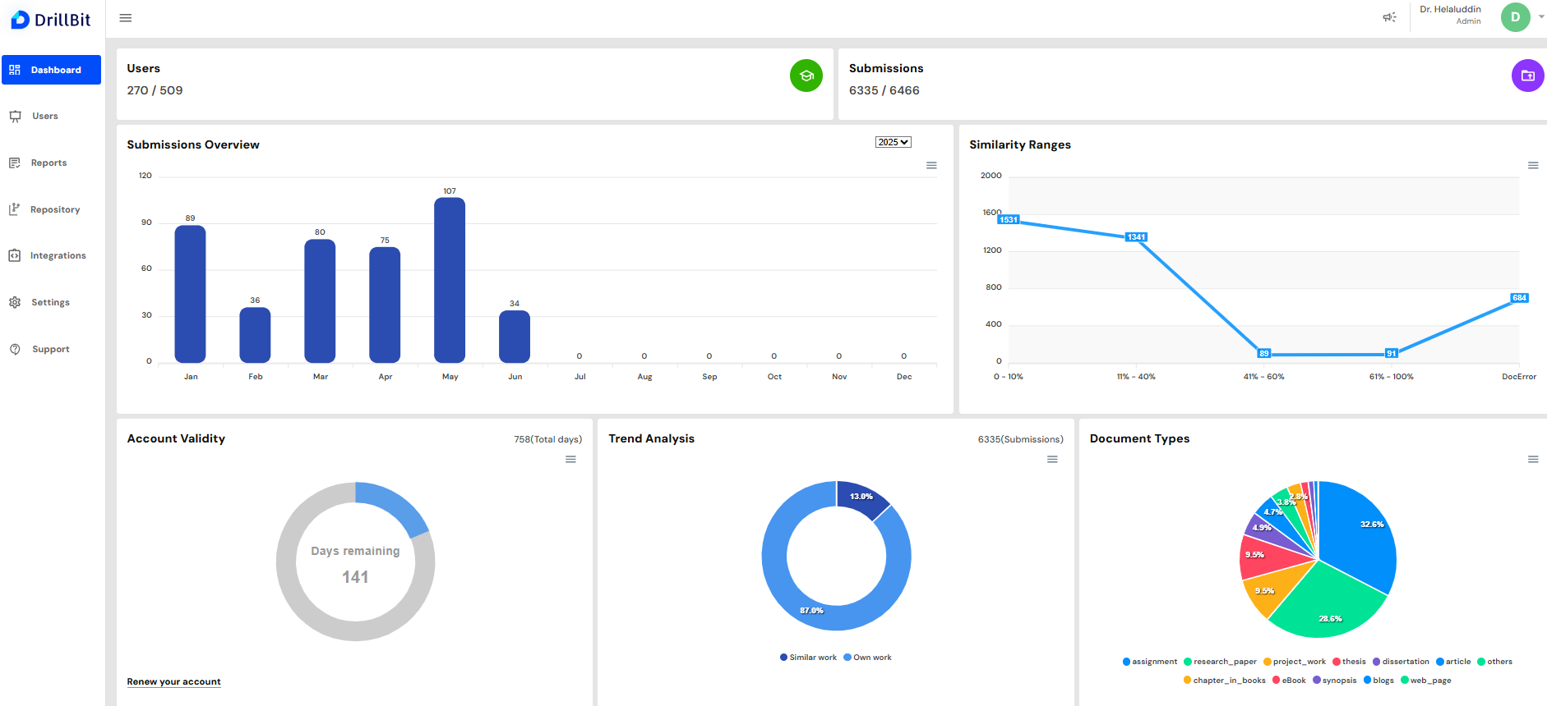
Plagiarism Checking

Slide 22
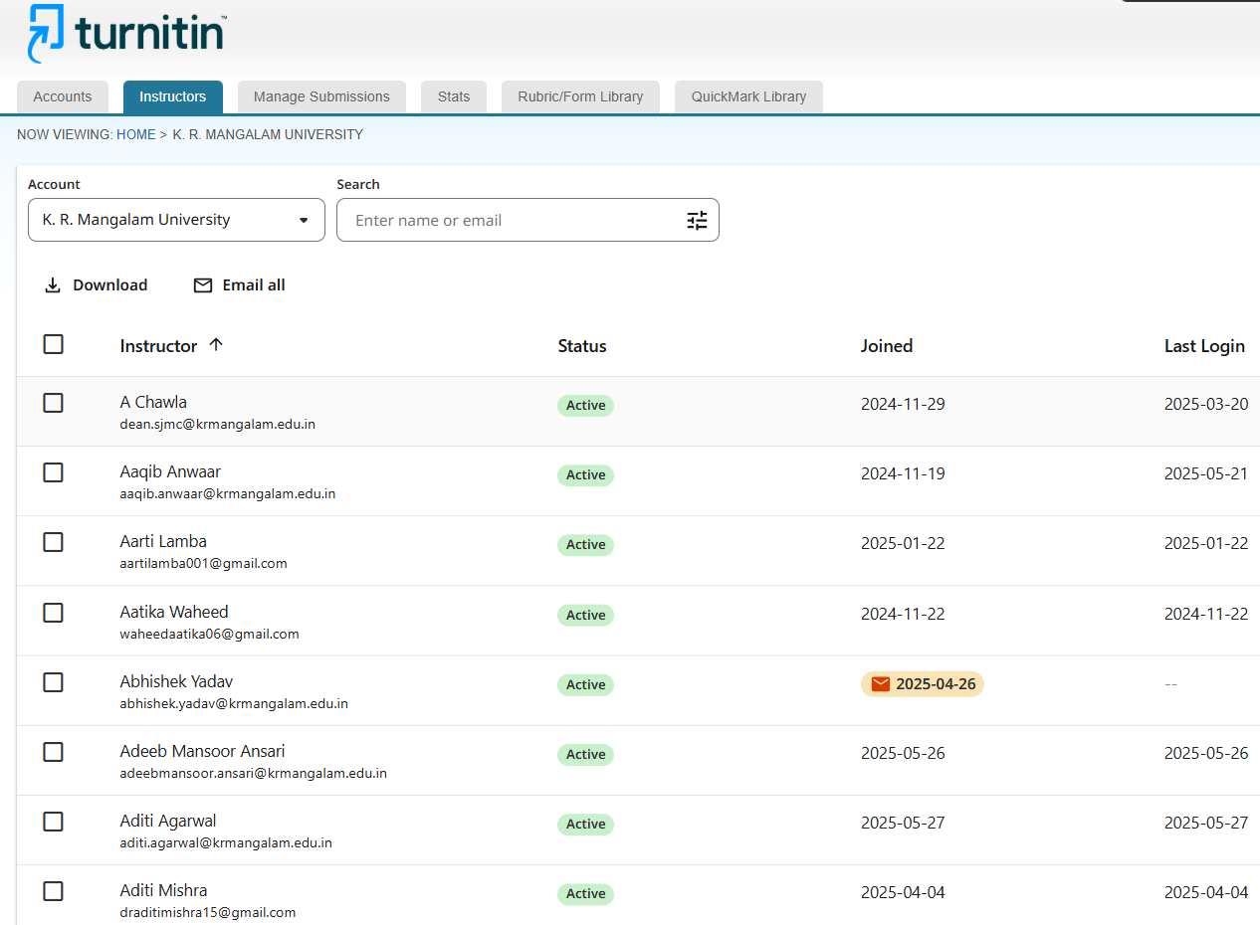
Plagiarism Checking

Slide 23
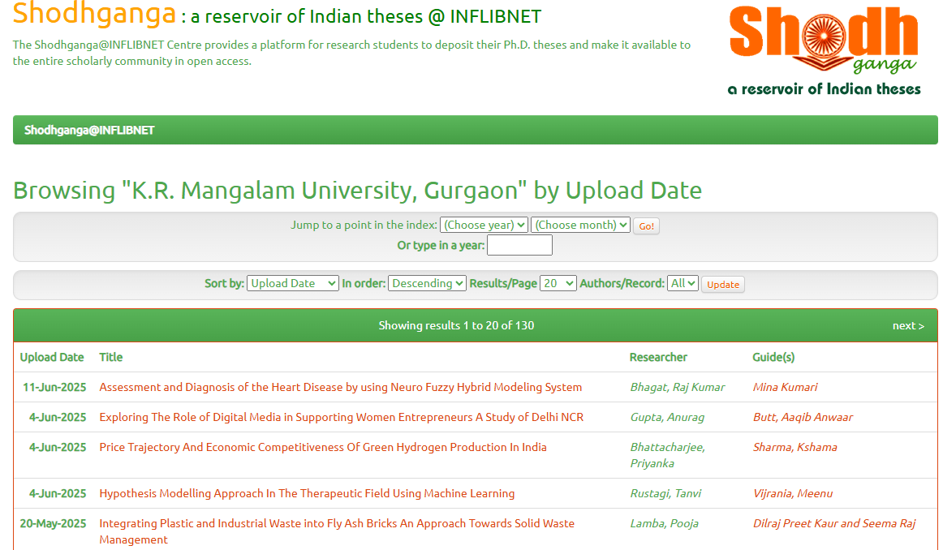
Thesis uploaded at Shodh Ganga

Slide 24
Books Exhibitions
07.04.2025
15.01.2024
20.02.2023
Workshops
22.03.2025 Workshop on Role and Importance of Academic Integrity and Research Ethics
26.03.2025 Workshop on Role and Importance of Academic Integrity and Research Ethics
05.03.2025 DELNET IPC & Infotrac Architecture
26.02.2025 IEEE CSDL
06.02.2025 SCC Online
09.03.2024 Workshop on Role and Importance of Academic Integrity and Research Ethics
24.04.2023 Workshop on Legal database: SCC online
03.04.2023 Workshop on Legal Database: Manupatra
FDP
12.08.2024 - 13.08.2024 FDP on Course Structure, Course Code, Handbook Data Mapping
Other Activities

Slide 25
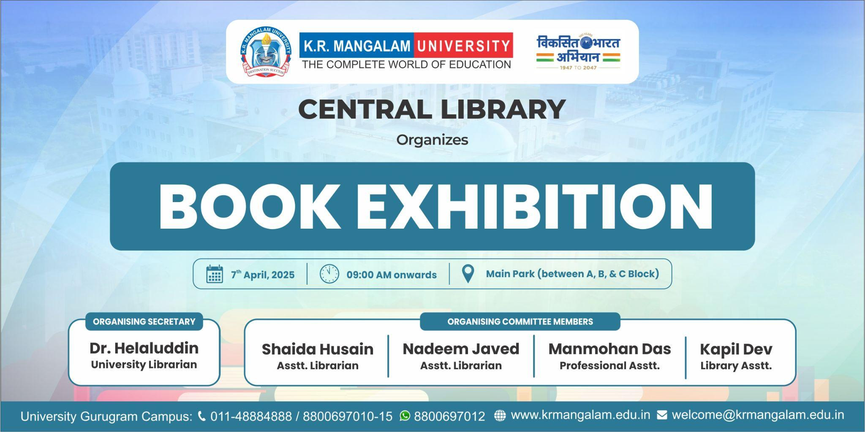
Other Activities

Slide 26
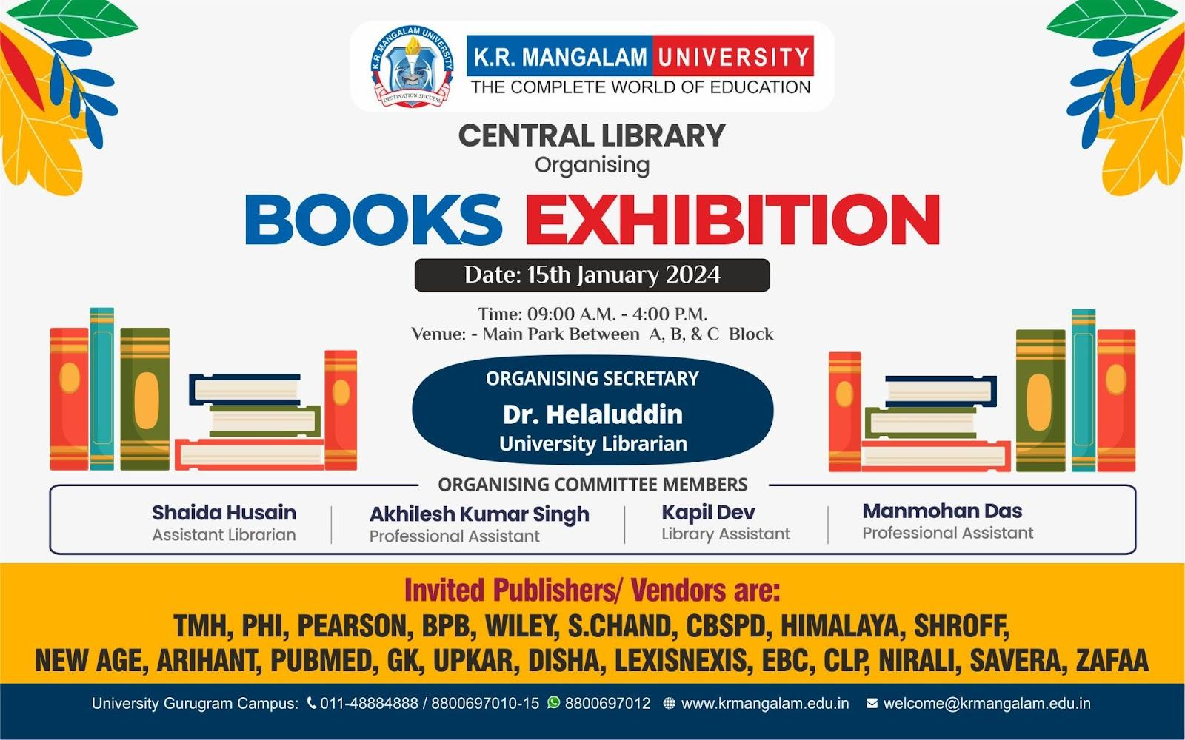
Books Exhibition
Other Activities

Slide 27
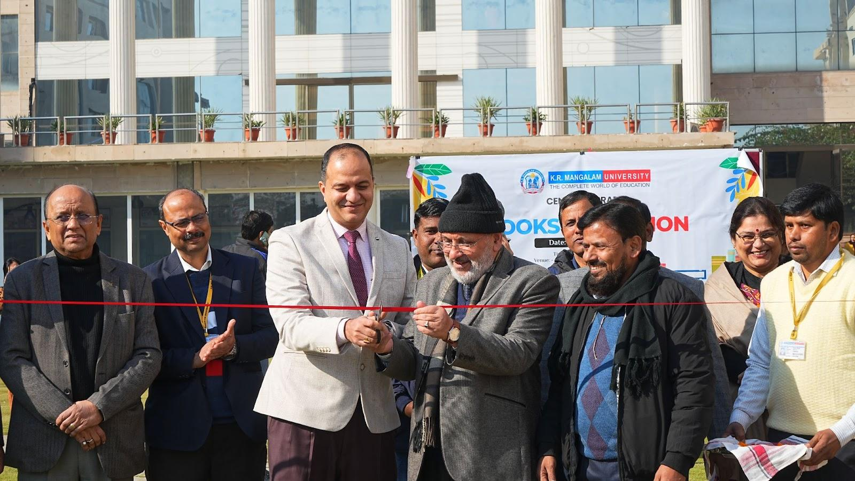
Books Exhibition
Inaugurated b VC Dr. Ankush Mittal Sir with Ex- VC of Central University of Kashmir Prof. Mehrajuddin Mir (Prof. Motilal Chair)
Other Activities

Slide 28
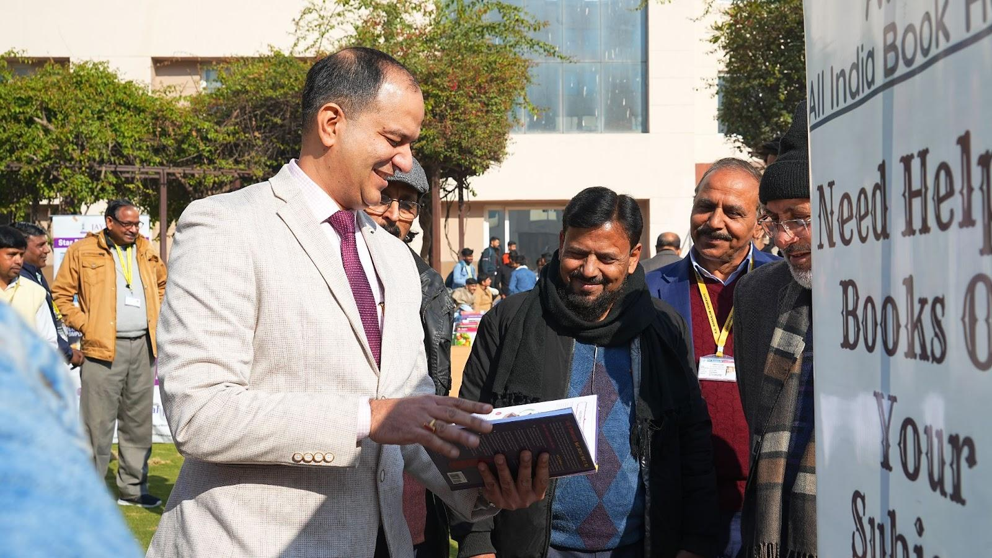
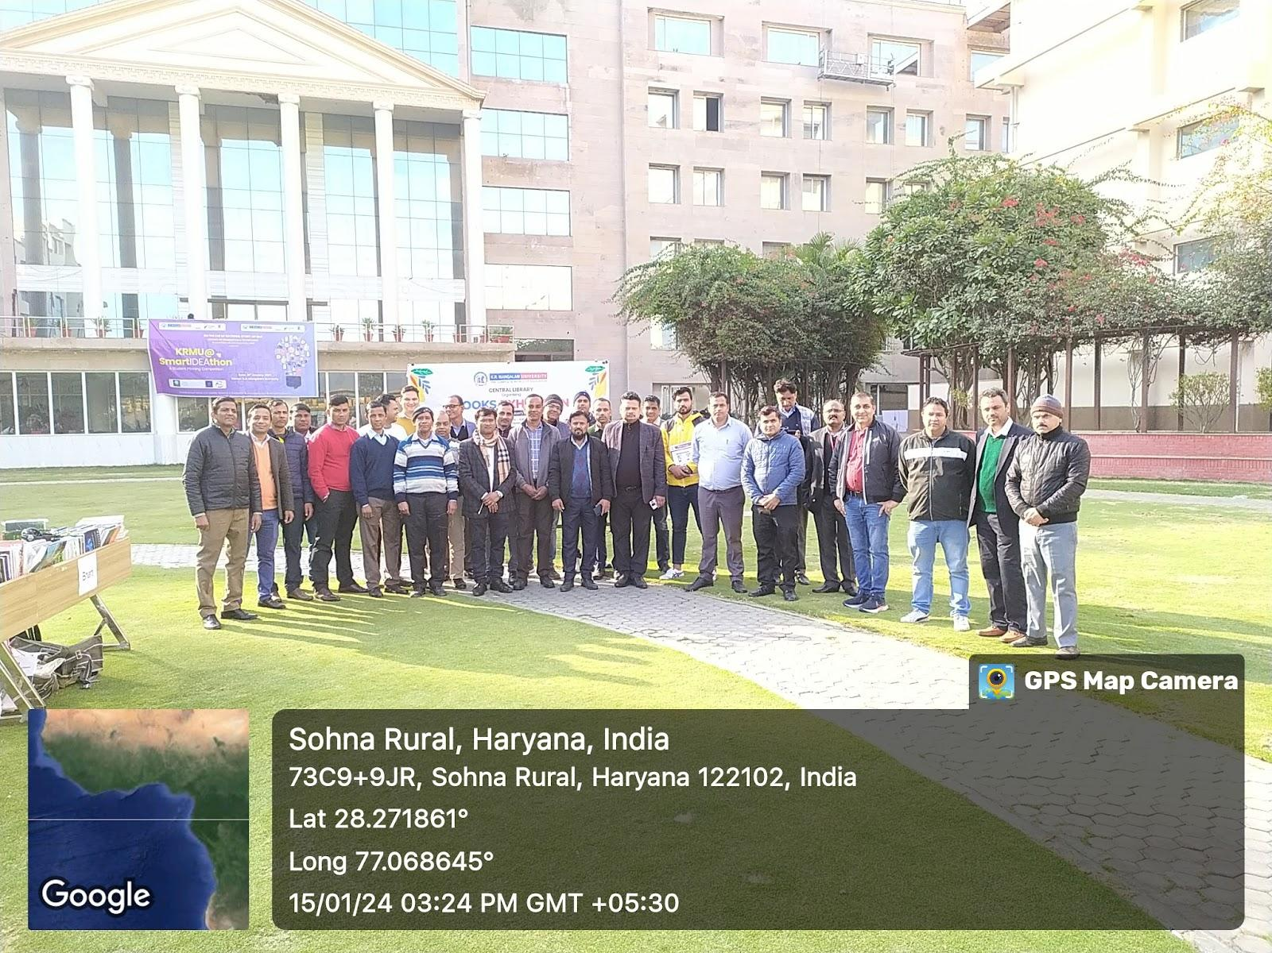
Books Exhibition
Vice Chancellor DR. Ankush Mittal, University Librarian Dr. Helaluddin, Dr. Joginder Singh Yadav (Dean SOAS), with Prof. Mehrajuddin Mir (Prof. Motilal Chair) Ex- Vice Chancellor, Central University of Kashmir
Participating Publishers
Other Activities

Slide 29
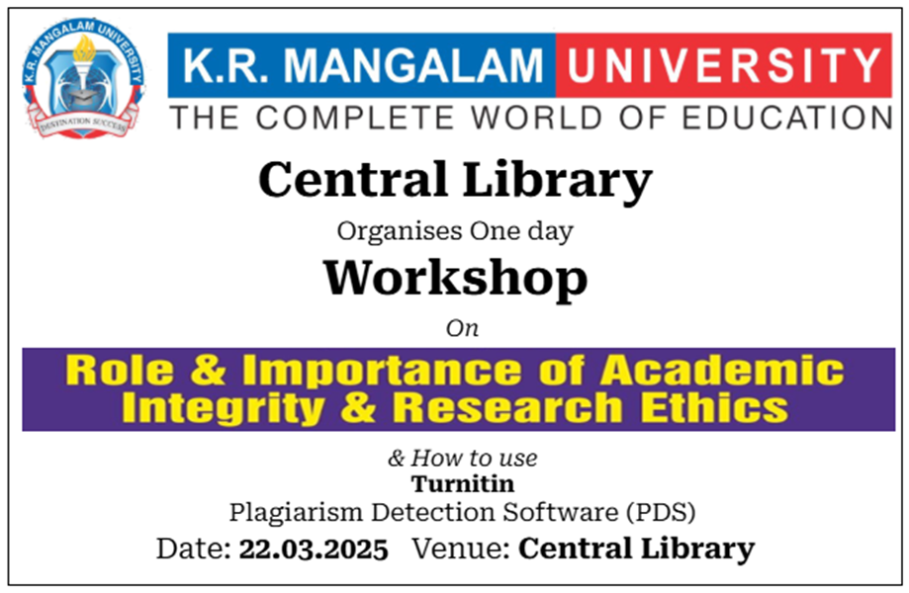
Workshop on Academic Integrity & Research Ethics
Other Activities

Slide 30
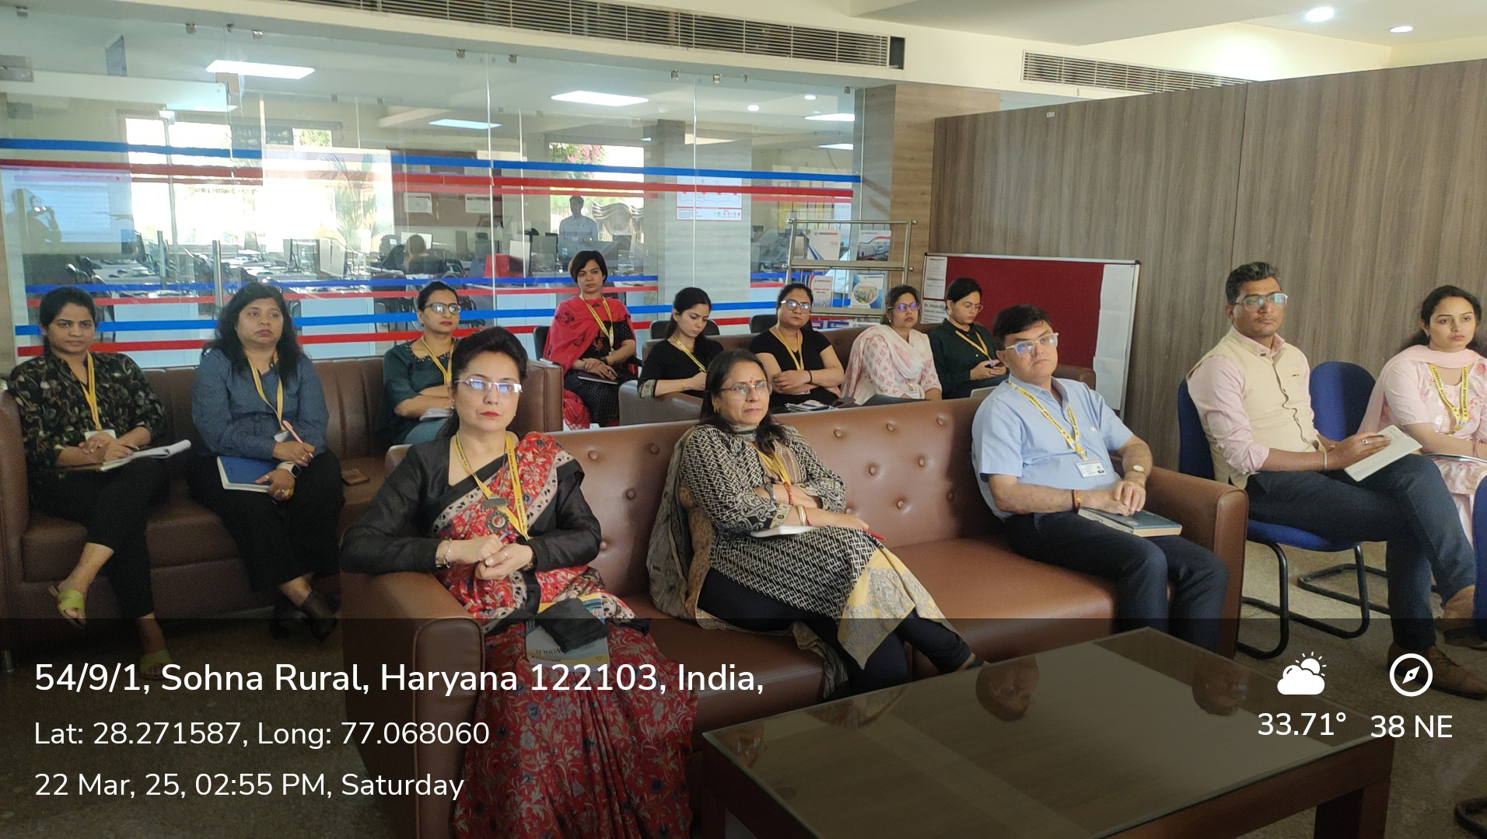
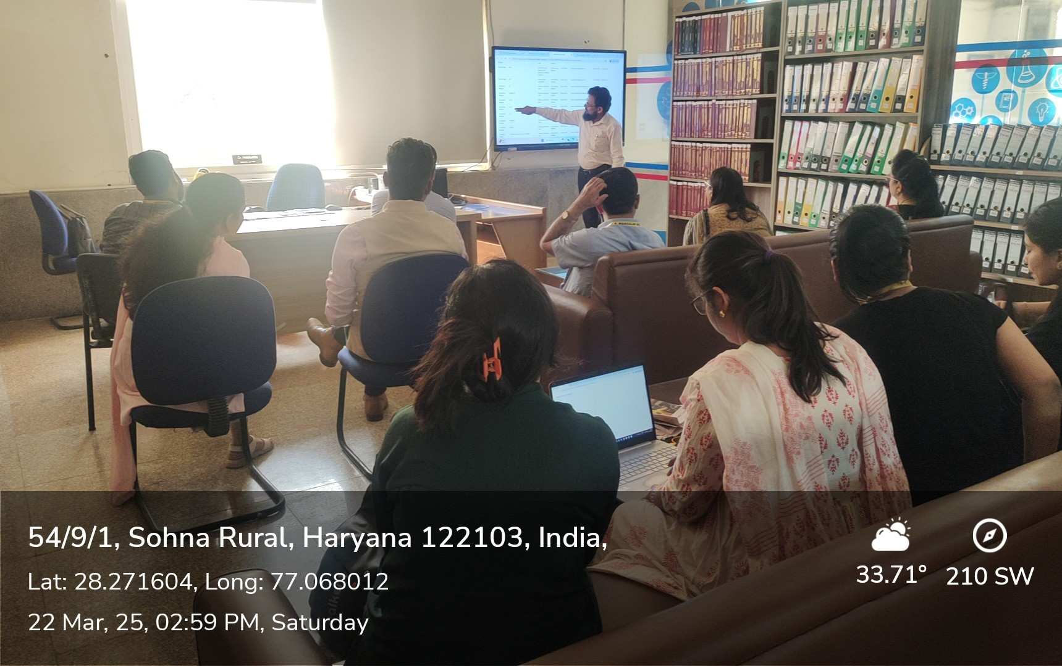
Other Activities

Slide 31
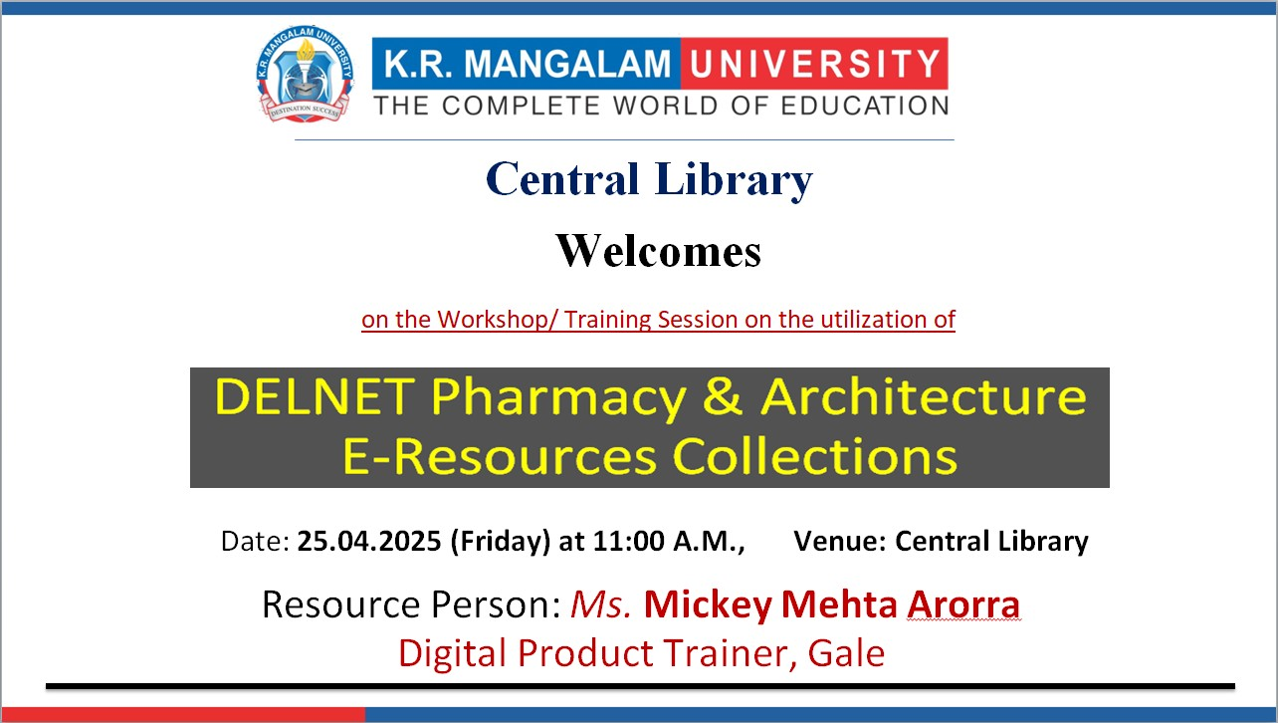
Other Activities

Slide 32
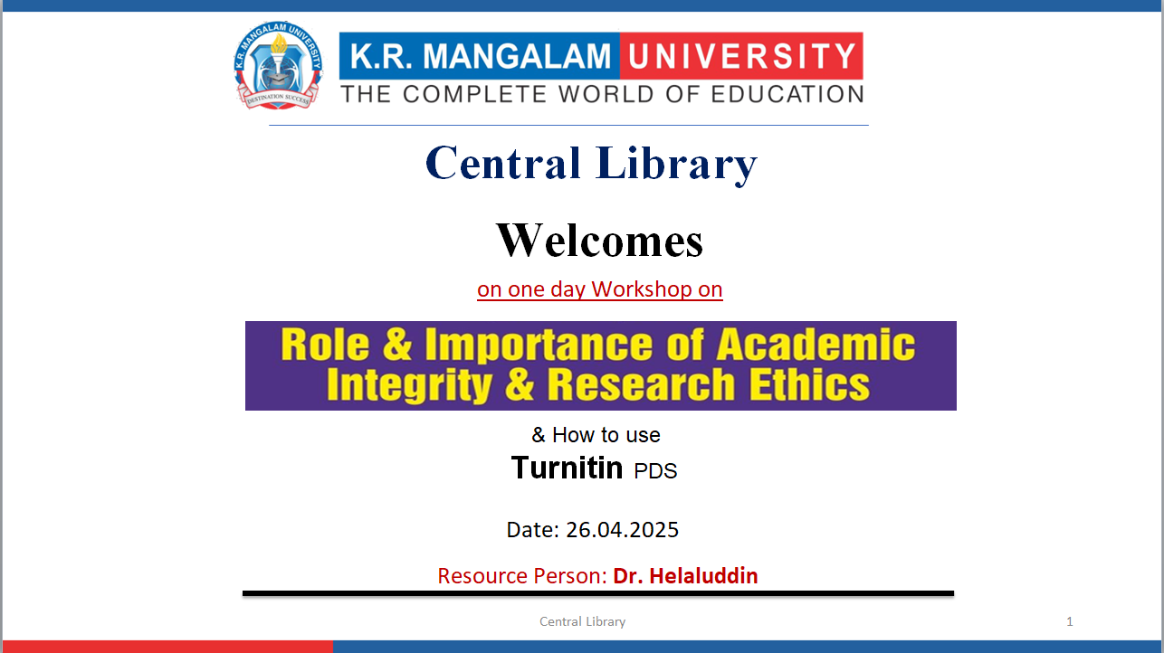
Other Activities

Slide 33
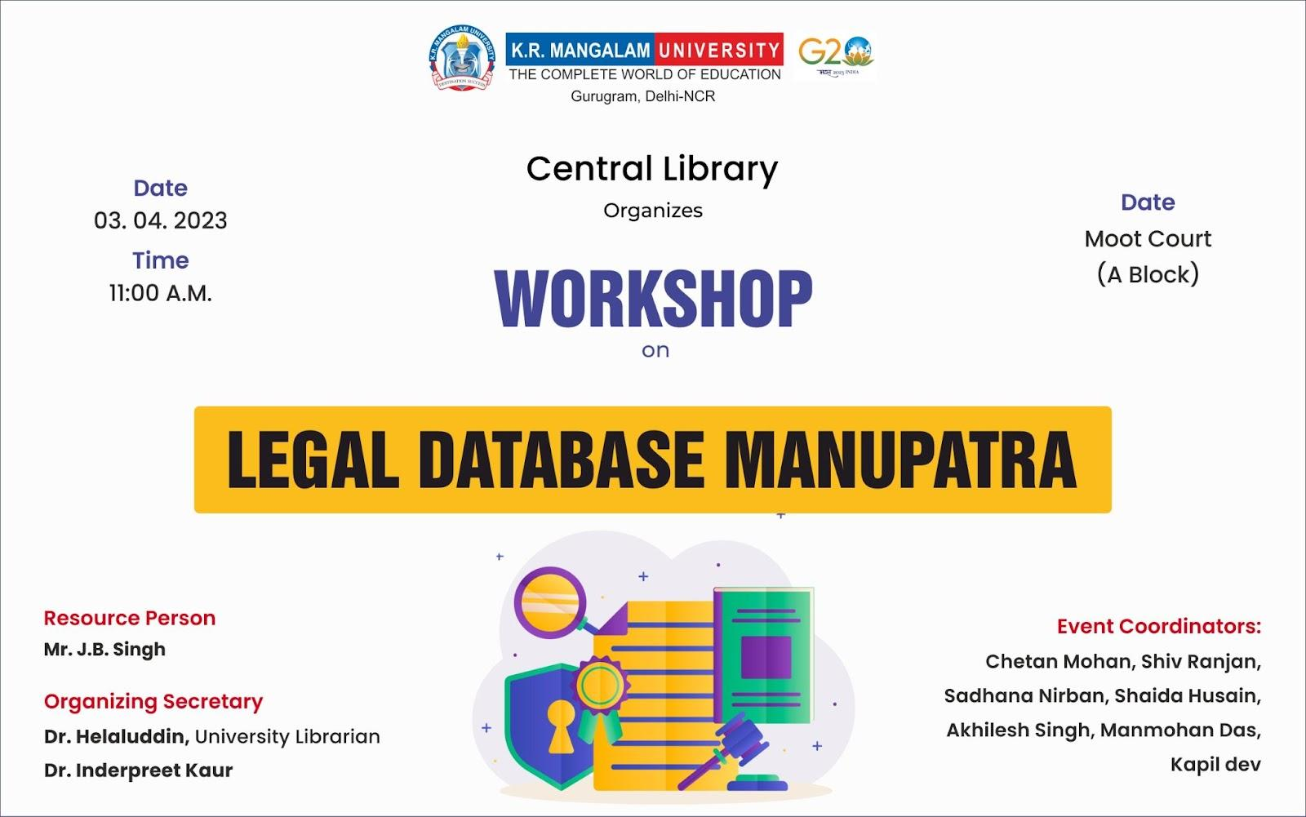
Workshop on Legal database: Manupatra
Other Activities

Slide 34
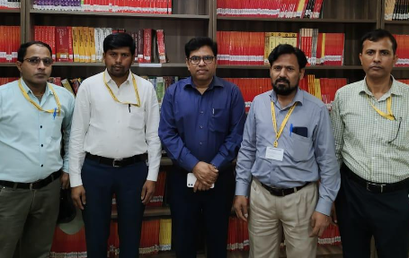
Manupatra Resource person Mr. J.B. Singh with Library team
Other Activities

Slide 35
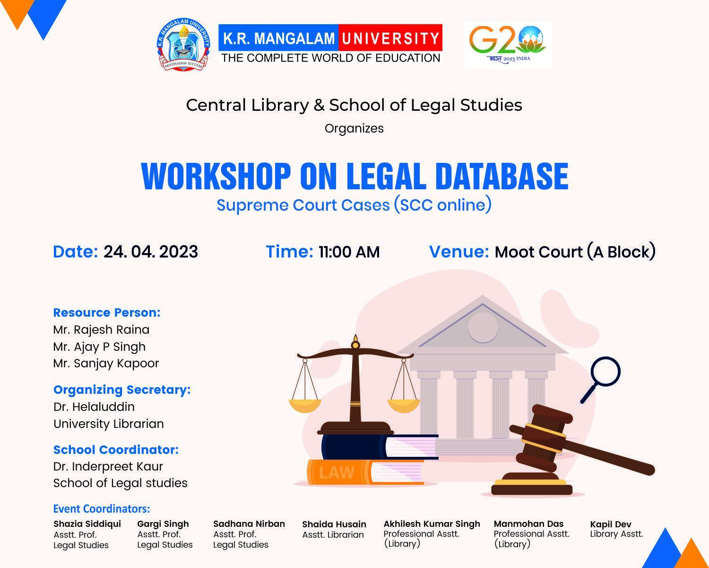
Workshop on Legal database: SCC online
Other Activities

Slide 36
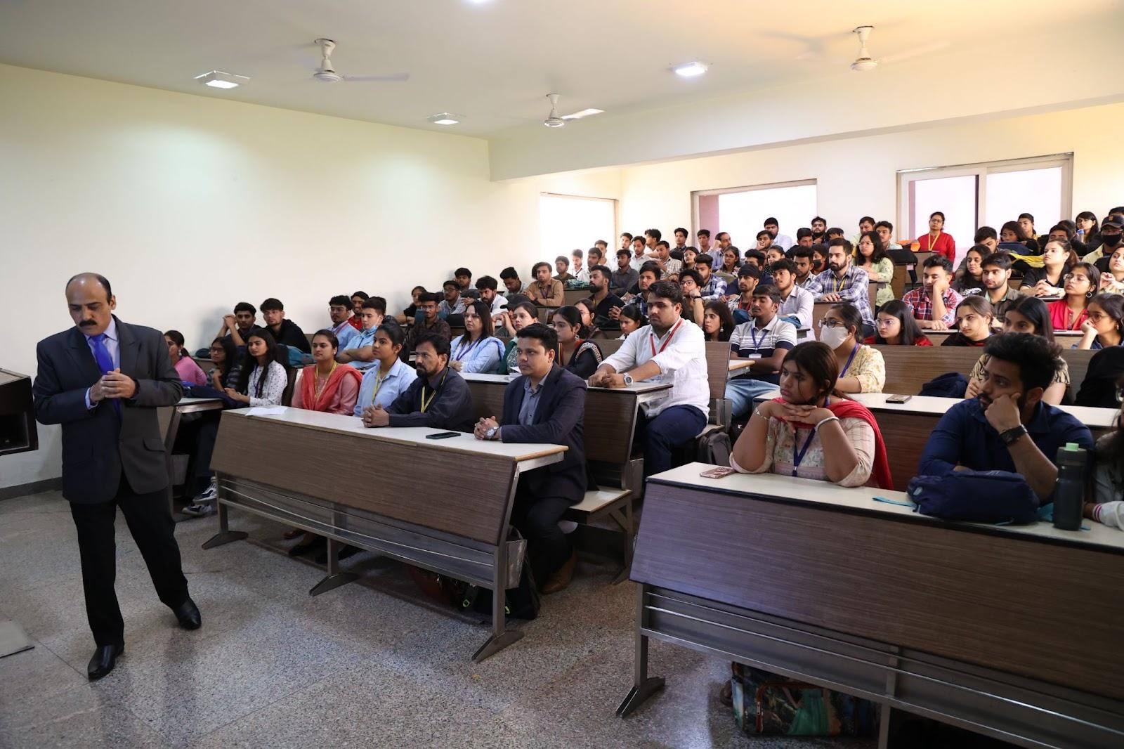
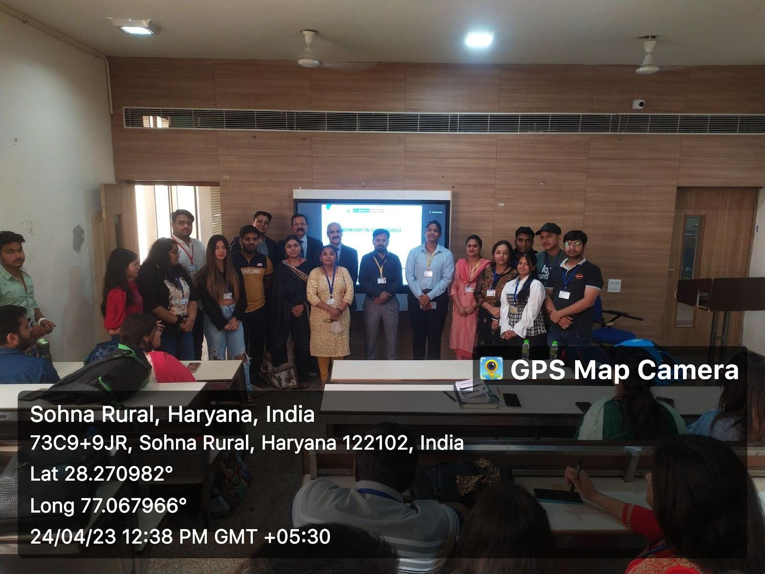
Workshop on Legal database: SCC online
Other Activities
Workshop photograph

Slide 37
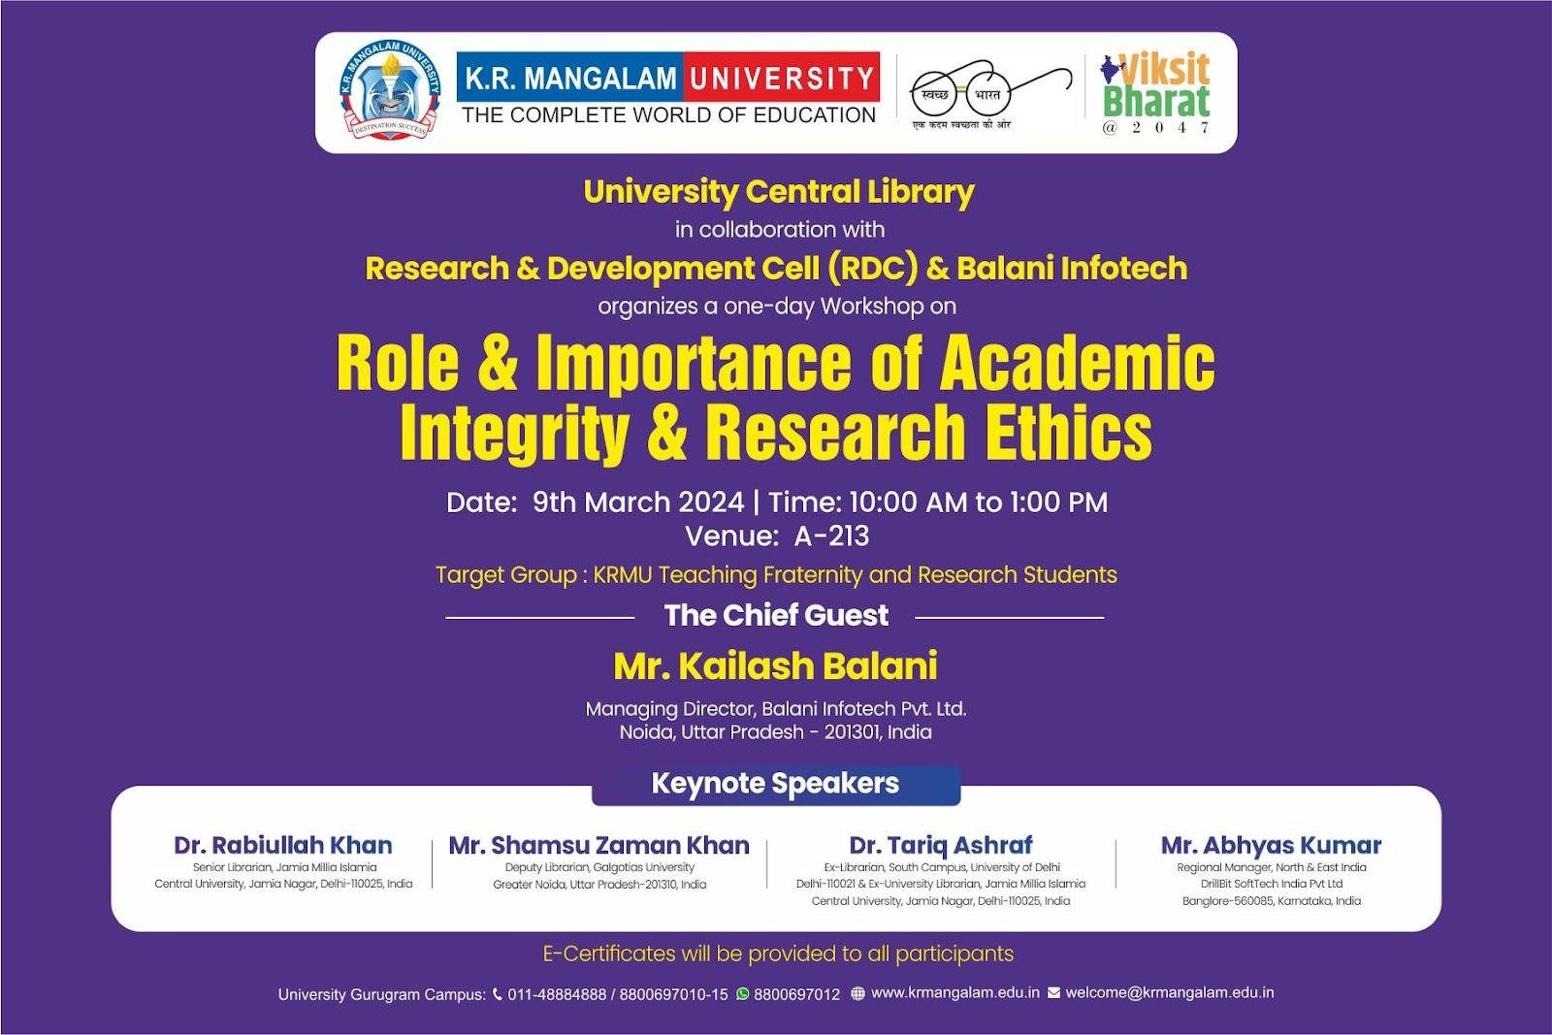
Workshop on Academic Integrity & Research Ethics
Other Activities

Slide 38
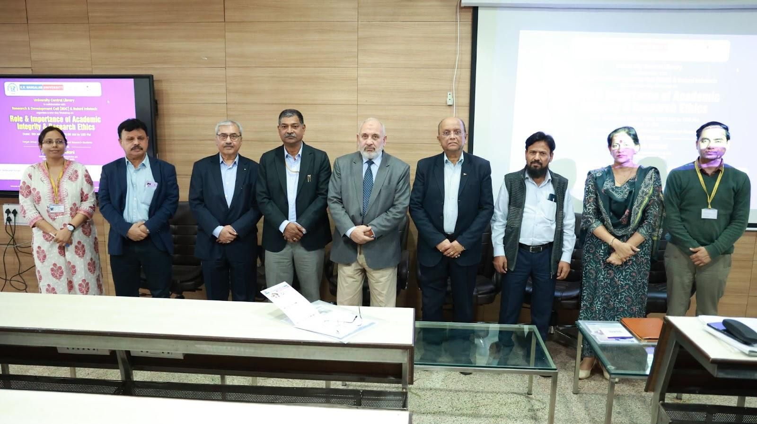
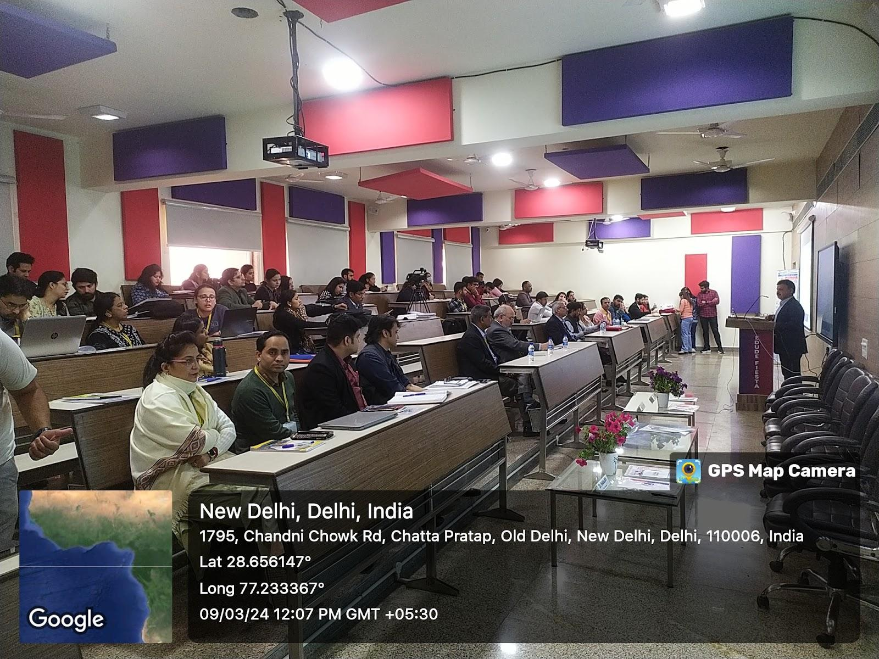
Workshop on Academic Integrity & Research Ethics
L-R: Dr. Indu Singh (Communication Officer RDC), Dr. Tariq Ashraf (Resource Person), Mr. Kailash Balani (Resource Person), Dean Research & offg. Vice Chancellor Prof. Dr. Rakesh Sinha, Prof. Mehrajuddin Mir (Motilal Chair), Mr. P. Mahajan (COE), University Librarian Dr. Helaluddin, Dr. Seema Raj (RDC), Dr. Pawan Kumar (RDC)
Participants
Other Activities

Slide 39
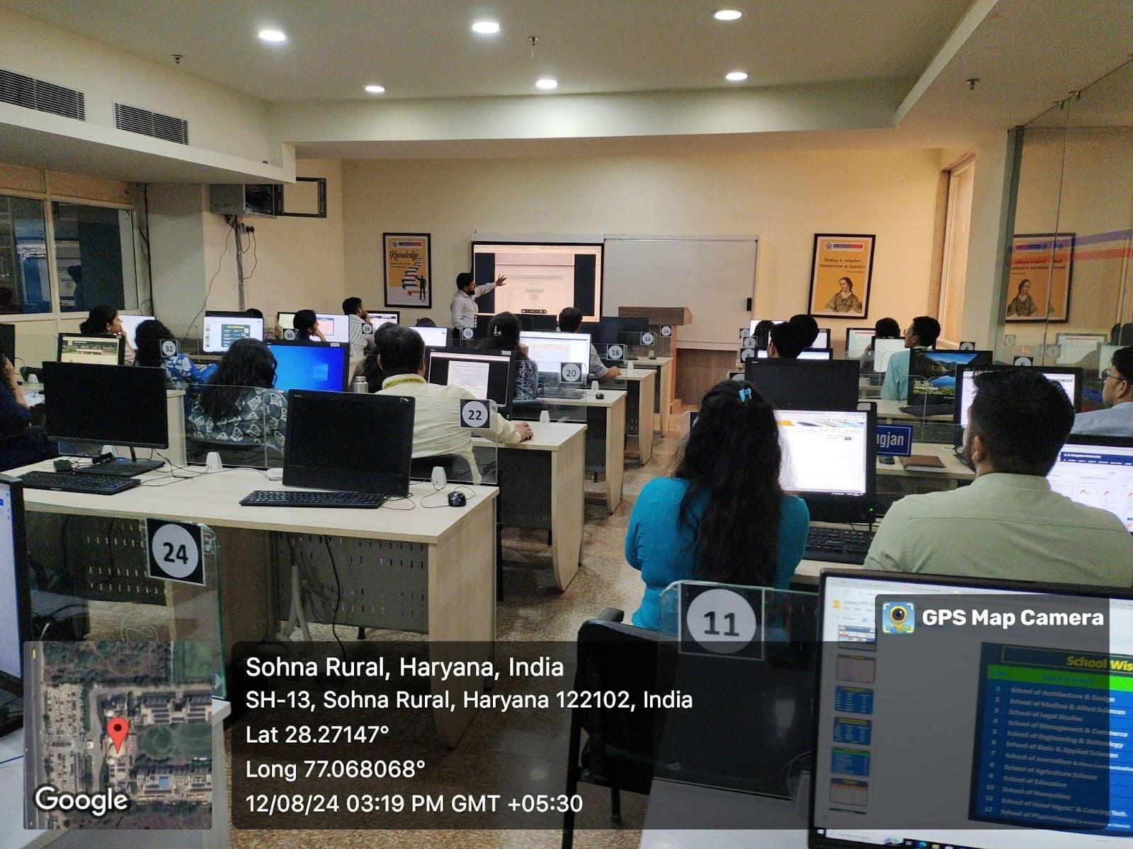
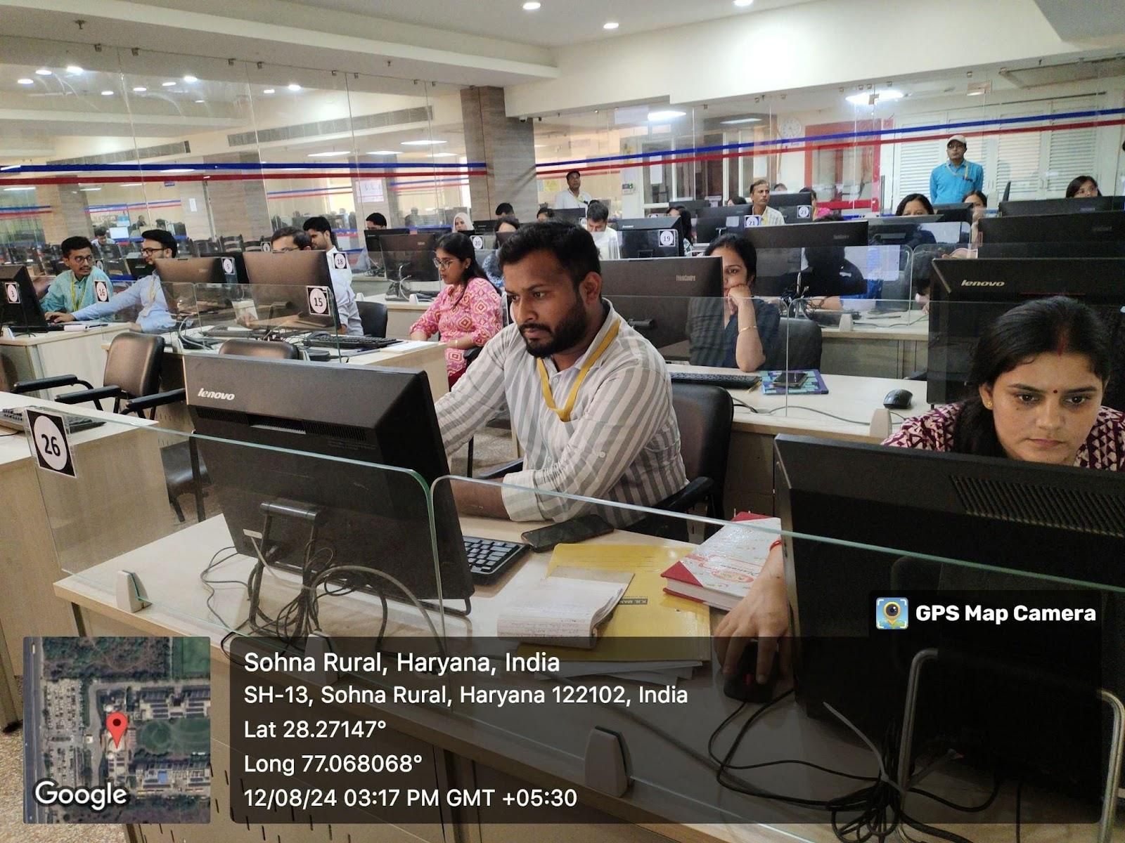
FDP Programme: The Library has organised a two day FDP programme in the Digital Library Section for our faculty members.
Participating Faculty Members
Other Activities

Slide 40

THANK YOU

