Slide 1


Slide 2



Welcomes
NAAC Peer Team Visit Members
to
Office of the Registrar
Presented by:
Dr. Rahul Sharma
Registrar
K.R. Mangalam University
Notes:
New Courses replaced with New Programmes

Slide 3

INDEX
Slide No. | Content
4 | Organogram of Office of the Registrar
5-6 | Internal Governance
7-9 | External Governance
10-24 | Administrative Functions
25-29 | HR Staff Welfare
30 | Student Help Desk
31-33 | Scholarship
34-37 | Infrastructure Facility (IT, Sports, Hostel and others)
38 | Future Action Plan

Slide 4
Organogram of Office of the Registrar
Registrar
Administrative Officer
Deputy Registrar
Director- Sports
Manager - IT
Chief
Warden
Manager-HR
Sports Coach
IT - Administrator
Warden
Boys’
Warden
Girls’
Transport
Store
HR Executive
Security
Assistant Manager
(Student Affairs)
Housekeeping/Maintenance
Office Assistant
Notes:
Glimpses instead of Glimpse

Slide 5
Internal Governance
The Internal Governance shall include following statutory authorities and committees of the University:
Anti-Ragging Committee
Student Grievance Redressal Committee
Employee Grievance Redressal Committee (Teaching & Non-Teaching)
Equal Opportunity Cell
Internal Committee
Gender Sensitization and Safety Committee
Anti-Discrimination and Minority Committee
Student Discipline Committee
University Admission Committee
Hostel Committee
Environment Compliance Committee
Governing Body
Board of Management
Academic Council
Finance Committee
University Research Committee
Board of Studies
School Research Committee
Selection Committee for Teaching and Non-Teaching Staff

Slide 6

Governance through University Statutory Bodies
S. No | NAME OF STATUTOURY BODIES | FREQUENCY OF MEETING (CALENDAR YEAR)
1. | Governing Body | 3
2. | Board of Management | 6
3. | Academic Council | 3
4. | Finance Committee | 2
5. | University Research Committee | 2
6. | Board of Studies | 1/ As and when required
7. | School Research Committee | 1/ As and when required
8. | Selection Committee for Teaching and Non-Teaching Staff | -
6

Slide 7
External Governance
(Registrar)
Deputy Registrar
UGC
MOE (Govt. of India)
DHE (Govt. of Haryana)
PCI
COA
NCTE
AICTE
HSCP
ICAR
BCI
Compliance of Regulatory Bodies

Slide 8
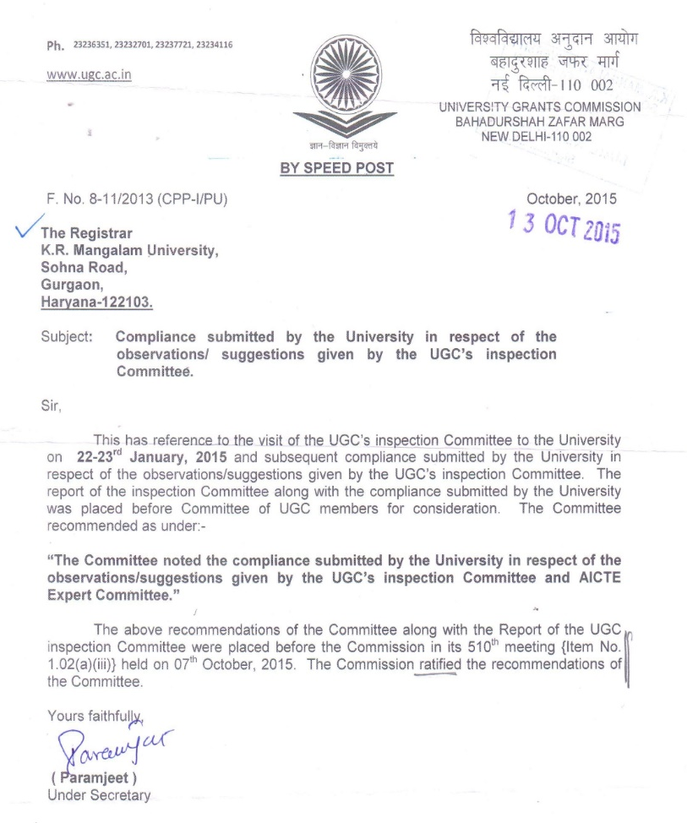
UGC
COMPLIANCE
REPORT
STATUS
8

Slide 9
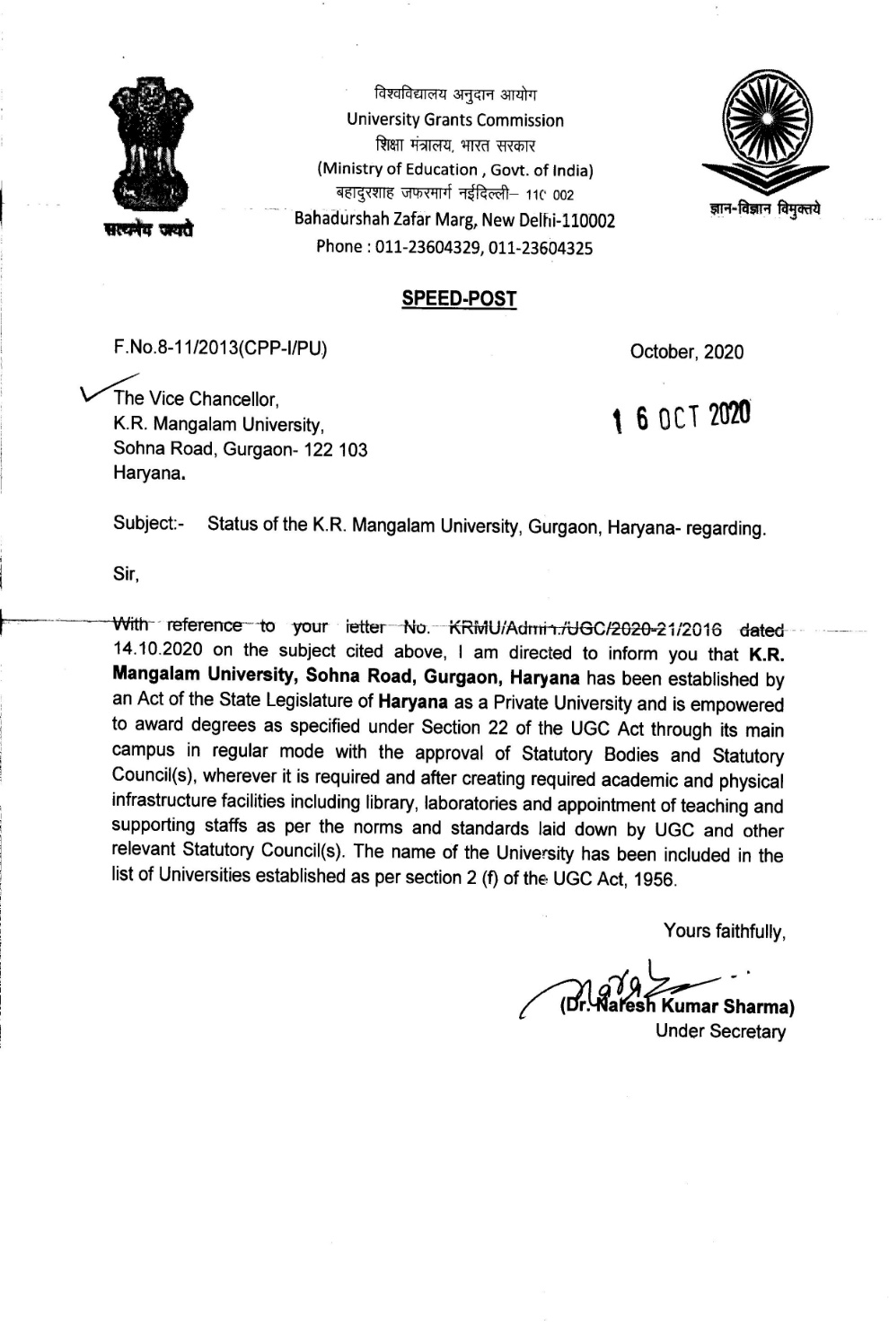
Recognition
under
UGC
2(f) of UGC Act, 1956

Slide 10
Administrative Functions of Registrar
1. Custodian of University Records
• Maintain official records of the university including student records, Statutory Bodies Records.
• Safe custody of common seal and official documents.
2. Statutory Body Coordination
• Secretary to statutory bodies such as: Governing Body, Board of Management, Academic Council, University Research Committee.

Slide 11
Administrative Functions of Registrar
3. Administrative Control
• General supervision over non-teaching staff and administrative branches.
• HR administration including service records, leave, and promotions.
• Implement policies and decisions made by authorities.
4. Regulatory Liaison
• Interface with Ministry of Education GOI , UGC, PCI , BCI, COA , NCTE, HSPC Directorate of Higher Education Haryana, District Administration, Police Authority.
• Submit Mandatory Reports .

Slide 12
Administrative Functions of Registrar
5. Admissions & Enrolments
• Coordinate with Departments on Admission Guidelines, Eligibility, and seat Matrix, document verification.
• Maintain Academic Records and issue Registration Numbers & Enrolment Numbers.
6. Legal and Statutory Compliance
• Represent the University in Legal Matters as per the direction of the Vice-Chancellor.
• Ensure implementation of University Statutes, Ordinances, and UGC Regulations.
7. Student Services and Grievance Redressal
• Oversee Student Welfare, Scholarships, and Grievance Handling Mechanisms.

Slide 13
Administrative Functions of Registrar
Environment Compliance:
Haryana State Pollution Control Board
University has agreement for Solid, Liquid, Hazardous, Bio, Chemical & E-waste Management.
Annual compliances for Air, Water, Noise, STP Inlet and Outlet, Transformer and DG Set.
Annual Energy, Green & Environment External Audit
Lift NOC & AMC
Fire & Safety NOC & AMC
ISO Certification: Environmental/Quality/Energy Assurance
ISO 14001:2015 (Environmental Management)
ISO 9001-2015 (Quality Management)
ISO 50001:2018 (Energy Management)

Slide 14
Administrative Functions of Registrar
Nature of MoUs | Benefits
Academic Collaboration MoUs | Enhances Curriculum, Student/Faculty Exchange
Industry-Academia MoUs | Boosts Placements, Internships, R&D Funding, and Skill-Aligned Courses.
Research & Innovation MoUs | Grants access to Funding, Labs, Patents, and Projects
International University MoUs | Student Mobility and Joint Publications.
Skill Development MoUs | Improving Employability.
Technology & Infrastructure MoUs | Upgrades Labs, Digital Tools, and Incubation Centers
Community Development MoUs | Strengthens CSR, Public Health, and Rural Engagement
Sports & Cultural Exchange MoUs | Promote Sports, Arts, and Cultural Activities.

Slide 15
Administrative Functions of Registrar
Policies and SOPs
1. Policy of Code of Conduct and Discipline for Students of KRMU
2. Employee Welfare Policy of KRMU
3. Mentor-Mentee Policy of KRMU
4. Hostel Handbook
5. Divyangjan Facilities Policy
6. Policy for Admission & Migration of Students
7. Leave Policy
8. Fee Refund Policy
9. Transport and Hostel Policy
10. Innovation and Start-Up Policy
11. SOP for Safety and Security of University Campus
12. SOP for Student Safety during Medical Emergencies
13. SOP for Signing MoU
14. SOP for Employee Exit Clearance at KRMU
15. Maintenance Policy for Academic Infra
16. IT Policy

Slide 16









Recognitions, Regulatory Approvals and Membership of Professional Bodies
UGC
Haryana Govt.
Recognized by University Grants Commission (UGC)under section 2 (f) of UGC Act, 1956, an apex body of the Govt. of India
Established under Haryana Private Universities Act 2006 (Amended Act 08 of 2013)
AIU
HSCP
Member of Association of Indian Universities (AIU)
Haryana State Council For Physiotherapy.
NCTE
COA
Education Programs approved by
National Council of Teacher Education (NCTE)
Architecture Program approved by
Council of Architecture (COA)
BCI
PCI
Law Programs approved by
Bar Council of India (BCI)
Pharmacy Programs approved by Pharmacy Council of India (PCI)

Slide 17











KRMU Registration on Various Portals
Notes:
Glimpses instead of Glimpse

Slide 18
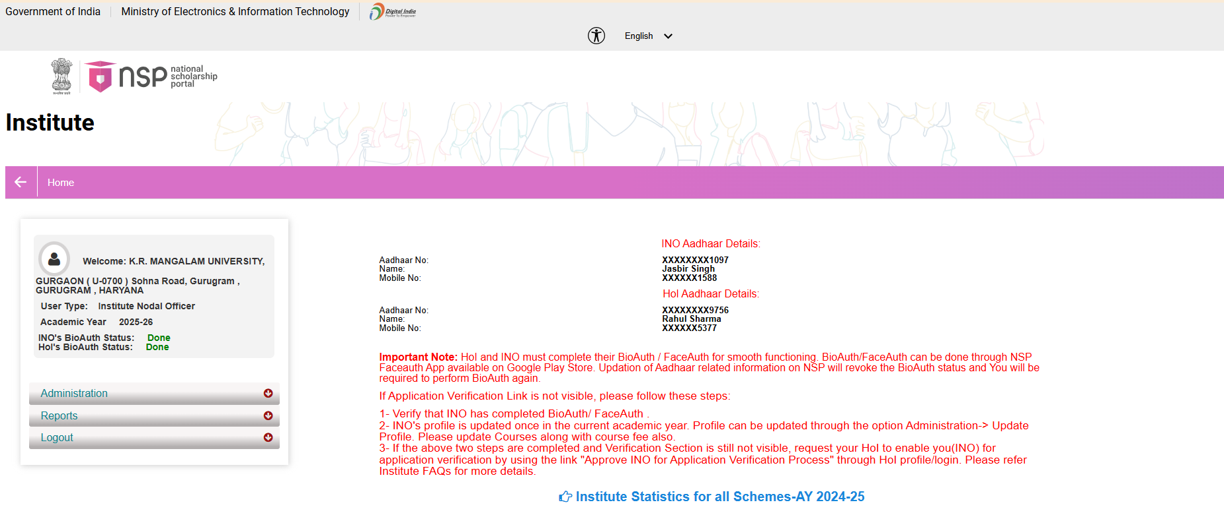
KRMU Registration on National Scholarship Portals (NSP)

Slide 19
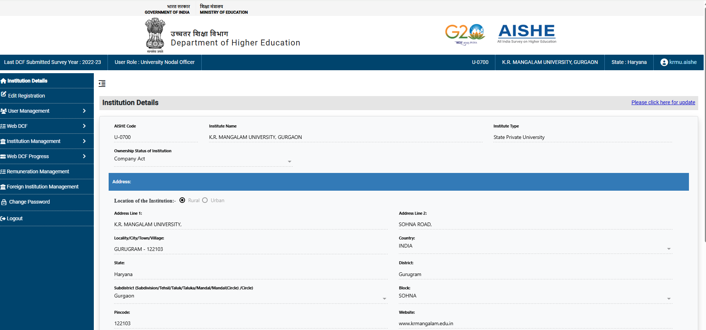
KRMU Registration on All India Survey of Higher Education (AISHE)

Slide 20
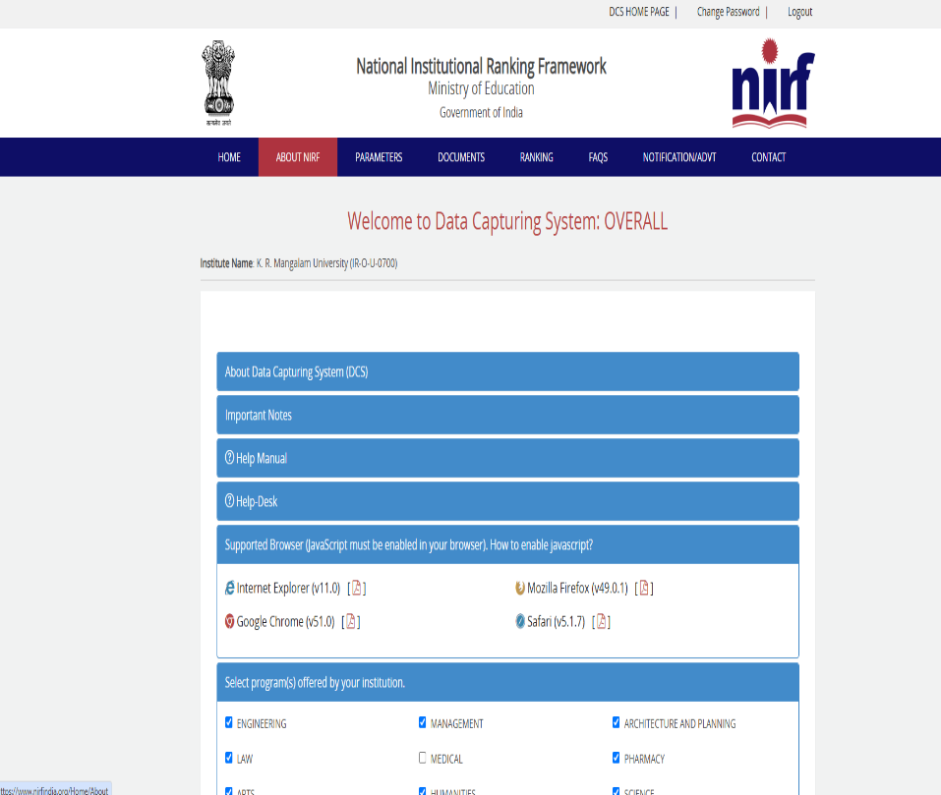
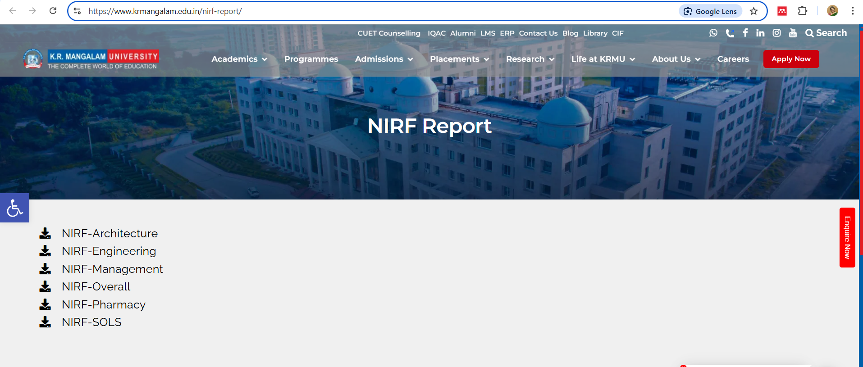
KRMU Registration on National Institutional Ranking Framework (NIRF)

Slide 21
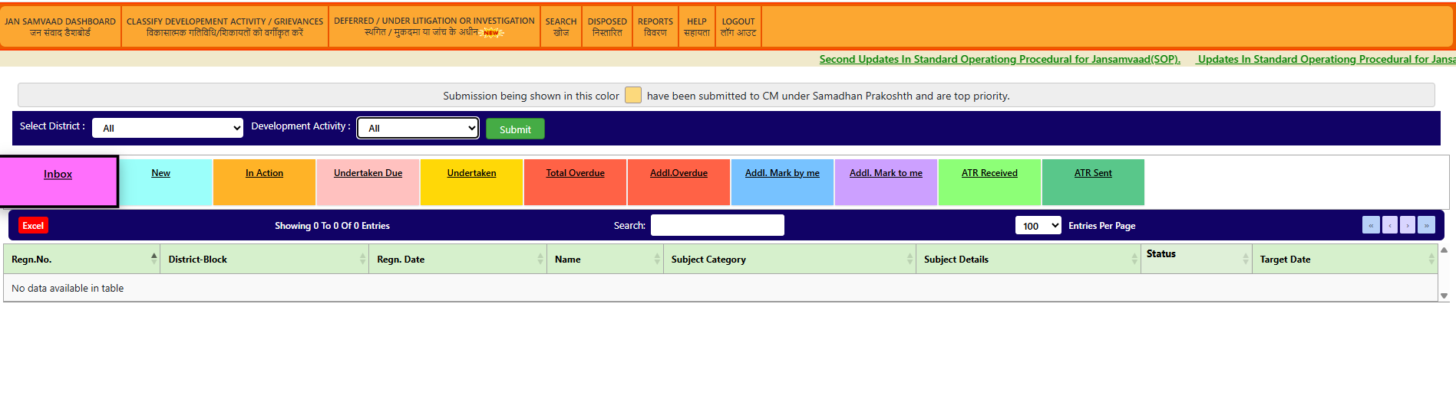
KRMU Registration on Chief Minister Window, Haryana Govt. (CM Window)

Slide 22

KRMU Registration on Online Grievance Redressal System e-SAMADHAN

Slide 23

KRMU Registration on Undertaking Transformative Strategies and Actions in Higher Education (UTSAH)

Slide 24
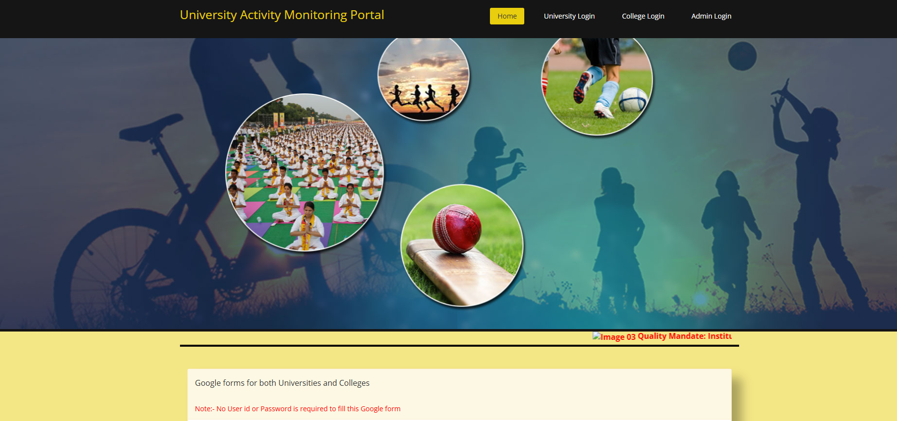
KRMU Registration on UGC- University Activity Monitoring Portal

Slide 25
Staff Welfare
76 AC Bus transport facility for faculty at Nominal Rate and free for Non-Teaching Staff.
Mental Wellbeing Counseling Center.
OPD Physiotherapy facilities at Nominal Rate.
Creche Facility for Employees' kids.
20% Fee Concession to Employees on PhD programme.
15% Fee Concession to Employees' wards for Admission
Recreational Facilities (Gym & Sports)
Gratuity, PF, ESI & Group Insurance Benefits to Employee.
Organic Veg Mart for Employees (Subsidized Rate).
24x7 Electricity, ATM, Medical & Ambulance Facility.
Notes:
New Courses replaced with New Programmes

Slide 26


KRMU has implemented an Education Management System like iCloud EMS to digitize its academic & administrative processes.
Employee biometric attendance marking, monitoring & leave management is carried out using iCloud EMS
Notes:
New Courses replaced with New Programmes

Slide 27
Annual Appraisal Policy
Appraisals – Once in a year - Given out twice a year – 1st July or 1st January – depending on when the employee has completed one year at the University
(i) Criteria for Faculty (Performance Assessment Exercise is implemented annually through ‘SeroSoft’)
S.No. | Criteria | Points
1. | Awards, recognitions and fellowships | 10 | 80
2. | Research publications | 20
3. | PhD supervision | 10
4. | Research and consultancy funding | 10
5. | Events and activities | 10
6. | Faculty attendance | 10
7. | Student feedback | 10
8. | Pedagogical innovation | 10 | 70
9. | Feedback from admission team | 10
10. | Feedback from NAAC criteria heads | 20
11. | Feedback from Deans | 20
12. | Other academic/ administrative works | 10
 | TOTAL |  | 150
(ii) Appraisal for Non-teaching staff is based on their Performance evaluation by Dean/Reporting Officer and Registrar respectively by filling Performance Appraisal form

Slide 28
Performance Appraisal System for Non-Teaching Staff​
Process Steps
Assessment by School Dean/Unit Head
Evaluation of Recommendations by the Registrar
Approval by the Vice Chancellor
Financial increment and incentives
Notes:
Glimpses instead of Glimpse

Slide 29
Career Advancement Scheme (CAS)/ Promotions
Selection Committees are constituted to consider Promotion or Cadre Review of Faculty Members under CAS (Career Advancement Scheme).
The Management, based on the recommendations of the Selection Committee, may like to promote the faculty members
Step 1
All the Faculty Members who are eligible for the Promotion have to submit an application for Promotion
Step 2
The Application and the Form is then forwarded to HR & RDC for further process of Interview.
Step 3
The Interview is conducted by the Selection Committee which comprises of One External Subject Expert and One Internal Subject Expert along with the Panel (Hon'ble Vice Chancellor, Pro Vice Chancellor, Dean Academics, School Dean & Registrar)
Step 4
The Recommended applications are sent for the Final Approval of Hon'ble Vice Chancellor.

Slide 30
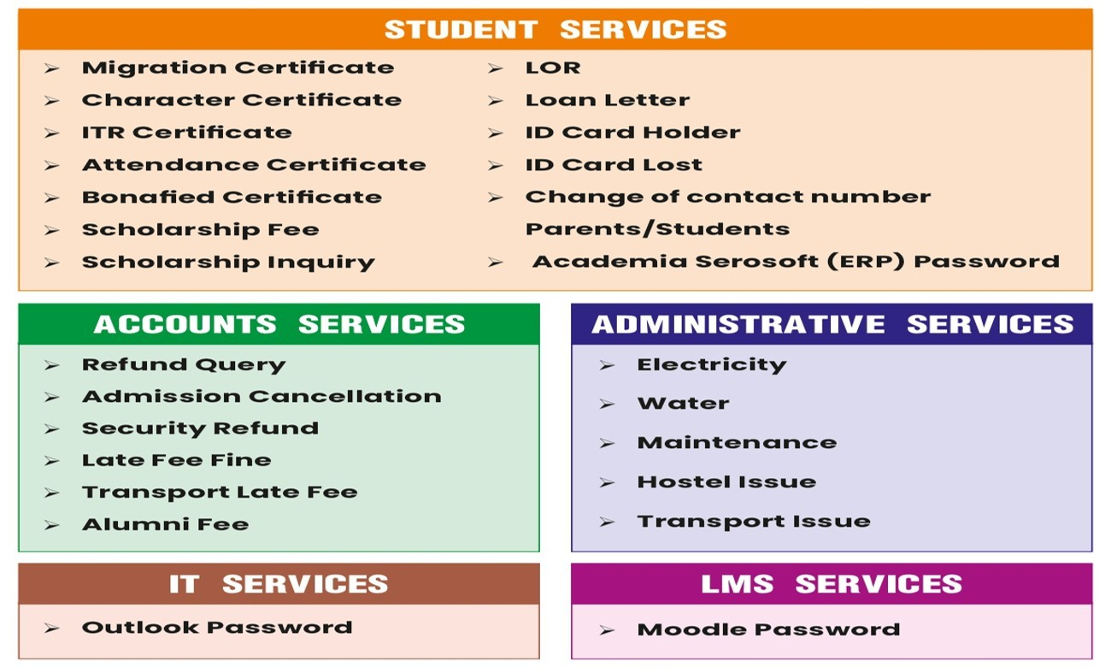
Student Help Desk

Slide 31
Student Support: Scholarships
Scholarship Details from 2018-2024
Type of Scholarship | 2018-19 | 2019-20 | 2020-21 | 2021-22 | 2022-23 | 2023-24 | 2024-25 | Grand Total
KRMU CGPA Based | 25 | 19 | 29 | 6 | 7 | 21 | 26 | 133
KRMU 12th Marks Based (Merit-cum-Means) | 65 | 38 | 85 | 230 | 596 | 1087 | 725 | 2826
Student Academic Record | 577 | 512 | 687 | 844 | 812 | 2384 | 4043 | 9859
EDU Empower | 640 | 657 | 652 | 948 | 1831 | 1839 | 1978 | 8545
Student Learning Enhancement Support | 508 | 293 | 380 | 301 | 160 | 2674 | 3042 | 7358
PM Scholarship (Armed Forces) | 0 | 1 | 0 | 3 | 5 | 0 | 0 | 9
Post Matric (Minorities SC/ST/OBC) | 0 | 3 | 18 | 20 | 31 | 0 | 0 | 72
Ishan Uday (NER) | 0 | 0 | 0 | 1 | 2 | 0 | 0 | 3
Central Sector Scholarship | 0 | 0 | 0 | 0 | 3 | 0 | 0 | 3
Finance Assessment (BEEDI/CIHE/IOMC…) | 0 | 0 | 0 | 0 | 5 | 0 | 0 | 5
Total | 1815 | 1523 | 1851 | 2353 | 3452 | 8005 | 9814 | 28813
Notes:
Glimpses instead of Glimpse

Slide 32
Student Support: Scholarships
MERIT SCHOLARSHIP 2024-25:
Part A-On the Basis of Marks Scored in Class XII Examinations
Eligibility Criteria | Scholarship
90% and above | 100%
85% to less than 90% | 35%
80% to less than 85% | 25%
Part B-On the Basis of Other Category
Category | Scholarship
Siblings | 15%
K.R. Mangalam Group | 15%
Defense Scholarship | 15%
Staff Discount | 15%
Sports Quota – State Level | NIL
 | 25%
Notes:
Glimpses instead of Glimpse

Slide 33
Student Support: Scholarships
MERIT SCHOLARSHIP 2024-25:
Part C-On the Basis of Entrance Examination
Entrance Exam Name | Eligibility Criteria | Scholarship in %
CUET -1 (On the basis of best 4 subjects score) | 90% & above | 100%
 | 75% to less than 90% | 50%
 | 60% to less than 75% | 35%
 | 50% to less than 60% | 25%
 | 45% to less than 50% | 10%
CUET -2, On the basis of best 3 subjects score with legal studies as a mandatory subject. This scholarship is applicable for School of Legal Studies only | 90% & above | 100%
 | 75% to less than 90% | 35%
 | 60% to less than 75% | 25%
JEE (MAIN) | 95.01 percentile and above | 100%
 | 90.01 percentile to 95 percentile | 35%
 | 85.01 percentile to 90 percentile | 25%
 | 75.01 percentile to 85 percentile | 10%
CLAT Rank | 01 to 2500 | 100%
 | 2501 to 5000 | 35%
 | 5001 to 10000 | 25%
NATA | 130.01 & above | 100%
 | 110.01 to 130 | 35%
 | 90 to 110 | 25%
NCHMCT Rank | 1 to 1000 | 100%
 | 1001 to 3000 | 35%
 | 3001 to 5000 | 25%
Notes:
Glimpses instead of Glimpse

Slide 34
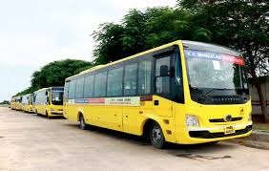
Transport Facility
For employees and Students residing in NCR, 78 air-conditioned bus facility is extended at nominal charges/free to ease their daily commute.
Transport Routes
Shuttle Service – For shorter routers to and from Huda and Rajeev Chowk (Gurugram)
Route Service – For route service buses all over Delhi, Gurugram, Rewari, Manesar, Farrukh Nagar, Bhiwadi, Faridabad & Bahadurgarh etc.
For Bus routes please click https://www.krmangalam.edu.in/pdfs/KRMU-ROUTE-JAN-2024.pdf
Notes:
New Courses replaced with New Programmes

Slide 35
Infra@ KRMU
Facility | Capacity
Solar Plant Capacity | 310 KW (Solar Pannels- 984)
STP | 300 KLD
Fire NOC | Block- A/B/C/ Hostels
DG Set | Total 5 (1-- 250 KV, 1-- 380 KV, 2-- 625 KV, 1--750 KV)
Transformer | 2000KV
Biogas | 2 KLD
Rainwater | 17-- Harvesting Pits
Lift | Total 9-- lifts (capacity of 8 persons minimum)
Ramp | 8-- Ramps (4-- A Block, 1-- B Block, 1—C Block, 2-- Hostel)
Emergency & Assembly Point | 3-- Assembly Point (Common for A, B, C Block and Hostel)
Transport | 76-- CNG Buses, 3-- CNG Vehicle, 4-- E Carts
Notes:
New Courses replaced with New Programmes

Slide 36
Infra@ KRMU
Facility | Nature of Service
Housekeeping, Horticulture & Security | Agreement with Outsource Vendor
Solid Waste Management | Agreement with Sohna Municipality Corporation.
Bio Waste Management | Agreement with Biotic Management.
Hazardous waste | Agreement with Bharat Oil
Sanatory Pad dispenser and Inclinator | Installed in Hostel
E- Waste | Designated area is allocated in the campus
Sensor Based Technology | Available in washroom for sensor tap, Sensor based gate and Sensor based corridors light in the campus
Notes:
New Courses replaced with New Programmes

Slide 37
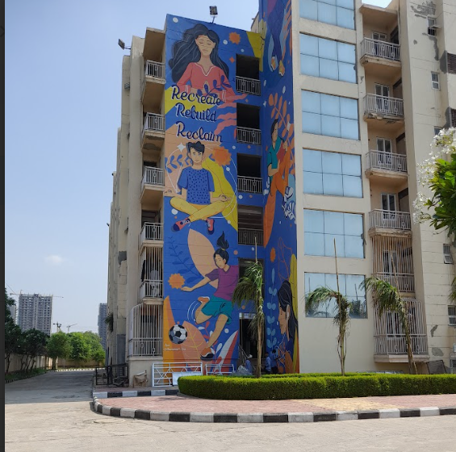
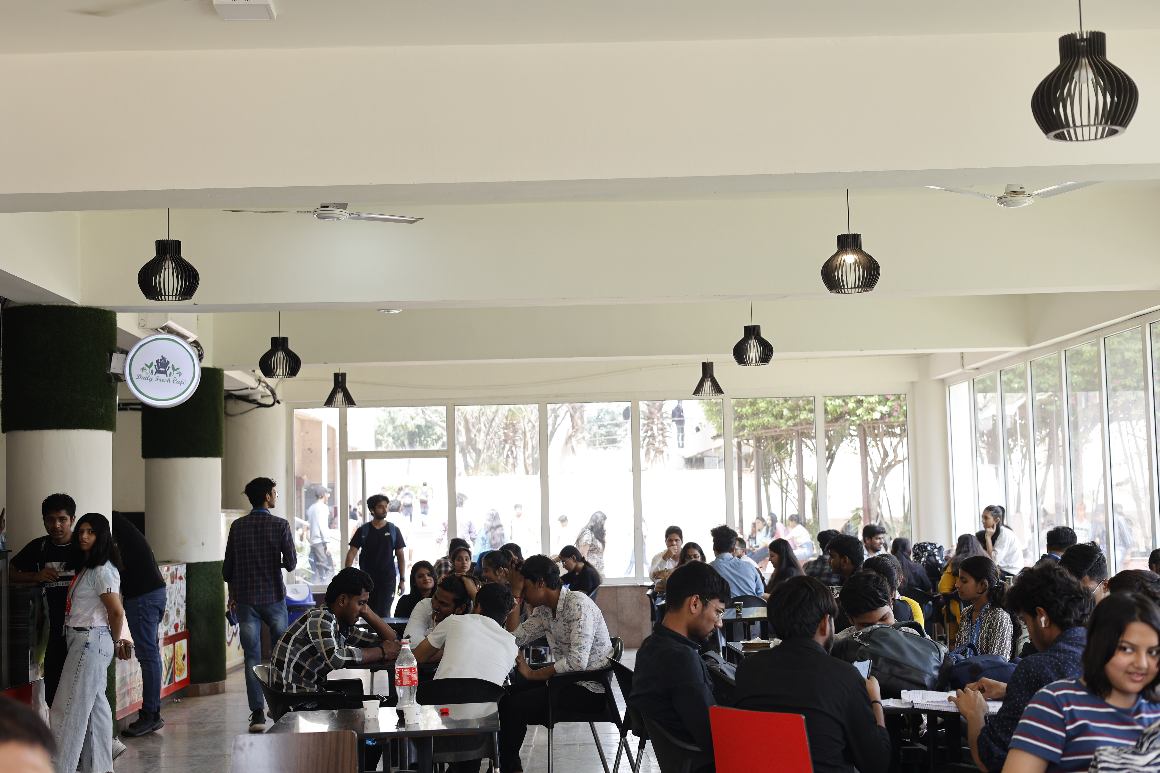
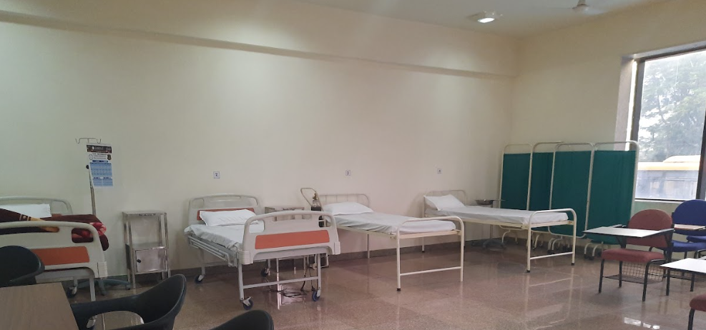
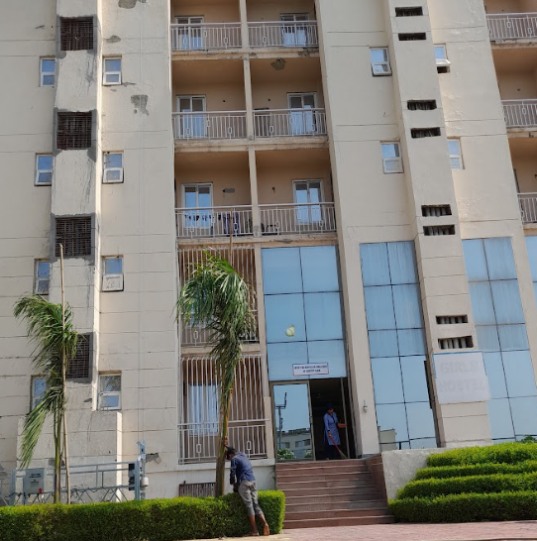
Hostel
Boys Hostel
(a) Total Student Strength : 336
Girls Hostel
(a) Total Student Strength : 312

Slide 38

Future Action Plan
1.Expand Reach and Access
-To Launch Off-Campus and offshore Campus.
-To Introduce Online And Distance Learning Programs.
2.Enhance capacity and facilities
1. To introduce New Hostel Block (600 Seats) (AY 2025-26)
2. To introduce New Academic Block (2 Lakh sq. ft, 6-Story Building) (AY 2025-26)
3. Achieve 100% student Enrolment
National Student Depository (NAD)
To Upload 100% academic certificates/degrees for Secure storage, retrieval-and Easy verification and Enhanced student mobility
b) Academic Bank Credit (ABC)
To Achieve 100% student enrolment For Flexible credit transfer And Enhanced student mobility
4.Automation Solutions
To Replace paper-based documents with electronic versions, Improve efficiency and reduce paperwork.
38

Slide 39
THANK YOU

