Slide 1



Research and Development Cell
(RDC)
Welcomes
NAAC Peer Review Team
16-18 June 2025

Slide 2

Presentation Overview
Research and Development Cell
Team RDC
Research Ecosystem
Key Initiatives for Research
Ph.D. Programme Process
RDC Responsibilities
Research Support@KRMU
Research Outcomes and Achievements
Research Awards
Future Plan
Notes:
Glimpses instead of Glimpse

Slide 3
Research and Development Cell
Research and Development Cell
IPR, Legal & Ethical Matters Cell
PhD Section
Central Instrumentation Facility (CIF) https://www.krmangalam.edu.in/cif/
Dean Research
Chairperson
Associate Dean
(PhD Programs)
Director
Associate Dean
(Research)
Member Secretary
Associate Director (Operations & Maintenance)
Associate Dean
(PhD Programs)
Technical Officer
Research Finance Officer
Research Communications Officer
Research Web Page Link: https://www.krmangalam.edu.in/research-and-innovation/
Notes:
Glimpses instead of Glimpse

Slide 4
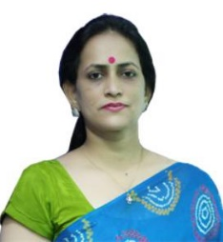
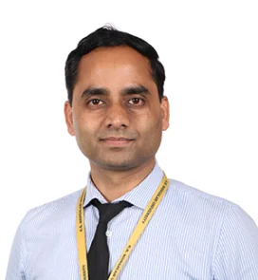
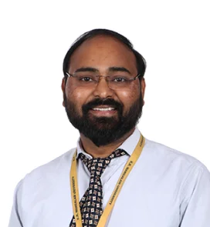
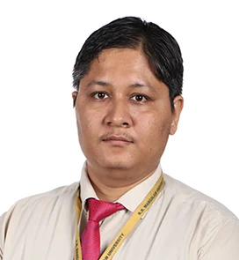
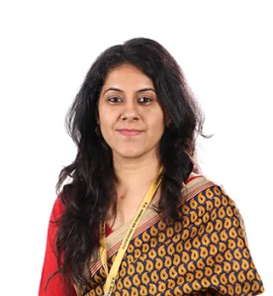
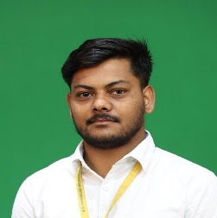
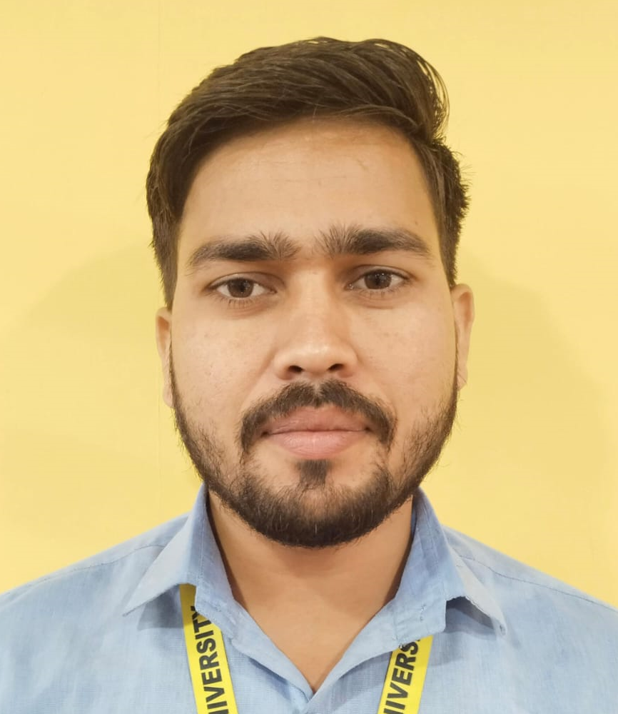
Team RDC
Dr. Pawan Kumar Associate Dean Research
Dr. Seema Raj
Dean Research
Dr. Surendra Kumar Yadav Associate Dean PhD Programme
Dr. Prabhakar Bhandari Research Finance Officer
Dr. Shivani Wadhva
Research Communication Officer
Mr. Aman Vishwakarma
MIS Executive
Mr. Saurabh Kumar
MIS Executive
14-06-2025
Notes:
Glimpses instead of Glimpse

Slide 5
Research Ecosystem
Research Ecosystem
Research policies
Seed Grants
Research Incentives
Research and Development Cell
Ph.D. Program
University Research Committee
Research Collaborations
School Research Committee
Research Facilities
University Research Ethics Committee
IPR, Legal and Ethical Matter Cell
KEIC
Research Promotion Policy
Seed Grant Policy
Faculty Research Incentive Policy
IPR Policy
Consultancy Policy
Anti Plagiarism Policy
University Research Fellow Policy
Ph.D. Students Research Reimbursement Scheme
Link of Policies: https://www.krmangalam.edu.in/PDF
Notes:
Glimpses instead of Glimpse

Slide 6
Key Initiatives for Research
URC & SRC: Powers & Functions mentioned in First Statutes of KRMU
PhD Programme Started in 5 schools (SBAS, SOET, SMAS, SOLS, SOMC) (Currently in 8 Schools we are offering)
University Research Grant Committee (Currently Seed Grant Review Committee)
Research & Development Cell Establishment
Research Promotion Policy
University Research Committee
2023 Onwards
Revision of Research Incentives
CIF characterization reimbursement policy for Internal faculties
Research Centre Establishment
PhD students research reimbursement scheme
More Seed Grant Sanction
CIF Upgradation
Appointment of IRF/URF
Web Application set-up for Research database management and automation
Appointment of Research Track Faculty
Notes:
Glimpses instead of Glimpse

Slide 7
RDC Functions
RESEARCH FACILITIES
RESEARCH TRAININGS
CONSULTANCY
SEED GRANTS
Ph.D. PROGRAMME
RESEARCH PUBLICATIONS/PATENTS
RESEARCH MoU’s & Collaborations
EXTERNAL RESEARCH FUNDING
Notes:
Glimpses instead of Glimpse

Slide 8
Support for Internal research scholar for characterization of samples in subsidize rate in CIF
Monetary Appreciation to the faculty by providing Incentive for publications and grants
Reimbursement of to the faculty for FDP’s/Memberships/Conference Participation
Provision of Academic leaves and On Duty for research activities
Provision of Seed Grant
Patenting Support from IPR, Legal & Ethical Matters =21
University Research Fellowship and 20% fees discount to Internal Faculty/Staff
Research Awareness Programs
Reimbursement of Research Expense to PhD students
Research Support@KRMU
Notes:
Glimpses instead of Glimpse

Slide 9
Ph.D. Regulations and Course Work as per UGC Regulation
Ph.D. Programme Process
Admission Process
(Admission Office)
Ph.D. Progress Monitoring (Ph.D. Section and SRC’s)
Semester Registration Process
(Ph.D. Section & Account Section)
Award of Ph.D. Degree
(COE-Office)
Advertisement
KRMU-Ph.D. Entrance Test
Declaration of the Results
Selected candidates offered for Admission in Ph.D. Program
RAC Formation (Sup.+2members)
Course Work Registration (for 14 credits)
Ph.D. Course work classes
Synopsis approval and Semester Progress Report 2nd Semester onwards till Pre-thesis Presentation
Semester Registration
Odd Semester: July-December
Fee submission Duration
(1 June to 30th June)
Even Semester: January-June
Fee Submission Duration
(1 Dec. to 31 Dec.)
Minimum Requirement of Publications to allow for Pre-Thesis Presentation
Approval from Ph.D. Section for Pre-thesis Presentation
Pre-thesis submission to COE office with approved time frame
Oral Defense
Result Notification
Provisional Degree
Degree Award
PhD Programme Web Page Link: https://www.krmangalam.edu.in/phd-regulations/
Notes:
Glimpses instead of Glimpse

Slide 10
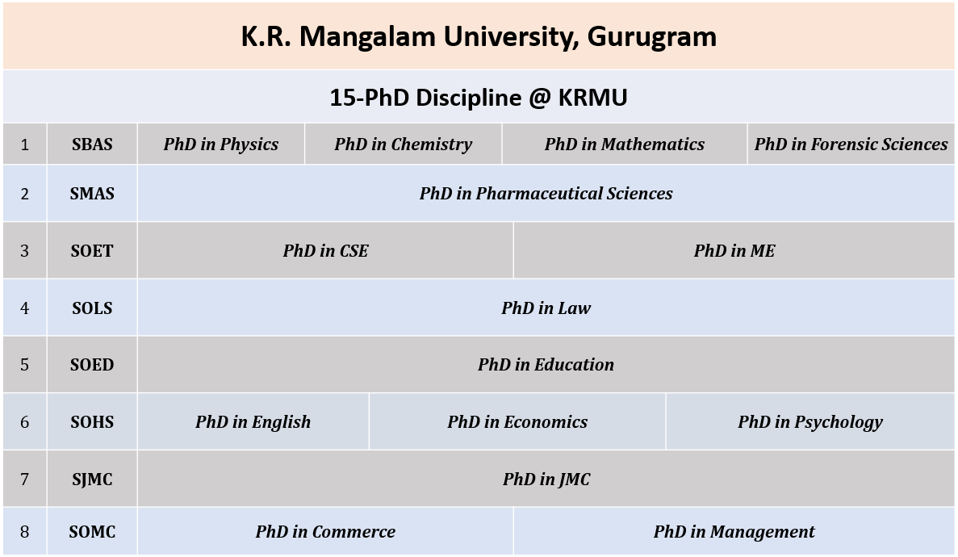
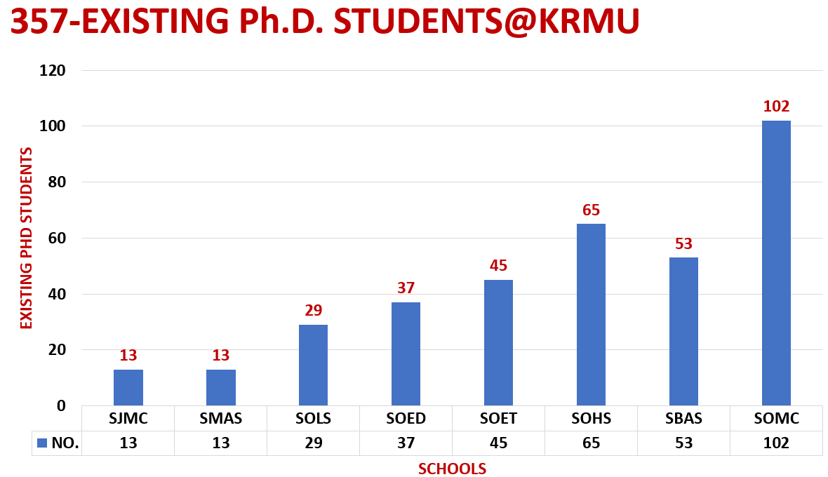
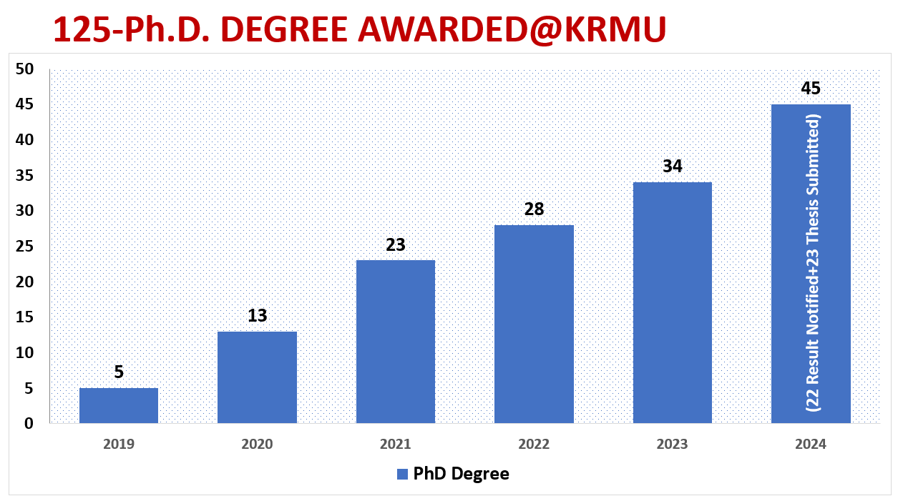
PhD Database
Notes:
Glimpses instead of Glimpse

Slide 11
Publications, Patents and Project Grants (2024-May 2025)
Year | Jan-Dec 2024 | Jan-May 2025
Journal Article Publications | 263 | 148
Categories | No. of Projects | Amount (in Lakh)
Govt. Funded | 3 | 182.88
Seed Grant | 19 | 42.03
Year | Jan-Dec 2024 | Jan-May 2025
Books | 1151 | 100
Book Chapters
Conference Proceedings Publications
Govt. Grants for Conference/Workshops etc. Rs 540000/-
2025
H-Index: 47 (SCOPUS)
2025
Average Citation Index: 13.3 (JOURNAL A SCOPUS)
Year | Jan-Dec 2024 | Jan-May 2025
Patents Awarded | 7 | 1
Design | 48 | 24
Published | 50 | 32

Slide 12
Publications and Patents (Assessment Period 2018-2023)
Year | 2018 | 2019 | 2020 | 2021 | 2022 | 2023 | Total
Journal Article Publications | 20 | 41 | 36 | 60 | 212 | 237 | 606
2023
H-Index: 28 (Avg. SCOPUS+WoS)
Year | 2018 | 2019 | 2020 | 2021 | 2022 | 2023 | Total
Books | 2 | 0 | 1 | 2 | 15 | 104 | 124
Book Chapters | 1 | 110 | 108 | 27 | 164 | 937 | 1347
Conference Proceedings Publications | 5 | 7 | 3 | 4 | 9 | 9 | 37
Total | 8 | 117 | 112 | 33 | 188 | 1050 | 1508
2023​
Average Citation Index: 7.41​ (Avg. SCOPUS+WoS)
Year | 2018 | 2019 | 2020 | 2021 | 2022 | 2023 | Total
Patents Awarded |  |  |  | 9 | 13 | 4 | 26
Design |  |  |  |  | 2 | 17 | 19
Published |  | 2 |  | 10 | 48 | 20 | 80
Notes:
Glimpses instead of Glimpse

Slide 13
Projects & Consultancy (Assessment Period 2018-2023)
Categories | No. of Projects | Amount (in Lakh)
Govt. Funded | 4 | 16.5
Non-Govt. Funded | 14 | 523.6
Seed Grant | 13 | 117.5
Consultancy | 28 | 232.23
Survey based studies
Community Empowerment
Trainings
Workshops
AI based studies
Scientific researches
Notes:
Glimpses instead of Glimpse

Slide 14




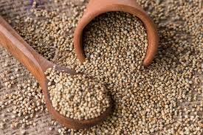
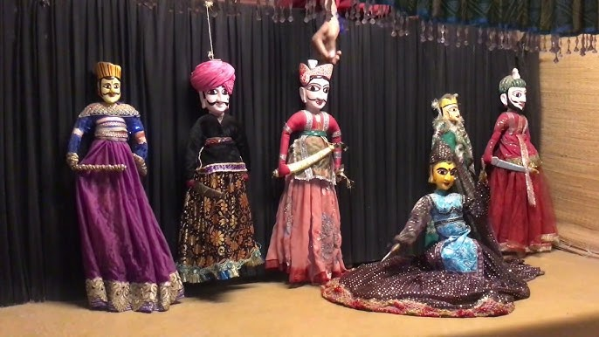

Ongoing Projects of KRMU
KRMU-KEIC STI Hub, Sohna Block, Gurugram, Haryana: 1.56 Crore
Strings of Resilience: Exploring the Socio-economic-cultural Significance of Puppetry in the Northern Region of India for Kathputli Community: 20.38 Lakhs
"वेदवाणी: स्कूलों के लिए वैदिक ज्ञान का डिजिटल स्वरूप" by Indian Knowledge Systems (IKS) Division, Ministry of Education: 6.3 Lakhs

Slide 15
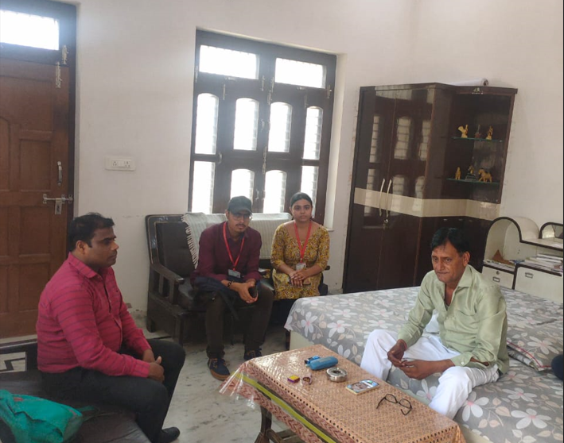
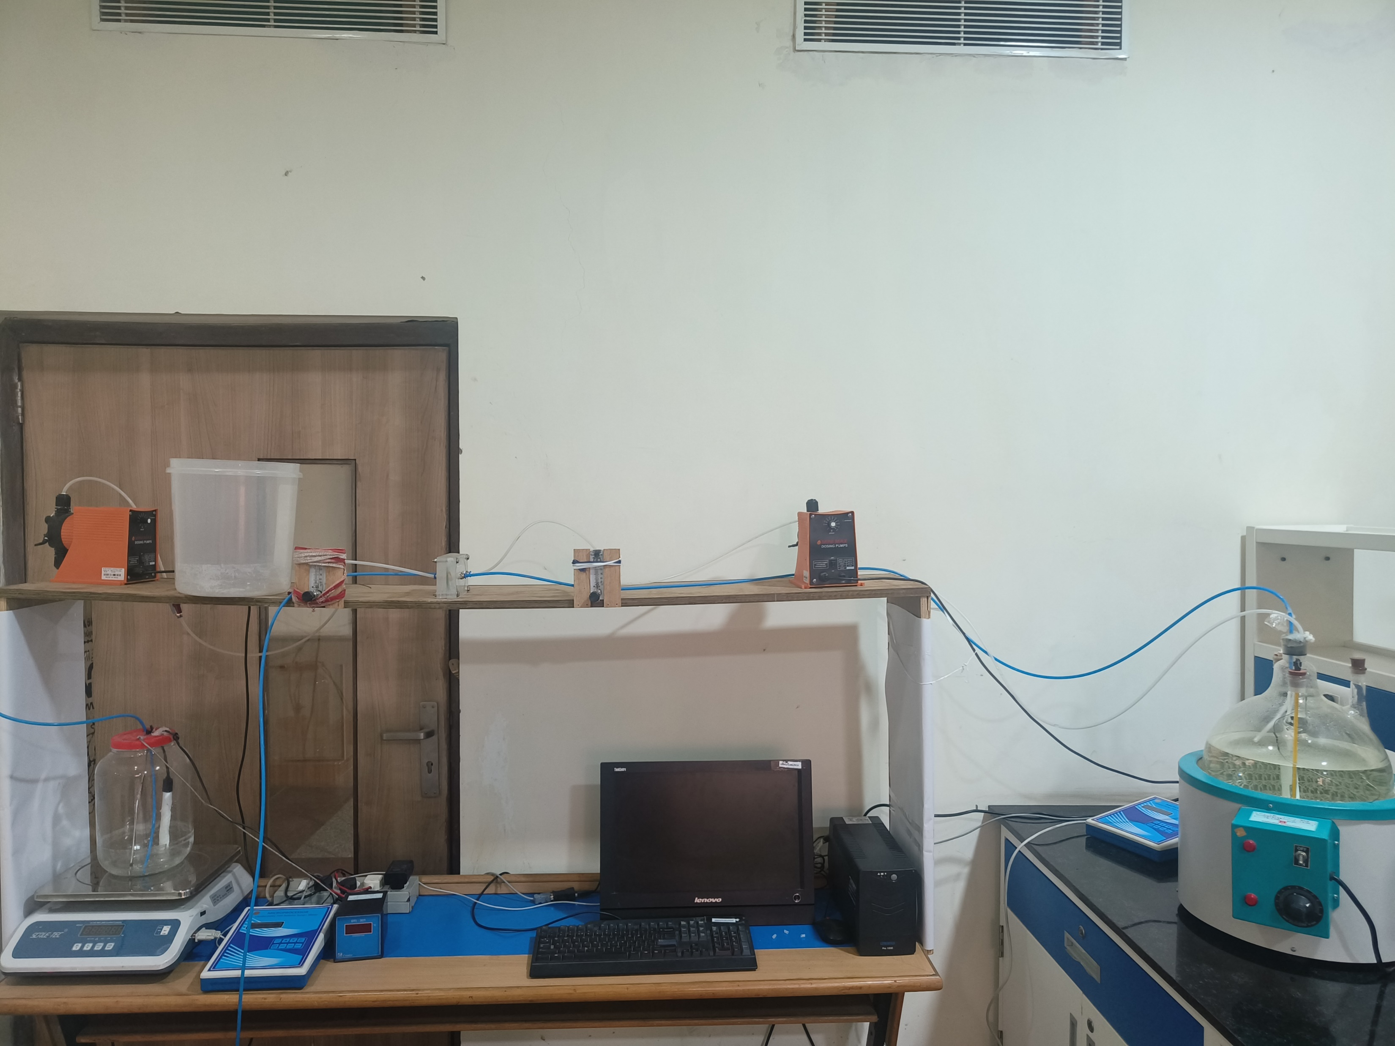

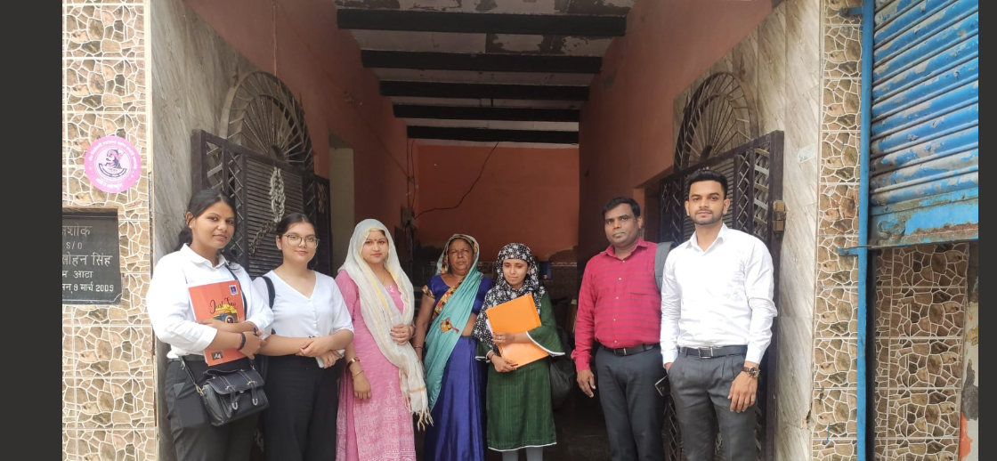
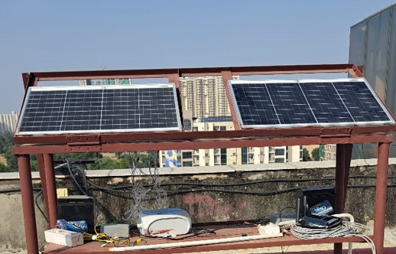
Outcome of Seed Grant Projects (2018-2023, 2024 and 2025)
Outcome of the Projects | Journal Article Published | Patents | Books | Accepted papers
Till May 2025 | 31 | 2 | 6 | 5
Survey Based Studies
Environmental Sustainability

Slide 16
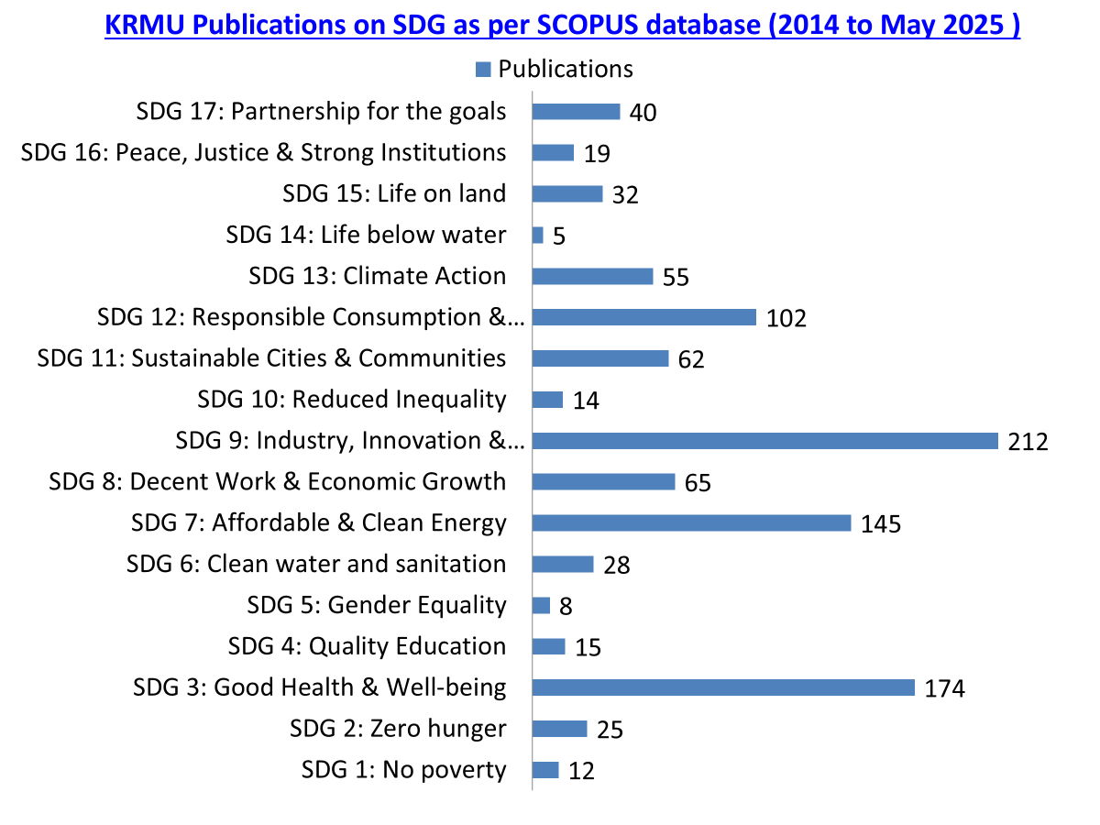

Publications on SDG as per SCOPUS database (1st Jan 2014 to May 2025 )

Slide 17
Top 11 Faculty Member: h-Index & Citations@KRMU​
Source: SCOPUS as on 31st May 2025
S.No. | Faculty Name | School | h-Index | Citations | No. of Publication
1 | Dr. Kaushal Kumar | SOET | 24 | 1696 | 126
2 | Dr. Chandra Mohan | SBAS | 21 | 1405 | 150
3 | Dr. Prabhakar Bhandari | SOET | 16 | 1068 | 83
4 | Dr. Mahipal Singh Sankhal | SBAS | 15 | 1196 | 117
5 | Dr Jagannath Jana | SBAS | 14 | 362 | 31
6 | Dr. Rupesh Kumar Tipu | SOET | 12 | 337 | 37
7 | Dr. Hema Chaudhary | SMAS | 10 | 963 | 23
8 | Dr. Rajni Gautam | SBAS | 10 | 385 | 33
9 | Dr. Saroj Verma | SMAS | 10 | 227 | 23
10 | Dr. Aman Jatain | SOET | 9 | 327 | 35
11 | Dr. Diwakar Padalia | SBAS | 9 | 333 | 18

Slide 18
Highest Cited Papers
S. No. | Title | Journal Name | Authors | Cited by
1 | Natural polyphenols: Chemical classification, definition of classes, subcategories, and structures | Journal of AOAC International | Garg A. et al | 411
2 | A Novel Smart Healthcare Design, Simulation, and Implementation Using Healthcare 4.0 Processes | IEEE Access | Sharma K. et al | 242
3 | Recycling/reuse of plastic waste as construction material for sustainable development: a review | Environmental Science and Pollution Research | Lamba P.; Kaur D.P.; Raj S.; Sorout J. | 165
4 | Purple heart plant leaves extract-mediated silver nanoparticle synthesis: Optimization by Box-Behnken design | Materials Science and Engineering C | Alam Md.S. et al | 159
5 | Application and use of different aluminium alloys with respect to workability, strength and welding parameter optimization | Ain Shams Engineering Journal | Varshney D.; Kumar K. et al | 135
6 | Lipid-based nanoformulations in the treatment of neurological disorders | Drug Metabolism Reviews | Javed, Md. N.; Barkat, A.; Alam, Md. S et al | 104
7 | Functionalized mesoporous silica nanoparticles in anticancer therapeutics | Seminars in Cancer Biology | Barkat, A.; Sunil K. et al | 103
8 | Structural, morphological, electrical and dielectric properties of Mn doped CeO2 | Journal of Alloys and Compounds | Kumar, Pawan et al | 101
9 | PGMD/curcumin nanoparticles for the treatment of breast cancer | Scientific Reports | Manchanda, R et al | 96
10 | Application of coolants during tool-based machining – A review | Ain Shams Engineering Journal | Kumar K. et al | 95
11 | Potential Applications of Engineered Nanoparticles in Plant Disease Management: A Critical Update | Chemosphere | Mehta, S. et al | 92

Slide 19
Research Awards​

Slide 20
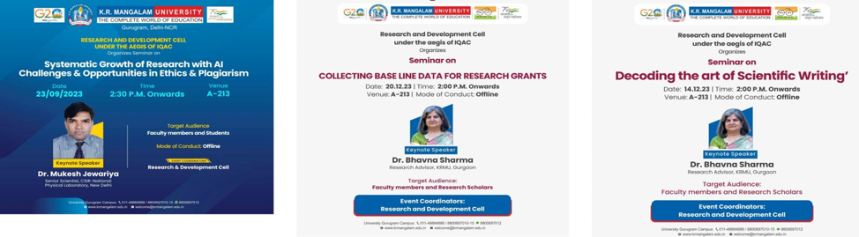
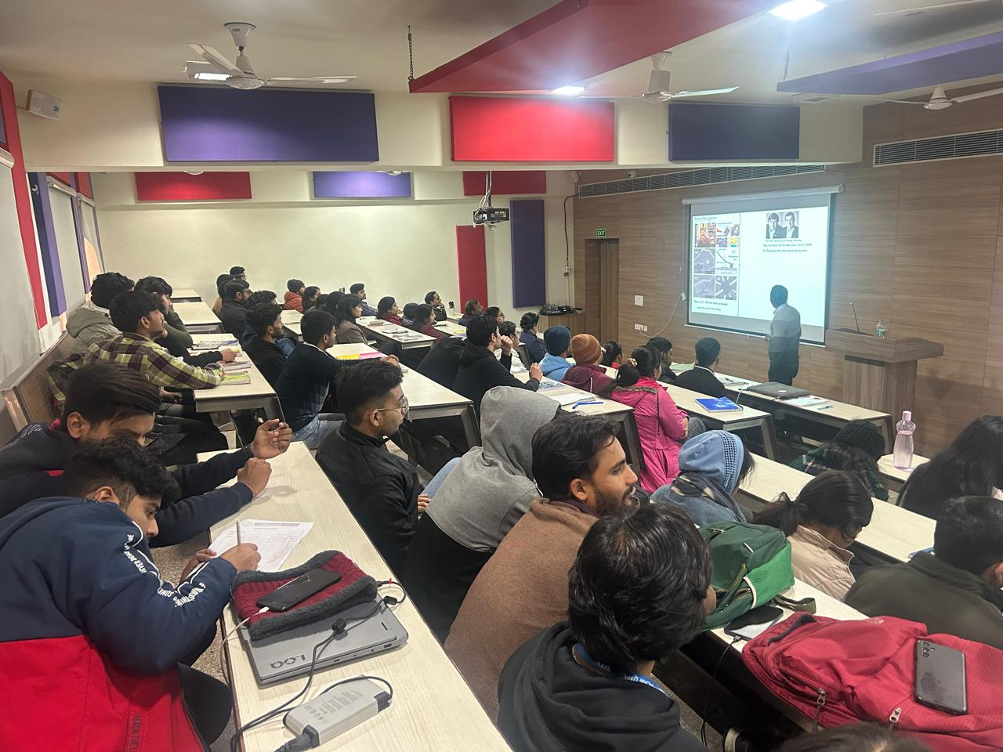
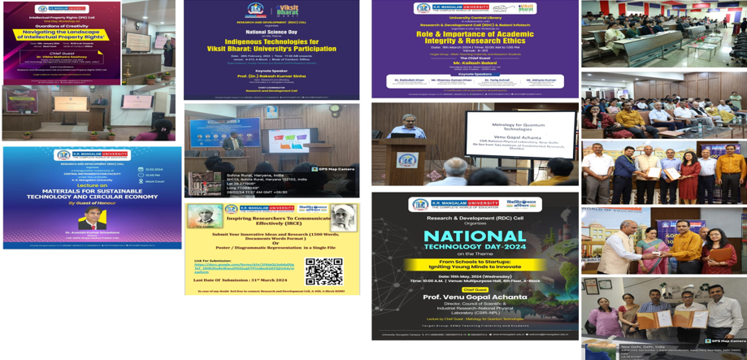
Research Events/Workshop​
Events conducted by RDC

Slide 21
RDC Future Plan
Secure National and International research funding.
Form specialized Research Clusters.
Conduct more Faculty Development Programs, Workshops and Conferences.
Promote more student involvement in research.
Invest in advanced research infrastructure.
Thank you
Notes:
Glimpses instead of Glimpse

