Slide 1
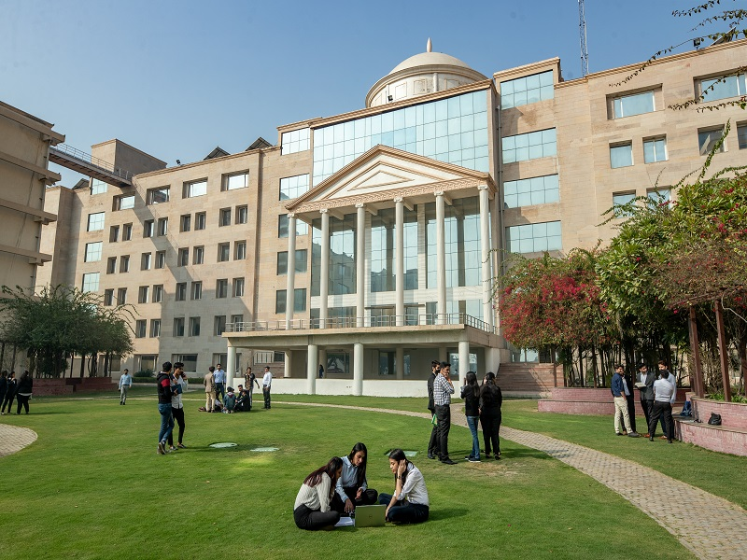


School of Basic and Applied Sciences
(SBAS)
Welcomes
ESTABLISHED
2013
NAAC Peer Review Team
June 16-18, 2025

Slide 2
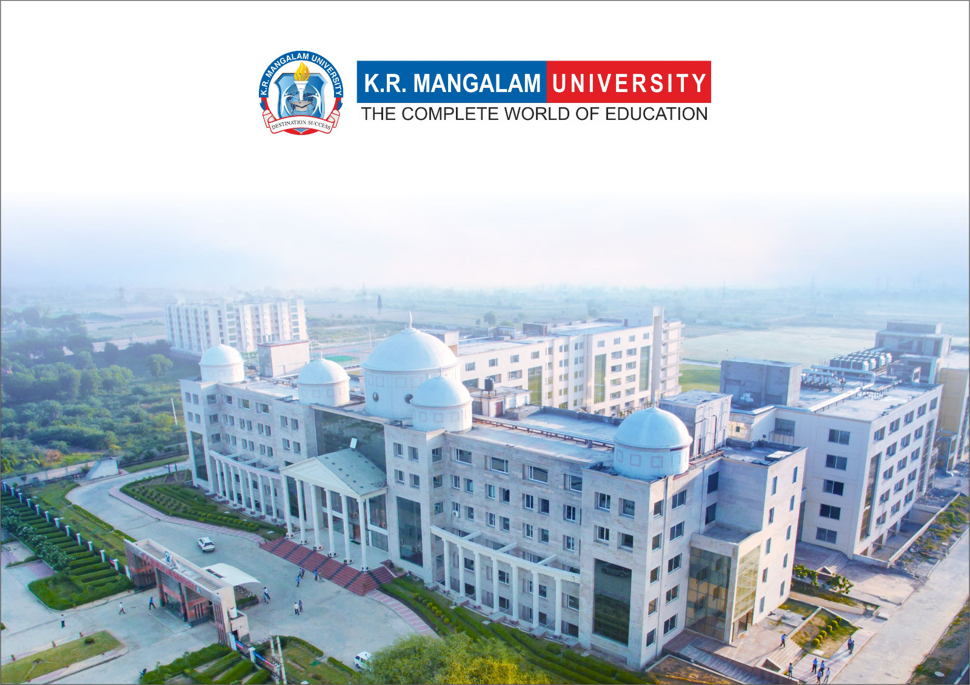

TABLE OF CONTENTS
School Introduction
SBAS as on date
Curricular Aspects
Teaching-Learning and Evaluation
Research, Innovation and Extension
Infrastructure and Learning Resources
Student Support and Progression
Governance, Leadership and Management
Institutional Values and Best Practices
A way forward

Slide 3
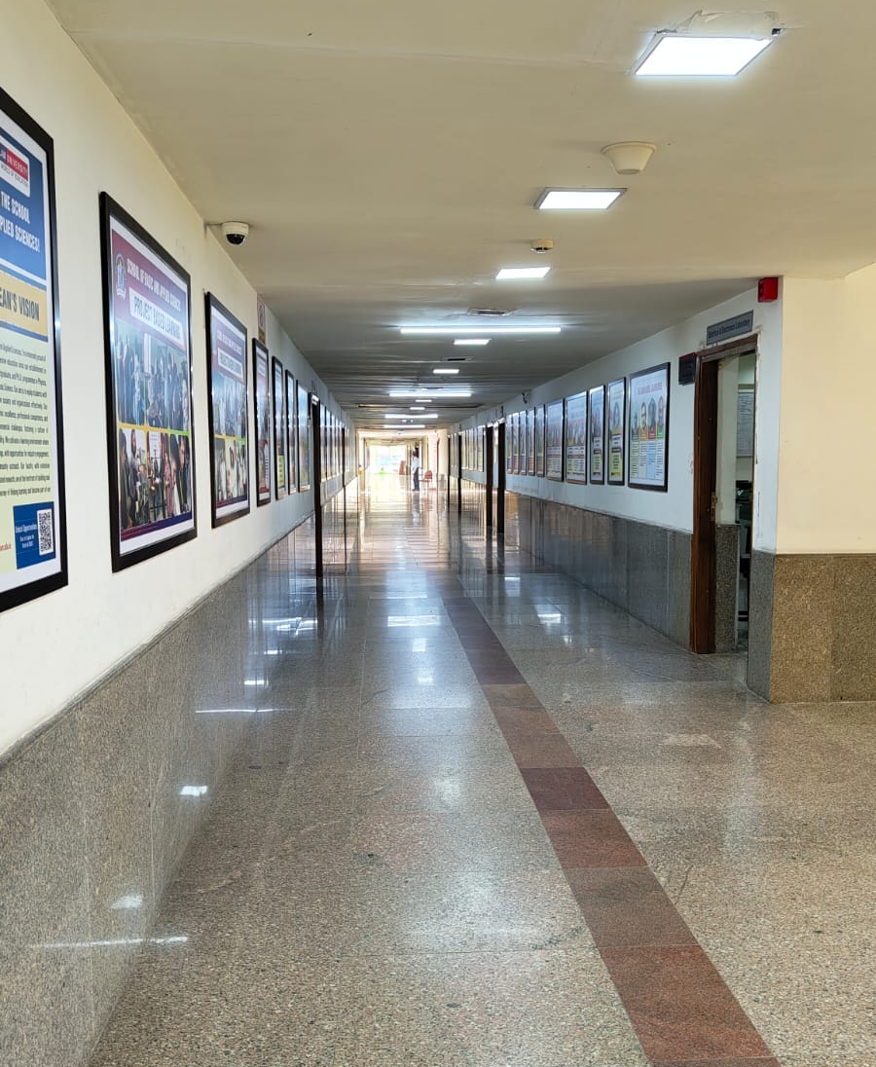



School Introduction
Collaborations with national, international academic & research organizations and industries for knowledge creation, advancement and application of innovative practices in sciences.
Create conducive environment for lifelong learning.
Empower students to be socially responsible and ethically strong individuals through value-based science education.
To be a premier school for advanced learning and research in the field of basic and applied sciences
00
VISION
MISSION
1

Slide 4
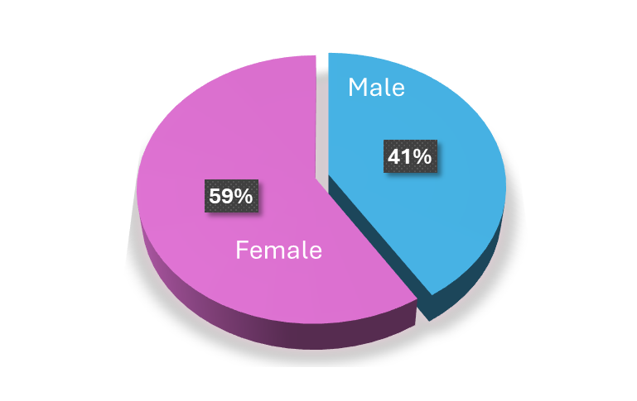
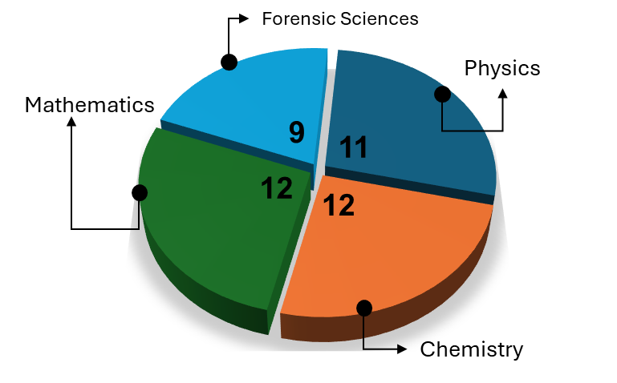
B. Sc (H) Chemistry
B.Sc. (H) Physics
B.Sc. (H) Mathematics
M. Sc Mathematics
M. Sc Physics
B. Sc. (H) Forensic Science
NEP Implementation
M. Sc Forensic Science
Integrated B. Sc/
M. Sc Forensic Science
M. Sc. Chemistry
SBAS as on Date
2013
2014
2015
2016
2022
2023
2024
Total Number of students
295
Total Number of Research Scholars
49
Total Number of Programmes
10
​FDP Organized
07 ​
Conferences Organized
04​
Total Number of Journal Articles
210​
Total Number of Patents
37
Total Number of Conference Proceedings
65
Total Amount of Seed Grant Sanctioned
36.79 Lakhs
Number of Govt Projects Sanctioned
02 (1.62 crore )
44
01
38
17
Non-Teaching Staff:
5 Lab Technicians &
1 office Assistant
Regular
Doctorate Faculty
NET Qualified
Visiting
Details
2

Slide 5

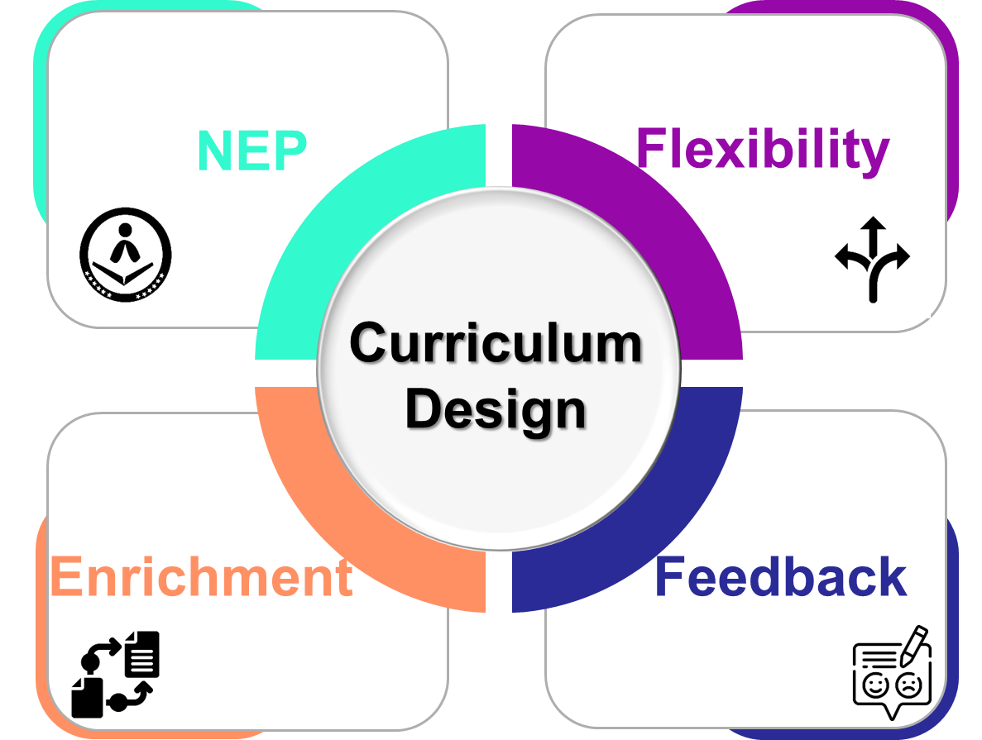


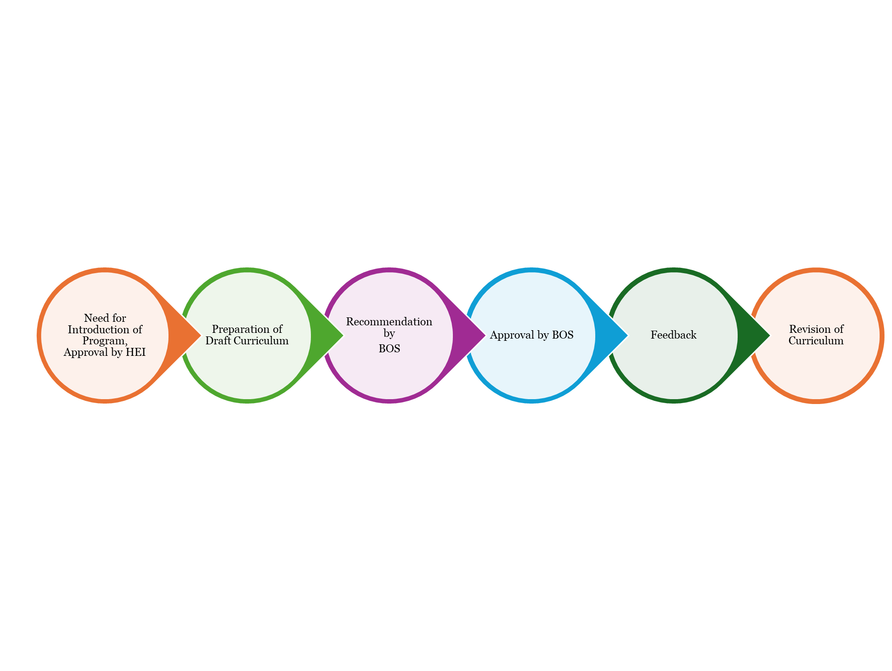
CURRICULAR ASPECTS
Curricular Aspects
Curriculum Design & Development
Regional and National
Ancient Science, Analytical Chemistry, Crime Scenario in India, Wildlife Forensic​
Global
Local
Environmental, Disaster Management, Food and Nutrition, Green Chemistry, Physics of Earth, Instrumentation
Crime and Society, Case studies, Internship and Projects ​
Curriculum
Relevance
Approval by AC
3

Slide 6






Curricular Aspects
CURRICULAR ASPECTS
Details
Focus on Employability/ Entrepreneurship/ Skill Development
Employability
Entrepreneurship
Skill Development
Intellectual Property Right (IPR) and Business Skills for Chemists (BSCH110A), Herbal Technology(BSCH109A) , Artificial Intelligence Lab (BSCS 451A), Basic Instrumentation skills(BSPH305A),
Forensic Dermatoglyphics (BSFS102A), Questioned Document (BSFS104A), Forensic Physics and Biometric Systems (BSFS202A)
Data Analysis and Visualization (ETCS109A), Analytical Techniques of Chemistry(BSCH205A), C++Programming for Mathematics(BSCS113A), Introduction to Computer Science and Programming In Python (ETCS104A), Crime Scenario in India (BSFS215A), Criminology and Penology(BSFS302A)
Medicinal Chemistry (BSCH305A), Applied Optics(BSPH306A), Basics of Digital Forensics(BSFS112A), Cyber forensic I (BSFS111A), Forensic Biology and Serology (BSFS203A)
Curricular Enrichment
Professional Ethics
Environment & Sustainability
SDG
NEP
Major Course, Minor Courses, Ability Enhancement Courses, MOOC, Skill Enhancement Courses, Value Added Courses, Internships and Projects
Quality Management and Ethics (BSFS313A)
Environmental Studies(UCES125A), Disaster Management(UCDM301A), Green processes of Chemistry (BSCH310A)
Through experiential calendar and research projects
4

Slide 7
CURRICULAR ASPECTS
Curricular Aspects
Outcome Based Education
Curriculum Design
Assessment & Evaluation
Faculty Training
OBE workshop, Examination reforms workshop
Intensive teaching workshop
Maintain Course File
Motivating faculty for creating standardized contents and Lab manuals
Using LMS
Feedback and Review
Teaching Pedagogy
Classroom Teaching
Outside Classroom Teaching
5

Slide 8
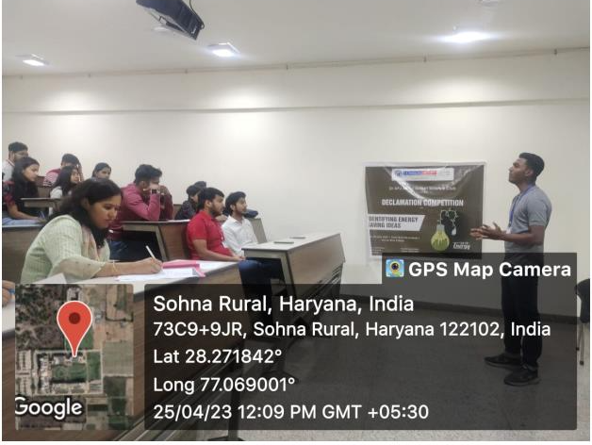
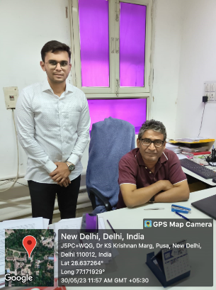
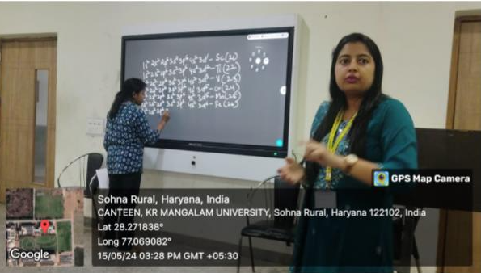
Teaching-Learning Evaluation
CATERING TO DIFFERENTIAL LEARNERS
Year | 2018-19 | 2019-20 | 2020-21 | 2021-22 | 2022-23 | 2023-24
#Students admitted | 33 | 27 | 9 | 14 | 50 | 104
#Faculty | 22 | 18 | 17 | 17 | 22 | 26
For Slow Learners
Remedial Classes
Learning Resources
For Advanced Learners
Enrichment Programs
Independent Study
Participation in Extracurricular Activities
Preparation for Competitive Examinations
Specialized Advising
Impact of Differential Learning ​
Improved Student Achievement
Increased Student Engagement
Enhanced Self-Efficacy
Positive Learning Environment
Participants in declamation on energy saving ideas
Career Counselling: Aditya Narayanan visited NPL before choosing career in physics
Remedial Classes
6

Slide 9
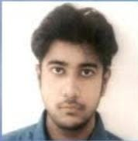
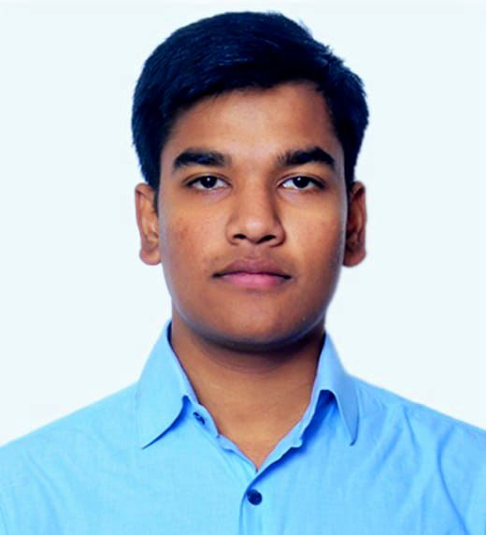
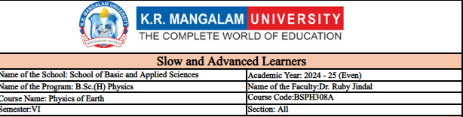
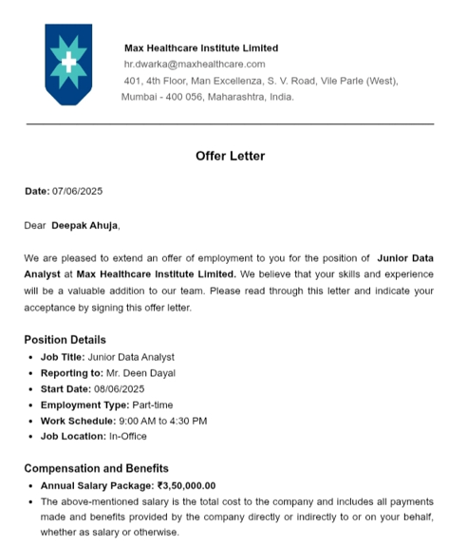
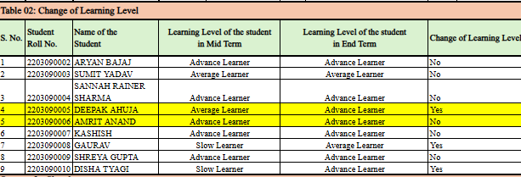
CASE STUDY: Slow and Advanced Learners​
Teaching-Learning Evaluation​
Mr. Amrit Ananad (B.Sc. (Hons.) Physics, 2022-2025)​
Selected as Lieutenant through CDS Examination​
Mr. Deepak Ahuja (B.Sc. (Hons.) Physics, 2022-2025)​
Position: Junior Data Analyst (Part Time)​
Company: Max Healthcare Institute Ltd.​
Package: 3.5 LPA CTC​
​
7​
7
7

Slide 10
TEACHING-LEARNING PROCESS
Teaching-Learning Evaluation
Outcome Based Education, Student centric process for holistic development of students
Participative Learning
Experiential Learning
Cognitive Learning
Test
Feedback
ENGAGE
EXPLORE
EXPLAIN
ELOBORATE
EVALUATE
Self-directing Learning
Case studies
Problem solving
Quiz
Mid and End Term Examination
Systematic, sequential, planned course of action
Technology Integration using ICT
8

Slide 11
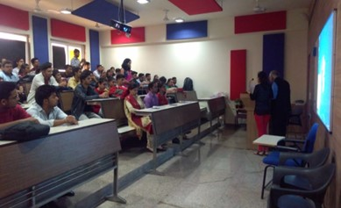
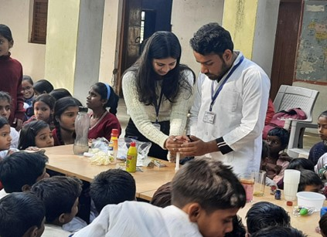
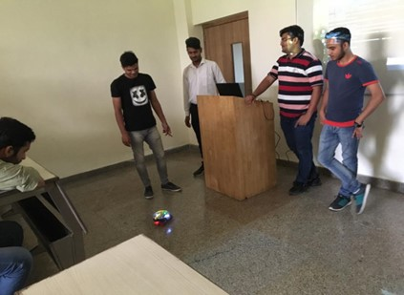
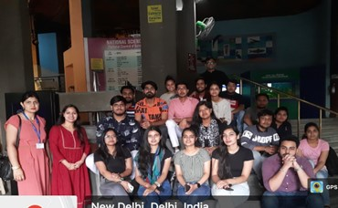
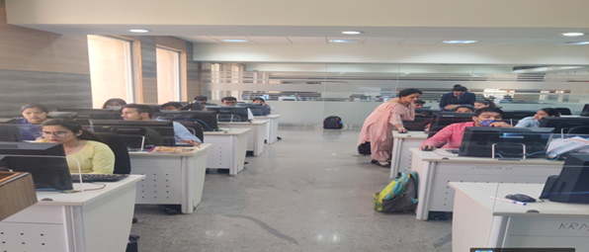
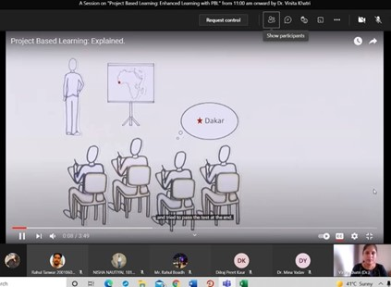
EXPERIENTIAL LEARNING
Teaching-Learning Evaluation
Workshop
Internships
Hands-on learning in labs
Guest Lecture by Prof. Ajoy Ghatak on November 14, 2018
Wacky Science Activities Dec 7, 2022
Workshop on Robotics on Sept 26, 2019
Visits
Extension activities
Visit to Science Centre on April 13, 2022
Chem-Soft workshop on Feb 28, 2022
Enhanced learning with PBL. June 30, 2021
9

Slide 12
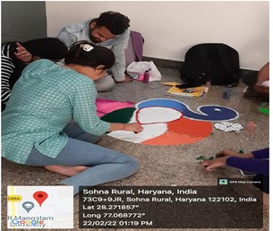
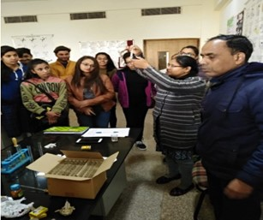
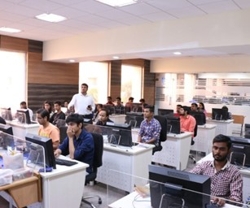
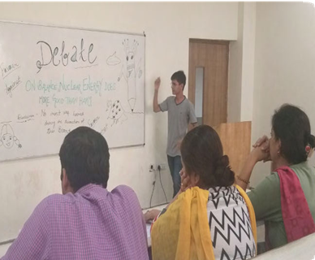
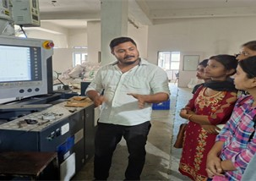
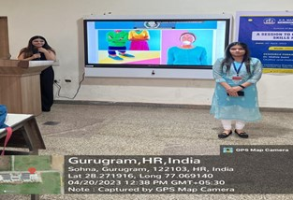
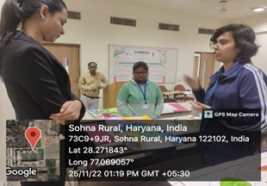
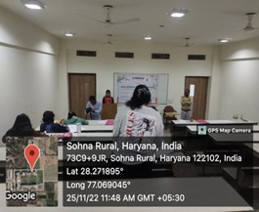
PARTICIPATORY LEARNING & PROBLEM SOLVING
Teaching-Learning Evaluation
Internships
Hands on learning
Decor Competition on Feb 22, 2022
Workshop on Food Adulteration Jan 23, 2020
Workshop on Introduction to the World of Microcontrollers and Robotics, on 26th September 2019​
Debate Competition
Competition
Case Studies
Debates
Projects
Industrial Visit to Zero Waste Chemicals IMT Manesar Sept 30, 2022
Session on Communication skills on April 20, 2023
Innovative Ideas for Sustainable Solutions Nov 25, 2022
10

Slide 13

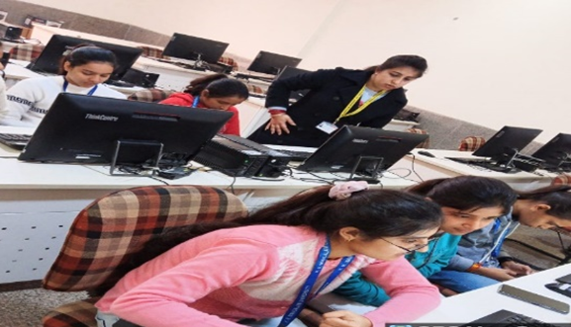
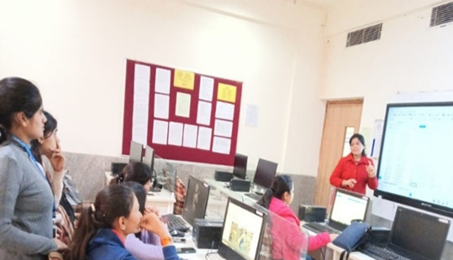
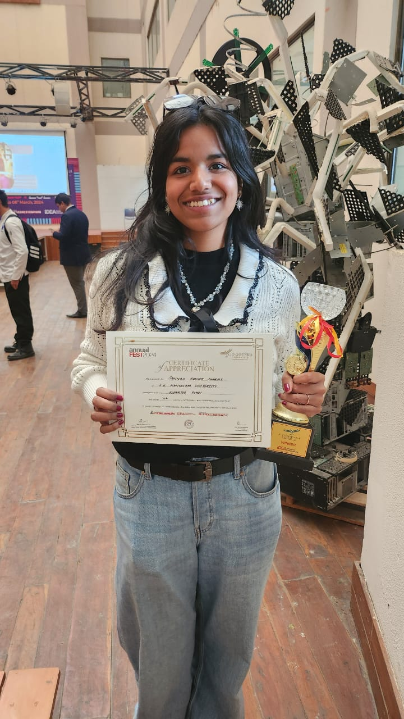
MENTOR-MENTEE SCHEME
Teaching-Learning Evaluation
Discuss the Mentor-Mentee Session Concept
Development of Knowledge and Skills
Academic Success
Career Development Guidance
Personal Development and Support
Career Exploration and Development
6th Lecture on Tuesday (Twice a month)
Progress Tracking
Continuous Guidance and Monitoring
Conducting Parent-Teacher Meetings (PTMs)
Academic and Emotional Support
Students asking doubts about assignment submission on LMS Moodle
A motivational talk for various career opportunities
Got admission offer at
University of Surrey, UK
Encouragement for Extracurricular Activities
Advising on Course Selection
11

Slide 14
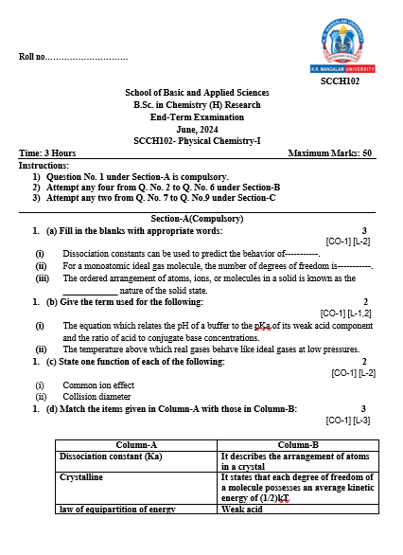
Teaching-Learning Evaluation
STUDENT PERFORMANCE AND LEARNING OUTCOMES
CO Attainment Calculation
Vision and Mission
Well defined PEO, PO and PSO
Alignment CO with PO
CO attainment
PO attainment
Course Outcomes
COs Attainment Level
Event |  | Mid-Term Exam (MM 20) |  | End-Term Exam (MM 50) |  | Average CO Attainment (% Calculation)
Course Code | Course Outcome | CO Percentage (%) | CO Attainment Level | CO Percentage (%) | CO Attainment Level | CO Attainment % | Overall CO Attainment | Final Average (Average Co Attainment per Course)
SCCH 102 | CO1 | 100.0 | 3 | 93.3 | 3 | 95.24 | 3 | 72.62
 | CO2 | 86.7 | 3 | 80.0 | 3 | 81.90 | 3
 | CO3 |  |  | 40.0 | 2 | 40.00 | 2
 | CO4 |  |  | 73.3 | 2 | 73.33 | 2
Course Title: PHYSICAL CHEMISTRY-I​
Course code : SCCH102​
Handbooks, Course File and Website
12

Slide 15




RESEARCH, INNOVATION AND EXTENSION
Research, Innovation and Extension
Research Publications (2018 – Till date)
Top IF Journals
Patents Published= 18
Patents Granted=19
Book/Book Chapters=682
Conference Proceedings= 65
Journal Publications = 210 (54 SCI)
PhD Awarded= 19
Q1, IF: 8.9
Q1, IF: 8
Q1, IF: 7.7
Q1, IF: 6.8
Highly Cited Publications
1250
2020-23
Faculty Name | Title | Journal | Year | Citations
Dilraj Preet Kaur and Seema Raj | Recycling/reuse of plastic waste as construction material for sustainable development: a review | Environmental Science and Pollution Research | 2022 | 153
Romila Manchanda | PGMD/curcumin nanoparticles for the treatment of breast cancer | Scientific Reports | 2021 | 91
Diwakar Padalia | Design modifications in micro pin fin configuration of microchannel heat sink for single phase liquid flow: A review | Journal of Energy Storage | 2023 | 79
16
Journal Articles
5
Projects
8
Faculty
Total Citations
22.21
Lakhs
18
h-index
2023 - 25
Seed Grants
14.39
Lakhs
2014 onwards
8 Faculty
Details
13

Slide 16
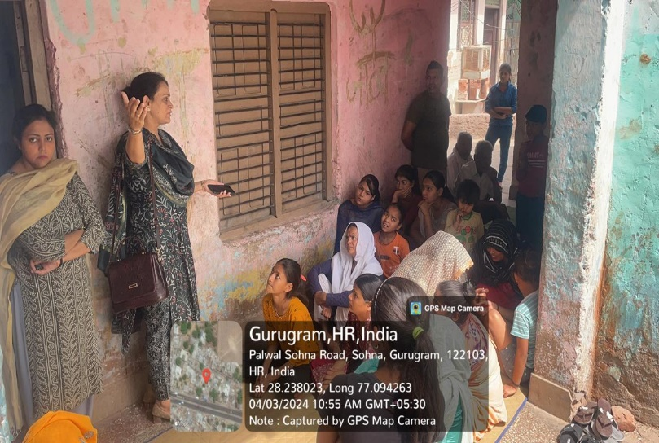
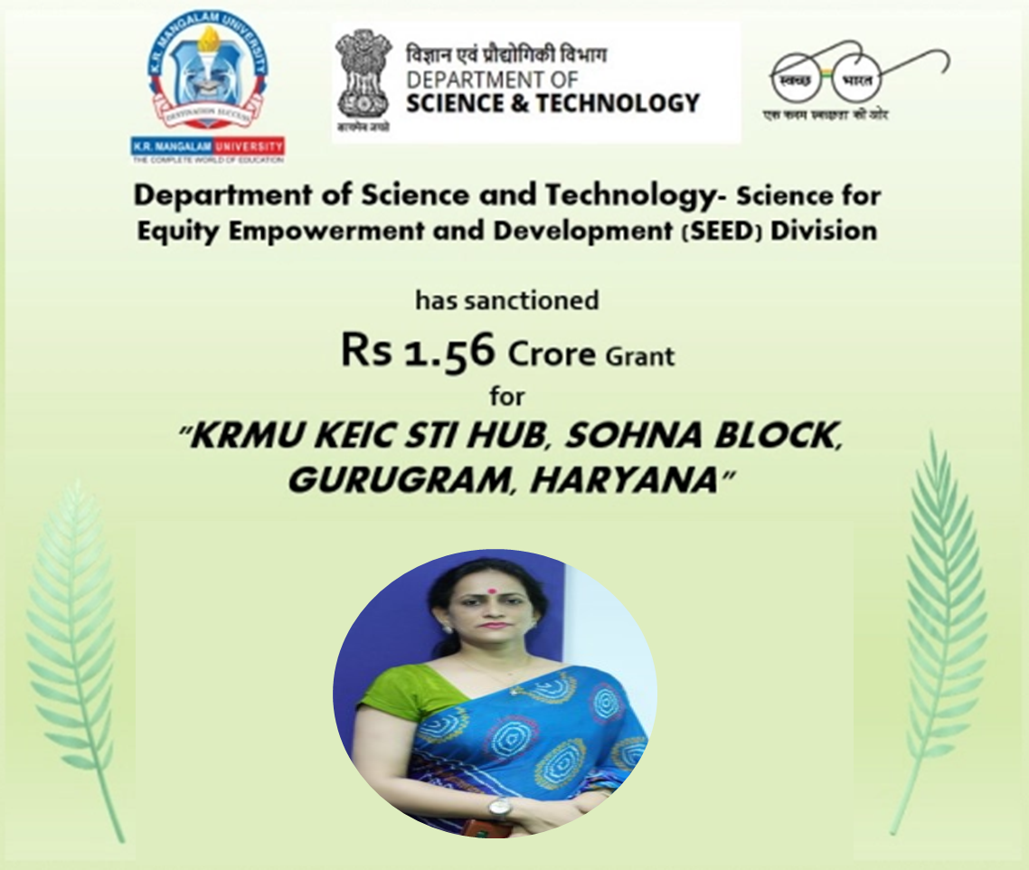
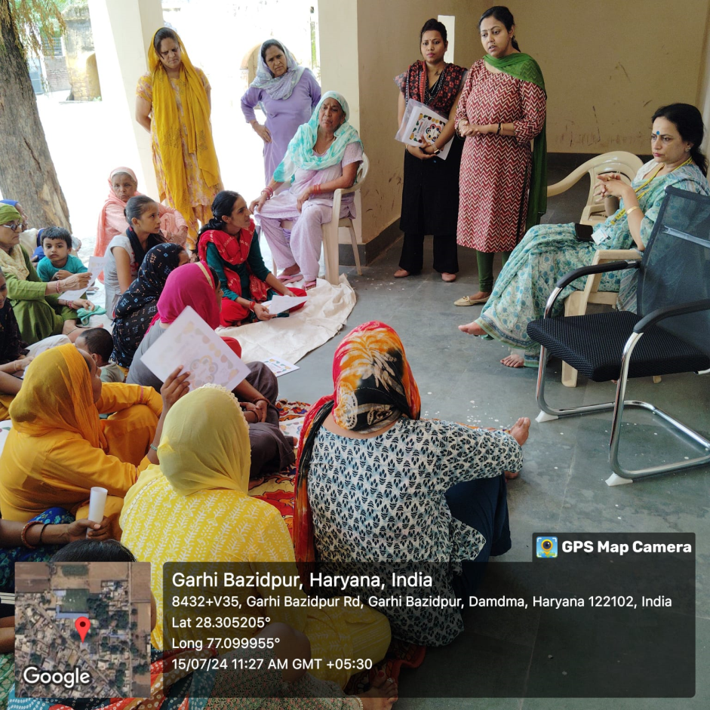
PROJECT SANCTIONED (2024-25)
Research, Innovation and Extension
DST SPONSORED PROJECT (2024)
Value Chain – Agriculture (Millet): At Lakhuwas Village in SC Community
Value Chain- Handicraft: At Garhi Bazidpur village in SC community
2. Research grant of ₹6.5 Lakhs under the 2025 IKS Samvahan Karyakram by the Indian Knowledge Systems (IKS) Division, Ministry of Education. Title "वेदवाणी: स्कूलों के लिए वैदिक ज्ञान का डिजिटल स्वरूप"
14

Slide 17
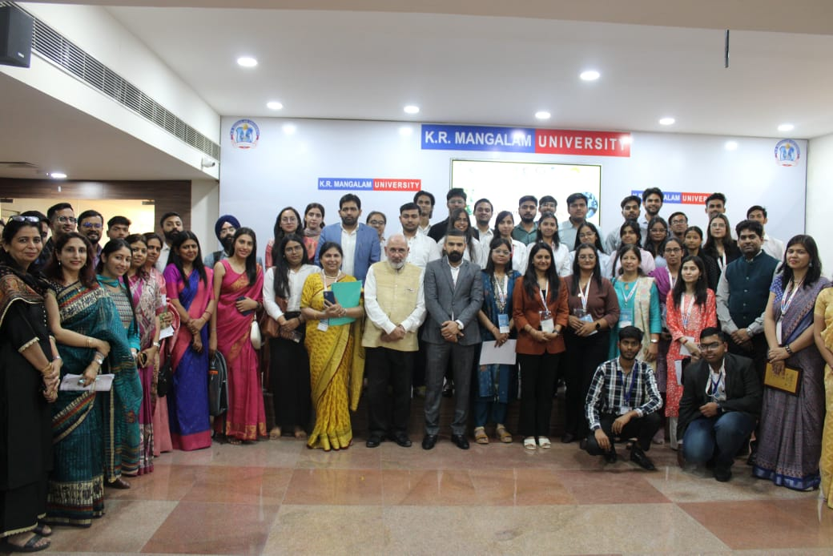
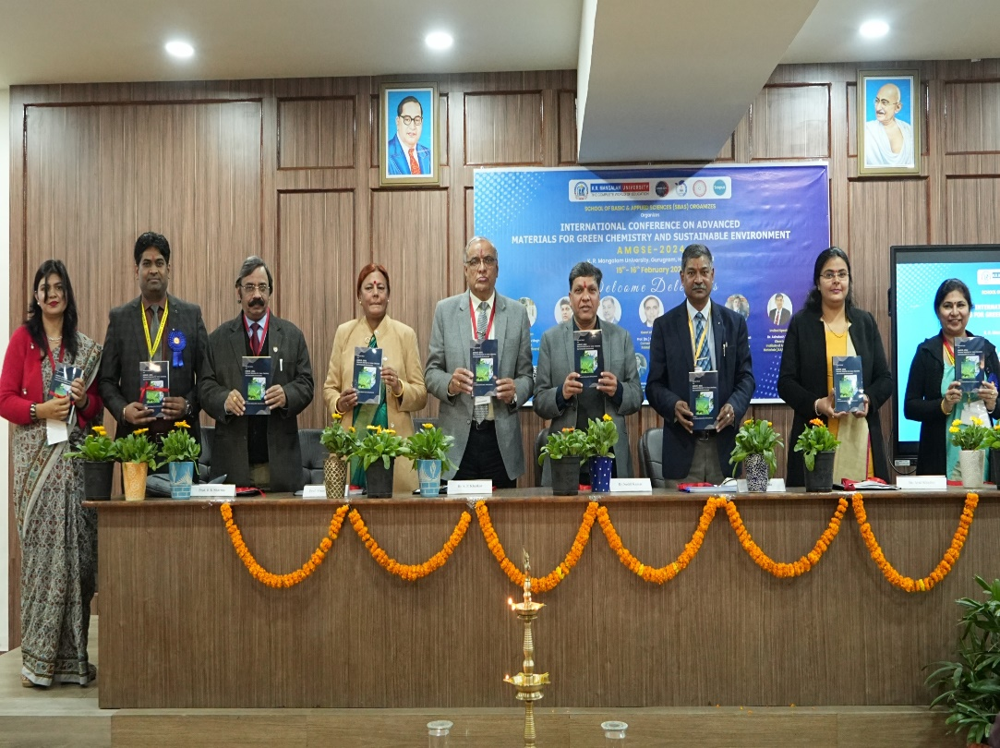
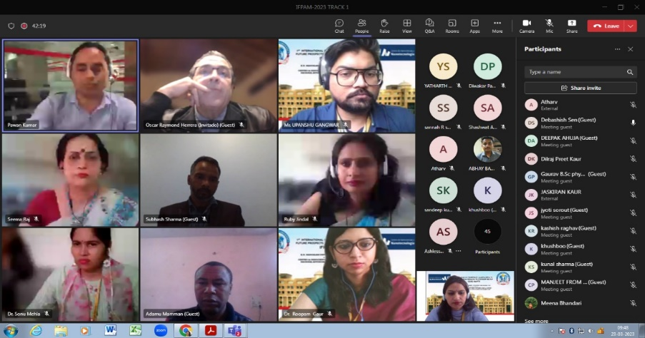
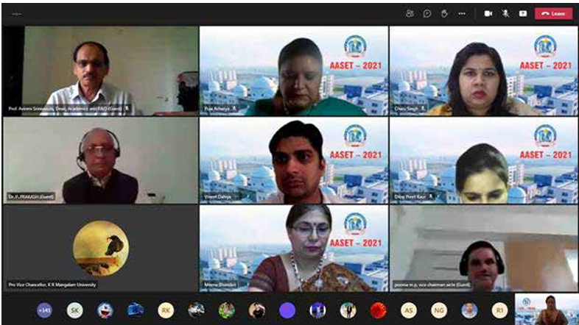
Research, Innovation and Extension
CONFERENCES ORGANIZED (4)
AMGSE-2025
March 20-21, 2025
AMGSE-2024
February 15-16, 2024
IFPAM-2023
March 23-24, 2023
AASET-2021
May 19-20, 2021
120
45
Keynote Speakers:
Dr. Teerawat Issariyaku, NTPCL, Thailand
Dr. Romila Manchanda, University
of Michigen, USA
Dr. K Srinavas, Senior Principal Scientist, CSIRIICT, Hyderabad
Keynote Speakers:
Prof. Oscar Raymond Herrera
Prof. J.L. Sanchez
Prof. R.K. Dwivedi
Dr. Jitendra Pal Singh
Dr. Subhash Chandra
Dr. Mukesh Kumar Thakur
180
70
Registrations
Poster
Presentations
Registrations
Poster
Presentations
60
50
Oral
Presentations
Online
Participants
75
Oral
Presentations
20
Research Article Published
79 papers presented
150
papers presented
15

Slide 18
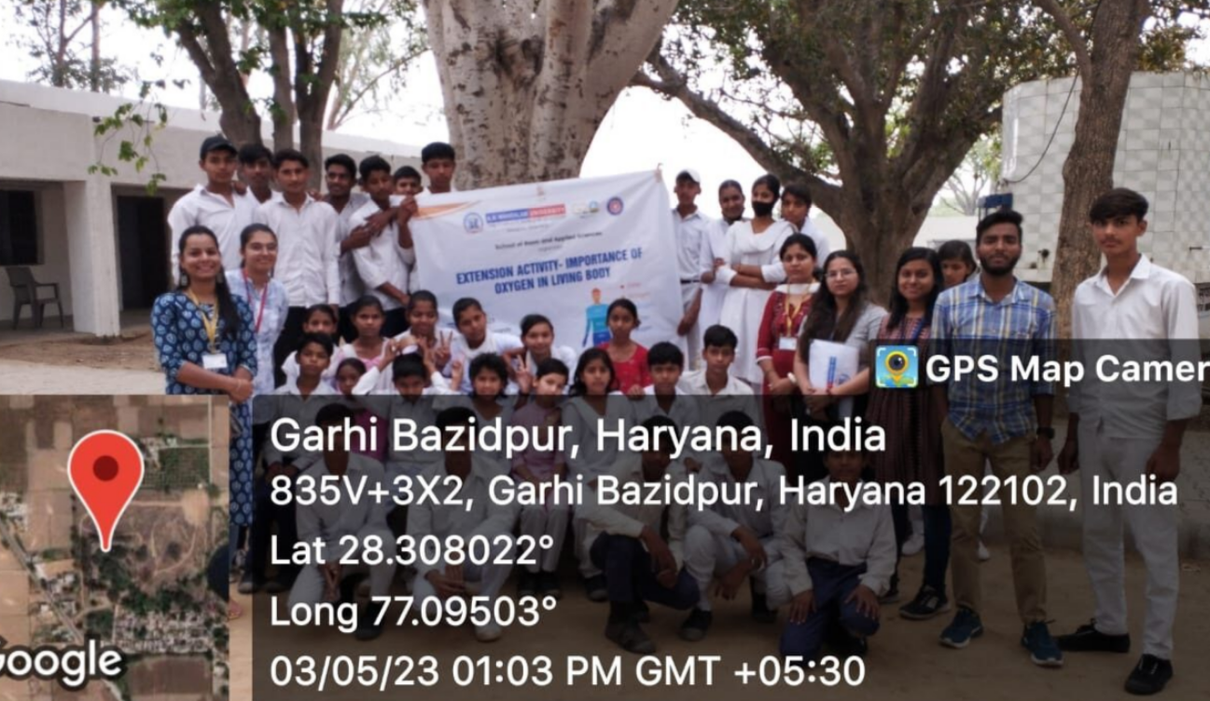
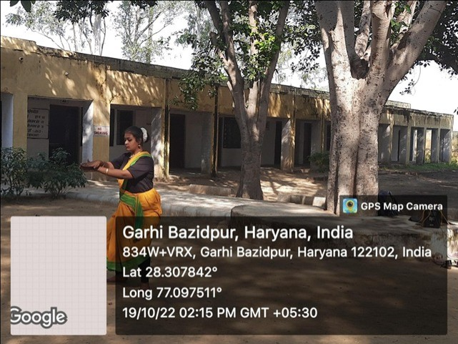
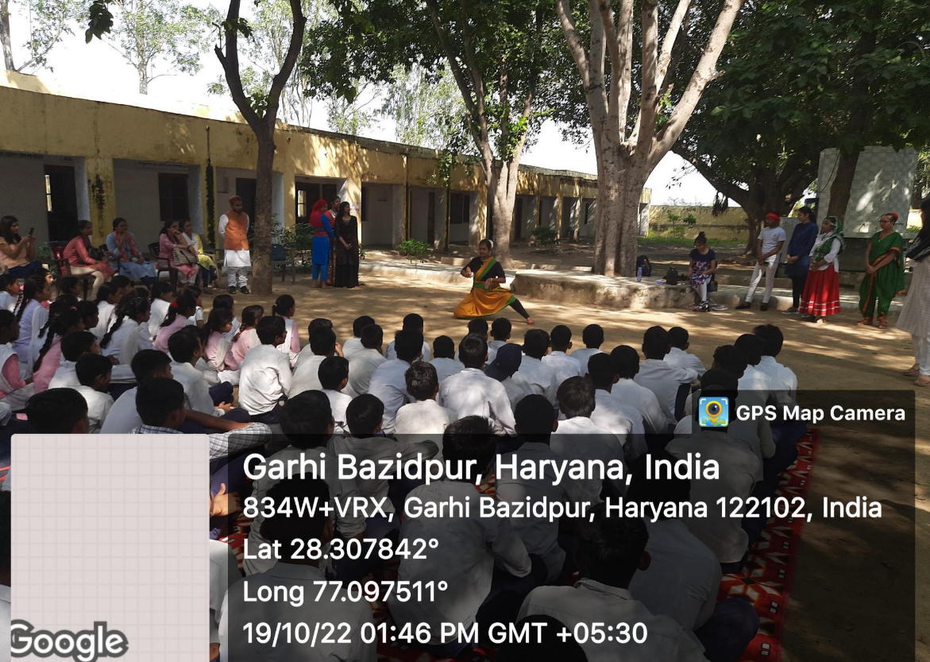
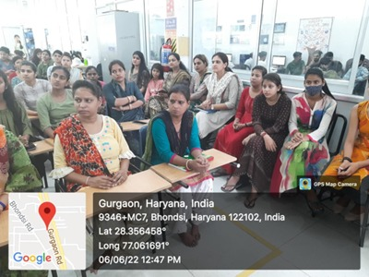
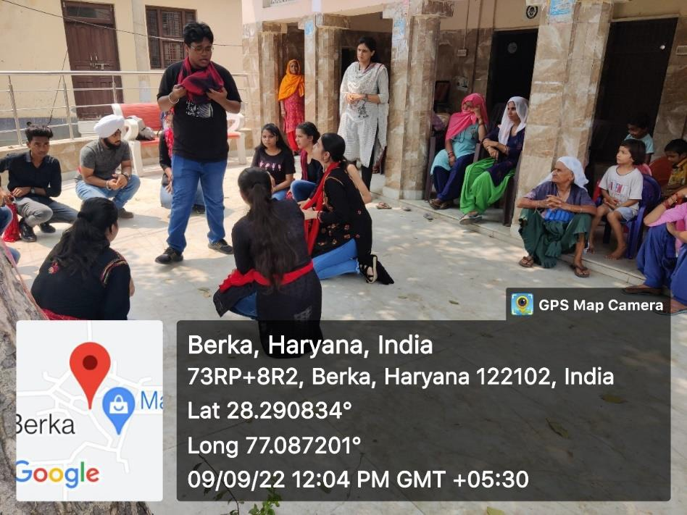
Research, Innovation and Extension
EXTENSION ACTIVITIES & CASE STUDIES
MOU Signed with DC Office, Gurugram
Adoption of five villages: Ghamroj, Berka, Garhi Wazidpur, Kharoda, Lakuwas
Nukkad Natak on Beti Bachao Beti Padhao
Diagnosis of health Problems in Women and their Cure
Paryavaran Mitra: Plantation Drive
Nukkad Natak on Female Foeticide
Play on cultural diversity of India
Importance of Oxygen in Living Body: Air and Atmosphere
Wellness Workshop: Food Adulteration
Street Play to create Awareness on Cyber and Mobile Phone Frauds In Collaboration with Red Cross Society
16

Slide 19
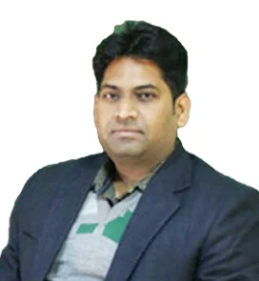
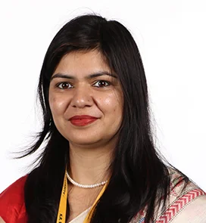
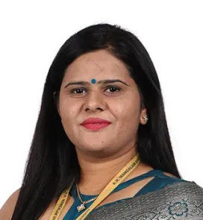
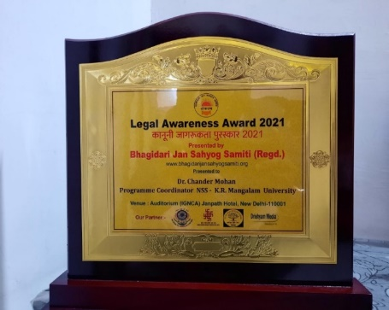
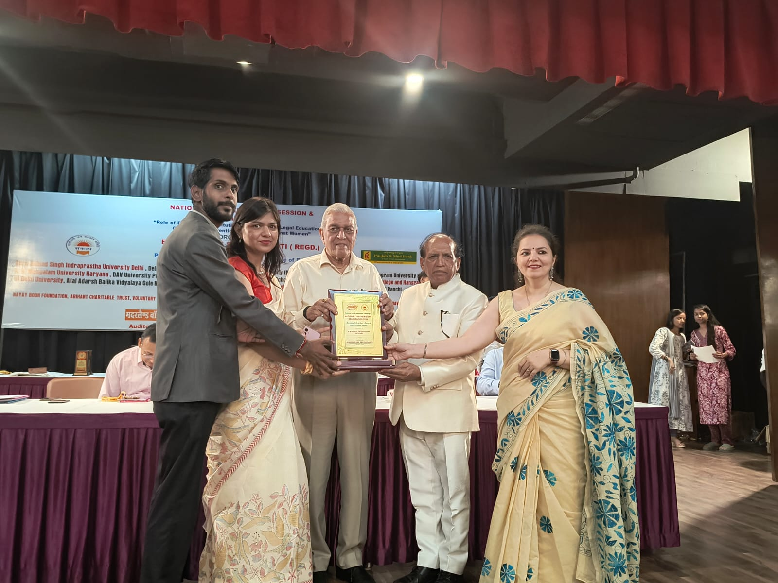

FACULTY AWARDS
Research, Innovation and Extension
Dr. Chandra Mohan
Dr. Neeraj Kumari
Ms. Komal Yadav
Legal Awareness Award
Special contribution in Social Initiative
Best Program Coordinator at Haryana State Level by Red Cross Society
Outstanding Performance towards Humanitarian Services by Indian Red Cross Society
17

Slide 20
















INDUSTRY AND PEER CONNECT: MOUs
Research, Innovation and Extension
Details
Collaboration
Internships
Resource Sharing
Research Publication
Education visit to Sherlock Institute of Forensic Science
Internship
FDP
Workshop on e-Learning
18

Slide 21







INFRASTRUCTURE AND LEARNING RESOURCES
Infrastructure and Learning Resources
09
06
1607
CLASSROOMS AND LECTURE HALLS
Smart boards, modern seating and adequate lighting
LABORATORIES: Labs for different disciplines with up-to-date equipment and safety measures
Books
LIBRARY:
11
Journals
Details
PHYSICS LAB
CHEMISTRY LAB
FORENSIC SCIENCE LAB
19

Slide 22






INFRASTRUCTURE AND LEARNING RESOURCES
Infrastructure and Learning Resources
T
Central Instrumentation Facility
LMS Moodle
Virtual Labs
Students can simulate experiments and gain practical experience remotely.
Instruments like ​
UV-Visible, FTIR, TGA, DTA and DSC, LC Meter, Muffle Furnace dedicated to supporting research of UG, PG and PhD students.
Scilab
Video link
20

Slide 23




CAREER COUNSELING
Student Support and Progression​
Efforts taken to provide career counselling including e-counselling and guidance for competitive examinations
Mentors and teachers provide career advise/counseling to the students as per their capability and interest
Career Counselling Sessions for preparation of Competitive Examinations ( JAM/NET/SSC) | 8-Sep-18
Career Counselling webinars for GATE/ESE Preparation | 14-Sep-19
Career Counselling webinars for GATE/ESE Preparation | 8-Feb-20
A Webinar on How to Prepare for NET Exam | 18-Aug-20
Exploring Career path - Virtual career counselling session | 22-Aug-20
Training Session For Competitive preparation for all UG/PG Students | 6-Jun-22
Coaching Classes for competitive exams (SSC, CGL, SSC CHGL, SSC CPO, SSC, JE) | 9-Sep-22
An Interactive Session in On Career counselling for JAM/ NET | 12-Sep-22
Coaching Classes for competitive exams such as SSC, CGL, SSC CHGL, SSC CPO, SSC JE Etc. | 30-Sep-22
Coaching Classes for competitive exams such as SSC, CGL, SSC CHGL, SSC CPO, SSC JE Etc. | 7-Oct-22
Coaching Classes for competitive exams such as SSC, CGL, SSC CHGL, SSC CPO, SSC JE Etc. | 21-Oct-22
Career Counselling Session on Interview Preparation | 7-Feb-23
Recruitment through coaching classes for competitive examination | 24-Feb-23
Session on NET/JAM Preparation by Mr Aquib and Ms Parul ( Alumni) on June 23, 2023
Workshop on Career Counselling session ​Feb 7, 2023
Session on NET/JAM Preparation by Dr. Neeraj Singh on Sept 12, 2022
Training session for competition preparation on June 6, 2022
21

Slide 24

STUDENT GRIEVANCES
Student Support and Progression
GRIEVANCE REDRESSAL COMMITEE
MECHANISM
Grievance Redressal Cell
Students can lodge their grievances in three ways
1. University Website
2. Suggestion box
3. Through Dean
Forwarded to respective unit for action ​
Resolved​
If not Resolved - Escalated​
Matters related to
Admission
Academics
Administration
Financial
Harassment
Discrimination
grievance.redressal@krmangalam.edu.in
22

Slide 25


STUDENT SUPPORT AND PROGRESSION
Student Support and Progression
Progression %
Scholarship and Freeship %
23

Slide 26








ALUMNI CONTRIBUTION
Student Support and Progression
Star Alumni: Higher Education
Alumni Interactions
Star Alumni: Placement
Declamation on skills required in corporate world​
Date:12 October 2022​
Resource Person: Ms. Ashu Berwal
Alumni Great Story Begins here
Date: 27 September 2023 ​
Resource Person: Mr. Agnivesh
24

Slide 27








STUDENT AWARDS
Student Support and Progression
B. Sc. (H) Physics 2nd Year
Annual Fest Ideathon
G D Goenka University
B. Sc. (H) Forensic Science 2nd Year
Summer Internship Competition
Sushant University
SBAS students-Group Singing Competition, 21 March 2023
Prakriti-Speech Competition, 7 Nov 2022
Aryan Bajaj
B. Sc. (H) Physics
Incubated at KEIC for his start-up
25

Slide 28











STUDENT COUNCIL MEMBERS
Student Support and Progression
2024-25
2021-22
2021-22
2020-21
2020-21
2019-20
Amrit Anand
B.Sc. (H) Physics
Aarti Gangadhar Shinde
B.Sc. (H) Chemistry
Kanishka Gupta
B.Sc. (H) Physics
Deepshikha Jain
M.Sc. Chemistry
Gourav Kumar Singh
B.Sc. (H) Mathematics
Monika Yadav
M.Sc. Mathematics
2019-20
2018-19
2017-18
2017-18
2017-18
Ajay Soni
B.Sc. (H) Chemistry
Sujeet Yadav
B.Sc. (H) Mathematics
Pooja Singla
M.Sc. Physics
Monika Yadav
B.Sc. (H) Mathematics
Divya
B.Sc. (H) Chemistry
26

Slide 29








Student Support and Progression
CO-CURRICULAR ACTIVITIES
Student Support and Progression
Movie screening
Tattoo making
Painting competition
Music and drama
Nukkad natak
Poster making
27

Slide 30
Governance, Leadership and Management
GOVERNANCE
Dean
Program Coordinators
Course Coordinators
Examination Committee
Mentors
Admission Coordinators
Training and Placement Coordinators
School Research Committee
Board of Studies
Timetable Coordinators
Admission, Review and Revision of courses, Creation of SOPs and Manuals for Lab, faculty load distribution, Evaluation work, Monitoring of progress of research scholars and students
28

Slide 31
Governance, Leadership and Management
STRATEGY DEVELOPMENT AND DEPLOYMENT
As per strategic plan of the university,
Curriculum Enrichment, Research Excellence, Intellectual Capital, Collaborations, Placements, Rankings
Plan for new programs, review and revision of curricula
Calculation of requirement of School before the start of semester/session
  Man -Power Requirement: Faculty and Non- Teaching Staff
  Infrastructure
  Lab Instruments
  Lab Apparatus and Chemical
Recruitment of Faculty and Staff
Purchase of lab equipment, consumables etc.
Planning for organization of Conferences/ FDP/Seminars for Faculty
Preparation of Experiential Calendar including career counselling for students
Conduct School Research Committee Meeting
Constitution of Committees
Designing of SOP and Formats for efficient functioning
Review Meetings
Plan
Review
Execute
29

Slide 32








Governance, Leadership and Management
FACULTY EMPOWERMENT STRATEGIES
Workshops on OBE, NEP, Intensive Teaching
FDPs -advances in sciences/Quality education
Invited Speaker, Examiner, Reviewer
Conferences
Trainings-Examination, LMS, use of interactive panels
Faculty Orientation
Provision of Academic Leave
30

Slide 33



Governance, Leadership and Management
FDPs ORGANIZED(7)
Average Number of faculty attended FDPs: (~77%)
Average Number of faculty received Financial Support (~68%)
FDPs organized
Year | Dates | Title of the Faculty Development Program | No. of participants
2020-21 | 13-07-2020 to 17-07-2020 | Advancements in Science and Technology for Sustainable Development | 55
2021-22 | 09-08-2021 to 13-08-2021 | Recent Advancements in Science and Technology | 45
2022-23 | 18-07-2022 to 23-07-2022 | Research Techniques in Science and Technology in collaboration with Gargi College, University of Delhi | 100
2022-23 | 27-07-2022 to 02-08-2022 | New Reforms in Higher Education with reference to NEP 2020 with CTEF | 298
2022-23 | 26-12-2022 to 31-12-2022 | Modern scientific technologies – Ways to enhance research skills in association with Hans Raj College, University of Delhi | 235
2023-24 | 27-05-2024 to 01-06-2024 | Fabrication and Characterization of Nanomaterials for Device Applications in collaboration with Hansraj College | 60
2024-25 | 19-05-2025 to 24-05-2025 | Imperatives of Indian Knowledge System | 64
31

Slide 34




Institutional Values and Best Practices
GENDER AUDIT AND PROMOTION OF GENDER EQUALITY
Faculty Male: 18 Female: 26 [1:1.4]
Students Male: 105 Female: 191 [1:1.8]
Measures for Promotion of Gender Equality
FACILITIES
1. Girls Common Room
2. CCTV cameras
3.Female Doctor
4.Transport Facility
5.Faculty Lounge
6.Sanitary Napkin Vending Machine and Incinerator
Diagnosis of problem in women and their cure on June 6, 2022
Women's day celebration on March 8, 2020
Nukkad Natak on Female Foeticide on September 9, 2022
Seminar on Education: A Tool for Awareness on Gender Equality on April 6, 2023
32

Slide 35




GREEN CAMPUS INITIATIVES​
33

Slide 36



Institutional Values and Best Practices
INCLUSIVE ENVIRONMENT
Tolérance and harmony towards cultural, regional, linguistic, communal socioeconomic and such other diversities​
Competition on "Share Our Similarities and celebrate Our Cultural Differences“ June 1, 2023
Inter University Event- 'Hindi Meri Pehchan: Debate Competition”. November 24, 2022
Inter University Competition: poster making competition- Jhalak of Indian Culture through Poster making. November 23, 2022
34

Slide 37








SENSITIZATION TOWARDS CONSITUTION OBLIGATIONS & CODE OF CONDUCT
Institutional Values and Best Practices
A session on fundamental rights of duties of Citizens on June 7, 2023​
Seminar on "Professional Ethics and their implication in life" for students on February 25, 2023
Seminar on "Professional Ethics and their implication in life" for students on May 16, 2023
Seminar on Phishing Emails & Detection of forgery in white collar Crimes Feb 23, 2023
Training Program for spreading awareness about the code of conduct and professional ethics August 30, 2022
Training program for spreading awareness about the code of conduct and professional ethics August 16, 2022
Code of Conduct and Professional Ethics for teachers on Feb 25, 2023. ​
35

Slide 38






Institutional Values and Best Practices
BEST PRACTICE
Innovating for Environmental Impact and Sustainability
Courses on Environment:
Green Processes of Chemistry
Environmental Studies
Disaster Management etc.
Environmental consciousness through organization of activities
Tree plantation drives
Research Publications
Wastewater treatment using photocatalytic degradation of dyes
Water remediation
Developing constructive blocks using flyash and other waste materials
Removal of heavy metals from water etc.
Air Quality
Removal of Dyes from Water bodies using Activated Charcoal
Preparation Of Biodegradable
Polymer Films Using Starch
Students taking oath to preserve environment on June 5, 2018
36

Slide 39






ENVIRONMENTAL INITIATIVES
Institutional Values and Best Practices
Recycle for Lifecycle – Feb 22, 2022
Awareness Session of E-Waste Management Feb 3, 2020​
Air We breathe, Sept 2, 2022​
Envirothon- Ideas for protection of environment on Feb 25, 2022​
Best out of waste, 2018
Webinar on Basic Concepts of Climate Modeling on June 24, 2021​
37

Slide 40


SUSTAINABLE DEVELOPMENT GOALS (SDGs)
Institutional Values and Best Practices
Details
Alignment of Activities in the Experiential Calendar with SDGs = (Quality Education-SDG 4, Decent Work and Economic Growth-SDG 8, Industry, Innovation and Infrastructure-SDG 9)
Research Scholars working on sustainability= 15
Conference on Advanced Materials for Green Chemistry and Sustainable Environment in 2024 and 2025 = SDG-9, 12, 13
Research Articles on sustainability- 30
38

Slide 41




Institutional Values and Best Practices
BEST PRACTICE Learning through Social Outreach
Details
Activities Organized: 10
Case studies: 3
Case Studies (2022 – 24)
Literacy Program for Women at Lakhuwas Village (20 volunteers; 60 villagers)
Case study on De-addiction Activity through Survey and De-addiction Campaign at Ghamroj Village (63 volunteers; 96 families)
Effect of Electronic Devices on Education of Students of Abhaypur and Dhaula Village ( For class 9-12 students) (50 volunteers, 600 school students)
39

Slide 42




Institutional Values and Best Practices
DISTINCTIVENESS Experiential Learning through Projects
Engineering Kitchen
Experiments on Crystal Growth from ‘MELT’
Devlopment of whisker crystals of potassium chloride (KCl)
Innovative low-cost technique for fabrication of thermocouples
Designing a furnace for high temperature up to approximately 1000 °C using local materials like mud as an insulator material
Designing a professional crystal growth system using local and waste material.
Membrane distillation and Construction Materials
Focal point to students and faculty especially interested in innovation, and entrepreneurial activities.
Publication: Indian Journal of Pure & Applied Physics, Vol. 59, October 2021.
40

Slide 43






Institutional Values and Best Practices
DISTINCTIVENESS Experiential Learning through Projects
Assessment of Air Quality Index in rural and urban areas- Jan 2020
Synthesis of Geo polymer
Area of research: Air pollution
Student publication
UG/PG Publications/Presentations: 21
Details
41

Slide 44








DISTINCTIVENESS Experiential Learning through Projects
Institutional Values and Best Practices
SCIZONE-2018
SCIZONE-2018
SCIZONE-2018
SCIZONE-2019
Inter-University Competition, SCIENCE – EXHIBIT – December 2022
Inter-University Competition, SCIENCE – EXHIBIT – December 2022
SCIZONE-2019
Innovation for Sustainable Future, Feb 2023
42

Slide 45


A Way Forward…………
2025-26
2027-28
2026-27
Promotion of research and innovation amongst undergraduate students
~2 Quality research
publications/faculty
Apply for government and private research grants
Collaborate with industries and international organization for projects and internships etc.
~4 Quality research publications/faculty
Initiate new programmes
Enhance student readiness for higher studies and careers
Incubated startups
43

Slide 46
Thank You!

