Slide 1

School of Journalism and Mass Communication (SJMC)
WELCOMES
NAAC Peer Team
16-18 JUNE 2025​
A presentation by
Dr. Amit Chawla, Professor and Dean – SJMC

Slide 2
Structure
PART 1
PART 2
SJMC as on date
During Assessment Period
What is covered?
In which slide number
What is covered?
In which slide number
3
12
Overview
Curricular Aspects & Enrichment
4
17
Vision, Mission and Core Values
Teaching, Learning & Evaluation
5
21
Programs and Student Diversity
Research, Innovation, & Extension
6
27
SJMC Alumni
Infrastructure & Learning Resources
7
30
SJMC Faculty and Staff
Student Progression & Support
8
36
Curriculum
Governance, Leadership & Management
9
38
Research Publications, Patents & Projects
Distinctiveness & Best Practices
10
40
Extension activities, Conferences and FDP
Future Roadmap

Slide 3

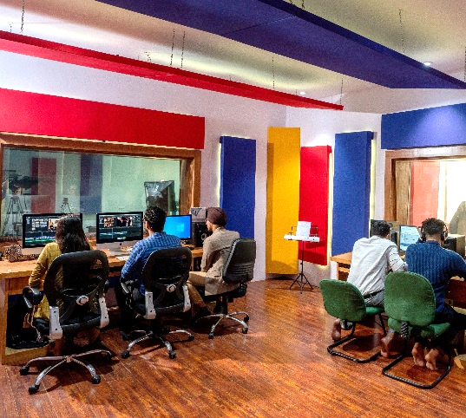
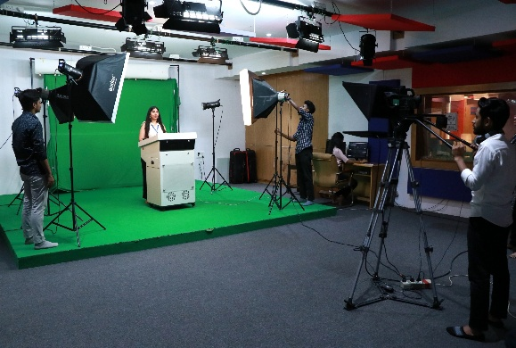
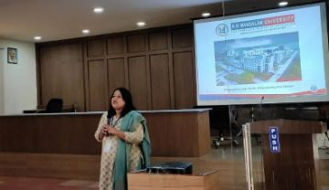
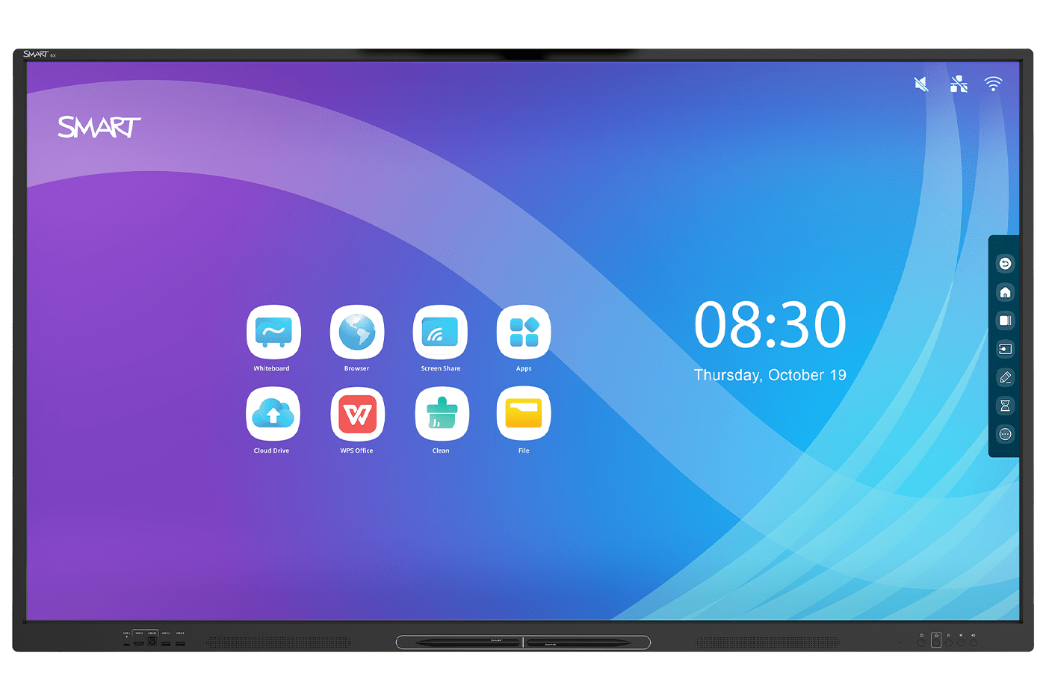
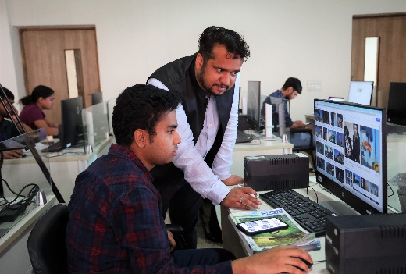
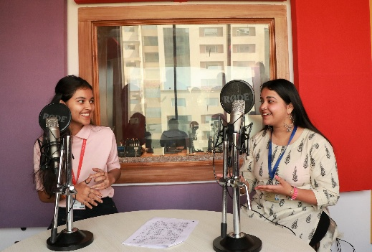


SJMC Overview
Est. in 2015.
Offers 3 programs.
128 Alumni; 101 Students enrolled (UG+PG) from 12+ states; 69% females.
9 Faculty (6 PhDs, 3 enrolled); 3 support staff; 50% females. STR – 12.77:1
TV Studio, Production Control Room.
Radio Studio, Computer Lab.
Design & Production Centre.
WiFi Enabled Smart Classrooms.
LMS-Moodle, ERP-Serosoft.
BA(J&MC) – 78 enrolled 168 credits, 8 sem, 52 courses | MA(J&MC) – 23 enrolled 107 credits, 4 Sem, 27 courses | Ph.D – 12 enrolled 11 awarded

Slide 4
Vision, Mission and Core Values
Vision
Core Values
School of Journalism and Mass Communication aspires to become an internationally recognized Media School through excellence in interdisciplinary project-based student-centric media education. We aim to develop socially responsible life-long learners who contribute to nation building through research and innovation.
The KASAM approach is a core value of KRMU that stands for:
K: Knowledge
A: Attitude
S: Skills
A: Ambition
M: Moral Values
Mission
To provide excellence in education by focusing on futuristic curriculum, progressive, outcome based hands-on education.
Foster employability and entrepreneurship through industry interface and live projects.
Instill the notion of lifelong learning through stimulating problem-solving skills, critical thinking, research and innovation.
Integrate global needs and expectations through collaborative programs with premier universities, research centers, industries and professional bodies.
Enhance leadership qualities among the youth having an understanding of ethical values and environmental realities.

Slide 5
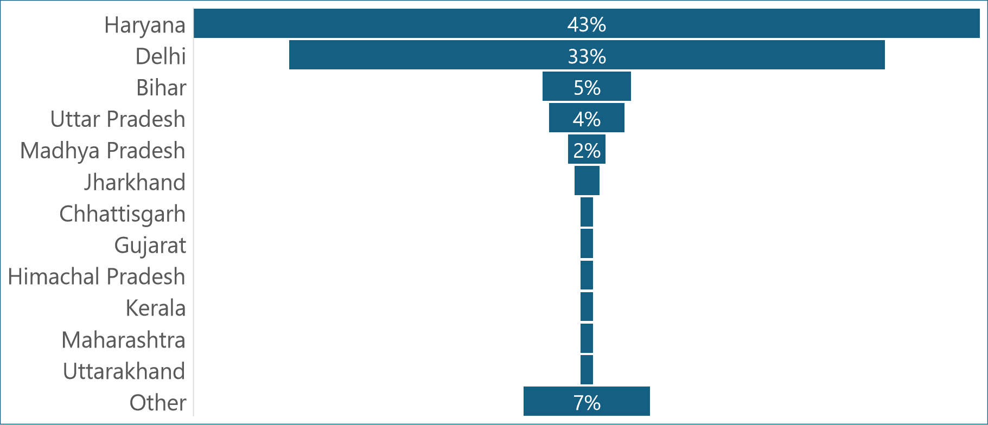
Program and Student Diversity
BA(J&MC) | MA(J&MC)
Ph.D. Scholars
Details of
SJMC Ph.D Scholars
Handbooks

Slide 6
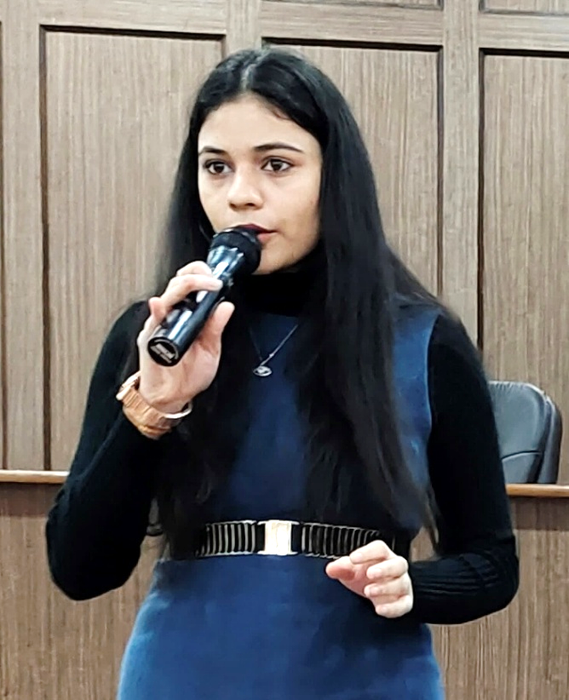
SJMC Alumni
Total Alumni 128
YEAR | BA(J&MC) | MA(J&MC) | Ph.D.
2022-2023 | 19 | 03 | -
2021-2022 | 24 | 01 | 1
2020-2021 | 11 | - | -
2019-2020 | 15 | - | 03
2018-2019 | 7 | - | 01
Before 2018 | 40 | - | 03
SJMC Placement Data - 2018-2023 and 2023-2024
Higher Education Data - 2018-2023 and 2023-24
List of Top 30 SJMC Alumni with photos

Slide 7
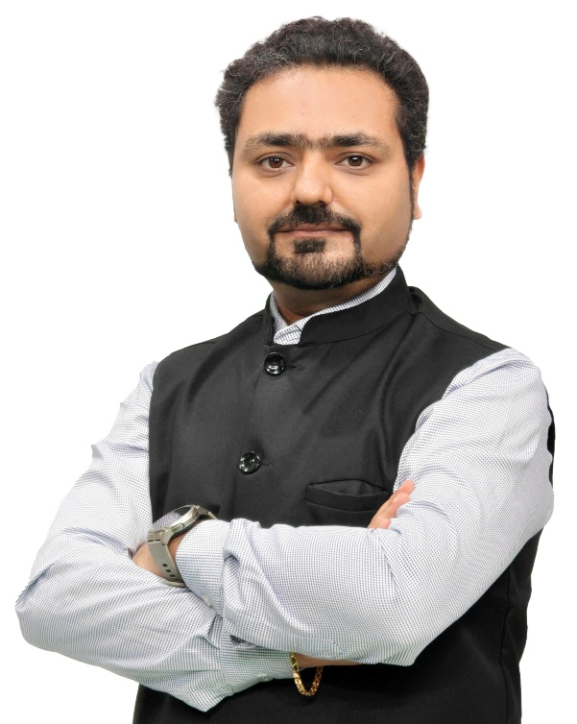
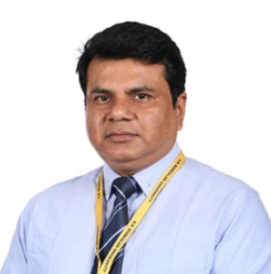
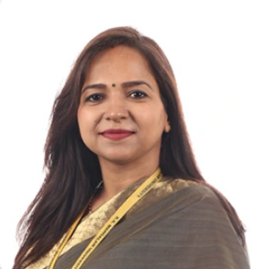
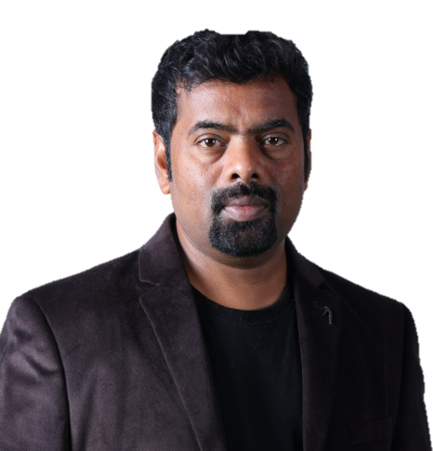
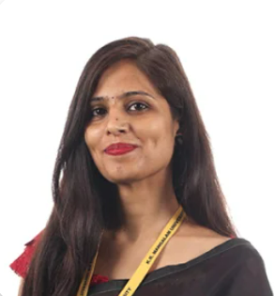
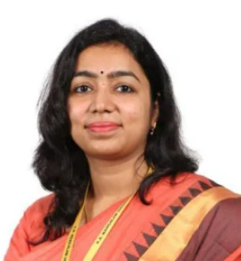
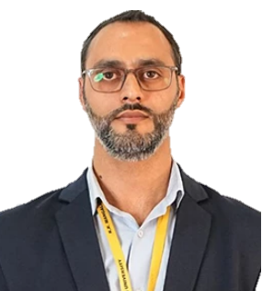
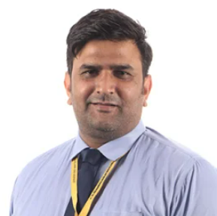
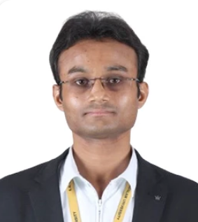
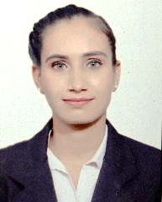
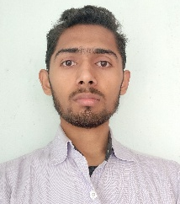
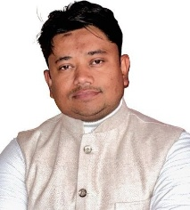
SJMC Faculty and Staff
Dr. Ritwik Ghosh
PhD (Journalism & Mass Communication)
Asst Professor & Prog. Coordinator
Dr. Sarina
PhD (Journalism & Mass Communication)
Assistant Professor
Dr. Ujjval Das
PhD (Journalism & Mass Communication)
Assistant Professor
Dr. Ritika Choudhary
PhD (Journalism & Mass Communication)
Assistant Professor
Dr. Amit Chawla
PhD (Mass Communication)
Professor and Dean
Ms. Aditi Agarwal
PhD (Pursuing)
Asst Professor & Prog. Coordinator
Dr. Aaqib Anwaar Butt
PhD (Media & Communication Studies)
Assistant Professor
Mr. Karan Singh
PhD (Pursuing)
Assistant Professor
Mr. Trilok Kumar Singh
PhD (Pursuing)
Teaching Assistant & Research Scholar
PhD (awarded-6 pursuing-3)
UGC NET Qualification - 7
Faculty = Male – 6 | Female – 3
Support Staff
Ms. Deepika
Office Assistant
SJMC, KRMU
Mr. Ujjwal Kumar
Lab Assistant
SJMC, KRMU
Mr. Salaam Mohammad
Video Content Creator
SJMC, KRMU
Detailed faculty profiles available on https://www.krmangalam.edu.in/school-of-journalism-and-mass-communication/

Slide 8
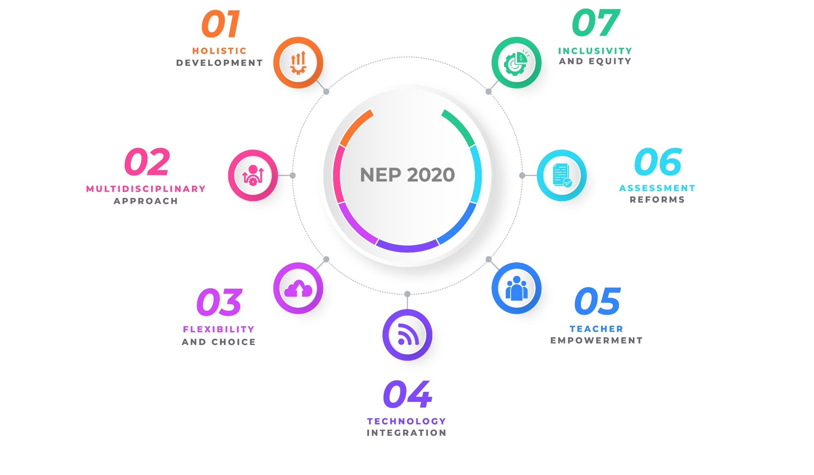
Compliance with New Education Policy 2020
Courses Catering to all domains
i.e. Cognitive, Affective, Psychomotor
Differential Learning, Mentorship
compliant since 2023
Electives, VAC, SEC, AECC, Entrepreneurship Courses
Formative, & summative assessments, Calculation of CO-PO attainments
Choice Based Credit System, Multiple Entry Exit
FDPs, Incentives for Research & Publication, Consultancy grants
Smart Classrooms, Studio, LMS, ERP – Serosoft, Open Source & Licensed Software, Use of Simulators and AI tools.
Documents supporting NEP Compliance by SJMC

Slide 9
Publications, Patents & Projects
Academic year 2018 onwards
Average publication/faculty/year – 3 | Total Publication in Nos. - 153
H-index. – 20 | Highest cited publication - 16 citation | Citations/faculty - 06
Policies related to research and innovation
established by KRMU to promote research and innovation ecosystem, available on university website.
10
Ph.Ds. Awarded
Projects
Patents Published
Research Papers Published
Book Published (Including Edited)
64
Book Chapters Published
02
04
34
12
Awards
12
21
Papers presented in conferences
SJMC PhD awarded
Project Details
Patent Details
Paper Publications
Book Publications
Chapter Publications
https://www.krmangalam.edu.in/research-policy/
Award Details
Papers Presented

Slide 10
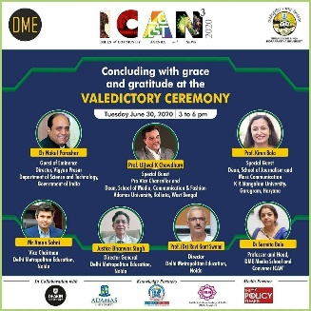
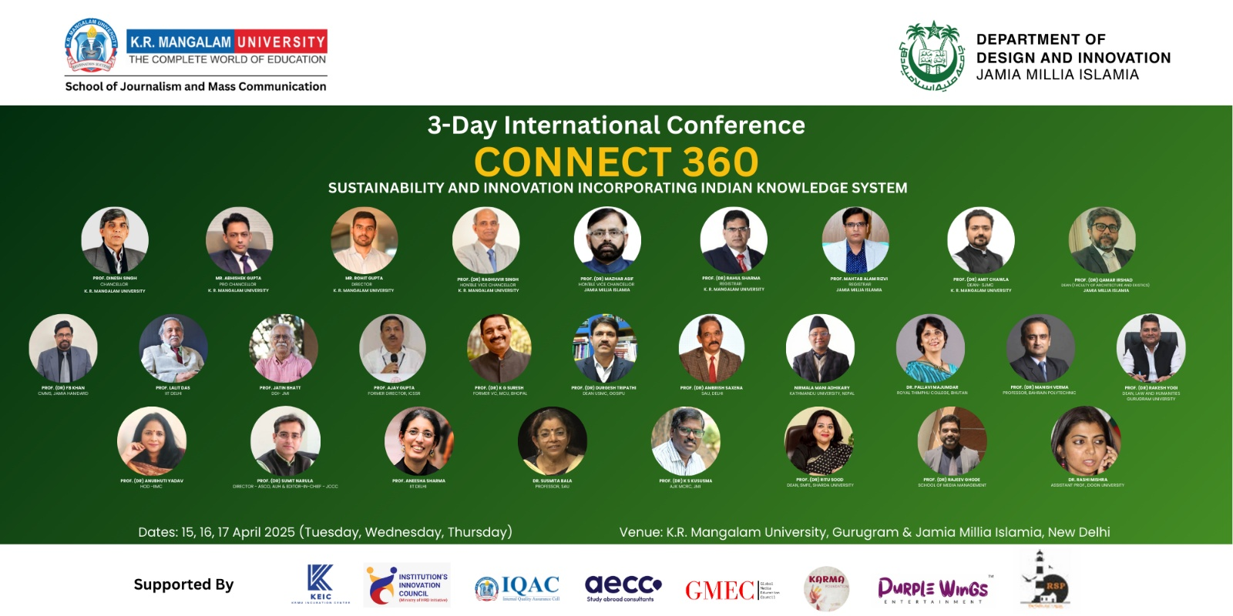
Extension activities, Conferences and FDP
8
87
2
Faculty’s Participation in FDPs/Workshops etc.
FDPs Organized, 279 participants
Conferences Organized, 294 participants
Faculty participation in Extension Activities
FDPs Details
Detail of Conferences Organized by SJMC
International Conference 1
International Conference 2
FDP/STTP Brochure

Slide 11
S.J.M.C.
During the Assessment Period

Slide 12
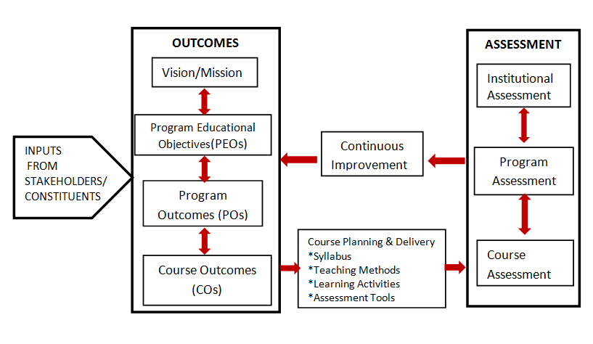
Curricular Aspects & Enrichment
Curricular Attributes
Employability
Entrepreneurship
Ethical & Professional Values
SAMPLE
STAKEHOLDER
FEEDBACK
2018-2024
Purpose: To enhance the quality, relevance, and effectiveness of educational programs and institutional practices.
STAKEHOLDERS:
Students.
Faculty and Staff
Alumni
Employers
SJMC Program Handbooks from 2018 - 2024
-Feedback Policy
-Stakeholder Feedback Forms
-Feedback Analysis
-Action Taken Report
Supporting document
Vision, Mission, PEO, PO, PSO,
aligned with Graduate Attributes & Learning Outcomes

Slide 13
Development Needs' Reflection in POs& COs of the Curricula
 |  | Year | Program | Sem | Course Code | Course Title
Global Level | Example 1 | 2019-20 | BA(JMC) | VI | SJBJ 302A | Global Media Scenario
 | Example 2 | 2022-23 | BA(JMC) | II | UCES 125A | Environmental Studies
National Level | Example 1 | 2022-23 | MA(JMC) | IV | SJMJ812A | Business & Political Coverage
 | Example 2 | 2022-23 | MA(JMC) | ​I | SJMJ705A | Current Affairs and Perspective
Regional Level | Example 1 | 2022-23 | MA(JMC) | III | SJMJ807A | Media, Law and Society
 | Example 2 | 2022-23 | BA(JMC) | VI | ​SJBJ364A | Communication and Development​
Local Level | Example 1 | 2022-23​ | BA(JMC) | I | SJBJ115A | Reporting and Editing – I
 | Example 2 | 2022-23​ | BA(JMC) | III | SJBJ201A | Radio Broadcasting and Programming
SJMC Program Handbooks
Link carrying complete year wise mapping

Slide 14
Courses with focus on Employability / Entrepreneurship / Skills
 |  | Year | Program | Sem | Course Code | Course Title
Employability | Example 1 | 2019-20​ | BA(JMC)​ | VI​ | SJBJ 352A​ | Preparing Students for Future Roles​
 | Example 2 | 20​21-22 | MA(JMC) | II​ | SJMJ706A​ | Reporting and Editing​
 | Example 3 | ​2020-21 | MA(JMC) | IV | ​SJMJ806A | Mobile Journalism​
Entrepreneurship | Example 1 | 2018-19 | BA(JMC)​ | VI​ | ​SJJM 302 | ​Media Organisations & Management
 | Example 2 | 2020-21​ | BA(JMC)​ | VI​ | SJBJ304A​ | Media Organizations and Entrepreneurship​
 | Example 3 | 2022-23 | MA(JMC) | IV | ​SJMJ826A | Brand Communication​
Skill Development | Example 1 | 2018-19​ | BA(JMC)​ | I​ | SJJM 101​ | English Writing Skills​
 | Example 2 | 2018-19​ | BA(JMC)​ | II​ | SJJM 158​ | Design and Graphics Lab​
 | Example 3 | 2021-22 | MA(JMC) | IV | SJMJ708A​ | Creative Visualisation Techniques​
SJMC Program Handbooks
Link carrying complete year wise mapping

Slide 15
Courses that focus on cross cutting issues
 |  | Year | Program | Sem | Course Code | Course Title
Professional Ethics | Example 1 | 2018-19 | BA(JMC) | II | SJJM 108 | Media Laws and Ethics
 | Example 2 | 2018-19​ | BA(JMC)​ | III | SJJM 209 | Advertising Concepts and Principles
Gender | Example 1 | 2021-22 | ​BA(JMC) | I | SJBJ151A | Gender, Media and Society
 | Example 2 | 2021-22 | MA(JMC) | I | ​SJMJ701A | Communication Theories and Models ​
Human Values | Example 1 | 2022-23 | MA(JMC) | I | SJMJ705A | Current Affairs and Perspective
 | Example 2 | 2019-20 | BA(JMC) | VI | SJBJ 302A | Global Media Scenario
Environment | Example 1 | 2022-23 | BA(JMC) | II | UCES 125A | Environmental Studies
 | Example 2 | 2022-23​ | BA(JMC) | III | UCDM 301A | Disaster Management
IKS Courses | Example 1 | 2018-19 | BA(JMC) | I | SJJM 107 | Indian Polity and Issues
 | Example 2 | 2020-23 | BA(JMC) | III | SJBJ261A | संचार के लिए हिंदी
SJMC Program Handbooks
Link carrying complete year wise mapping

Slide 16

Activities aligned with Sustainable Development Goals
All SDG related Activity Details
SDGs Covered | No. of Activities
Goal 1: End poverty in all its forms | 2
Goal 2: Zero hunger | 1
Goal 4: Quality education | 50
Goal 5: Gender equality and women's empowerment | 2
Goal 8: Decent work and economic growth | 5
Goal 9: Industry, innovation, and infrastructure | 2
Goal 11: Sustainable cities and communities | 4
Goal 16: Peace, justice, and strong institutions | 2
Goal 17: Partnerships for the goals | 33
TOTAL | 101
Details on web-link http://krmangalam.in/krmuorg/Login.aspx

Slide 17
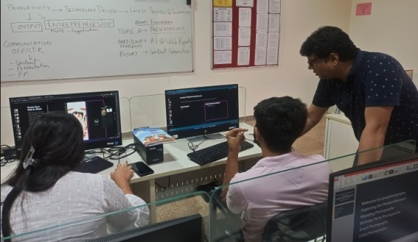
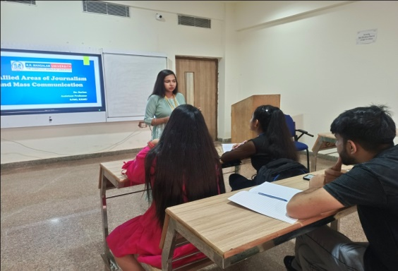
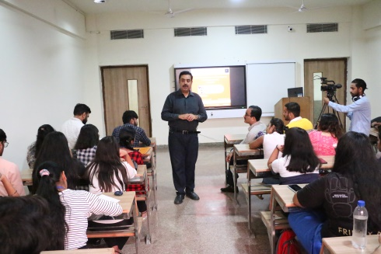

Teaching–Learning @SJMC (Differential Learning)
Interventions for Advanced Learner:
One who exhibits the ability to grasp learning materials more quickly than their peers, achieving high scores.
Assessment: ≥ 80% in MTE & assessments
Interventions: Capacity enhancement programs, Challenge with enriched materials, Promote independent projects, Offer leadership roles.
Interventions for Slow learner:
Struggles to keep pace with academics compared to peers. They may encounter difficulties such as exam failures or achieving lower grades.
Assessment: ≤ 55% in MTE & assessments
Interventions: Remedial Classes, Guided Mentorship, Extended Lab Sessions, Peer-Assisted Learning, Simplified Notes, Personal Counselling, Feedback with positive reinforcement.
EXAMPLES OF IMPACT CREATED
Changed learning level of students: (2022-23)
Independent Leadership Roles
Career Readiness Training Sessions
Name: Kanishka Bhandari
Course Name: Social Media Marketing
Support Provided: Remedial classes, Counselling, Practical assignments aimed at Peer Learning
Result Till MTE – 50% ETE result – 82%
GNI Workshop by Nimish Kapoor

Slide 18
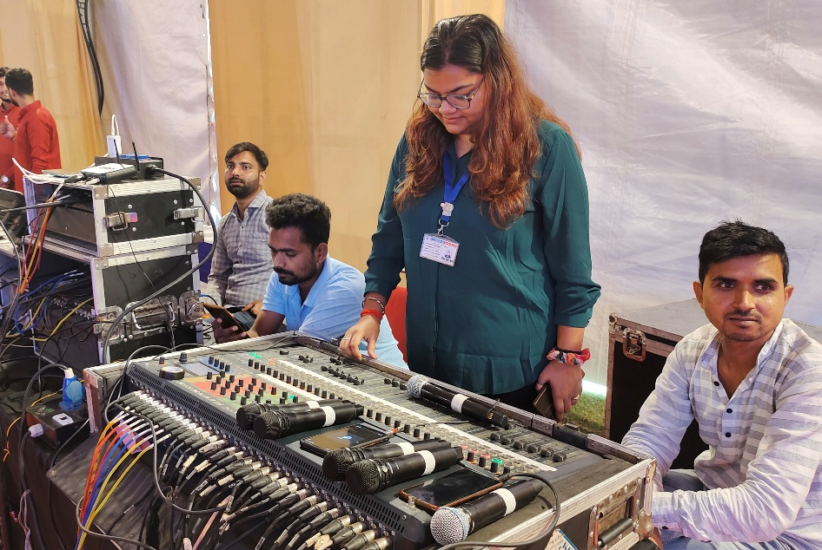
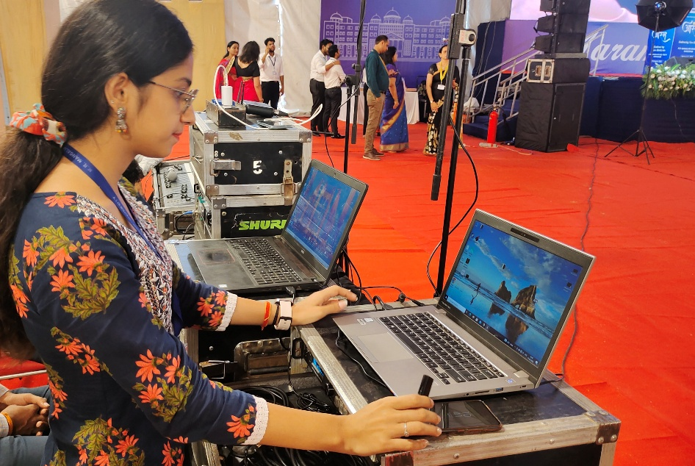
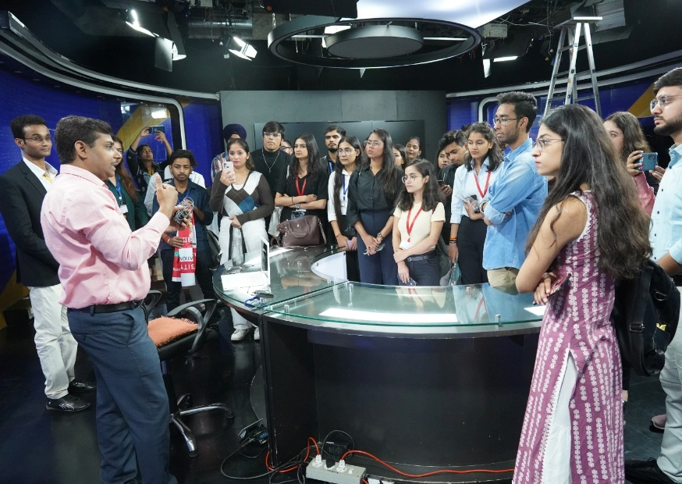
Learning Experience (Inside & Outside Classroom)
PARTICIPATIVE LEARNING
Mapped with:
Event as a Marketing tool
EXPERIENTIAL LEARNING
Mapped with: Idea to Screen, Broadcast News production
SJMC Students in the core organizing team of
KRMU Techno Fest and Convocation
Students visit studio facility of BBC India
INSIDE CLASSROOM
Case Based Learning, Discussions, Q-A, Lecture, Activity, Experience Sharing, Story Telling, Problem Solving, Simulations, Role Plays
OUTSIDE CLASSROOM
Field Projects, Internships, Industry & Exhibition Visits,
Society Connect, Assignments, Chat Bot (Moodle), Conferences/Seminars etc.

Slide 19
Mentoring @ SJMC
Case Study 1: Mental health support
Counseling Support: Dhairya* received personalized counseling to address his mental health needs, helping him navigate challenges effectively.
Therapy Sessions: He engaged in regular therapy sessions, which provided him with tools to manage stress and improve his overall well-being.
Successful Outcome: As a result of this support, he graduated with flying colors and maintained good mental health throughout his academic journey.
Case Study 2: Academic support and improvement
Attendance Improvement: Dhara* initially struggled with class attendance and performed poorly in her first-year exams.
Mentoring and Counseling: She received consistent mentoring and counseling, which helped her stay focused and motivated.
Increased Responsibility: Dhara was assigned important responsibilities in events, enhancing her engagement and skills.
Successful Outcome: Ultimately, she graduated with flying colors and secured a position as a social media executive at a reputable brand.
Policy & Mentors Responsibilities
List of SJMC
Mentor Mentee
Action Taken
Report
*Students’ names in both case studies have been changed to maintain anonymity
MENTOR-MENTEE DOCUMENTS
MENTOR - MENTEE FILES SAMPLES

Slide 20
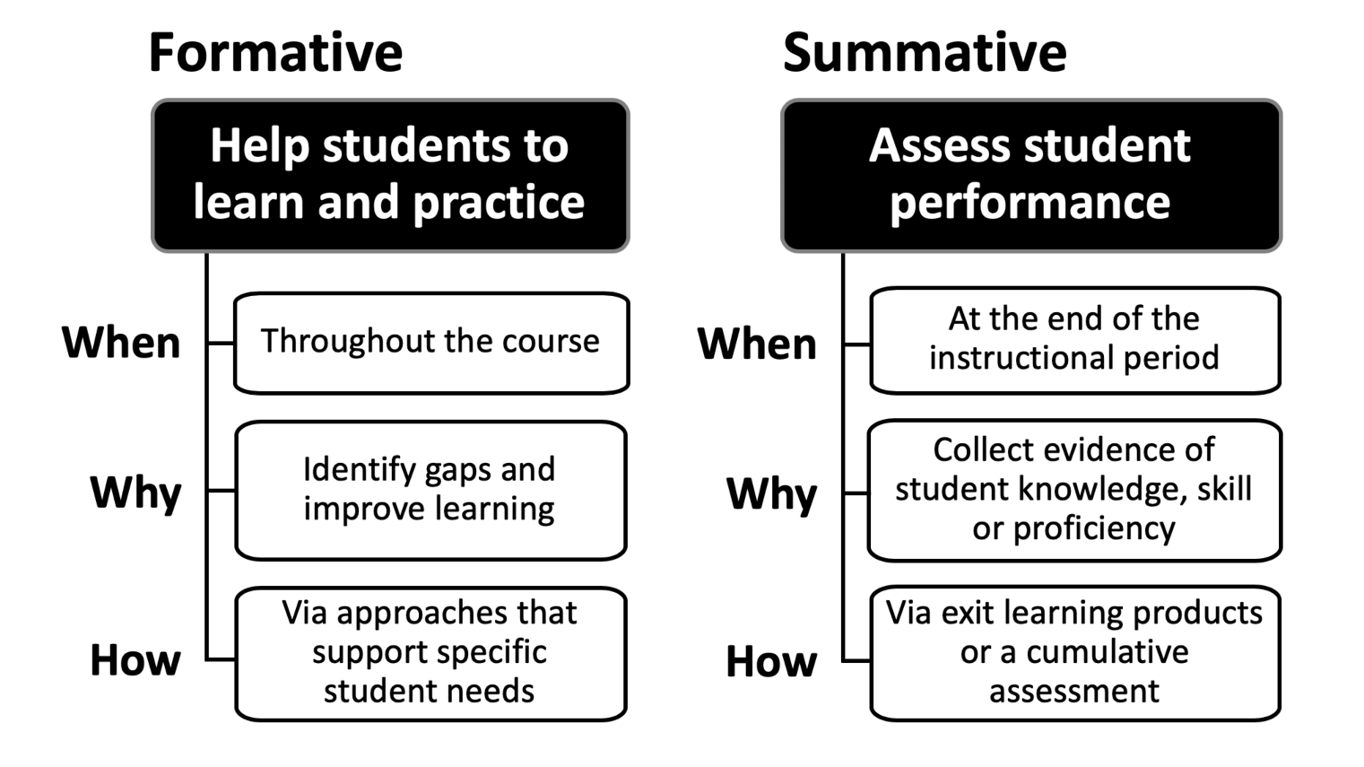
Evaluations & Results
BREAKUP
Continuous assessment : End term :: 50 : 50
End-Term Exams
Presentations
Projects
Quiz
Class Tests
Assignment
Participation
Mid-Term Exams
CLICK ON LINK
Examination system is given on page 31 of students’ handbook
and is also available on the weblink
https://krmangalam.edu.in/pdfs/Examination-Rules-Regulations-2022.pdf
Internal Assessment Components maintained by faculty in Course Hand Out by faculty along with CO attainments
Sample CO Attainments are available here
SJMC Result analysis since 2018

Slide 21










Research, Innovation & Extension
8
Research Papers Published
Click here for details
2
eContent Developed for eGyanKosh & LMS
Click here for details
11
Book
Chapters Published
Click here for details
2
Patents Published
Click here for details
3 Fellowships Secured
Click here for details
4
Faculty Research Grants
Click here for details
1
Seed
Funded
Projects
Click here for details
10+
Extension Activities & Social Camps
Click here for details

Slide 22
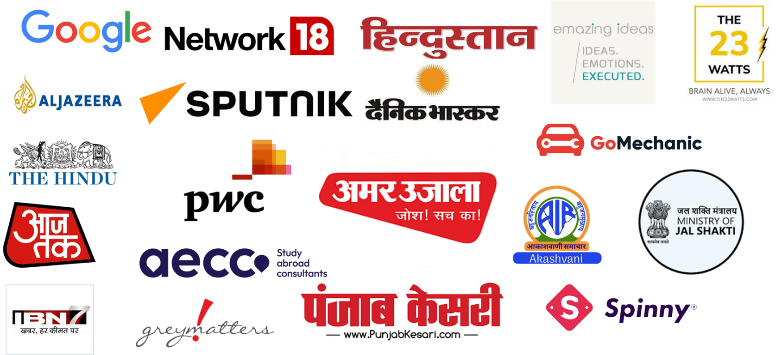
Industry & Peer Connects
All Events
12
MoUs
List of SJMC MoUs
with details of activities
DME
ICAN3
Grey Matters Communications & Consulting Pvt. Ltd.
SPUTNIK (Russia)
Meant4Environment Foundation
Emazing Ideas Execution Pvt. Ltd.
AECC
ISOMES
Newspaper Association of India
Bhagidari Jan Sahyog Samiti
Guided Self Publishing India LLP
New Delhi Film Foundation
During the assessment period (2018-2023)

Slide 23
Functional Memorandum of Understanding (MoU)
MOU Partner | Nature of Organization | Events conducted under the MoU
Delhi Metropolitan Education ICAN3 | Education | Conference
Meant4Enviornment Bhagidari Jan Sahyog Samiti | NGO | Workshops and Research Paper On the Job Training (2)
1. New Delhi Film Foundation | Film | On the Job Training (2)
Sputnik Newspapers Association of India ISOMES | News and Media | Photo Exhibition On the Job Training (2) Industrial Visits (1)
1. Guided Self Publishing, India | Publication House | On the Job Training (1)
Emazing Ideas Execution Pvt Ltd. Greymatters Communications & Consulting | AD and PR Agency | Workshops Workshops
1. AECC India Pvt. Ltd. | Global Consultancy | Counseling Sessions
Academic year 2018 onwards

Slide 24
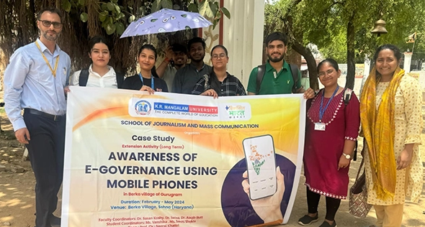
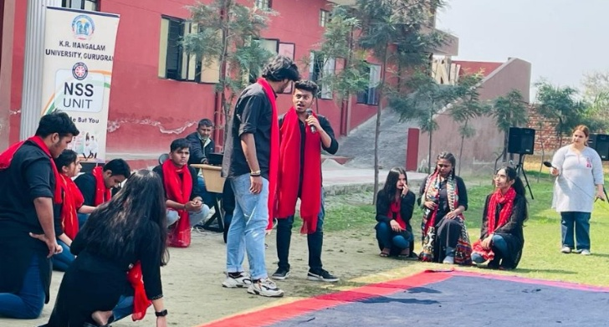
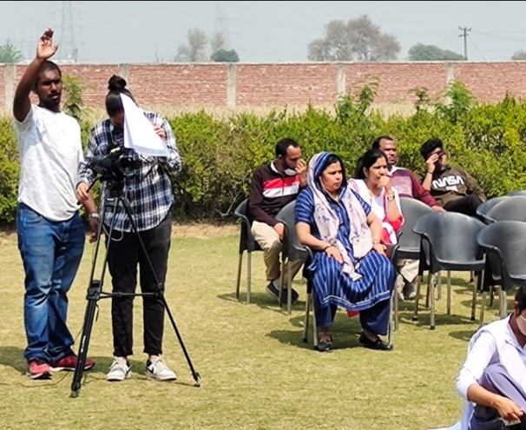
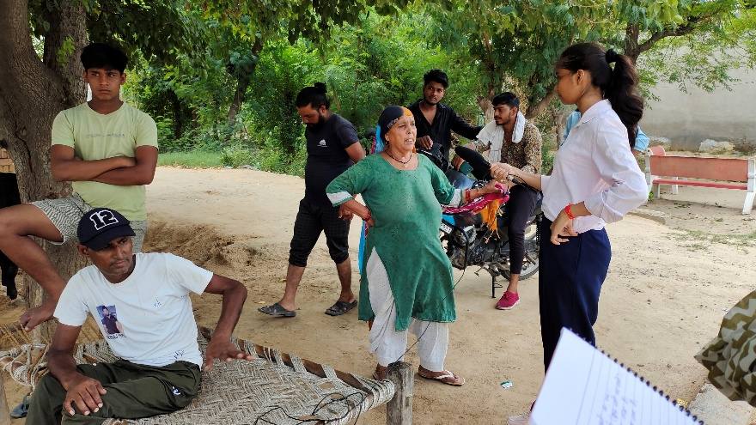
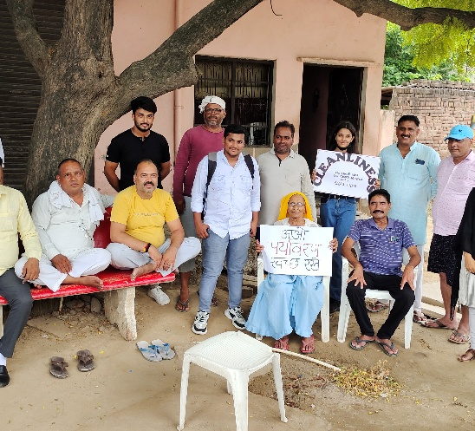
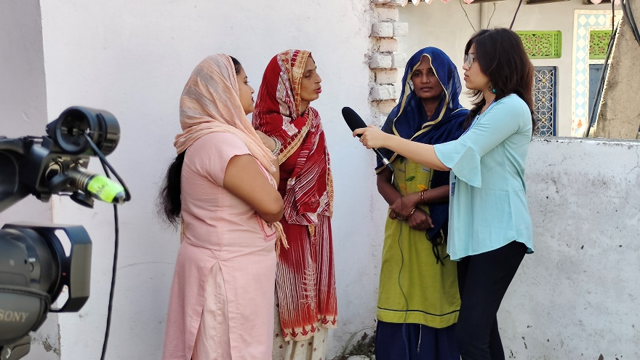
Social Outreach
Social Outreach Activities
Purpose: Sensitize students towards their duties & responsibilities within the society and for citizenship training goal of education through the development of various skills like soft skills, leadership skills, and team-building skills. Keywords – Sensitivity, Empathy, Societal concern, Better Citizens, Good Human Beings
Covering areas around: Media and Digital Literacy, Health, Cleanliness & Hygiene related awareness (campaigns at 5 villages adopted by KRMU), Communication Skills, Gender related, Bio & Solar Energy, Awareness about Agriculture Policies with NSS, E-Governance, Role of Digital Media etc.
Average Yearly Activities: 4 activities per academic year are conducted by SJMC.
Extension activity on awareness of e-governance using mobile phones
Nukkad natak on ‘Beti Bachao Beti Padhao
Women’s Health Sensitization
Nukkad Natak on Awareness on Cleanliness
Campaign ‘Say No to Polythene’’
Extension activity on awareness of waste recycle

Slide 25
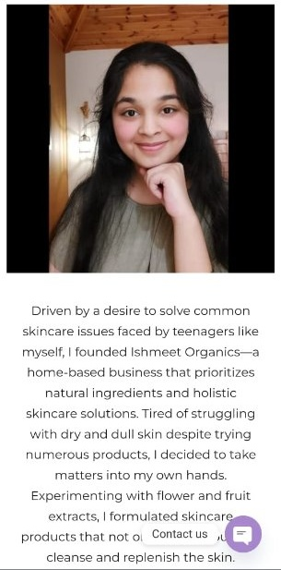

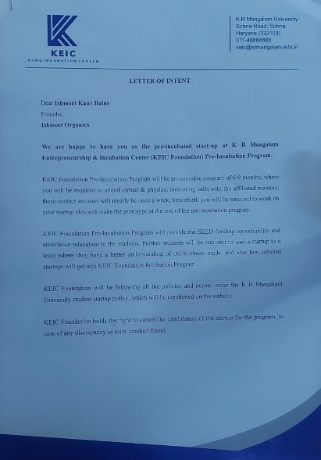
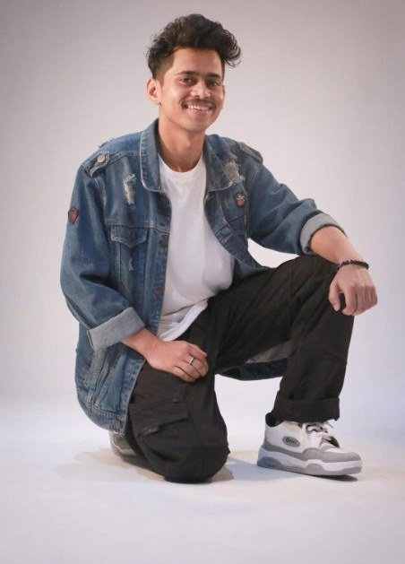




K.E.I.C. Support for Innovative Startups
SJMC Case Study 2
SJMC Case Study 1
https://www.krmangalam.edu.in/keic/
Ishmeet Kaur Bains from BA(J&MC) received
Incubation support from KRMU for her startup
Soumitra Haldar from BA(JMC) got
Incubation support from KRMU for his startup

Slide 26
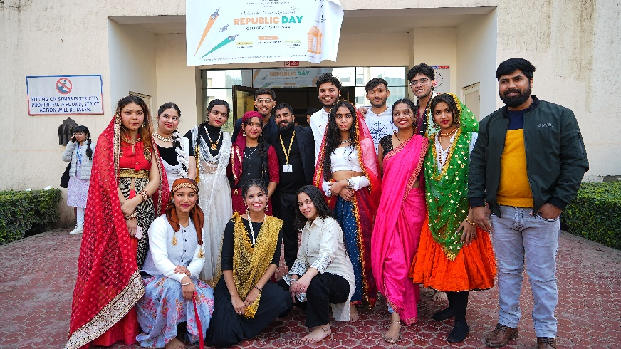
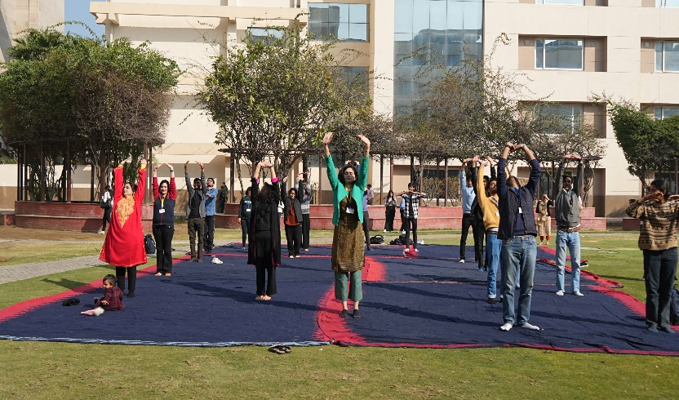
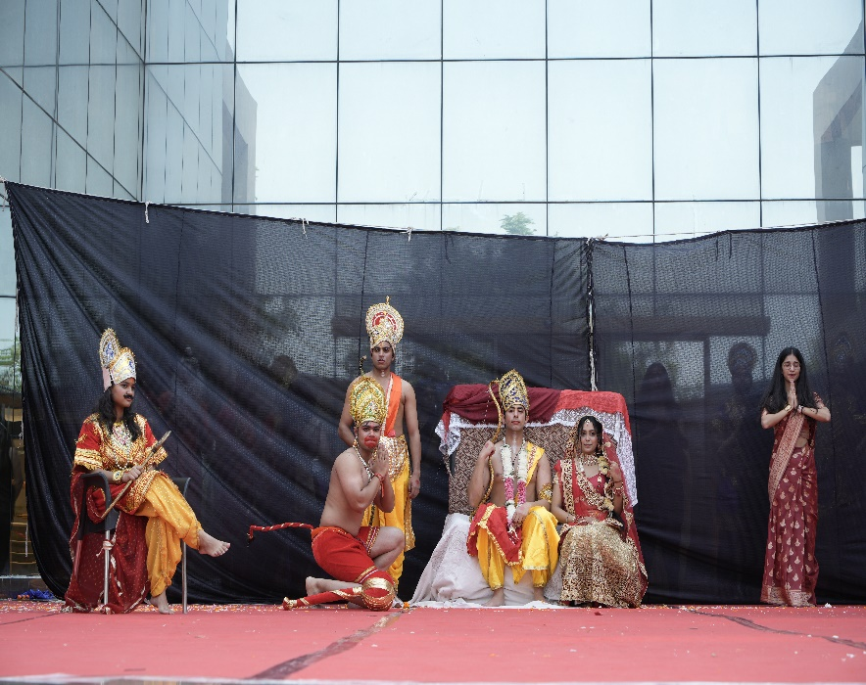

Promoting Indian Knowledge System
Students promoting cultural diversity in India during Republic Day celebrations.
SJMC students practicing and promoting ‘Yoga’.
SJMC students organize ‘Ram Leela’
Neeraj Mehta’s film on Qutub Minar highlighting India’s architectural marvel.
VAC courses on IKS also undertaken by students.
Core Courses also carry components on IKS
A
B
C
D

Slide 27
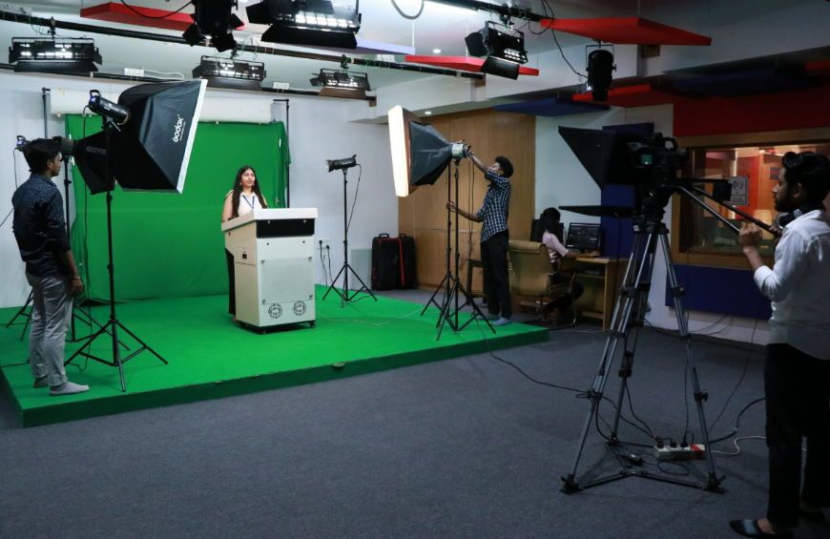
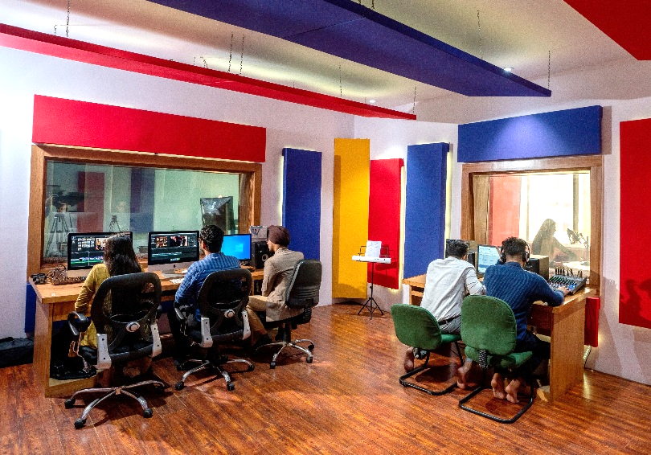
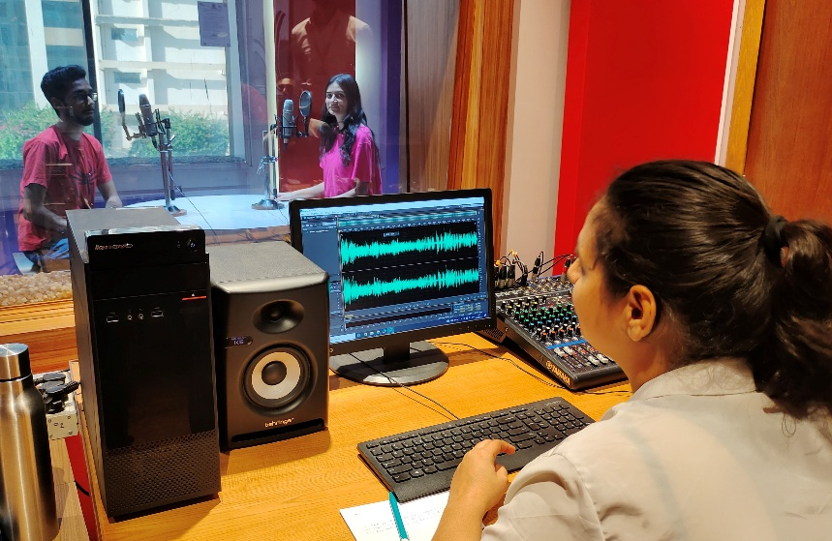
Infrastructure & Learning Resources
Media Production Facilities
TV Studio with PCR
Chroma background,
Teleprompter, Editing bays,
Portable and mounted lights,
Advanced audio equipment and more
Production Control Room, Print Production Studio and Computer Lab
Radio Studio with
complete acoustic treatment,
Rode Microphones, Audio Mixers, Audio Editing Software
like Adobe Audition and more.
LIST OF AVAILABLE EQUIPMENT

Slide 28
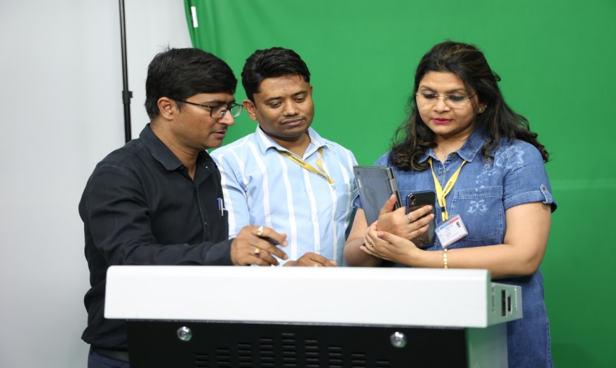
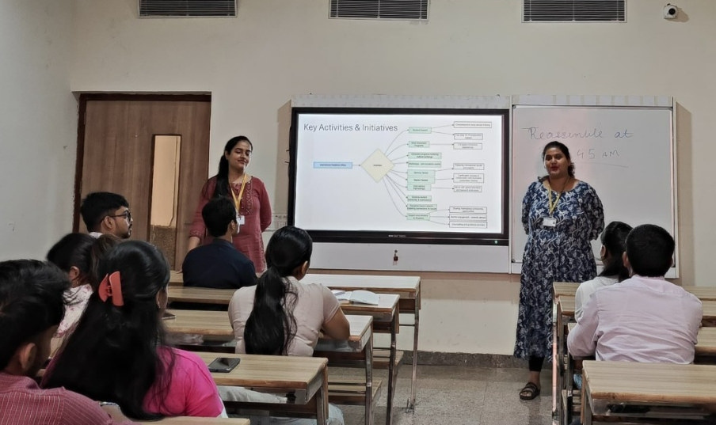
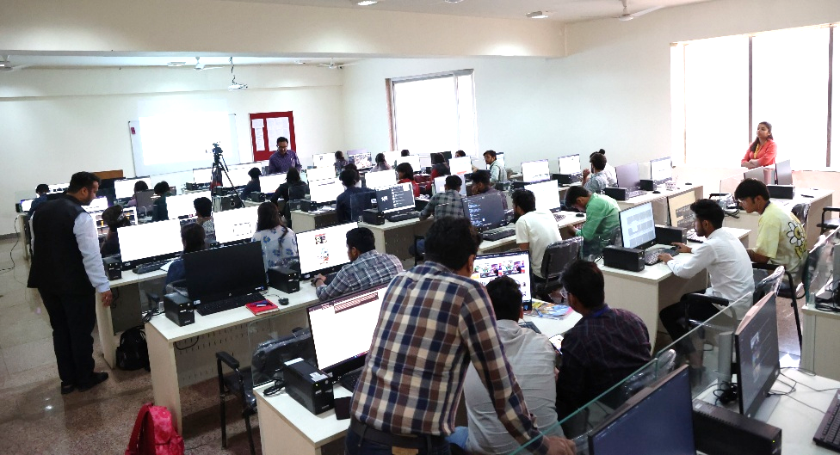


Infrastructure & Learning Resources
Lecture Capturing System & IT Infrastructure
Smart Classrooms
with interactive boards
Computer Lab
with multimedia software and high-speed internet connectivity
Lecture Capturing System
USAGE RECORDS
550+ Videos Content Recorded

Slide 29





Infrastructure & Learning Resources
Library
SJMC reading area
for faculty & students
Subscription to Newspapers & Magazines
through central library
SJMC Section
at KRMU Central Library
Books – 584 Journals – 6
Audio Visual Library
archives maintained as digital media
Shared Digital Resources
Over 73000 e-books through Knimbus platform
https://library.krmangalam.edu.in/
Plagiarism Checking
24x7 online library support
Access to Online Library Resources

Slide 30
Student Support & Progression (Scholarships)
Scholarship on basis of CGPA.​
Edu Empower & Academic Support Scheme- Educational resources are provided to both UG & PG students​
Enhancement Support Scheme for UG & PG students with CGPA < 6.50​
Merit Scholarship Scheme for UG students based on marks scored in 12th Board Exams​
Year | Academic Support Scheme | CGPA | Edu Empower | Enhancement Support Scheme | Merit Scholarship Scheme | TOTAL Scholarship and Freeships
2018-19 | 15 | 4 | 16 | 16 | 1 | 52
2019-20 | 13 | 1 | 38 | 8 |  | 60
2020-21 | 22 | 1 | 30 | 19 | 3 | 75
2021-22 | 28 |  | 22 | 13 | 4 | 67
2022-23 | 22 |  | 37 | 8 | 8 | 75
Yearly and Scheme wise summary
Details
Scholarship Policy
https://www.krmangalam.edu.in/kr-mangalam-university-scholarship/

Slide 31




Student Counselling (Career and Personal)
Year | Session Name
2022-23 | Workshop on Career Counselling on Soft Skills; Science Communication & Elevator Pitch
2022-23 | Career Counselling Session - Presentation Techniques
2022-23 | Session on Career Counselling - Influencer marketing and Scope of Internship - International
2022-23 | Career counselling session on Higher Education and Scope of Internship-International
2022-23 | Counselling session for on-the-job Training in association with AECC
Session on career counseling and Employability
Session on career counseling at American Centre on theatre as a career
Presentation Techniques -Etiquette, Body Language and Dressing
Session on career counseling (Higher education abroad & Scope of internship -international)
Placement Data
Students opting for HE

Slide 32




Beyond Academics
Fests, Competitions and other activities
Regular participation in Cultural Club Events
Inter-University Events
Intra-University Events
Sports & Games competitions organized by university Sports club.
SJMC students compete in games like Badminton, Table Tennis, Volleyball, Football, Cricket etc.
Year wise documentary support is available here
Beyond Curricula
Entertainment
Sports
Celebrations
Clubs
Celebrations
Freshers’ & Farewell Party, Teacher’s Day, World Photography Day, Press Freedom Day, Gandhi Jayanti, Diwali Mela, Halloween, World Radio Day, Environment Day, Yoga Day and more.
SJMC provides 360⁰ media coverage; supports in organizing events; and students participate.
13 Clubs & Societies-
E-Yantra, Computer Society of India, Investment Club, Management Society, Chetna Club, Model United Nations Club, DIA, Rhetoric Club, Cultural, Sports club, Entrepreneurship and Media verse
Events 2024
Year wise events
since 2021
University Students’ Council Members
Garima Sethi
Cultural Secretary
Shruti Sharma
Member
Poorvi Sapra
Member
Abhishek Mudgal
Member

Slide 33





Sports Achievements – SJMC Students
SJMC student won Gold medal at annual university sports event Sportura 2021 at KR Mangalam University in 100 meter race.
Aman Saini BA JMC III year student won Gold in Inter university athletics at GD Goenka university.
SJMC students participated and Won Silver medal at inter university athletics competition at Galgotia university
SJMC student won Gold medalist at February Fitness pro challenge held at KR Mangalam university
Students of SJMC represented KRMU at India North zone athletics competition at KIIT Bhubaneshwar Odisha.
A
B
C
D
E

Slide 34



Students’ Achievements
SJMC students won the group dance event at Best of Zest, Lingayas.
Samiksha Rathore from BA(JMC) anchoring the budget discussion at India News in 2022.
Duet Dance performance winners at AIIMS fest - Pulse 2022.
Kushal from BA(JMC) won Battle of Bands at MNIT, Jaipur in 2022.
BA(JMC) students’ from SJMC won group dance at JECRC, Jaipur in 2022.
Samiksha Rathore from BA(JMC) anchoring at Hindi Khabar.
A
B
C
D
E
F

Slide 35

SJMC Alumni Support
Total Alumni 128

Slide 36

Governance, Leadership & Management
Dean SJMC
Admission
Coordinator
School Research Committee (SRC)
Executive Assistant
e-Content Manager
Support Staff
Academic Staff
Program Coordinator
Time-Table Coordinator
Mentors
Class Coordinators
Alumni & Placement
Coordinator
Faculty
IQAC Coordinator
Lab (Studio) Assistant
Board of Studies (BOS)
Grievance Redressal Committee
Examination
Coordinator
Student Coverage Team
Class Representatives
Student Podcasts Team
Student’s PR & Social Media Team
Decentralized Management of Responsibilities
with active involvement of faculty and students

Slide 37



Initiatives to promote Gender Equity
Guest lecture on Diversion
and inclusion session
(in context to LGBTQ)
Extension activity on Gender Literacy level amongst the rural students
Details of initiatives to promote Gender Equity
(Gender Sensitization and Safety Committee)
Workshop on International Women Day, 2022

Slide 38








Best Practices
Nurturing socially responsible and compassionate citizens who possess the ability to influence change in society.​
Best Practice 1: Nurturing Eco-Conscious Behavior: Taking steps towards Environment Sustainability​
Green Collaborations: MOU with Meant4Environment. 2 Activities conducted by SJMC. ​
Curriculum Integration: Course like Environmental Studies and Disaster Management.​
Eco-Friendly Initiatives: Student and faculty research papers on alternative energy sources like Bio & Solar Energy, Encouraging minimum the use of plastics, Paperless work environment with LMS. ​
Workshops and Campaigns: eGovernance, Environmental issues like global warming, Waste management.​
Best Practice 2: Holistic Sustainable Learning through Social Connect ​
Projects on environment: SJMC students engage in community-based activities such as rural development, health care, education, and digital literacy.​
Alumni Connects: The school organizes alumni connects for the students to strengthen institutional reputation, career development and job placement, networking for students and industry updates.​
Education through partnerships: MoUs like New Delhi Film foundation, ISMOES, Guided Self Publication, Bhagidari Jansehyog Samiti, Newspapers Association Of India, Greymatters, AECC, Emaging Ideas and Sputnik to promote knowledge exchange, research, enhance learning opportunities and facilitates internships.​
Interactions and educational sessions: Social outreach activities, Interactions and educational sessions to develop skills, exposure to expert, enhance learning experience, engagement and motivation.​​
Click here for documentary proofs of SJMC best practices

Slide 39







Institutional Distinctiveness
EXPERIENTIAL LEARNING
SJMC TV - YouTube Channel
Podcast Channel on Spotify
University Newsletter - KRMU Times
Research Papers & Capstone projects
TECHNOLOGY INTEGRATION IN LEARNING
AI Anchor ‘Palak’
on SJMC TV
Drone Production
(DGCA Certified
Trainer)
Devyanshu – BA(J&MC)
Batch of 2020

Slide 40



Future Roadmap
Boost SJMC’s YouTube & Spotify reach to 5000+ & to showcase students’ work and enhance visibility by Q3 2025.
Curriculum redesign to incorporate AI & Digital Media Components in the existing UG/PG programs by Q3 2025
Introduce additional Pan University minor stream in the Emerging Media and Creator Economy domain program by Q3 of 2025.
Introduce PBL based/ apprenticeship embedded BA in Emerging Media and Creator Economy program by AY 2026.
Launch SJMC Research Journal to drive publications, patents & quality research output by Q1 2026.
Expand global exchange programs and internships for international exposure by Q3 2026.
Increase consultancy projects to target an annual revenue of Rs. 50 Lakhs by Q2 2026.
Implement advanced training for SJMC faculty to enhance expertise and teaching quality by Q3 2025.

Slide 41

THANK YOU
SJMC - Intro Video Link

Slide 42
STUDENT PROJECTS - SAMPLE
MENTOR - MENTEE FILES SAMPLES
MENTOR-MENTEE DOCUMENTS: It contains all documents of Mentor-mentee for 2024-24 including list of mentor-mentees, ATR & office order.
Slow-Advanced Learners Files (Even Sem 2024-25)
2024-25 Even Sem Slow fast
2024-2025 ODD SEM SLOW FAST

