Slide 1




















WELCOMES
NAAC PEER TEAM
16 - 18 June , 2025

Slide 2










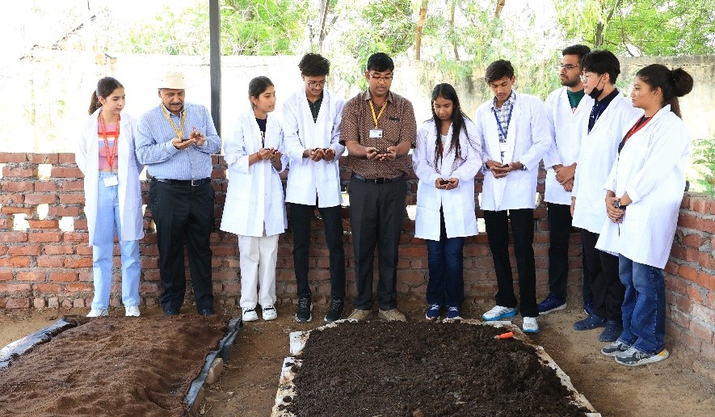
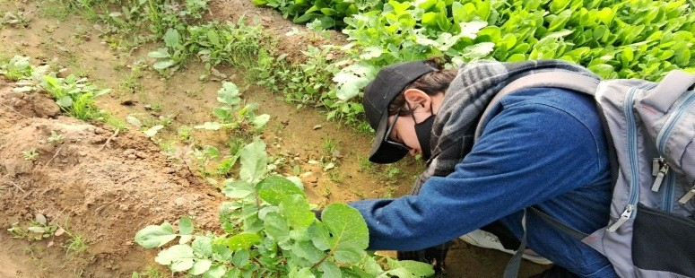
SCHOOL OF AGRICULTURAL SCIENCES
Presented by:-
Dr. J. S. Yadav, Professor & Dean

Slide 3









TABLE OF CONTENTS
S. No. | Slide Title | Slide No. | S. No. | Slide Title | Slide No.
1. | School Vision and Mission | 02 | 11. | Industry and Peer Connects | 17-18
2. | School as on Date | 03 | 12. | Mentor-Mentee System | 19-22
3. | Faculty Members | 04 | 13. | Research and Innovation | 23
4. | SOAS Organogram | 05 | 14. | Physical Infrastructure and Learning Resources | 24-27
5. | Course Curriculum | 06 | 15. | Student Progression & Support | 28-34
6. | Course Mapping with Skills, Employability, Entrepreneurship and LRNG | 07 | 16. | Faculty Empowerment | 35
7. | Teaching-Learning Process | 08 | 17. | Best Practices | 36
8. | Learning Experiences | 09-14 | 18. | Institutional Distinctiveness | 37
9. | Learning Resource | 15 | 19. | Future Road Map | 38
10. | Learning Outcome | 16
01

Slide 4
SCHOOL VISION & MISSION
VISION
To be an internationally recognized Agri-institute for agriculture education, research & innovation, and Agri-entrepreneurship.
MISSION
An interdisciplinary approach, innovative pedagogy, stimulating research to foster Agri-based employability and entrepreneurship.
Integrate global needs and expectations through collaborative programs with premier universities, research centers, industries, and professional bodies within India and abroad for global exposure & real-life work experience.
Practicing cutting-edge technologies, tools, techniques, practices, and processes in the ﬁeld of agriculture
Developing leadership, ethical values, and sensitivity to the environment.
02

Slide 5
SCHOOL AS ON DATE
Name of Programme
Year of Starting No. of Male Students
No. of Female Students
Total Students
B. Sc. (Hons.) Agriculture (82)
2019
58 (64%)
32 (36%)
90
Assessment (2019-22) Intake.pdf
Establish and DHE Intake Approval.pdf
03

Slide 6
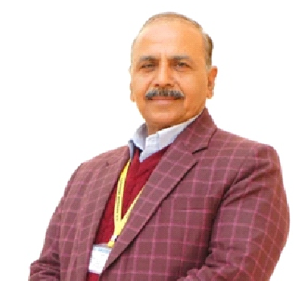
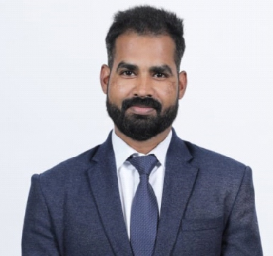
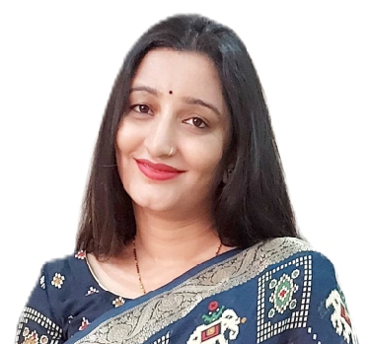
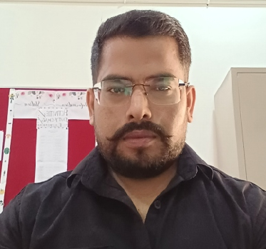
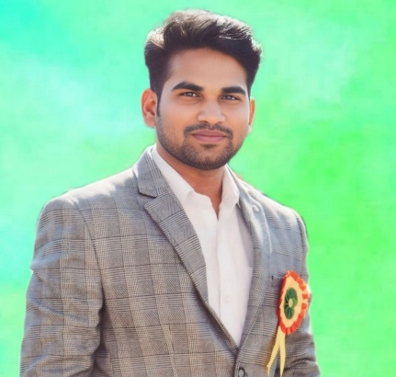
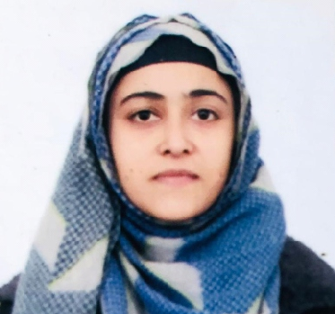
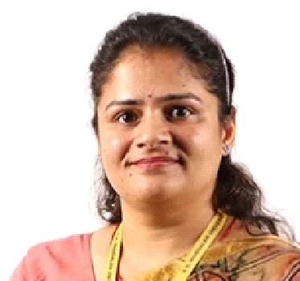
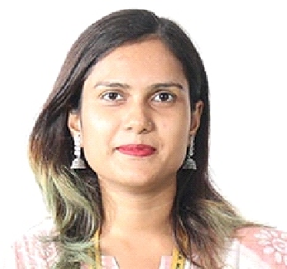
TOTAL FACULTY MEMBERS- 08
(6 from Allied Disciplines)
Dr. J. S. Yadav
Dean & Professor
Dr. Deepak Kumar (Assistant Professor) Ph.D. (Genetics and Plant Breeding) ANDUAT, U.P.
Dr. Ambika Bhandari (Assistant Professor) Ph.D. (Horticulture) SKUAST, J & K.
Dr. Gajraj Yadav (Assistant Professor) Ph.D. (Soil Science & Agricultural Chemistry)
ANDUAT, U.P.
Dr. Jay Nath Patel (Assistant Professor) Ph.D. (Agronomy) SVPUAT, U.P.
Dr. Rabiya Basri (Assistant Professor) Ph.D. (Entomology) AMU, U.P.
Dr. Neha Sharma (Assistant Professor) Ph.D. (Microbiology) PU, Punjab.
Dr. Anjali Tomar (Assistant Professor) Ph.D. (Agricultural Extension Education) SKUAST, J & K.
All Faculty Members Doctorate from SAUs/CUs
04

Slide 7
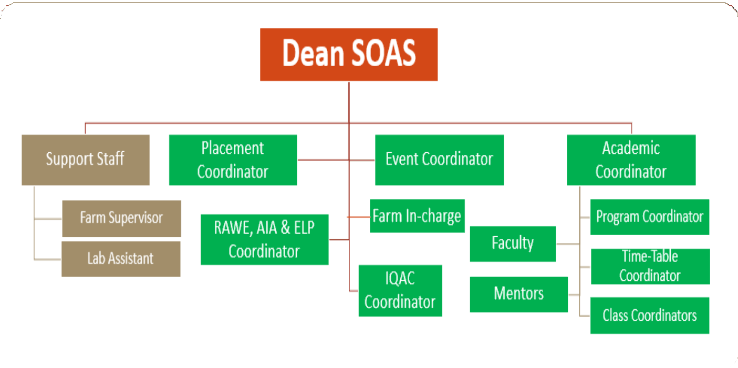
SOAS ORGANOGRAM
05

Slide 8
Curriculum Details: As per ICAR 5th Dean’s Committee Report
Course Distribution
I Year – Basic and Fundamentals
Year – Principles and Methods (Technology)
Year – Production System and Best Practices (For Encouraging Talent)
Theory- 09, Practical- 3, Theory + Practical - 48
All Disciplines
IV Year – Skills and Entrepreneurship Development
(Case Studies, Live Projects, Training, and Internship)
Remedial Courses
ElectiveCourse (3/12)
RAWE & AIA
ELP Courses (2/12)
Components
IKS/ITK (Indigenous Technical Knowledge
Agriculture Heritage
Ethics
Human Values and Ethics
1. Sustainability Through Organic Kitchen Gardening (54 Students).
1. Natural Farming
VAC
2. Role of Biofertilizers and Bio-Pesticides in Organic Farming
OE
BOS MOM 2019-22.pdf
2. Urban Agriculture
Programme at a glance.pdf
AY 2025-26
6th Dean's Committee Report.docx
06

Slide 9
Course Mapping with Employability, Skills, Entrepreneurship, and Local, Regional, National, and Global
Skills | Employability | Entrepreneurship
Protected Cultivation, PCP Rabi & Kharif | Principles of Seed Technology, Fundamentals of Commercial Horticulture, | Mushroom Cultivation
Local | Regional | National | Global
Crop Production Technology, Rabi & Kharif Crops | Crop Improvement-I, II | Introductio n to Forestry | Fundamentals of Agronomy
Mapping Skills, Entrepreneurship, and Employability
Mapping- Local, Regional, National, Global
Local
Global
Skill
Employability
Regional
Entrepreneurship
National
Skills, Entre. and Employbility.xlsx
LRNG.docx
07

Slide 10
TEACHING-LEARNING PROCESS
Participatory
ENGAGE
Assignment
Hands-on Training
EXPLORE
Case Study/Projects
EXPLAIN
Cognitive Learning
ELABORATE
Problem Solving
Test
Feedback
EVALUATE
Quiz
Mid-Term and End-Term Examination
08

Slide 11









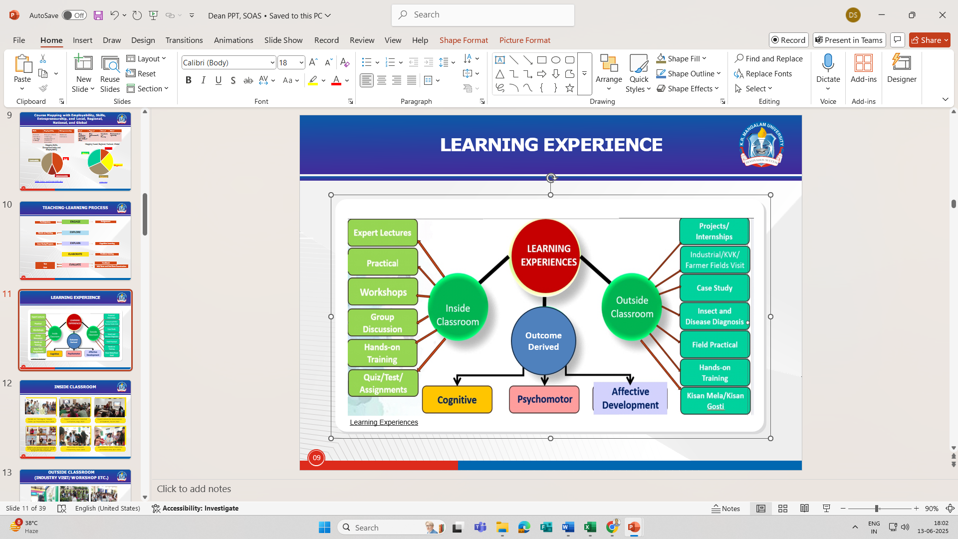
LEARNING EXPERIENCE
Learning Experiences
09

Slide 12
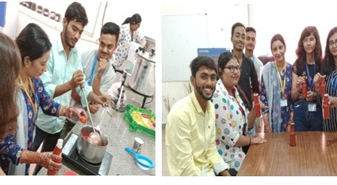
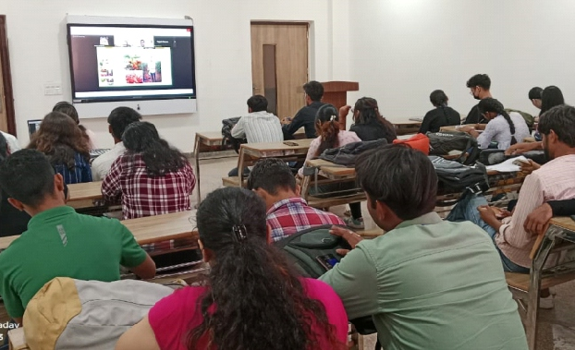
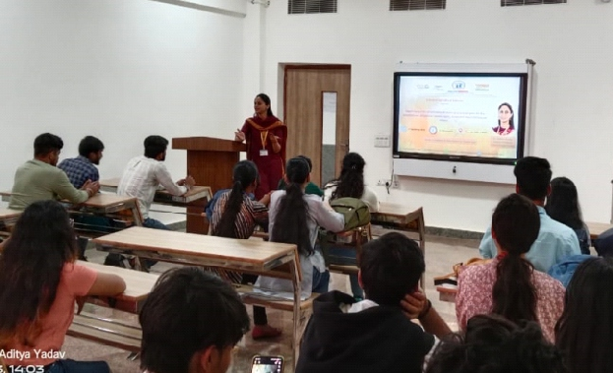
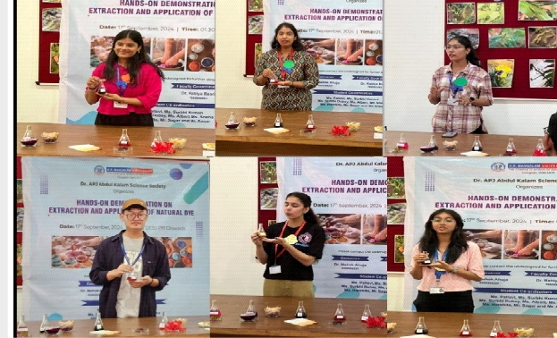
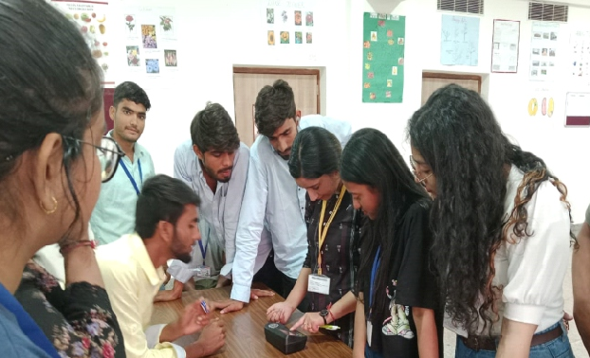
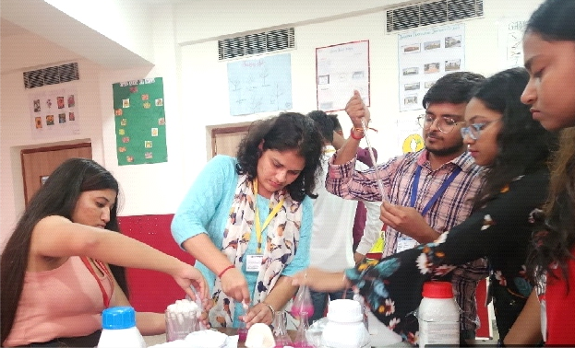
INSIDE CLASSROOM
Hands-on Training on Tomato Catch-up Preparation, April 2023
Expert Lecture on Protected Cultivation, Aug. 2023
Expert lecture for Sensitization of Students, March 2022
Students have demonstrated the method of the obtaining color and their use for dying fabric and as food color
Workshop on Squash Preparation, Sept. 2023
Workshop on Mass Production on Biofertilizers, April 2024
10

Slide 13
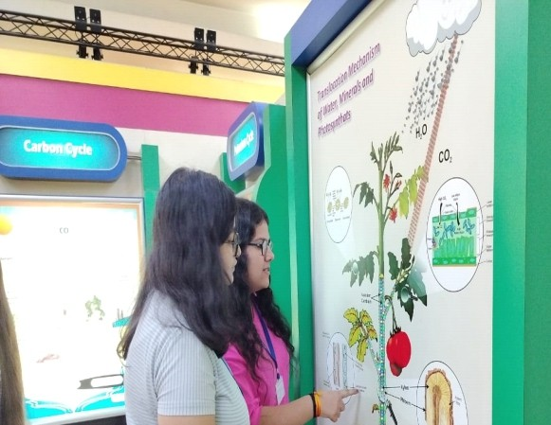
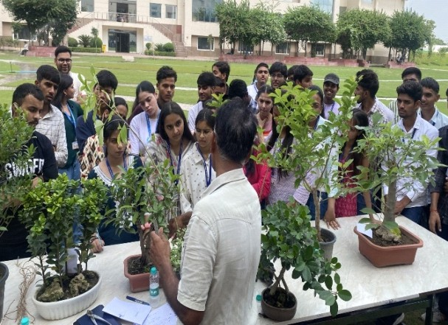
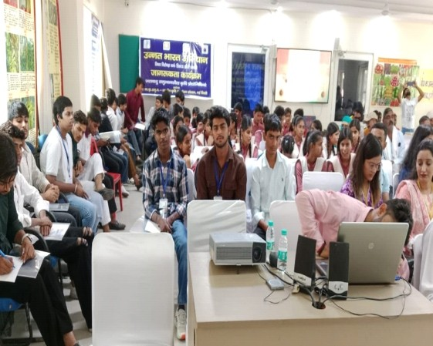
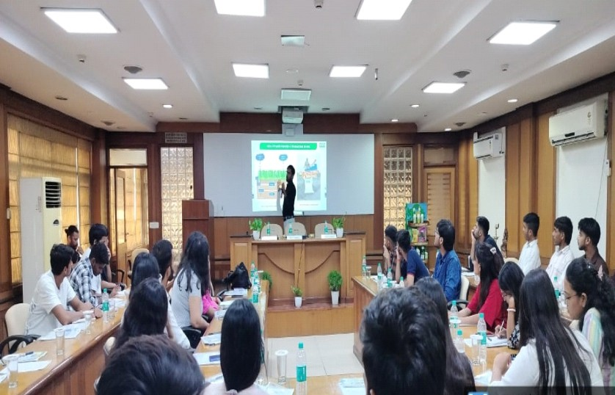
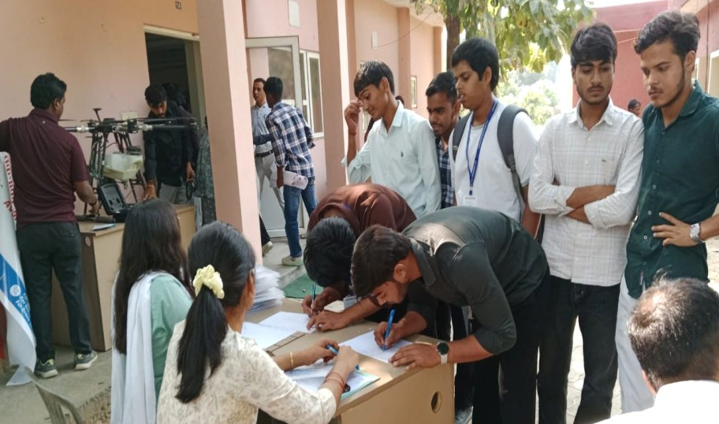
OUTSIDE CLASSROOM (INDUSTRY VISIT/ WORKSHOP ETC.)
Visit at Agriculture Industry March 2022
Workshop on Bonsai Sep 2024
Farmer’s Awareness Program at KVK Feb 2023
Interaction Session at IFFCO Delegates Sep-2024
Participation KisanGosthi Jan 2023
13

Slide 14
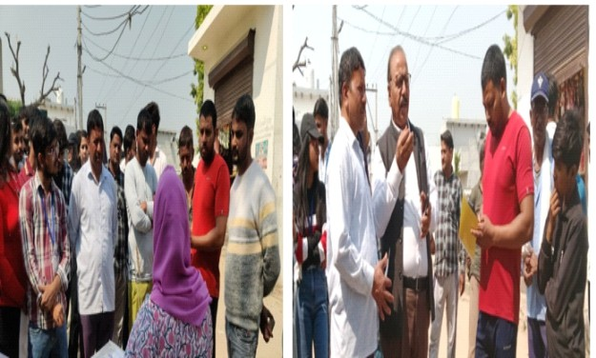
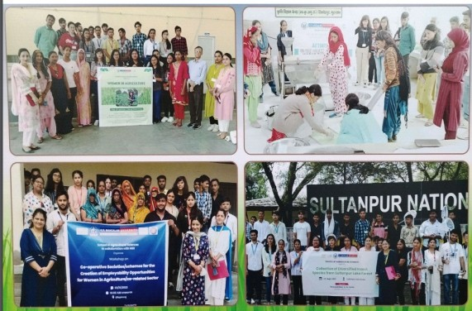
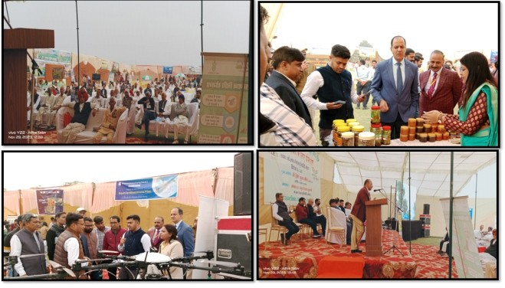
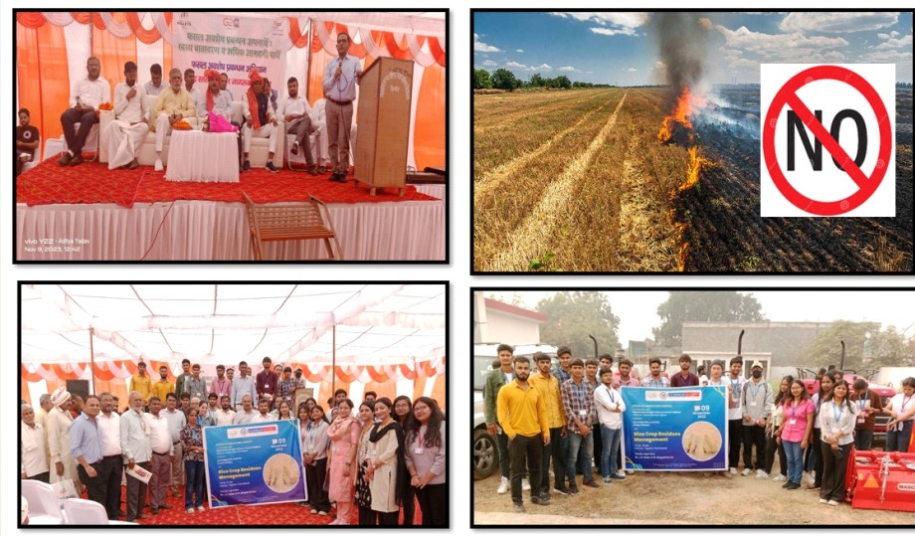
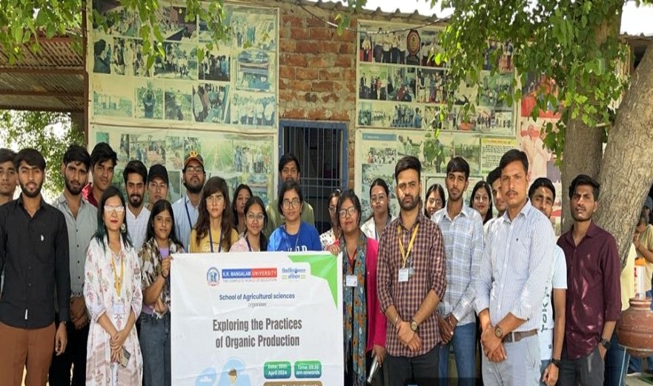

OUTSIDE CLASSROOM
Awareness Campaign on IPM, Dec. 2023
Awareness Campaign to Promote Women in Agriculture, March 2022
Kisan Mela, Nov.2023
Case Study on Rice Residues Management, Oct. 2023
Promoting Organic/Natural Farming, April-2024
14

Slide 15
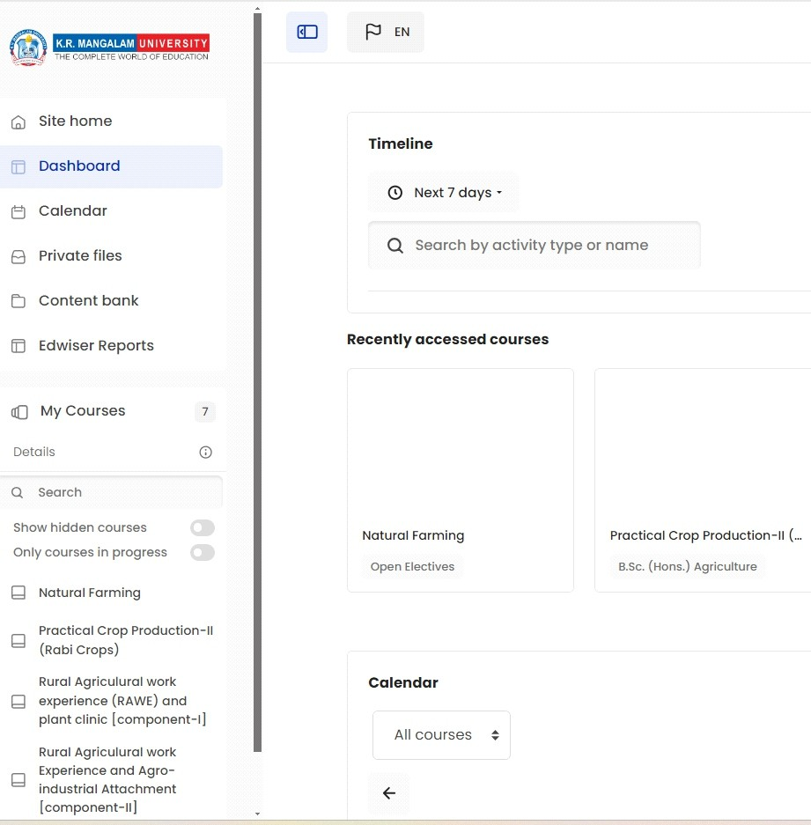
LEARNING RESOURSES
LMS
Textbooks
Reference Books
Journals
Magazines
Software
E-Library
SOAS_List of Books in the Library (4).xlsx

Slide 16
LEARNING OUTCOMES
Packages Of Practices For Crop Cultivation
Communication Skills
Teamwork and Leadership
To Design Layouts, Conduct Experiments, And Analyse
LEARNING OUTCOMES
Problem- Solving
Interpersonal Relationship Skills
Ethical Principles & Professional Ethics
16

Slide 17











INDUSTRY AND PEER CONNECTS- MOUs ACTIVITY
S. No. | Title of Activity | Date of Activity | S. No. | Title of the Activity | Date of Activity
 |  |  | 1 | Training on the production of organic Farm Produce and supply chain in collaboration with Dharuhera Organic Agro Farm | 27/03/2024
1 | Survey of diﬀerent exotic vegetables under MOU with Green Planters (ﬁeld project) | 03/11/22
2 | Field project and workshop on composting under MOU with Kinder Poly farm | 10/11/22 | 2 | "Project on the inclination of farmers towards adoption of natural farming in southern Haryana in collaboration with Dharuhera Organic Agro Farm | 27/03/2024
3 | Field survey of Diﬀerent horticultural, spices, and condiments crops (Activity Under MoU with Kinder Poly farm) | 22/02/22
 |  |  | 3 | Research project on mass multiplication of horticultural crops through tissue culture techniques (Activity 1 under new MoU with Neer Care Agro pvt. Ltd.) | 07/03/2024
4 | Field Project on Production of Medicinal- value Mushrooms (Activity 1 Under MoU with Bio credence) | 11/11/22
 |  |  | 4 | Project on Processing of mustard seed: FROM SEED TO BOTTLE in collaboration with Verdanta Food industry | 05/03/2024
5 | Session on Preparation of media for mushroom cultivation (Activity Under MoU with Biocredence) | 02/12/22
 |  |  | 5 | Training on Fruit and Vegetable Preservation Techniques (under new MOU with Verdanta Food industry, | 05/03/2024
6 | Field project on hands-on collection of insects, soil && water samples under MoU Biocredence | 22/12/22
 |  |  | 6 | Training and Project Work on food processing (extraction of juice from various fruits & and their preservation methods) at Verdanta Food industry | 05/03/2024
7 | Field Project on the Art of Vermicomposting (Activity 1 Under MoU with Pranab Mukherjee Foundation) | 13/11/22
 |  |  | 7 | Identiﬁcation of insects on seasonal vegetables and their management at farmer's ﬁeld in collaboration with Insecticides India Ltd, Lusa Tower, Azadpur, New Delhi-110033 | 30-12-23
8 | An activity on Lemon grass oil extraction and techniques under MoU with Pranab Mukherjee Foundation | 11/10/22
 |  |  | 8 | Field Project on transfer of tissue culture plants in soilless substrates and hardening of plantlets under a protected environment | 30-11-23 to
9 | An activity on Post-harvest handling of Mushrooms under MoU with Pranab Mukherjee Foundation | 16/12/22
 |  |  | 9 | Establishment of a small functional model at KRMU on Litopenaeus Vannammi (prawn culture) in collaboration with Growel Formulation Pvt Ltd. | 09-10- 2023
10 | An interactive session on weed management under an organic crop production system (Activity Under MoU with Pranab Mukherjee Foundation) | 06/09/22
 |  |  | 10 | Project on saltwater prawn farming (ﬁsh farming) at Rewari lakhnor farmer's unit in collaboration with Growel Formulation Pvt Ltd. | 06-09-23
Neer Care Pvt. Ltd
17

Slide 18
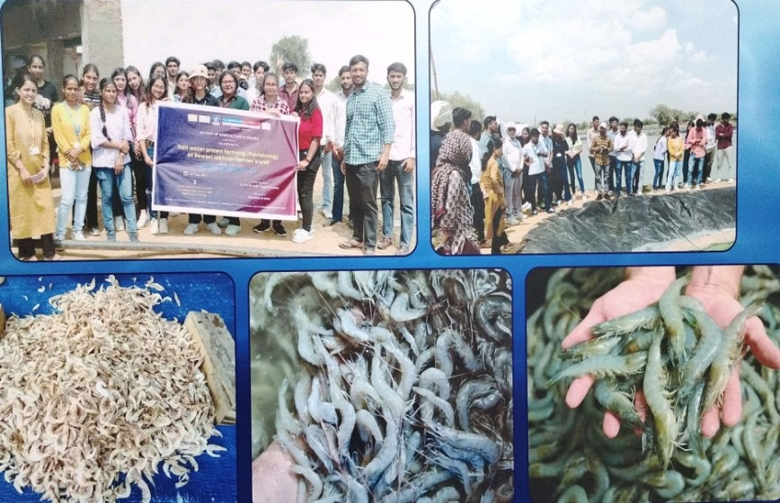
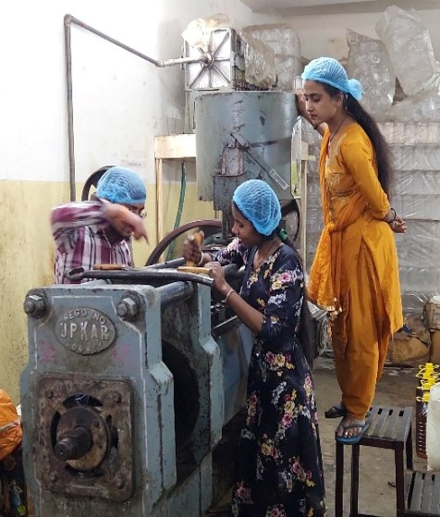
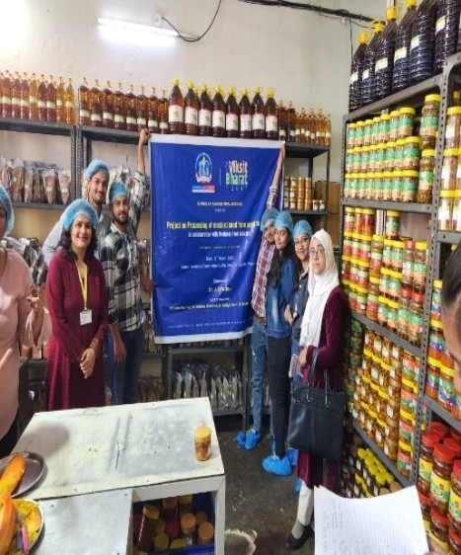
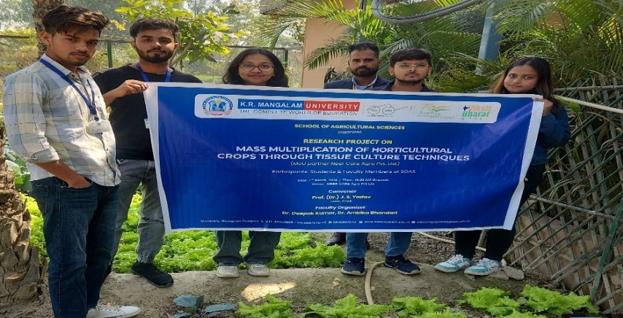
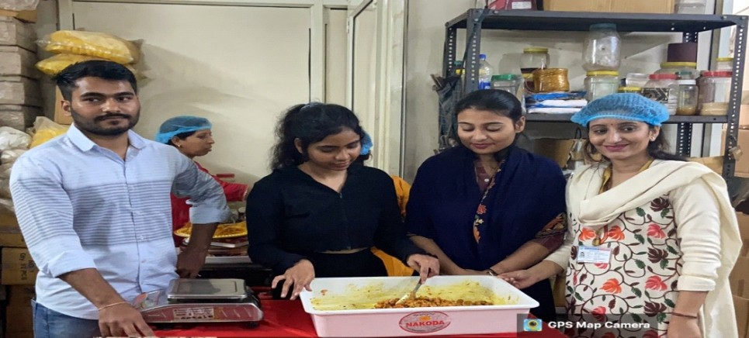
INDUSTRY/MOUs ACTIVITY
Project on Prawn farming in collaboration with Growel Formulation Pvt. Ltd. 2023
From Seed To Bottle in collaboration with Richa Food industry (Verdanta ) 2023
Project on mass multiplication of horticultural crops through tissue culture techniques with Neer Care Agro Pvt. Ltd.,2023
Post-harvest handling of Mushrooms under MoU with Pranab Mukherjee Foundation 2023
18

Slide 19
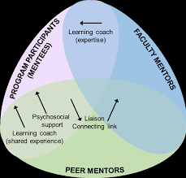
MENTOR-MENTEE SYSTEM
It fosters a close student-faculty connection, providing ongoing emotional support and encouragement throughout the academic experience.
We oﬀer guidance and support to nurture students' academic, personal, and professional development.
Provide individual attention in learning apart from classroom.
A mentor is assigned 10 to 15 students for mentoring
Help students to reduce feelings of inadequacy that can lead to behaviour or motivation issues.
19

Slide 20
SLOW-ADVANCED LEARNER
An advanced learner is a student who excels beyond standard expectations, demonstrating high proficiency and a quick grasp of complex concepts. They are often self-motivated, eager for deeper challenges, and display strong critical thinking skills.
A slow learner is a student who takes longer than average to grasp new concepts and requires additional time, support, and practice to understand and retain information. They benefit from personalized teaching strategies that accommodate their learning pace.
Assessment based on marks = to 80% in internal assessment
Assessment based on marks =to 55% in internal assessment.
Interventions: Oﬀer capacity-building programs, provide enriched materials, encourage independent projects, and create leadership opportunities to help in extension services for the farmers
Interventions: Provide remedial support, oﬀer professional and personal counseling, promote peer learning, and give constructive feedback with positive reinforcement.
20

Slide 21
SLOW LEARNER
Counselling of the students
Remedial classes
Bilingual explanations and discussions
Initiatives taken for Slow Learners
Focus on English language and communication skills
Slow and Advance Learner SOAS
Personal guidance for preparation of examination
Multiple revision
21

Slide 22




ADVANCE LEARNER
Presentations and peer tutoring
Online workshops
Projects
Initiatives taken for Advanced Learners
Involvement in case studies
Slow and Advance learner SOAS
Recommendation of MOOC Courses
Encourage participation to provide extension services to farmers related to IPM
22

Slide 23
RESEARCH, AWARDS, MEMBERSHIP & FDPS
17
Research Papers Published
Publications.docx
12
Book & Book Chapters Published
book chapter.docx
8 & 4
Awards & Patent
Faculty Awards.docx
16
Professional Membership
Membership Certificates.docx
21
FDP (atended)
FDP Certificates SOAS.docx
02
Fellowship Support
fellowship support.docx
AY 2024-25
RESEARCH, AWARDS, MEMBERSHIP & FDPS, 2024-25.docx
23

Slide 24
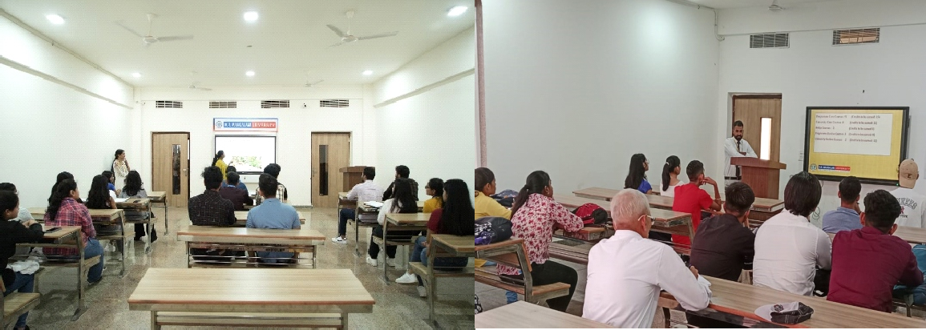
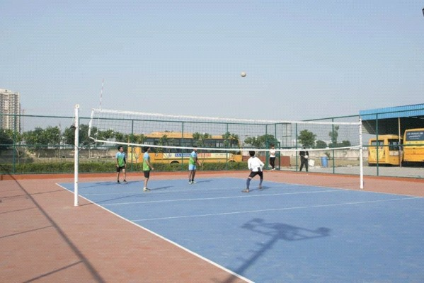
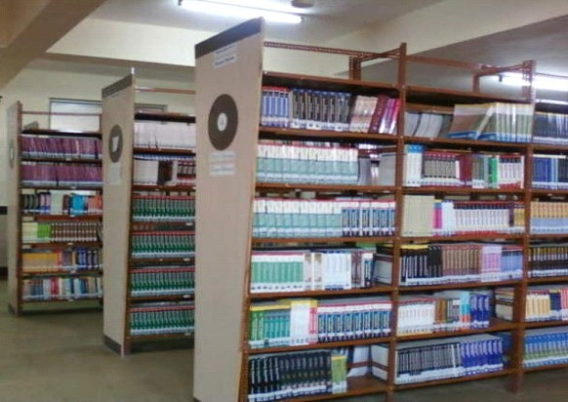
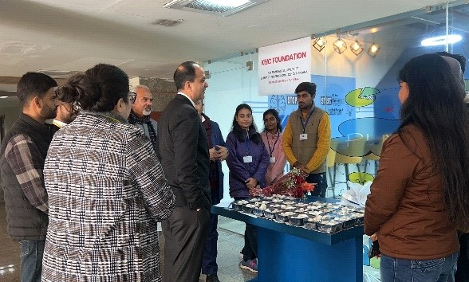
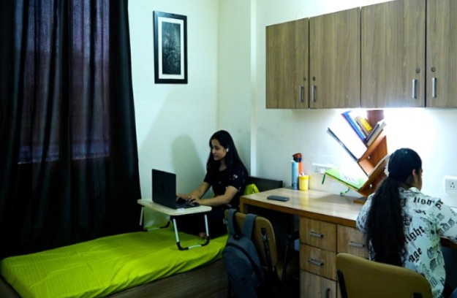
INFRASTRUCTURE
ICT Enabled Classrooms
Sports Facility
Library (Physical/Digital)
Entrepreneurship Development through KEIC
Hostel (Boys/Girls)
24

Slide 25
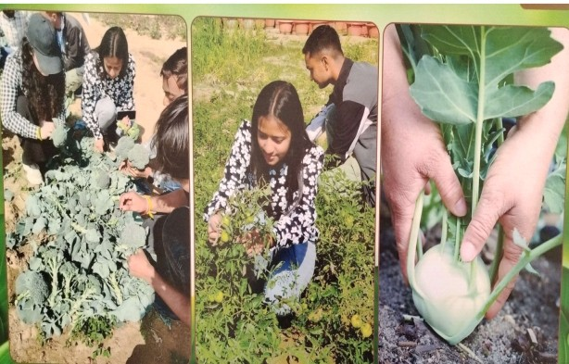
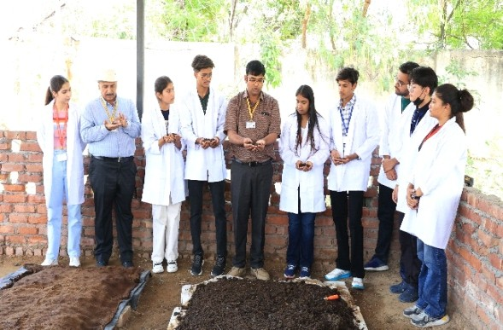
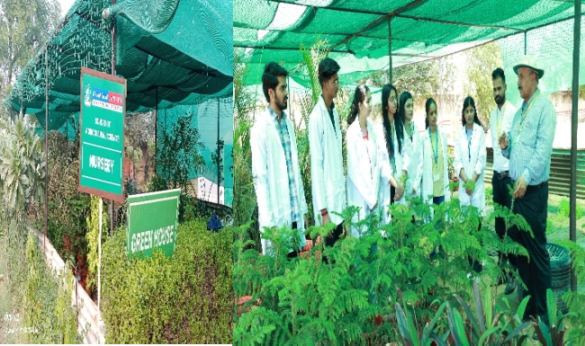
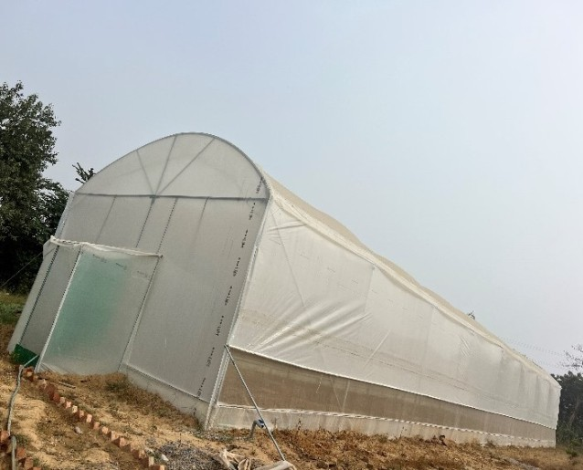
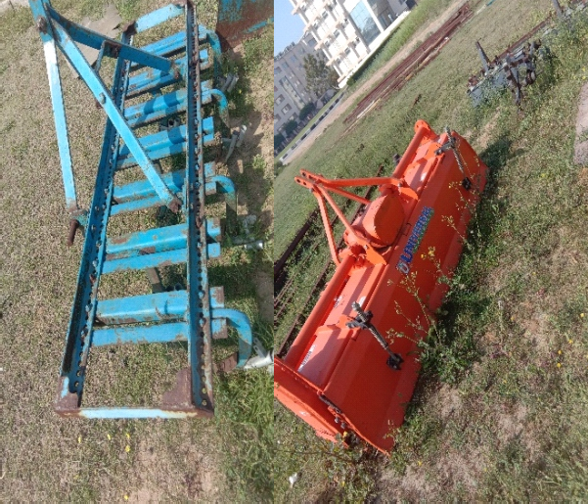
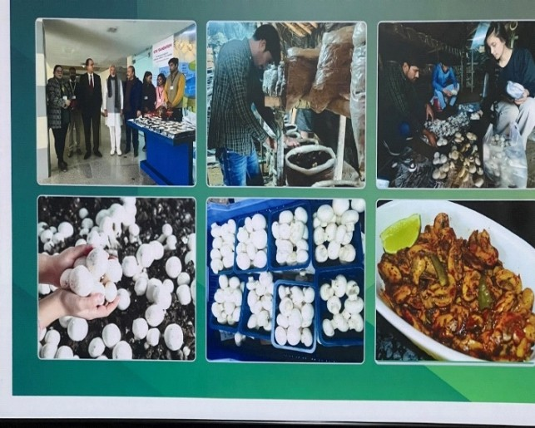
INFRASTRUCTURE
Crop Cafeteria
Vermicompost Unit
Nursery Unit
Polyhouse/Shade net
Farm Machinery Workshop
Mushroom Unit

Slide 26
INFRASTRUCTURE
Crop Cafeteria
Vermicompost Unit
Nursery Unit
Polyhouse/Shade net
Farm Machinery Workshop
Mushroom Unit

Slide 27
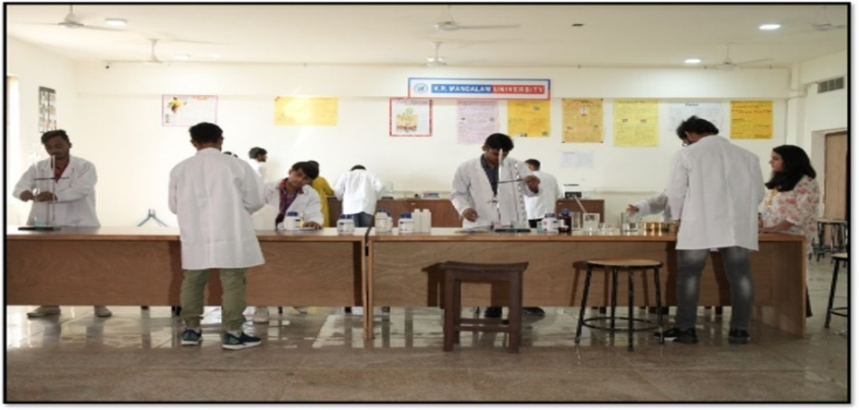
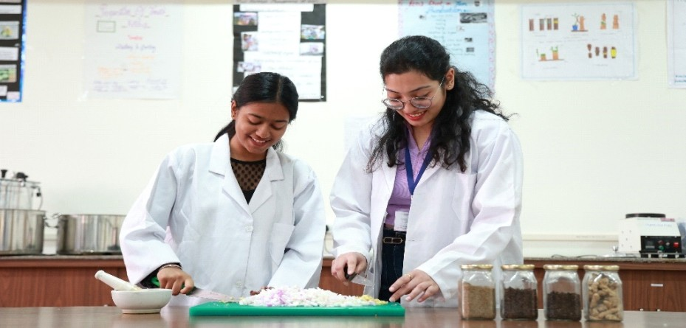
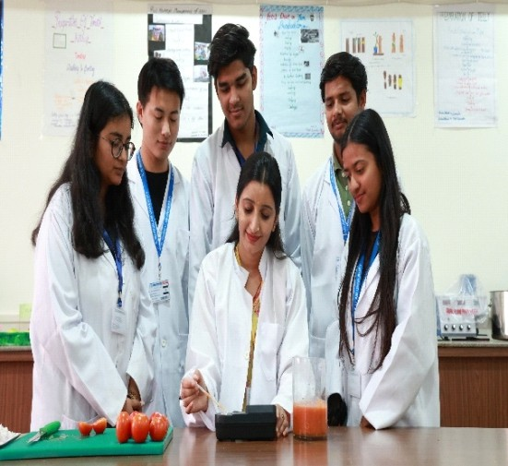
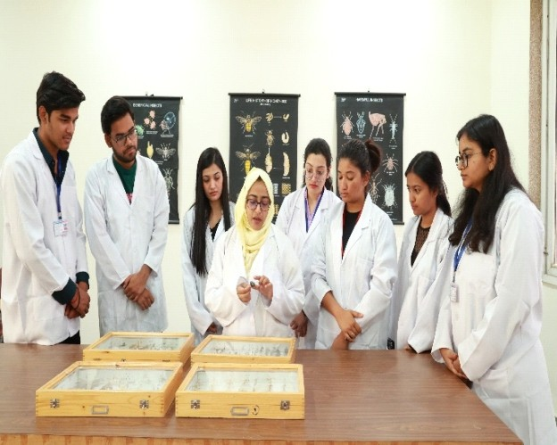

INFRASTRUCTURE
Agronomy
Horticulture
Post-Harvest
Entomology
Soil Science

Slide 28
STUDENT PROGRESSION & SUPPORT
Career Counselling
Start-up Guidance
RAWE & AIA
Participation of
University Club and
Live Projects
Alumni Events
Societies
Guidance for
Capacity
Competitive Exams
Development and Skill Enhancement
Alumni Engagement

Slide 29

CAREER COUNSELLING
1

Slide 30
GUIDANCE FOR COMPETITIVE EXAM
Year | Name of the Activity conducted by KRMU to oﬀer guidance for competitive examinations & career counselling | Resource Person | Date | Type
2022-23 | Coaching Classes for ICAR JRF Entrance Exam, State and Central Agricultural University entrance exams for PG Admissions | SOAS Faculties | 23-Aug-22 | Guidance for Competitive Exam
2022-23 | Competitive Exam Preparation Strategy & Tips | Dr. S.S Sharma, Dean, SOAS | 7-Nov-22 | Guidance for Competitive Exam
2022-23 | Coaching Classes for ICAR JRF Entrance Exam, State and Central Agricultural University entrance exams for PG Admissions | SOAS Faculties | 29-Mar-23 | Guidance for Competitive Exam
2022-23 | Exams Preparation Strategy and tips for ICAR AIEEA (PG) and Av's (PG) Exams | Ms. Priyanshu Choubey | 5-Apr-23 | Guidance for Competitive exam
Coaching classes report.pdf

Slide 31
CAPACITY DEVELOPMENT AND SKILL ENHANCEMENT INITIATIVES
Session | Name of the capacity development and skills enhancement schemes. | Date
2021-22 | Workshop on Honey Extraction, Filtration, and Bottling | 29-Apr-2022
2021-22 | Workshop on the Preparation of Tomato Ketchup | 30-May-2022
2022-23 | Nurturing and Integrating Greenery(Preparation of Seeds, Soil and Ingredients) | 31-Aug-2022
2022-23 | Training on the Production Technology of Oyster Mushroom | 14-Oct-2022
2022-23 | Seminar on Soilless/Hydroponic cultivation and vertical Farming of High value Horticultural Crops | 17-Mar-2023
Report Tomato Ketchup.pdf
New Report Hands-on training.pdf

Slide 32
ALUMNI EVENTS
Session | Date of Event | Name of Event
2022-23 | 30-Sep-22 | Alumni Session On Pursuing Higher Education
2022-23 | 13-Mar-23 | Ted Talks with Seniors; Career Counselling by Alumni of KRMU On " Scope and Prospects in being an Entrepreneur"
Report.pdf

Slide 33
STUDENT ACHIEVEMENTS SPORTS & EXTRA CO-Curricular
Number of awards/medals won by students for outstanding performance in sports/cultural activities at inter-university/ state/ national/international events (award for a team event should be counted as one) during the last ﬁve years
S. No. | Activity Name | Date | Event Type | Organized By
1 | Jhalak of Indian Culture-Poster Making Competition | 23-Nov-22 | Inter-University | K.R. Mangalam University
2 | Haryana Idol | 24-Feb-22 | Inter-University | K.R. Mangalam University
3 | Imagine Tomorrow : Cartooning Competition | 22-Feb-22 | Inter-University | K.R. Mangalam University
4 | Battle of Minds- Inter University Debate Competition | 21-Feb-22 | Inter-University | K.R. Mangalam University
5 | Vritika 2021- Mobile Film Making | 11-Oct-21 | Inter-University | Delhi Metropolitan Education
DOCUMENT REPORT

Slide 34

PLACEMENT AND HIGHER EDUCATION
S. No. | Batch | Employability (%) | Higher Education (%)
1. | 2019-23 | 60% | 40%
2. | 2020-24 | 50% | 50%
STAR ALUMNI
As on Date
Placement Data SOAS.xlsx

Slide 35
FACULTY EMPOWERMENT
FDPs/Conferences
Appreciation/ Awards/Incentives
Faculty Orientation
Training/Workshops on OBE, LMS,
Examination Reforms,
Session on NEP 2020 (ICAR, 6th Dean’s Report)

Slide 36


Best Practices- Solid Waste Management
Brown and Green Waste Management
Production of Vermi- Compost for Organic Farming

Slide 37




INSTITUTIONAL DISTINCTIVENESS
1
Exposure to Marketing of Agri-inputs, Produce, and Value-Added Products
2
Start-up with KEIC

Slide 38


FUTURE ROAD MAP

