Slide 1

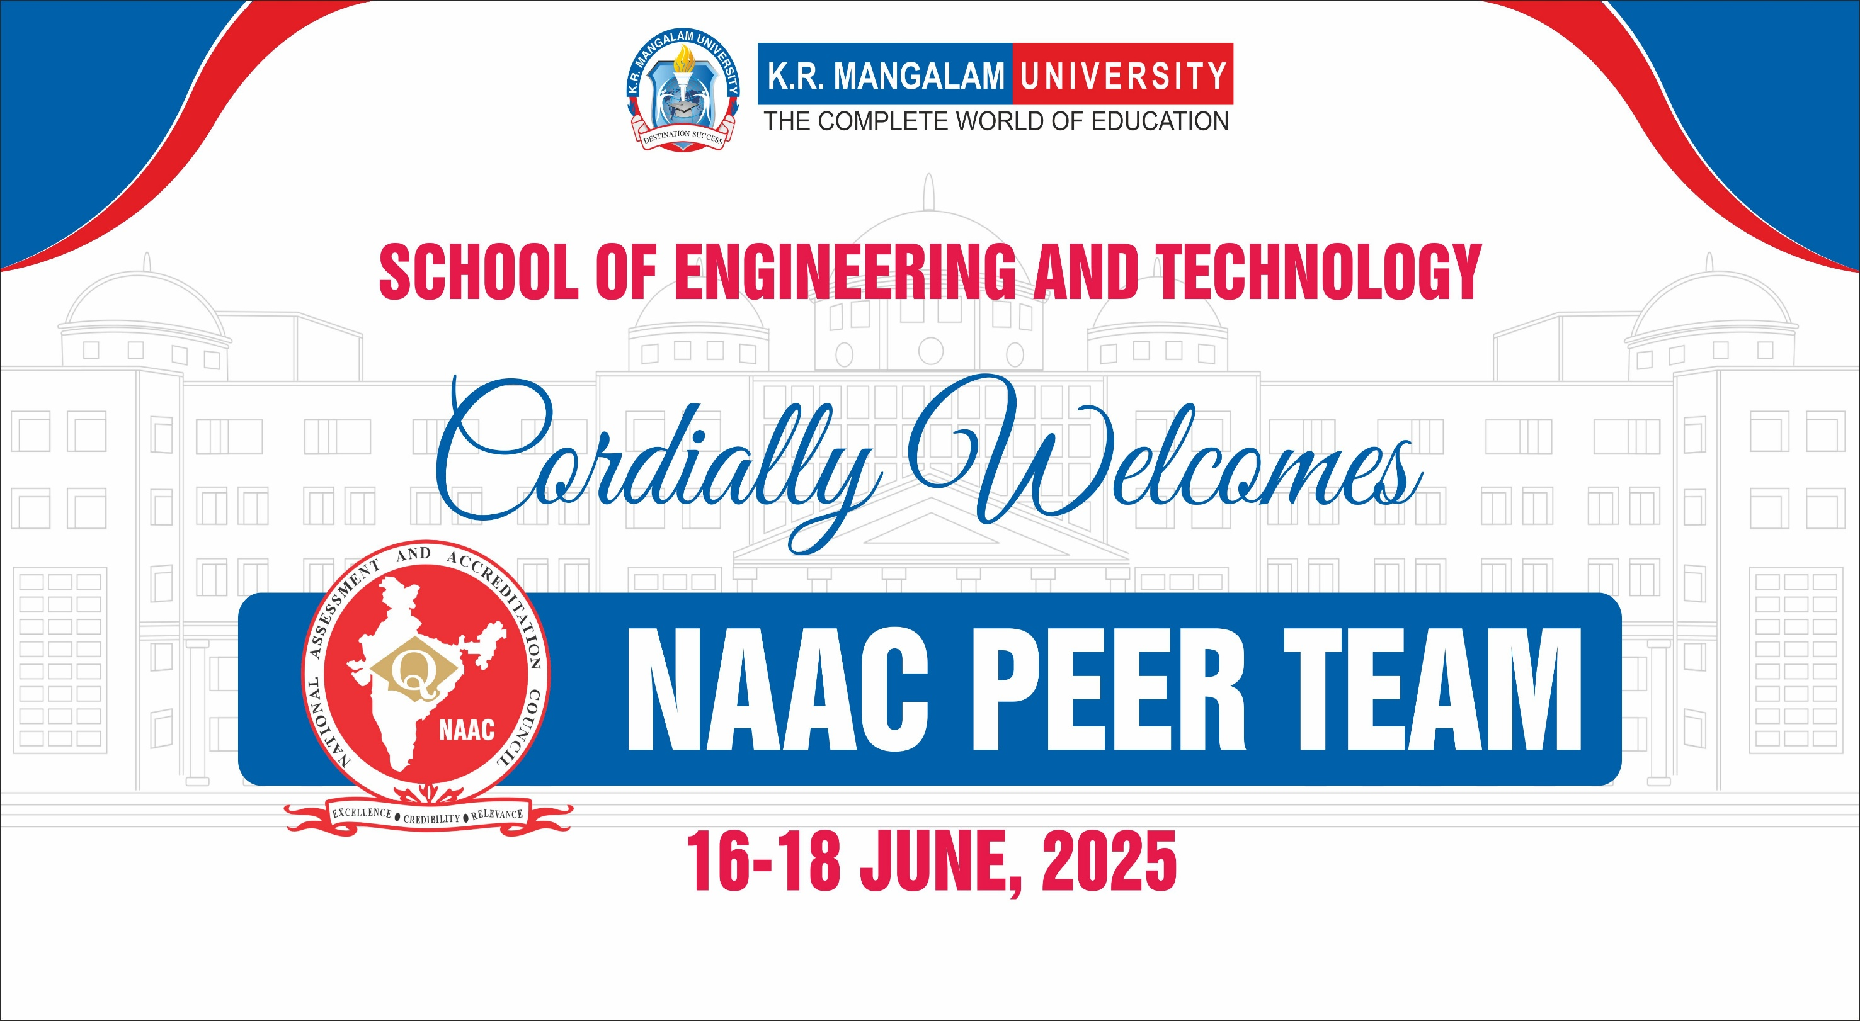
Notes:
New Courses replaced with New Programmes

Slide 2


School of Engineering & Technology
Presentation Outline
School Overview (1) | Curricular Aspects (2) | Teaching-learning & Evaluation (3)
Research , Innovations & Facilities (4) | Infrastructure & Learning Resources (5). | Student Support & Progression (6)
Initiatives & Continuous Improvement (7) | Best Practices & Distinctiveness (8) | A 5-Year Strategic Roadmap & Conclusion (9)

Slide 3

School Vision & Mission
Vision:
To excel in scientific and technical education with integrated teaching-learning, research, and innovation.
Mission:
Creating a unique and innovative learning experience to enhance quality in the domain of Engineering & Technology.
Promoting Curricular, Co-curricular and Extracurricular activities that support overall personality development and lifelong learning, emphasizing character building and ethical behavior.
Focusing on Employability through research, innovation and entrepreneurial mindset development.
Enhancing collaborations with National and International organizations and institutions to develop cross-cultural understanding to adapt and thrive in the 21st century.
Notes:
New Courses replaced with New Programmes

Slide 4


Programs Offered
Year of Establishment: 2013
UG PROGRAMS
Bachelor of Technology - Computer Science & Engineering Bachelor of Technology - Computer Science & Engineering (Artificial Intelligence & Machine Learning) : IBM & Samatrix Bachelor of Technology - Computer Science & Engineering (Cyber Security) : EC Council Bachelor of Technology - Computer Science & Engineering (Data Science) : IBM Bachelor of Technology - Computer Science & Engineering (UX OR UI) : Imagine XP Bachelor of Technology - Computer Science & Engineering (Full Stack Development): Xebia Bachelor of Computer Applications - (Artificial Intelligence & Data Science): IBM & Samatrix Bachelor of Science (Hons) - Computer Science/Cyber Security/Data Science
PG PROGRAMS
Master of Computer Applications (MCA)
M.Tech in Computer Science & Engineering
Ph.D. PROGRAM
(Engineering)
Program Structure 2024-25
Ph.D Details
Program Evolution
Sanctioned Seats
Notes:
New Courses replaced with New Programmes

Slide 5
Faculty-The Intellectual Capital
Faculty - SOET
70
Full Time Faculty
55
Industry Faculty
15
Professor
2
Associate Professor
8
Assistant Professor
45
School Organogram
RF: 02,Non-Teaching: 12
Faculty List

Slide 6
Student’s Profile
Total Students: 2798
Sanctioned Intake
Student Diversity
Teacher-Student Ratio
Scholarship
Notes:
New Courses replaced with New Programmes

Slide 7

School of Engineering & Technology
Curricular Aspects (Assessment Period)
"Curriculum should teach students how to think, not what to think." – Margaret Mead
Notes:
New Courses replaced with New Programmes

Slide 8

Curriculum Design & Development Process
Need Assessment & Feedback (1)
[identify areas where the curriculum requires revision]
School Review Committee(2)
[Analysis by School Review Committee ]
School Meeting (3)
[prepare 1st draft]
Approval through(5) Academic Council (AC)
Notification, Implementation & Monitoring, Ratification(6)
Recommendations by BOS(4)
[Prepare final Draft]
Employers
Parents
Faculty
Industry Experts & Alumni
Students
Benchmarking
Sample Survey
Alumni Feedback Analysis
Employer Feedback Analysis
Sample Feedback Report of SOET
Alumni Feedback
Sample Action Taken Report

Slide 9

Relevance to Local, Regional, National & Global Development in Curriculum
Curriculum are mapped with aspects including Local, Regional, National & Global Development. SAMPLE MAPPING
These aspects are reflected in Program Outcomes , Course Outcomes .
Majority Courses caters to Global needs.
Examples of Courses catering Local & Regional​ Needs:
Entrepreneurship Development
Workshop Practices
Minor /Major Projects/Summer Internships/Practical Training I, II, III
Community Service
Disaster Management/Renewable Energy Systems/Environmental pollution & control
Web Technologies
Data Analysis and Data Visualization
Practical Robotics and UAV Applications (VAC)/ Introduction to Automation, Robotics and Drones
Applied Automotive Engineering
Cyber Crime with for Social Media
Applied Generative AI: Practical Tools
Employability Skills I,II,III
3D Printing Technology
Inspections and Quality Control
Mobile Application Development
Machine Learning/Programming

Slide 10

Focus on Employability, Entrepreneurship,
Skill Development
Employability
Entrepreneurship
Skill Development
15-20% of total Courses
Employability Skills-I, II,III (VAC)
Data Structures & Algorithms
OS, DBMS, OOPS, CN
Practical Training I, II
Communication and Analytical Skills-I,II,III
Boot Camp (Training and Placement)
Skill Development for Technical Interviews (VAC)
Projects | Internships
Specialization Courses
1-2 Courses per program
Business Application of Economics (ETMC123A)
Entrepreneurship Development
Chasing The Rainbow: The Entrepreneurial Streak(ETMC310A)
Fundamentals of Innovation and Entrepreneurship (IIIT102A)
Entrepreneurship and Business Development (VAC048)
All Lab based Subjects (30-40%)
Industry Driven Courses (15-20%)
Minor/Major Projects (18 Credits)
Summer Internships(6 Credits)
VAC Courses (9 Credits)
Competitive Coding
SEC | Seminars
Web Development

Slide 11
Curriculum Design- Key Pillars
FLEXIBILITY
Discipline Specific Electives
Open Electives
Multiple Entry/Exit for BCA
Multiple Industry Specializations
MULTIDISCIPLINARY APPROACH
Maths, Science, Engineering, Computer.
Interdisciplinary courses, Specializations
Value Added Courses
CREATIVE & INNOVATION
Problem Solving skills through Coding
Innovation Through Design Thinking
Innovation Through Project-Based Learning
Innovation through Applied Skills
EXPERIENTIAL & ETHICAL LEARNING
Environmental Studies & Disaster Management
Entrepreneurship Development
Projects/Internships/Field Visits
Open Electives, VAC Courses
CAREER READINESS AND LIFELONG LEARNING
Competitive coding & Internships
Career boot-camps, industrial/R&D projects
INDUSTRY-ALIGNED, FUTURE-READY CURRICULUM
Industry-Integrated Curriculum
Global certifications
Focus on Emerging Fields
Blended Learning
2018-19
2019-20
2020-21
2021-22
2022-23
2023-24
2024-25
Notes:
New Courses replaced with New Programmes

Slide 12
Integration of Outcome Based Education
Define Vision & Mission
Formulate PEO,PO, PSO
Define COs aligned with Curriculum as per Bloom’s Level
Continuous Assessment and Evaluate Student Performance
Feedback, Improvement and Review
Implement Teaching Learning Strategies
Sample Action Taken Report
Education Philosophy
Sample Feedback Report
PEO,PO, PSO Statements
Result Analysis
Class Observation
Calculation of
CO-PO Attainment
Scheme of Studies
Sample Continuous Assessment Sheet
Sample Mapping
Sample CHO
Sample Program Handbook
Sample Course File
Sample Assignment
Instructions to Prepare Contents
Sample Question Bank
Sample Course Introduction PPT
Sample Lab Manual
Sample Classroom presentation
Notes:
New Courses replaced with New Programmes

Slide 13

NEP-2020 Compliance
Course Category | Credits
AEC (Ability Enhancement Course) | 9
Audit | 0
CS (Community Service) | 2
INT (Internship) | 6
Major (Core) | 63
DSE (Discipline Specific Elective) | 20
Project | 18
SEC (Skill Enhancement Course) | 6
Open Elective | 9
IDC (Industry Driven Course) | 24
MOOC | 6
VAC (Value added Course) | 4
 | 167
SOET implemented NEP 2020 Guidelines in 2023-24 for the BCA program.
3 Year BCA Program is now offered as 4 yr BCA (Honors with Research) as per NEP-2020 Guidelines.
Program Name: Bachelors in Computer Application (Honors/Honors with Research) with specialization in AI & Data Science
Curriculum Features:
Multiple Entry and Exit Options (Degree Nomenclature)
Holistic and Multidisciplinary education
Choice and Flexibility
Industry Integration- Samatrix & IBM
Program Name | I | II | III | IV | V | VI | VII | VIII | Total Credits
BCA (AI & DS) | 24 | 23 | 23 | 25 | 21 | 20 | 19 | 12 | 167
Details
Notes:
New Courses replaced with New Programmes

Slide 14

School of Engineering & Technology
Teaching Learning & Evaluation (Assessment Period)
"Tell me and I forget. Teach me and I remember. Involve me and I learn.“
– Benjamin Franklin
Notes:
New Courses replaced with New Programmes

Slide 15
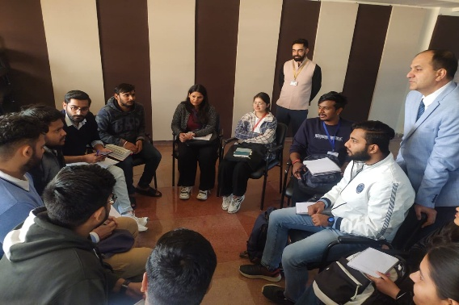
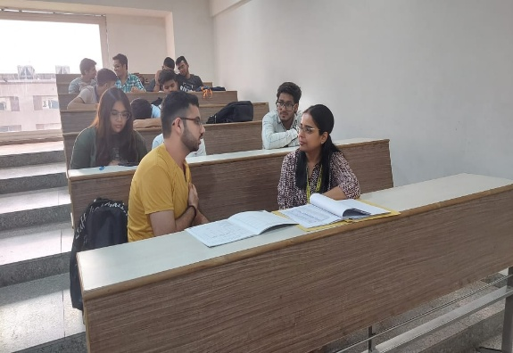
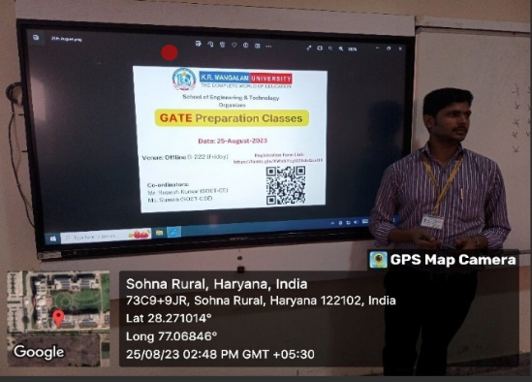
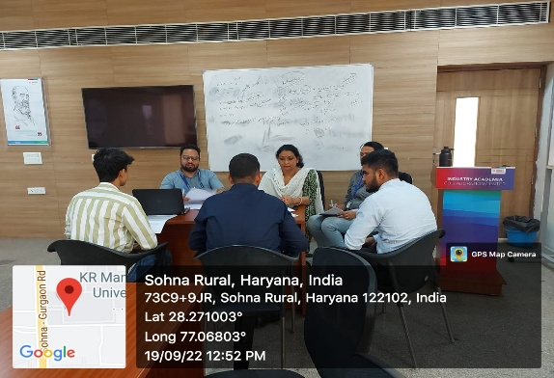
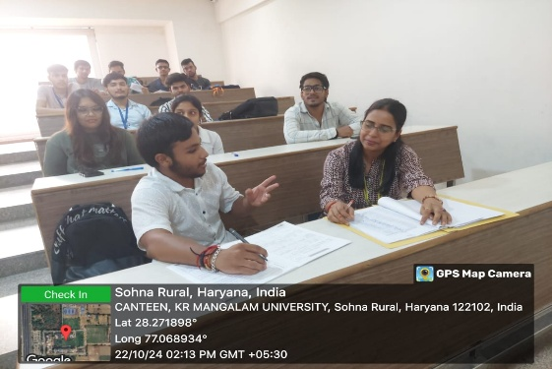
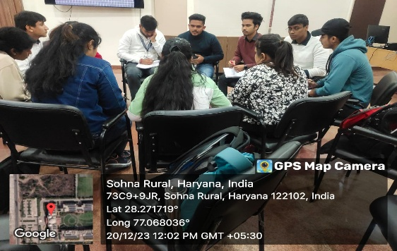
Focused Attention for Diverse Learning Needs
For Slow Learners
Remedial Classes
Learning Resources
For Advanced Learners
Workshops/
Hackathons
Competitive Programming
Certifications
Preparation for Competitive Examinations
Project
Contests
Practice Assignment
ISSUES​ IDENTIFIED: Students have differential Learning abilities, Lack of confidence, Poor Communication skills , Limited Critical Thinking Skills , Inconsistent Motivation Levels, Inadequate Technical Skills, Low Self Discipline & Time Management
OUTCOMES: CASE STUDY on Student Progress
Enhanced Participation level: Project Competitions/Hackathons/Certifications
Consistent Placements & Enhanced Internships
Sample Slow & Advance Learner File
Notes:
New Courses replaced with New Programmes

Slide 16
Mentor-Mentee Program
Issues
Execution
Outcomes
Psychological stress: Emotional support, coping stress.
Academic struggles: Personalized guidance, study strategies, time management help, Advising on Course Selection.
Career Confusion: career paths, skills needed, and professional development.
Social isolation: Building connections and enhancing social skills
Well Defined Policy
Sample Interaction Form
Mentor-Mentee handbook
Mentor-Mentee List
Dedicated session in timetable (Tuesday)
Fortnightly Interaction
Monitoring
Evaluation & Analysis
Action taken report
Early identification
Effective Resolution
Increased satisfaction
Confidence building: Greater self-esteem and belief in their abilities.
Enhanced Participation
Greater check on academic Progress
Sample Mentor Mentee Diary

Slide 17
Student-Centric Learning Approach
INSIDE CLASSROOM​ LEARNING | OUTSIDE CLASSROOM​ LEARNING​
Standard classroom teaching contents (PPTs /PDF) : Sample Project Enabled Lab assignments: Sample Collaborative Learning Hands-On Activities Tutorial Classes Problem Based Class Assignments: Sample Project-Based Learning Skill development & Value-added workshops | Internships & Industrial Training Workshops & Seminars Extension Activities Project Contests/Hackathons Peer Teaching and Tutoring Community Engagement Entrepreneurship and Start-Up Programs Career Mentoring Extra Curricular Activities Self Enabled Learning and MOOCs Activity Summary
Notes:
New Courses replaced with New Programmes

Slide 18
School of Engineering & Technology
Research, Innovations and Extensions (Assessment Period)
"To raise new questions, new possibilities, to regard old problems from a new angle, requires creative imagination and marks real advance in science.“ — Albert Einstein
Notes:
New Courses replaced with New Programmes

Slide 19
Promotion of Research
School Research Committee: Members
Research Promotion & Incentive Scheme: Details
Reimbursement to Faculty: Link
Dedicated Research Section for Ph.D Scholars in Central Library: Link
Entrepreneurship and Innovation Center (KEIC) : Students involved
Notes:
New Courses replaced with New Programmes

Slide 20
irins.org
Research Outcomes
Total Citations– 3593 | H-index – 25 | Highest cited publication - 336
18
Patents Published(112)/Granted (14)
Research Journal Publications
Book Published
352
Conference Papers/Book Chapters
126
271
393
Projects Submitted
8
07
Consultancy Projects
05
Seed Grant
Ph.D. Awarded
Ph.Ds. Awarded in SOET
Patents Published/Granted
Journal Publications
Book Published
Conference /Book Chapters
Projects Submitted
Consultancy Projects
Seed Grant
More Details
Notes:
New Courses replaced with New Programmes

Slide 21
Research Progression
Notes:
New Courses replaced with New Programmes

Slide 22
School of Engineering & Technology
Infrastructure & Learning Resources (Assessment Period)
Notes:
New Courses replaced with New Programmes

Slide 23

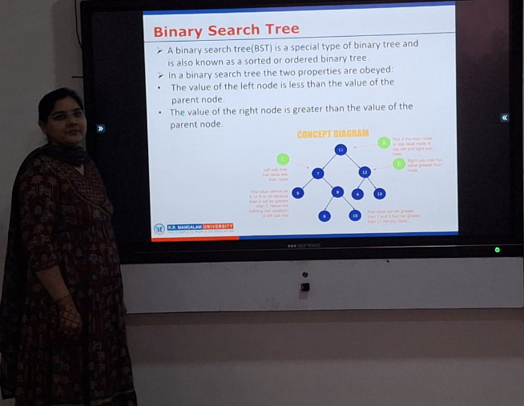
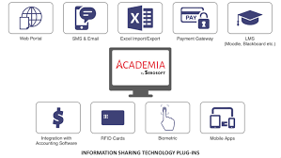
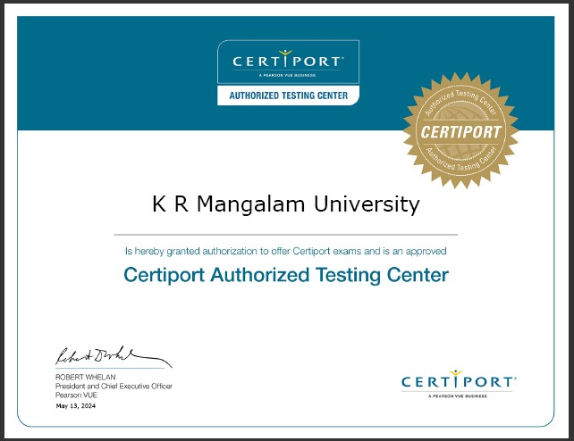
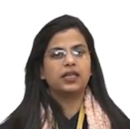
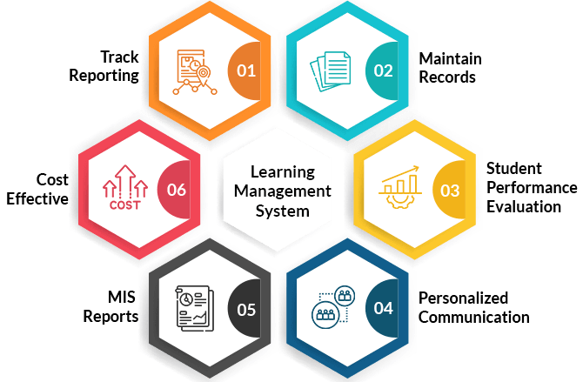
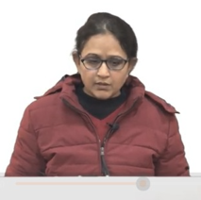
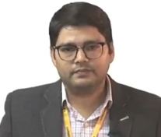
Learning Resources
Titles: 1625 │Books : 6229
Books (School Library): 324
Print Journals: 14
For Plagiarism : Turnitin, Drill Bit
E-Journals: IEEE (EBSCO)
Smart Teaching Panels
ERP: Academia
Recorded Videos by faculty : 63 (Details)
Certiport Authorized Testing Center (Microsoft,CISCO,Pearson,Meta etc)
LMS Moodle
Total Classrooms: 59
Notes:
New Courses replaced with New Programmes

Slide 24

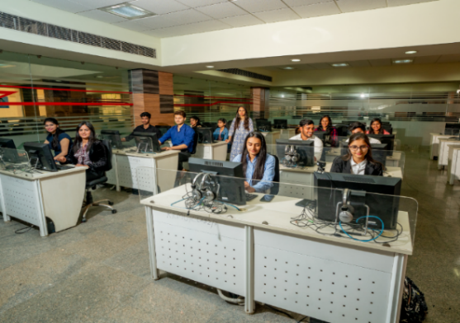
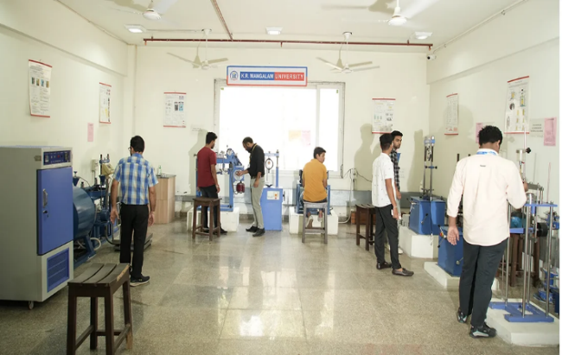
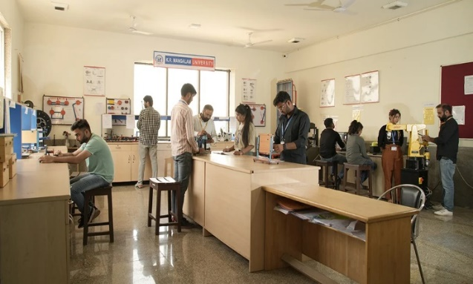
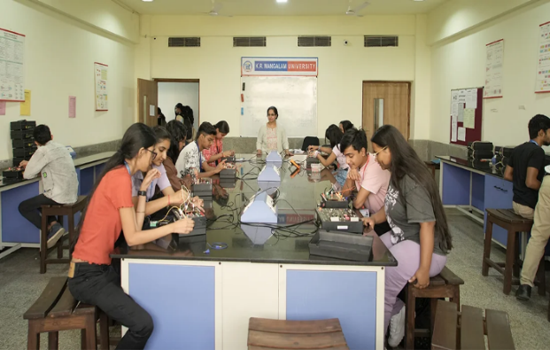
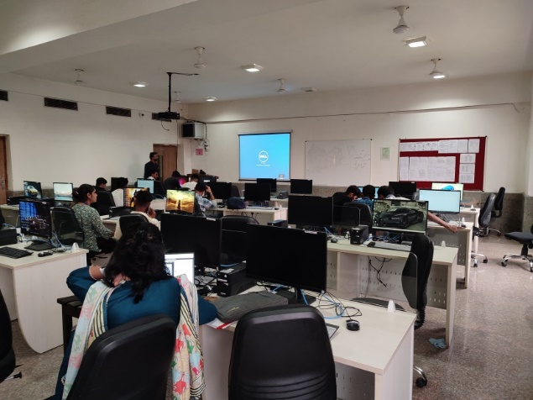
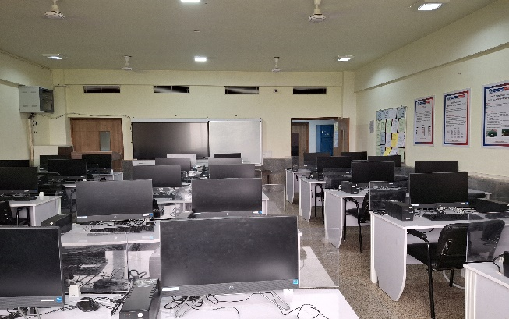
Learning Resources: Lab Facilities
Internet bandwidth:
1 GBPS
Total Computer labs with SOET: 19
Total Number of Computer Systems: 871
All labs: Screen Panels/Projectors
Operating Systems: Windows 10/11
Service Provider: Airtel
Student: Computer Ratio: 1 : 3.2
Details
iOS lab(01)
Workshop Facility(01)
Robotic Lab (02)
Electrical & Electronics lab(02)
Computer Lab(19)
AI Lab (01)
Notes:
New Courses replaced with New Programmes

Slide 25

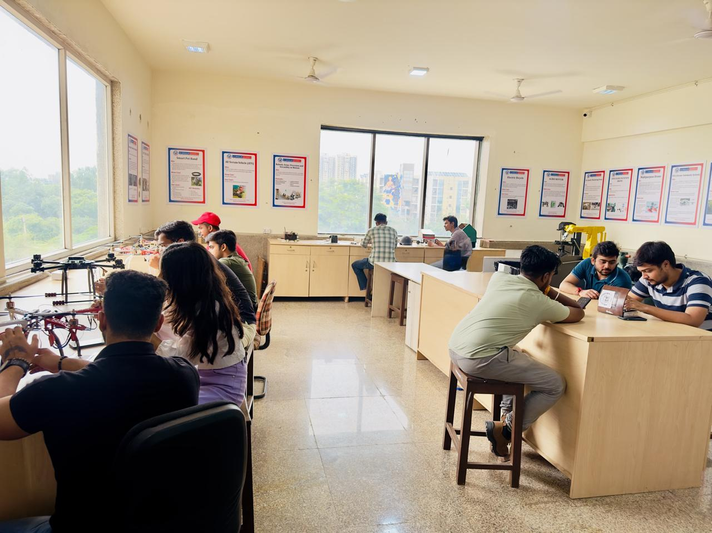
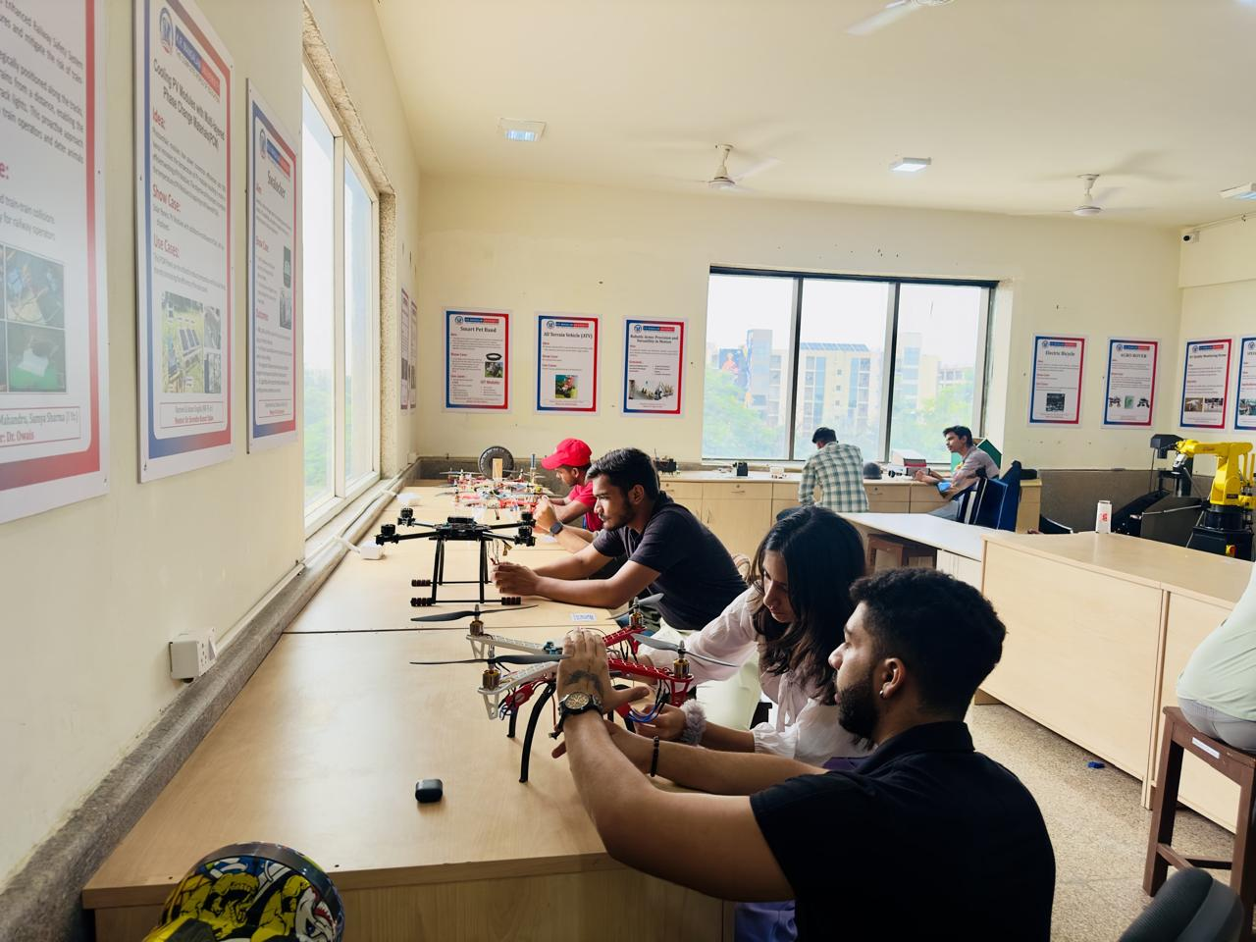
Center of Excellence – Robotics and Automation Lab
Lab Number: B 201
COERA link
Purpose: Equip students with practical skills in robotics, empowering them to work on innovative projects that address real-world problems.
No. of Projects Completed: 20+
Active Student Projects: 30
Start-ups: 3
E-Yantra Lab (IIT Bombay) Projects: 15
Phoenix Drone Flying Centre Certifications: 10
MindBenders - Innovative Project Competition: 150+
Internships at IIT Mandi: 170+ students
Notes:
New Courses replaced with New Programmes

Slide 26
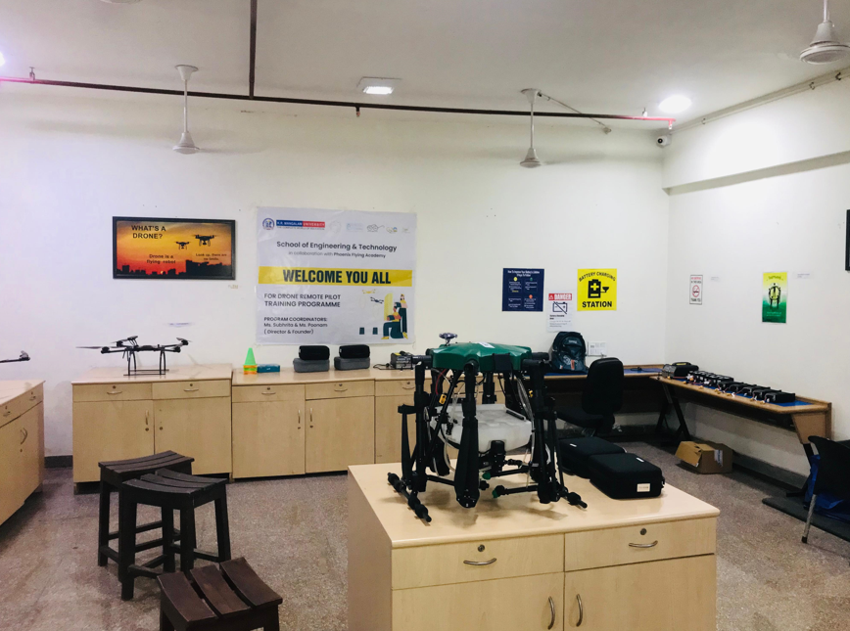
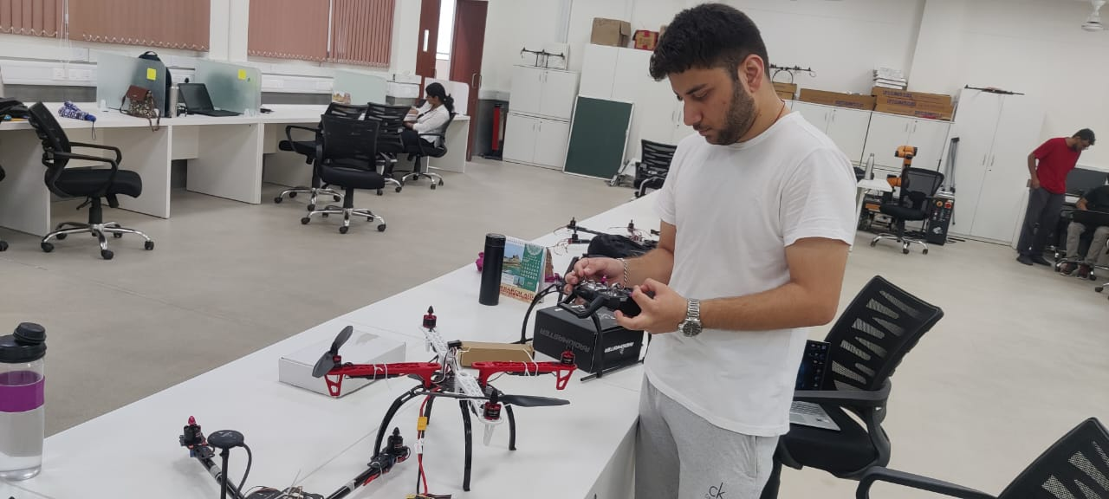
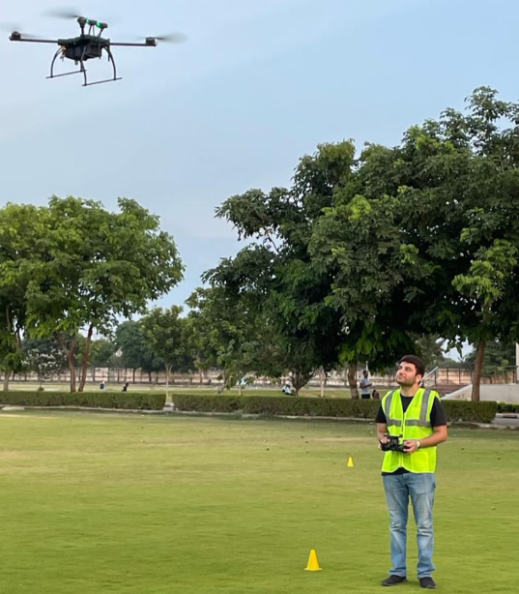
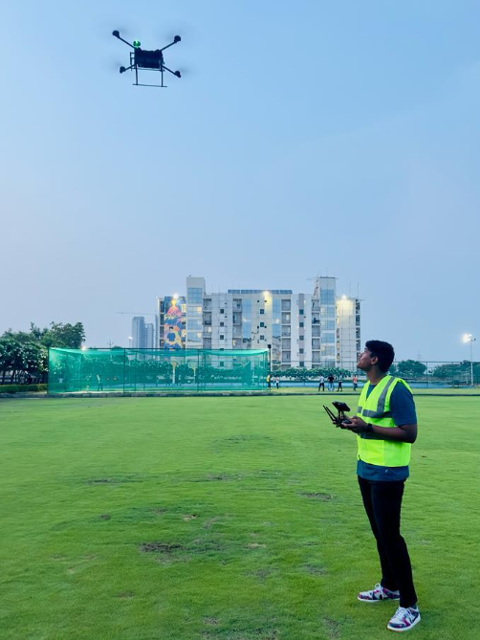
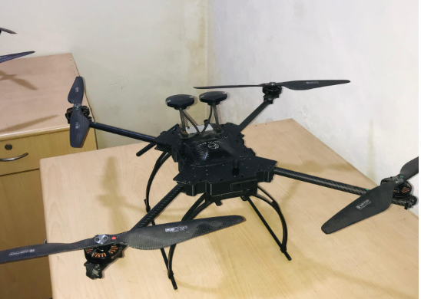
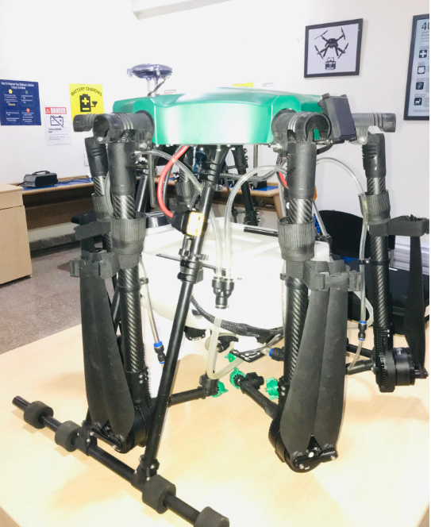
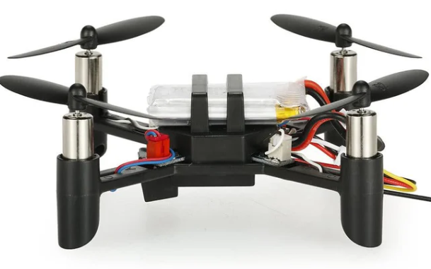
Phoenix Drone Flying Centre- Industry Sponsored Lab
Drone Lab Facility
Govt. Certified Drone Pilot Certifications: 10
Small
Medium
Nano
Notes:
New Courses replaced with New Programmes

Slide 27




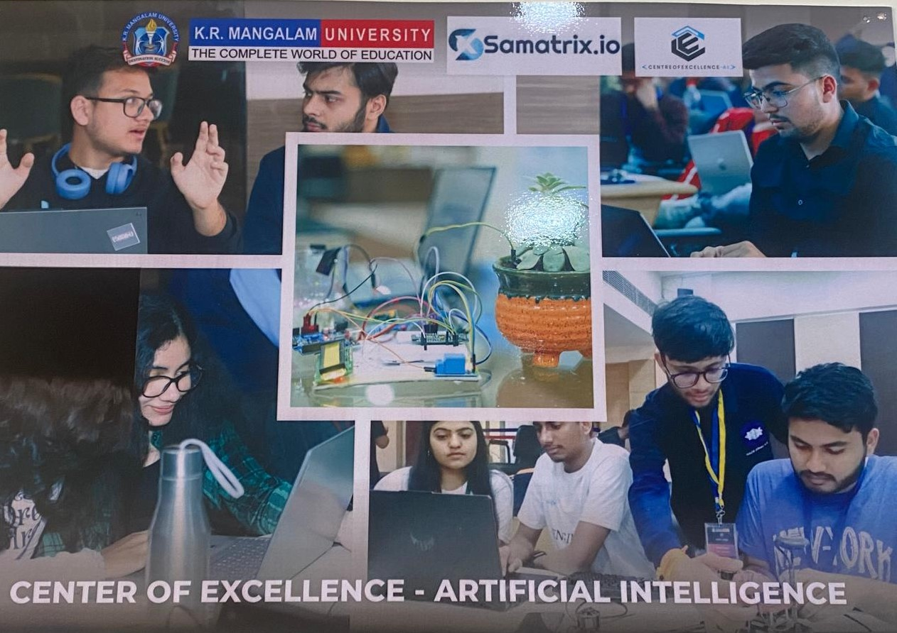
Centre of Excellence- Artificial Intelligence
Lab Number: B 207
Purpose: develop students' practical skills in artificial intelligence and machine learning, enabling them to work on projects that solve real-world problems
Collaborations
Centre of Drone Technology, IIT-Guwahati
Completed Student Projects: 28
Research Project Granted: 01
Research Projects Submitted: 06
Summer Internships Programs: 02
Edited Books – 03
Publications – 04
Ongoing Research Projects: 03
COE-AI
Facility: Nvidia GeForce GPU GTX 1080, AWS Cloud, Number of Systems: 30
Notes:
New Courses replaced with New Programmes

Slide 28
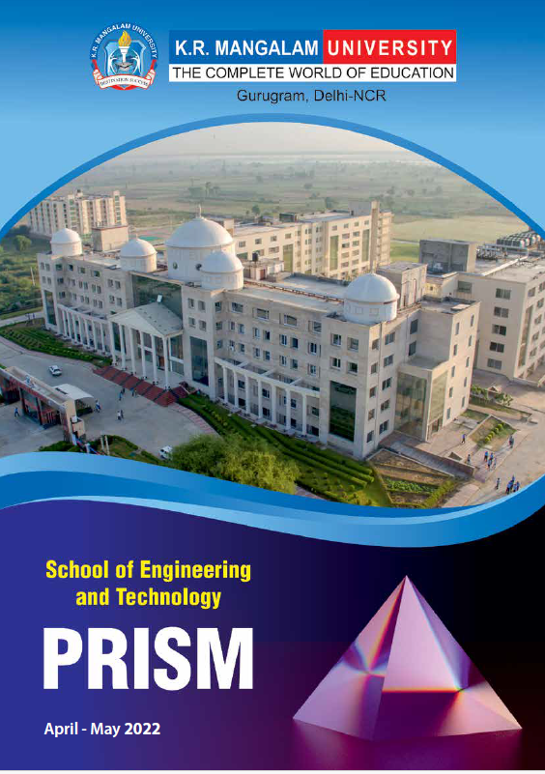

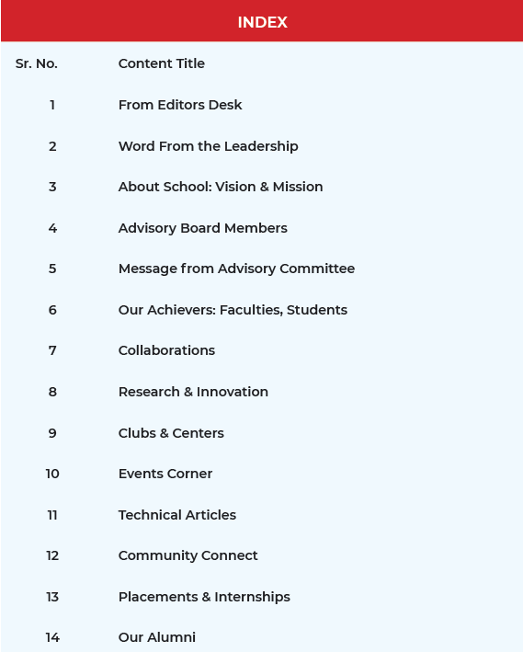
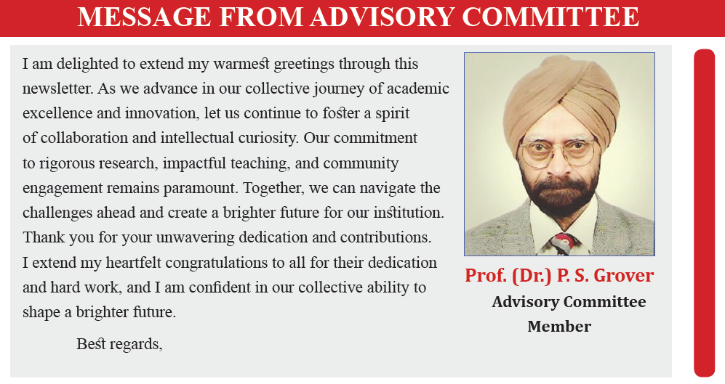
PRISM: Quarterly E-Magazine
PRISM serves as a dynamic platform for students and faculty to share their technical and literary articles, achievements, and school activities.
PRISM enables our students to express their thoughts and creativity, fostering a culture of innovation and intellectual growth.
Notes:
New Courses replaced with New Programmes

Slide 29
School of Engineering & Technology
Student Support & Progression (Assessment Period)
Notes:
New Courses replaced with New Programmes

Slide 30

Student Performance: Graduate Outcomes
Year | outgoing Students | Campus Placement | Competitive Exams/Higher Studies | Entrepreneurship/ Startups | Graduate Outcome
2023-2024 | 158 | 144 | 8 | 5 | 99.36
2022-2023 | 100 | 78 | 1 | 12 | 91
2021-2022 | 86 | 67 | 7 | 5 | 91.8
2020-2021 | 71 | 71 | 1 | 0 | 100
2019-2020 | 63 | 61 | 2 | 0 | 100
2018-2019 | 97 | 97 | 3 | 5 | 100
Highest Package: 36 LPA
Average Package: 3.7 LPA
Details
Notes:
New Courses replaced with New Programmes

Slide 31
Student Career Counselling Initiatives
Special Placement Preparation classes on DSA by Industry Experts from AlgoPrep
(9 Months Online Program)
Special Modules by CDC on : Verbal Ability, Communication & Personality Development, Arithmetic and Reasoning Skills
Industry Driven Courses in Curriculum: 15-20% of total Credits
Global Certifications through Certiport Authorized Testing Center
(Microsoft, Cisco,Adobe)
Career Readiness Boot Camp of 200 hrs (Infosys Module): DSA/Java/Python/DBMS
3rd party assessment through AMCAT/CO-Cubes
Competitive Coding Sessions:
2 hrs/week, 30 Hrs, Semester III,IV,V,VI
Regular Sessions by experts/alumni with focus on career development
Regular MOCK Interviews & GD Sessions
Summer Internships, Minor Projects, Major Project
Regular Technology Driven hands-on Workshops
Related Activities
Notes:
New Courses replaced with New Programmes

Slide 32
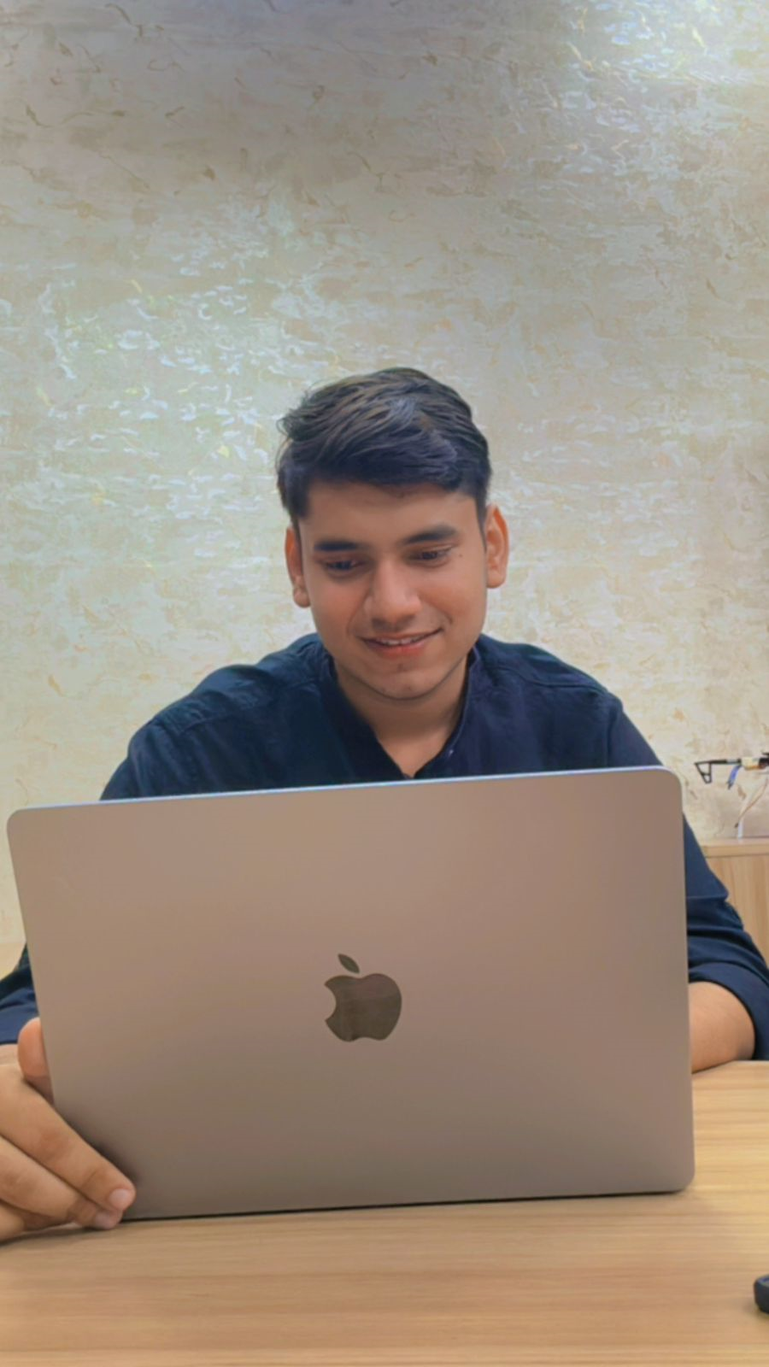
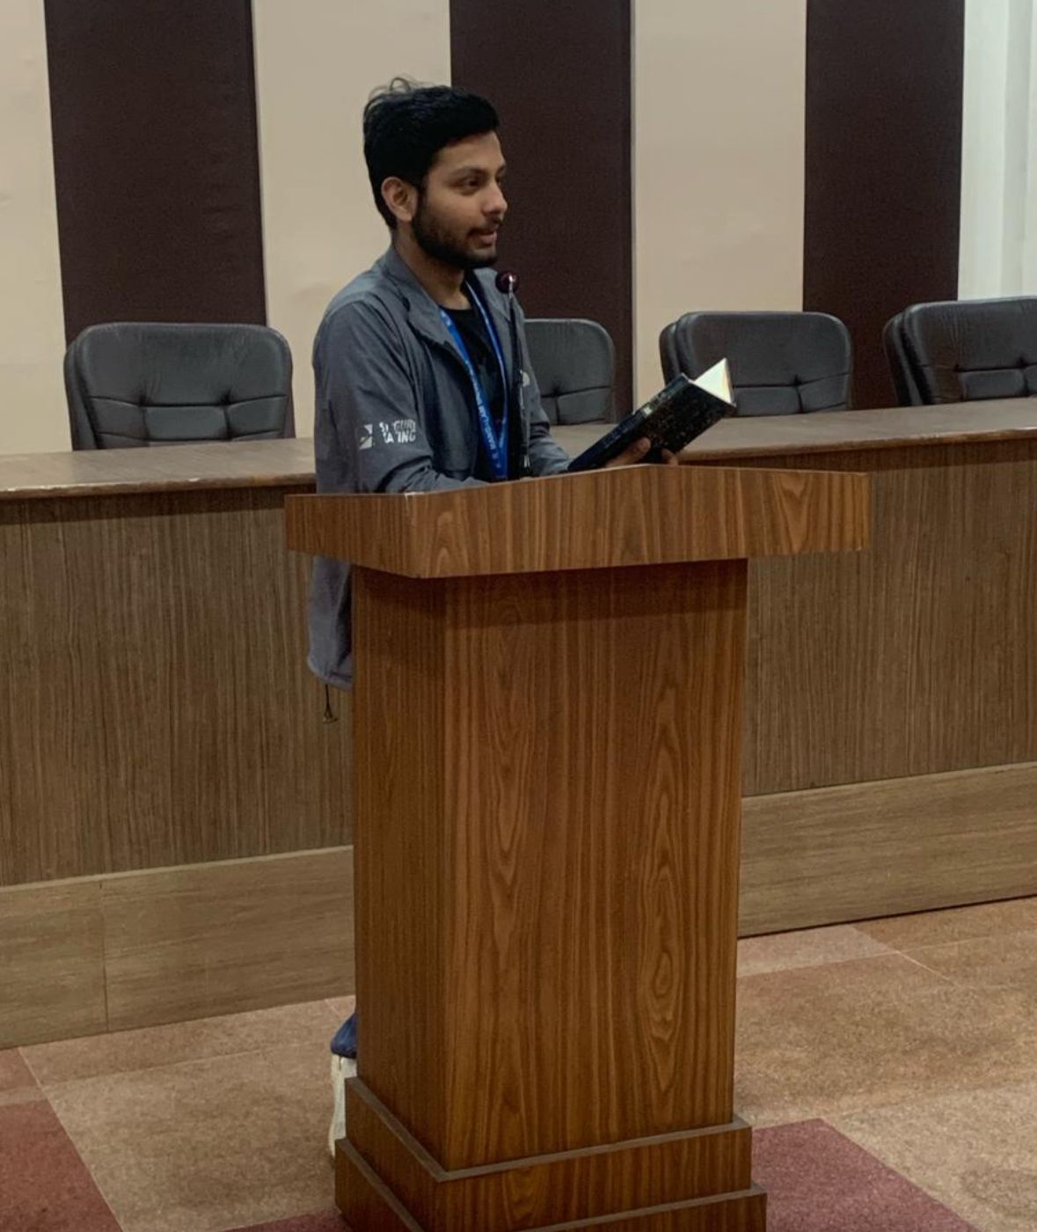
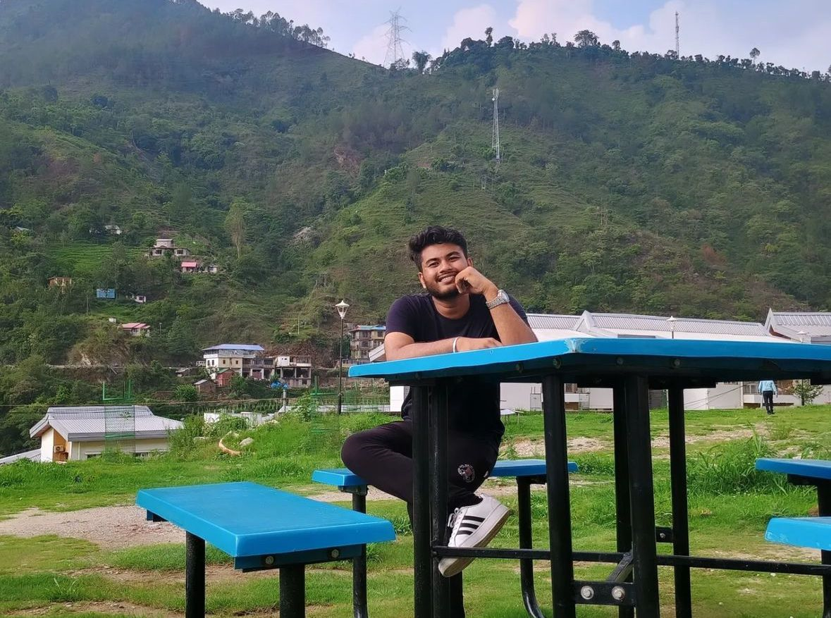
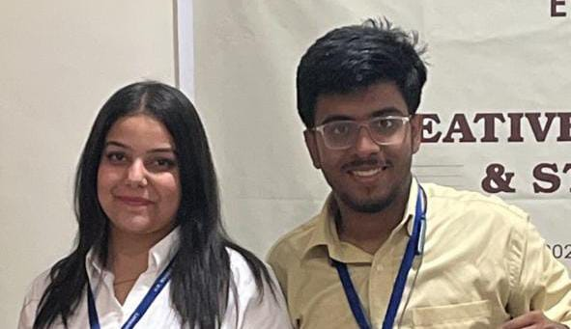



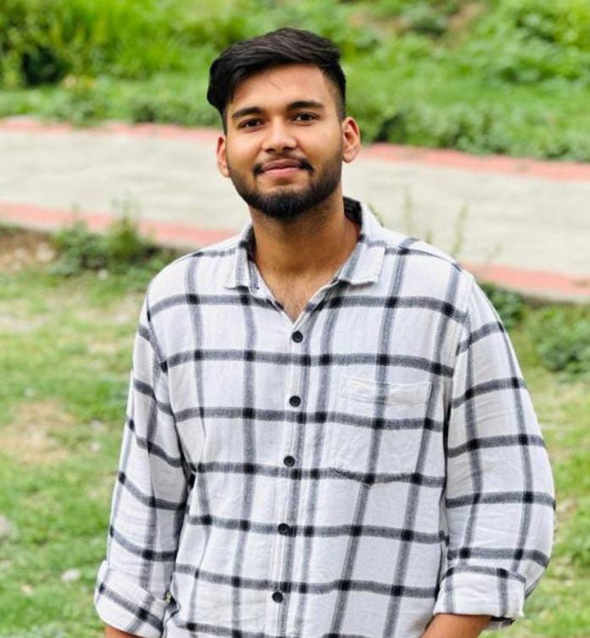



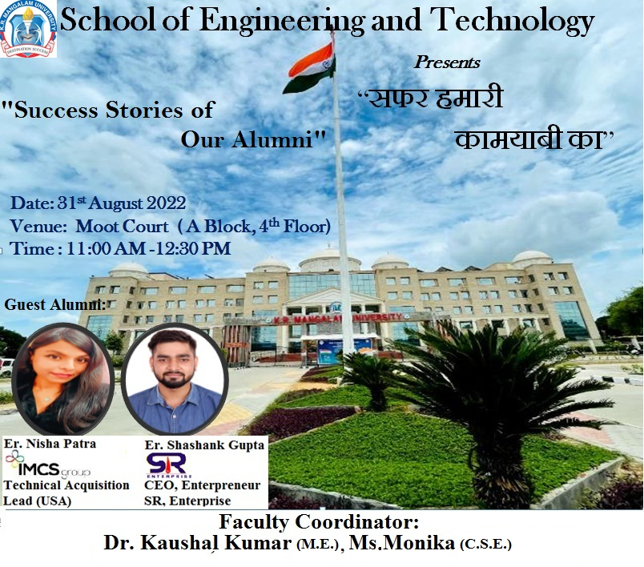
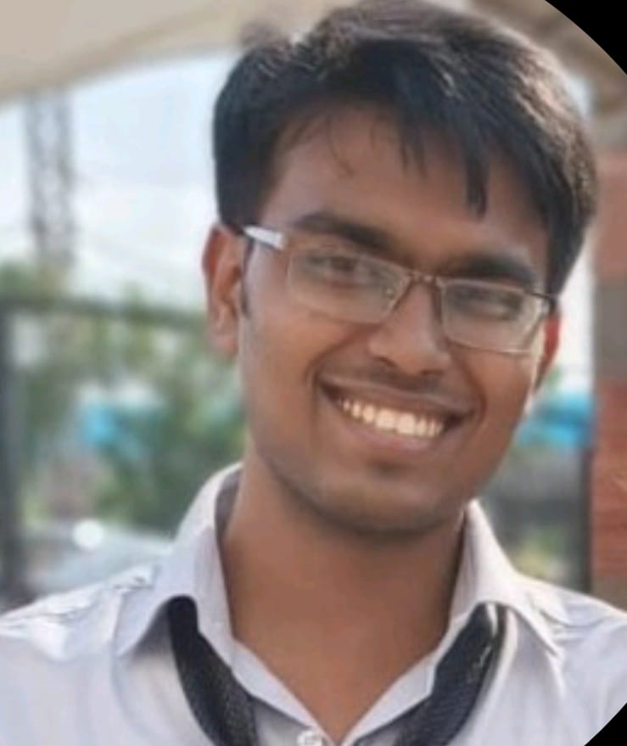




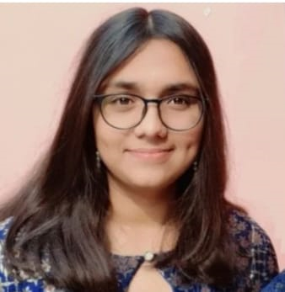
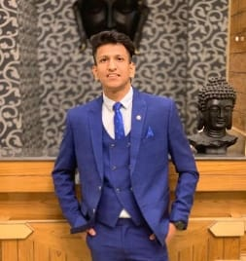
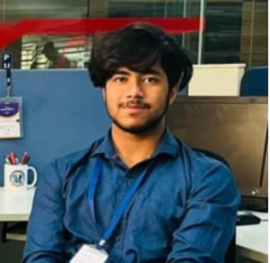

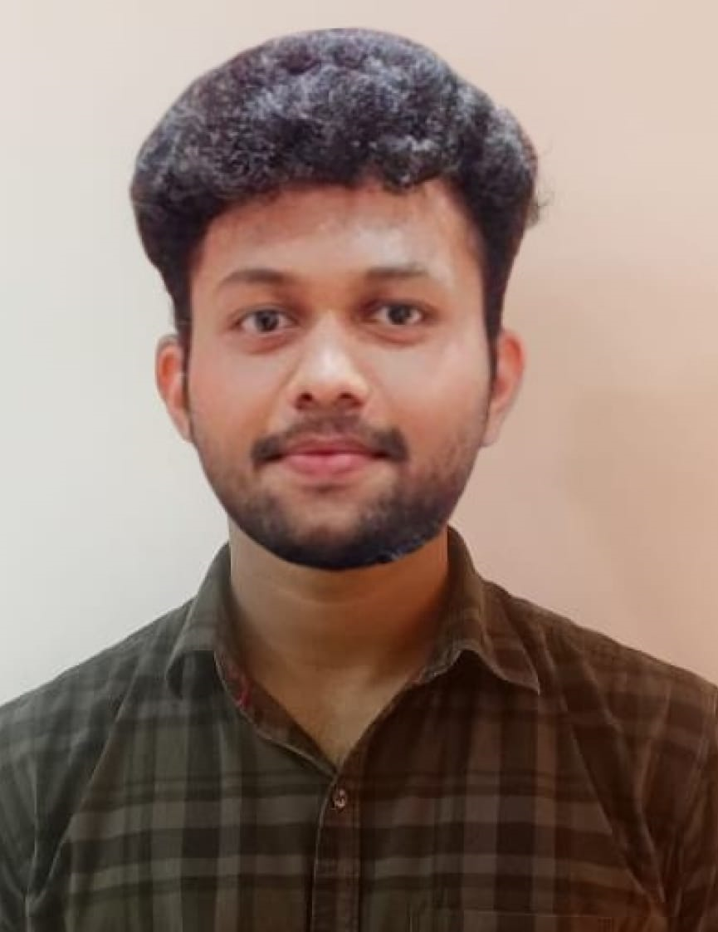

Student Engagement in Entrepreneurship & Startups
HARSH RAJ
(2023-27)
ANUJ (2022-26)
KRISH AGARWAL
(2023-27)
TARANPREET (2023 – 26 )
SHUBHAM CHADHA
( 2023 -26 )
SWA LOCKER
BLACK ORCHID
H COIN LOGIX MIND
DAKSH MEHTA
( 2018-21 )
KARTIK RATHI ( 2021 – 25 )
ABHINAV SINHA
( 2019-23 )
ER. SHASHANK GUPTA ( 2018-21 )
SR ENTERPRISE
ANISH KUMAR SINGH
( 2015 -2019 )
NAMAN PUNN (2023-26)
SHANVI MATHURIA (2023-26)
SOURABH BISHT (2023-26)
ENIVSION
B-TRACK
SHREIYA MALLA (2023-27)
CHIRAG BHAL
(2023-27)
More Details

Slide 33

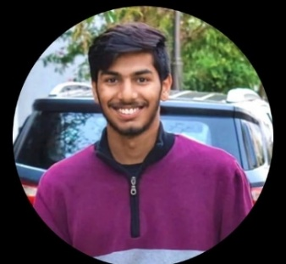


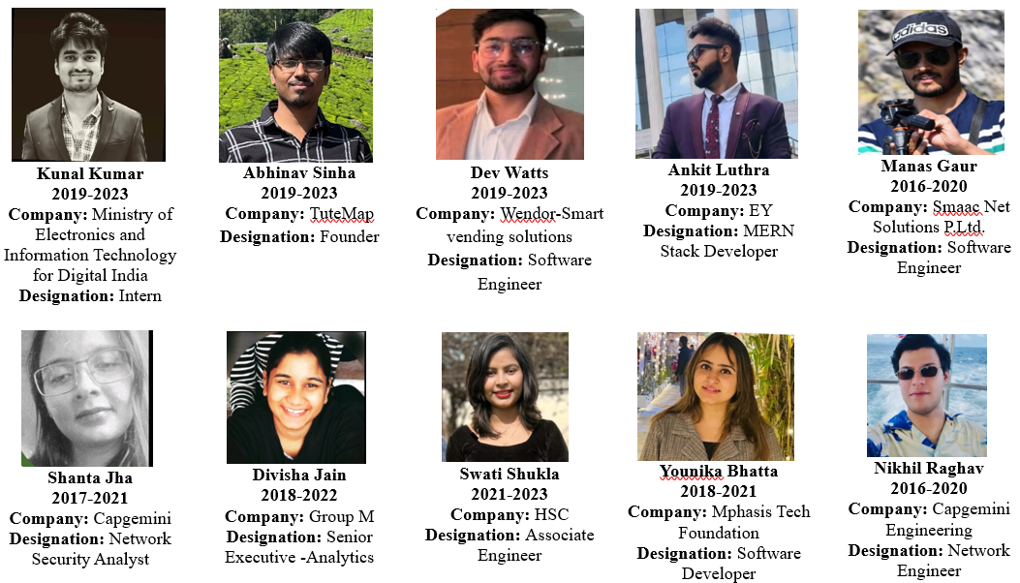
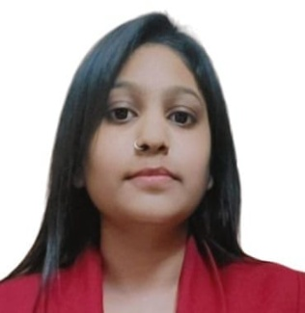

Star Alumni
Daksh Mehta
(B Tech CSE 2021 Pass out)
Company Name-UNIAS Inc.
Product Engineer
Package 36 LPA
Darshit Raghav
(MCA 2023-2024)
Debcor Engineering
Product Engineer
Package 24.5 LPA
Rishav Bakshi
BCA (2017-20)
Sales Manager
Ferrari
Package: 56 LPA
Raghav Gupta, B.Tech (2016-2020) MSc Data Science at Cardiff Metropolitan University, UK.
Ms. Kriti, BSc (Cyber Security) 2023 batch, SOC Analyst (Security Operations Center) Clouds Tech FZE in Dubai.
Aman Bindra,(B.Tech 2016-2020) MS from Concordia University of Edmonton,Canada.
Notes:
New Courses replaced with New Programmes

Slide 34

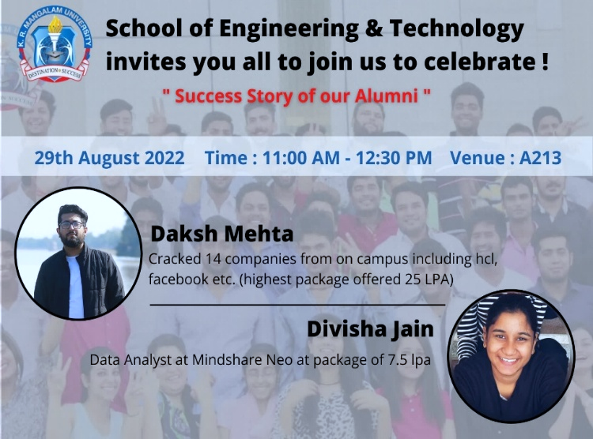
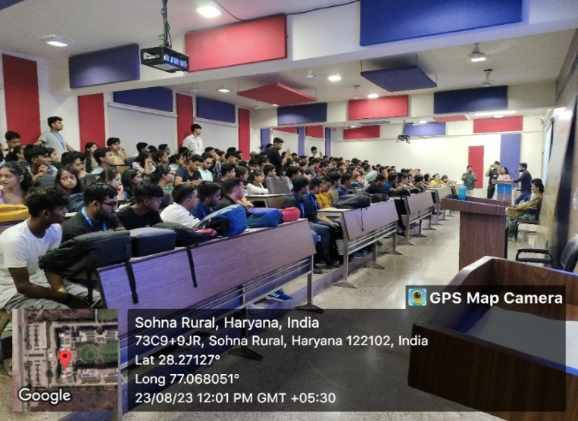
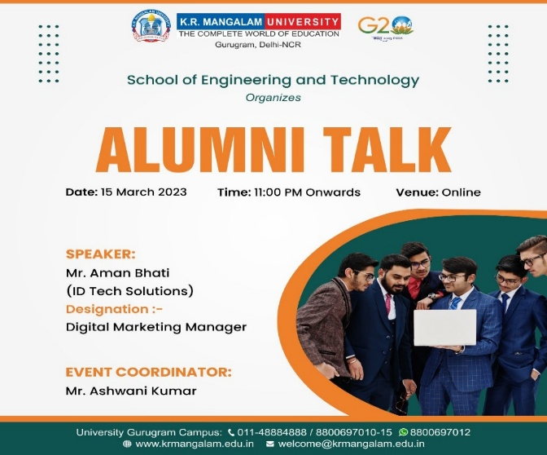





Alumni Connect
Registered Students: 595
Alumni Contribution
Alumni: Dasksh Mehta, Divisha
Participants: 250 [29 Aug 2022]
Alumni: Mr. Mohit and Mr. Dev(2023)Participants: 190
Alumni: Mr. Aman Bhati (15-03-2023) Participants: 60
Key Alumni Interactions
Ms. Nisha Patra (2021)
Mr. Shashank Gupta (2021)
Mr. Daksh Mehta (2021)
Ms. Divisha Jain (2022)
Mr. Abhinav Sinha (2023)
Mr. Lokesh Jain (2023,24)
Mr. Ankit Luthra (2023)
Ms. Anchal (2021)
Daksh Mehta(2024)
Alumni Sports Meet, Participants: 20
Alumni: Ms. Nisha & Shashank (31-08-2022), Participants: 175
Notes:
New Courses replaced with New Programmes

Slide 35







Student Awards and Recognitions
1st Prize (1 Lakh) at Smart India Hackathon 2023 Competition at Jaipur
(19-20 Dec 2023.)
Ms. Sejal Mittal, BCA represented India. Won Silver at 22nd World Traditional Karate Championship Villa Do Conde, Portugal, held from October 7 to 14, 2024
Chancellor's Excellence Award - 2023 to M.Ria (B.Tech). business summer school program at the University of Portsmouth
Nandini Chauhan, BCA- 1st Prize, project presentation at KIIT college of Engineering, 30 May 2023
1st Position at Matrix 2.0 Hackathon, GGSIPU-IITM University, Delhi Janakpuri, Sep 2024
Hackmor Hackathon at Manav Rachna University Oct 24
Winners at Hack Utsav Hackathon at NorthCap Univ, Oct 2024
Notes:
New Courses replaced with New Programmes

Slide 36
School of Engineering & Technology
Initiatives & Continuous Improvement
(Assessment Period)
Notes:
New Courses replaced with New Programmes

Slide 37



Hackathon: HACK-KRMU
HACK-KRMU 2.0: Total participation of more than 350 students. Awards worth 1 lakh
HACK-KRMU 3.0: Total participation of more than 500 students. Awards worth 1 lakh
Notes:
New Courses replaced with New Programmes

Slide 38





MindBenders : An Innovative Project Competition
MindBenders 1.O – Social & Innovative Project Contest
(20 Oct 2022)
MindBenders 2.0- An innovative Project Competition (25th Nov 2023)
Total Projects: 80
Participation: more than 200 Students
Prize worth 30000
Total Projects: 40
Participation: more than 100 Students
Prize worth 20000
Mindbenders 3.O –Innovative Project Contest
(29-30 April 2024)
38
Notes:
New Courses replaced with New Programmes

Slide 39






Conferences, FDPs etc
Total Received Papers: 90, Final Selected and Published: 30
Scopus Indexed/Wiley

Slide 40





International conference on “Design and Applications of Multifunctional Materials, Interfaces, and Composites (DAM2IC-22)” June 4-6,2022
Total Received Papers: 90, Final Presented and Published: 25
Journal: Meterials Today

Slide 41





Computer Society of India (CSI) Chapter
Tech –Odyssey (Tech Fest) Participants: 226
Visit- National Small Industry Corporation Participants: 44
Workshop on Github & Kaggle Participants: 112
Coding Competition Participants: 32

Slide 42








Peer Tutoring Initiative (12 Activities)
Technical Workshop Series
MindSpark: Learn with Hand-on Project Development
BYTECODE- A Competitive Coding Forum with 1400 Students
14 March 2023 (128 participants)
Beginner-Intermediate Web Development Workshop
18th October 2024
140 participants
https://www.youtube.com/@Logikxmind/videos
26 Sep 2024 (150 participants)
Web Application Development Workshop
Notes:
New Courses replaced with New Programmes

Slide 43


Project Enabled Learning - Outcomes
Purpose: develop practical skills by engaging students in real-world projects, bridging theory with hands-on experience.
Project Video Presentations
Key Outcomes:
Few students published their results in conferences/Journals/chapters: Details
More than 80% Projects are Industry Based problems in 2024-25
Most of the projects were deployed in Real world
Video Presentations by all.
17 Project groups won hackathons & Project competitions (2023 to 2025)
Project Outcomes
Notes:
New Courses replaced with New Programmes

Slide 44
Summer Internships
Year: 2023-2024
Total Students : 935
Certification Details
554 Certifications by Google, Cisco, Microsoft, Oracle etc
39 Internships from Reputed Organizations like IIT, NSIT, IGDTU, CDAC etc
Notes:
New Courses replaced with New Programmes

Slide 45














Robotics & Drone Making Bootcamp for K R Mangalam University Students at IIT Mandi: Dec, 2023 [150 Students]
Summer Internship (July, 2024): 18 Students
LIP Synchronization
Surveillance Drone
Fine tuning LLM
Husky UVG
Internship Certificate
Total 18 Projects with Internship
Notes:
New Courses replaced with New Programmes

Slide 46









Three Days Workshop on IoT
National Institute of Technology, Kurukshetra
28/09/2023 to 30/09/2023 [53 participants]
Visit to NIT Kurukshetra for Autokriti 14.0 workshop
(27 September to 29th September 2024) [93 Students]
Notes:
New Courses replaced with New Programmes

Slide 47




Experiential Learning: Extension Activities
Awareness on latest techniques in Agricultural Farming with NSS​​ Participation: 10 Students
Cyber Security and Digital Awareness for the People of Village, Alipur Participation: 45 Students
Computer literacy program for underprivileged in Bhondsi village (Spark minda Foundation)- 40 Students
Awareness Camp on Cyber Crime & Ethical Hacking. Students: 20
Notes:
New Courses replaced with New Programmes

Slide 48




Experiential Learning: Field Visit
Visit to CSIR-National Physics Laboratory,
New Delhi , Participants: 50
Field Visit to AICTE IDEA Lab, PIET Participants: 22
Field Visit at World Book Fair, Pragati Maidan Number of Participants: 46
Visit to Hero Honda, Manesar(Haryana)
Participants: 30 students
Notes:
New Courses replaced with New Programmes

Slide 49
























Industry & Peer Connect
Memorandum of Understanding (MOU)
Functional MOUs: 22

Slide 50





Industry Expert Talks
50+ Expert Talks
More Details
Session: Placement process for Dream Companies. By Dr. Ankush Mittal, IIT Mandi,Participants: 180
Expert talk by Dr. Usha Jagannathan, Director for AI Products at IEEE, USA. Participants: 45
“Machine Learning and Data Science for Business” by Mr. Sunny Pathak, Vishal jain, Samatrix on 29/08/2022 & 02/09/2021
Session on “Empowering Your Future” by Mr Shubham Agarwal & Ms. Shrishti (IIT Alumni). Participants: 240
Notes:
New Courses replaced with New Programmes

Slide 51
Industry & Peer Connect-Outcomes
Certifications through Samatrix (1614)
Certifications through IBM(827)
Notes:
New Courses replaced with New Programmes

Slide 52







Faculty & Staff Development
Faculty & Staff Development Programs
Conferences/Memberships
Attended FDP: 359 │Organized:09
Total Reimbursement: Rs. 615749
Intensive Teaching Workshops
Faculty/Staff Orientation
For all faculty members
Session on Code of Conduct/IPR/HR
Sessions on
NEP- 2020/OBE
Certifications
Session by VC/Dean
Encouragement for Certifications
Details

Slide 53






Faculty Development Programs Organized
AWS (Cloud Practitioner)
By Ms. Kamatchi Devi, AWS Solutions Architect
(30 Jan 2023 to 3 Feb 2023)- 51 Participants
Short Term Course cum Faculty Development Program on "Communication Technologies - Connectivity Evolutions“- May 27 to May 31, 2024 through NITTTR, Chandigarh- 58 Participants
Big Data Analytic
11th July, 2021 – 22 July , 2022- 38 Participants
FDP on blockchain and cyber security
(22-26 July 2024)-27 Participants
Resource Persons
Mr Sunil Kumar, CDAC Noida
Ms. Akansha CDAC Noida
Ms Chandini, CDAC Noida
Resource Persons:
Dr. Sumit Kumar Pandey, IIT Jammu
Dr. Mohona Ghosh, IGDTUW, Delhi
Notes:
New Courses replaced with New Programmes

Slide 54




Faculty & Staff Workshop Series
“Empowering Research Excellence: Tools for Effective Scientific Writing” - May 11, 2024
Workshop on Scientific Writing Using LATEX, Saturday”- 27th April 2024
Notes:
New Courses replaced with New Programmes

Slide 55











Faculty Awards & Recognitions
Solanki Gupta
Assistant Professor
Best Paper Award at the 5th International Conference on Science & Technology Metrics (#STMet 2024), held at Tien Giang University, My Tho, Vietnam
Notes:
New Courses replaced with New Programmes

Slide 56
Best Practices
Holistic Sustainable Learning through Social Connect
Details
Details
Notes:
New Courses replaced with New Programmes

Slide 57
Best Practices
Nurturing Eco-Conscious Behavior: Taking steps towards Environment Sustainability
Course on Environmental Studies & Disaster Management (2 credit)
VACs (2 credits) offered on: Renewable Energy Systems, Automation and Industry 4.0, Sustainable Development, Practical Robotics and UAV Applications, Applied Automotive Engineering: Hands-On Practices etc
E-Waste Management Project by Dr. Rishabh Arora
Activities on Environment Sustainability in mapped in School Activity Calander
Notes:
New Courses replaced with New Programmes

Slide 58
Distinctiveness
Enhancing Education through Industry-Driven Curriculum, Project-Based & Innovative Learning.
INDUSTRY-DRIVEN CURRICULUM & TRAINING 15-20% Courses by Industry Experts Curriculum by Industry Experts Full-Semester Engagement of Industry Expert Industry Certifications & Internships Industry Collaborators: IBM, EC Council, Nasscom, Samatrix, Imagin-XP, Xebia, C-DAC etc Focus on Diverse Industry Domains: AI & ML, Cyber Security, Data Science, UI & UX, Full Stack, Cloud Computing etc | PROJECT-BASED & INNOVATIVE LEARNING Projects & Internships in all years of study (15% Credits) Project based lab assignments (4-5 Mini Projects) Projects through COE: Robotics , AI & ML Industry based & Real-world Projects Mindbenders/RoboRush: Innovative Project Competitions. Hackathon: innovative & real-world problem solving. Recognition & awards to winners in project competitions
Details
Notes:
New Courses replaced with New Programmes

Slide 59

SOET Vision 2029: A 5-Year Strategic Roadmap
AICTE Approval for B.Tech Programs
.
NIRF Top 100 Ranking for School of Engineering.
2025
2026
2027
2028
2029
Launch of New Specializations in Robotics & AI etc
NBA Accreditation for B.Tech Programs
.
International Faculty & Students. Student Exchange.

Slide 60
THANK YOU

