Slide 1
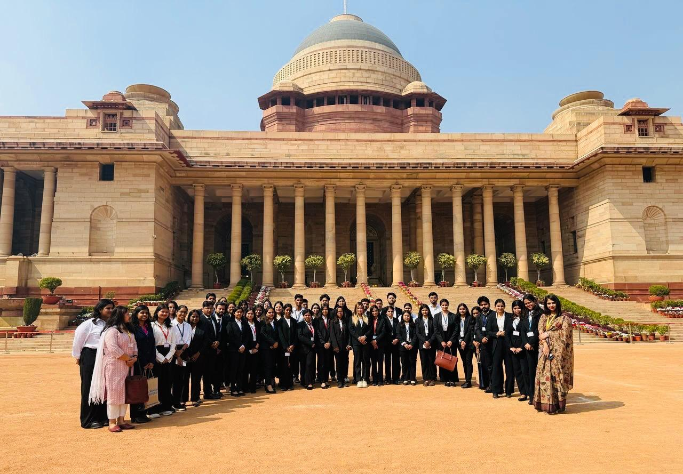

SCHOOL OF LEGAL STUDIES
Welcomes
NAAC Peer Team
(16th -18th June 2025​)

Slide 2
VISION & MISSION
Vision of the University
To become an Internationally recognized institution of Higher learning through excellence in inter-disciplinary education, research and innovation preparing socially responsible life long learners contributing to nation building
Mission of SOLS
To advance knowledge and nurture the essential abilities required for public service, legal professionalism for the advancement of justice.
To foster learning supported by well qualified faculty, moderate facilities, advanced technology and latest curricula.
To promote progressive legal research that addresses contemporary challenges, contributes to scholarly discourse, and influence policy and practice.
To provide expertise without being constrained by any barrier.
SOLS JOURNEY SINCE 2013
2013
BBA LL.B.(H)
B.Com LL.B.(H)
2015
B.A. LL.B.(H)
LL.B.(H)
2016
LL.M. (One year)
PH.D.
Vision of SOLS
To be a prominent legal education Institution for the promotion of academics and excellence in legal research.
https://www.krmangalam.edu.in/pdfs/Approval/8-DHE-NOC-2015-16.pdf
BCI APPROVAL_2024-25.pdf

Slide 3
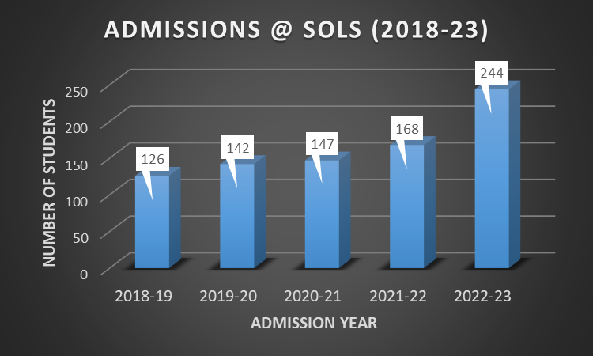
ABOUT SOLS
PROGRAME NAME | Student Intake | 2018-19 | 2019-20 | 2020-21 | 2021-22 | 2022-23
B.A. LL.B (H). | 120 | 54 | 65 | 54 | 70 | 118
BBA LL.B (H). | 60 | 37 | 27 | 32 | 28 | 51
B.Com LL.B (H). | 60 | 6 | 7 | 8 | 9 | 8
LL.B.(H). | 60 | 13 | 19 | 20 | 11 | 27
LL.M. | 60 | 16 | 24 | 33 | 50 | 40

Slide 4
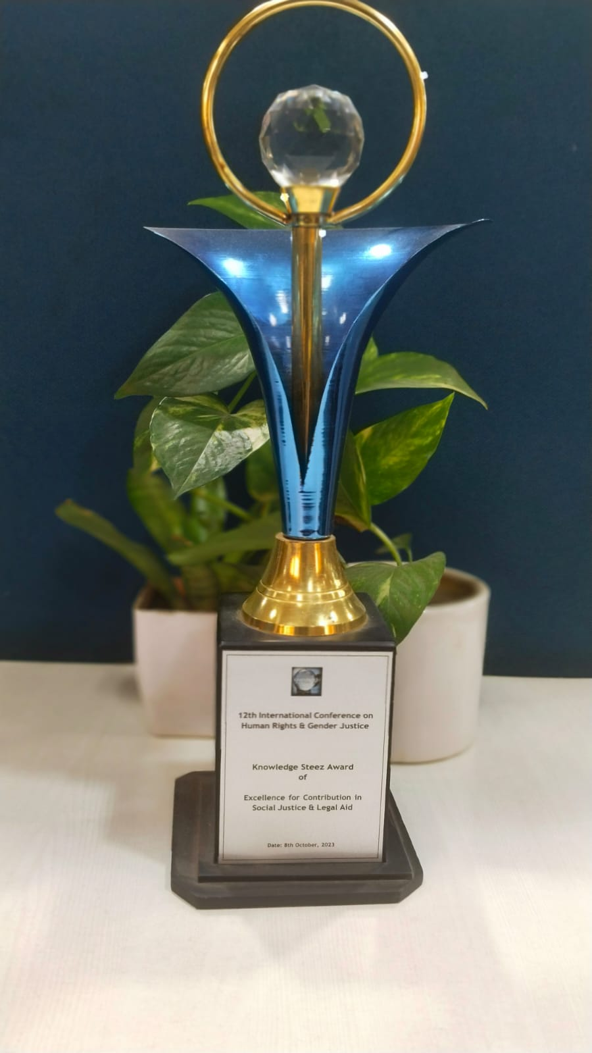
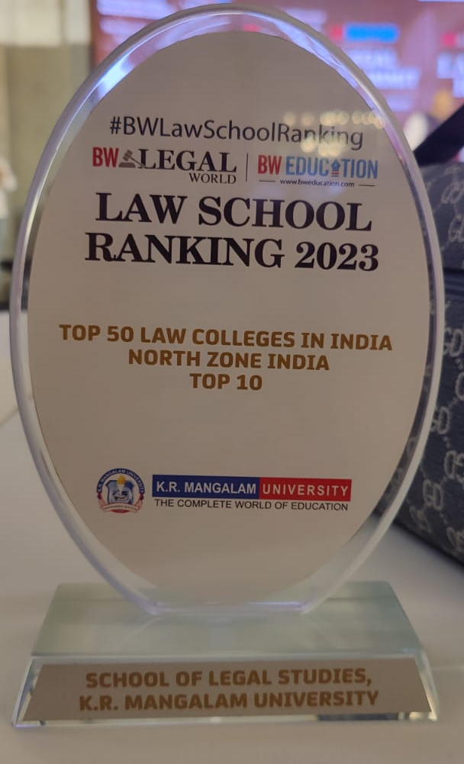
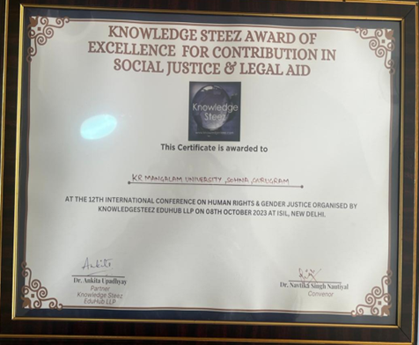
ABOUT SOLS
SOLS- Advisory Board
Moti Lal Nehru Chair
Centre for Criminology and Victimology
Centre for Human Rights
RANKINGS & AWARDS
1.
2.
3.
Legal Aid and Social Justice Activities during the 12th International Conference on Human Rights and Gender Justice in 2023, at the Indian Society of International Law in New Delhi.
4.
Ranked in Top 10 Colleges in North Zone India by BW Legal World Law School Ranking 2023
Award of Excellence for Contribution in Social Justice & Legal Aid in 2023 by Knowledge Steez

Slide 5
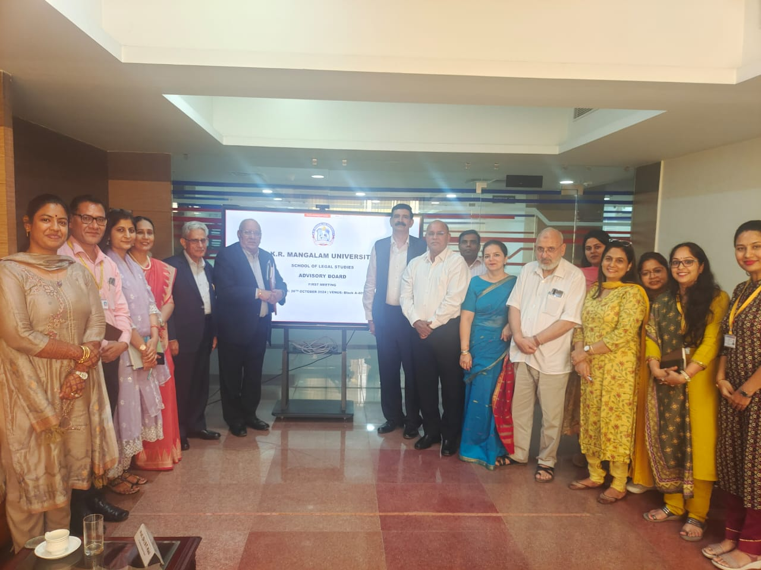
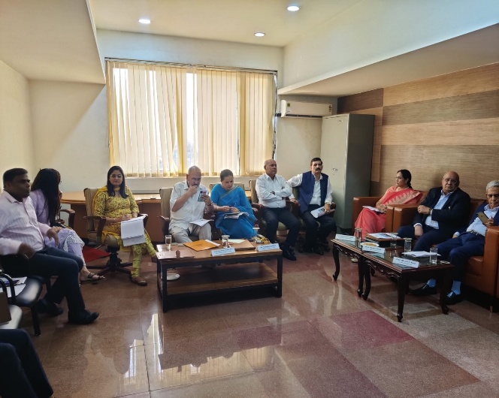
SOLS ADVISORY BOARD
CONSTANT GUIDANCE BY THE LEGAL LUMINARIES
ENRICHMENT OF COURSE CURRICULUM
COURSES DELIVERED BY INDUSTRY EXPERTS
MEMBERS | DESIGNATION
Hon’ble Justice Manju Goel (Chairperson) | Former Judge of Delhi High Court,
Hon’ble Justice Ali Mohammad Magrey | Former Chief Justice of the Jammu & Kashmir and Ladakh High Court.
Hon’ble Justice Ajit Prakash Shah | Former Chief Justice of Delhi High Court
Hon’ble Justice B A Khan | Former Chief Justice of Jammu and Kashmir High Court.
Prof. B. B. Pande | Professor of the National Human Rights Commission
Professor BT Kaul | Former Chairperson, Delhi Judicial Academy
Advocate Pradeep Rai | Senior Advocate at Supreme Court of India
Prof. Raj Nehru | Vice Chancellor, Vishwakarma Skill University
Professor Ranbir Singh | Former VC, Delhi National Law University
Professor Balraj Chauhan | Former Vice-Chancellor of Dr. Ram Manohar Lohiya National Law University Lucknow
Professor Purvi Pokhariyal | Dean, School of Law, Forensic Justice & Policy Studies
Prof. G.S Vajpayee | Vice-Chancellor National Law University, Delhi.
Professor Nuzhat Parveen | Former Dean & Professor Law,Jamia Millia Islimia, New Delhi
Professor Shruti Bedi | Professor, Law Punjab University, Chandigarh
Professor Madhuri Parik | Director & Dean, Faculty of Law, Nirma University
Mr. S. N Srivastava | Former Commissioner of Police, New Delhi
Mr. Nachiketa Goyal | Principal Associate, Kochhar & Co.
Amit Panigrahi | Partner, Luthra and Luthra
First Meeting held on 26/10/24

Slide 6
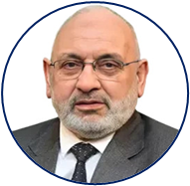
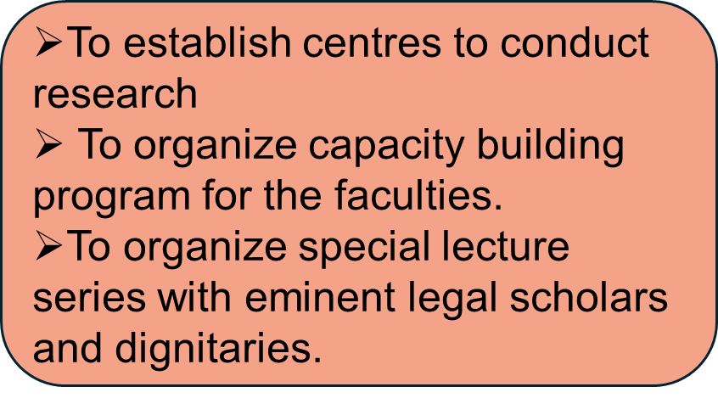
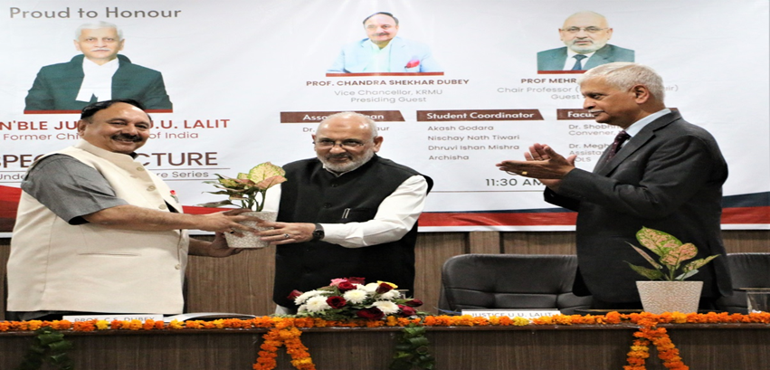
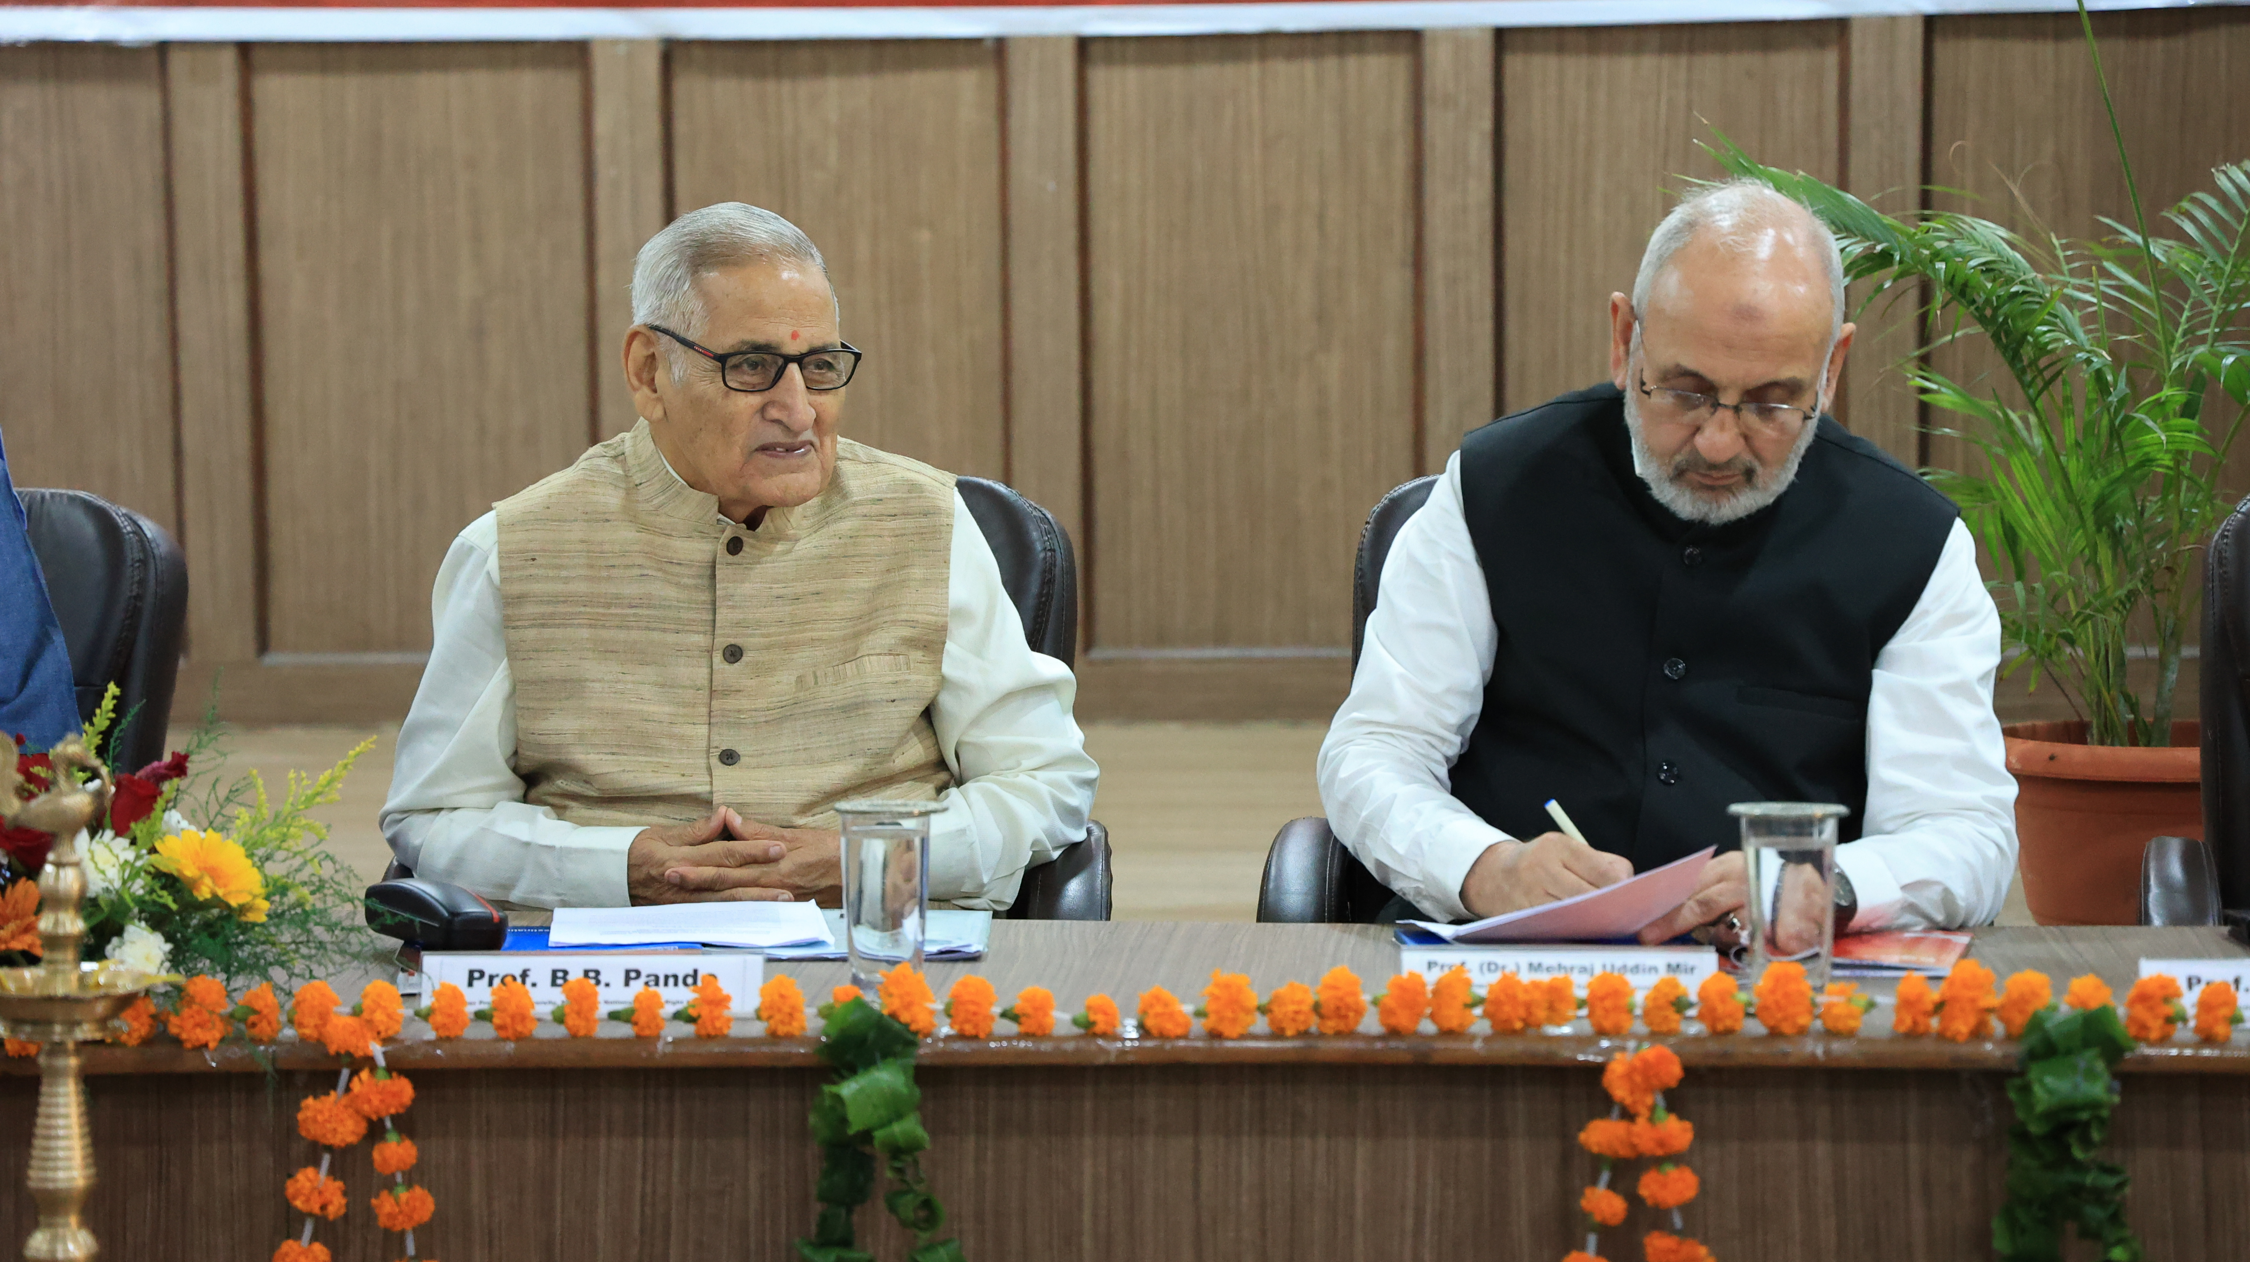
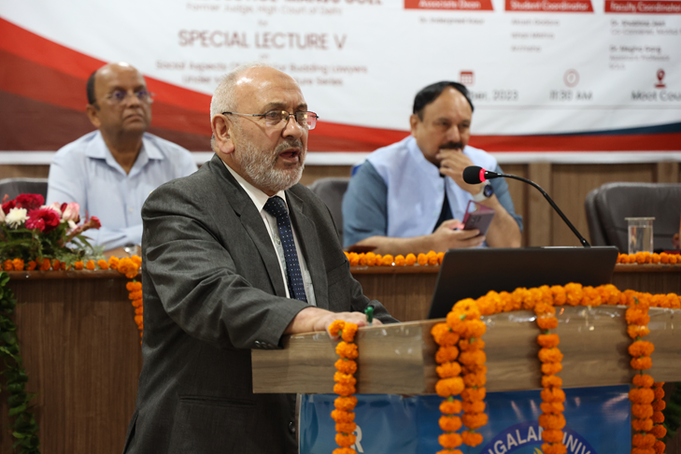
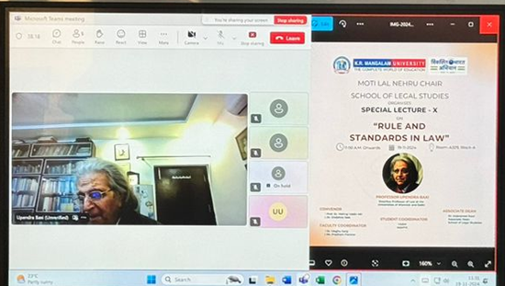
CHAIR PROFESSOR, MOTI LAL NEHRU CHAIR (Estd- 2023)
UGC_Guidelines-for-Chairs_2014.pdf
Prof. (Dr.) Mehrajuddin Mir

Slide 7
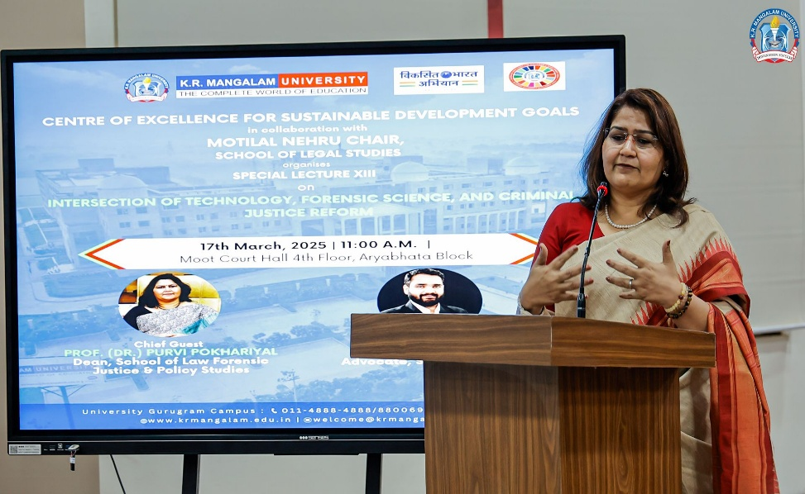
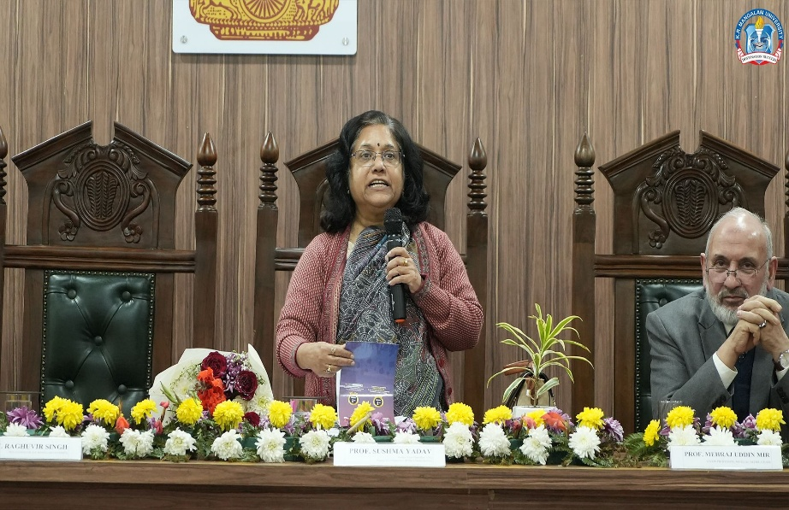
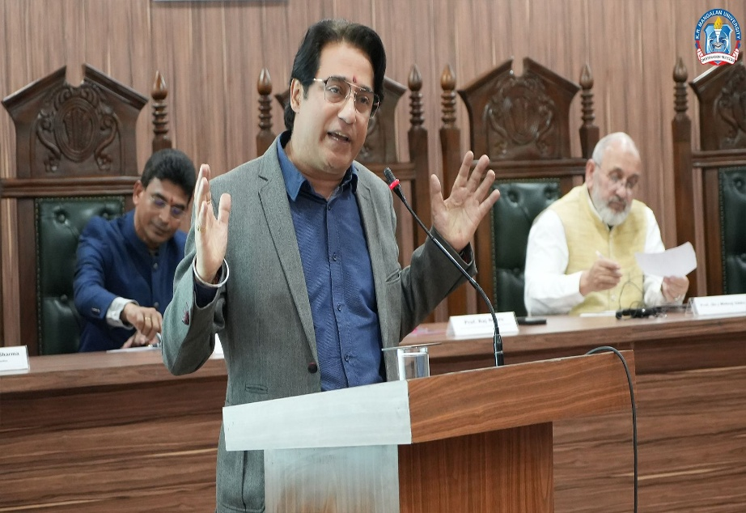
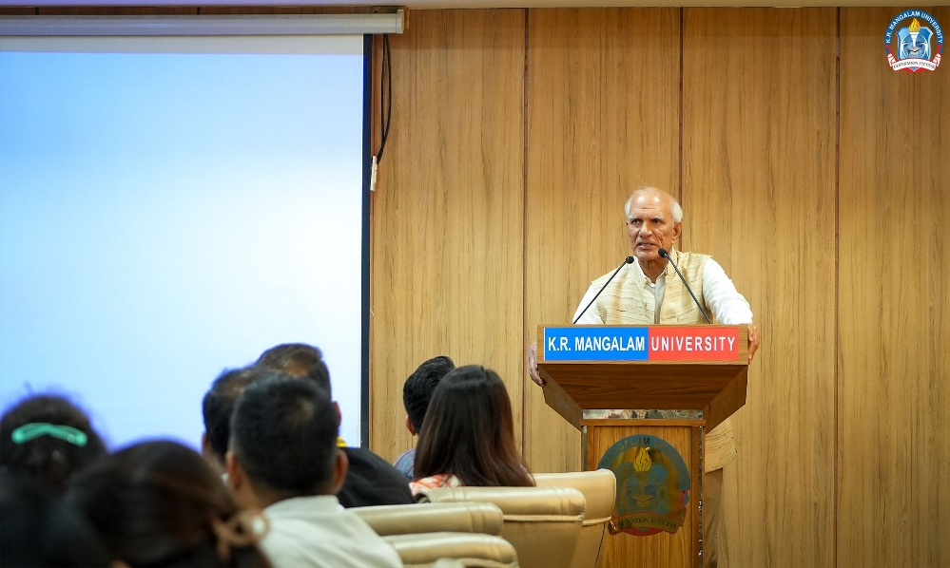
SPECIAL LECTURES SERIES
Guest Speakers
Hon’ble Mr. Justice Ajit Prakash Shah
Hon’ble Mr. Justice A.M. Magrey
Professor (Dr.) G. S Bajpai
Prof. Mehraj Uddin Mir
Hon’ble Mr. Justice U U Lalit
Hon’Ble Mr. Justice Manju Goel
Prof. B.B.Pande
Prof. (Dr.)Ranbir Singh
Prof. M. K. Bhandari
Prof. (Dr.) Tabraz Ahmad
Professor Upendra Baxi
Prof. Sushma Yadav
Prof. Raj Nehru
Prof. (Dr.) Purvi Pokhariyal
Prof. Ved Prakash

Slide 8
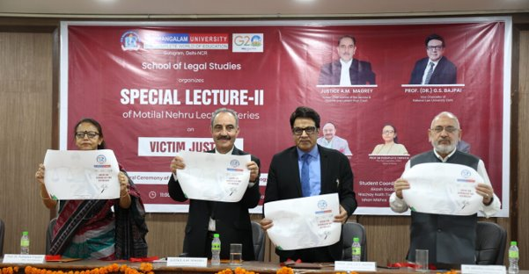
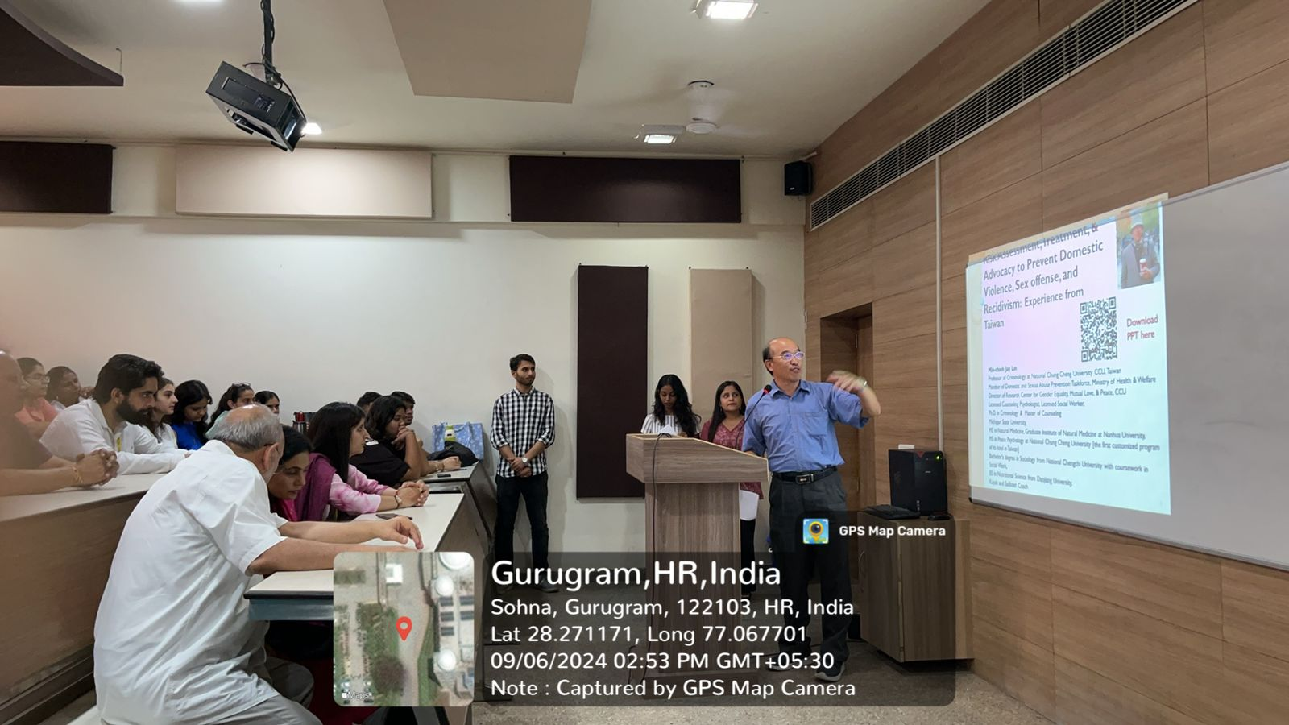
CENTRES @ SOLS
Centre For Criminology and Victimology (Year of Establishment-2023)
To promote research and action in the selected areas of Criminal Justice, Criminology, Victimology, and Victim justice.
To undertake publications and coordinate with various National and International agencies working in the broader areas of criminology and victimology.
To organize student-centric activities in the form of victim advocacy, Legal Clinics, and Outreach Programmes for extending victims’ support services.
To seek cooperation from the different segment of the criminal justice system to help out victims.
UPCOMING EVENTS
MOU with Bhondsi Jail & Tihar Jail
Handbook on ‘Street Smart Laws’ for Jail inmates
National Conference on ‘Digital Arrest’
‘Street Smart Laws’- Value Added Course & Awareness Camp
Hon’ble Mr. Justice A.M. Magrey, Former Chief Justice of Jammu & Kashmir and Ladakh High Court and
Professor (Dr.) G. S. Bajpai, Vice Chancellor of National Law University, Delhi.
Title | Seed Grant Details
Project Title | A Critical Analysis of Juvenile Justice System in Delhi
Researchers | Dr. Megha Garg & Dr. Shobhna Jeet
Grant Amount | 1.27 Lakh
Funding Institution | K.R. Mangalam University
Project Duration | 2 Years
Expert Talk by Professor Lin Mingjie,
Department of Criminology,
National Chung Cheng University, Taiwan

Slide 9
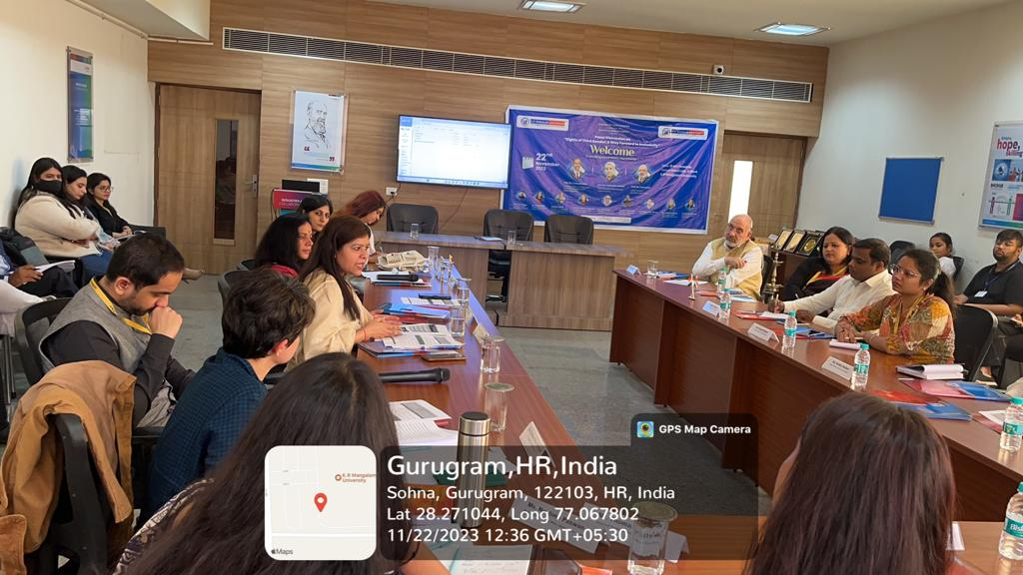
CENTRES @ SOLS
Centre For Human Rights (Year of Establishment-2023)
Hon’ble Justice Mr. Ajit Prakash Shah, Former Chief Justice (Delhi HC)
Mr. Vijendra Gaur, Dy. Supt, Distt Prison, Nuh @ the National Symposium
Book Publication “From Cells to Society”
Awareness Building
Societal Interaction
Analysis of Issues
Research
Legal Development
UPCOMING EVENTS
Collaborative research with NHRC
MOU with Navjyoti Foundation + three upcoming projects on Girl Child Scheme of GOI
Establishing a Human Rights Clinic
Notes:
on “Prison Reforms and Human Rights”

Slide 10
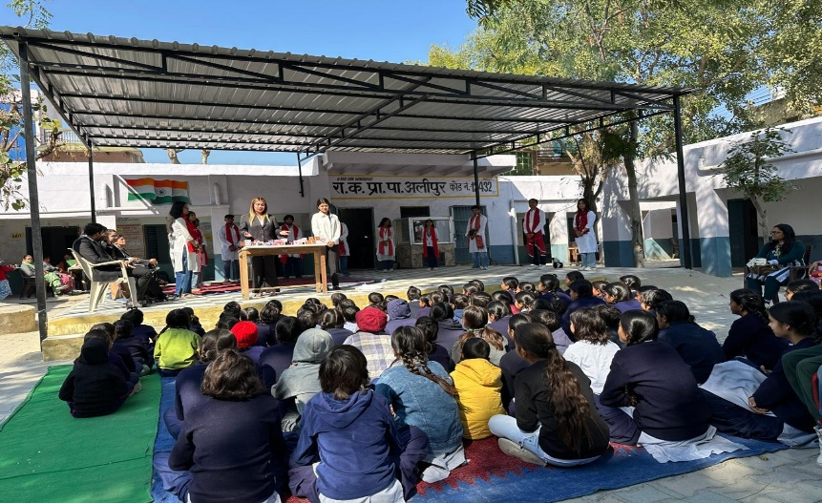
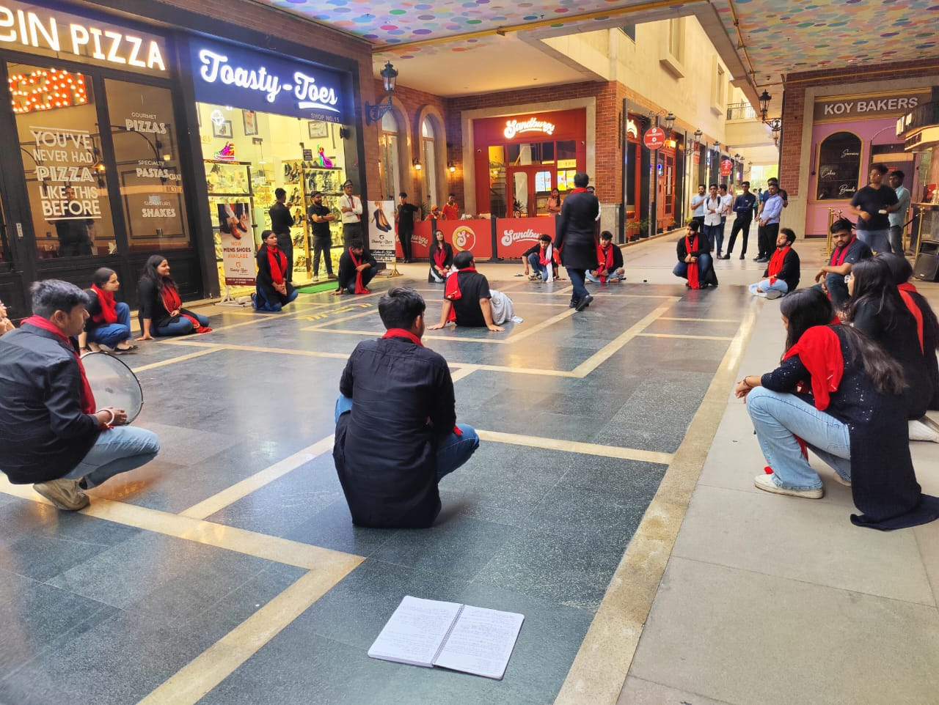
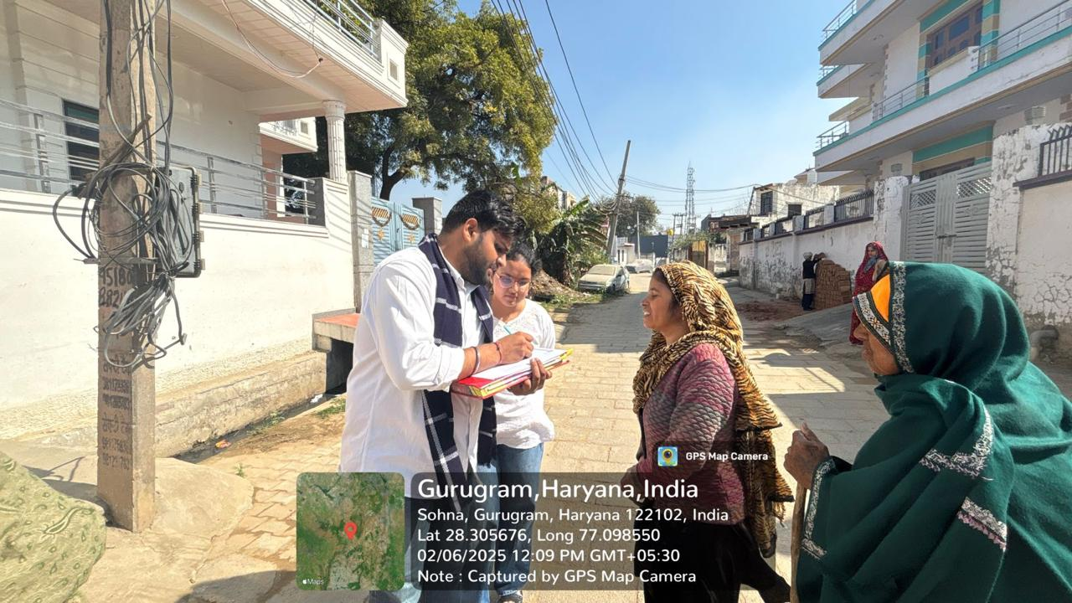
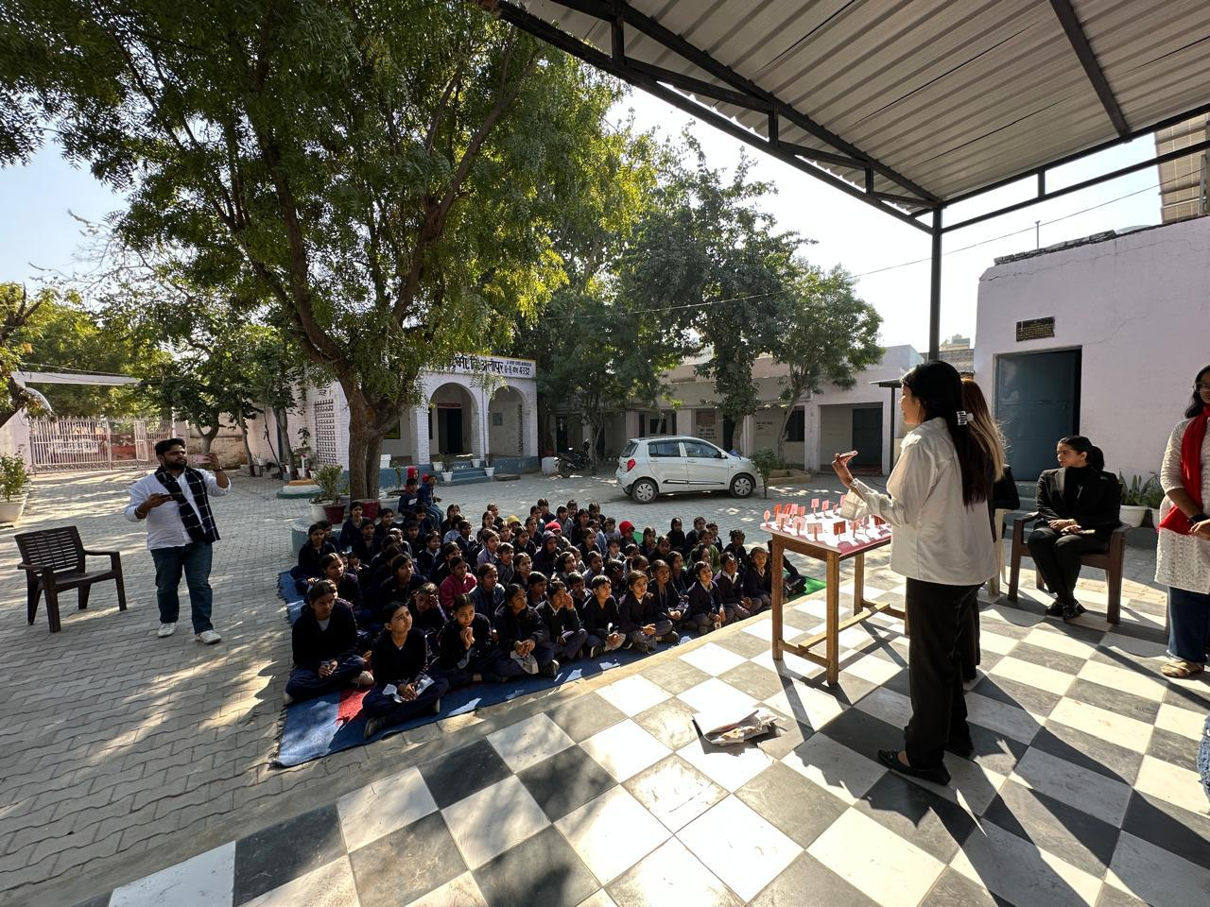
SOLS INITIATIVES
Extension Activities
S. No. | Academic Year | No. Of Activities
1 | 2021-22 | 12
2 | 2022-23 | 12
3 | 2023-24 | 08
4 | 2024-25 | 13
SOLS - Extension Activities.xlsx
Best Extension Activities

Slide 11
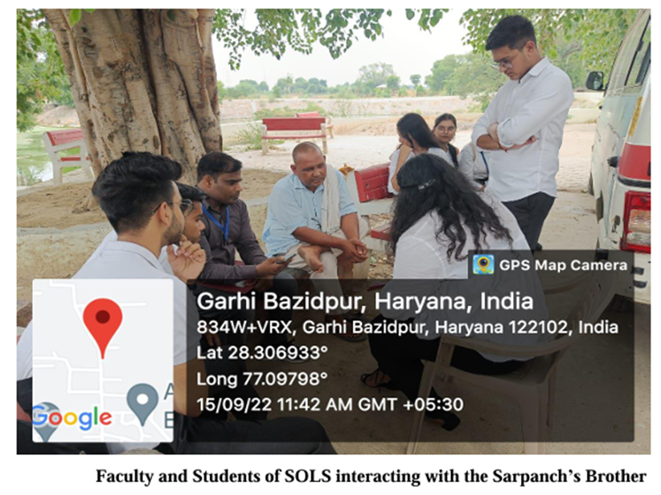
COMMUNITY CONNECT- CASE STUDIES
“Enrolment of Girls in higher studies” Outcome- 1. Extension Activity IV: Workshop on Right to Education in Collaboration with NSS 2. Sent Proposal to Ministry of Women and Child Development on 22 August 2022 3. Constant encouragement of parents to enroll their girl children in non-traditional professional courses like ME, ECE, CSE and so on. 4. Project Proposals to raise fund for girls belonging to SCs and STs - willing to pursue non-traditional professional courses more than any other sections of society, will be sent to various private and government agencies
SEED GRANT -THOMAS page 2.pdf
Seed grant.xlsx

Slide 12
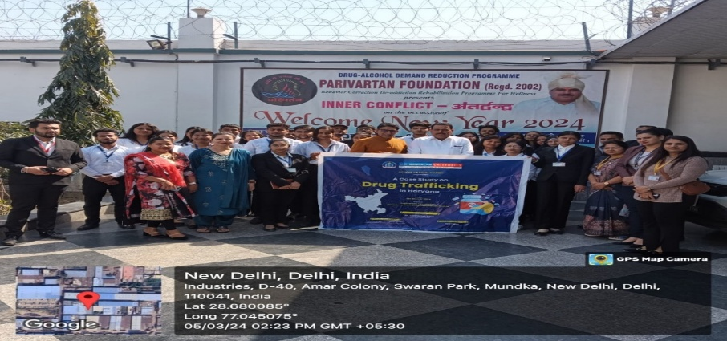
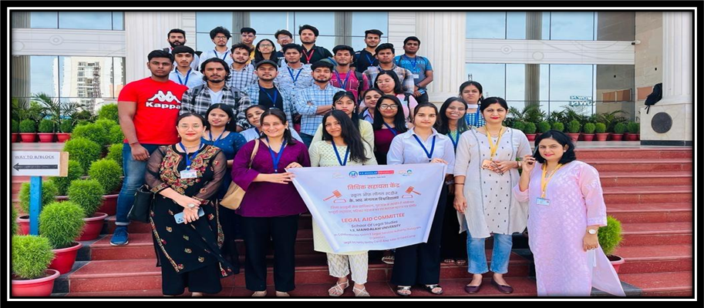
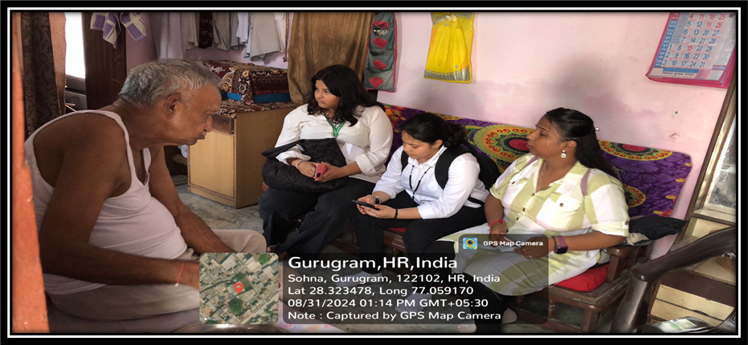
COMMUNITY CONNECT- CASE STUDIES
“Drug Trafficking in Haryana”
Outcome:
Book Published/Spread Awareness Amongst Youth
“Understand and Identify Existing Issues Related to Registration of Voter ID Cards and Lack of Awareness about Legal Aid”
Outcome:
15 Voter ID cards were made
SEED GRANT - MEGHA.pdf
“Environmental Law and Safeguards”
Outcome:
Awareness drive & Plantation Drive (Village- Garhi Bajidpur)

Slide 13
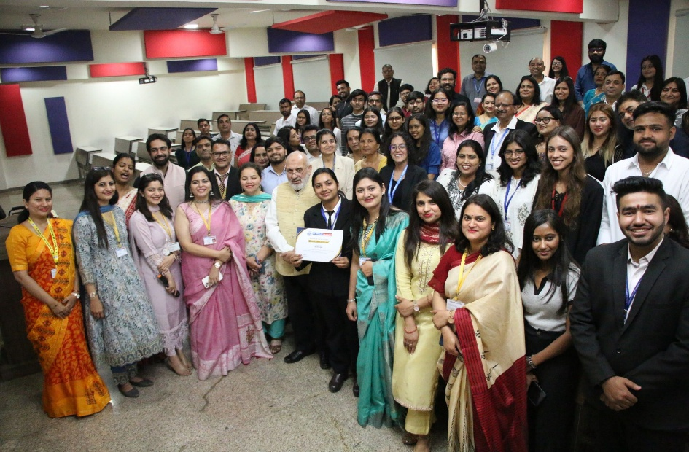
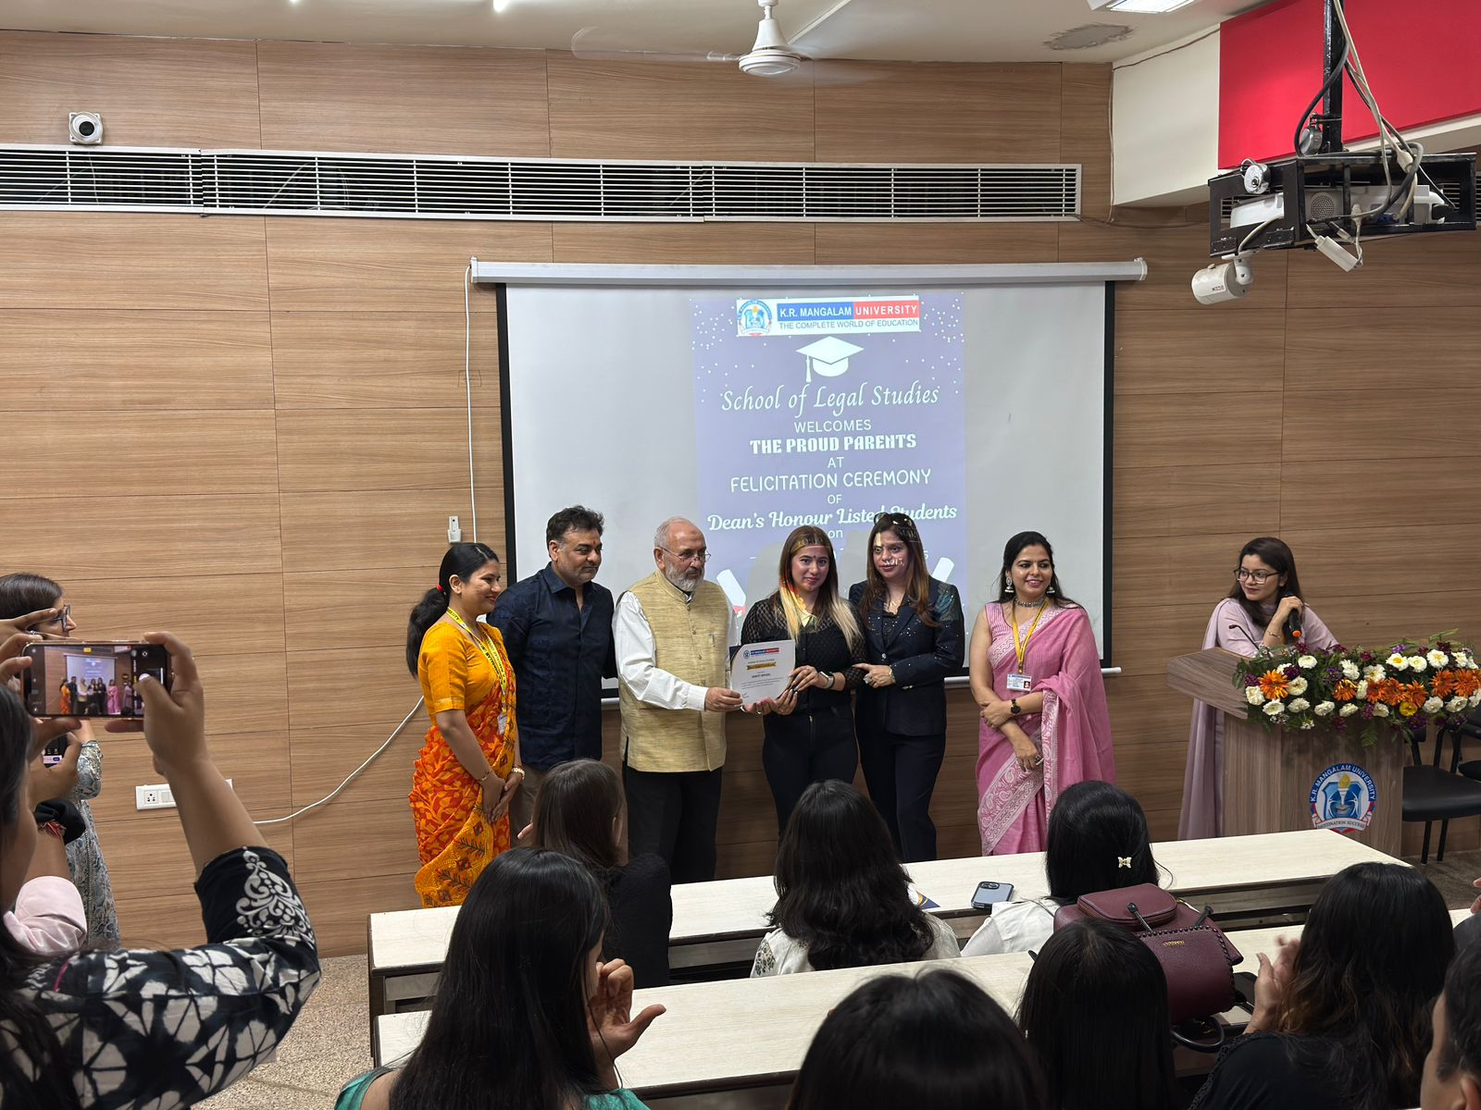
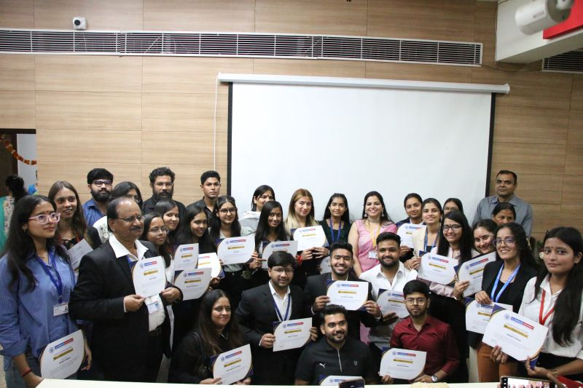
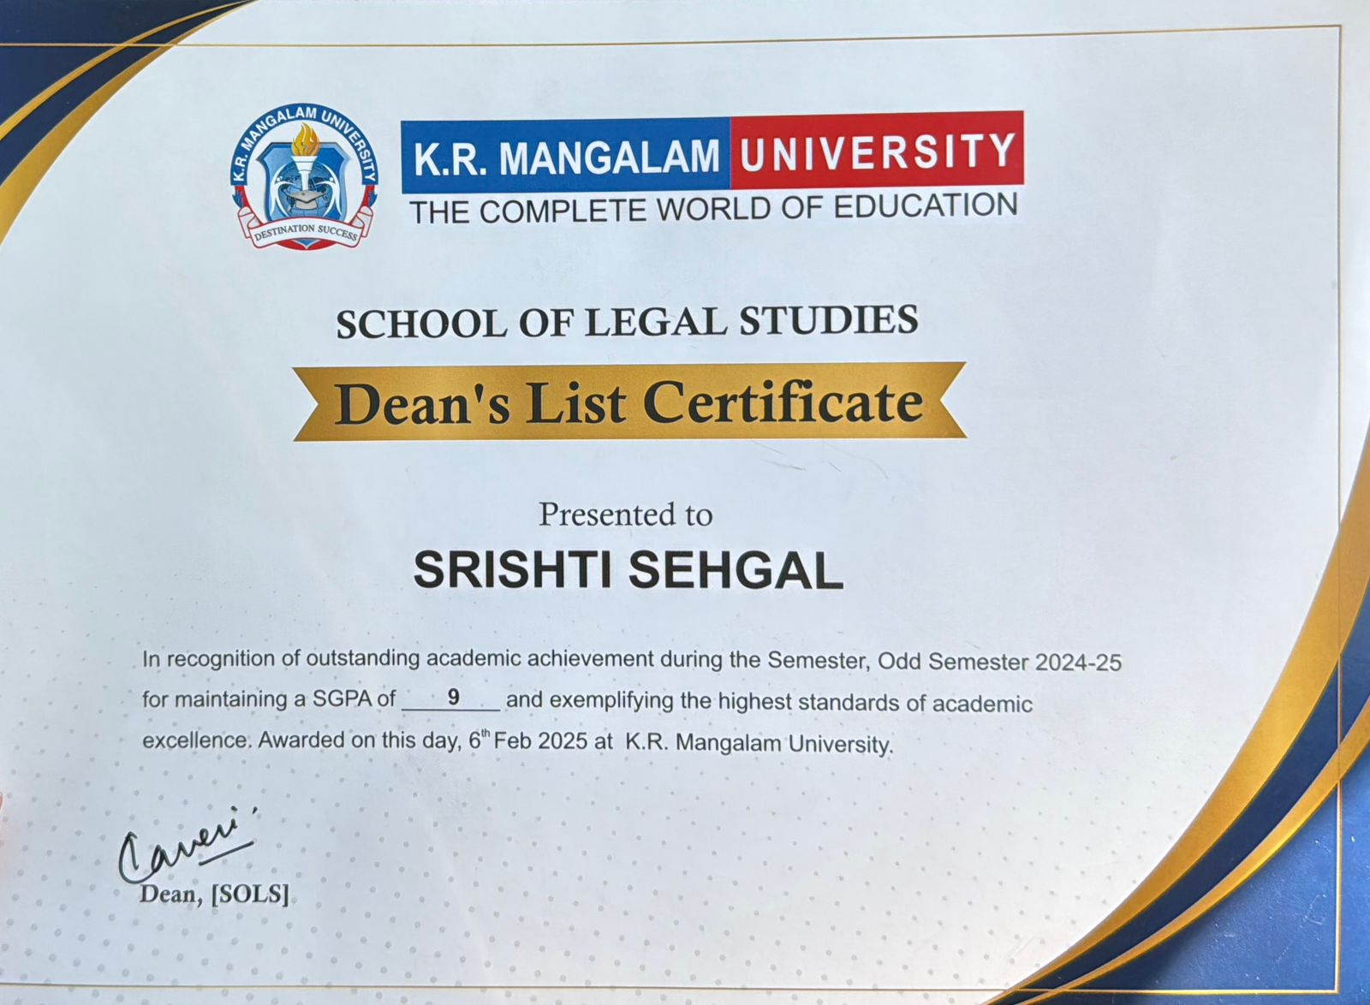
SOLS INITIATIVES
To celebrate the academic brilliance and dedication of our outstanding students, in the presence of their proud parents.
DEAN’S HONOUR LIST
https://www.krmangalam.edu.in/dean-honor-list/

Slide 14
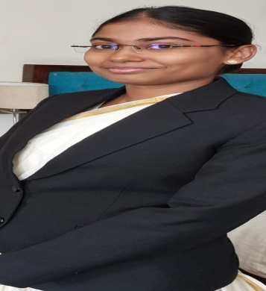
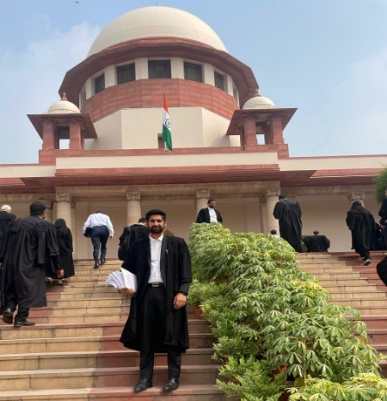
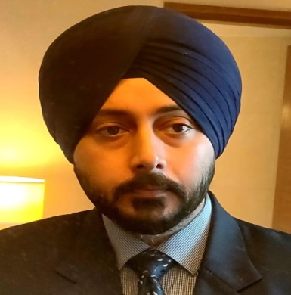
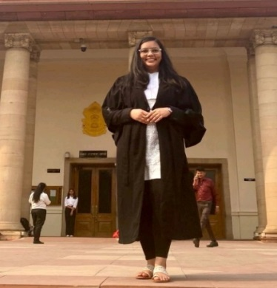
STUDENTS’ ACHIEVEMENTS
Nishi Jindal,
Civil Judge/Metropolitan Magistrate
(Batch 2023)
Sanyam Diwan,
Kayak Law Offices,Patiala house Courts
(Batch- 2020)
ACADEMICS
Pratiksha Varshney,
IPR Attorney, Associate,
Perfelexio Legal
( Batch 2020)
Dr.Navjot Singh Khurana,
Chief Manager (Law),
GAIL (India) Ltd. (New Delhi)
(Batch- 2021)

Slide 15
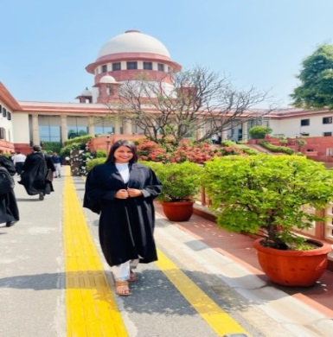
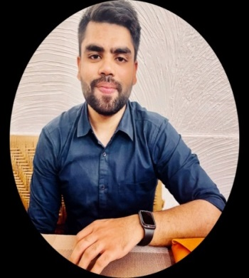
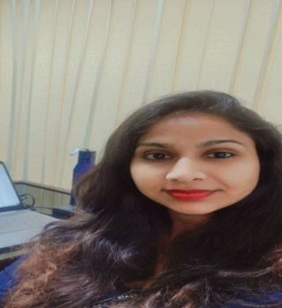
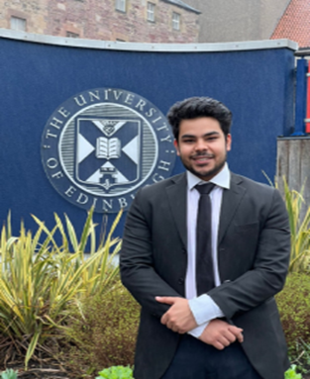
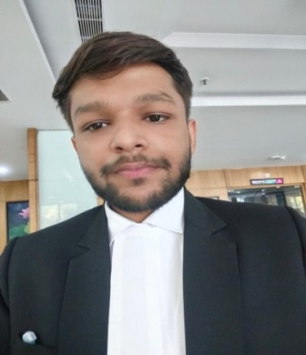
STUDENTS’ ACHIEVEMENTS
ACADEMICS
Pranav Sachdev,
Executive Legal and Strategy, Mumbai
(Batch 2019)
Mehroonisha,
Advocate, Delhi High Court
(Batch
Saksham Gupta,
Advocate, Delhi High Court
(Batch 2021)
Tanmaya Jha
LL.M, University of Edinburgh, (Batch 2023)
Komal Sharma,
Founder of KV Associates, Currently Legal Associate
at Singhania and Company (Batch 2018)

Slide 16
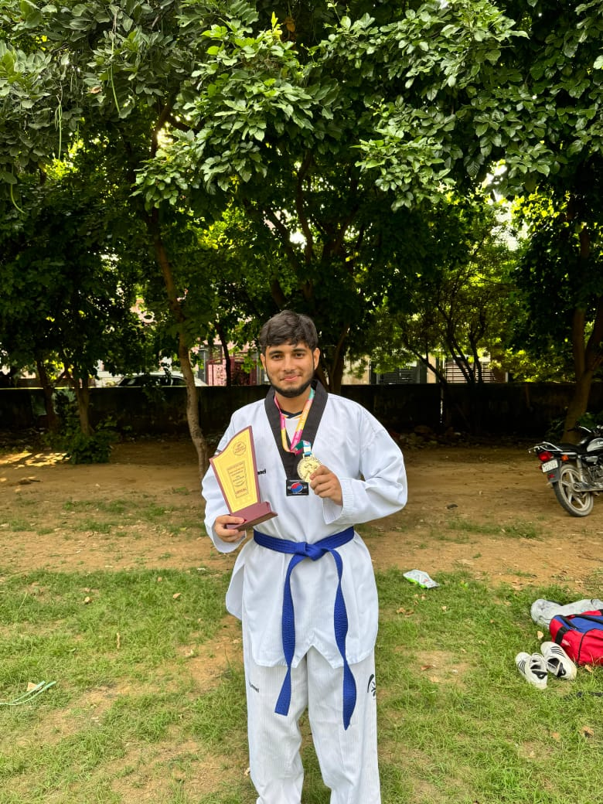
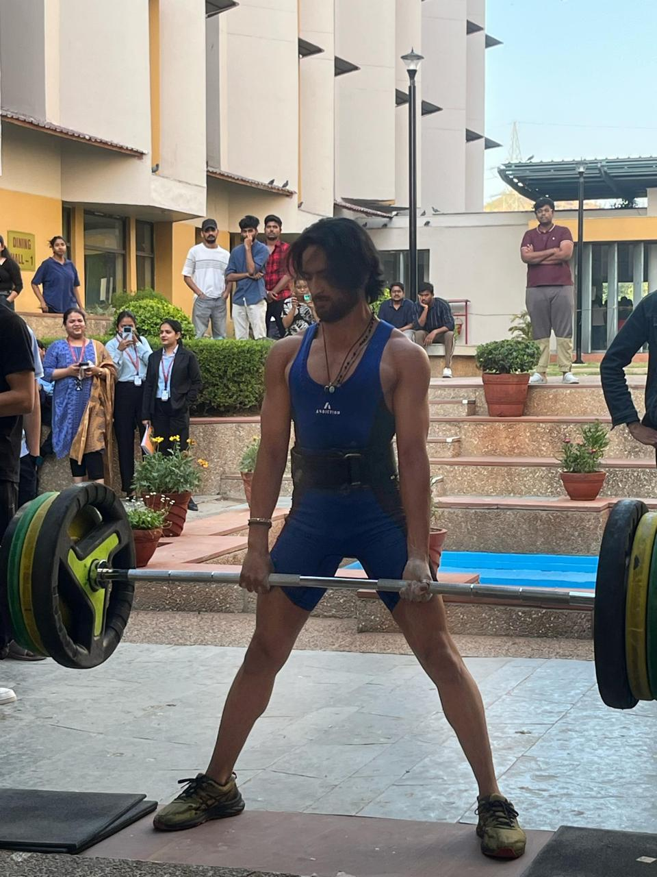
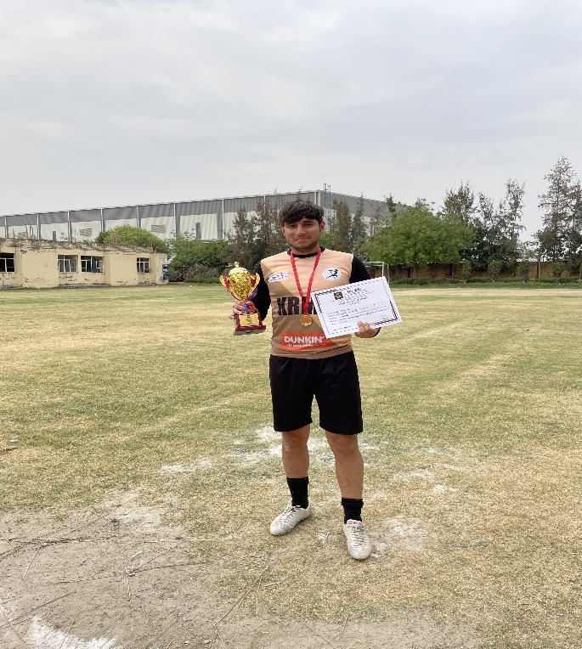
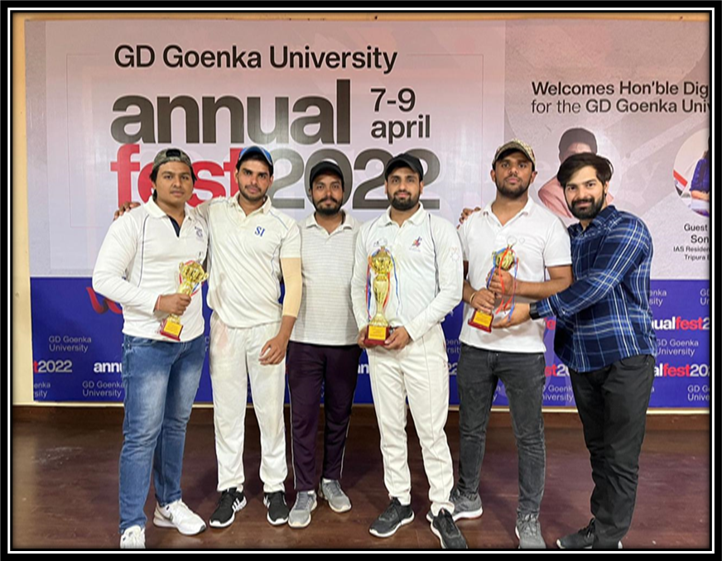
STUDENTS’ ACHIEVEMENTS
Ayush,
BBALLB(H)
won prize in Taikwando
Vaibhav Joshi, BA LL.B.(H)- Won Ist prize in NIIT University 'Gym Sher' All India Powerlifting Tournament in Neemrana, Rajasthan
EXTRA CURRICULAR
Sunil and Team from LLB Hons. at G.D. Goenka University
Ayush secured 1st position in Sprotan League Inter-College Football Tournament

Slide 17
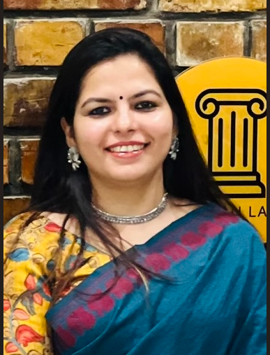
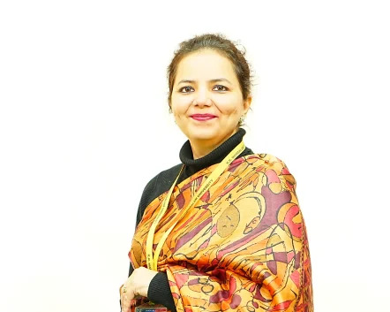
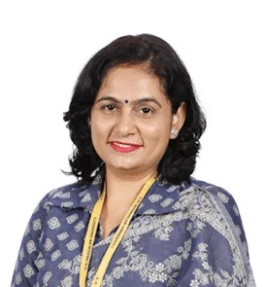
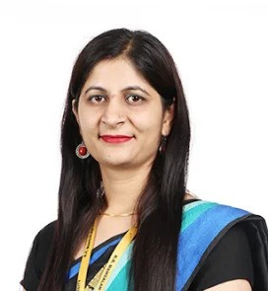
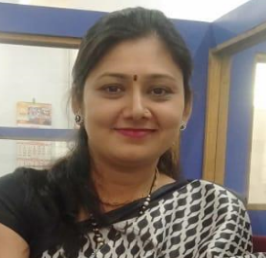












FACULTY MEMBERS @ SOLS
Prof (Dr.) Kaveri Sharma,
Professor & Dean
Dr. Inderpreet Kaur,
Asso. Professor & Asso. Dean
Dr. Shobhna Jeet, Associate Professor
Dr. Megha Garg, Assistant Professor (Sr Scale)
Dr. Arti Sharma, Assistant Professor
Dr. Kriti Singh, Assistant Professor
Dr. Gargi Singh, Assistant Professor
Dr. Parul,
Assistant Professor
Dr. Amrita Singh, Assistant Professor
Dr. Aarti Lamba
Assistant Professor
Dr. Tijender,
Assistant Professor
Mr. Thomas Monteiro, Assistant Professor
Mr. Prashant Panwar,
Assistant Professor
Mr. Anurag Sharma,
Assistant Professor
Ms. Kritika ,
Assistant Professor
Ms. Sadhana Nirban, Assistant Professor
Ms. Akanksha Singh, Assistant Professor
Notes:
Well qualified faculty members along with support of the expert faculty members from Academia, Bench, Bar, Executive, Industry

Slide 18















BENCH, BAR AND EXECUTIVE
Hon’ble Mr. Justice U.U. Lalit
Former Chief Justice of India
Hon’ble Ms. Justice
Indira Banerjee Former Judge
Supreme Court of India
Hon’ble Mr. Justice A.P Shah
(Former CJ High Court of Delhi)
Hon’ble Mr. Justice A.M. Magrey
(Former CJ, J&K and L High Court)
Hon’ble Ms.Justice Manju Goel
(Former Judge of Delhi High Court)
Hon’ble Judge Nagendra Prasad
District Court Ranchi
Sr. Adv. Aadish C Aggarwal
Former President (SCBA)
Sr. Adv. Pradeep Rai
Former Vice President (SCBA)
Sr. Adv. Ashok Bhan
Supreme Court of India
Sr. Adv. Hemant K Batra
Sr. Legal Consultant & Lead
Shardul Amarchand Mangaldas
Adv. Maan Singh Yadav
P & H High Court
Adv. Manik Mohan Sharma
P & H High Court
Sr. Adv. Tezpal Yadav
Advocate Gurugram District Court
Mr. Vijendra Singh Gour
(DY Spt. District Prison, Gurugram)
Mr. Charan Singh
(DY Spt. District Prison, Gurugram)

Slide 19


















EMINENT PROFESSORS/SCHOLARS
Prof. Ranbir Singh
Founder Former VC NLU
Delhi and NALSAR University of Law
Prof B.B. Pandey
Former Professor, Delhi University
Prof. Balraj Chauhan
Founding Vice Chancellor DNLU Jabalpur
Prof. Paramjit S. Jaiswal
Vice Chancellor, SRMU
Prof. G.S. Bajpai,
Vice Chancellor of
National Law University Delhi.
Prof. (Dr.) Manoj Kumar Sinha
Vice-Chancellor
Dharmashastra NLU, Jabalpur
Prof. (Dr.) Raj Nehru
Vice Chancellor
Shri Vishwakarma Skill University
Prof. Nishtha Jaiswal
VC HNLU
Prof. Madhuri Parik
Director & Dean
Faculty of Law Nirma University
Prof. Nuzhat Parveen,
Former Dean Jamia Millia Islamia
Prof. Naresh Kumar Vats
Professor of Law &
Dean Academics, RGNLU
Prof. B.T. Kaul Prof Emeritus
DU & Former Chairperson of
Delhi Judicial Academy
Prof. (Dr.) Rajesh
HOD & Senior Professor, DACEE,DU
Dr. Vageshwari Deswal
Professor, Faculty of Law, DU
Prof. (Dr.) Aksha Sheikh
Professor, Jamia
Hamdard University
Prof. (Dr.) Rajesh Kumar Malik
Department of Law, CHU
Prof. (Dr.) Monika Malik
Department of Law, CHU
Prof. Lin Mingjie
National Chung Cheng
University, Taiwan\

Slide 20

STUDENT & FACULTY STRENGTH
Student Strength (A.Y. 2024-25)
Total Students | 615
UG | 573
PG | 42
Faculty Members (Total-18)
Chair Professor/ Professor | 02
Associate Professors | 02
Assistant Professor(Senior Scale)/ Assistant Professors | 1+13
Final Programme and Intake 2023-24[1].pdf
Ph.D. Scholars (Total enrolled till date- 41)
Ph.D. Scholars (as on date) | 25 (Including 2 IRFs)
Ph.D. Awarded | 16
Notes:
Faculty student ratio- 1:12 approx. (615:52)

Slide 21
CURRICULAR ASPECTS
Initiated at Departmental level, or by Faculty Member
or
On the guidelines by UGC/ BCI
Feedback from Industry and Academia
Draft with Revisions in Syllabus of the course
Approval by Board of Studies
Approval by Academic Council
Curriculum Design and Development:
As per BCI Legal Education Rules, 2008
SOLS MoM 2023-24.pdf
Notes:
The curriculum is developed in the light of BCI and UGC guidelines. To cater the needs of the industry, time and again we make changes in the curriculum by adopting the following steps.

Slide 22
COURSE CURRICULUM
Scheme of Studies 2023-24.xlsx
Etiquettes for Professionals
Cyber Crime with Special Reference to Social Media
Self- Directed Emotional Learning for Empathy and Kindness
Application of Sustainable Development Goals
Contemporary Issues under Copyright Law
Self Directed Emotional Learning for Empathy and Kindness
VALUE ADDED COURSES
Scanned Copies of VAC 2018-23
YEAR | No. of VAC Courses
2024-25 | 1
2023-24 | 7
2022-23 | 3
2021-22 | 1
2020-21 | 1
2019-20 | 2
2018-19 | 2
Notes:
VAC -17 Since 2018

Slide 23
COURSES RELATED TO EMPLOYABILITY, PROFESSIONAL ETHICS,GENDER, HUMAN VALUES
CURRICULUM COMPONENTS HAVING
CONSTITUTIONAL RESPONSIBILITIES
Indian Constitution
Constitutional Law-I
Legal and Constitutional History
Constitutional Law-II
8 Courses- Constitutional Law Specialization
Graph Courses on Employability Etc. (1).xlsx
Courses focus on cross cutting issues.xlsx
Notes:
Total Courses -

Slide 24





COMPETENCY BASED TEACHING LEARNING METHODOLOGIES
Participative Learning
Case studies
Moot Court Competitions
Legal Drafting
Research Paper Publications/ Presentations
Panel Discussions
Flipped Classroom
Experiential Learning
Industrial Visit
Internship
Legal Aid and Awareness
Workshops
Problem Based Learning
Quizzes
Mock/Youth Parliament
Moot Court Competitions
Debates
Research Paper Presentation
Legal Drafting
Legal Aid Committee- Office order.pdf
Internship Report- 2024-2025 (605).pdf
Hon'ble Mr. Justice U U Lalit delivering lecture @ SOLS​

Slide 25





Teaching learning Process
Inside
Classroom
ICT Enabled Teaching
LMS
Workshop on “Mastering Procedural Law and Forensic Evidence”
Special lecture by
Hon'ble Ms. Justice Manju Goel
Lecture Method

Slide 26






Teaching learning Process
Outside classroom
Extension Activity on RTI
LMS
Visit to Supreme Court
Visit to Bhondsi Jail
Intra School Moot Court Competition
Case Study on Drug Trafficking

Slide 27
RESEARCH, AWARDS, MEMBERSHIP & FDP’s
2018-2023
From 2023 till date
Research Paper Publication | UGC-CARE= 45 SCOPUS/WoS= 13
Books | 24
FDP (attended) | 5
Books Chapters | 62
Conference Proceedings | 7
Patents | 2
Seed Grant | 2
Consultancy | 1
Research papers Published
57
Book Chapters Published
78
Professional Membership
11
54
FDP(attended)
Research Policies.xlsx
Summary Sheet of Journal Publication.docx
Books & E-Books
8 + 10
https://www.krmangalam.edu.in/events-and-news/conference-on-embracing-diversity-exploring-third-gender-marriages-and-gender-equality/
Student Publication_list.docx

Slide 28






GLIMPSES OF THE IPR & LEGAL SKILL ENHANCEMENT ACTIVITIES
Workshop- “Role of IPR in encouraging innovation and creativity”
Hands on training on registration of IPR.
Workshop on Role of IPR
Hands on training on registration of IPR.
FDP on IPR in Collaboration with Ramanujan College
Training session on research methods on IPR
Notes:
Workshops, webinars, Guest Lectures, International Conference, Capacity Development Programme

Slide 29











ACDEMIC AND INDUSTRY COLLABORATIONS
Pahuja Law Academy (Academic) | Karat Law Academy (Academic) | MIT World Peace University (Research & Academic) | V Rankers Judiciary (Academic) | Knowledge Steez Edu Hub (Academic)
1.. Workshop on Law of Evidence 2.Workshop on Constitutional Rights 3. Workshop on Contemporary Issues in Constitutional Law 4. Competitive Exams Preparation Strategy and Tips 5. Workshop on Sensitizing Youth towards Their Constitutional Duties and Obligations | 1. Workshop on Essentials of Crime By KLA 2. Workshop on “Crime and Punishment: The Law of Rape in India and “Confession to Police Officer”. 3. Workshop on Domestic Violence 5. Career Counseling and Scholarship Drive | 1. Human Rights Day Celebration 2. Student Interaction Program with MIT World Peace University | 1. Guest Lecture on Jurisprudential Analysis of Criminal Procedure Code (CrPC): Competency to take Cognizance and Competency to Trial 2. Case Study of MC Mehta versus Union of India 3. Career Counseling Session on Competitive Exam | 1. Seminar On Sexual Harassment at Workplace 2. Case Study on Bandhua Mukti Morcha Versus Union of India and “Right to Education versus Child Labour” 3. Training Program for Non-Teaching Staff: Spreading Awareness about Legal Apps.
Donation Box India Foundation (Internship) | The Chambers Advocates (Placement/ Industry) | Tankam Law Classes (Academic) | Tez Law Associates (Industry) | NLU Delhi ( Academic) | Shobit University (Academic)
Internship: Ms.Yashika Mangla and Ms.Ishika Sharma | 1. Workshop on Safe Uses of Social Media 2. Case Study on Keshwanand Bharti v. State of Kerala AIR 1973 3. Internship: Purvit Jain | 1. Collaborative research on Recent Case Study/ amendments in POCSO Act, 2012 2. Collaborative Research on Recent Case Study/ amendments on Pre- Conception and Pre-natal Diogenitic Technique Act, 1994 | Internship of Ms.Ritika and Ms.Liza kesi | Student Exchange Program with NLU Delhi | 1. Faculty Exchange 2. Publication
Notes:
Academic -8
Internship-3
Industry-2

Slide 30






MOU ACTIVITIES- Few Glimpses
MOU with Nek Foundation, Saksham Project
Student Exchange with NLU -Delhi
Workshop on Law of Evidence with PLA
31

Slide 31





INFRASTRUCTURE- PHYSICAL FACILTIES
Well Equipped Moot Court Hall
ICT Enabled Classrooms with Wi-Fi
SOLS Library

Slide 32
LEARNING RESOURCES - LIBRARY
Number of Textbooks: | 126668
Print Books Titles | 1708
Number of periodicals/Journals: | 6
E-Journal | 636
Digital Library Computer | 35
Remote Access | https://library.krmangalam.edu.in/user#/home
Library Portal | https://www.krmangalam.edu.in/library/
Library Online Catalog | https://opac.krmangalam.edu.in/
WiFi | WiFi enabled library
Area | 1457 Sq. Mtr. (15683 Sq. ft.)
Library Management System | Koha
E- Mail | Libraryadmin@krmangalam.edu.in universitylibrarian@krmangalam.edu.in
MANUALS AND LAW JOURNALS
Indian Bar Review
Supreme Court Cases Online
Practical Lawyer
The Law Reports
AIR Reporter
SOLS List of Books.ods
BCI_LEGAL EDUCATION RULES 2008.pdf

Slide 33
LEARNING RESOURCES - LIBRARY
SOURCE | Web site URL | Access Type
Digital Library | https://library.krmangalam.edu.in/ | Web-based
SCC online | https://www.scconline.com/ | IP based
IEEE | https://www.ieee.org/ieeexplore | IP based
DELNET | https://delnet.in/ | Web based
NDL | https://ndl.iitkgp.ac.in/ | Web based
INFLIBNET | https://inflibnet.ac.in/ | Web based
IRINS | https://krmangalam.irins.org/ | Web based
Shodh Ganga | https://shodhganga.inflibnet.ac.in/ | Web based
DrillBit | https://www.drillbitplagiarismcheck.com/ | Web based
J-Gate | https://jgateplus.com/home/ | Web based

Slide 34



STUDENT SUPPORT
ADVANCED LEARNER
NAME: Pratiksha Varshney
BATCH- 2017-2022
SLOW LEARNER
NAME: Piyush Jha
BATCH- 2017-2022
MM Policy.pdf
sample mentee personal details.pdf
Sample interaction record 2022-2023.pdf
Mentor Mentee System
To provide guidance support to the students and address various
Career Counselling Sessions
To help students navigate their career paths and make decisions that will lead to
Cater the differential needs
Motivation for Competitive Examination
To provide a thorough understanding of the exam format, syllabus, and key topics to be covered.
To provide a thorough understanding of the exam format, syllabus, and key topics to be covered.

Slide 35



FACULTY DEVELOPMENT PROGRAMMES
Year | No. of FDPs (Attended)
2018-19 | 4
2019-20 | 2
2020-21 | 3 FDPs 2 Workshops 1 Refresher Course
2021-22 | 15 FDPs 3 Refresher course
2022-23 | 15 FDPs 1 Seminar 1 Refresher Course
2023-24 | 2 Orientation Programmes 17 FDPs 2 Refresher Courses 3 Swayam Credit Course
2024-25 | 34 FDPs
Year | No. of FDPs (Organized)
2020-21 | 1
2021-22 | 1
2022-23 | 1
2023-24 | 1
2024-25 | 2
Prof. B.T.Kaul address on “Legal teaching Internal Learning & research education”
Ms. Amrita Singh, NLIU FDP 2024.pdf
Consolidate Sheet for the PDP and FDP.docx
Prof.Ranbir Singh sharing his insights on
“Professional development”

Slide 36
SCHOOL LEVEL COMMITTEES-(CURRICULAR /
CO-CURRICULAR ACTIVITIES)
MOOT COURT COMMITTEE
LEGAL AID COMMITTEE
INTERNSHIP & PLACEMENT COMMITTEE
PRO-BONO CLUB
Re-constitution of Moot Court Committee of KRMU.pdf
LAC Newsletter_2023-24.pdf
B.A.LL.B. _ Internship Reports
Pro Bono Club File.pdf
Office order.pdf
SOLS_INTERNSHIP GUIDELINES.docx
Revised Moot Court Committee Composition, Rules and Regulations 2025 ( 2nd Amendment) (1).pdf
Student Committee 2023-24.pdf

Slide 37





Alumni Connect and Engagement
Lecture : Sharpening Legal Skills for Corporate Success.
Career in law : Prospects and Challenges
Career in Law Prospects and Challenges
Emerging Career Opportunities and Challenges for the Law students.

Slide 38




STUDENT PROGRESSION
Year | Total no. of Graduated Students
2018-2023 | 452
Notes:
Enrolment- 2018-19 (126) , 2019-20 (142) , 2020-21 (147) , 2021-22 (168) , 2022-23 (244)

Slide 39
BEST PRACTICES -SOLS
Competency Based Teaching Learning Pedagogy
Legal Aid and Awareness
Advancing Sustainable Development Practices and Fostering ‘Environmental Awareness’

Slide 40





Legal Aid and Awareness
Legal Aid Clinic -students engage in clinical work by helping individuals in need of legal advice.
Legal Awareness and Community Outreach initiatives to promote understanding of different rights.
Legal Aid and Outreach Programme with Case studies
Advancing Sustainable Development Practices and Fostering Environmental Awareness
S. No. | Academic Year | No. Of Legal Aid Activities
1 | 2021-22 | 12
2 | 2022-23 | 12
3 | 2023-24 | 08
4 | 2024-25 | 13
Office order.pdf
Student Committee 2023-24.pdf
Notes:
45+

Slide 41







Legal Aid and Awareness Activities
Workshop on Menstrual health and Hygiene
Workshop on RTI
Blood Donation Camp
Awareness Drive for Women’s Right
Workshop on the Awareness of Traffic Rules
Laado Panchayat
Health camp

Slide 42



Advancing Sustainable Development Practices and Fostering ‘Environmental Awareness’
International Conference on Environmental Law
Edited Book on Environmental Law
Plantation Drive
international conference environment
Notes:
Objective: To foster environmental awareness and advancing sustainable practices to instill a deep sense of responsibility towards the environment among individuals and communities.
Practice: The students engage in environmental law as a core part of curriculum courses focussed on issues like climate change, natural resource management and sustainable development.
Outcome: The school has organised conferences, lectures, plantation drive, published a book, and initiate a case study.

Slide 43
COMPETENCY BASED TEACHING LEARNING PEDAGOGY
Role Play
Client Consultations
Mock Trial/ Trial Advocacy
Peer To Peer Learning
Youth Parliament
Case Studies
https://www.krmangalam.edu.in/events-and-news/client-counseling-session/
Case Studies - SOLS.xlsx
YOUTH PARLIAMENT_2023
Peer to Peer Learning.pdf
Client Counselling Report.pdf
Report_Mock Trial.pdf

Slide 44
FUTURE GOALS
SOLS Journal
2026
2027
Sponsored projects from Human Rights Commission
Centre for Competitive Examination
2028
2029
MOUs with International Institues
Commercial Centre for Alternate Dispute Redressal
20230

Slide 45


THANK YOU

