Slide 1


COUNSELLING AND MENTAL WELLBEING CENTRE – WE DOST
Welcomes
NAAC Peer Team
16th – 18th June 2025

Slide 2
Key points
Introduction
Establishment And Constitution
Objective
Services
Areas Of Intervention
Appointment Process
Team
Case Profile (2024–25)
Student And Staff Distribution
Gender Breakdown
Case Profile (2023-24)
Key Events & Workshops (2024–25)
Key Events & Workshops (2023–24)
Community Engagement
Compliance
UGC Guidelines
APA Guidelines For Professional Ethics
Conclusion

Slide 3
Introduction
In alignment with the UGC’s commitment to student health and psychological welfare, K.R. Mangalam University established the Counselling and Mental Wellbeing Centre – We Dost on 23rd September 2023 (Office Order No. KRMU/Admin./O.O./2023-24/3591).
The centre aims to provide accessible, inclusive, and ethical mental health care to students and staff.
ESTABLISHMENT AND CONSTITUTION

Slide 4
Objectives
Address academic, emotional, psychological challenges
Build coping skills and resilience for stress, anxiety, and exam pressure.
Self exploration and emotional intelligence
Enhance self-esteem and interpersonal connection

Slide 5
Services
Individual & Group Counselling
Career Guidance & Psychoeducation
Emotional Support
Workshops & Crisis Management
Multi-access via QR, forms, calls, walk-ins

Slide 6
Team
Oversight & Leadership:
Dr. Anjana Singh – Dean, Student Welfare
Dr. Anshul Saluja – Assistant Dean, Student Welfare
Counselor: Ms. Jasindah Mir

Slide 7
Case Profile (2024-25)
Issue | % of Cases
Family Conflicts | 25%
Self-worth & Esteem | 15%
Anxiety | 15%
Adjustment & Friendship Issues | 15%
Career Concerns | 15%
Confidence & Communication | 10%
Professional Stress | 5%
Total 20 cases (17 students, 3 staff)
60% (12) Male, 40% (8) Female

Slide 8
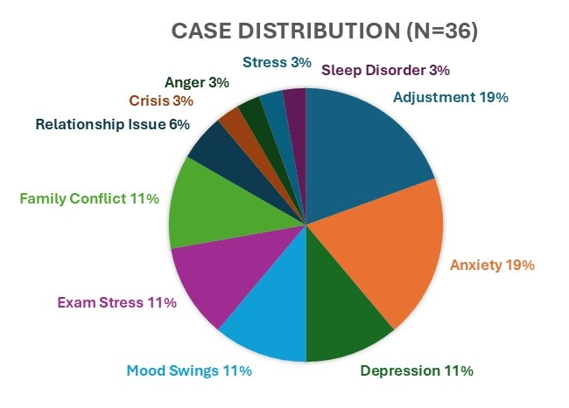
CASE DISTRIBUTION- 2023-24

Slide 9
Key Events & Workshops (2024–25)
Awareness Series on Mental Health Services (Jan–Feb 2025) Conducted by Ms. Preeti Yadav to educate on emotional hygiene, signs of distress, and support-seeking.
Special Workshop: Managing Rage & Anger (18 Feb 2025) Facilitator: Ms. Kanchan Gaur (Psychologist, Founder, Samsara Foundation) Topics: Anger types, beliefs, health impact, CBT, grounding and breathing techniques.

Slide 10
Events & Workshops (2023-24)
Yoga for Stress & Anxiety
Counselling Skills Training for Faculty
Relationship Skills & Emotional Wellness
Youth Day Celebrations
Meditation and Heartfulness via Chetna Society (with ISKCON)
Mental Health Festival Visit (AIIMS Delhi)

Slide 11
Compliance
The Centre adheres to:
Mental Health Care Act 2017
APA Ethical Code 2017
UGC Guidelines for Student Wellbeing

Slide 12
Conclusion
Safe, inclusive space for mental wellbeing
Empowers students for social and personal growth
Reflects KRMU’s commitment to holistic education

Slide 13
Thank you

