Slide 1



YOUTH RED CROSS COMMITTEE
(YRC)
Welcomes
NAAC Peer Team
16th -18th June 2025
Notes:
New Courses replaced with New Programmes

Slide 2


PRESENTATION OVERVIEW:
Introduction Of YRC
Objectives Of YRC
Youth Red Cross Committee
Process and Activities
Outcomes and Achievements
Future Roadmap and Action Plan
Notes:
Glimpses instead of Glimpse

Slide 3
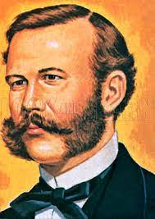
INTRODUCTION OF YRC:
Introduction to the Indian Red Cross Society (IRCS):
Established in 1920 under the Indian Red Cross Society Act, with affiliation to the International Federation of Red Cross and Red Crescent Societies (IFRC).
Functions as a humanitarian organization providing emergency assistance, disaster relief, and health programs across India.
Guided by the seven principles of the Red Cross Movement: humanity, impartiality, neutrality, independence, voluntary service, unity, and universality.
About Youth Red Cross (YRC):
A youth-centric wing of the Red Cross Society, dedicated to developing compassionate, skilled, and socially responsible young citizens.
Part of the global Red Cross and Red Crescent movement, operating under principles of humanity, neutrality, impartiality, and voluntary service.
Notes:
Glimpses instead of Glimpse

Slide 4
INTRODUCTION OF YRC:
About Youth Red Cross (YRC):
Establishment: Youth Red Cross (YRC) unit was established at K.R. Mangalam University in October 2023.
Operations Commenced : The unit started its activities in January 2024.
Volunteer Participation: Approximately 150 student volunteers are actively involved in the YRC.
Activities: The student volunteers participate in various humanitarian and community service activities through the YRC.
Notes:
Glimpses instead of Glimpse

Slide 5
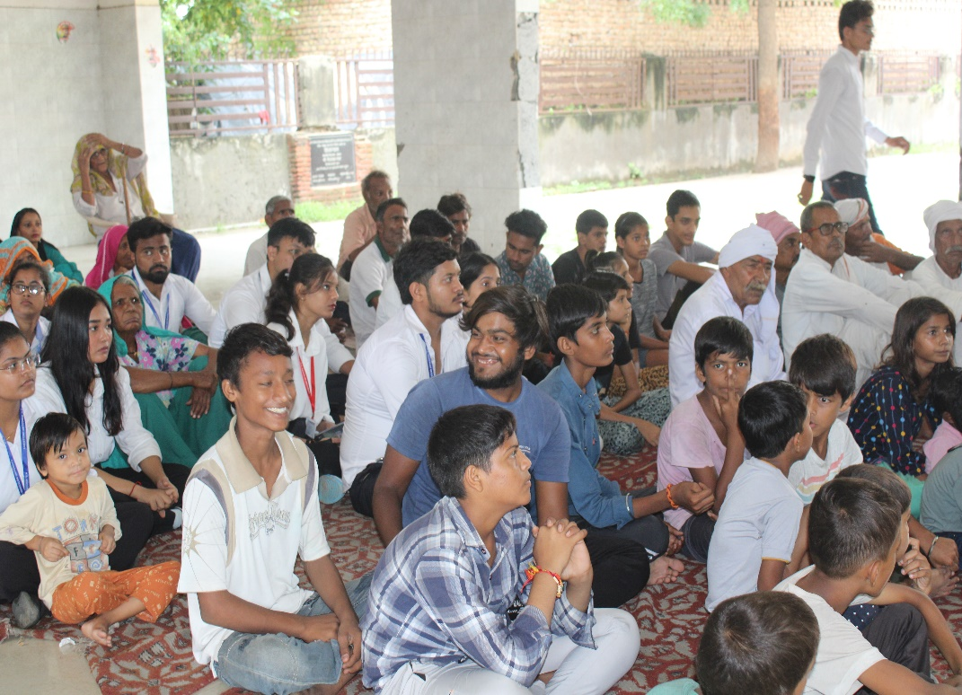
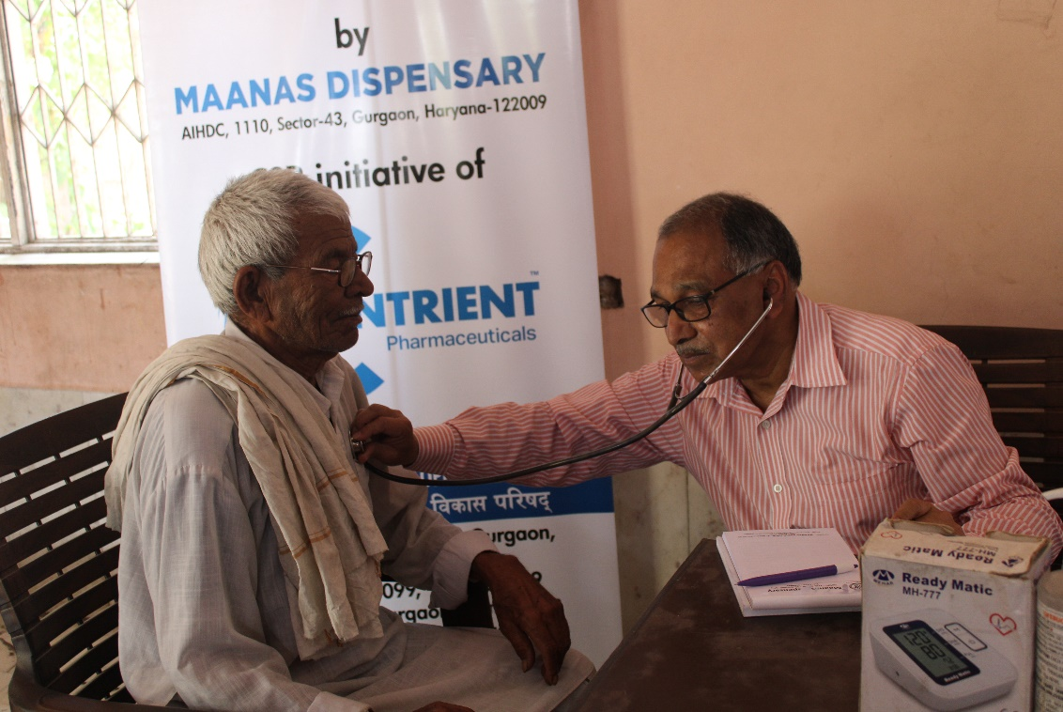
OBJECTIVES OF YRC:
Youth Empowerment through Experiential Learning: Equip students with opportunities to engage in real-world social, health, and emergency response activities, empowering them to make a positive impact in their communities.
Fostering Humanitarian Values: Encourage students to embrace humanitarian principles through hands-on projects and initiatives that cultivate compassion, empathy, and service-mindedness.
Strengthening Community Resilience: Through skill-building workshops and outreach programs, develop students' capacity to support community resilience and apply their learning to address real-world challenges.
Notes:
Glimpses instead of Glimpse

Slide 6

YOUTH RED CROSS COMMITTEE:
 | S. No. | Name | Designation
1 |  | Prof.(Dr.) Raghuvir Singh Vice-Chancellor K R Mangalam University | Chairperson
2 |  | Dr Anjana Singh – Dean Student Welfare | Member
3 |  | Dr. Rahul Sharma Registrar K R Mangalam University | Member
4 |  | Mr. Rohit Sharma, Camp Director, Haryana State Branch, Chandigarh | Member
5 |  | Mr. Vikas Kumar, District Red Cross Branch, Gurugram | Member
6 |  | Dr. Nitin Tyagi, Program Counsellor | Member
7 |  | Dr. Shikha Dutt Sharma, SOHS | Member
8 |  | Ms. Shweta Kumar, SPRS | Member
9 |  | Ms. Gargi Singh, SOLS | Member
10 |  | Dr. Pradeep Kumar | Member
11 |  | Dr. Neeraj Kumari, NSS Program Coordinator | Member
12 |  | Mr. Priyanker, Student volunteer | Member
13 |  | Mr. Shivang, Student Volunteer | Member
14 |  | Dr. Monika Yadav, Program Coordinator | Member Secretary
Notes:
Glimpses instead of Glimpse

Slide 7
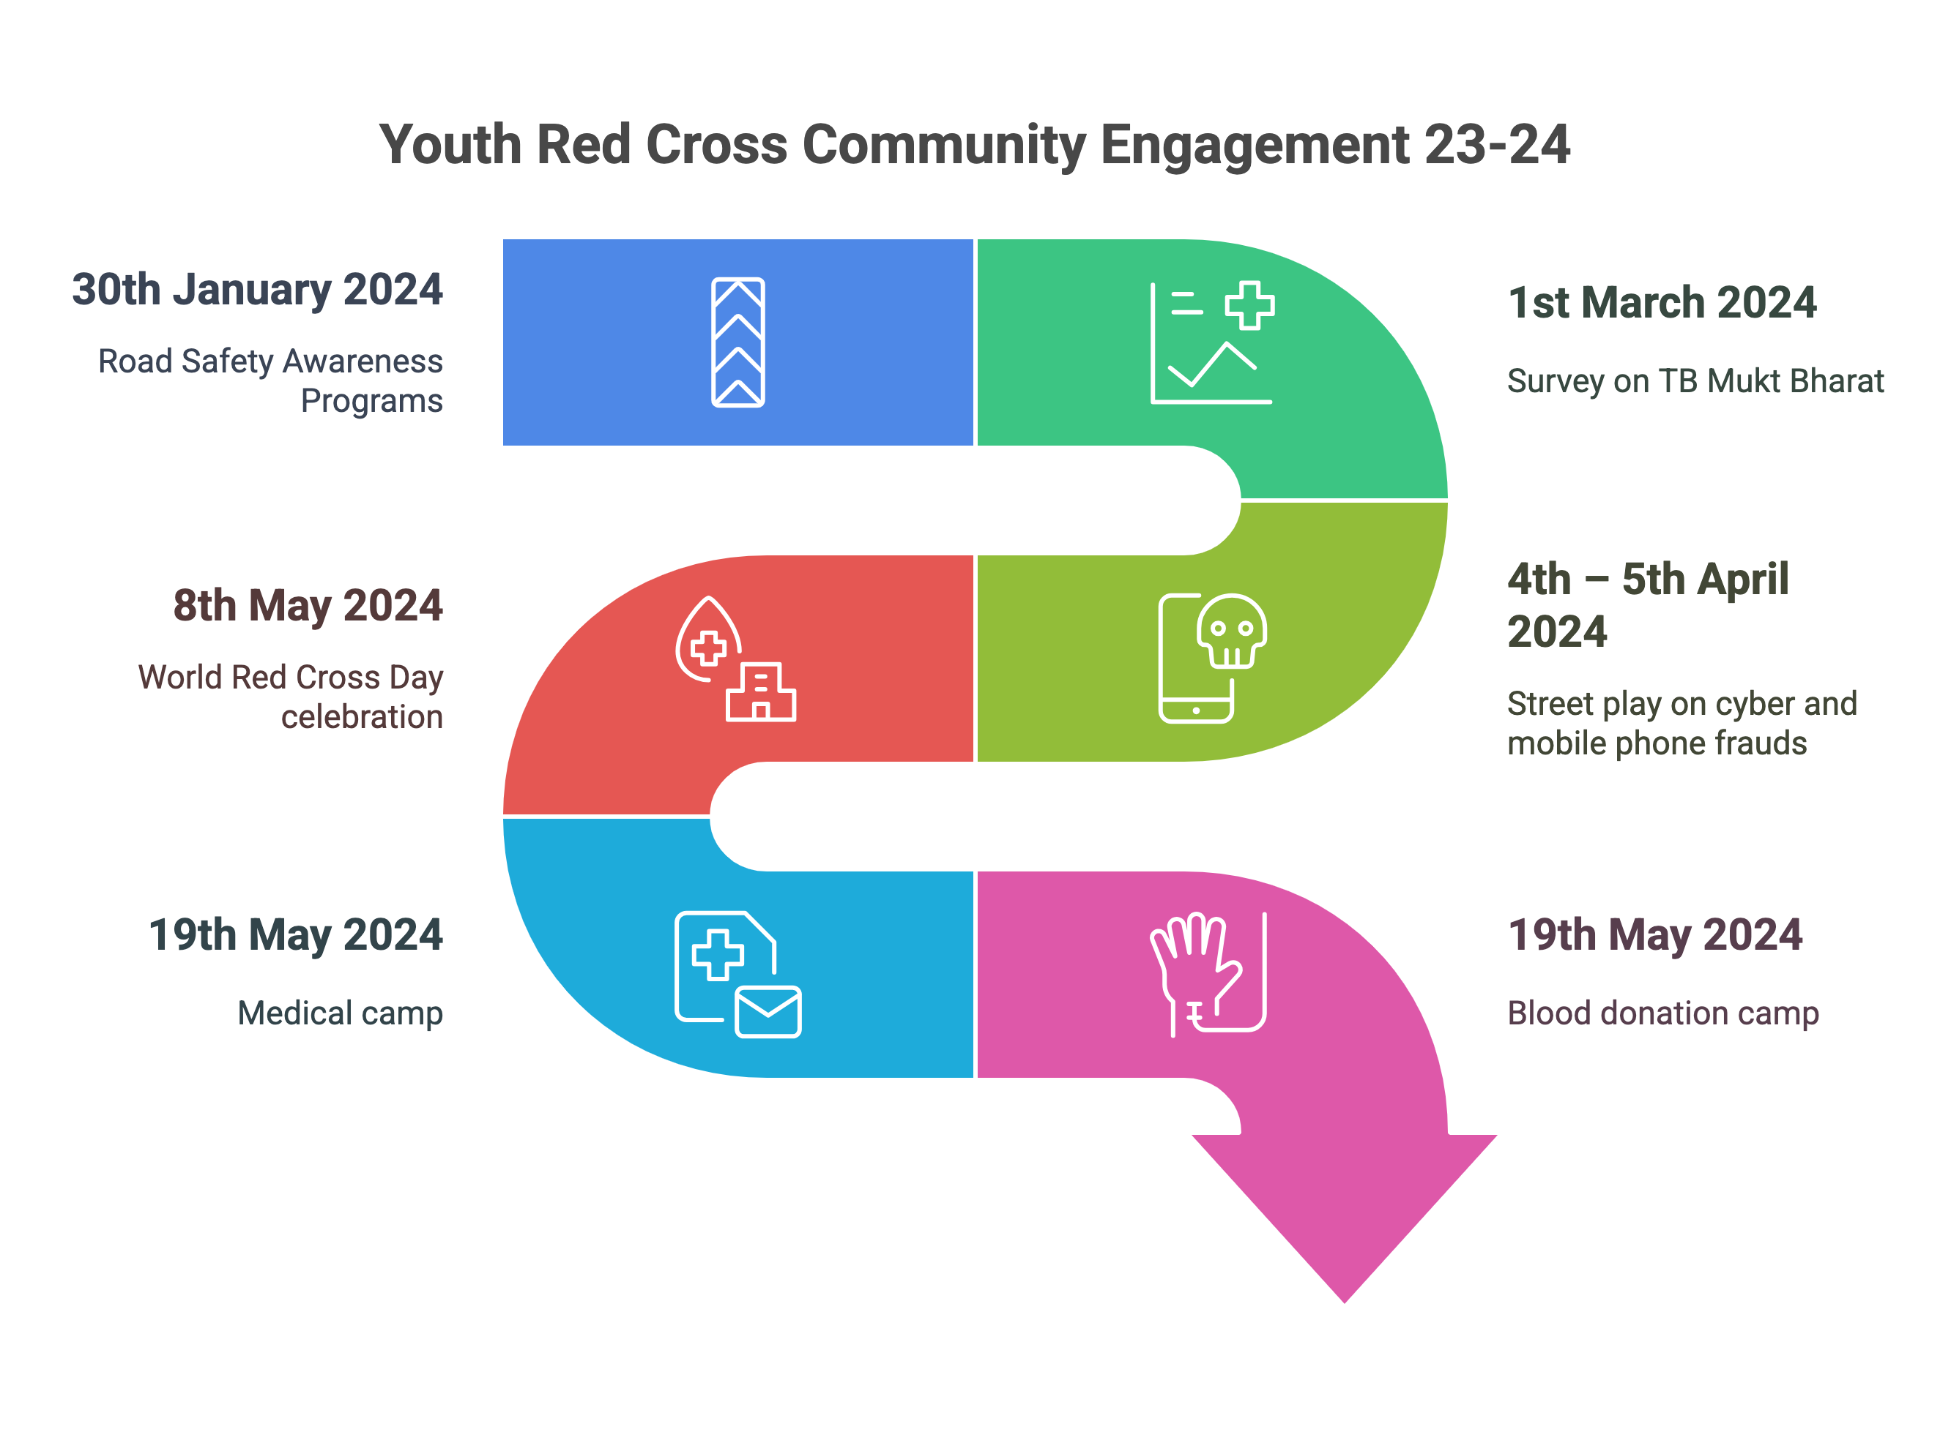
YOUTH RED CROSS COMMITTEE:
Notes:
Glimpses instead of Glimpse

Slide 8
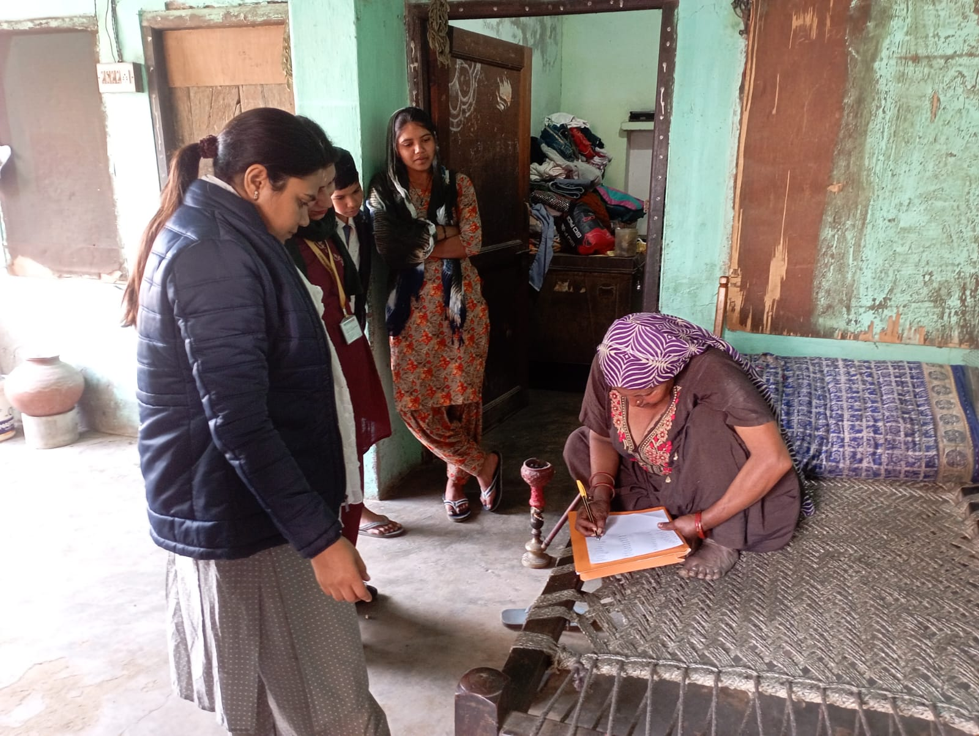
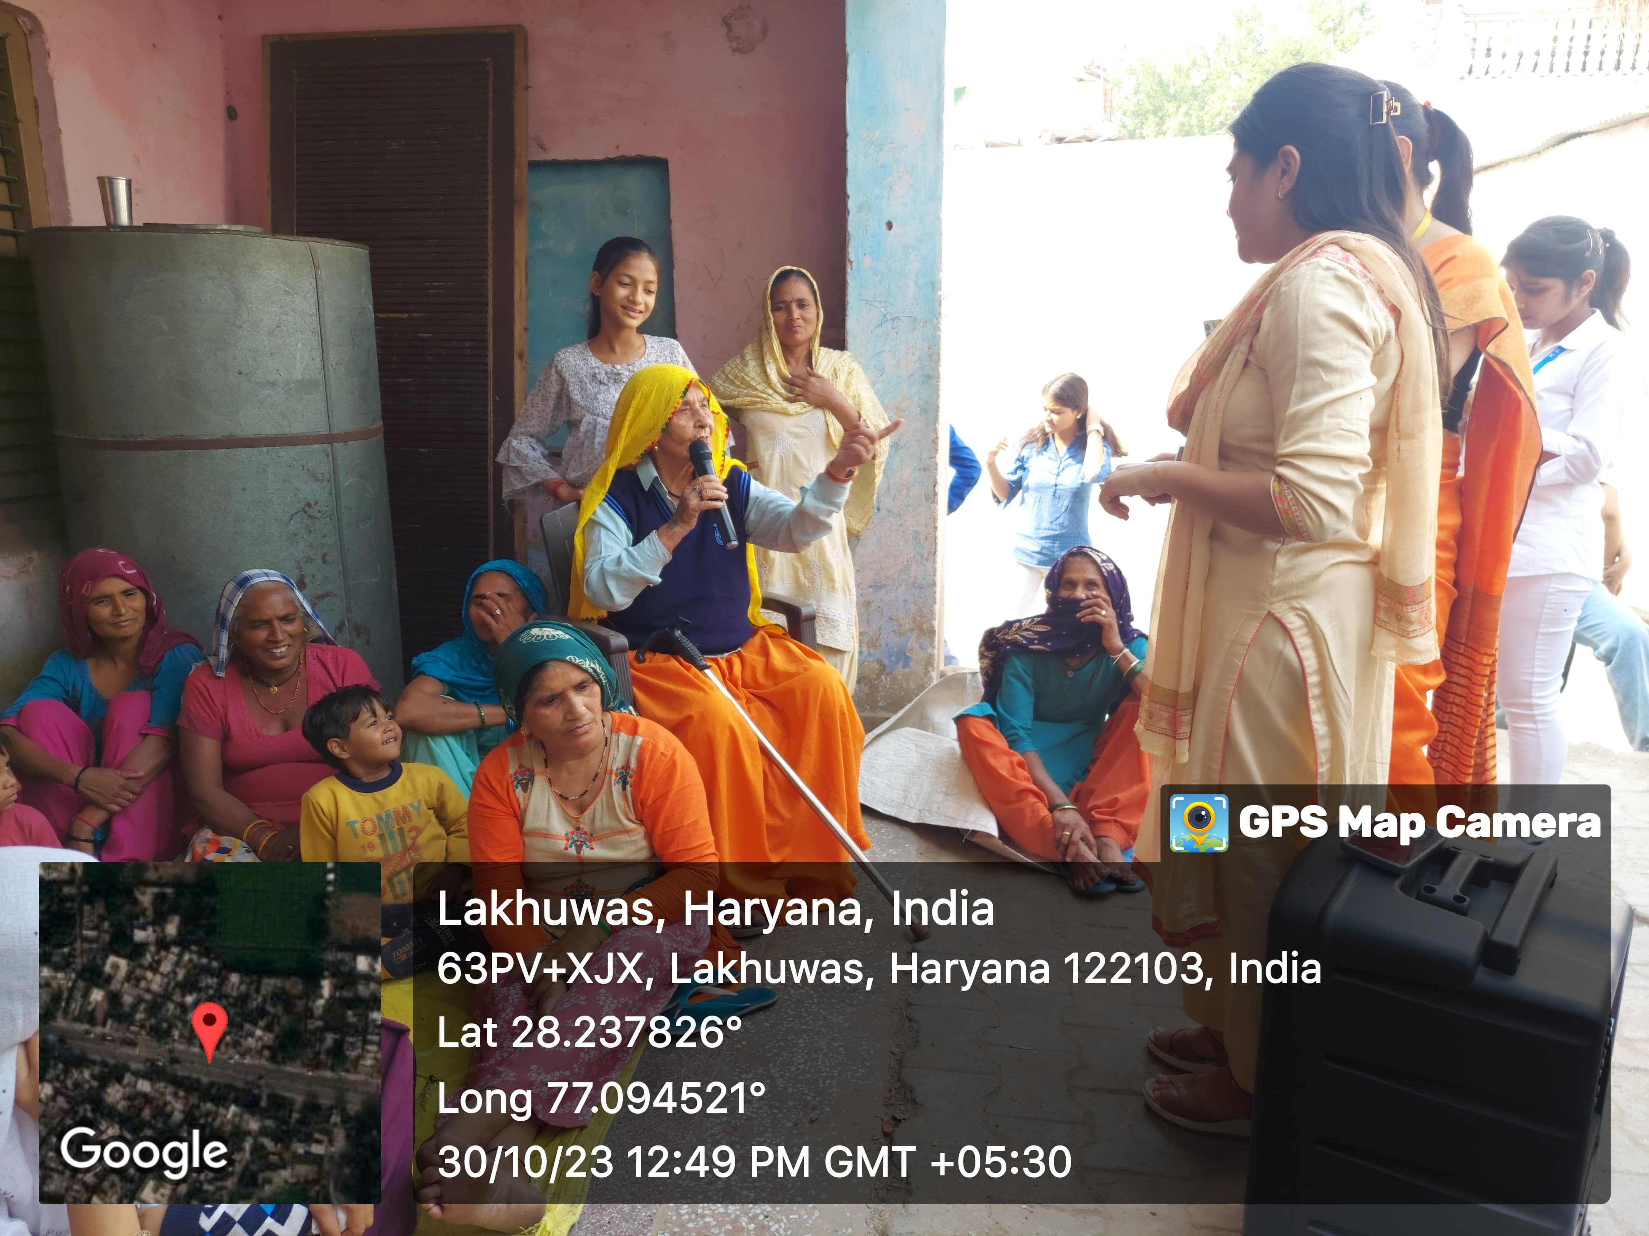
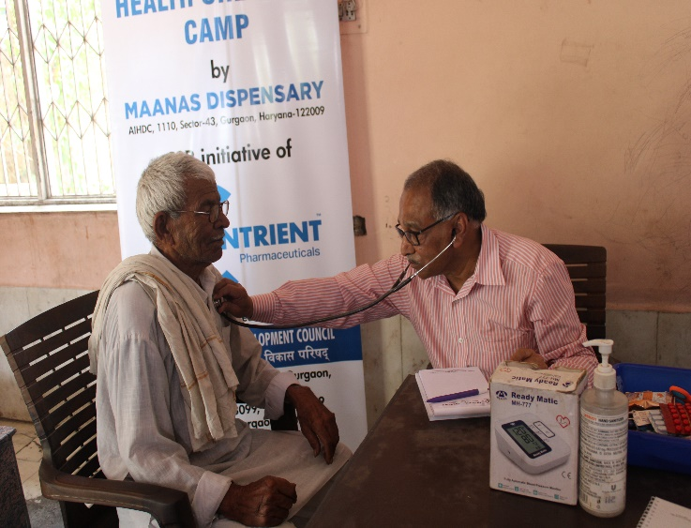
ACTIVITIES: AY23-24
An awareness program on the adverse effects of drug use was held in Lakhuwas, Haryana, as part of an extension activity by K.R. Mangalam University in collaboration with the Youth Red Cross Committee.
Survey on TB Mukt Bharat, involving community engagement and awareness on tuberculosis eradication.
Health check-up being conducted at the Health Camp in Lakhuwas Village.
Notes:
Glimpses instead of Glimpse

Slide 9
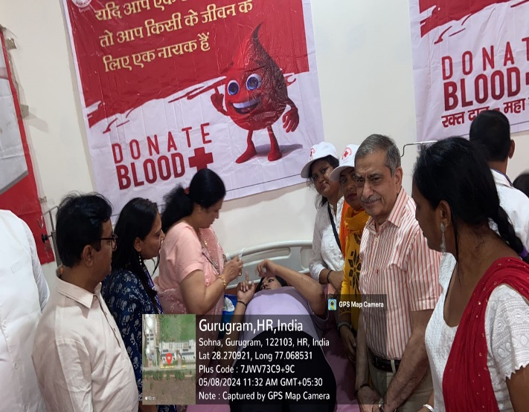
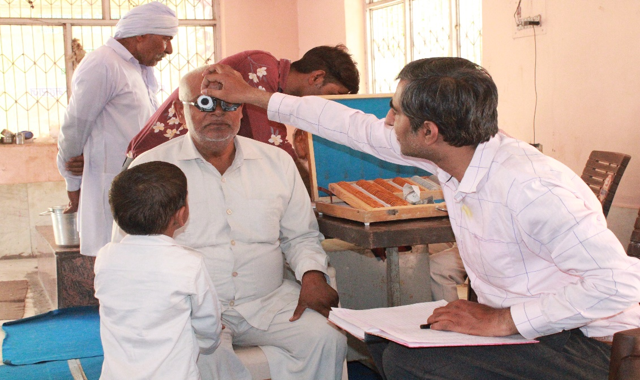
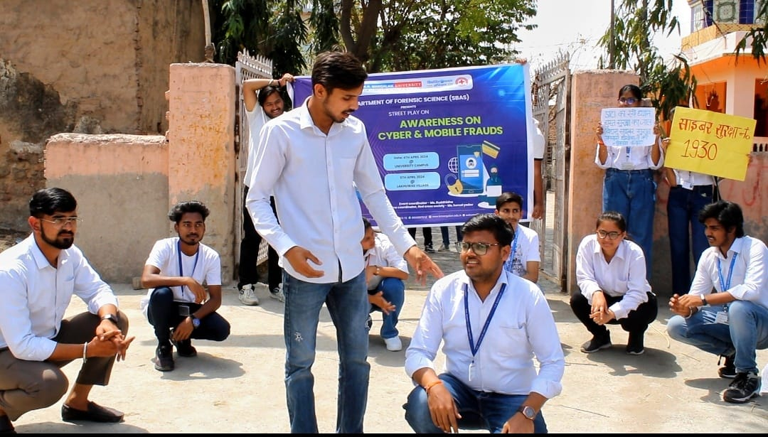
ACTIVITIES: AY23-24
A short interaction with the blood donors in blood Doantion Camp.
Health check-up being conducted at the Health Camp in Lakhuwas Village.
Notes:
Glimpses instead of Glimpse

Slide 10
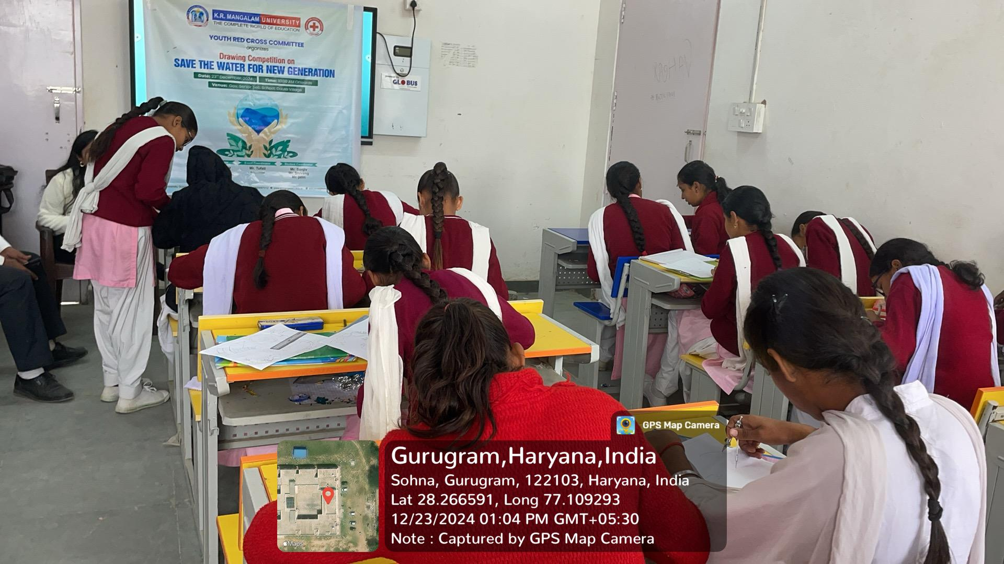
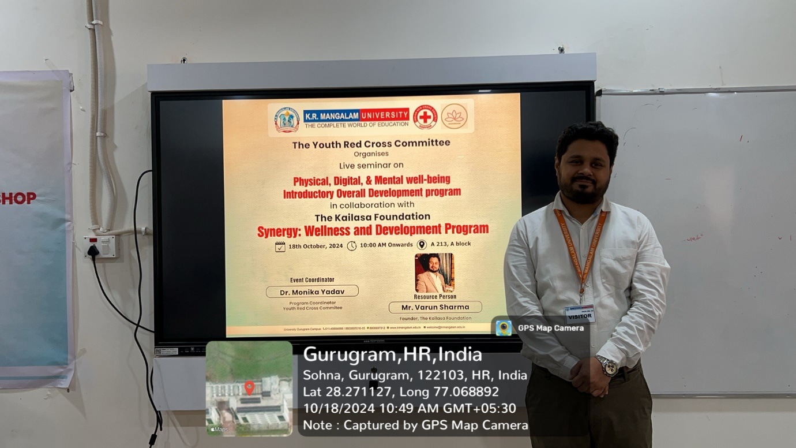
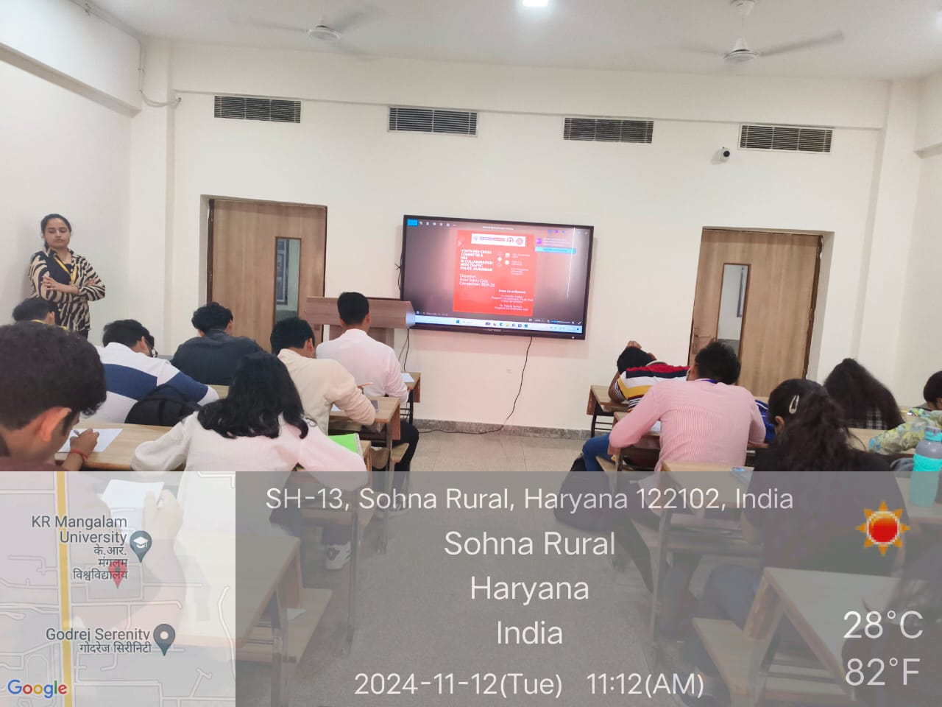
ACTIVITIES: AY23-24
Students actively participating in the Youth Red Cross Drawing Competition on "Save the Water for New Generation" atGovt. School, Daula, Sohna, Gurugram.
Live seminar on “Physical, Digital & Mental Well-being” conducted under the Youth Red Cross Committee in collaboration with The Kailasa Foundation at K.R. Mangalam University.
Notes:
Glimpses instead of Glimpse

Slide 11
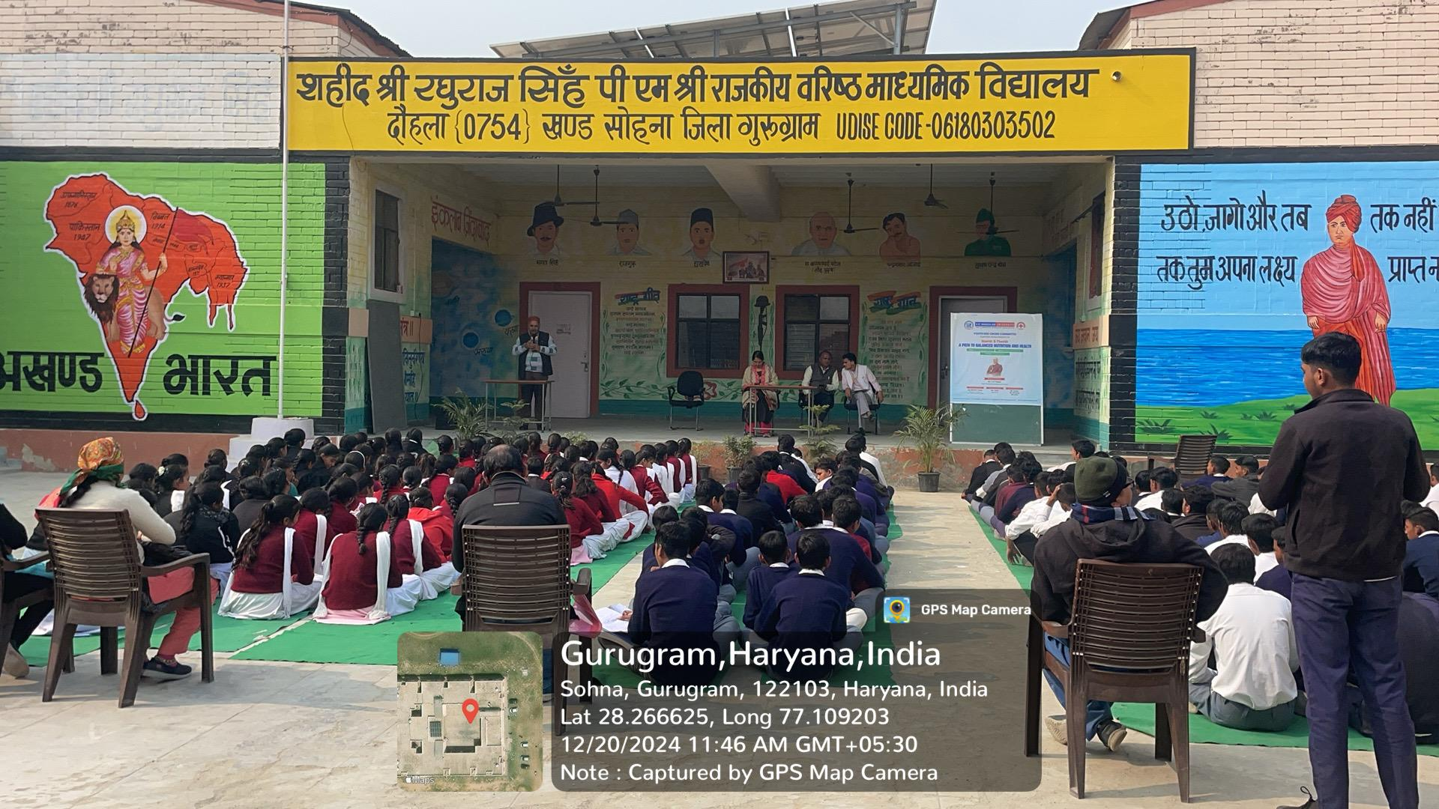
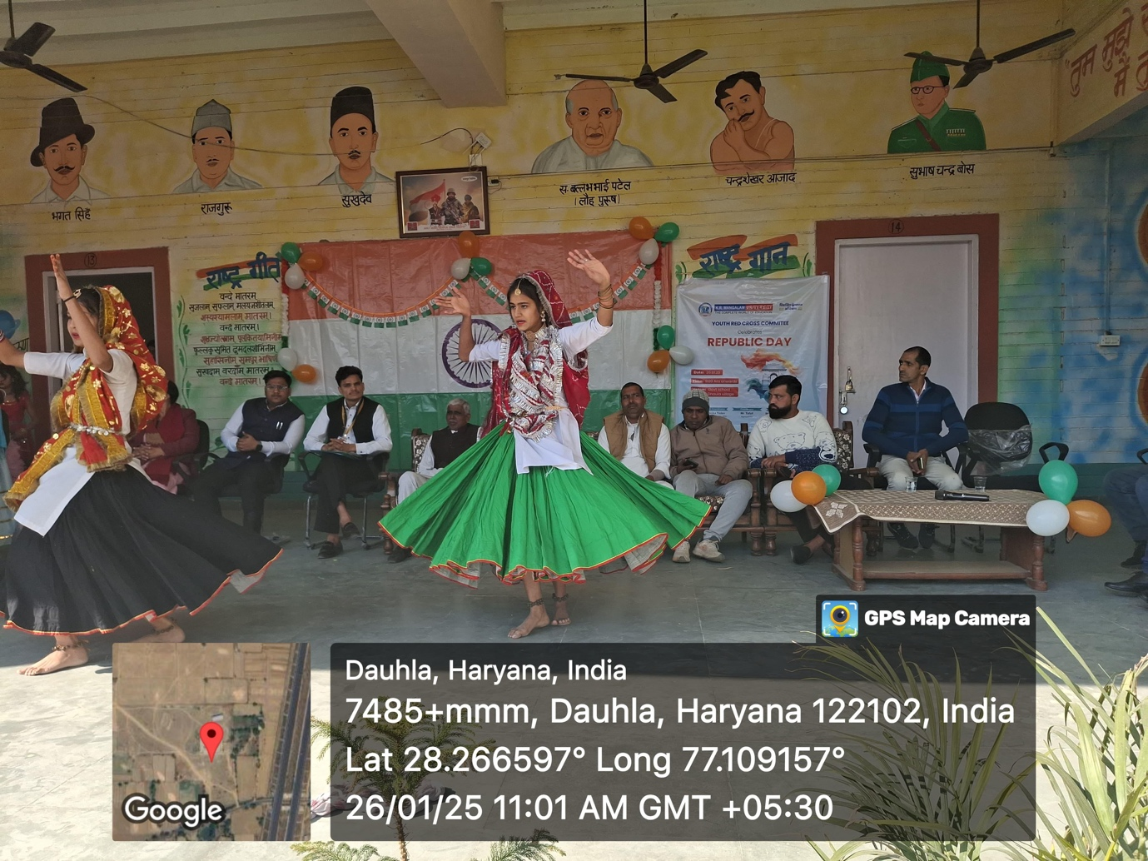
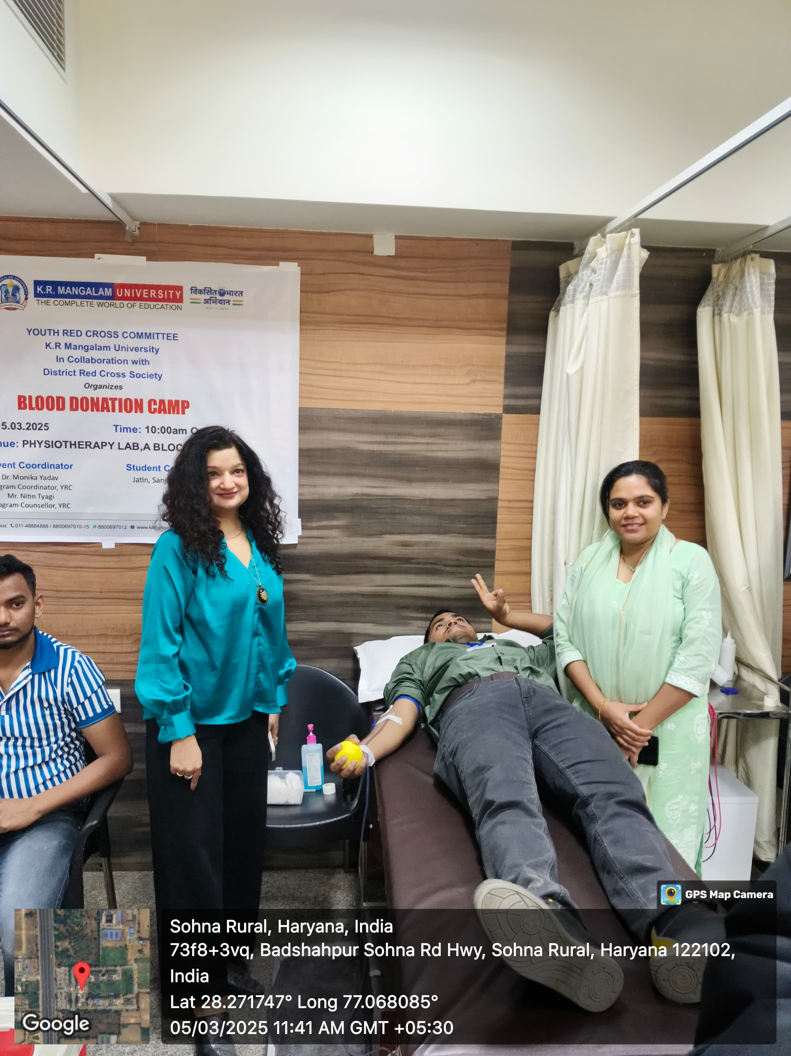
ACTIVITIES: AY24-25
Republic Day 2025 celebrated by Youth Red Cross Committee at Dhaula Village with vibrant cultural performances and community engagement.
Students attending a Youth Red Cross awareness session on drug prevention at Shaheed Shri Raghuraj Singh Government Senior Secondary School, Sohna, Gurugram.
A student donor during the Blood Donation Camp at KR Mangalam University on 5th March 2025, supported by faculties for a noble cause.
Notes:
Glimpses instead of Glimpse

Slide 12
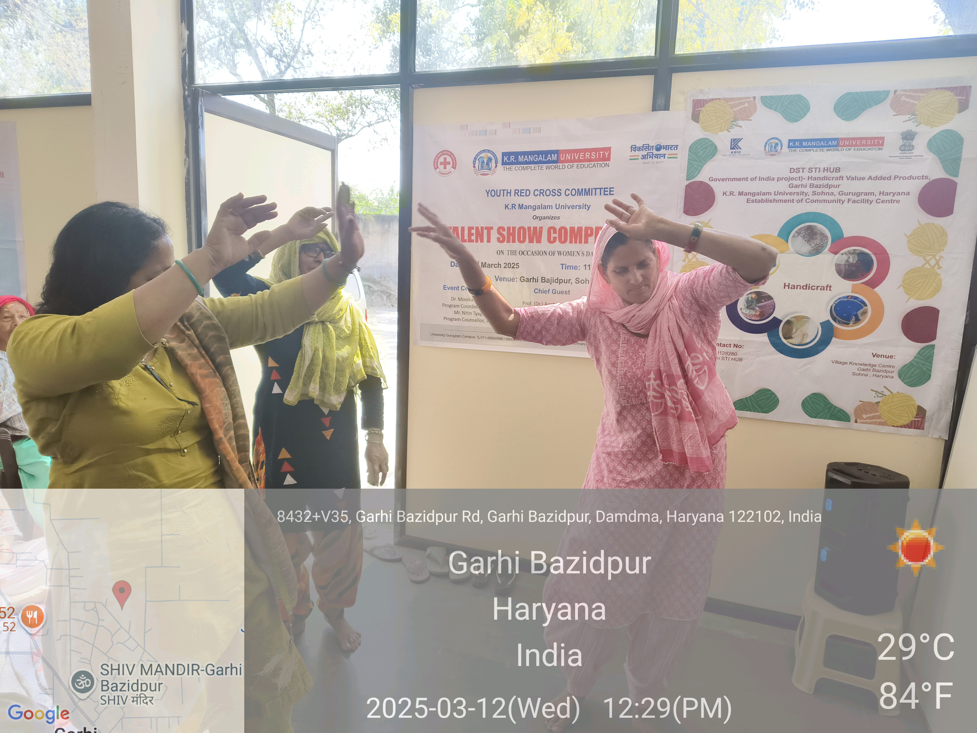
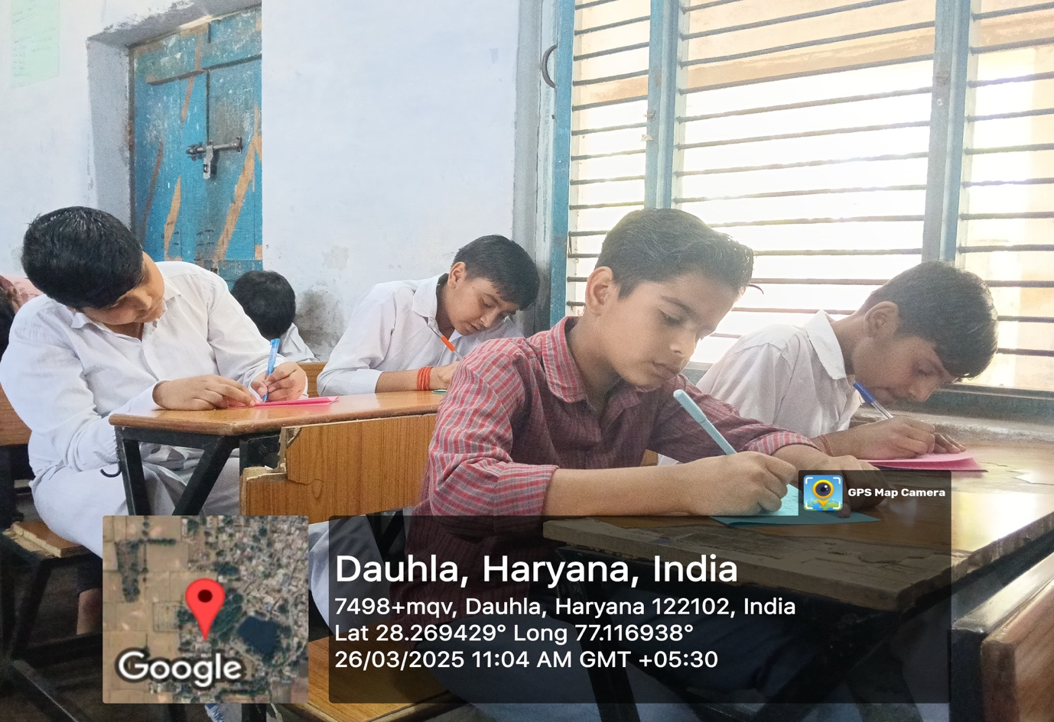
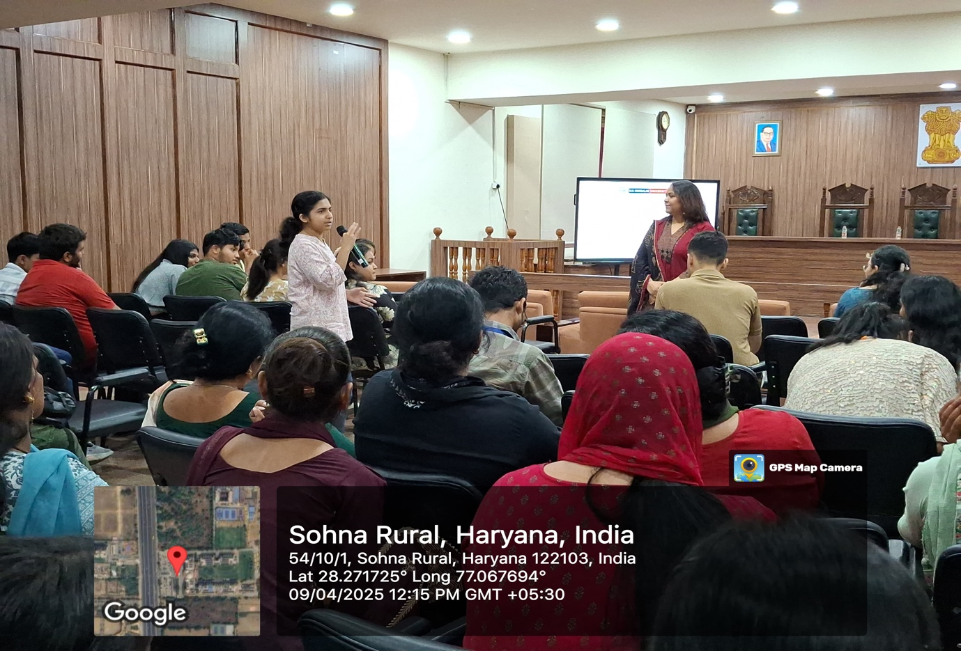
ACTIVITIES: AY24-25
Women showcasing energetic and graceful dance performances during the Talent Show Competition on Women’s Day, 12th March 2025, at Garhi Bazidpur.
Students actively participating in the essay writing competition held at Dauthla, Haryana, showcasing their creativity and writing skills.
m.
An interactive moment during the Confidence Building lecture session as a student engages with the speaker, Mrs. Madhu Yadav, fostering a dynamic and empowering learning environment
.
Notes:
Glimpses instead of Glimpse

Slide 13
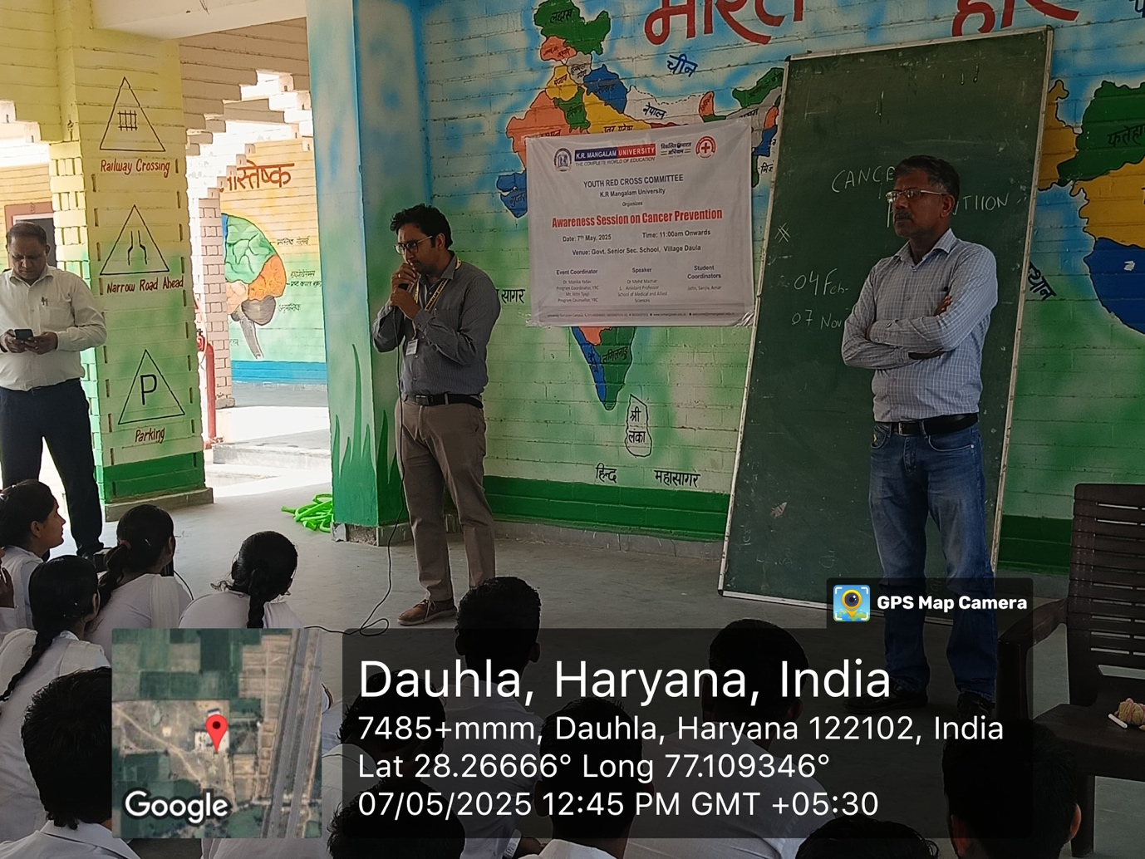
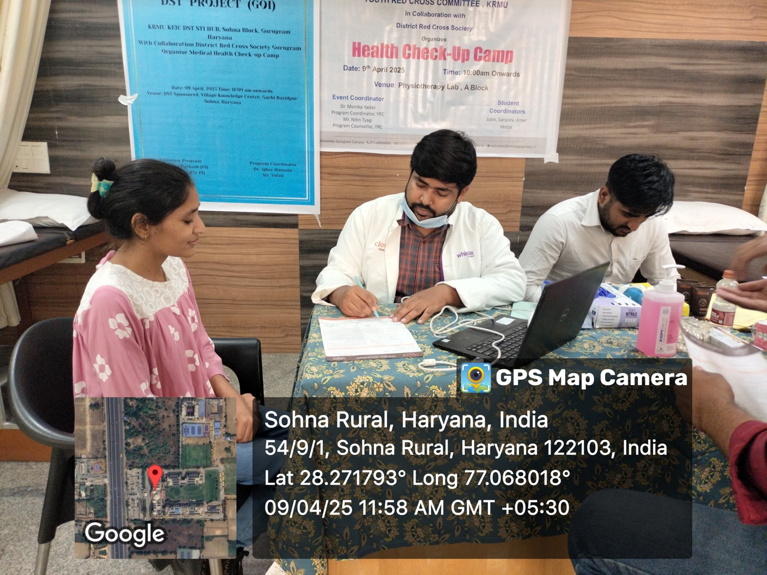
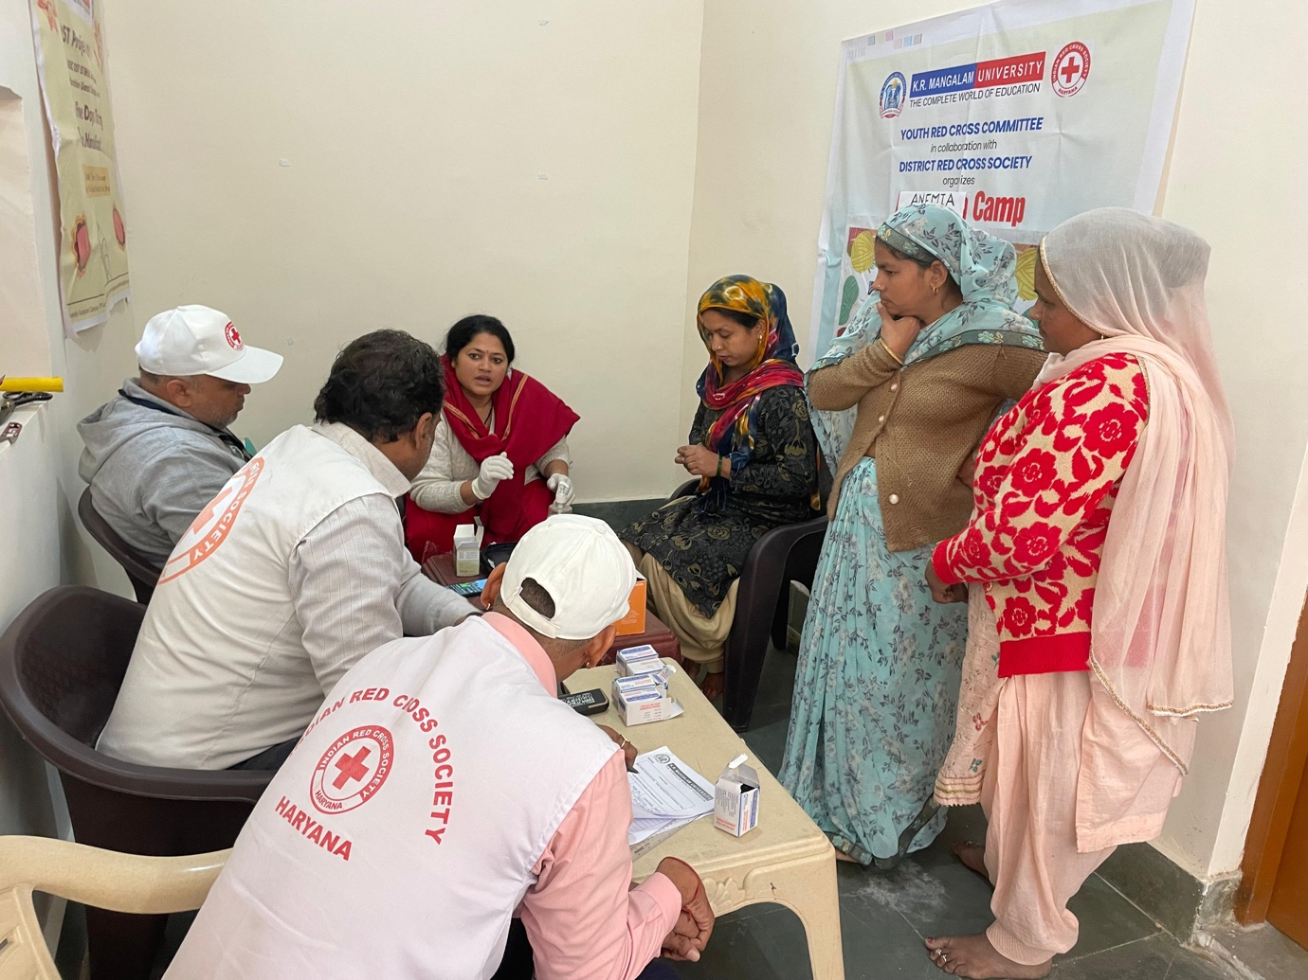
ACTIVITIES: AY24-25
Students actively participating in the Cancer Prevention Awareness Session held at Govt. Senior Sec. School, Daula on 7th May 2025.
m.
Doctors conducting a detailed Dental check-up for villagers and students during the Health Camp.
.
Notes:
Glimpses instead of Glimpse

Slide 14
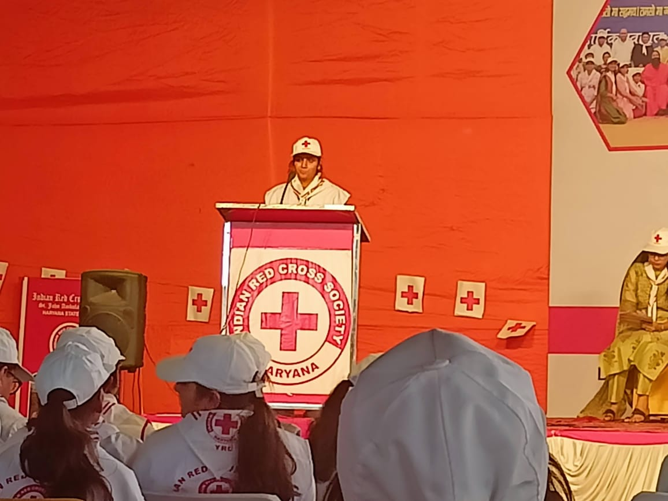
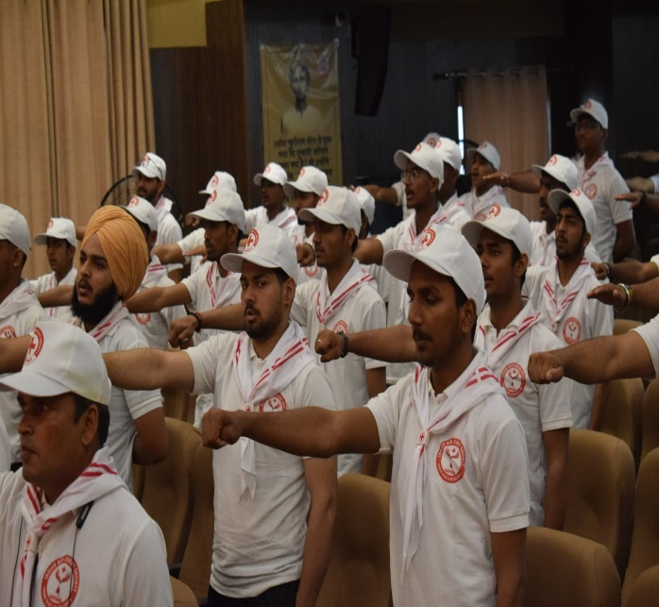
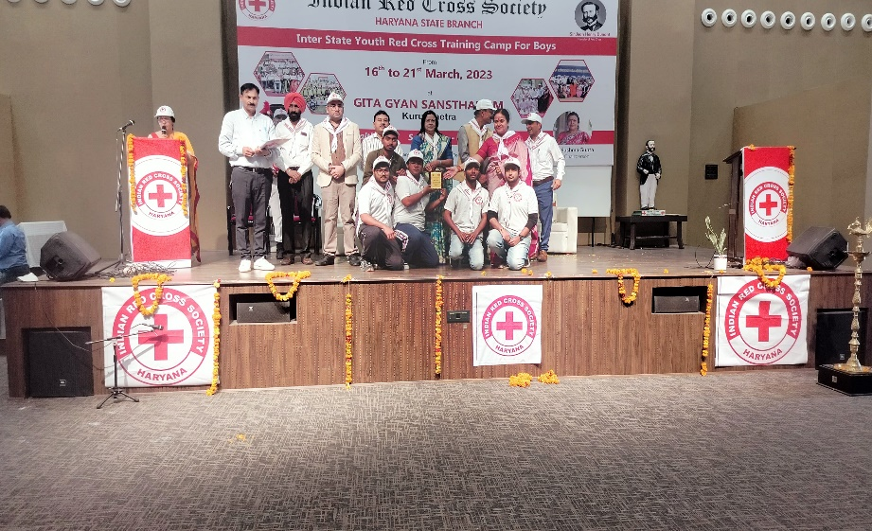
CAMPS FOR BOYS & GIRLS:
Volunteer interaction at the State-Level Youth Red Cross Training Camp for Girls.
Students taking the Youth Red Cross Pledge during National Level youth Red Cross Training Camp For Boys.
Notes:
Glimpses instead of Glimpse

Slide 15
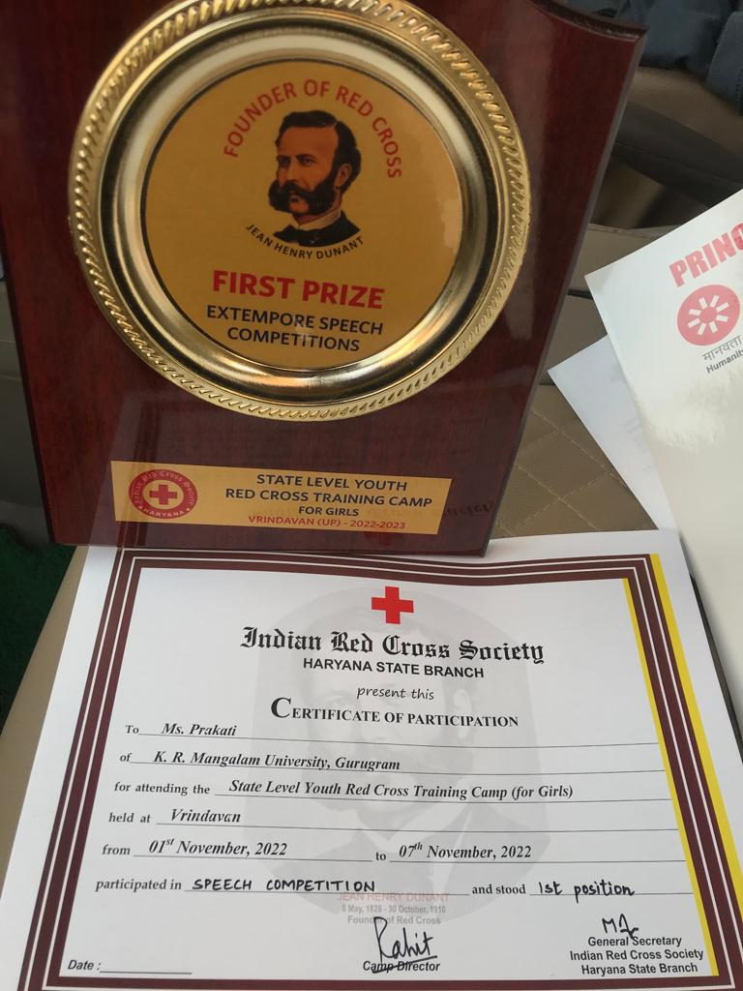
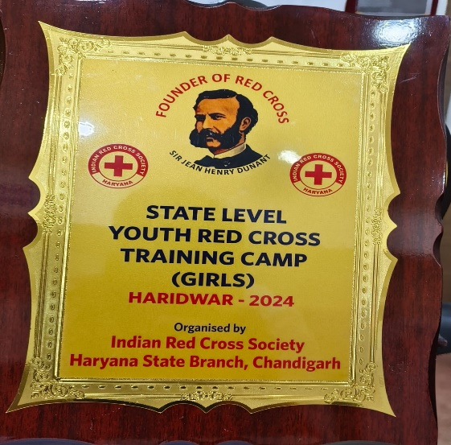
OUTCOME & ACHIEVEMENTS:
First Prize Trophy and Certificate awarded to Ms. Prakriti from K.R. Mangalam University, Gurugram, for securing 1st position in the Extempore Speech Competition at the State Level Youth Red Cross Training Camp for Girls, held in Vrindavan from 1st to 7th November 2022.
Notes:
Glimpses instead of Glimpse

Slide 16
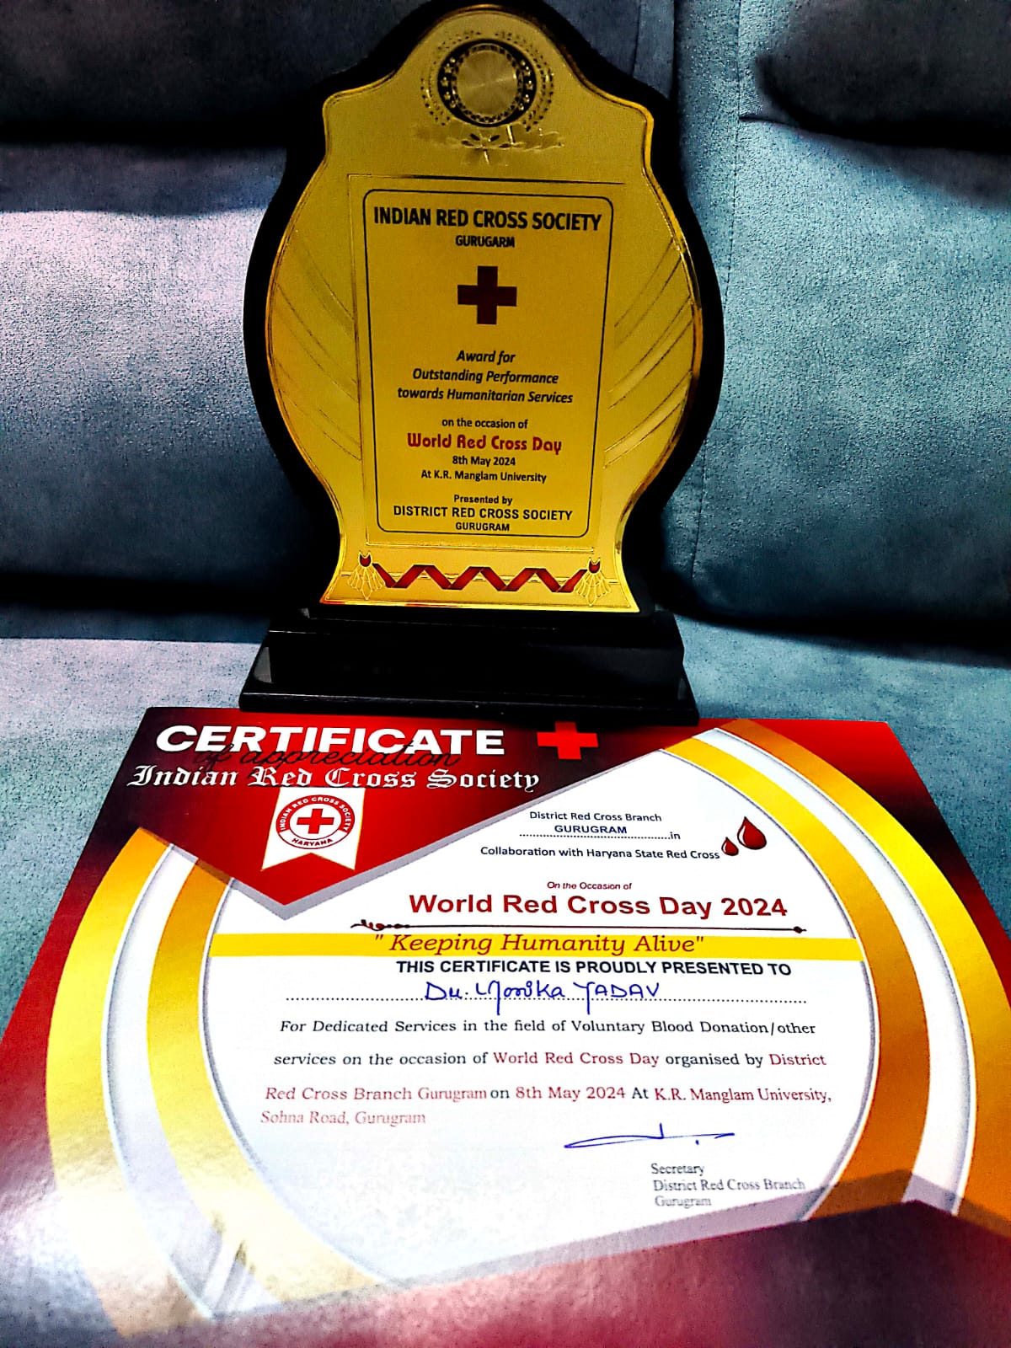
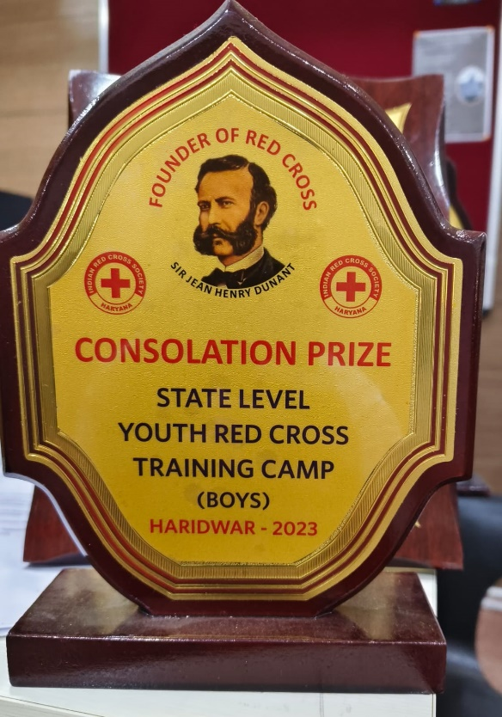
OUTCOME & ACHIEVEMENTS:
Award presented to Dr. Monika Yadav( Program Coordinator , YRC) K.R. Mangalam University by the District Red Cross Society, Gurugram, on 8th May 2024, for outstanding performance in humanitarian services on the occasion of World Red Cross Day.
Consolation Prize awarded at the State Level Youth Red Cross Training Camp (Boys) in Haridwar, 2023.
Notes:
Glimpses instead of Glimpse

Slide 17
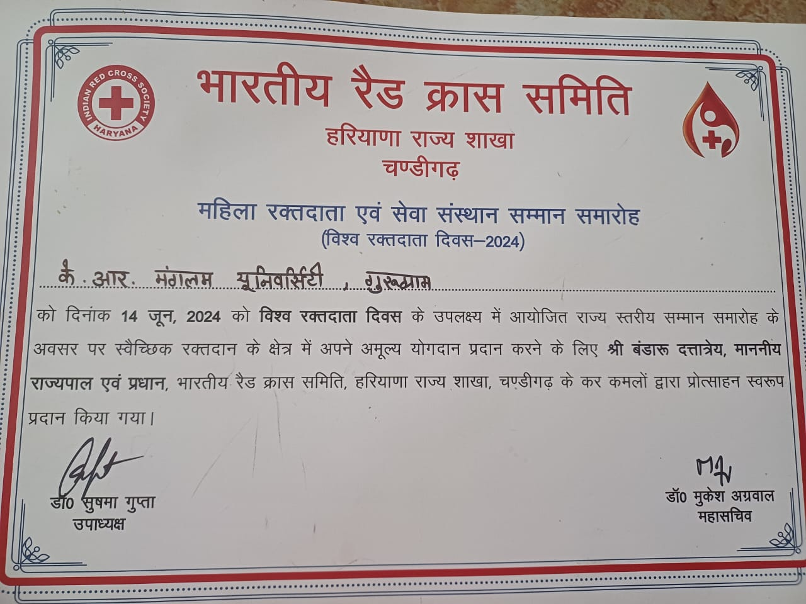
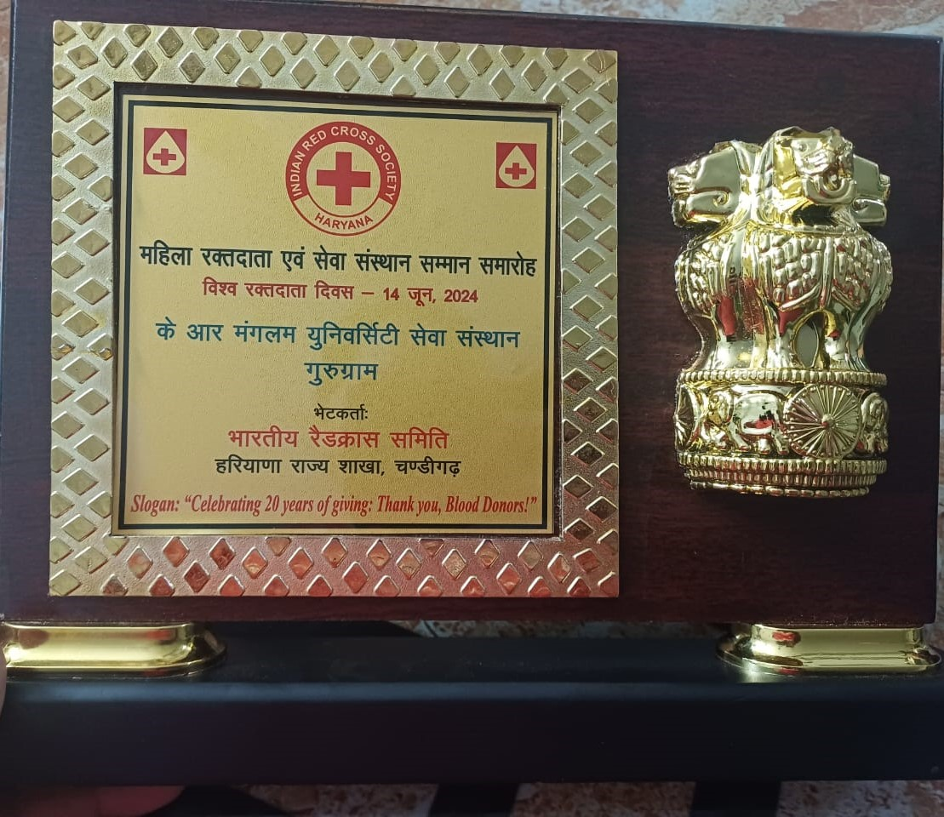
OUTCOME & ACHIEVEMENTS:
K.R. Mangalam University, Gurugram Awarded by the Indian Red Cross Society, Haryana State Branch, on 14th June 2024, in recognition of significant contributions in the field of blood donation, presented by the Honorable Governor of Haryana, Shri Bandaru Dattatraya.
Notes:
Glimpses instead of Glimpse

Slide 18
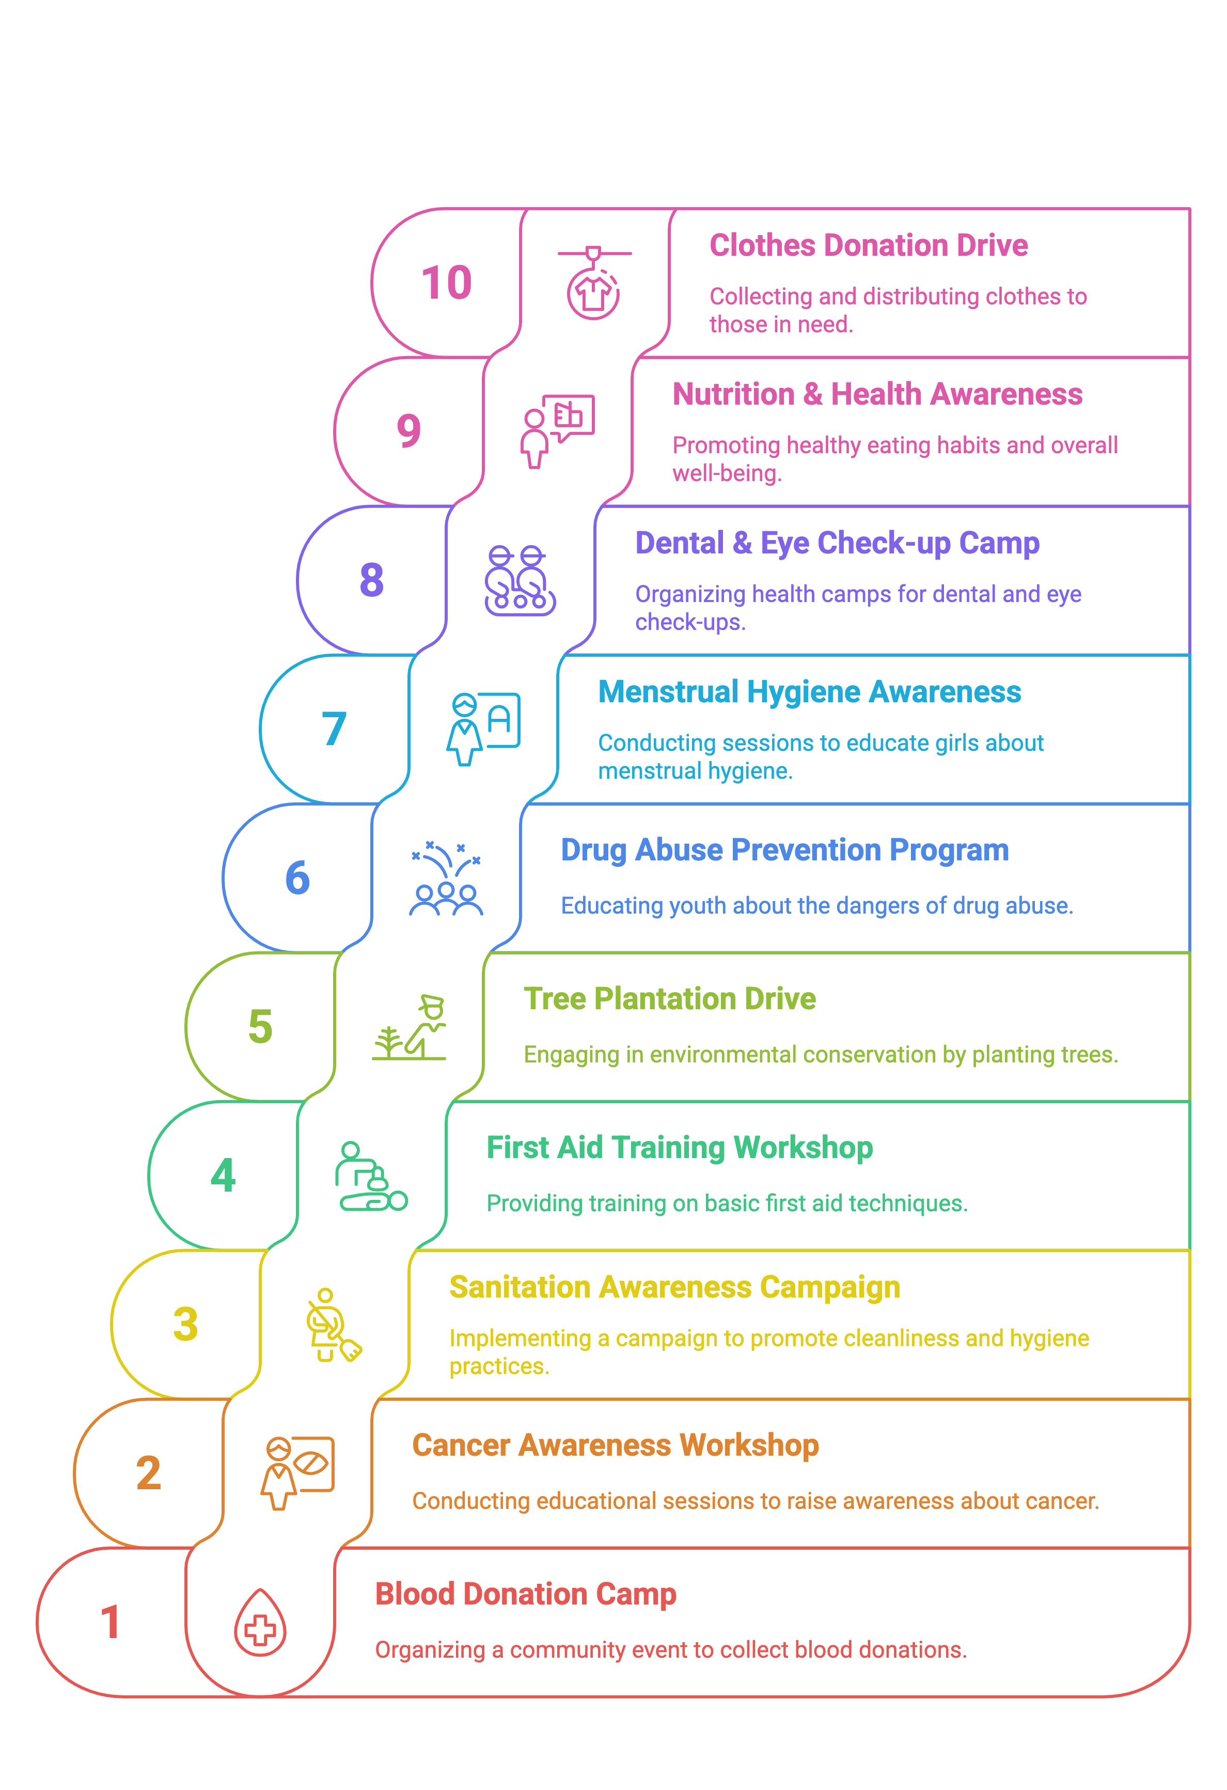
FUTURE ROADMAP & ACTION PLAN:
Notes:
Glimpses instead of Glimpse

Slide 19

Notes:
Glimpses instead of Glimpse

